Slide 1
Monitoring FCI during MTG-I1 commissioning with GSICS inter-calibration algorithms
Tim Hewison, Vincent Debaecker, Ali Mousivand
(EUMETSAT)
2023 EUMETSAT Conference
Malmö, 14.09.2023

Slide 2
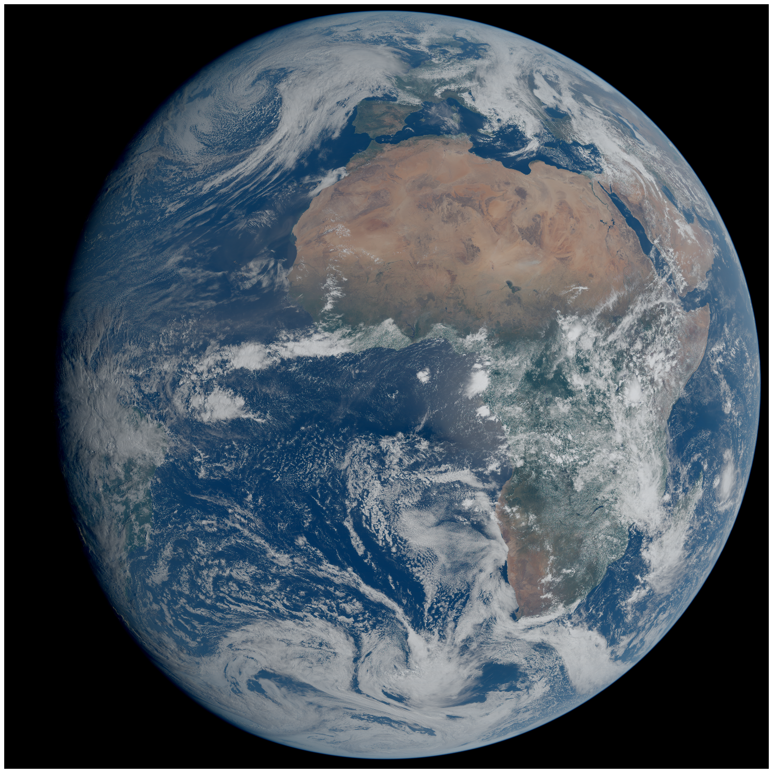
First Acquisition from MTG-I1/FCI
15.03.2023 10:00 UTC

Slide 3
Introduction
Commissioning of MTG-I1/FCI is ongoing…
  EUMETSAT run a suite of Offline Functions & Tools
  To thoroughly test all aspects of performance
  Focus here is on radiometric calibration
  Showing example results to illustrate benefits of inter-calibration
  Performance expected to improve & Operational L1c data meet requirements
GEO-GEO inter-comparisons can
  Identify instrument and processing artefacts (e.g. striping)
  Identify diurnal calibration variations
  Confirm medium-term stability
  Confirm consistency with SEVIRI
GEO-LEO IR inter-calibration can
  Quantify absolute radiometric calibration (wrt IASI + CrIS)
  Provide radiometric corrections if needed
Continuous Monitoring can
  Confirm long-term stability – over mission lifetime
Data used here is not radiometrically tuned!
VNIR calibration is not yet updated in-flight
Many corrections are not yet enabled
Demonstration of capability and testing tools

Slide 4
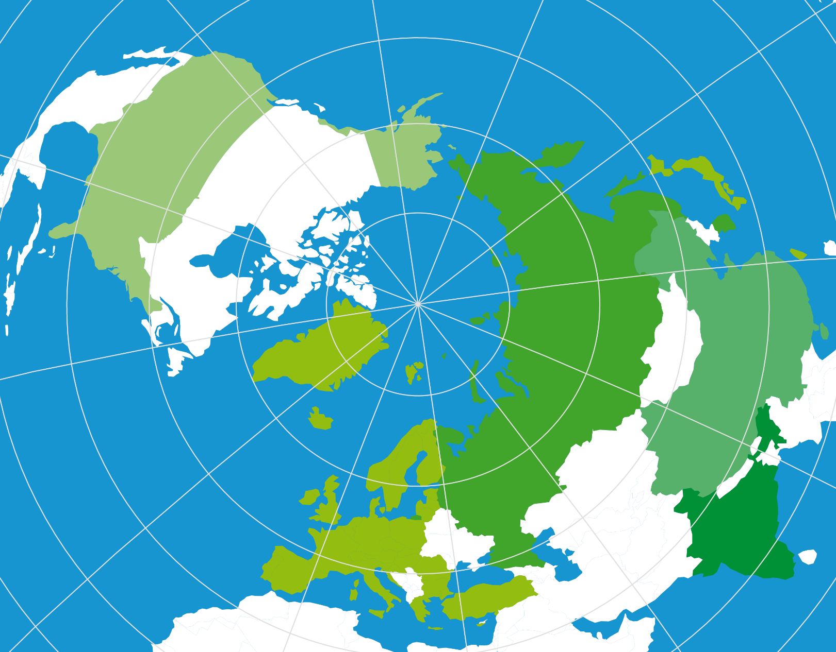

















Global Space-based Inter-Calibration System
What is GSICS?
Initiative of CGMS and WMO: gsics.wmo.int
Effort to produce consistent, well-calibrated data from the international constellation of Earth Observing satellites
What are the basic strategies of GSICS?
Improve on-orbit calibration
by developing an integrated inter-comparison system
Initially for GEO-LEO inter-satellite calibration
Being extended to LEO-LEO and GEO-GEO
GSICS algorithms
Allow us to compare, monitor and correct L1 data
Empirical corrections in radiance-space
  could also be spectral corrections
Greater understanding of instruments’ calibration
  by analysing the root causes of biases
Allow Inter-operability:
  NRT for more accurate weather forecasting products
  Re-Analysis to better understand climate processes
  Re-Calibration for Fundamental Climate Data Records
NASA
USGS
JAXA
NOAA JMA
NIST KMA
WMO ROSCOSMOS
CMA
ROSHYDROMET
EUMETSAT
ESA IMD
CNES ISRO

Slide 5
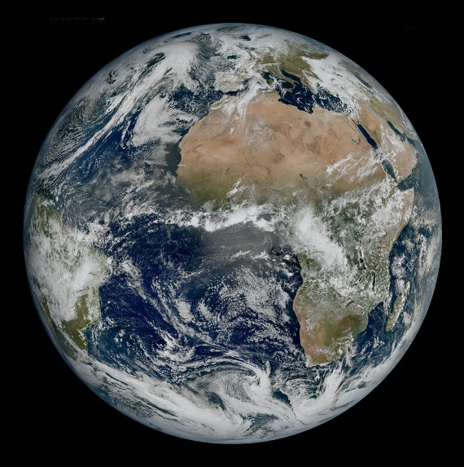
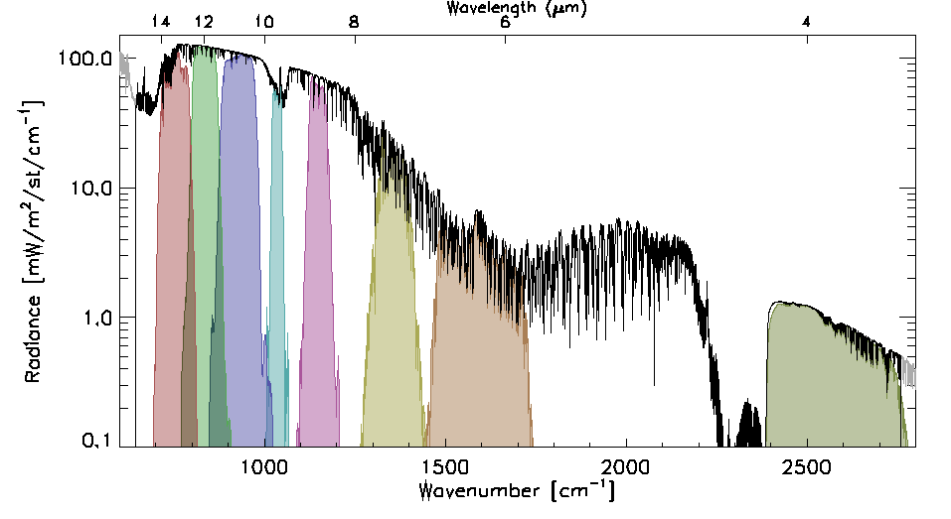
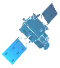
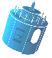
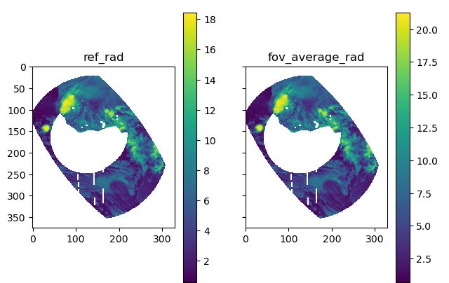
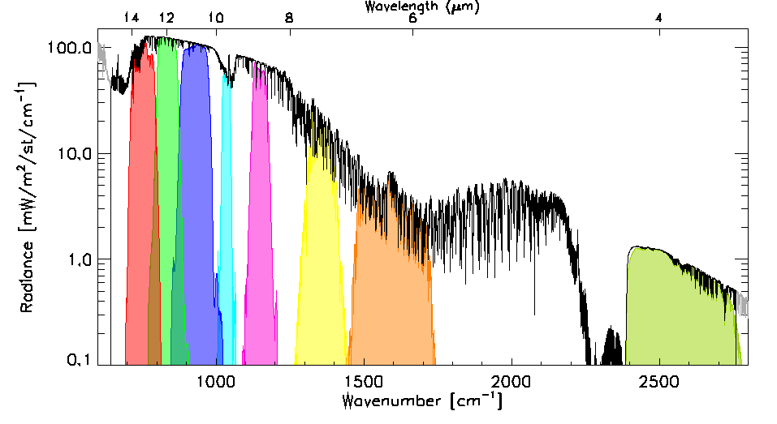
GEO-GEO inter-comparison algorithm: FCI-SEVIRI
Time (1 hour)
Collocate in Space, Time, Angle
  Subset to 30°x30°N/S/E/W (VZA<30°)
  Re-grid GEO images to 15x15 km
  Maximum difference in |dsec(VZA)| < 0.03
  Pixels’ max time difference |dt| < 300s
  Calculate Mean & Variance
Account for Spectral differences
  Apply Spectral Band Adjustment Factors
Filter
  Apply Sun-Glint mask to solar channels
  Tag land/sea/day/night for analysis
Combine
  Collocations within 1 hour windows
Compare
  Weighted regression of radiances
  Evaluate uncertainties
Evaluate & Monitor Bias
  Check medium-term radiometric stability <0.1 % / 24 hr for VIS/NIR
  <0.1 K / 10 min for IR
SEVIRI SRFs
(µ, σ)
|
(µ, σ)
Spectral Band Adjustment Factors
SEVIRI VIS0.6 FCI VIS0.6
FCI SRFs
Notes:
Move grids to top right
Add scatterplot

Slide 6
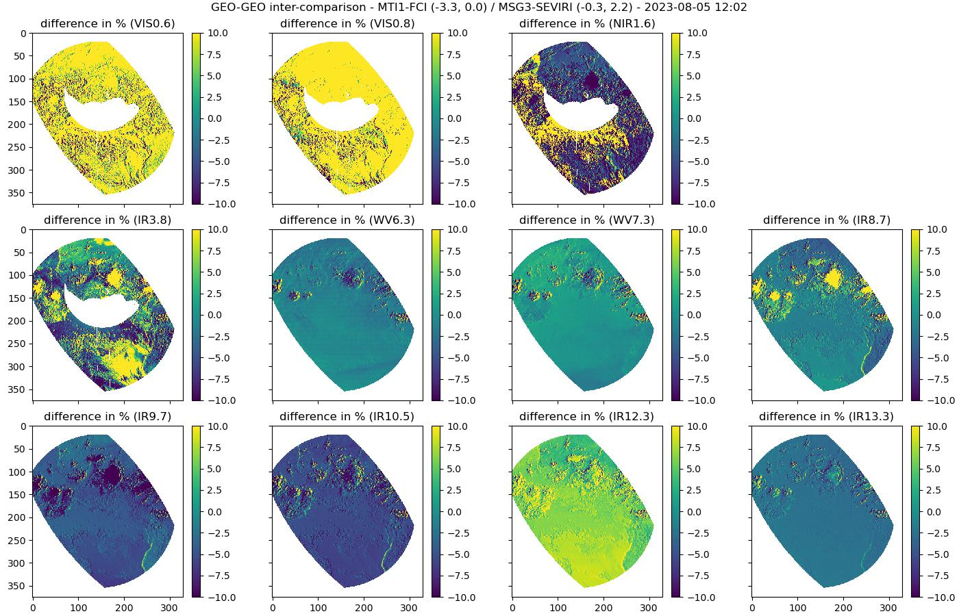
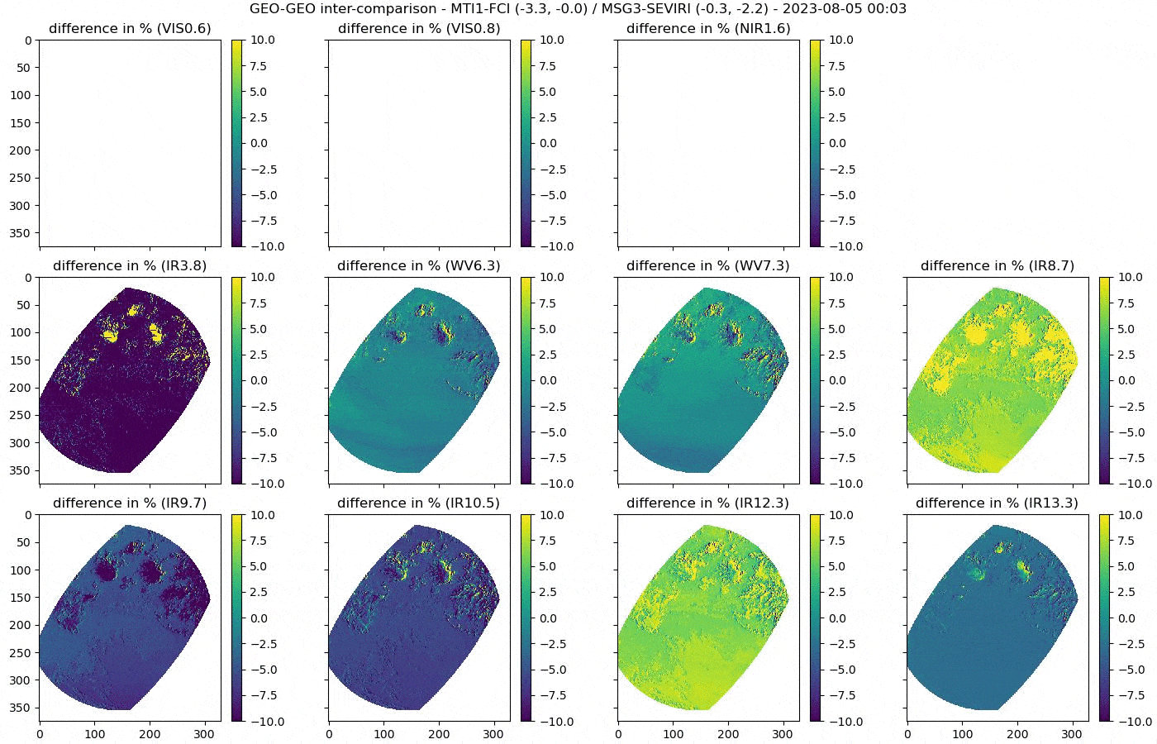
Example GEO-GEO Results – Normalised Differences
FCI VNIR calibration is not yet updated in-flight
SEVIRI VIS0.6/0.8 calibration known to be biased by 10%/ 7%
Other differences/stripes due
to ongoing detector calibration
Target area moves due to satellites’ orbital inclination
Sun glint mask moves with Sun during the day
Differences vary with:
  Time of day
  Land/Water
  Scene radiance
  (clear/cloudy)
  Cloud edge effects
Notes:
Made with http://micmicsdev4:8888/notebooks/FCI/Commissioning/IDPF_IVV_June2023/IIIC_Time_Series.ipynb
Animation made with ImageMagick convert –delay 10 –loop 0 *.png animation.gif
Animation optimised and cropped with https://ezgif.com/crop

Slide 7
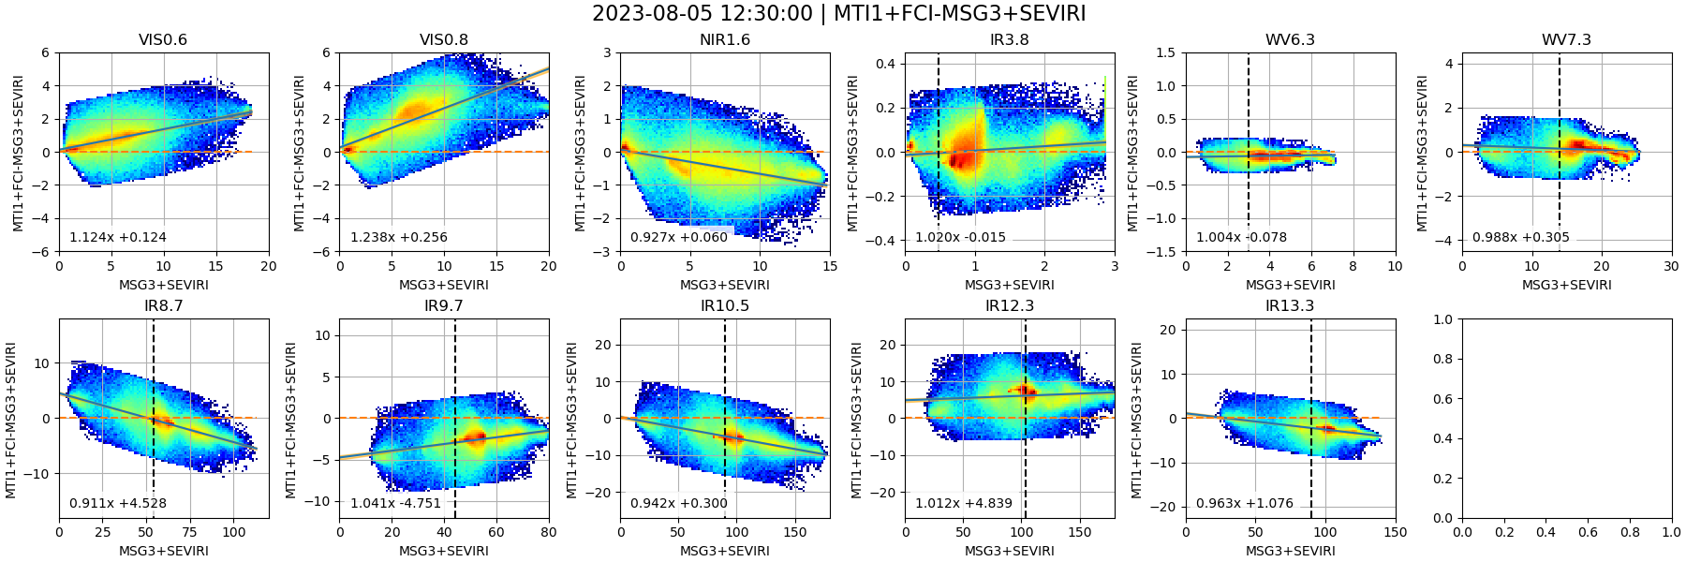
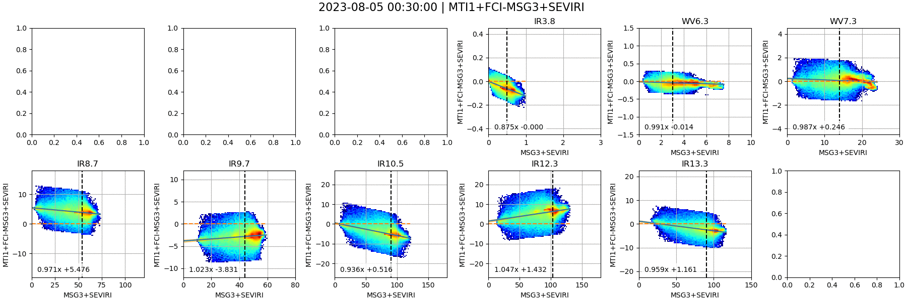
Example GEO-GEO Results – Scatterplots + Regression
Scatterplots show relationship between collocated superpixels – e.g. calibration bias, non-linearity
Currently using linear regression to define relationship (under review)
Results sensitive to Spectral Band Adjustment Factors
Results currently vary during day for some channels – highlighting processing issues
  Data is not radiometrically tuned – and many corrections not yet enabled
Notes:
Scatterplots show relationship between collocated superpixels – e.g. calibration bias, non-linearity
Currently using linear regression to define relationship (under review)
Results sensitive to Spectral Band Adjustment Factors – especially IR3.8 – which may need different SBAFs in daytime and nighttime
Results currently vary during day for some channels – highlighting processing issues
!$ cd /tcenas/proj/calib/results/MICMICS/VAL/COD/products/SATCAL_NRTC_GEOGEO_QLK/Meteosat-12+FCI_Meteosat-10+SEVIRI/v01/2023/08/
!$ convert -delay 20 -loop 0 *20230805*.png 20230805_animation.gif

Slide 8
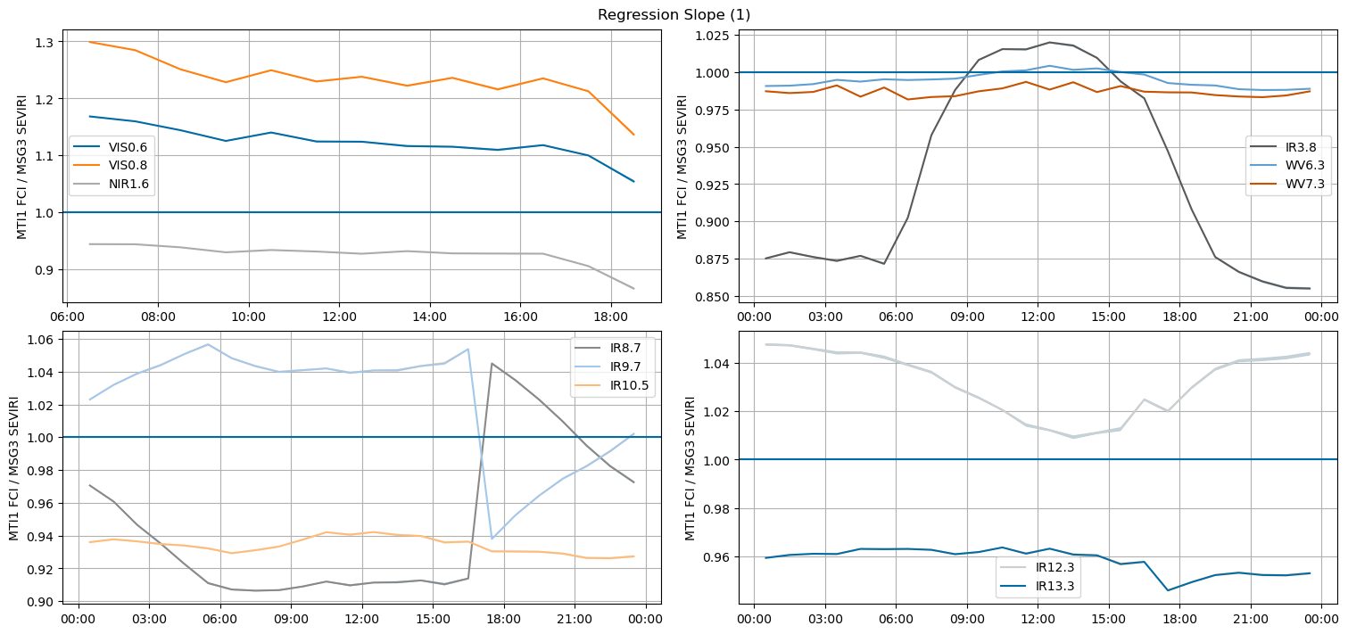
Example GEO-GEO Results – Regression Coefficient
MTG-I1/FCI-Meteosat-10/SEVIRI VIS0.6 2023-08-05
Notes:
VIS/NIR calibration shows large biases – partially explained by SEVIRI calibration – but remains relatively stable during the day
IR channels’ calibration generally in line with SEVIRI – IR3.8 clearly shows different behaviour during the daytime due to sensitivity to solar signal + something in IR8.7+9.7 around sunset
Remaining difference subject to ongoing investigations

Slide 9
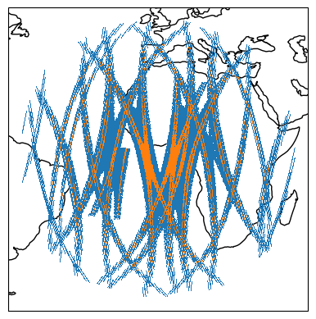
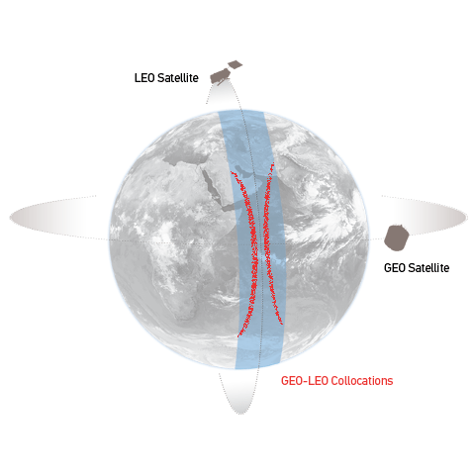
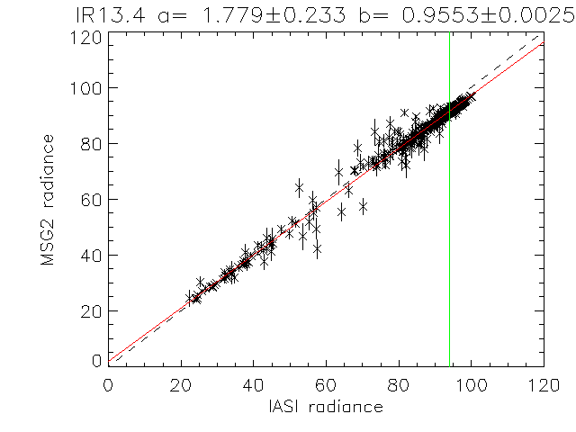
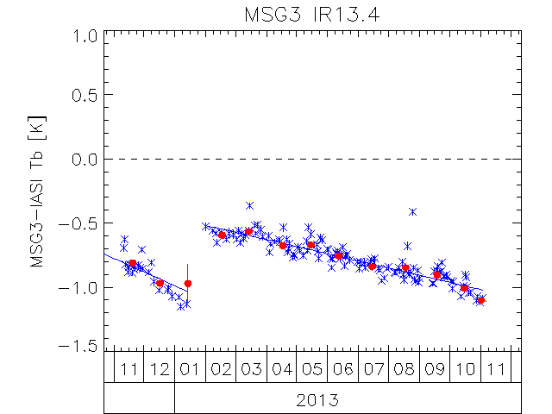

Current GSICS GEO-LEO IR algorithm: FCI-IASI
Collocate in Space, Time, Angle
  Collect Simultaneous Nadir Overpasses (SNOs)
  Maximum difference in |dsec(VZA)| < 0.03
  Pixels’ max time difference |dt| < 300 s
  Day- and Night-time data (IR3.8 night-only)
  Average all FCI pixels in each IASI FoV (+ var.)
Hyperspectral Reference (IASI)
  Convolve IASI spectrum with FCI SRFs
  Can investigate SRF errors
Compare
  Apply weighted regression to collocated radiances
  Evaluate uncertainties
Generate GSICS Correction
  Update daily
  Distribute via GSICS Servers
Evaluate & Monitor Bias
  Verify Radiometric Accuracy Requirement (<0.7 K)
  Check long-term stability (<0.3 K over lifetime)
  Including decontaminations
[mW/m2/sr/cm-1]
[mW/m2/sr/cm-1]
Bias at Standard Scene Radiance (~285K)
Bias at Cold Scene (220K)

Slide 10
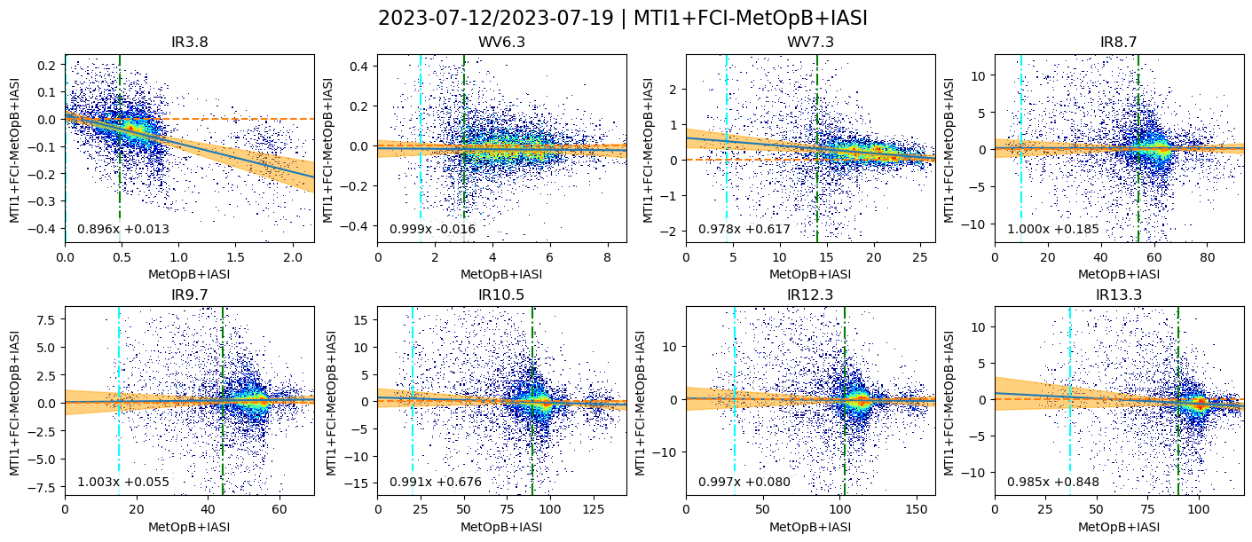
Scatterplot of Collocated Radiances + fitted GSICS Correction
Uncertainties from algorithm inflated by 10x for plotting purposes
Data used here is not radiometrically tuned - Many corrections are not yet enabled
Notes:
Radiance-dependent biases in IR3.8, WV7.3, IR13.3 – SRF errors?

Slide 11
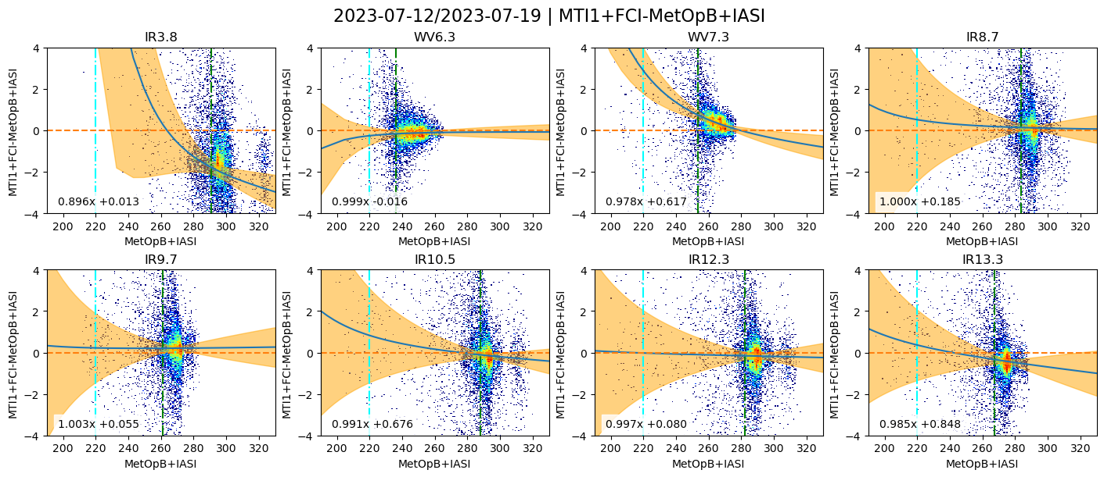
Scatterplot of Collocated BTs + fitted GSICS Correction
Bias Requirement ±0.7K
Uncertainties from algorithm inflated by 10x for plotting purposes
Data used here is not radiometrically tuned - Many corrections are not yet enabled
Notes:
Uncertainties are shown multiplied by 10
at extremes of dynamic range appear larger when projected into brightness temperatures
but only 4 days’ data here – will reduce when more data is available, and as more of the dynamic range is filled with more variable cloudiness

Slide 12
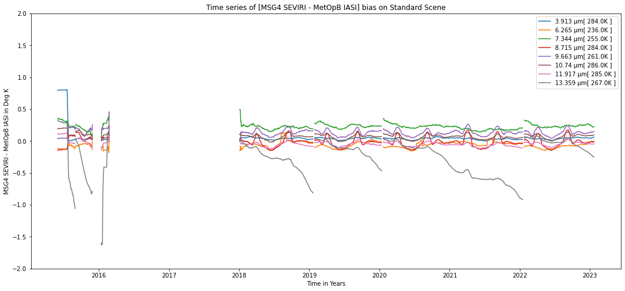
Long-term monitoring during FCI Operations
Example long-term monitoring of Meteosat-11/SEVIRI-IASI
From GSICS Product Catalog
GSICS Corrections
Standard formats - Common tools
Bias wrt IASI for standard scene radiances
Seasonal variations
Decontaminations introduce regular calibration jumps
esp. in IR13.4
(grey line)
(gap 2016/2017 due to In-Orbit Storage)

Slide 13
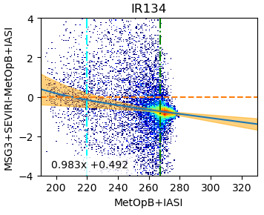
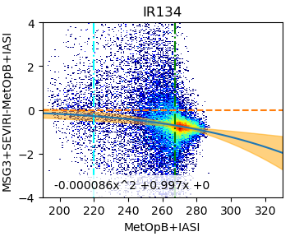
Development of GEO-LEO IR v2 algorithm for FCI
Collaborative developments to improve GSICS GEO-LEO IR inter-calibration algorithm:
Improve usability
    Simplify formula and implementation
    Planning to integrate GSICS Corrections into SatPy L1 readers
Performance at the Cold End
    Reformulate inter-calibration equation
    To ensure biases tend to zero for zero radiance
Previous issue with collocations over Hot Land now resolved
    Important to ensure collocations are symmetrically distributed in time
    To prevent aliasing components of diurnal cycle
    Allows inclusion of daytime collocations to extend dynamic range
Impact of high viewing angles already reduced
    Caused inconsistent results from Full Disc and Rapid Scan Service
    More careful handling of cloud parallax needed
Diurnal variation
    Need to handle multiple references - including IASI, CrIS, HIRAS, …
    To cover full diurnal cycle and monitor any calibration variations
Improved Uncertainties
    Dynamic calculation, following FIDUCEO approach
Testing development with MTG-I1/FCI data
    Expect first demonstration products in 2024
    In L1c format and on GSICS Server (+SatPy?)
v1 GEO-LEO IR
Current GSICS Correction for Meteosat-10/ SEVIRI IR13.4 channel, based on linear regression with IASI-B radiances during night-time only, plotted in brightness temperatures
2023-08-01/30
v2 GEO-LEO IR
Candidate v2 algorithm,
based on regression with quadratic term + zero offset in radiances, during day+night
CrIS will be included as reference

Slide 14

Conclusions and Outlook
GEO-GEO inter-comparisons can
  Identify processing artefacts (e.g. striping)
  Identify diurnal calibration variations
  Confirm consistency with SEVIRI
GEO-LEO IR inter-calibration can
  Quantify absolute radiometric calibration (wrt IASI + CrIS)
  Provide radiometric corrections if needed
Continuous Monitoring can
  Confirm long-term stability – over mission lifetime
Commissioning of MTG-I1/FCI is ongoing
  Results shown to illustrate benefits of inter-calibration
  Performance expected to continue to improve
  To meet requirements once L1c data is operational
Plan to Extend inter-calibration analysis
  Longer time series needed
  Check linearity and potential SRF shifts
Use FCI data to develop GEO-LEO IR v2 algorithm
  And associated uncertainty framework
Thank you!
Questions are welcome.

