Slide 1
GOES-13 and GOES-16 3.8µm and 11µm BT direct comparisons to stress the importance of scene dependent SBAFs
David Doelling and Conor Haney
GSICS IR subgroup meeting
Nov 2, 2023

Slide 2
Motivation
Can the same nighttime cloud retrieval algorithm be used between GOES-16 and GOES-13 utilizing only the 3.8µm (SIR) and 11µm (WN) channels?
The goal is continuity cloud properties between GOES 2nd (GOES-8 to 15) and 3rd generation (GOES-16 to 19) for the CERES project
During December 2017 the GOES-13 and GOES-16 GEO satellites were both located at 75° W
Both GEO domains are angle matched
The GOES-13 and GOES-16 sensor differences
SIR and WN IR channels are spectrally different
The SIR and WN channels pixel resolution is 4x2.3-km for GOES-13 and 2x2-km for GOES-16
GOES-13 scans FD from North to South in 26 minutes
GOES-16 scans a FD image every 15 minutes
Comparison of GOES-13 and GOES-16 0.1° gridded BT for Jan 1, 2018, 5:45 GMT (both sensors)

Slide 3
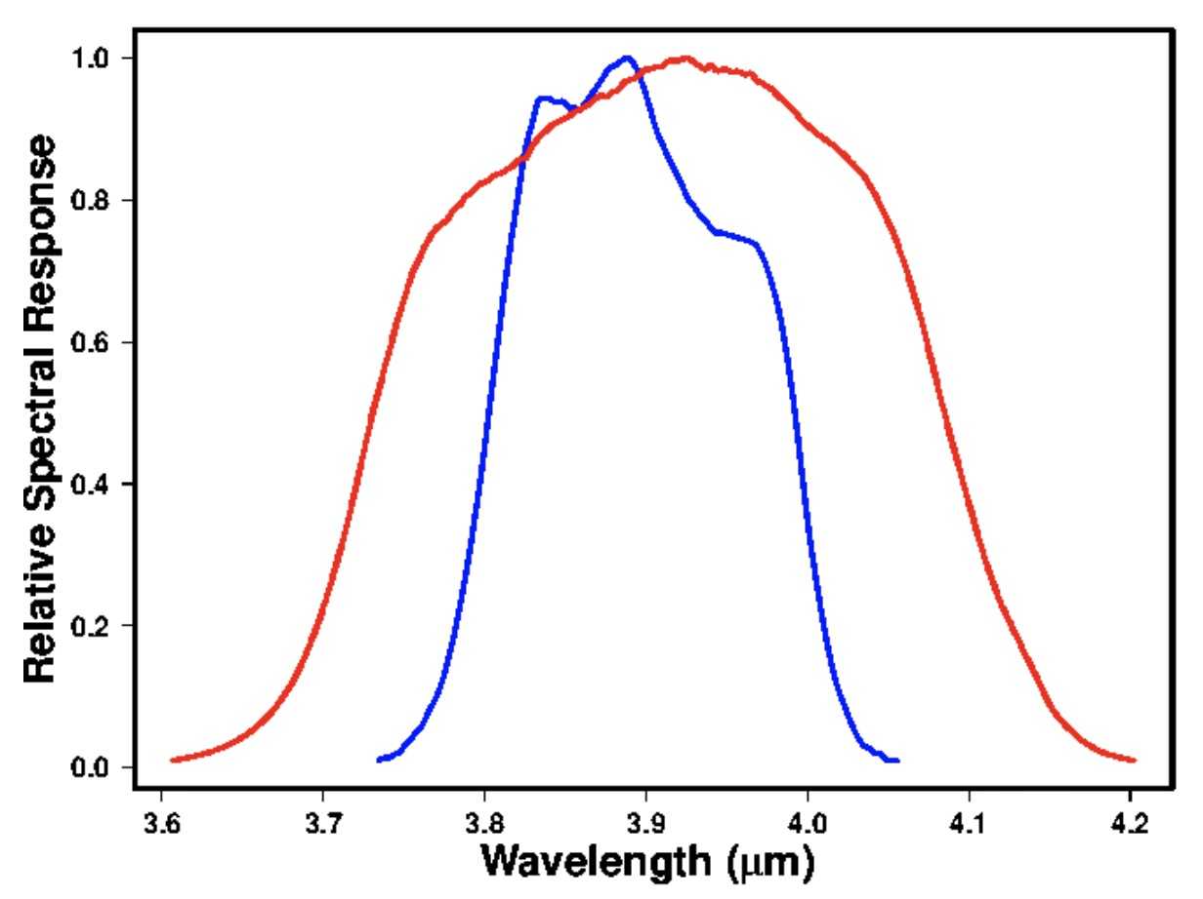
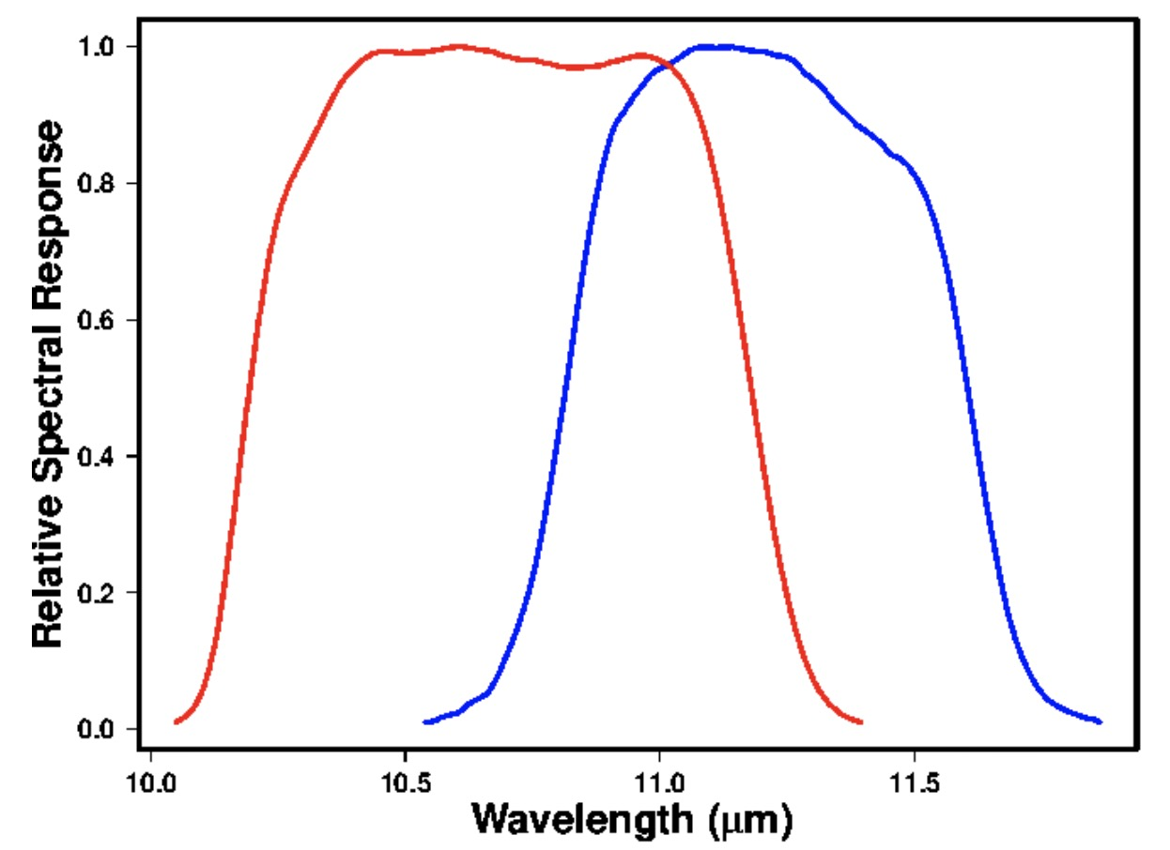
Spectral Response functions

Slide 4
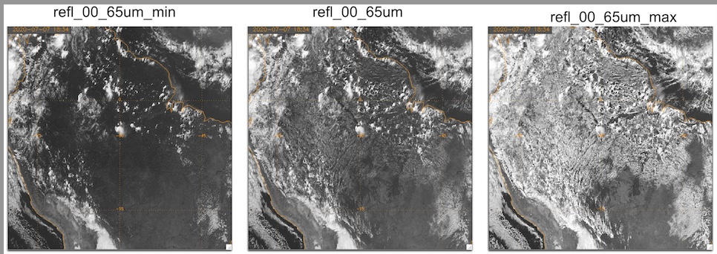
darkest 0.5-km reflectance within a 2-km footprint
brightest 0.5-km reflectance within a 2-km footprint
mean 2-km reflectance
courtesy of Andy Heidinger

Slide 5
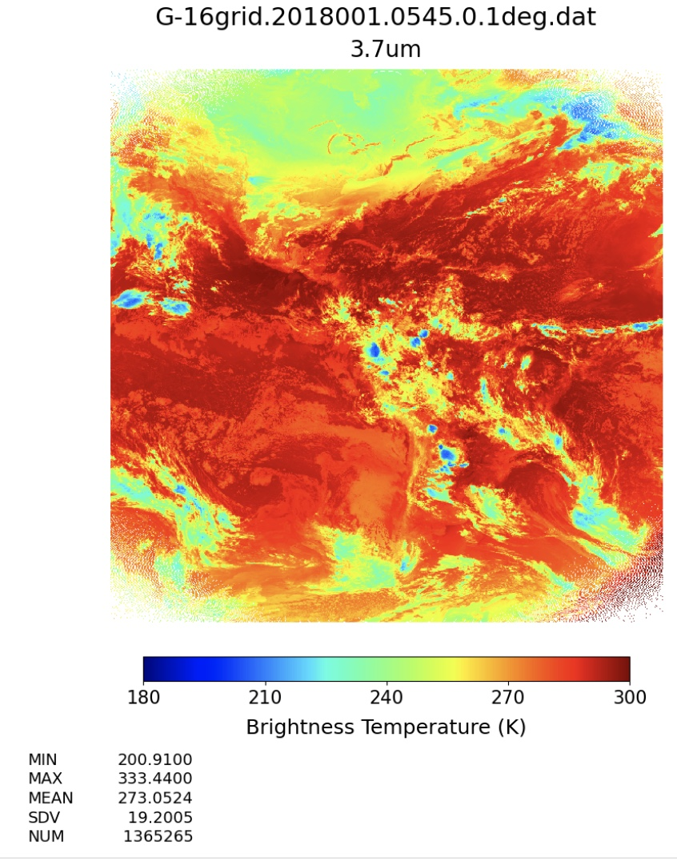
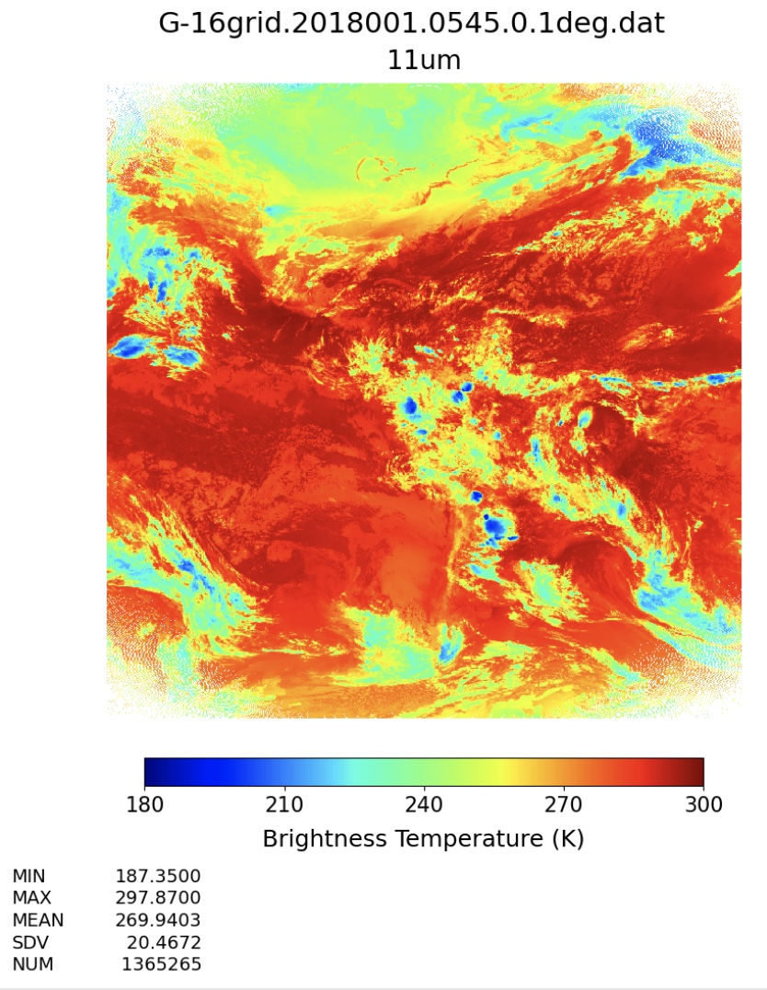
G16 BT

Slide 6
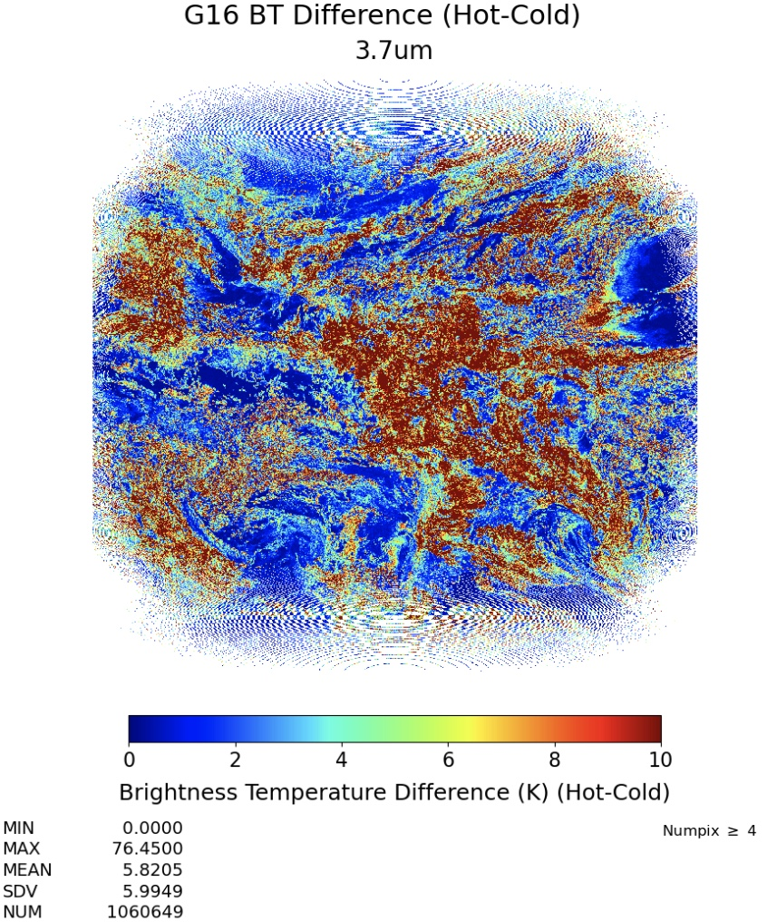
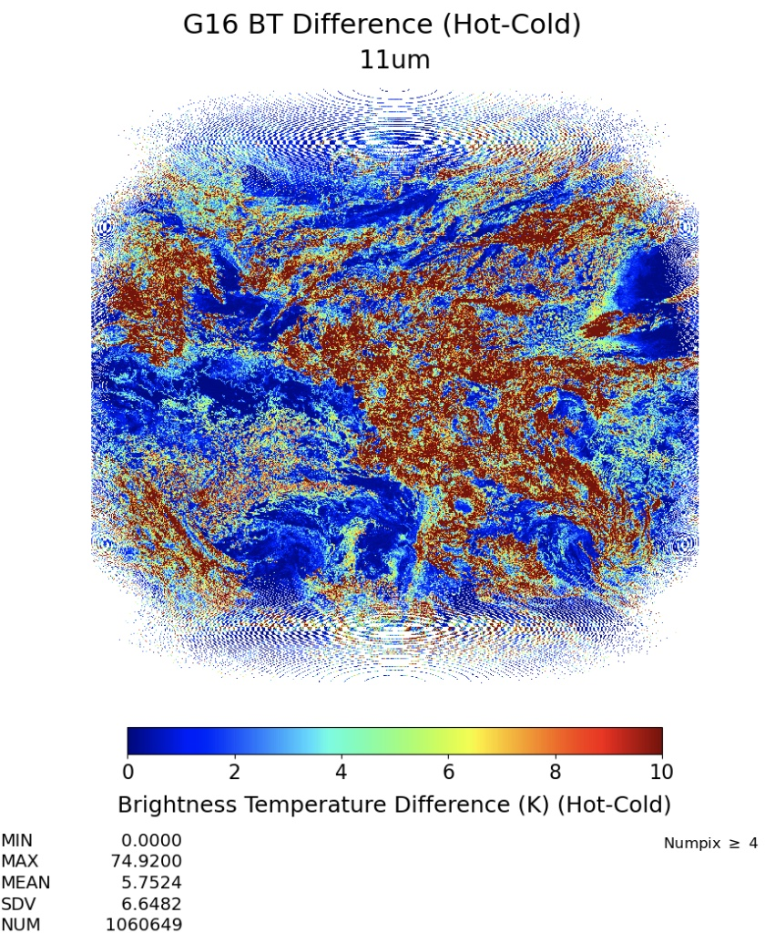
G16 HOT-COLD BT pixel in 0.1° grid

Slide 7
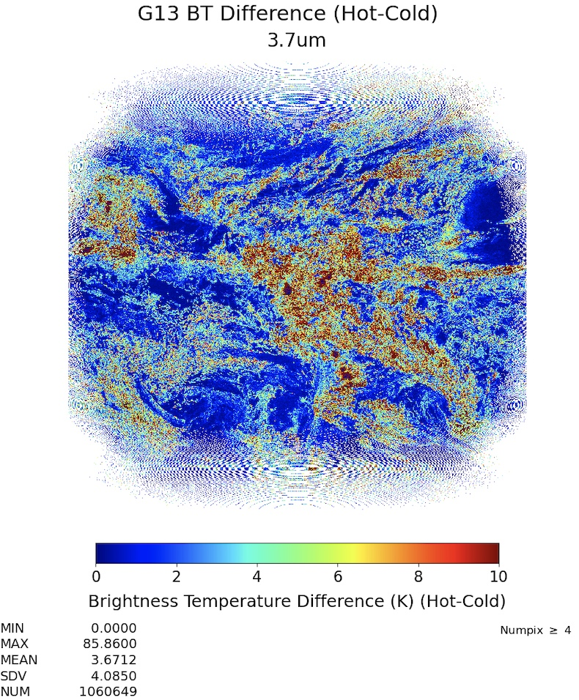
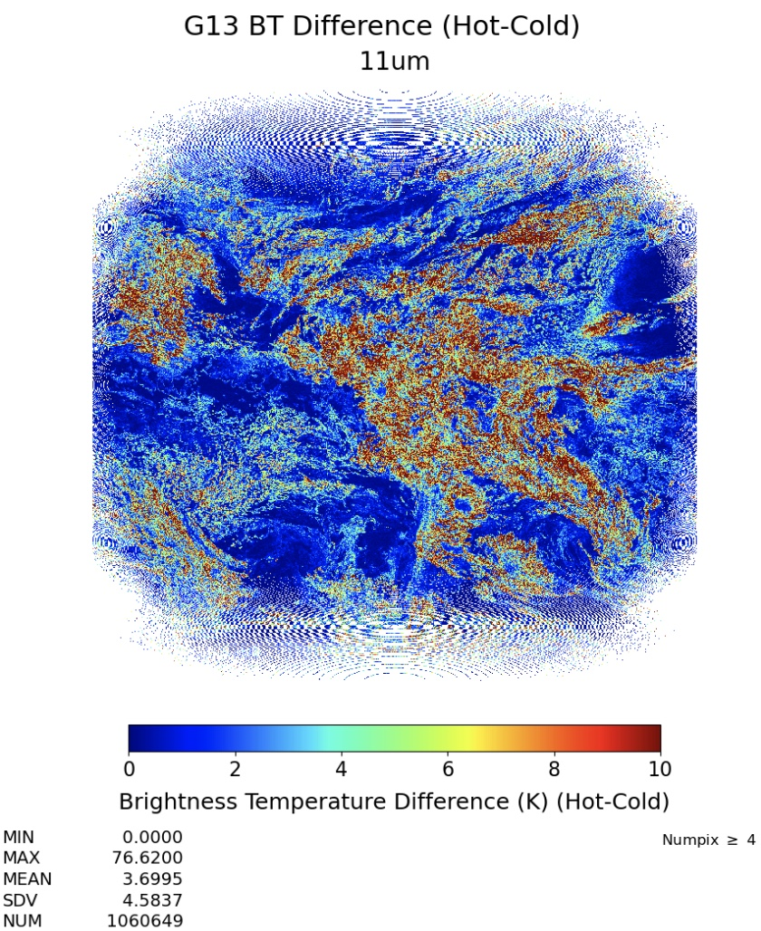
G13 HOT-COLD BT pixel in 0.1° grid

Slide 8
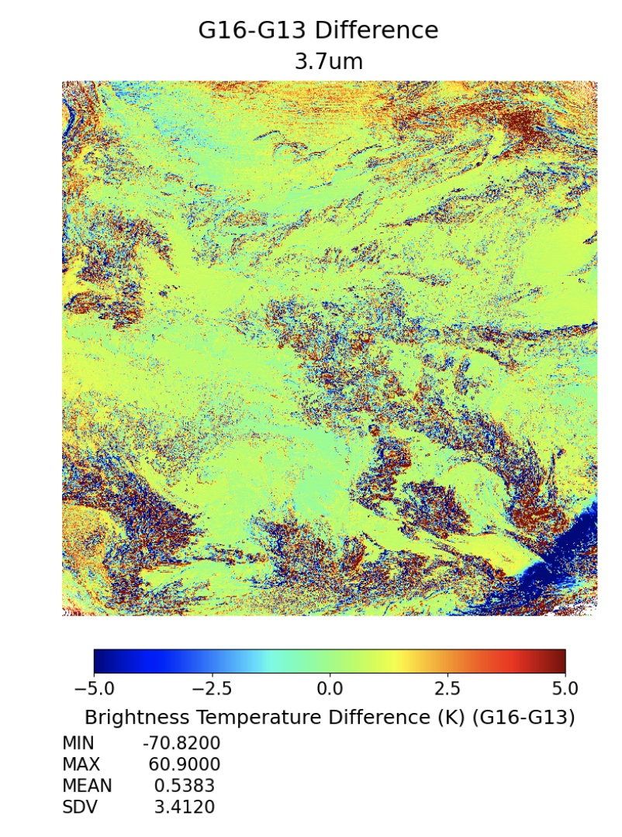
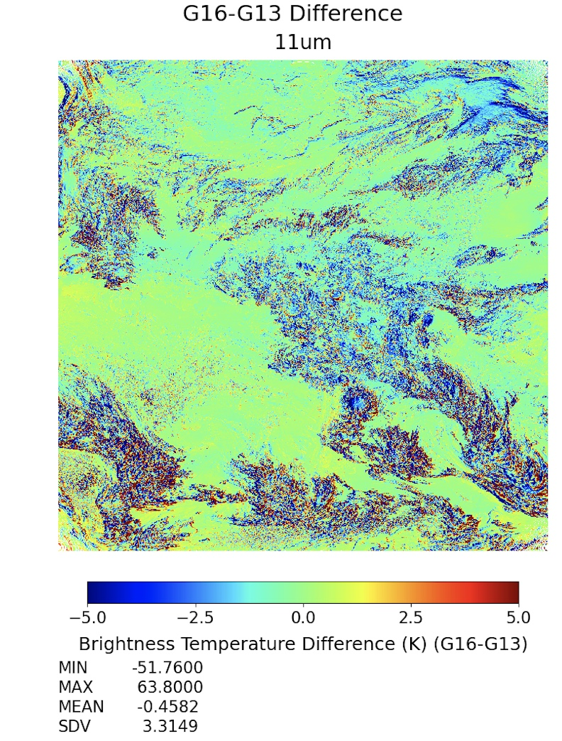

Slide 9
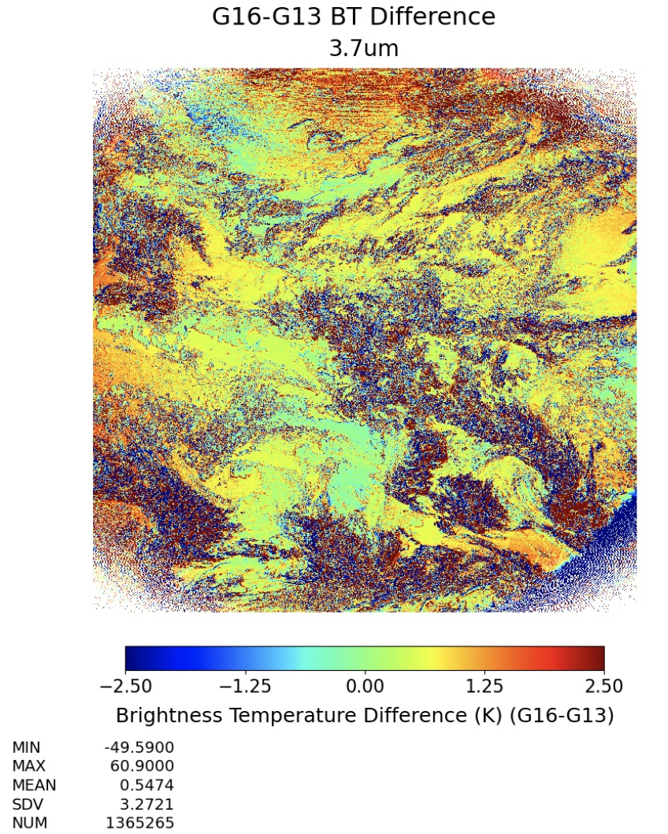
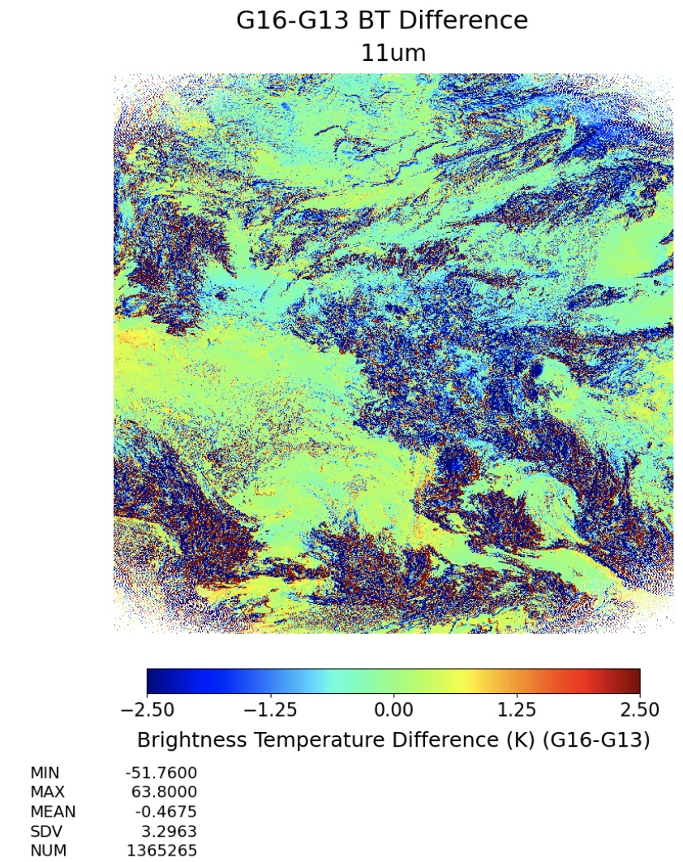
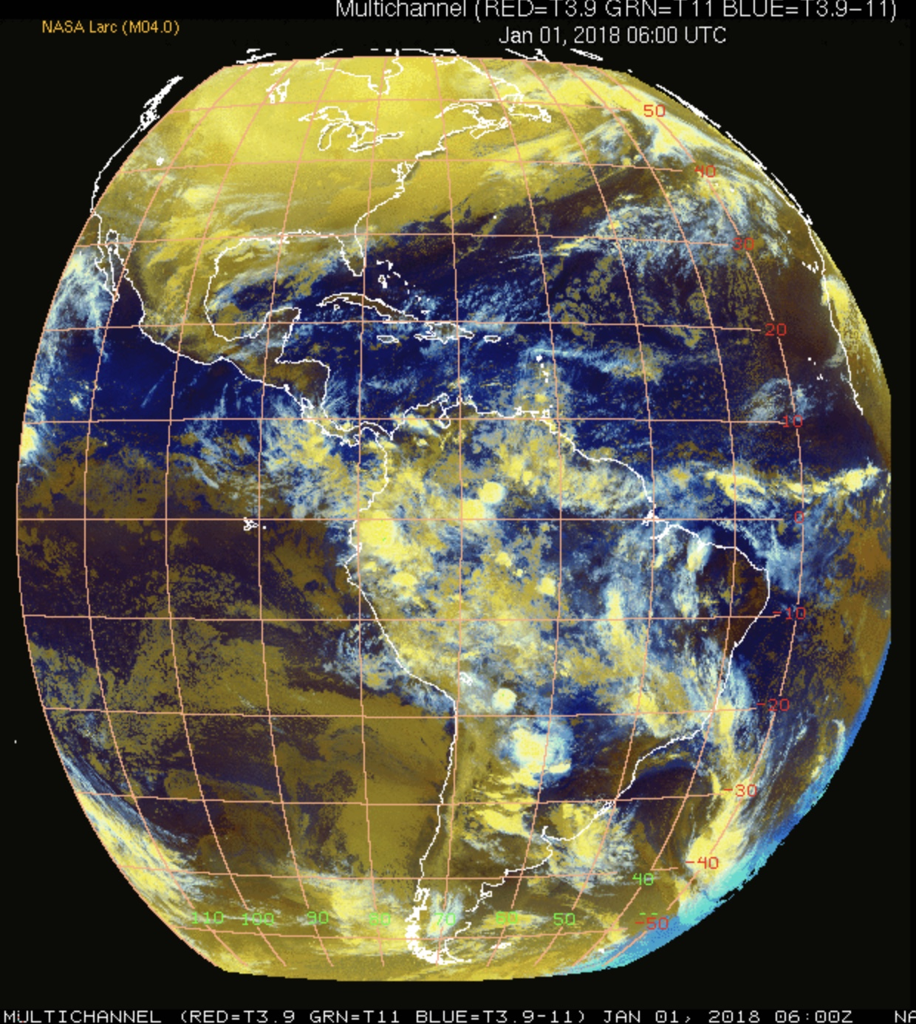
reduced colorbar range

Slide 10
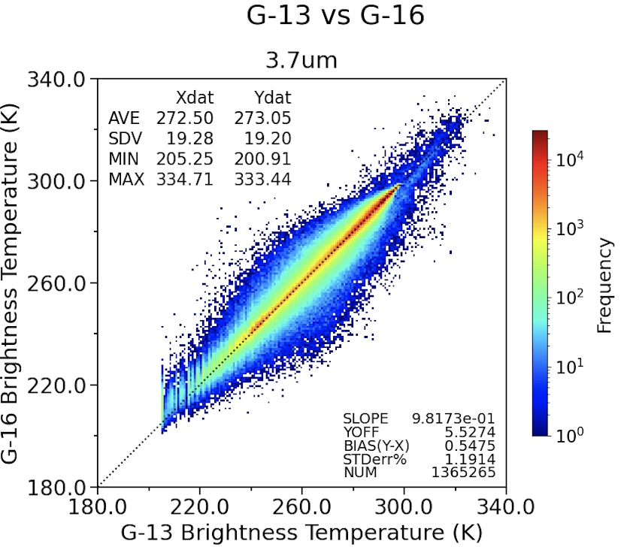
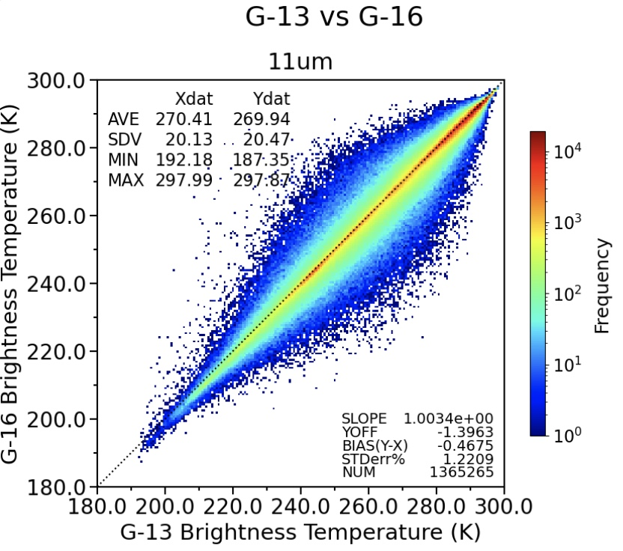
SE corner has some visible light

Slide 11
• The next slides have BTsigma<0.25K homogeneity filtering applied • no land and ocean separation or VZA stratification

Slide 12
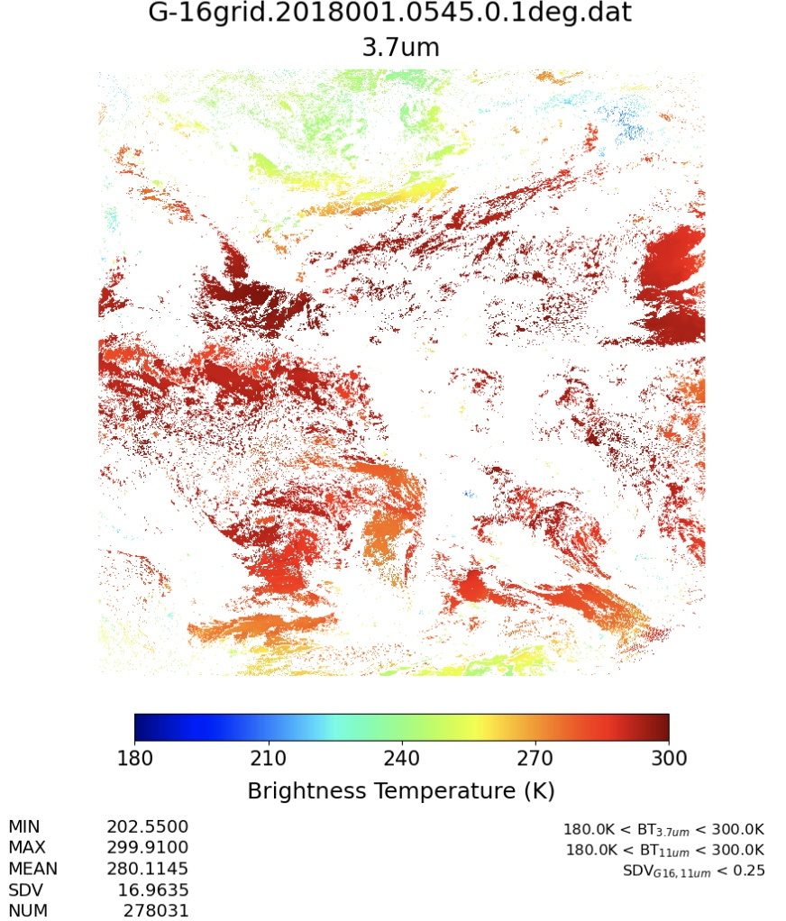
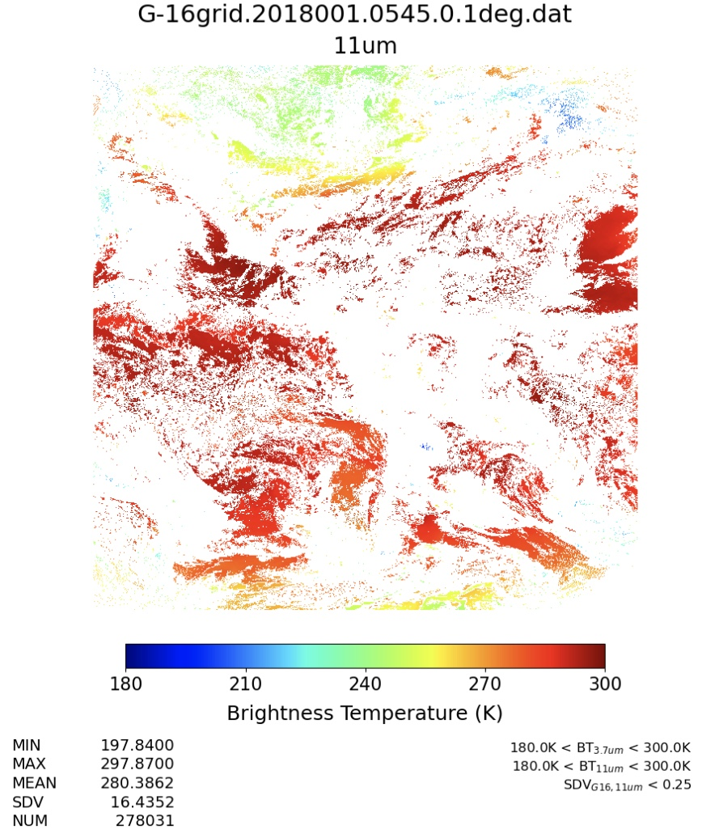
G16 BT
BTsigma<0.25K

Slide 13
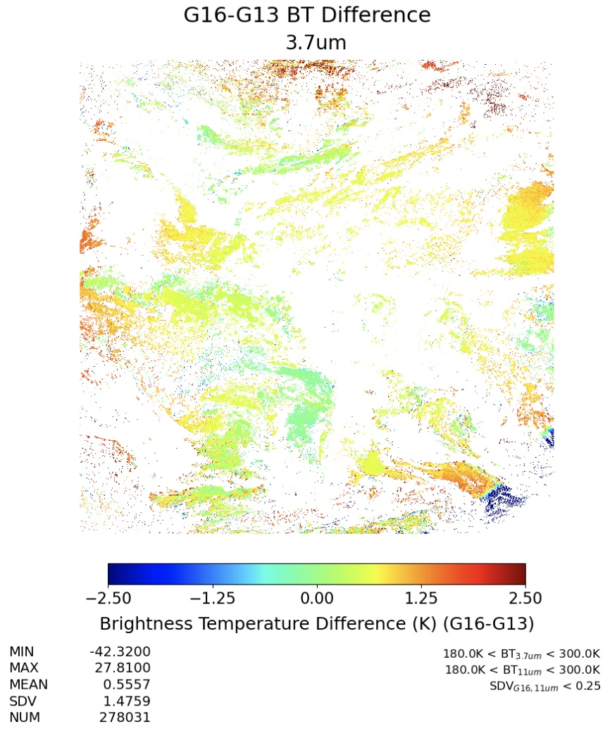
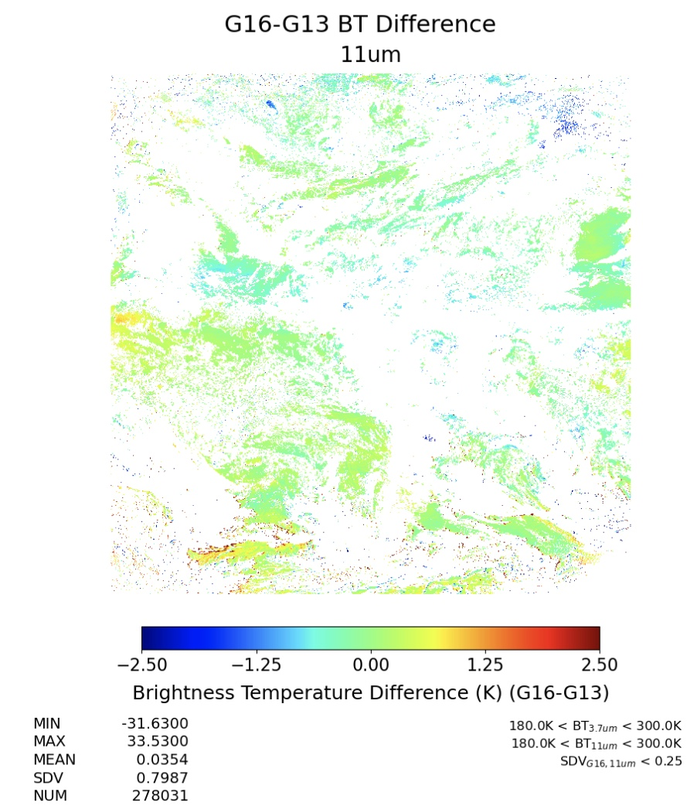
G16-G13 BTD
BTsigma<0.25K

Slide 14
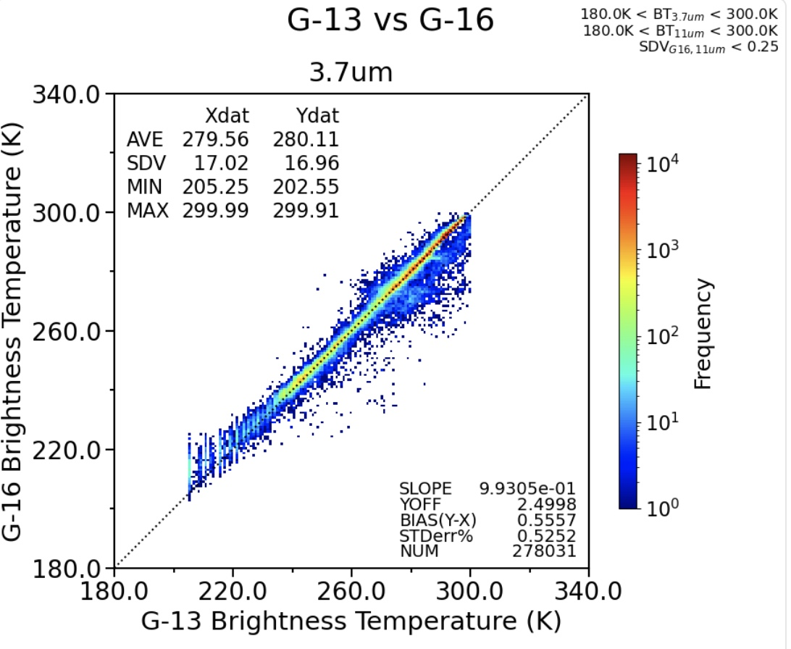
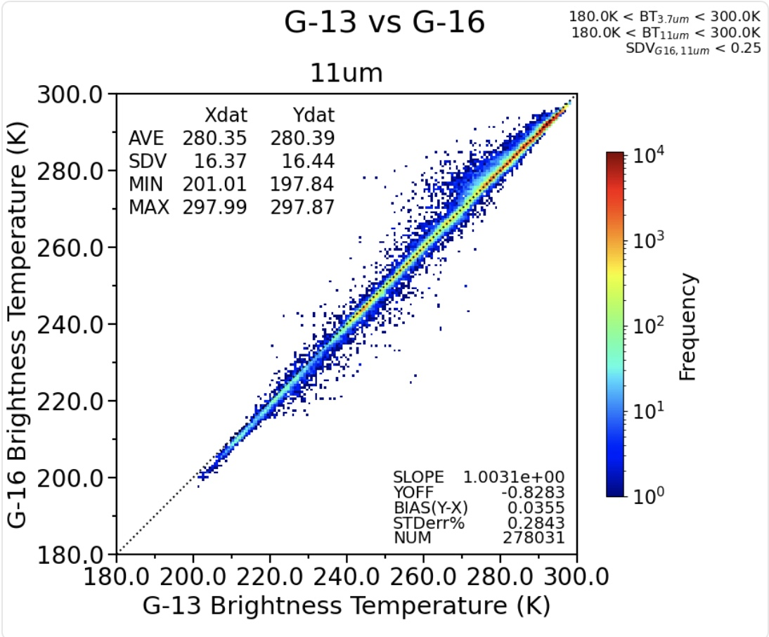

Slide 15
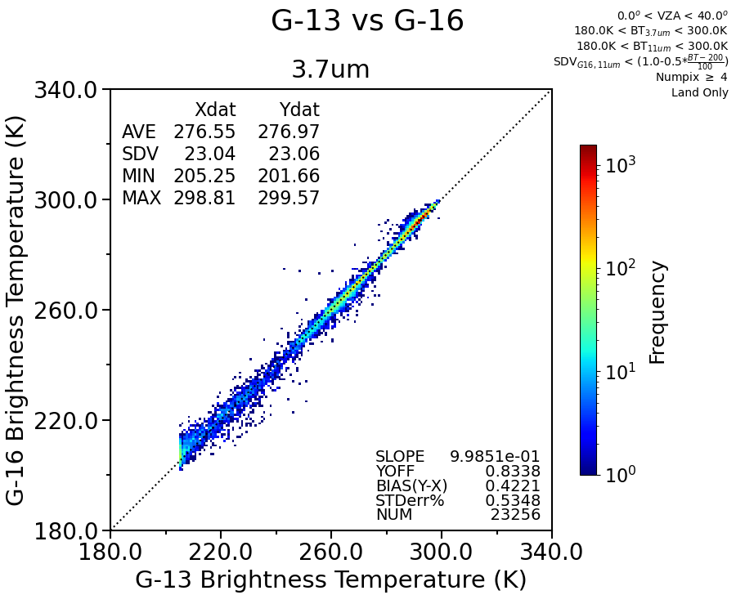
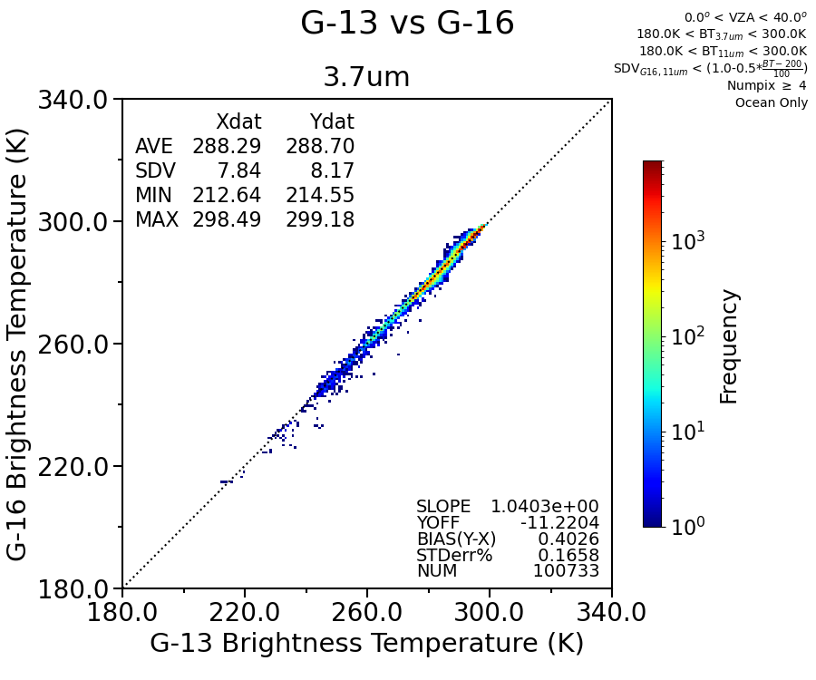
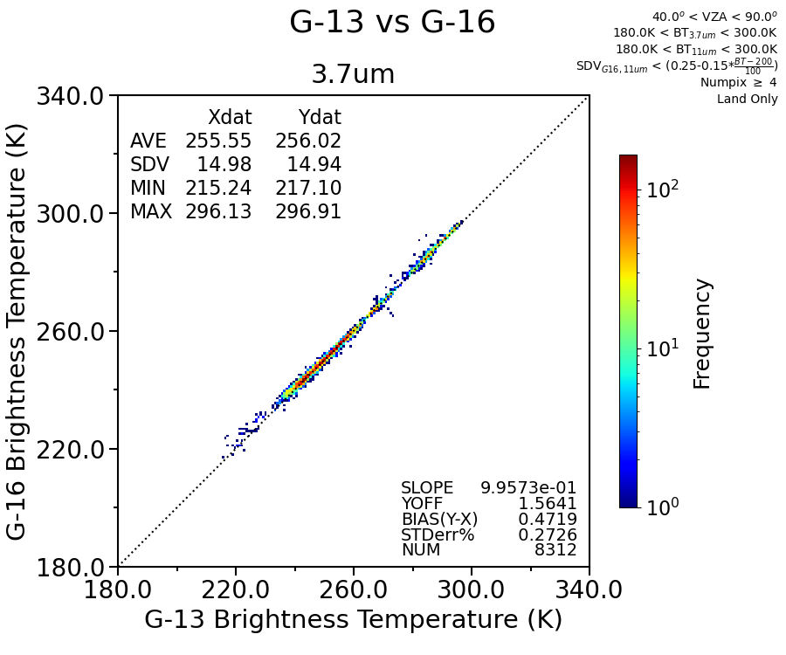
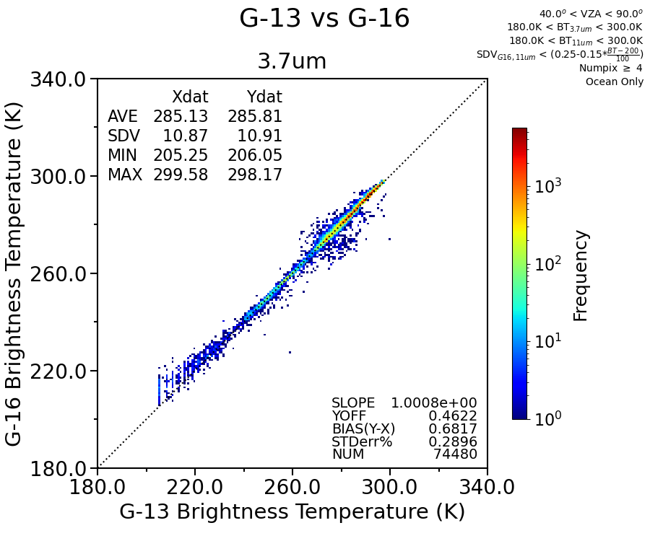
Land
ocean
Land
3.7µm
most spatial homogeneous (SDV) 0.1° gridded regions G-13 and G16 scatter plot
0°<VZA<40°
40°<VZA<90°

Slide 16
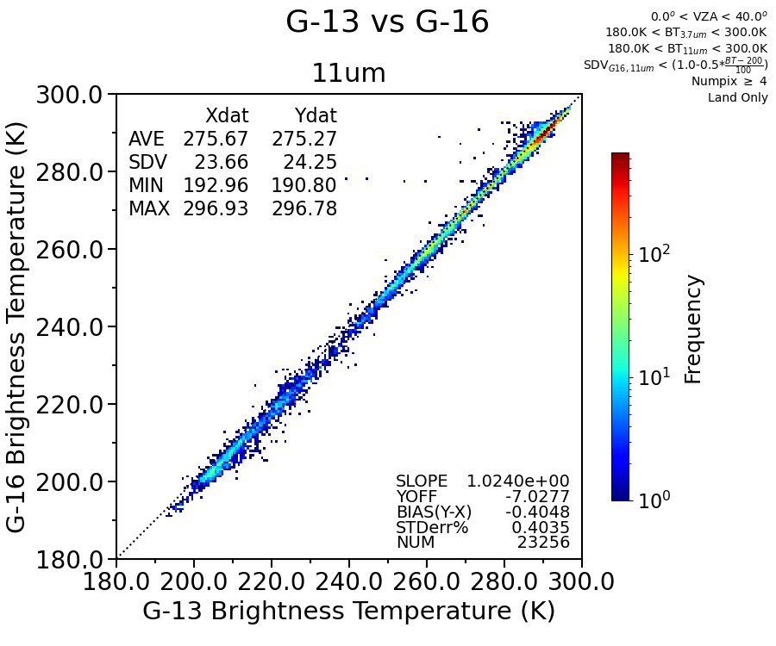
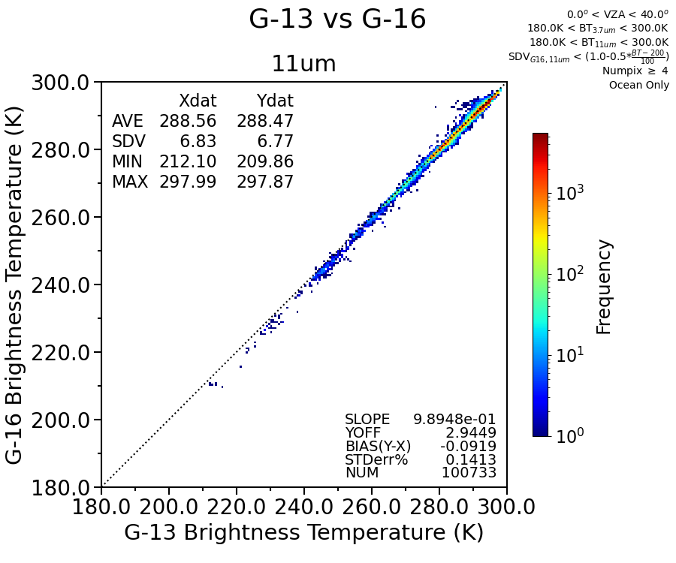
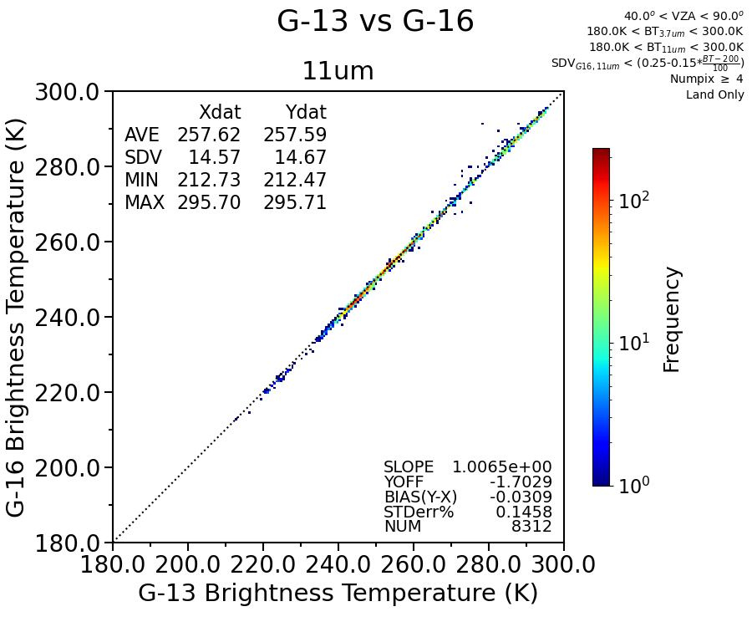
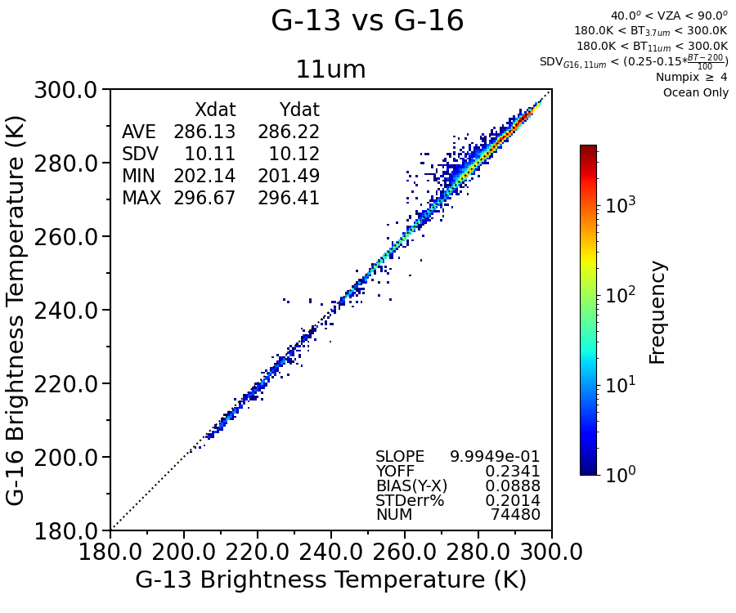
Land
ocean
11µm
most spatial homogeneous (SDV) 0.1° gridded regions G-13 and G16 scatter plot
0°<VZA<40°
40°<VZA<90°

Slide 17
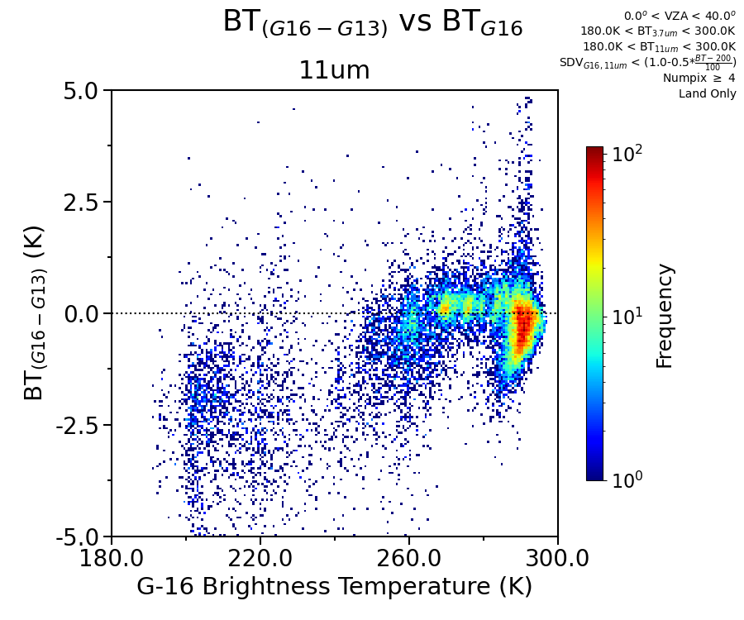
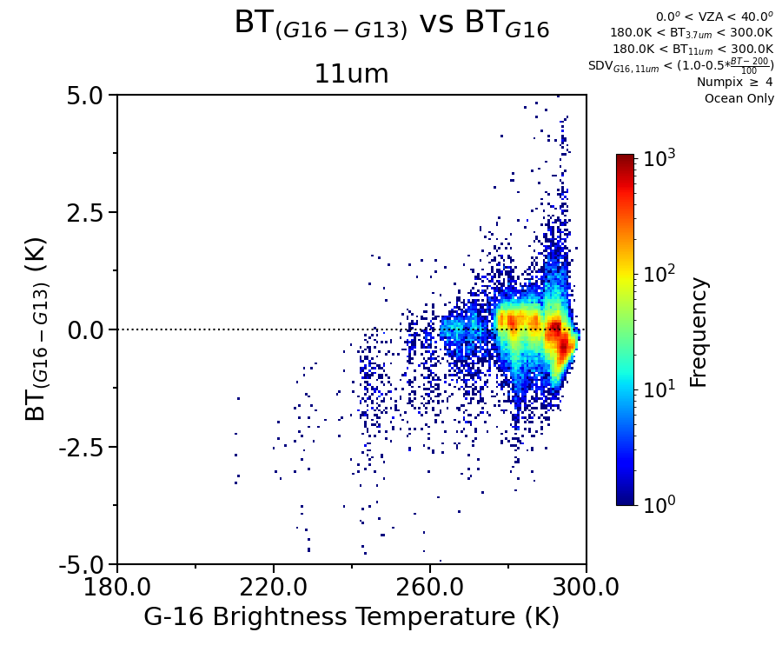
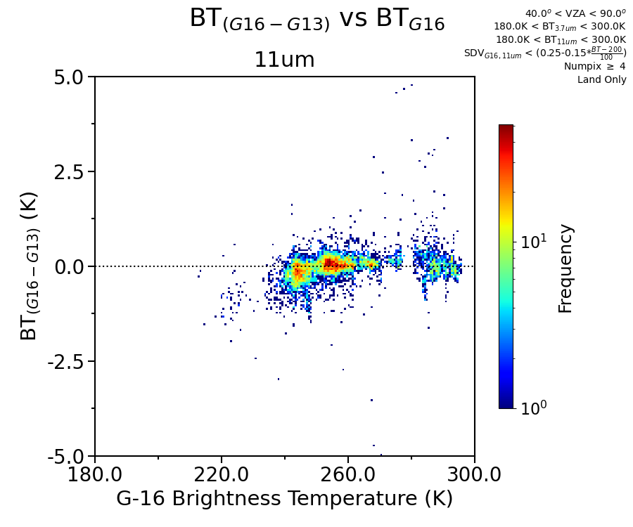
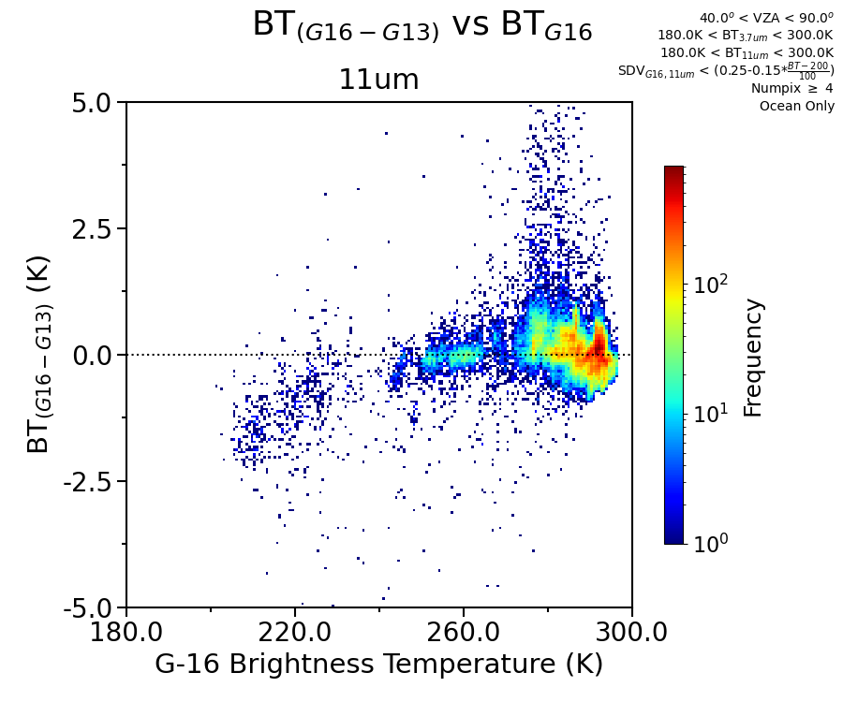
Land
ocean
11µm
most spatial homogeneous (SDV) 0.1° gridded regions G16 minus G13 BTD density plot
0°<VZA<40°
40°<VZA<90°

Slide 18
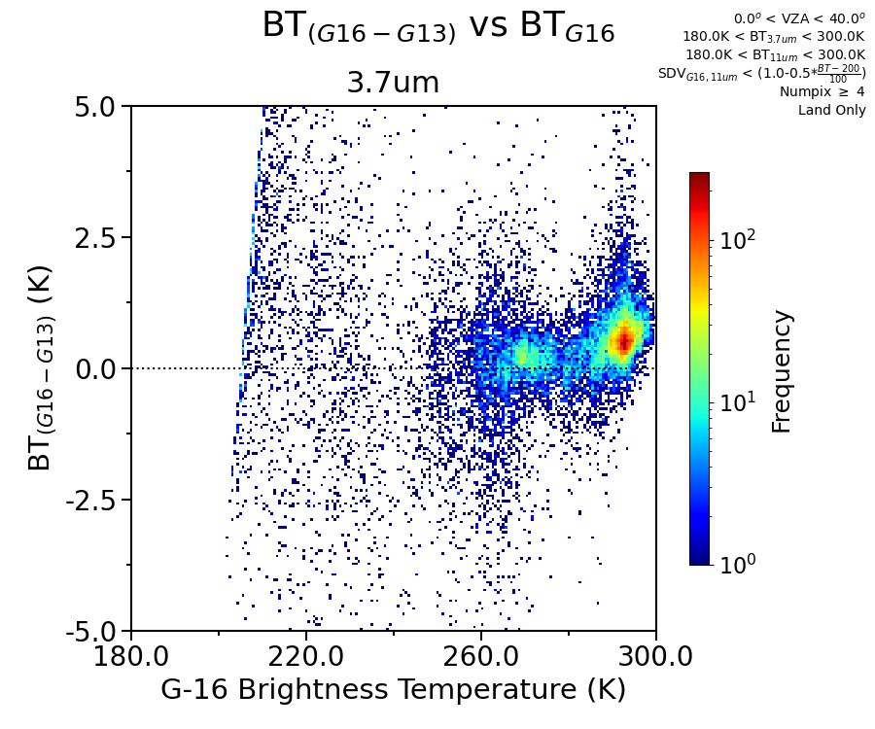
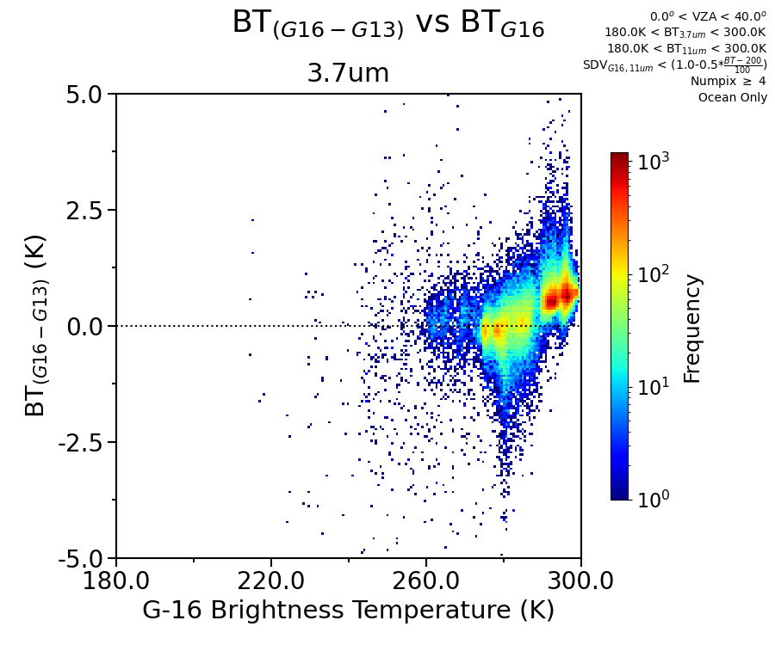
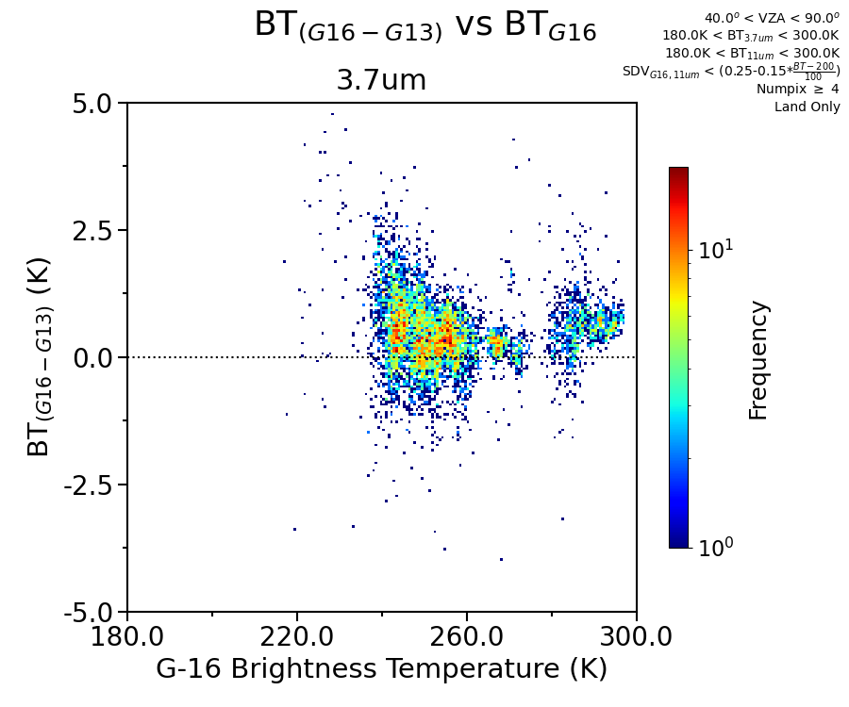
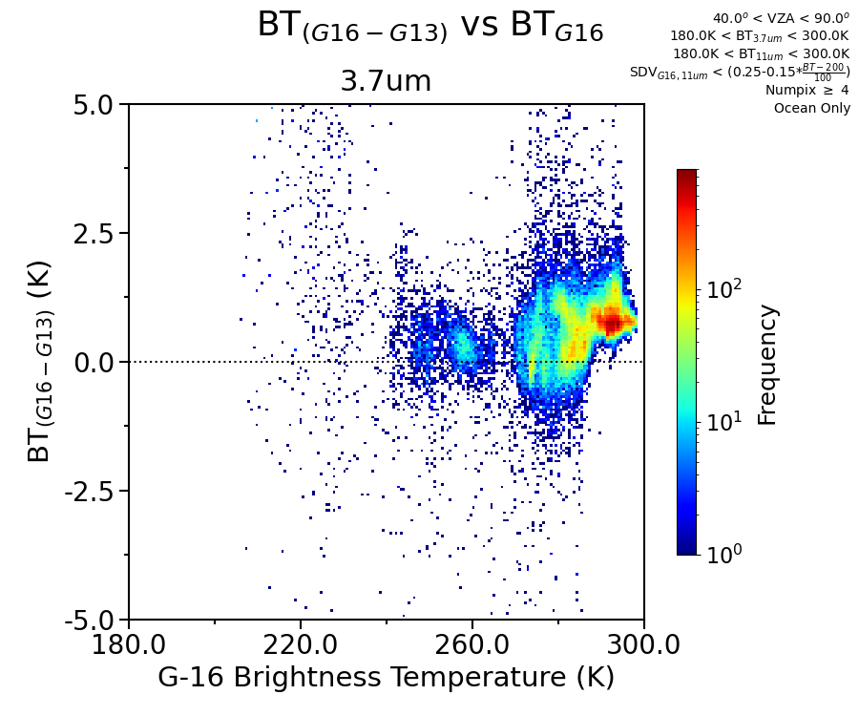
Land
ocean
3.7µm
most spatial homogeneous (SDV) 0.1° gridded regions G16 minus G13 BTD density plot
0°<VZA<40°
40°<VZA<90°

Slide 19
Conclusions
The world is partly cloudy, if the satellite has differing spatial resolutions, must locate the spatially homogeneous gridded BT to identify inter-calibration events
To account for IR sensor spectral differences, the scene type specific SBAF must be utilized

