Slide 1
THE NEXT GENERATION OF THE INTERNATIONAL SATELLITE CLOUD CLIMATOLOGY (ISCCP-NG)
Briefing to GSICS
Andrew Heidinger, NESDIS GEO Scientist, GEWEX DAP/ ICWG, ISCCP-NG
March 29, 2021

Slide 2
Goals for this Talk
Explain our ISCCP-NG Level-1b gridded (L1g)
Invite all to try our L1g demo data, try out the code and join our development efforts.
Seek guidance how to automatically imbed GSICS Corrections into L1g.

Slide 3
ISCCP-NG L1G Prototypes
ISCCP-L1g is an attempt to make a consistent data set from all GEO L1b
Using the SatPy tools, an L1g prototype code has been developed and made available via git: https://gitlab.ssec.wisc.edu/cphillips/isccp_l1g_prototype
Sample Data is available at: ftp://ftp.ssec.wisc.edu/ISCCP-NG
Default resolution is all channels (19 max), 6 km, 30 minutes. Final values are TBD.
Concept supported by CM-SAF, NASA, NOAA and others.
Daytime RGB + Nighttime IR window for one day of ISCCP-NG L1g from GOES-17, GOES-16, Meteosat-11, Meteosat-8 and Himawari-8. (Martin Stengel/DWD). Default Resolution
L1g Development Team (all welcome)
Martin Stengel (DWD)
Coda Phillips, A. Walther (CIMSS)
Ken Knapp (NOAA)
Arata Okuyama, Kazutaka Yamada (JMA)
GSICS will be leveraged.

Slide 4
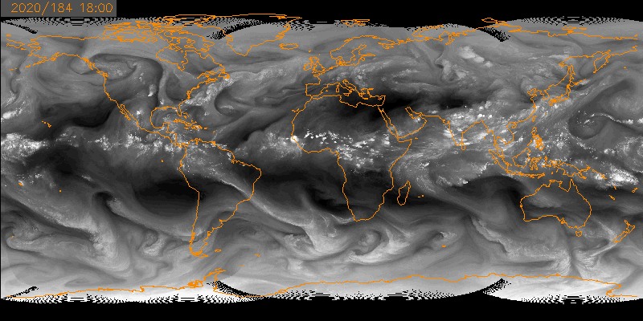
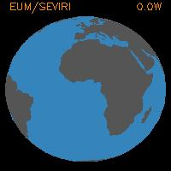
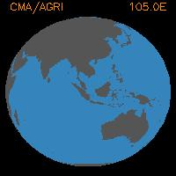
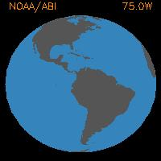
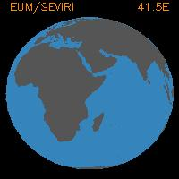
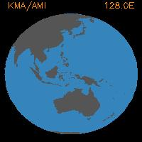
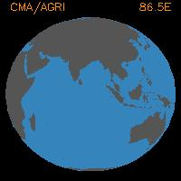
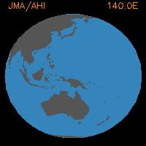
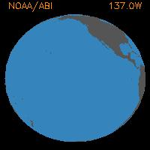
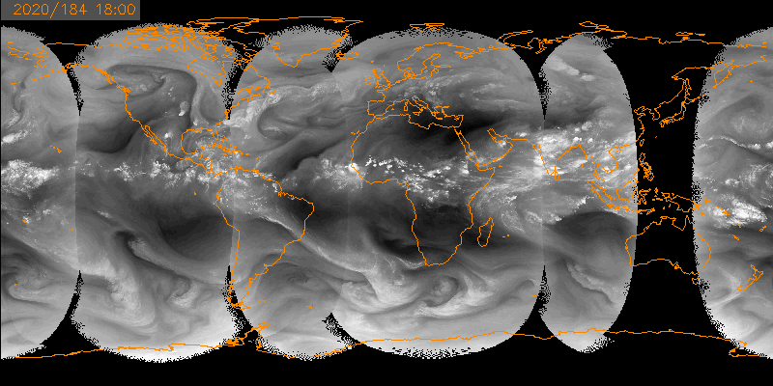
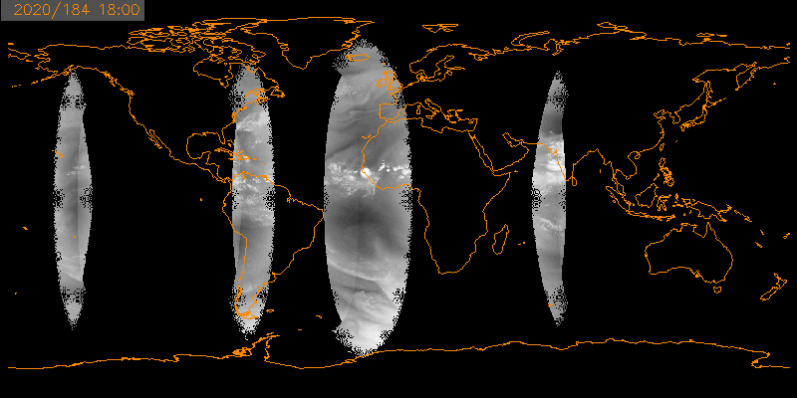
Handing of Overlap (3 Layers)
MOST NADIR
2nd MOST NADIR
3rd MOST NADIR
Maybe this facilitates some radiometric consistency checks

Slide 5
File Naming Convention
All channels included but renamed using nominal channel wavelengths
Up to 3 layers of data to handle sensor overlap.
One file per channel
One file for standard deviation of certain channels.
WMO_ID
Sensor Zenith
Missing:
Solar Angles
Better Pixel Time
You Tell Us!
ISCCP-NG_L1g_demo_A1_v1_res_0_10deg__refl_00_47um_20200704T1800.nc
ISCCP-NG_L1g_demo_A1_v1_res_0_10deg__refl_02_20um_20200704T1800.nc
ISCCP-NG_L1g_demo_A1_v1_res_0_10deg__temp_10_40um_20200704T1800.nc
ISCCP-NG_L1g_demo_A1_v1_res_0_10deg__refl_00_51um_20200704T1800.nc
ISCCP-NG_L1g_demo_A1_v1_res_0_10deg__sample_mode_20200704T1800.nc
ISCCP-NG_L1g_demo_A1_v1_res_0_10deg__temp_11_00um_20200704T1800.nc
ISCCP-NG_L1g_demo_A1_v1_res_0_10deg__refl_00_65um_20200704T1800.nc
ISCCP-NG_L1g_demo_A1_v1_res_0_10deg__satzen_20200704T1800.nc
ISCCP-NG_L1g_demo_A1_v1_res_0_10deg__temp_11_00um_count_20200704T1800.nc
ISCCP-NG_L1g_demo_A1_v1_res_0_10deg__refl_00_65um_count_20200704T1800.nc
ISCCP-NG_L1g_demo_A1_v1_res_0_10deg__temp_03_80um_20200704T1800.nc
ISCCP-NG_L1g_demo_A1_v1_res_0_10deg__temp_11_00um_max_20200704T1800.nc
ISCCP-NG_L1g_demo_A1_v1_res_0_10deg__refl_00_65um_max_20200704T1800.nc
ISCCP-NG_L1g_demo_A1_v1_res_0_10deg__temp_06_20um_20200704T1800.nc
ISCCP-NG_L1g_demo_A1_v1_res_0_10deg__temp_11_00um_min_20200704T1800.nc
ISCCP-NG_L1g_demo_A1_v1_res_0_10deg__refl_00_65um_min_20200704T1800.nc
ISCCP-NG_L1g_demo_A1_v1_res_0_10deg__temp_06_70um_20200704T1800.nc
ISCCP-NG_L1g_demo_A1_v1_res_0_10deg__temp_11_00um_std_20200704T1800.nc
ISCCP-NG_L1g_demo_A1_v1_res_0_10deg__refl_00_65um_std_20200704T1800.nc
ISCCP-NG_L1g_demo_A1_v1_res_0_10deg__temp_07_30um_20200704T1800.nc
ISCCP-NG_L1g_demo_A1_v1_res_0_10deg__temp_12_00um_20200704T1800.nc
ISCCP-NG_L1g_demo_A1_v1_res_0_10deg__refl_00_86um_20200704T1800.nc
ISCCP-NG_L1g_demo_A1_v1_res_0_10deg__temp_08_50um_20200704T1800.nc
ISCCP-NG_L1g_demo_A1_v1_res_0_10deg__temp_13_30um_20200704T1800.nc
ISCCP-NG_L1g_demo_A1_v1_res_0_10deg__refl_01_38um_20200704T1800.nc
ISCCP-NG_L1g_demo_A1_v1_res_0_10deg__temp_08_70um_20200704T1800.nc
ISCCP-NG_L1g_demo_A1_v1_res_0_10deg__wmo_id_20200704T1800.nc
ISCCP-NG_L1g_demo_A1_v1_res_0_10deg__refl_01_60um_20200704T1800.nc
ISCCP-NG_L1g_demo_A1_v1_res_0_10deg__temp_09_70um_20200704T1800.nc

Slide 6
Contents of Each L1g File
netcdf ISCCP-NG_L1g_demo_A1_v1_res_0_10deg__refl_00_65um_20200704T1800 {
dimensions:
time = 1 ;
layer = 3 ;
latitude = 1800 ;
longitude = 3600 ;
variables:
short refl_00_65um(time, layer, latitude, longitude) ;
refl_00_65um:_FillValue = -32767s ;
refl_00_65um:ahi_band_number = "03" ;
refl_00_65um:ahi_original_nadir_resolution_km = 0.5 ;
refl_00_65um:abi_band_number = "02" ;
refl_00_65um:abi_original_nadir_resolution_km = 0.5 ;
refl_00_65um:band_nickname = "Red" ;
refl_00_65um:central_wavelength_um = 0.65 ;
refl_00_65um:em_class = "visible" ;
refl_00_65um:units = "%" ;
refl_00_65um:standard_name =
"toa_bidirectional_reflectance" ;
refl_00_65um:gsics_calibration = "{}" ;
refl_00_65um:coordinates = "end_time start_time" ;
refl_00_65um:add_offset = 50LL ;
refl_00_65um:scale_factor = 0.25 ;
short latitude(latitude) ;
latitude:_FillValue = -32767s ;
latitude:standard_name = "latitude" ;
latitude:units = "degree_north" ;
latitude:scale_factor = 0.05 ;
short longitude(longitude) ;
longitude:_FillValue = -32767s ;
longitude:standard_name = "longitude" ;
longitude:units = "degree_east" ;
longitude:scale_factor = 0.05 ;
int64 start_time(time) ;
start_time:description = "time at start of window for data inclusion" ;
start_time:units = "seconds since 1970-01-01" ;
start_time:calendar = "proleptic_gregorian" ;
int64 end_time(time) ;
end_time:description = "time at end of window for data inclusion" ;
end_time:units = "seconds since 1970-01-01" ;
end_time:calendar = "proleptic_gregorian" ;
}

Slide 7
L1g Calibration Plans
Automatically imbed GSICS corrections into L1g
Keep the original L1b “counts/DN”, scale factors and offsets
The user needs to apply GSICS corrections
We are open to make other correction available (Remy Roca’s)
We can update calibration corrections without regenerating L1g (we just modify L1g attributes)
Is there a better way?

Slide 8
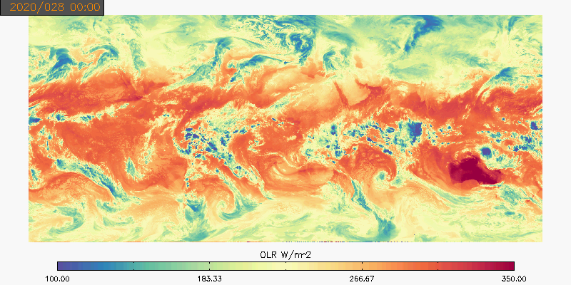
Level2 Products
OLR From JMA, NOAA, EUMETSAT and CMA GEO Imagers
L1g team is experimenting with L2 products to help ensure L1g is capable of this.
We’ll conduct these discussions within ICWG.
All are welcome to participate if you can process the minimum number of products and data.
Ancillary data has been made to support L2.
Still optimizing how to do this seamlessly.
Level2 comparisons should be help verify GSICS radiometric consistency

Slide 9
Conclusions
ISCCP-NG L1g prototype code and data are available. Level-2 will be coming soon.
We have made space for GSICS calibration information in L1g.
We need help in developing tools to automatically access GSICS data bases – could we get a training for our L1g team?
ISCCP-NG promises to start giving feedback on GSICS.

Slide 10
Thank You

Slide 11
Executive Summary
With the availability of MTG in 2023, the entire geostationary ring will be encircled by imagers which offer capabilities far superior to those from the previous generation of imagers. The Next Generation of the International Satellite Cloud Climatology Project (ISCCP-NG) is proposed as a follow-on to the classic ISCCP to more fully exploit the new capabilities. The challenge facing ISCCP-NG is to define a new baseline from this data and processing methods to extract meaningful information for the scientific community in the coming decades.
Since the inaugural workshop in late 2019, ISCCP-NG has focused on its gridded Level-1 (L1g) data. L1g is meant to be the primary input into all ISCCP-NG Level-2 and Level-3 and is an attempt to make access to these new data easy for the ISCCP-NG community. L1g combines all of the data from all of the sensors into one standard and consistent format. Currently, L1g concepts are being prototyped and made available for testing. L1g development is relying on the GSICS project for calibration.
With L1g data available, the work on ISCCP-NG L2 data is beginning and will be discussed at future International Cloud Working Group (ICWG) Workshops in the next two years.

Slide 12
Motivation for ISCCP-NG
With assumed launch of the MTG in 2022, the entire equator is encircled by “advanced” geostationary imagers. This is our targeted start date for new cloud property data records
New sensors provide information absent from the original ISCCP:
Cloud Dynamics
Cloud Microphysics
Aerosol
Diurnally consistent cloud climatologies
Maintaining these and the unimagined applications while sub-setting the data to a manageable size is the challenge.
Consistency with past climatology for common information is achievable. Data rescue, new quality control, re-calibration, and uncertainty estimates for past sensor radiances improve historic estimates.
Polar component is not yet specified but will likely have an equal-role as geo, not a supporting role as in the case of the original ISCCP.
Cloud Computing and other developments are making the project more appealing.

Slide 13
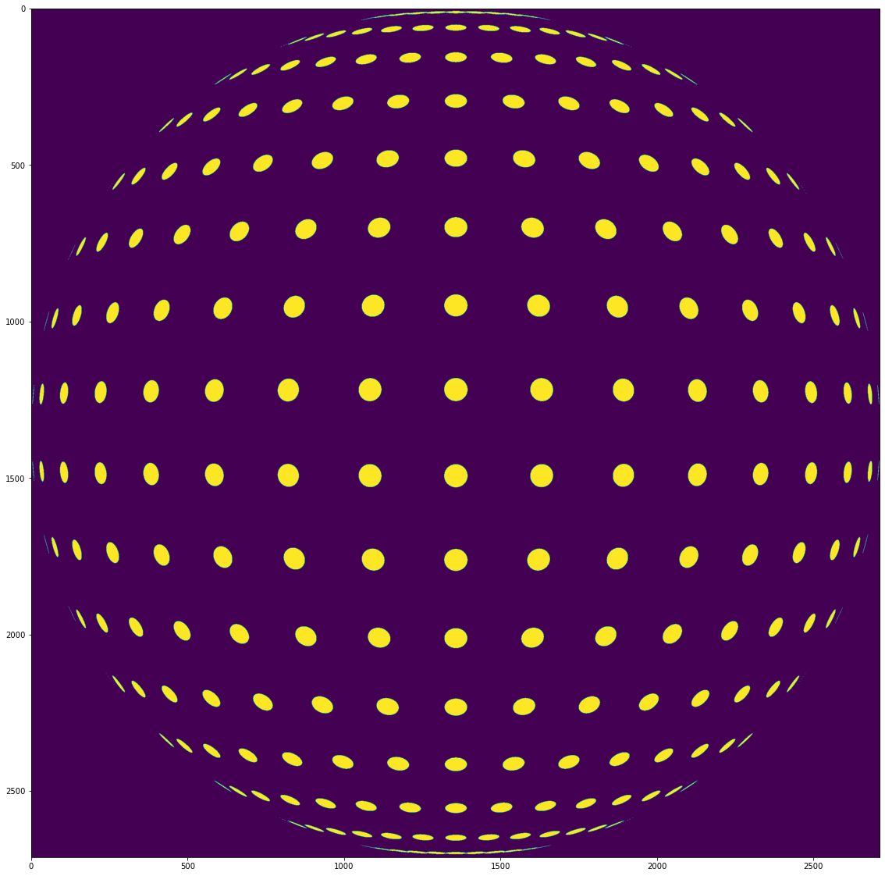
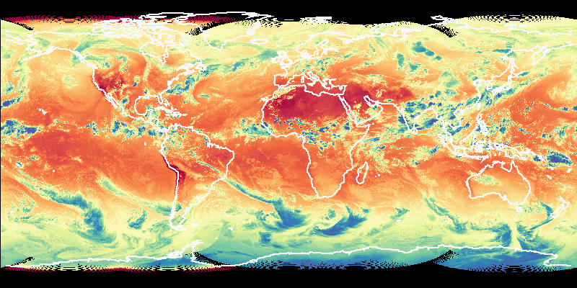
Current Concept for ISCCP-NG
Raw L1b from Advanced Geo Imagers (ABI, AHI, AMI, AGRI, SEVIRI/FCI )
L1g Data: All Channels mapped to standard grid. When sensors overlap, we keep the data. (6.2 μm BT shown)
L1g Gridding Code that imposes spatial and temporal and spectral resolution choices.
Satpy
GSICS
Most Nadir
Second Most Nadir (similar to GridSat)
ISCCP-NG Applications
The improved spatial, spatial and temporal characteristics of ISCCP-NG compared to ISCCP will allow:
Cloud Microphysics
Multi-spectral Aerosol Retrievals
Improved Day/Night Consistency of Cloud Macrophysics
Ability to track smaller and shorter-lived convection
Improved detection of atmospheric motions
Multi-angular views in overlap regions provide for stereoscopic retrievals of cloud/aerosol heights
L2 Data from Different Agencies and Applied to L1g data (Image Outgoing Longwave Radiation). L2 algorithms will be compared and discussed at CGMS Working Groups such as ICWG and other venues.

