Slide 1

Tim Hewison (EUMETSAT)
On behalf of
GSICS Research Working Group
Feedback between GSICS and NWP Community on Radiometric and Spectral Biases

Slide 2
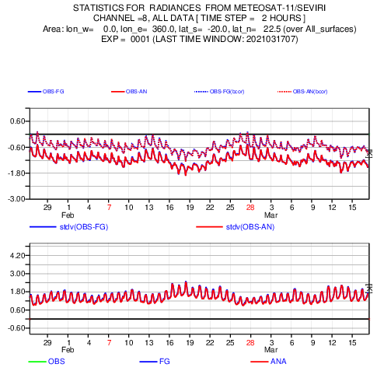
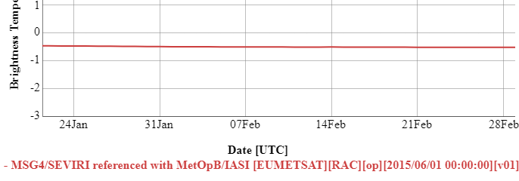
Compare GSICS and NWP Bias Monitoring
GSICS Plotting Tool
for Standard Bias wrt IASI-B for
Meteosat-11/SEVIRI IR13.4 (Channel 8)

Slide 3
GSICS-NWP Commonalities
Function | GSICS | ECMWF
Bias Monitoring Systematic Comparisons of L1 data v. reference Bias Correction Radiance-dependent Airmass-, VZA-, Latitude, … | GEO IR Meteosat-8 to -11, GOES-13, -15 Himawari-8 INSAT-3D | GEO IR Meteosat-8, -11, GOES-16, Himawari-8
 | LEO IR Sounders - HIRS-A | LEO IR Sounders - AIRS, CrIS, HIRS, IASI, IRAS
 | LEO MW Sounders | LEO MW Sounders - AMSUA, MHS, ATMS, MSU, MWHS, MWHS2, MWTS, SSMIS, SSU
 | LEO MW Imagers | LEO MW Imagers SSMI, Windsat, GMI, SAPHIR, AMSR2
Change Alerts | No? (only prototype) | Yes – hard + soft limits - Email alerts + others via NWPSAF
Maintain Block lists | No | Yes – instruments + channels

Slide 4
Radiometric Calibration Dependences
For GEO imagers, GSICS corrections only depend on scene radiance and time
  Vary slowly based on ~monthly rolling window
In general the radiometric biases can also be functions of
  date, time of day,
  instrument scan and solar geometry, latitude, longitude,
  radiance, airmass, water vapour burden, scene type (including polarisation),
  …
Diagnose the sensitivity of instrument’s calibration to these
Similar to NWP bias correction schemes
Some bias variations may be due to the instrument’s calibration
  Or reference instrument, inter-calibration algorithm, or NWP and/or RTM
  Comparison of GSICS results and NWP biases can provide valuable insight

Slide 5
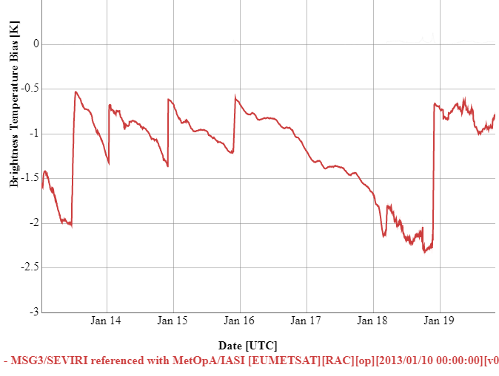
Radiometric – or Spectral Errors?
GSICS focused on characterising errors as radiometric biases
Some cases better explained as errors in spectral space
  e.g. due to modification of SRF
  (Spectral Response Function)
e.g. Meteosat/SEVIRI 13.4µm bias
Varies with time
Due to ice contamination
Ice libration band modifies SRF
Appears as radiometric bias
Users preferred correction in radiance-space (still?)
  No need to update RTMs
Time Series of Bias in Meteosat-10/SEVIRI IR13.4 channel from GSICS Re-Analysis Correction for standard scene (267K)
based on inter-calibration with Metop-B/IASI.
From GSICS Plotting Tool: gsics.tools.eumetsat.int/plotter

Slide 6
GSICS – SRF Updates
GSICS was instrumental in refining SRFs for IR channels of GOES & AMI imagers
  By optimising differences in inter-comparison with hyperspectral reference instrument
  During Commissioning
  Important test
GSICS investigating SRF retrievals
  Based on comparison with hyperspectral ref
  At least for non-window channels
GOES-13 Imager Channel 6 SRFs, (blue) original and (red) revised from the instrument vendor, and (green) NOAA-recommended SRF, superimposed on (black) AIRS spectral radiance.
From Wu & Fu 2013, 10.1109/TGRS.2012.2236100

Slide 7
Outcome of ECMWF/NWP SAF Error Workshop
ECMWF/EUMETSAT NWP SAF Workshop on treatment of random and systematic errors in satellite data assimilation
2-5 Nov 2020 - online
The workshop encourages community efforts to better analyse and address observation-related biases, through:
  inter-comparison of bias corrections from different centres (incl. bias models used),
  open sharing of databases with feedback information, and
  better dialogue between NWP centres, GSICS and instrument designers.
  Continued effort should be made to identify biases at source.
Bias Correction
  Bias corrections and model predictor bias definitions could be exchanged between centers
  and compared for the different types of instruments,
  including with other independent estimates (e.g. GSICS)
Anchor Observations
  Can be assimilated without bias correction – help identified model errors
  GNSSRO, CLARREO
  Potential GSICS Corrected observations in future?
  Recommendation: Explore the use of hyperspectral infrared satellite data as anchor measurements
Recommendation: establish greater dialogue between NWP centres and GSICS leading to a systematic data exchange system for biases and alerts.

Slide 8
Discussion
GSICS and NWP can provide information on satellite instruments’ biases
  Radiometric – or Spectral
Comparing GSICS and NWP results can help understand biases causes
  and ultimately improve them at source
Cooperative framework between GSICS and the NWP community
What to exchange?
  Satellite instrument biases, alerts, block lists
How to exchange?
  Define standards? Or start with ad-hoc informal emails?
  (ECMWF can also share values – not just plots)
Who? How to set up dialogue with NWP Community?
  NWP-SAF – currently assigning new coordinator
  International TOVS Working Group
  Others?

