Slide 1
Report from ROSHYDROMET
Presenter - Alexey Rublev
State Research Center “PLANETA”, ROSHYDROMET
Russia
GSICS-EP-22, Online Meeting
30 March 2021

Slide 2
Participation in EP, GDWG, GRWG
Points of contacts/meeting participants:
  EP : Alexander Uspensky
  GRWG: Alexey Rublev
  GDWG: Sergey Uspensky
Main contribution to GDWG actions
  Provision of near-real-time MTVZA-GY/ Meteor-M #2-2 data to EUMETSAT
  Provision of near-real-time IKFS-2/ Meteor-M #2 data to EUMETSAT
Main contribution to GRWG actions
  Development of post-launch calibration procedure for Russian scanners and sounders (MSU-MR, MTVZA-GY, IKFS-2, MSU-GS)
  Development of post-launch HEO-GEO calibration procedure for MSU-GS/Arktika-M #1 scanner
  Development of the Russian meteorological Cal/Val system portal with access to long-time archive of satellite instruments data covering test regions selected worldwide (https://planet.rssi.ru/calval)

Slide 3
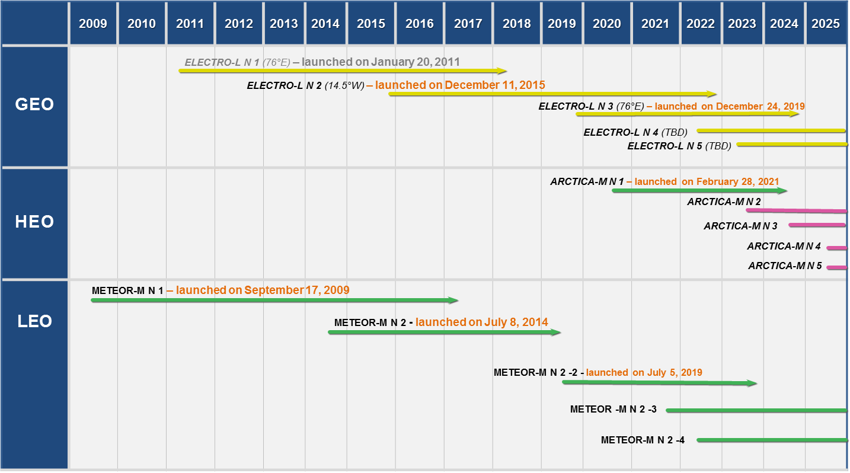
Russian Meteorological Satellite Systems
Federal Space Program for 2016-202)

Slide 4
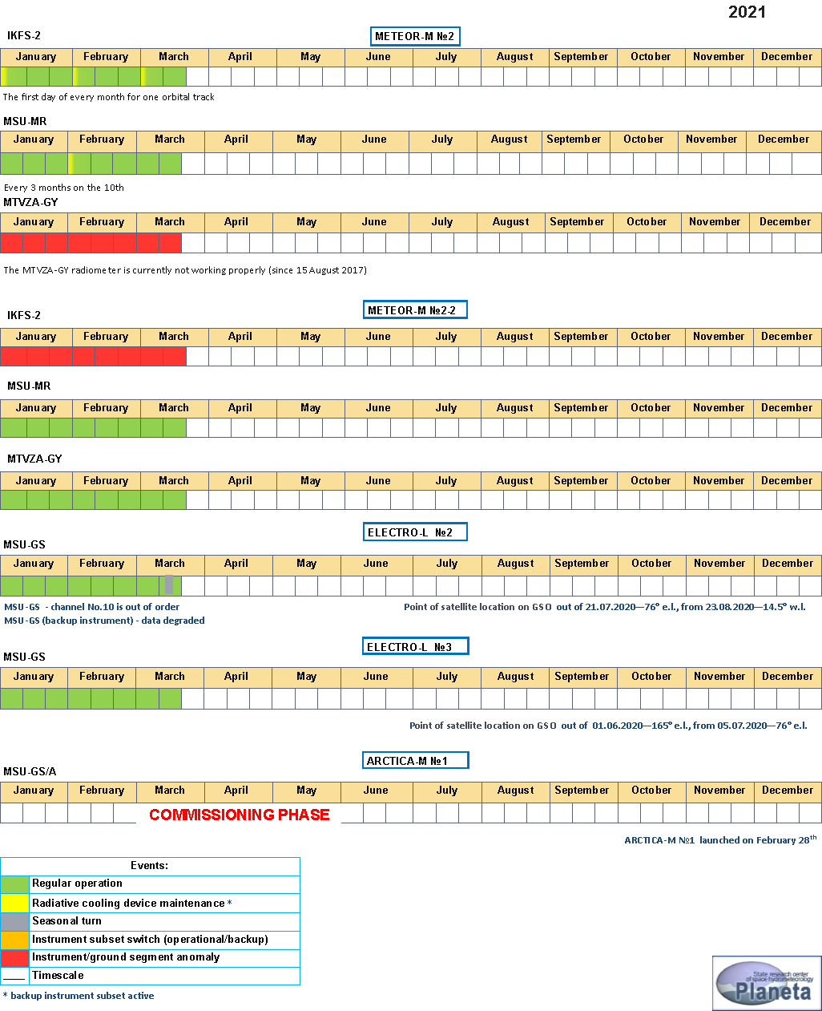
Satellite/Instrument Summary
2021

Slide 5
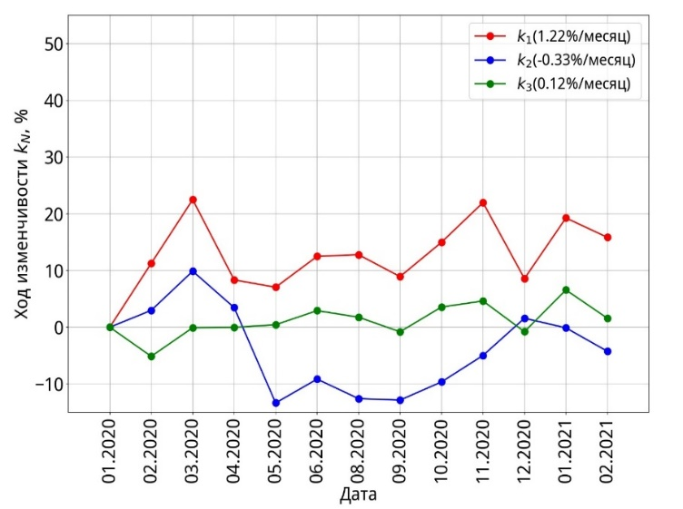
Meteor-M #2 Intercalibration
Performance: MSU-MR
LEO-GEO intercalibration
IR channels vs SEVIRI/Meteosat-10 (-11)
LEO-LEO intercalibration
shortwave channels vs AVHRR/Metop-A
Channel 5
MSUmr – SEVIRI, K
Day number of year, 01.2016-02.2020
Channel 6
MSUmr – SEVIRI, K
Date | к₁ | к₂ | к₃
05.2020 | 1.34 | 1.41 | 1.43
06.2020 | 1.40 | 1.40 | 1.40
07.2020 | 1.36 | 1.47 | 1.41
08.2020 | 1.50 | 1.47 | 1.66
09.2020 | 1.51 | 1.50 | 1.66
10.2020 | 1.35 | 1.35 | 1.50
11.2020 | 1.30 | 1.26 | 1.34
12.2020 | 1.16 | 1.34 | 1.27
01.2021 | 1.27 | 1.32 | 1.36
02.2021 | 1.24 | 1.27 | 1.30
Day number of year, 01.2016-02.2020
Channel | N pixels | Bias | RMS_{bias}
5 (10.8μm) | ~15000 | -1.22 K | 0.72K
6 (12.0μm) | ~15000 | -1.35K | 0.78K

Slide 6
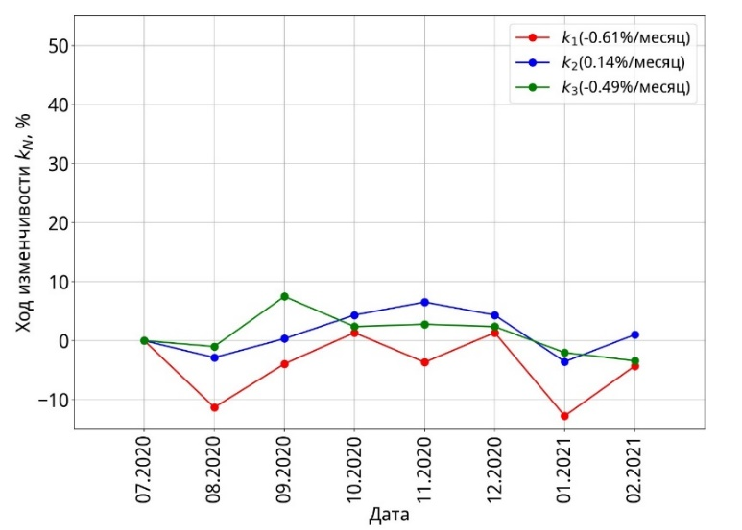
Meteor-M #2-2 Intercalibration
Performance: MSU-MR
LEO-GEO intercalibration
IR channels vs SEVIRI/Meteosat-10 (-11)
LEO-LEO intercalibration
shortwave channels vs AVHRR/Metop-A
Channel 5
MSUmr – SEVIRI, K
Day number of year, 2020
Channel 6
Date | к₁ | к₂ | к₃
09.2020 | 1.24 | 1.21 | 1.39
10.2020 | 1.17 | 1.13 | 1.19
11.2020 | 1.08 | 1.12 | 1.16
12.2020 | 1.14 | 1.11 | 1.16
01.2021 | 0.99 | 1.02 | 1.11
02.2021 | 1.08 | 1.06 | 1.09
MSUmr – SEVIRI, K
Day number of year, 2020
Channel | N pixels | Bias | RMS_{bias}
5 (10.8mm) | ~15000 | 0.06 K | 1.03K
6 (12.0mm) | ~15000 | 0.76K | 0.96K

Slide 7
2019-2021
LEO-GEO: IKFS-2 vs SEVIRI under sea surface
Ch 7.3 μkm
Ch 8.7 μkm
Ch 9.7 μkm
Tb_{SEVIRI}, K
T\b_{SEVIRI}, K
Tb_{SEVIRI}, K
Y=10.125+0.962xBIAS= -0.262 K
RMS_{bias}= 0.231 K
Y=8.512+ 0.971x
BIAS= 0.081 K
RMS_{bias}= 0.37 K
Y=10.125+ 0.964x
BIAS= -0.166 K
RMS_{bias}= 0.39 K
Tb_{IKFS-2}, K
Tb_{IKFS-2}, K
Tb_{IKFS-2}, K
Ch 10.8 μkm
Ch 12.0 μkm
Ch 13.4 μkm
Tb_{SEVIRI}, K
Tb_{SEVIRI}, K
Tb_{SEVIRI}, K
Y=3.53+ 0.988х
BIAS= -0.097 K
RMS_{bias}= 0.357 K
Y=5.02+ 0.983x
BIAS=-0.017 K
RMS_{bias}= 0.311 K
Y=8.098+ 0.97x
BIAS= 0.022 K
RMS_{bias}= 0.256 K
Tb_{IKFS-2}, K
Tb_{IKFS-2}, K
Tb_{IKFS-2}, K

Slide 8
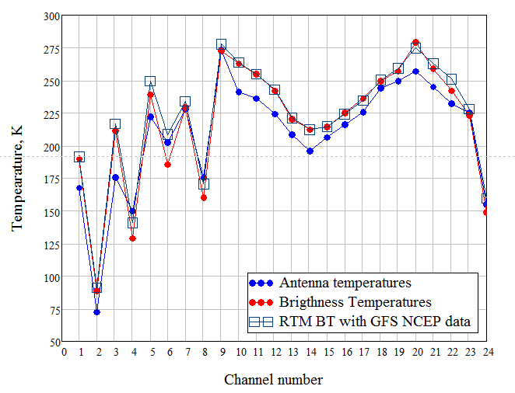
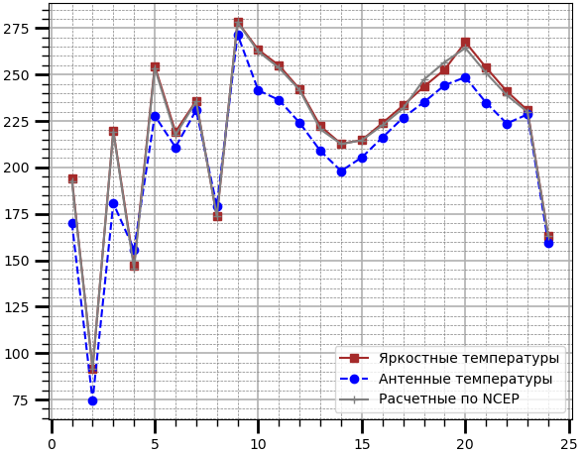
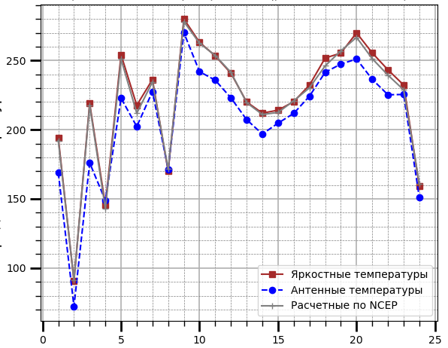

Absolute post-launch calibration of MTVZA-GY/Meteor-M #2-2 channels
Absolute post-launch calibration is based on relationships between observed radiances (antenna temperatures) and RTM-simulated radiances (Brightness Temperatures).
20.02.2020
The calibration relationships for BT were obtained for special test sites in October 2019 using RTM of RTTOV type and GFS NCEP data as input. The emissivity of the ocean surface was specified in acoordance with FASTEM-5 model in depedence of wind speed.
The maximum BT discrepancies with simulated RTM BT (20.02.2020) are observed in the scanner channels with horizontal polarisation 18.7, 23.8, 36.7 GHz.
The calibration coefficients for BT obtained in October 2019 were used during 2020-2021. It was demonstrated rather good agreement between measured and calculated BTs as well as stable MTVZA-GY operation.
25.12.2020
17.01.2021

Slide 9
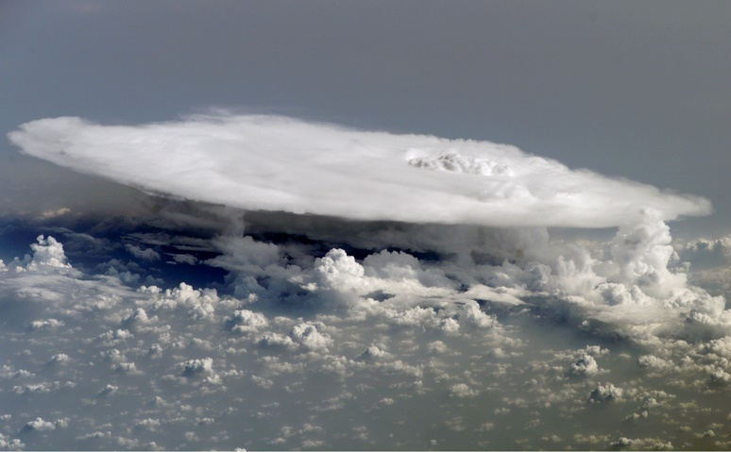
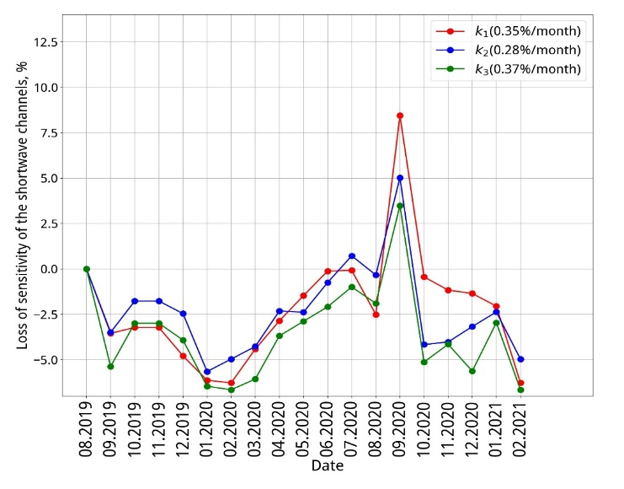
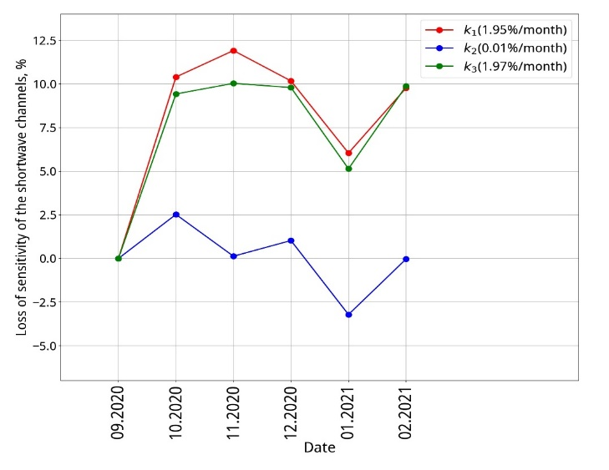
MSU-GS vs VIIRS INTER-CALIBRATION
(visible channels)
ELEKTRO №2
https://www.seas.harvard.edu
ELEKTRO №3
The use of deep convective clouds
Calc SBAF between spectral bands of reference (VIIRS) and calibrated instruments (MSU-GS) bands
Comparison of TOA reflectance measured by both instruments

Slide 10
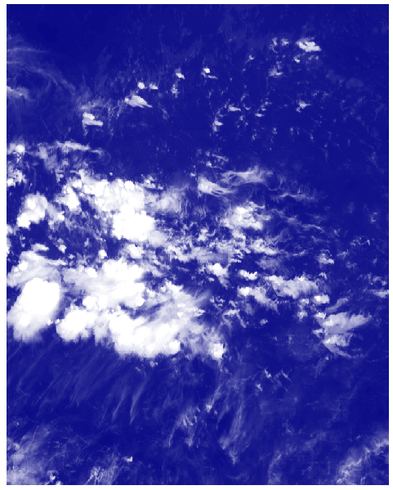
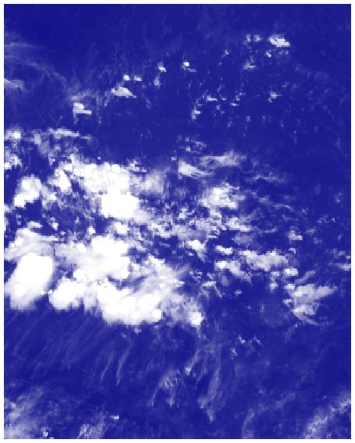
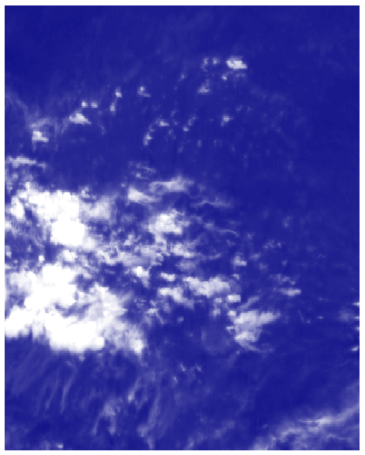
Evaluation of MSU-GS/Elektro-L #3 spatial resolution vs AHI/ Himawari-8measurements (10.4 vs 10.8 μm)
Averaging
Defocusing to bring to MSU-GS image
AHI 2 km
AHI 4 km
(MSU –GS nominal resolution)
MSU-GS
Synchronized images from two scanners, May 19, 2020

Slide 11
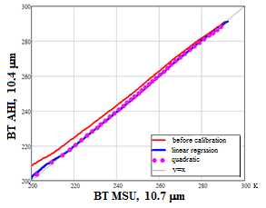
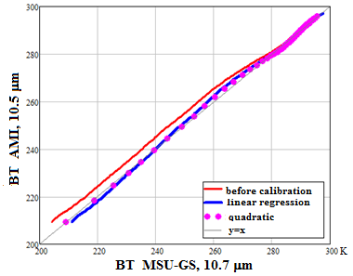
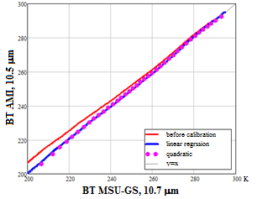
12 December 2020.16:00 UTC
Intercalibration of the MSU-GS (10.70 μm) channel
6 October 2020.20:00 UTC
Intercalibration of the MSU-GS (10.70 μm) channel
vs AMI 10.5 μm channel
vs AHI 10.4 μm
T_{AHI}= 18.769+ 0. 938⋅T_{МСУ}
vs AMI 10.5 μm
T_{AMI}= 19.769+ 0. 933⋅T_{МСУ}
T_{AMI}= 21.62+ 0. 928⋅T_{МСУ}

Slide 12
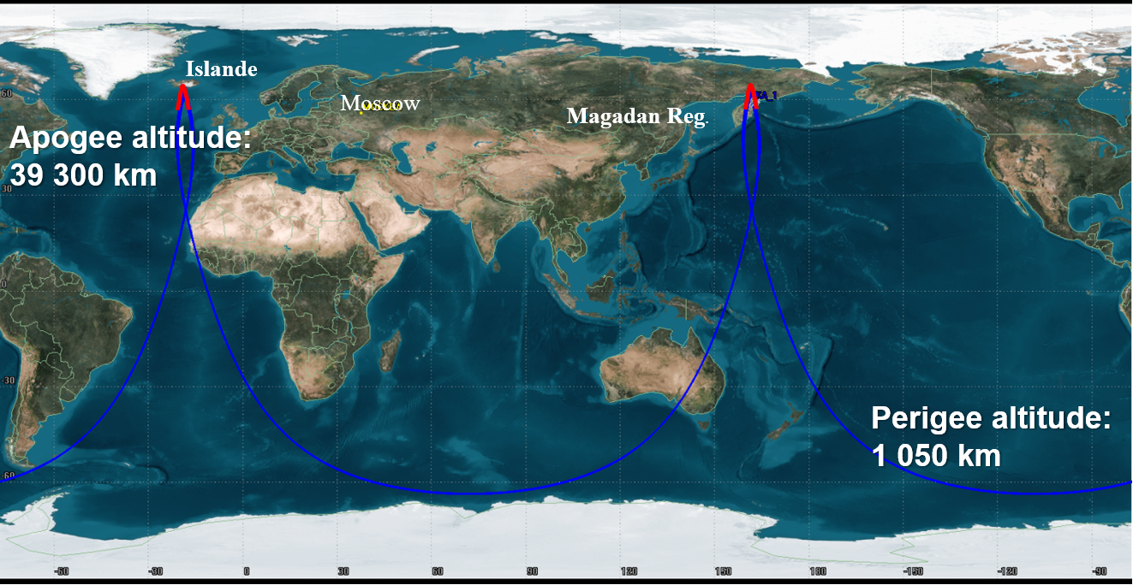
Ground track of Arctica-M #1
(highly elliptical orbit of “Molniya” type)
Iceland
Red is operational part
Longitude of the ascending node λ = 335°(155°)
Orbital period is 12 hours
In the operational part of the orbit (three hours on each side of apogee), the satellite is north of 55° N;
The satellite in these orbits moves most of its time over the northern hemisphere and passes quickly over the southern hemisphere.

Slide 13
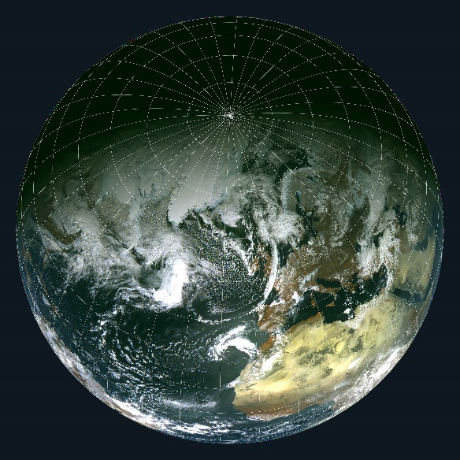
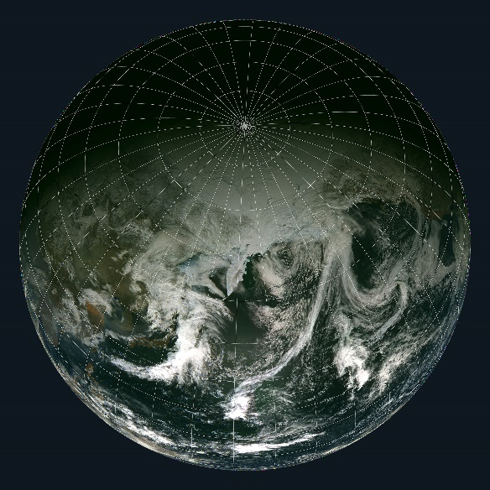
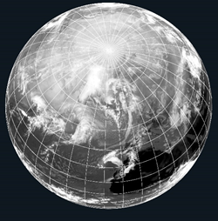
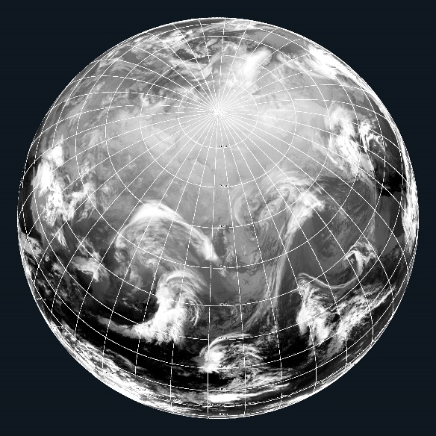
Arctika-M #1 satellite images
West
East
RGB image
Channel 1 (0.5-0.65) μm, Channel 2 (0.65-0.8) μm, Channel 3 (0.8-0.9) μm
IR channel 9 (10.2-11.2) μm
26.03.2021 00:59 UTC
29.03.2021 00:59 UTC

Slide 14
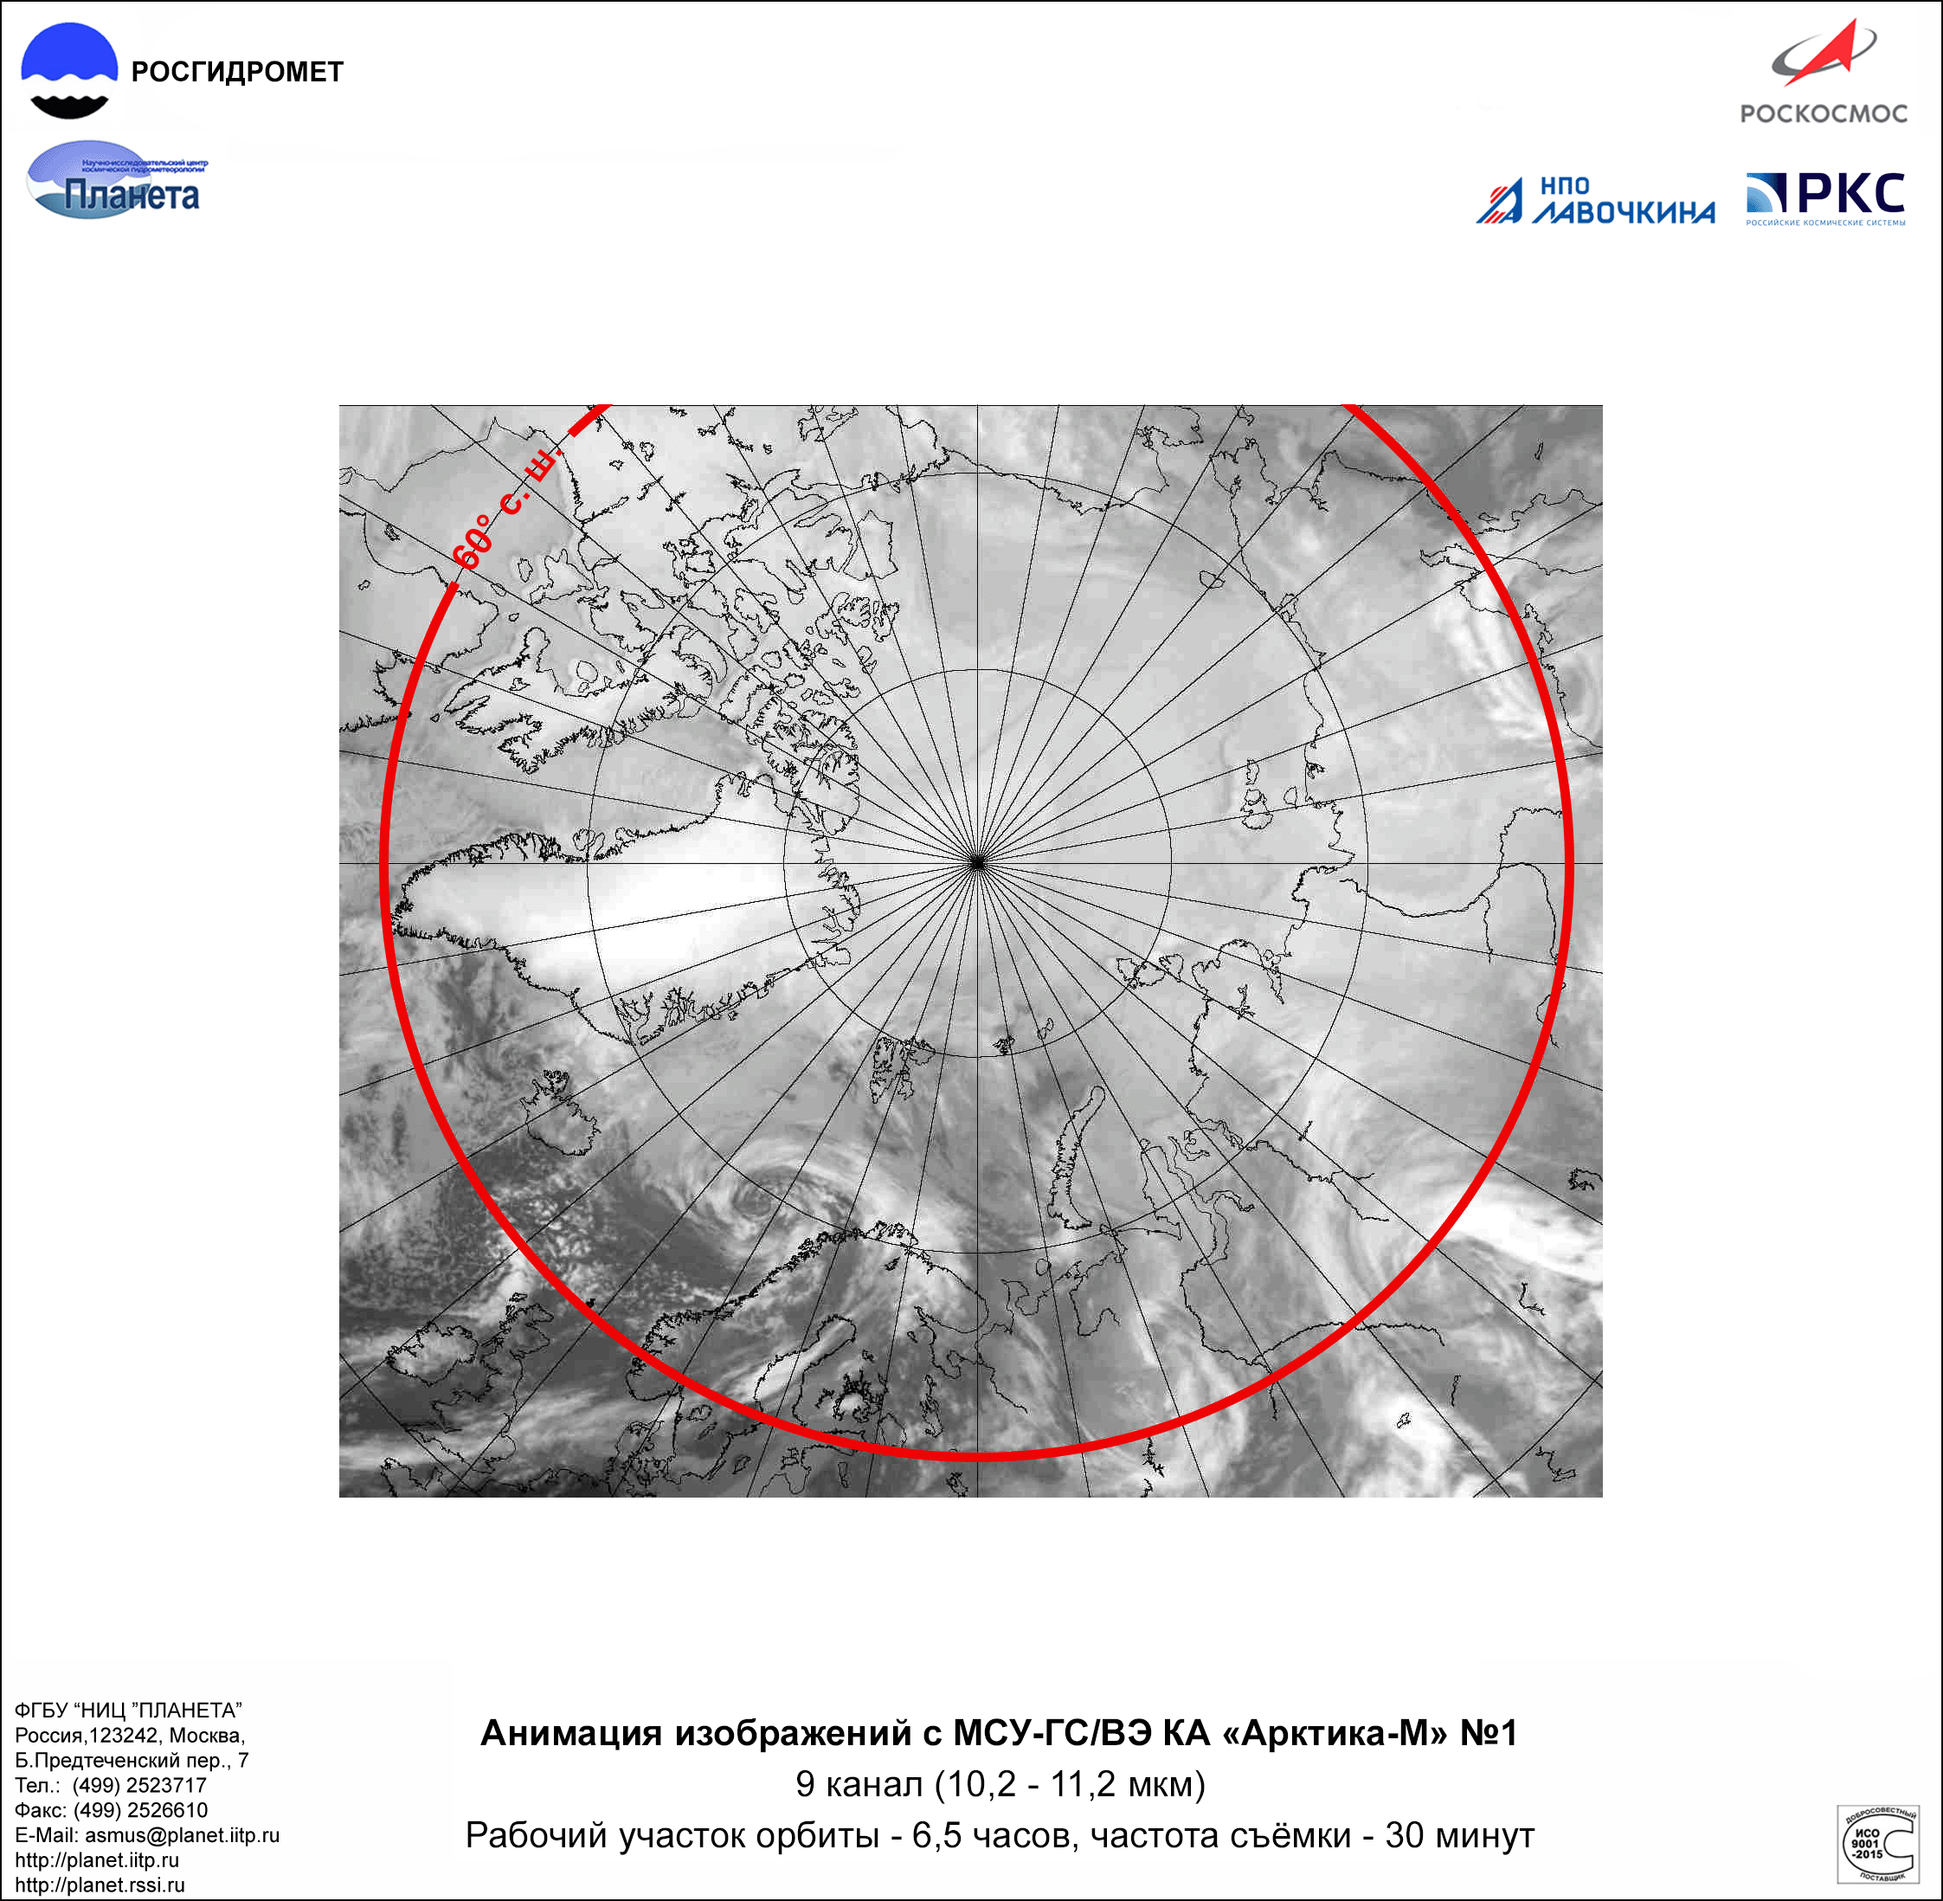
Cloud motion animation
Western orbit, channel 9

Slide 15
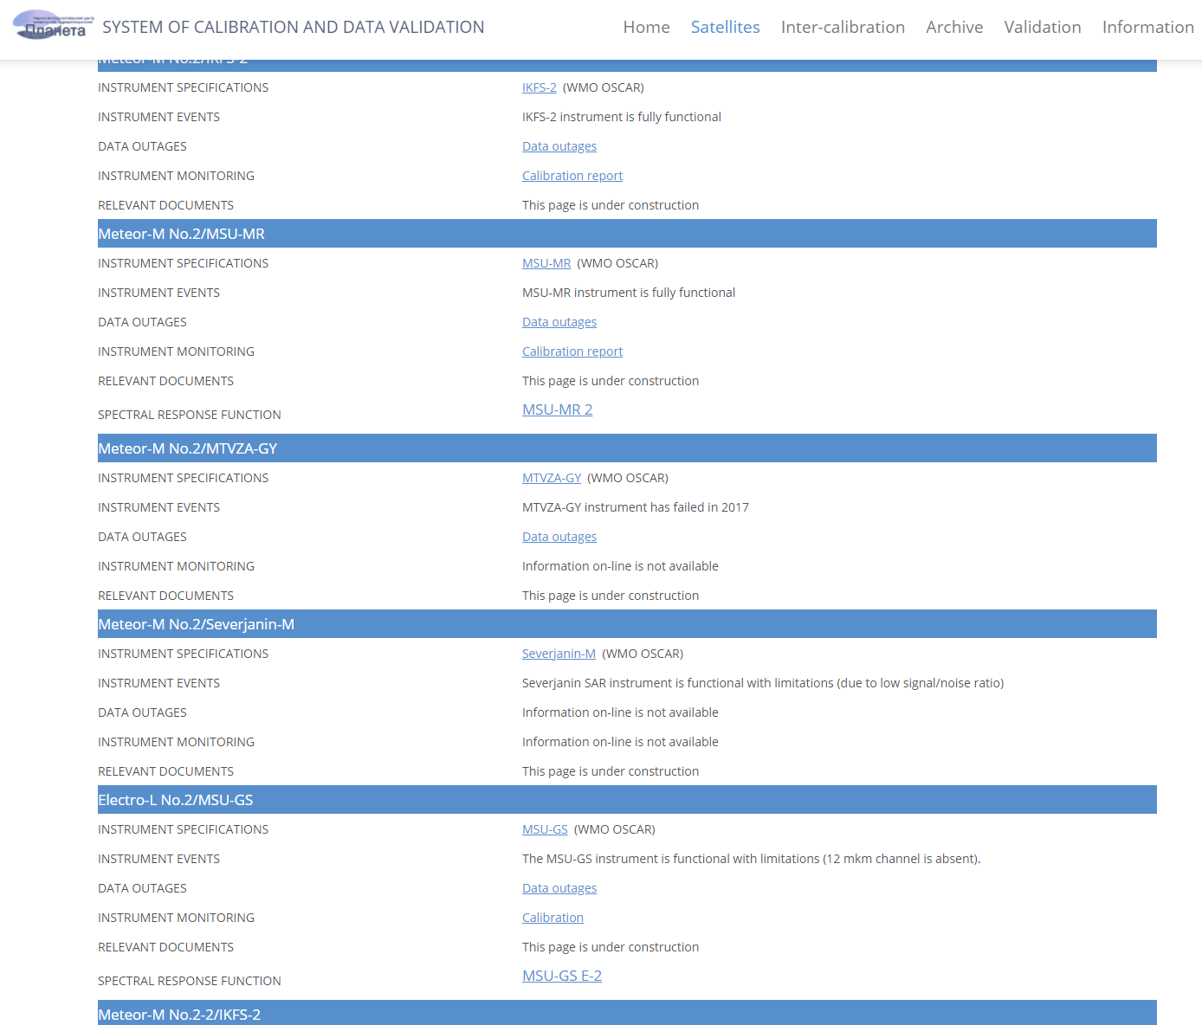
Cal/Val site of Russian hydrometeorological instruments
http://planet.rssi.ru/calval/
Spectral Response Functions
(IR bands)
Welcome !

Slide 16
Thanks for attention!

