Slide 1
GRWG IR Sub-Group Briefing Report
Likun Wang
ESSIC/Univ. of Maryland; Likun.Wang@noaa.gov
2021 GSICS annual meeting, April 2 2021

Slide 2
Outline
Scope of IR Subgroup
IR Group Activities
Status of Action Items
GSICS GEO-LEO IR Product Status
Emerging Issues & Future Direction
Conclusion and Issue to EP

Slide 3
Review Scope of the IR Sub-Group
Counterpart of VIS/NIR, Microwave and UV Sub-Groups
  For satellite instrument channels in thermal infrared
  For Hyperspectral instruments
To establish user requirements for inter-calibration
Cooperate with instrument calibration groups
  To communicate relevant information to the users
  To help them understand the root cause of observed biases and develop fixes
Review existing, or develop new inter-calibration
  Algorithms, procedures, corrections, collocation, spectral-gap filling etc.
  Using NWP, ground-based, near-space measurements, etc.
To define and promote calibration standards, tools and datasets, and best practices
  Including selection of inter-calibration reference
Chair: Likun Wang (NOAA affiliation, Since 2018) with the help from Tim Hewison

Slide 4
Instruments and Measurements
Hyperspectral IR Sounders
  AIRS (CHIRP product)
  IASI (A, B, C)
  CrIS (SNPP and N20)
  IRAS (FY3D, E)
  GIIRS (Geostationary FY4)
  IKFS-2
Narrow-band sounders
  HIRS (1979 – current MetOp-B)
  GOES Sounders
IR channels of broad- or narrow band imagers
  GEO imagers:
    ABI, AHI, AMI, AGRI, CMOS-MI, MVIRI/ SEVIRI, NSAT-3D
  LEO imagers:
    MODIS, VIIRS, AVHRR, SENTINEL-3 SLSTR, MERSI
NWP RTM simulations, Ground-based measurements, Lunar (Mercury) etc .

Slide 5
Current Sub-Group Activities (i)
Instrument specification, pre-launch characterization, Cal/Val Testing, Operational Calibration Support
  Thomas (NASA/JPL), Dave (UW), Chengli (CMA)
Hyperspectral instrument calibration and inter-comparison
  Likun (NOAA), Dave (UW), Larrabee (UMBC), Clemence P., Laura B. (CNES), Chengli Q. , (CMA), Dorothee C. (EUMETSAT)
Promote GEO-LEO IR products to Operational + Support & Further Development
  Tim (EUMETSAT), Arata (JMA), Minju (KMA), Fred, Banghua, Fangfang (NOAA), Na (CMA), Pradeep (ISRO)
Development of LEO-LEO Inter-calibration between imager and hyperspectral sounders
  Likun, Banghua (NOAA), Jack X. (NASA)., Dave T. (UW), Hanlie (CMA), Alessandro B. (EUMETSAT)
Deployment of Prime GSICS Corrections
  Tim (EUMETSAT), Arata (JMA), Fangfang & Fred (NOAA), Minju (KMA), Na (CMA)
Diurnal calibration variations for GEO-LEO inter-calibration
  – Arata (JMA) , Fangfang(CMA), Minju (KMA)
Instrument Calibration or Inter-calibration Error Budget Analysis
  Chengli Q. (CMA), Arata (JMA)

Slide 6
Current Sub-Group Activities (ii)
Development of NWP inter-calibration method
  – Roger & Tim (EUMETSAT), Yong (NOAA), Larrabee (UMBC)
GEO-GEO comparisons
  Dave (NASA), Hidehiko (JMA), Hyeji Yang, Minju (KMA) , Fangfang, Likun, Fred (NOAA), Tim (EUMETSAT), Alexey Rublev (ROSCOSMOS)
Broadband Reference IR inter-calibration (e.g., reprocessing using HIRS )
  – Dave (NASA), Rob (EUMETSAT), Masaya (JMA), Hanlie, Xiuqing (CMA)
Collocation Improvements
  – Likun (NOAA), Qiang (CMA), Alessandro (EUMETSAT)
Using the Moon (or other celestial object) for IR Inter-Calibration
  Clemence P., Laura B. (CNES), Martin Burgdorf (Univ. of Hamburg)
Interaction with other communities – NWP & ISSCP-NG
  Tim (EUMETSAT), Fred, Likun (NOAA), Dave (NASA)

Slide 7
Five Web Meeting in 2020-2021
Likun Wang (NOAA Affiliate) - GEO-LEO inter-calibeation status and other topics (03/19/2020)
Tim Hewison (EUMETSAT) ECMWF Workshop on Error treatment (06/08/2020)
Likun Wang (NOAA Affiliate) - Refining Inter-Calibration algorithm and other Topics (06/24/2020)
Tim Hewison (NOAA Affiliate) - Scoping ISCCP-NG - GSICS interactions (08/12/2020)
Likun Wang (NOAA Affiliate) – Investigation Inter-calibration bias for 3.9 µm (03/29/2021)

Slide 8
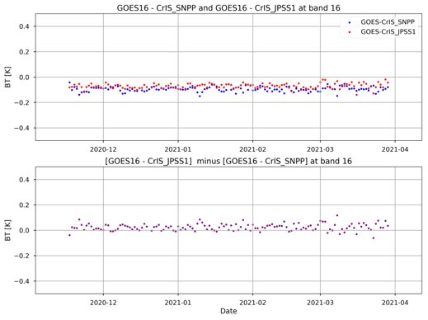
Highlights:
Stability of Hyperspectral Reference Instrument
SNPP-CrIS and IASI-B have been selected as reference instruments in IR group for inter-calibration.
The group members closely monitor the difference between CrIS vs CrIS, IASI vs. IASI, and CrIS vs IASI through the direct or indirect inter-comparison.
The reference instruments are very stable. The agreement between CrIS, AIRS, IASI is very good.
Tobin (2021)
Double difference between SNPP and N20 CrIS
Wang (2021)

Slide 9
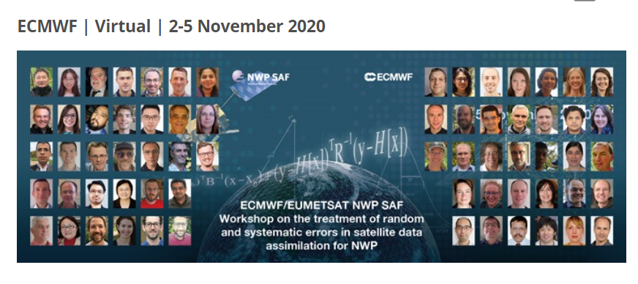
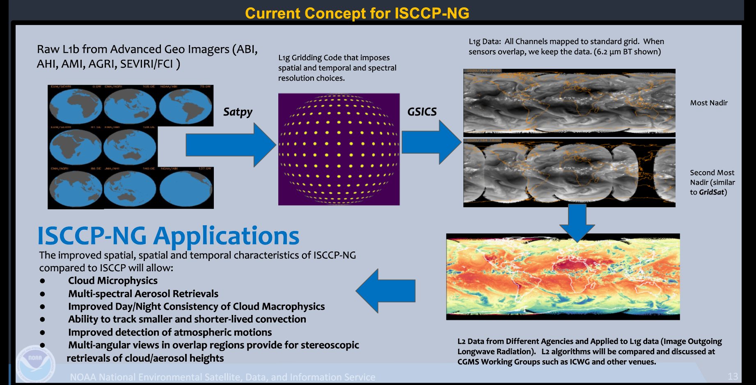
Highlights:
Cross Community Dialogue with ISSCP-NG and NWP
The IR group response to the ECMWF/EUMETSAT NWP SAF Workshop on the treatment of errors in satellite data assimilation to develop the cooperative framework between GSICS and the NWP community
The IR Group is now building partnership with ISCCP-NG to contribute the ISCCP-NG product through the GSICS inter-calibration product.
More web meetings will be planned next year to exchange ideas and further understand each community’s need.
Hewison 2021
Heidinger 2021

Slide 10
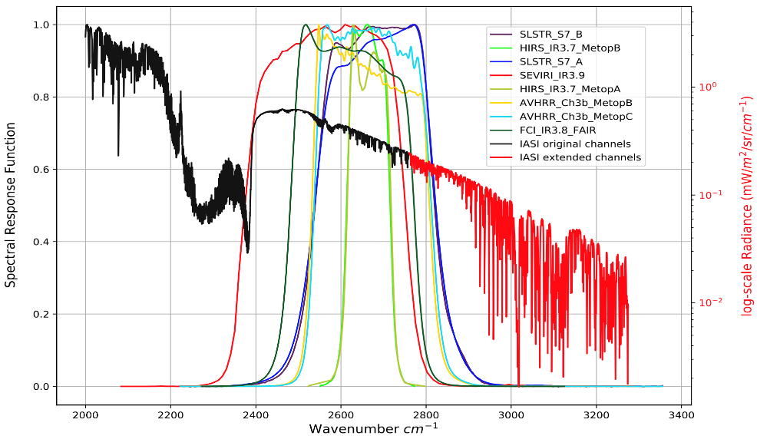
Highlights
Gaping Filling Extending to IASI SW Range
A PCA-based spectral gap filling method was originally developed to fill up the CrIS gap channels.
This method is extended to IASI shortwave region from 2760 to 3275 cm⁻¹ to inter-calibrate 3.9 µm channel using LBLRTM + DISORT simulated dataset.
A collaborative study in the IR team indicates that the PCA-based spectral gap filling method can help for use of IASI channels for intercalibration of other instruments e.g. SLSTR (3.7µm), FCI (3.8µm), SEVIRI (3.8µm) and Channel 3 of AVHRR.
Xu and Wang (UMD) - Updates on IASI SW Gap Filling
Burini, Mousivand, Hewison 2021

Slide 11
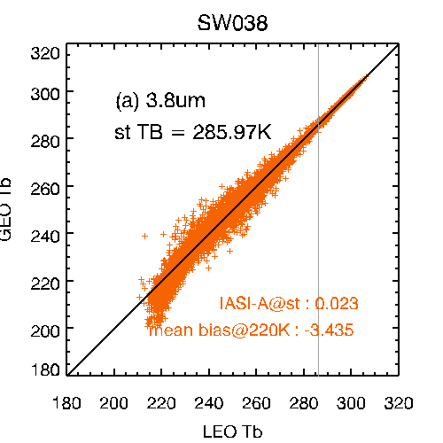
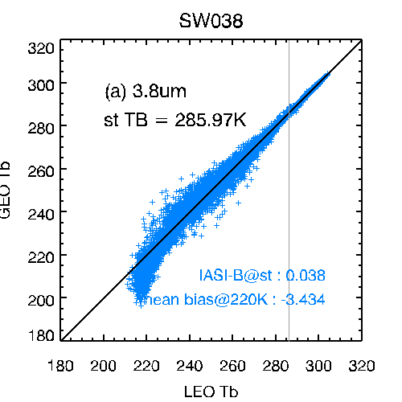
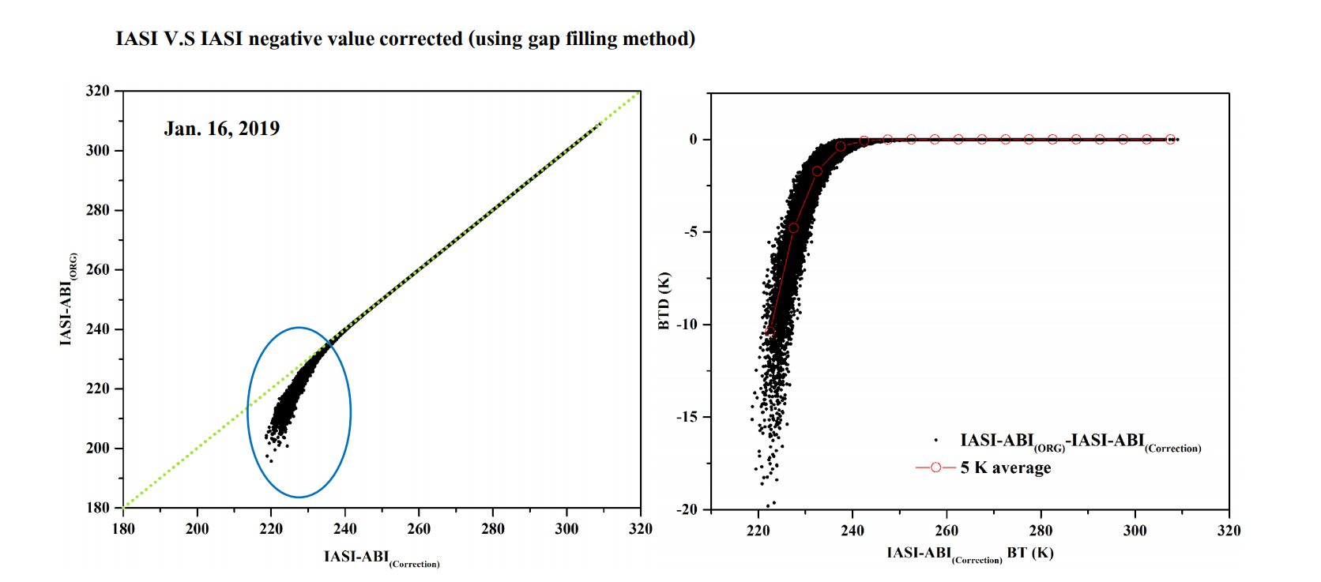
Highlights
Investigation of IASI inter-calibration Bias at SW
IASI vs. AMI
Efforts have been made to investigate the inter-calibration bias at 3.9µm channel when comparing IASI with geostationary imagers (especially for AMI and AHI).
The bias is mainly caused by the inappropriate way to handle the IASI negative bias.
The negative radiance values are normal, which are caused by the instrument noise on low radiances often found in the SW spectral region. If one changes it or replaces it with positive values, it will introduce a false bias into the IASI spectra.
Minju Gu (KMA) - KMA GEO-LEO IR product status
Real data
Hui Xu (UMD), 2020.
Simulation Data

Slide 12
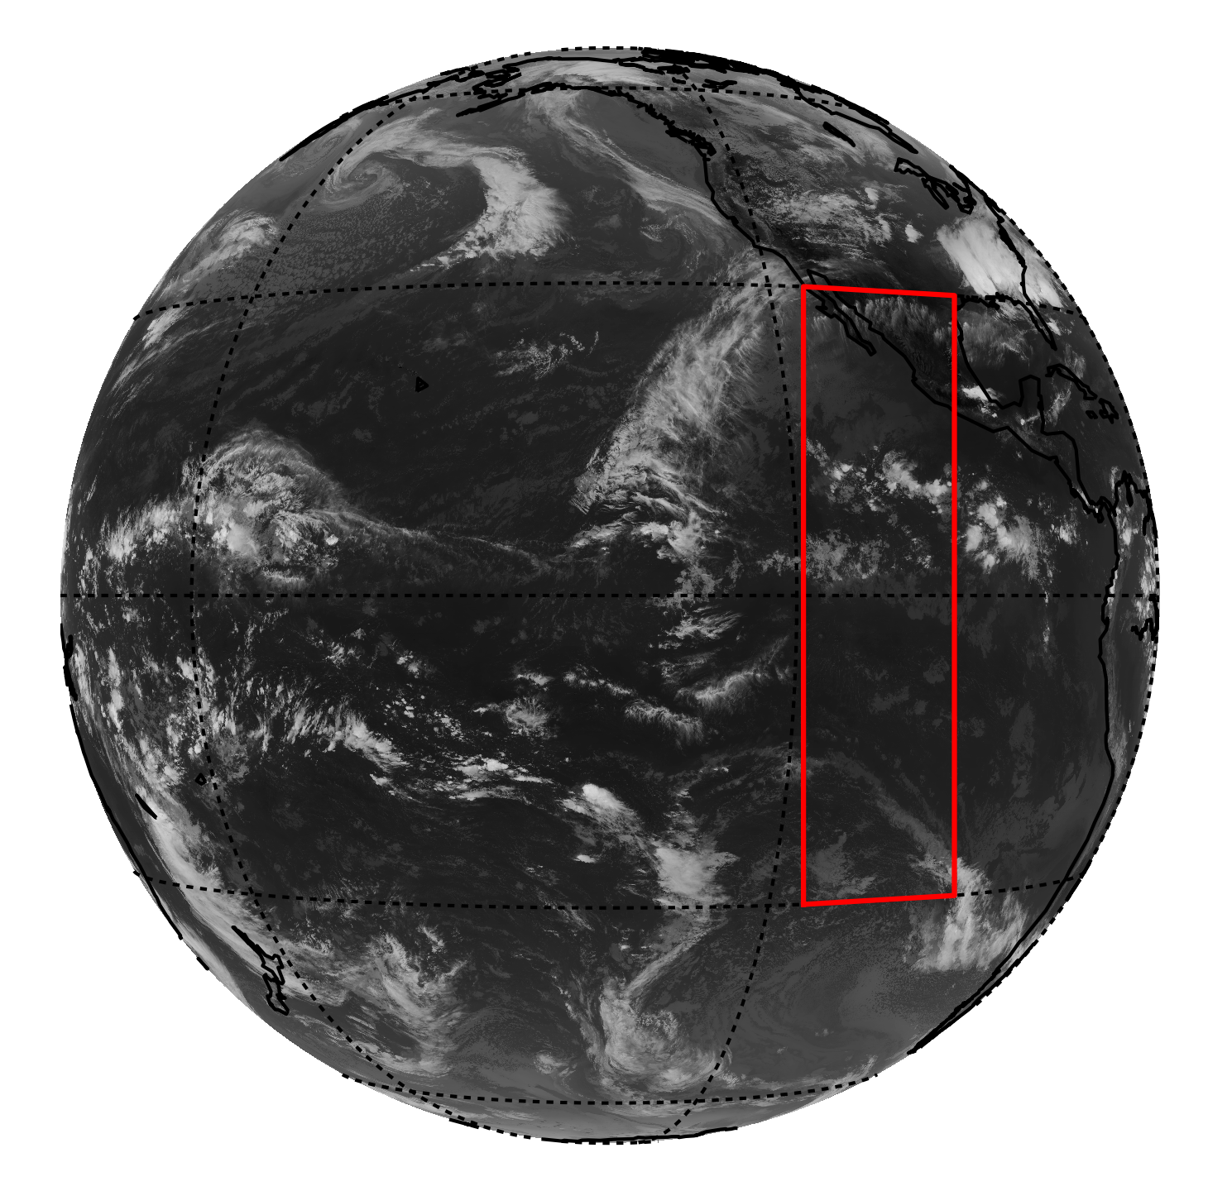
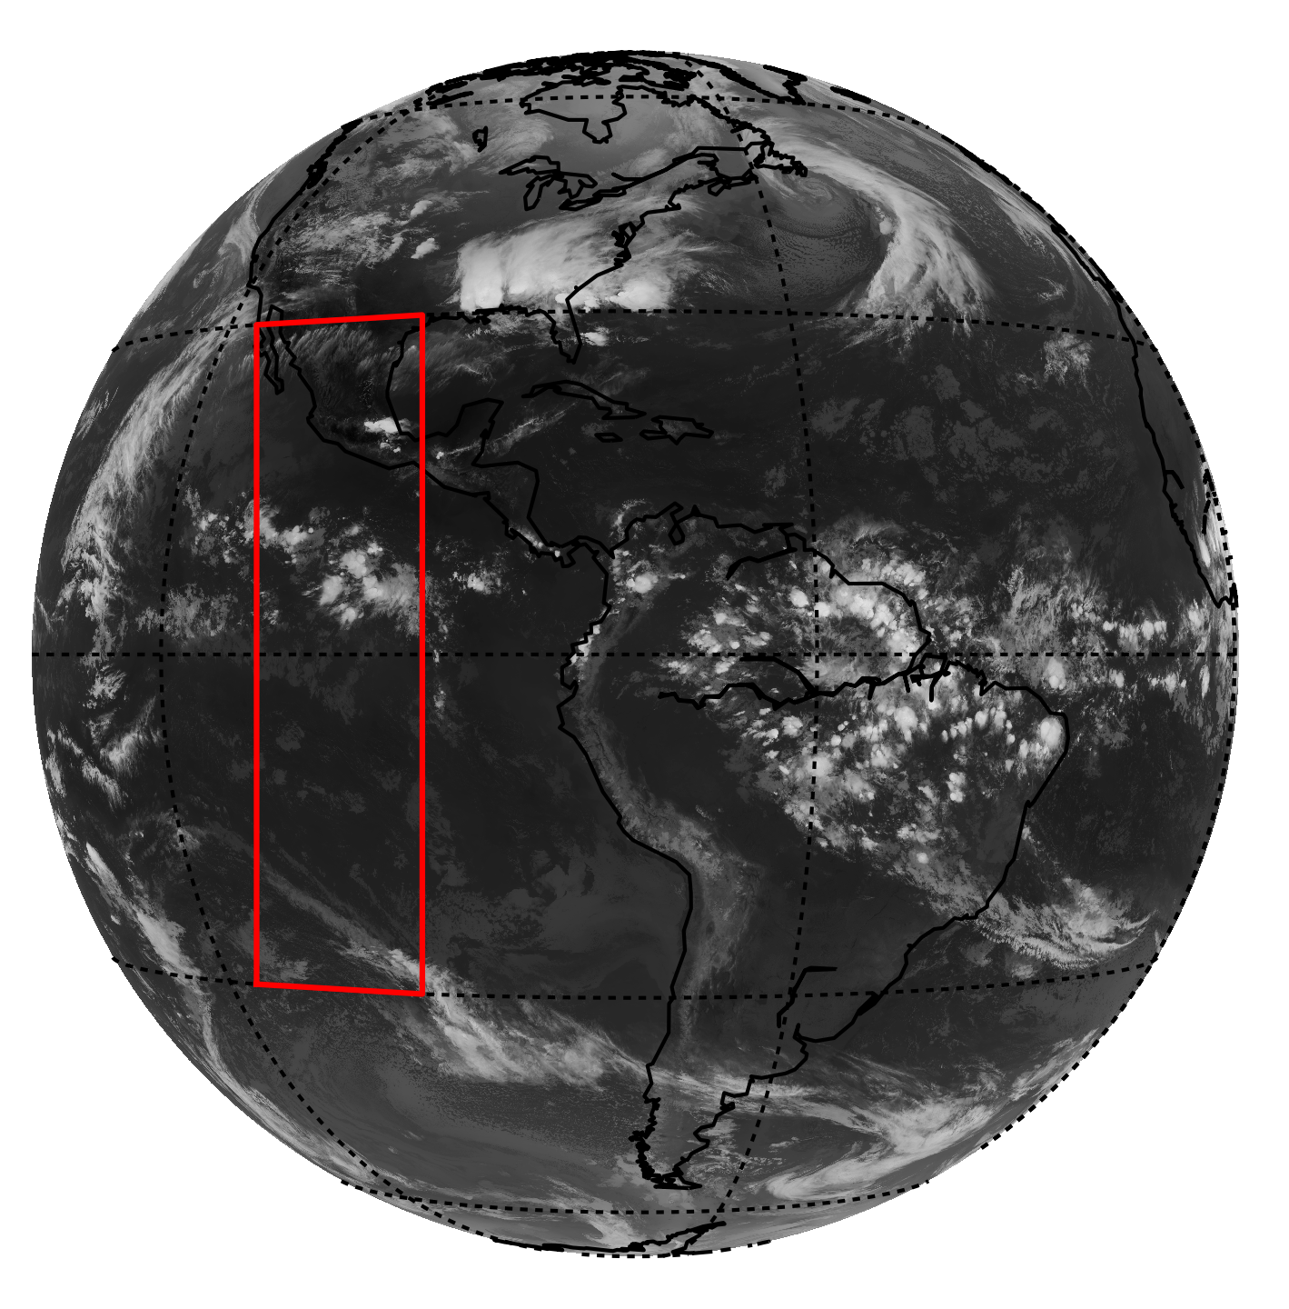
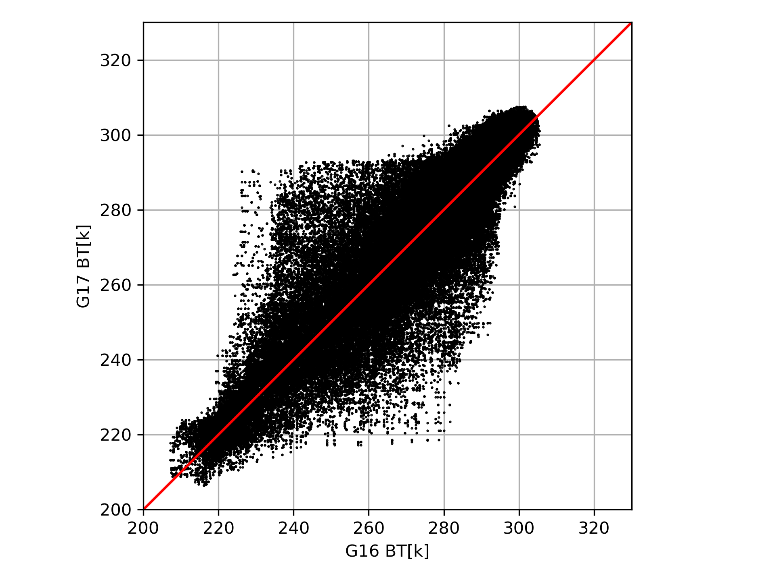
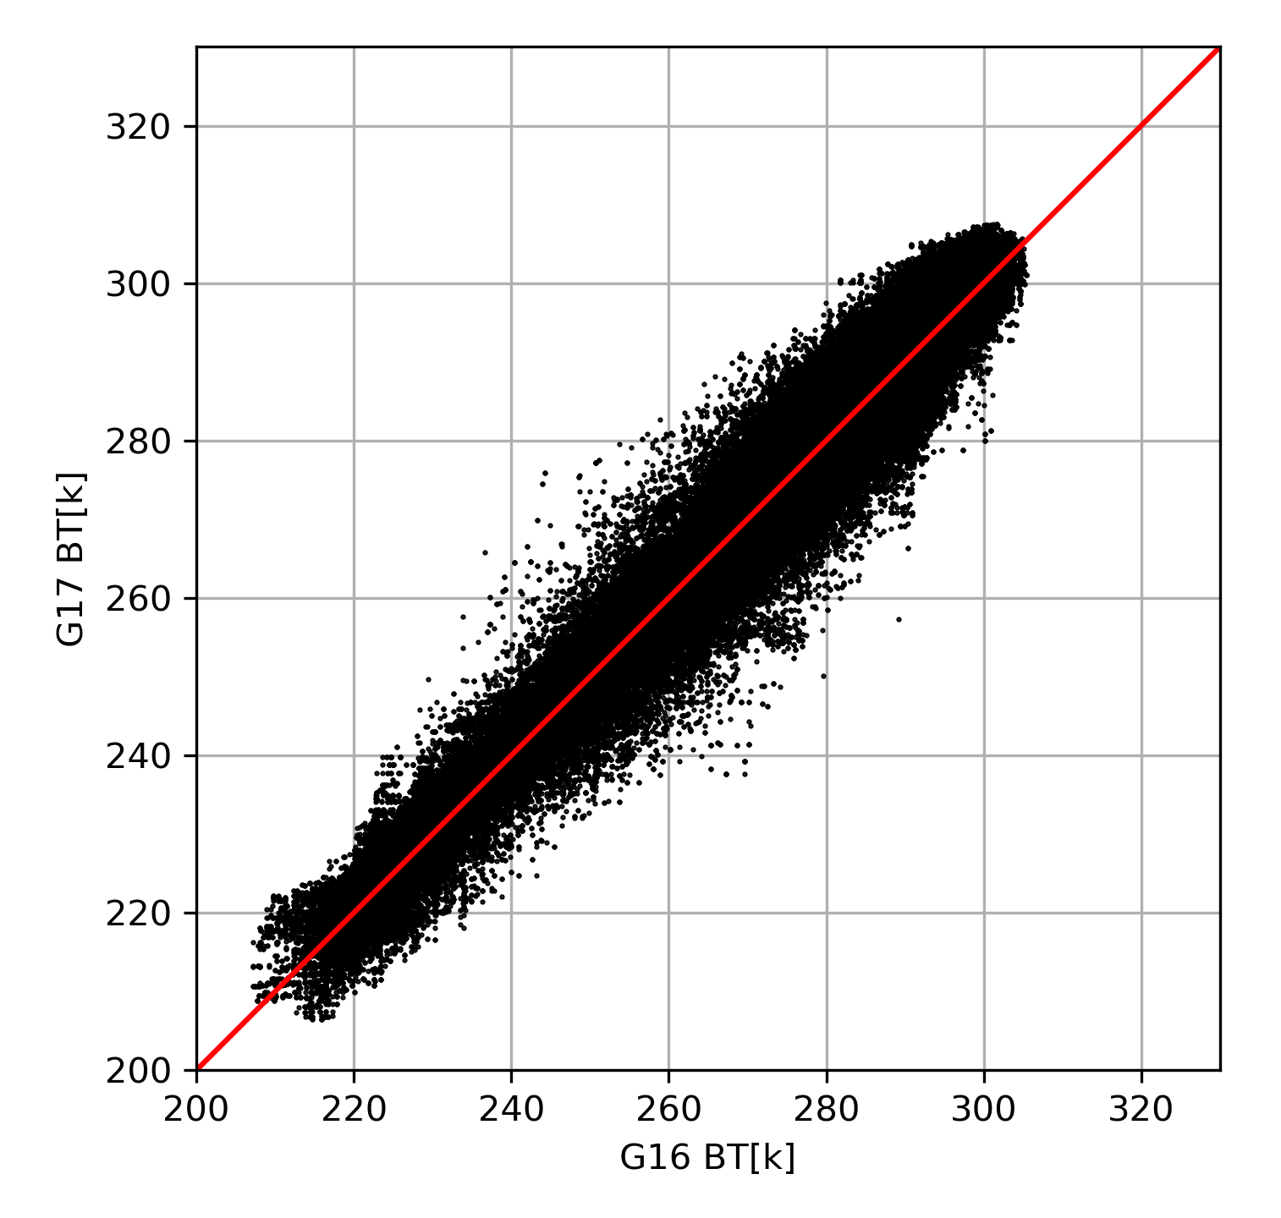
Highlights
Optimizing Inter-Calibration Algorithm
Efforts have been made in the IR group to further improve the GEO-GEO and GEO-LEO inter-calibration algorithm to meet the challenges.
The areas involves all the procedures during inter-calibration.
  Fast and accurate collocation
  Parallax effect handling
  Gap fillings and spectral integration
  Data processing at extremely cold and hot scenes ​
  Optimized GSICS correction ​
  Improved regression methods
  Data plot tools and user guide ​
GOES17
GOES16
wrong collocation at deep convective cloud edge due to parallax effects, low BTs compared with high BTs
Collocation by correcting parallax effects to reduce inter-calibration uncertainties
Wang 2020

Slide 13
GSICS GEO-LEO IR Product Status 2020-21
GPRC | Monitored Instrument | Reference Instrument | GSICS NRT Correction | GSICS Re-Analysis Correction | GSICS Bias Monitoring
EUMETSAT | Meteosat-8-11/SEVIRI | Metop-A/IASIv2 Metop-B/IASI Metop-C/IASI Prime | Operational Operational Operational - | Operational Operational Operational Demo | RAC Plotting Tool ProductCatalogImages
JMA | MTSAT-2 Imager Himawari-8/AHI (Himawari-9/AHI) | IASI-A+B+AIRS (CrIS SNPP) | Demo (Ready for GPPA) | Demo | RAC Plotting Tool JMA Web ProductCatalogImages
NOAA | GOES-11-12 Imager GOES-15 Imager GOES-16-17/ABI | IASI-A+B+C CrIS-SNPP+N20 | - - - | Demo Pre-Op Pre-Op | NOAA GOESCAL
CMA | FY2C,D,E,F,G/VISSR FY4A/AGRI FY4A/GIIRS (Plan) | IASI-A+B + AIRS+CrIS+HIRAS | Development | Development | CMA Web CMA Web Cloud (Plan)
KMA | COMS KOMPSAT-2A? | IASI-A+B AIRS+ CrIS SNPP+N20 | Demo | Demo | KMA Web ProductCatalogImages
ISRO | INSAT-3D/Imager INSAT-3D/Sounder INSAT-3R | IASI-A | Demo | Demo | ISRO Web
Full GSICS Product Catalog available at http://www.star.nesdis.noaa.gov/smcd/GCC/ProductCatalog.php

Slide 14
Action Review

Slide 15
Discussion for Future Plans and Issues
New IR chair is needed (2018-now, three years’ term is full)
  Will set the deadline for nomination
Plan monthly or bi-monthly web meeting
  Plan on Thursday for the first week of each Month (Next one will be May 6 2021)
Support more cross-community efforts,
  Dialogue between GSICS with ISSCP-NG, NWP community, CEOS WGVS
Encourage more experts involved in the IR group
  Updates on new instrument, methods, and datasets for the IR group
Share the tools and codes, knowledge Exchange memo
  GitHub or GSICS wiki may be the best host place
Other Items?

Slide 16
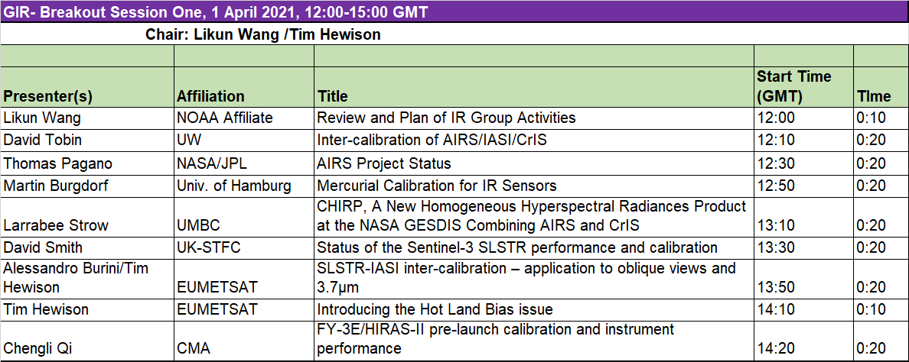
Session I – General Topics for IR Calibration
Webex Meeting Information
https://noaa-nesdis-star.webex.com/noaa-nesdis-star/j.php?MTID=ma9cae25c6027a894bcda5b6d727d8b4b
Join by meeting number
Meeting number (access code): 199 013 7531
Meeting password: STAR

Slide 17
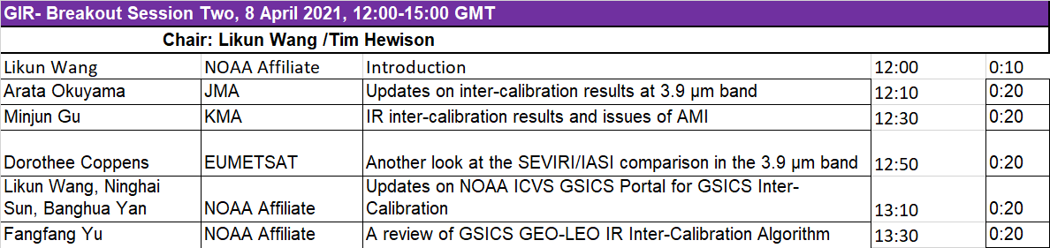
Session II – GEO-LEO inter-calibration
Webex Meeting Information
Meeting link:
https://umd.webex.com/umd/j.php?MTID=md5ceff07826ddde62513bf6f7171b858
Meeting number: 120 304 4075
Password: gsics

Slide 18
Summary
IR group is very active
Continued expansion of group
  From GEO/LEO inter-calibration to GEO/GEO, LEO/LEO, other datasets
  Imager/Sounder
  Hyperspectral Sounder inter-calibration
  Reprocessing, New Measurements, Gap Filling, Collocation
  More ideas, new collaborations, exploit other ongoing activities of relevance to GSICS
  Software, dataset, best practice, methods,
Sub-topical leads/formation
  Develop tasks, move forward with them
    References, Methods, Correction Tables, Tools …
  Taking a little longer than I had hoped…
Contributions to GSICS Newsletters

