Slide 1
JMA Agency Report 2021
OKUYAMA Arata
Meteorological Satellite Center of JMA

Slide 2
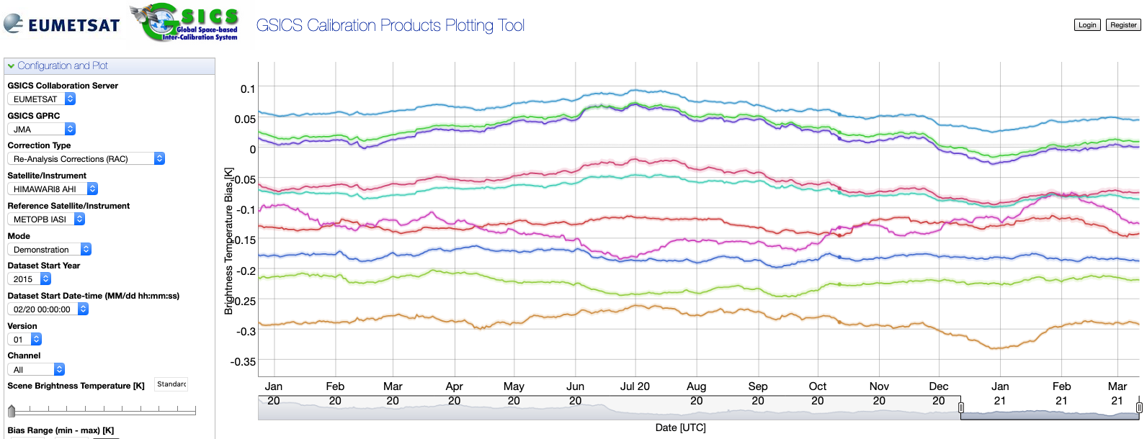
JMA GSICS Corrections
Status of GSICS Correction by JMA
The following Corrections are available from the GSICS server in EUMETSAT
Near-Real Time Correction
Himawari-8 / AHI / IR based with reference to IASI-A/-B, AIRS: Demo. phase
MTSAT-2 / IMAGER / IR with reference to AIRS, IASI-A: Demo. phase
Re-analysis Correction
Himawari-8 / AHI / IR with reference to IASI-A/-B, AIRS: Demo. phase
MTSAT-2 / IMAGER / IR with reference to AIRS, IASI-A: Demo. phase

Slide 3
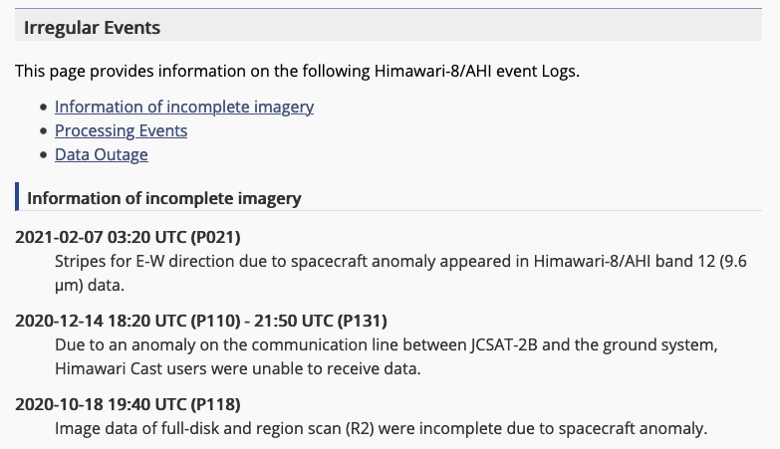
JMA GPRC web pages
Landing page (cal. portal)
Calibration monitoring
New validation approach (ray-matching) will be added in 2Q this year.
Navigation monitoring
Event logging
Instrument information
Event logging
Information of incomplete imagery
Processing Events
Data Outage
Landing page:
https://www.data.jma.go.jp/mscweb/en/oper/calibration/calibration_portal.html
Event logging:
https://www.data.jma.go.jp/mscweb/en/oper/event_H8.html

Slide 4
Support to GDWG Activities
A landing page of JMA/MSC is updated responding to the update of WMO/OSCAR.
WMO/OSCAR page structure is updated in the last October. JMA/MSC landing page (calibration portal page) has some links to the WMO/OSCAR. The links are updated. (in response to an action in CGMS)
The CGMS action also recommend for members to make SRF information available on their landing page. We confirmed that JMA/MSC landing page has the information.

