Slide 1
Way forward of MW subgroup MW Subgroup Progress Report
Qifeng Lu, Quanhua (Mark) Liu, Robbie Iacovazzi and Shengli Wu
March 31, 2021

Slide 2
Outline
General Achievements and Progress
Wiki Update
Web Meeting Summaries and Highlights
Actions
Planned Activities

Slide 3
General Achievements and Progress (1 of 3)
Four MW subgroup meetings
18 Mar 2020 (Annual Meeting)
21 Jan 2021, 16 Feb 2021, and 18 Mar 2021 (Web meetings)
FCDR Challenges and Improvements
EUMETSAT/CS3 SSMT2 FCDR: Bias assessment challenges include scan-dependent and non-linear antenna temperature bias uncertainties, while progress was made on cloud clearing methods using FIDUCEO
CMA MWRI FCDR: Challenges include accounting for antenna back lobe, hot target efficiency, and non-linearity related calibration anomalies, while progress has been made using GMI as a reference instrument
NOAA MSU/AMSU/ATMS FCDR: Challenge includes using MSU/AMSU references that may have drifted, while progress is hoped by adopting the more stable AMSU-A onboard Aqua and MetOp-A, and the ATMS onboard SNPP

Slide 4
General Achievements and Progress (2 of 3)
Instrument performance monitoring and uncertainty characterization improvements
SNO method: Implemented inter-satellite data interpolation and use of spatial inhomogeneity to screen data
RTM simulation method supported by GNSS-RO soundings
Augmented to include ATMS (AMSU) Chs 2, 3, 14, and 15 (Chs 2, 3, 13, and 14); and ATMS (AMSU) Chs 6-15 (Chs 5-14) over land regions.
Incorporates sounding gap filling using ECMWF NWP output, and improved screening based on sounding quality control.
User Outreach
NWP and Reanalysis Community
ECMWF, UK Met Office and CMA NWPC have reinforced the importance of microwave radiometer data in NWP and Reanalysis efforts, and the need for GSICS to work with these efforts.
Current development includes using “All-sky” microwave imager and humidity sounder measurements, as well as incorporation of 118 GHz measurements, and points to a potential use and need for calibration of future cubesat and/or smallsat mission data.

Slide 5
General Achievements and Progress (3 of 3)
SI Traceability and Adopting Microwave Standard Instruments
Group discussed the salient characteristic of microwave radiometers needed to have stable and calibration with low uncertainty
China National Institute of Metrology
Showed improved antenna characterization using the Spherical Near Field method instead of other far- and near-field methods.
Shared the process of making SI power measurements in the microwave region
NOAA/EUMETSAT/CMA continue showing the importance of adopting community standard microwave radiometers for the purpose of creating FCDRs that can be used as references by the broader GSICS community.
GRUAN program offers high-quality soundings that can be used as benchmark measurements.
There has been considerable Microwave Subgroup Wiki development
A hyperspectral microwave sounder being considered by the UK Met Office that could be a boon to inter-calibration and sounding alike.
Development of an AI-based radiative transfer model

Slide 6
MW Subgroup Wiki Revision and Expansions
Landing Page Streamlined
Includes only Charter, Members, Scope, and links to Activities, Actions, Items Delivered, and Subgroup GSICS Quarterly articles.
Separate Microwave Sounders and Microwave Imagers Wiki Pages Created. They Contain
Introductory material
Links to past and present agency instrument descriptions
Links to agency instrument and product performance monitoring sites
Links to Wiki pages dedicated to write-ups on individual calibration and inter-calibration methodologies
Simultaneous Nadir Overpass, Simultaneous Conical Overpass, RTM Comparison Using GNSS RO and Numerical Weather Prediction Output
Determining Lunar Intrusion, Geolocation Monitoring Using Coastlines, Vicarious Calibration,
Double Difference
Individual Wiki Pages Created for Each Subgroup Meeting that include a Meeting Summary, Presentations, and Minutes

Slide 7
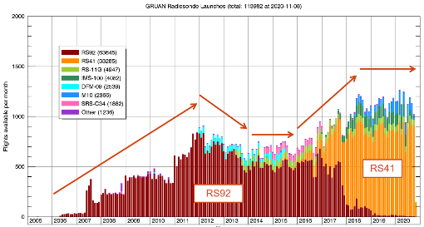
21 Jan Meeting Highlights: GRUAN
IASI-NG
NWP humidity sounding channel uncertainties are too large to detect small uniform biases (<1K).
Some temperature channel uncertainties don’t exceed 0.15 K, and the NWP fields are consistent with GRUAN.
Comparison with IASI observations will bring additional uncertainty sources, driving the total uncertainty up, so it is not certain that a uniform bias of 0.25 K could be detected.
MWS
NWP humidity sounding channels uncertainties for are too large to detect small uniform biases (<1K), except maybe in the tropics.
Temperature channel biases on the order of the instrument radiometric accuracy (1K) should be detectable.

Slide 8
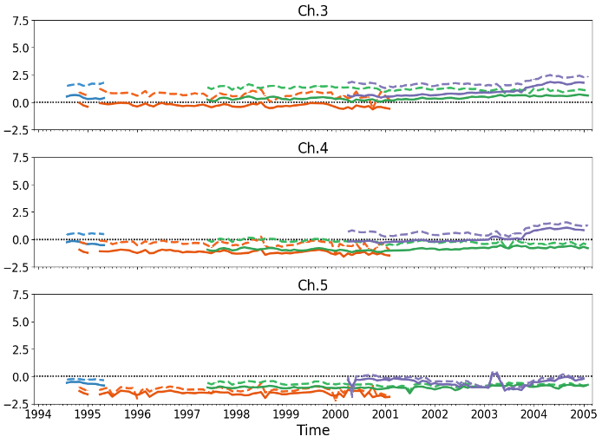
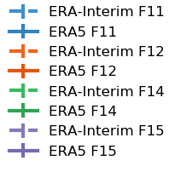
21 Jan Meeting Highlights: SSMT2 FCDR

Slide 9
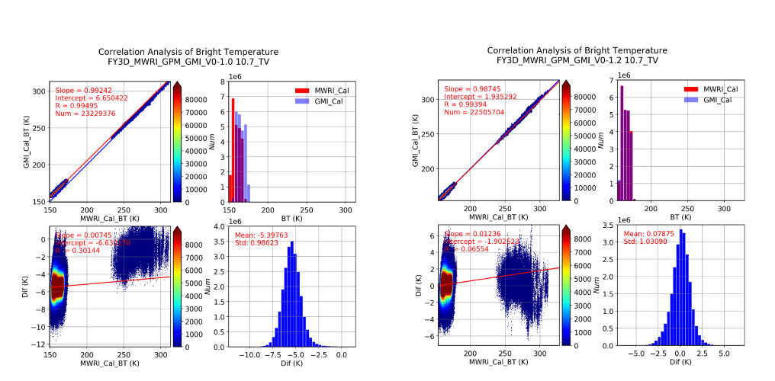
21 Jan Meeting Highlights: FY-3/MWRI FCDR
Corrections on:
hot reflector back lobe hot load reflector emissivity
hot load efficiency non-linearity

Slide 10
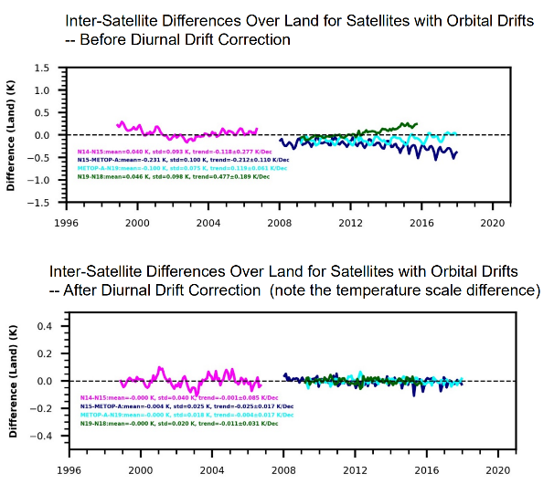
16 Feb Meeting Highlights: AMSU/ATMS FCDR
For TCDR development, diurnal drift correction algorithms were developed and used to correct diurnal drift errors for satellites with orbital drift.
After diurnal drift correction, inter-satellite difference trends become zero.

Slide 11
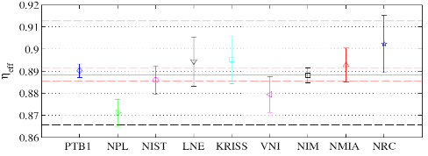
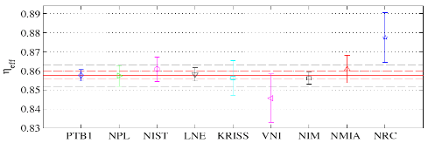
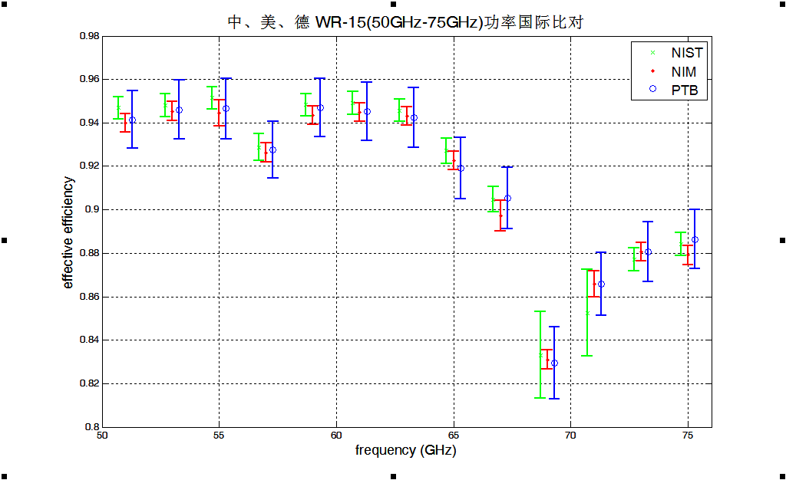
16 Feb Meeting Highlights: Microwave Power Measurement
33GHz
40GHz
45GHz
50GHz

Slide 12
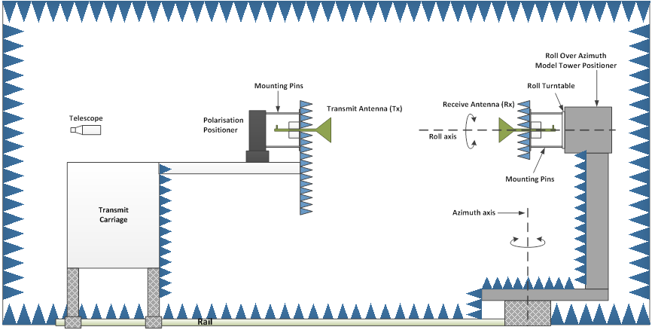
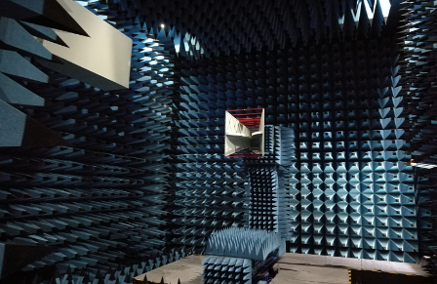
16 Feb Meeting Highlights: Metrology of Antenna Radiation Pattern

Slide 13
18 Mar Meeting Highlights: EUMETSAT’s MW Contribution to C3S Phase 2 (Highlighted in Black)
ERA6 preparations (delivery <2025)
HIRS: infrared, soundings (1978-2021)
SSMT: microwave, soundings (1991-2005)
SSMIS: microwave, soundings (2003-2021): addressing upper-atmospheric sounding
Japanese GEO radiances (1978-2015): assimilation readiness report
F
R
130
F
R
25
F
R
47
R
FCDR/TCDR for European high-resolution reanalyses
METEOSAT: radiances and atmospheric motion vectors from First and Second Gen. Rapid-Scan
F
T
11
15
Early satellite era FCDR/TCDR
Benchmark FCDR
SMMR: microwave, images (1978-1987)
SSH: infrared, soundings (1977-1980)
SI-1: infrared, spectra (1977, 1979)
THIR: polar atmos. motion vectors (70-85)
MSU & AMSUA: microwave, soundings (1978-2020): FIDUCEO-type analysis
ATMS: microwave, soundings (2011-2021): FIDUCEO-type analysis, all channels
F
R
9
F
R
F
R
5
152
F
<1
F
T
R
12
14
FCDR
TCDR
Report
Some uncertainty, related to availability and quality of the sensor data
F
T
R
Builds on existing programme (2016-2021)
which will/has deliver(ed) FCDRs for HIRS, ATMS, MHS and MWHS-1/-2
xx
Satellite-years expected in deliverable CDR

Slide 14
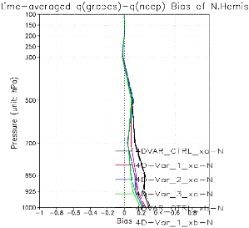
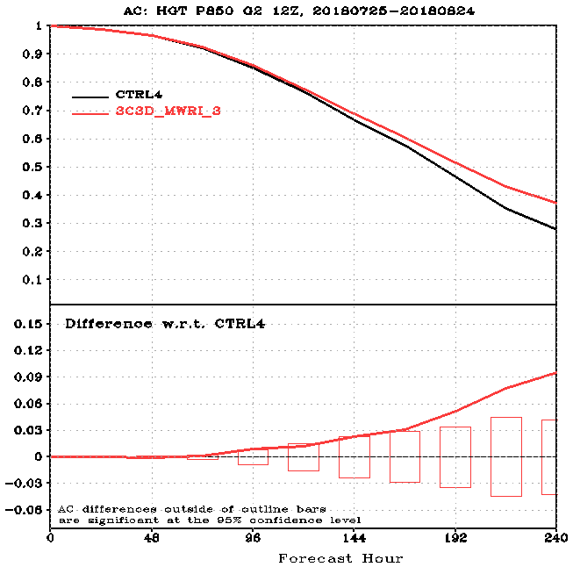
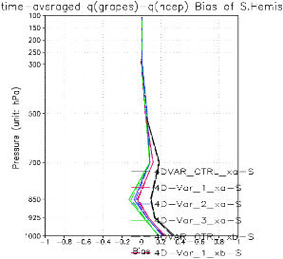
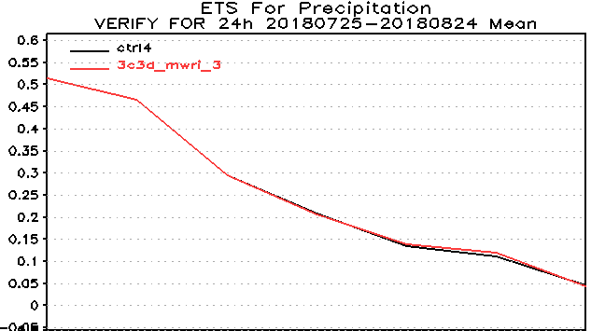
18 Mar Meeting Highlights: Assimilation of Microwave Imager in GRAPES
Humidity (>500hPa) is improved.
Accuracy of Geopotential Height is improved.
The short-term forecast of heavy rain is slightly improved.
Assimilation of FY3C&D-MWRI has positive effects on forecast in southern hemisphere.

Slide 15
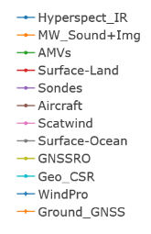
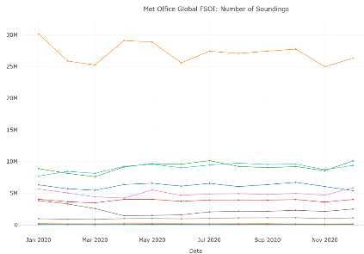
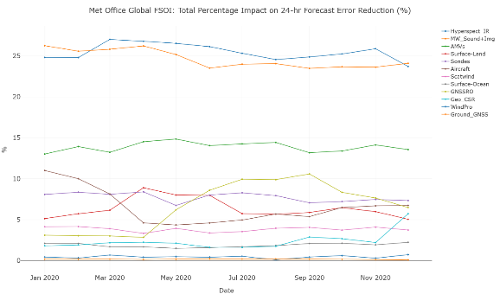
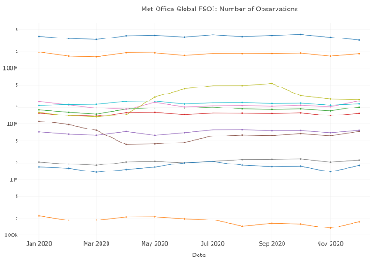
18 Mar Meeting Highlights: Applications of MW to NWP - Met Office
Current data usage at the Met Office
Number of Soundings (25M-30M)
Number of Observations (~200M)
24 Hour Forecast Error Reduction (~25%)

Slide 16
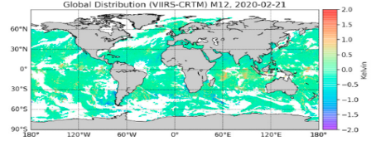
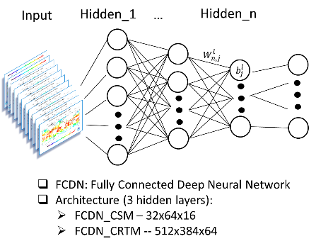
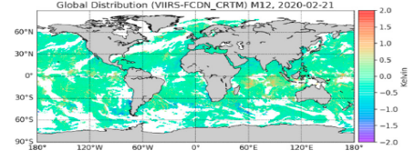
18 Mar Meeting Highlights: AI-based RTM
Global Distribution of VIIRS Ch M12 – CRTM simulated VIIRS Ch M12 for the CRTM (top) and FCDN_CRTM (bottom)

Slide 17
18 Mar Meeting Highlights: Applications of MW to NWP Reanalysis - ECMWF
MW Imagers
MW Sounders
Year

Slide 18
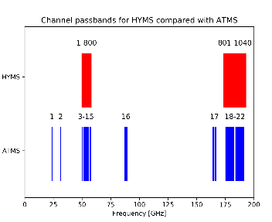
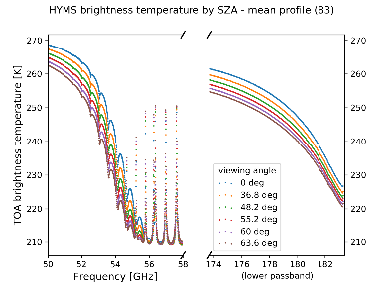
HYMS (HYperspectral Microwave Sounder)
18 Mar Meeting Highlights: Hyperspectral MW Sounder
A Key Advantage for NWP: Improved observations in Upper Stratosphere Lower Mesosphere, identified as a key error source, causing operational model failures and a gap that will be left by SSMI/S
Measurement | Frequency Range | RBW (MHz) | NE∆T (K) | Polarisation | Nonlinearity (K) | Out-of-band Rejection (dB)
Temperature | 50.0 – 57.3 & 53 – 67.9 | 10 | 0.4 | QV or QH | < 0.3K | > 40
Water vapour | 175 – 192 | 40 | 0.4 | QV or QH | < 0.3K | > 40
RTTOV HYMS simulations
A Key Objective: Reduction in uncertainties of spectroscopic parameters, enabled through fine spectral resolution never before measured from space.
emissivity = 1
Notes:
Led by RAL Space, HYMS is a collaboration with JCR Systems, Met Office, STAR, ECMWF and FAAM, with CEOI funding.
It has two bands, one oxygen and one water vapour.
Further advantages of a hyperspectral instruments:
Increased accuracy and precision of the products Due to decreased cross talk & better isolation of signals
Reduced sensitivity to background information Due to increased information content
RFI mitigation - Spectral resolution allows for elimination of interfered channels

Slide 19
Complete Action Items
Action Item: A.GMW. | Description | status
20191119.2 | Wes Burg to hold a dedicated workshop to explore the implementation of the GPM XCAL algorithms to inter-calibrate other microwave imagers. This potentially could be implemented in Q4 after the 2020 EUMETSAT Conference. | Open (OBE)
20200318.a1 | Update the architecture of Ralph Ferraro’s initial MW Subgroup Wiki page. Find someone to spearhead this task, working towards a more complete roadmap, and present it at another GSICS Meeting this year. | Close
20200318.a2 | MWSG Co-Chairs to coordinate the development of the documentation of the X-Cal algorithms. | Close

Slide 20
MW Subgroup Planned Activities (1 of 2)
Meetings 2021
Web Meeting (April) : (TBD - Possibly active microwave remote sensing)
Workshop (May or June 2021, 2 days) : The future development of the satellite microwave remote sensing (active and passive sensors)
Web Meetings (Sep, Dec 2021): Invite users to discuss their needs and expectations
Collaborative Activities
Within the MW Subgroup (inter-sensor comparison)
With other Subgroups (Hyperspectral IR SDR for ATMS calibration accurate estimate)
Deliverables
Reprocessed SNPP and NOAA-20 ATMS SDR data
MW RO testbed with the gap filling using ECMWF data
Draft review document for on-orbit and near future microwave sounding and imagery instruments
Draft review document for on-orbit and near future scatterometers

Slide 21
MW Subgroup Planned Activities (2 of 2)
Technical Explorations
SmallSat and CubeSat Microwave Instrument Preparations
MW water vapor sounding channels exercise with Temporal Experiment for Storms and Tropical Systems - Demonstration (TEMPEST-D)
Possible ERA6 (2021-2026) use the reprocessed SNPP and NOAA-20 ATMS SDR (Timo and Bill)?
MW Sounder Accuracy Estimate
Relative comparison: SNO among MW sensors, also SNO double difference
“Absolute” estimate: O – B (NWP/RO data, RT model, observations)
Using hyperspectral IR radiance to predict MW stratospheric sounding channels via RT model (RT model, observations).

Slide 22
Potential Action Items 2021
Action Item: A.GMW. | Description | status
20210330.1 | Draft review document for on-orbit and near future microwave sounding instruments | TBD
20210330.2 | Draft review document for on-orbit and near future microwave imaging instruments | TBD
20210330.3 | Draft review document for on-orbit and near future scatterometers | TBD
20210330.4 | Hold a workshop to discuss current status and future development of MW sensors, including active and passive | TBD
20210330.5 | Develop a report for requirement of MW sensors from different users | TBD
20210330.6 | Using AMSU-A and ATMS as reference sensors for FCDR | TBD
 | ......

Slide 23
Back Up Slides

Slide 24
21 Jan Meeting Summary: Fundamental Climate Data Record Activities
Co-Chair discussion of Microwave Subgroup Activities, Actions and Plans
Fundamental Climate Data Record Activities
(EUMETSAT/CS3) SSMT2 microwave FCDR bias assessment challenges include scan-dependent and non-linear antenna temperature bias uncertainties, while progress was made on cloud clearing methods using FIDUCEO.
(CMA) FY-3/MWRI FCDR challenges include bias uncertainties associated with a warm load antenna reflector with non-zero emissivity and back lobes, cold reflector RFI, and hot load efficiency, while progress was made using the GPM GMI instrument as a reference during SNO events.
(NOAA) MSU/AMSU/ATMS atmospheric temperature FCDR challenges include large changes in orbital local equatorial crossing time of early MSU/AMSU, while progress includes improved stability by using AMSU-A onboard Aqua and MetOp-A and ATMS onboard SNPP as references.
FCDR Measurement Support or Enhancement Activities
(UK Met Office) GCOS Reference Upper-Air Network (GRUAN) and its applications illustrated the availability of high-quality, ground-based instruments – e.g., radiosondes, Lidars, ozone sensors, and sounding rockets - distributed throughout the globe that can be used as a microwave and infrared instrument FCDR measurement reference. The GRUAN is also augmenting its network using the high-quality Global Navigation Satellite System Radio Occultation soundings.
(Hamburg University) Performing post-launch characterization of AMSU-B/MHS antenna response and pointing accuracy using the moon
(JAXA) AMSR-3 instrument status was updated.

Slide 25
16 Feb Meeting Summary: SI-traceable Microwave Radiometer Calibration
(China National Institute of Metrology (NIM)) Measuring MW Power and Antenna Response
Described traceable power measurement techniques and capabilities, and state-of-art power sensor, micro-calorimeter and best-practice development needed for MW radiometric measurement.
Introduced antenna radiation pattern metrology, and the merits of the NIM spherical near-field antenna characterization method and facility, compared to far- and near-field methods and facilities.
Provided measurement uncertainty.
(MIT) Reference MW Radiometer Characteristics, Desirable Features and Stable References
Characteristics – e.g., linearity, frequency stability, calibration stability, low antenna sidelobe levels, and stabilized orbit altitude.
Desirable Features - Phase-locked local oscillator(s); 2- 3- or 4-point calibration (e.g. target, space, noise diode); Reduced sensitivity to gain fluctuations (e.g. Dicke switching); Low-sidelobe antenna; Dual polarization for comparisons to rotating-pol instruments like ATMS; and Temperature control of radiometer and target.
Suggested the GNSS-RO refractivity be used as an SI-traceable and stable microwave measurement standard.
(NASA) MW Radiometer RFI
United Nations’ International Telecommunication Union (ITU) provides spectrum protection regulations through the World Radio-communication Conference (WRC).
Regulation decisions include cost-benefit and power limit studies associated with releasing portions of the radio frequency (RF) spectrum for commercial use.
In the recent WRC-19, relaxation of some RF protections could introduce terrestrial RF sources at on-orbit microwave sounder operating frequency bands.
The possibility of dedicated RFI measuring missions, or RFI onboard screening were briefly discussed.

Slide 26
18 Mar Meeting Summary: Applications of MW to NWP
(ECMWF) ECMWF Reanalyses Microwave Data Assimilation : ERA5 Aspects and Future Plans
Microwave sounder data has greatly improved reanalysis, especially in the Southern Hemisphere, and “All-sky” microwave imager and humidity sounder data have also brought some improvements.
Instrument improvements, orbit stabilization, and radiative transfer model (RTM) developments lead to microwave radiometer data bias corrections with reduced magnitude and uncertainty.
(UK Met Office) Current and future use of MW data at the Met Office
The UK Met Office NWP model input data is composed of about 25% microwave radiometer data, and forecasts degrade with respect to observations (ECMWF analysis) by about 1.3% (2.6%) when they are removed.
“All-sky” measurements from instruments such as MHS have revealed forecast improvements. Also, 118 GHz measurements have a positive impact, which is promising for future smaller radiometers.
A low-noise hyperspectral microwave sounding radiometer with 10 MHz bands is under study.
(CMA/NWPC) Assimilation of Microwave Sounding Observations in Chinese NWP system
GRAPES_GFS model MWRI and AMSR-2 microwave radiometer data quality control measures itemized.
Bias corrections as a function of channel, polarization, scan angle and satellite orbital node, and impacts of incorporating MWRI and AMSR-2 data on GRAPES_GFS forecast skill, are presented.
(NOAA/STAR) AI-based Radiative Transfer Model (RTM)
An AI-based RTM algorithm is shown to have merits and limitations with respect to a conventional RTM.
The FCDN_CRTM and CRTM show initial good agreement that diminishes over the period of months, and the importance of applying physics to the input data during method training cannot be ignored.
(Subgroup Co-Chairs) GSICS Annual Meeting Plan

