Slide 1
Microwave FCDR Activities at EUMETSAT
Viju John, Timo Hanschmann, Paul Poli, Jörg Schulz
GSICS Annual Meeting, March 2021

Slide 2
Released datasets since last GSICS Annual Meeting
Data Record | Period | Satellite | Status
Visible
MVIRI R1 | 1981 – 2017 | Meteosat-2, -3, -4, -5, -6, -7 | Available from https://navigator.eumetsat.int/product/EO:EUM:DAT:0080
Infrared
MVIRI R1 | 1981 – 2017 | Meteosat-2, -3, -4, -5, -6, -7 | Available from https://navigator.eumetsat.int/product/EO:EUM:DAT:0080
HIRS R1 | 1978 – 2020 | TIROS-N, NOAA-6 to 19, Metop-A & -B | Available on request to ops@eumetsat.int
Microwave
SSM/T-2 R2 | 1994 – 2005 | DMSP-11, -12, -14, -15 | Available from https://navigator.eumetsat.int/product/EO:EUM:DAT:0343
AMSU-B R1 | 1999 - 2014 | NOAA-15, -16, -17 | Available from https://navigator.eumetsat.int/product/EO:EUM:DAT:0303
MHS R2 | 2006 – 2018 | Metop-A & -B | Available from https://navigator.eumetsat.int/product/EO:EUM:DAT:0344
MWHS-1 R1 | 2008 – 2018 | FY-3A & -3B | Available from https://navigator.eumetsat.int/product/EO:EUM:DAT:0348
MWHS-2 R1 | 2013 – 2018 | FY-3C | Available from https://navigator.eumetsat.int/product/EO:EUM:DAT:0349
ATMS R1 | 2011 – 2018 | SNPP | Available from https://navigator.eumetsat.int/product/EO:EUM:DAT:0345
Radio Occultation
GRAS R3 | 2006 – 2020 | Metop-A, -B, & -C | Available on request to ops@eumetsat.int
IGOR R1 | 2006 – 2020 | COSMIC | Available on request to ops@eumetsat.int
Black Jack R1 | 2007 – 2017 | GRACE | Available on request to ops@eumetsat.int
Black Jack R1 | 2001 – 2008 | CHAMP | Available on request to ops@eumetsat.int

Slide 3
Uncertainty characterised Microwave Humidity Sounder data
FIDUCEO – their Release 1 contains data from SSM/T-2, AMSU-B, and MHS – Brightness temperatures and fully traceable uncertainties – Independent, structured, and common
I. Hans, M. Burgdorf, S. A. Buehler, M. Prange, T. Lang, V. O. John (2019) An Uncertainty Quantified Fundamental Climate Data Record for Microwave Humidity Sounders, Remote Sens., 11, 548.

Slide 4
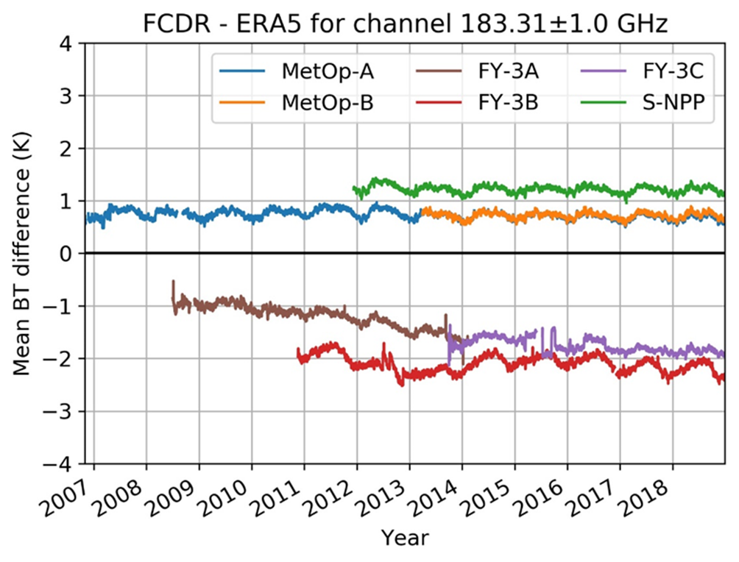
Uncertainty characterised Microwave Humidity Sounder data
We extended the FIDUCEO methods to MWHS, MWHS-2, and ATMS – only for 183 GHz channels;
Currently working on the harmonisation of these individual data records;
We look for collaborations with other agencies.

