Slide 1
Comparison between NOAA and NASA NOAA-20 VIIRS calibrations -GSICS VIS/NIR reference calibration recommendation
Presented by Sirish Uprety
On behalf of NOAA STAR VIIRS SDR team
March 31, 2021
GSICS Annual meeting

Slide 2
Background
NOAA-20 VIIRS has been performing very well since launch with excellent Earth observation data.
Using VIIRS data for time series studies, and long term climate records requires stringent calibration.
Users’ have the option to choose NOAA-20 VIIRS SDRs (calibrated radiance, reflectance, geo):
NOAA operational product (https://www.class.noaa.gov)
NASA product (https://ladsweb.modaps.eosdis.nasa.gov/archive/allData/5200/)
This presentation focus on three different comparisons between NOAA and NASA calibrations for NOAA-20 VIS/NIR bands:
Calibration coefficients (F-factors)
Radiance products (earth observations)
Deep Convective Clouds observations (independent validation of stability)
The calibration difference between NOAA and NASA products needs to be quantified and monitored regularly to help users understand the impact on Environmental Data Records (EDRs) or level 2 products.
NOAA-20 VIIRS is an excellent candidate for GSICS on-orbit reference for VIS/NIR bands (Doelling et al., 2021, GSICS Newsletter, doi: 10.25923/jmbt-d994)

Slide 3
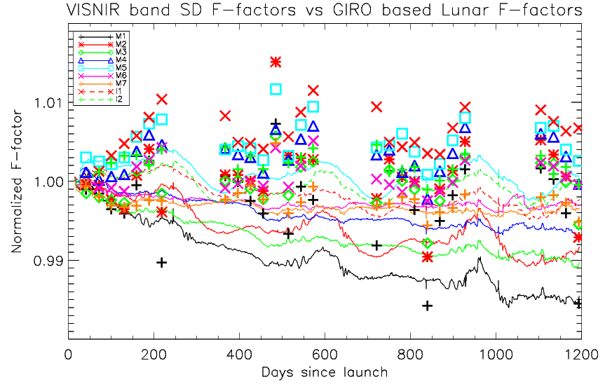
Using Lunar Calibration to Monitor NOAA-20 VIIRS calibration stability
Lunar F-factors suggest stable sensor response in all VIIRS VIS/NIR bands with no noticeable degradation, as a result, NOAA so far uses constant F-factors in operational calibration since April 27, 2018.
NOAA’s offline version of the Solar Diffuser (SD) F-factors show some erroneous degradation trends compared to lunar F-factors especially in the short wavelength bands (M1~M4).

Slide 4
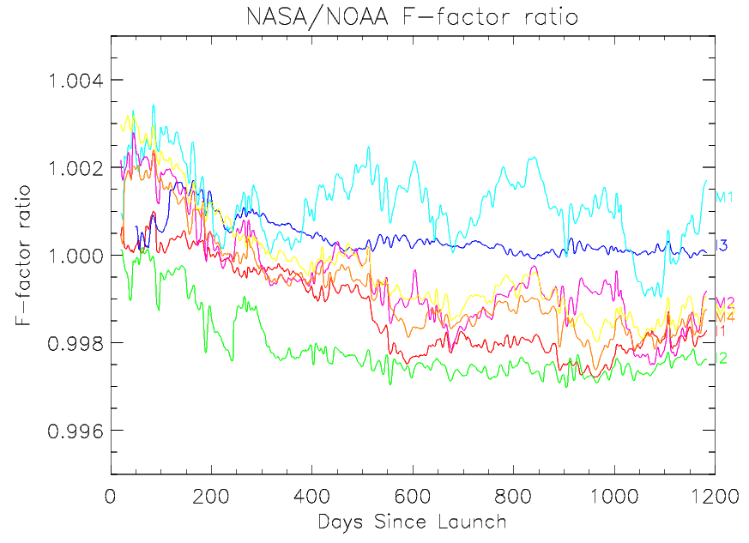
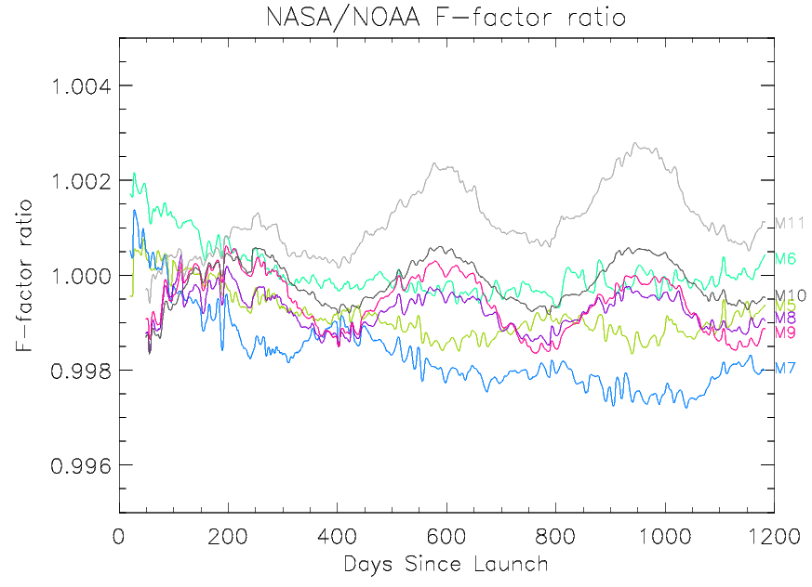
NASA (modeled) and NOAA F-factor Ratio
NASA and NOAA RSB calibrations are within 0.2% (for 84% of ratios).
NASA’s F-factors for some VIS/NIR bands show trends of ~-0.1% to -0.2% over 3 years.
NASA’s F-factors for SWIR bands show annual oscillation patterns.
NOAA’s operational F-factors for NOAA-20 VIIRS VIS/NIR are constant after April 27, 2018, because Lunar F-factors, DCC, SNOx and PICS trends indicate stable sensor response.

Slide 5
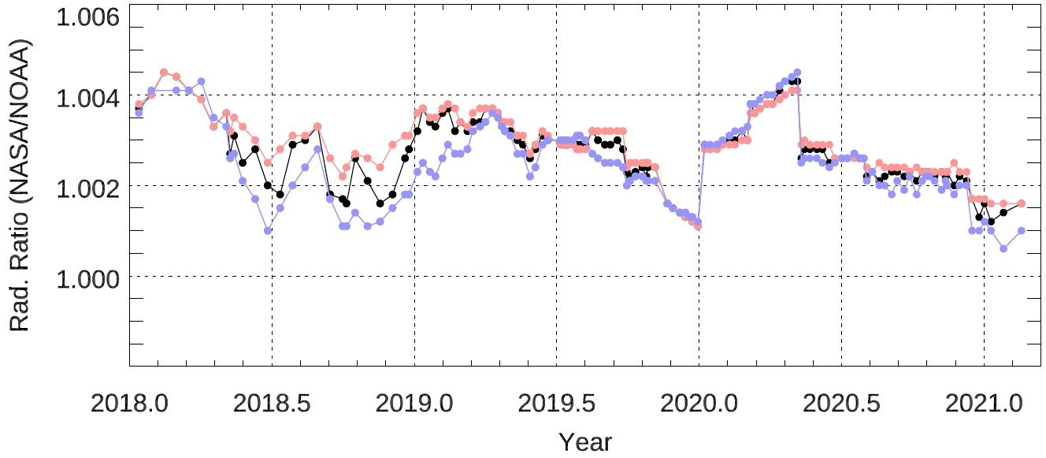
Comparing NOAA and NASA Radiance Product (M1)
Temporal trending of radiance ratio (NASA/NOAA) shows the calibration differences
NOAA: Reprocessed (1/6/2018 – 4/30/2018) and Operational (5/1/2018 – 12/31/2020)
NASA: Collection 2 L1B (5200)
Black dot: non-bow region from center (~1000*768 samples)
LG HG Both
M1 (0.412 µm)
Jumps are nearly of same magnitude
Cal. update?
Why up and down?
Agrees within 0.4%
M1 NASA Radiance are higher than NOAA, agreeing to within 0.4% (with exceptions)
Two noticeable discontinuities (0.2%) are observed in early 2020
Calibration updates at NASA
Up and down jumps are almost of same magnitude.
Visit: https://ncc.nesdis.noaa.gov/NOAA-20/GSICS_on-orbit_Reference.php for interactive analysis of the differences.

Slide 6
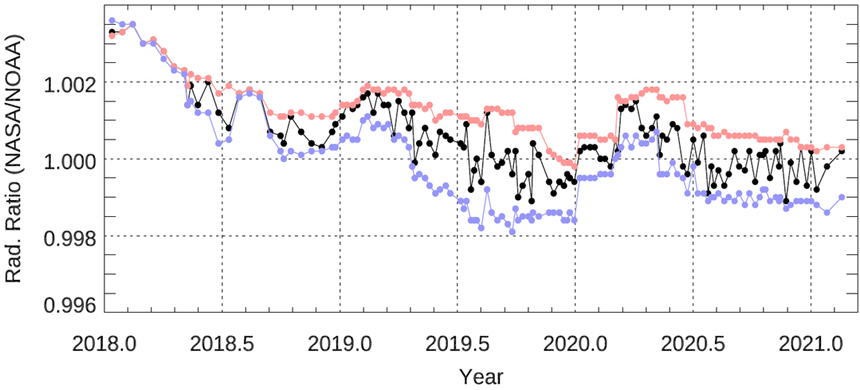
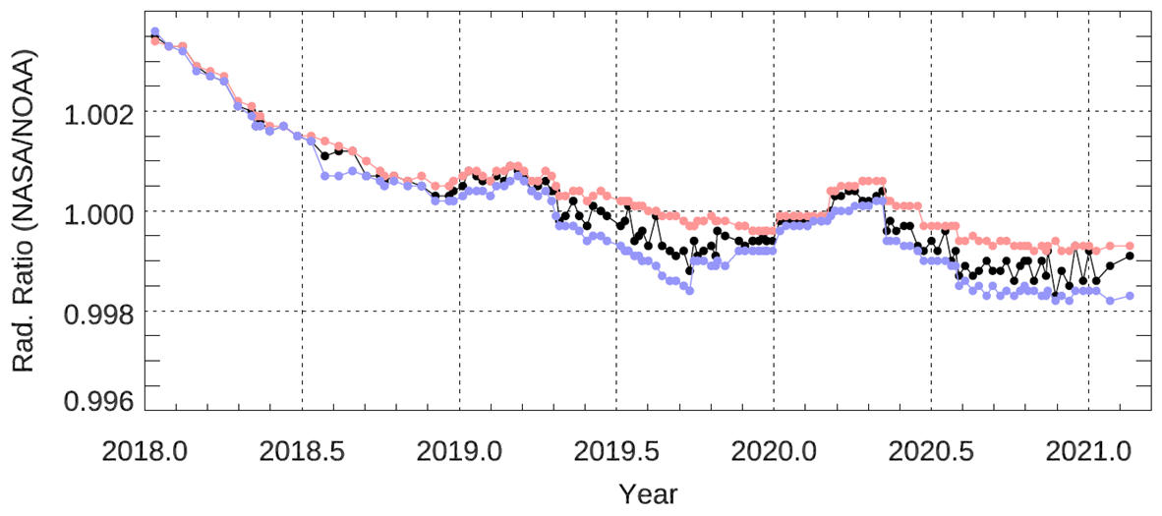
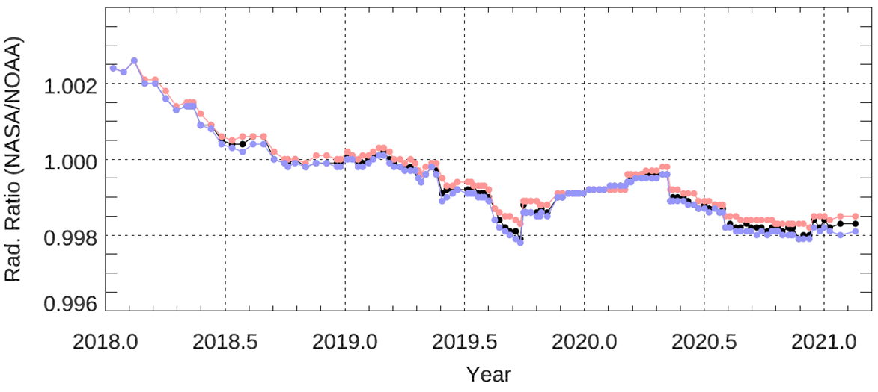
Comparing NOAA and NASA Radiance Product (M2-4)
NOAA and NASA radiance agrees within 0.2% (except early orbits)
Unlike M1, M2-4 ratio suggest more than 0.2% decreasing trend during 1st year (2018)
HG and LG ratios show larger differences for M2 by up to 0.2%
The trend is due to NASA calibration (suggesting increasing gain during early orbits), since NOAA calibration is kept constant
LG HG Both
M2 (0.445 µm)
within 0.2%
M3 (0.488 µm)
Larger difference during early 2018
within 0.2%
M4 (0.555 µm)
within 0.2%

Slide 7
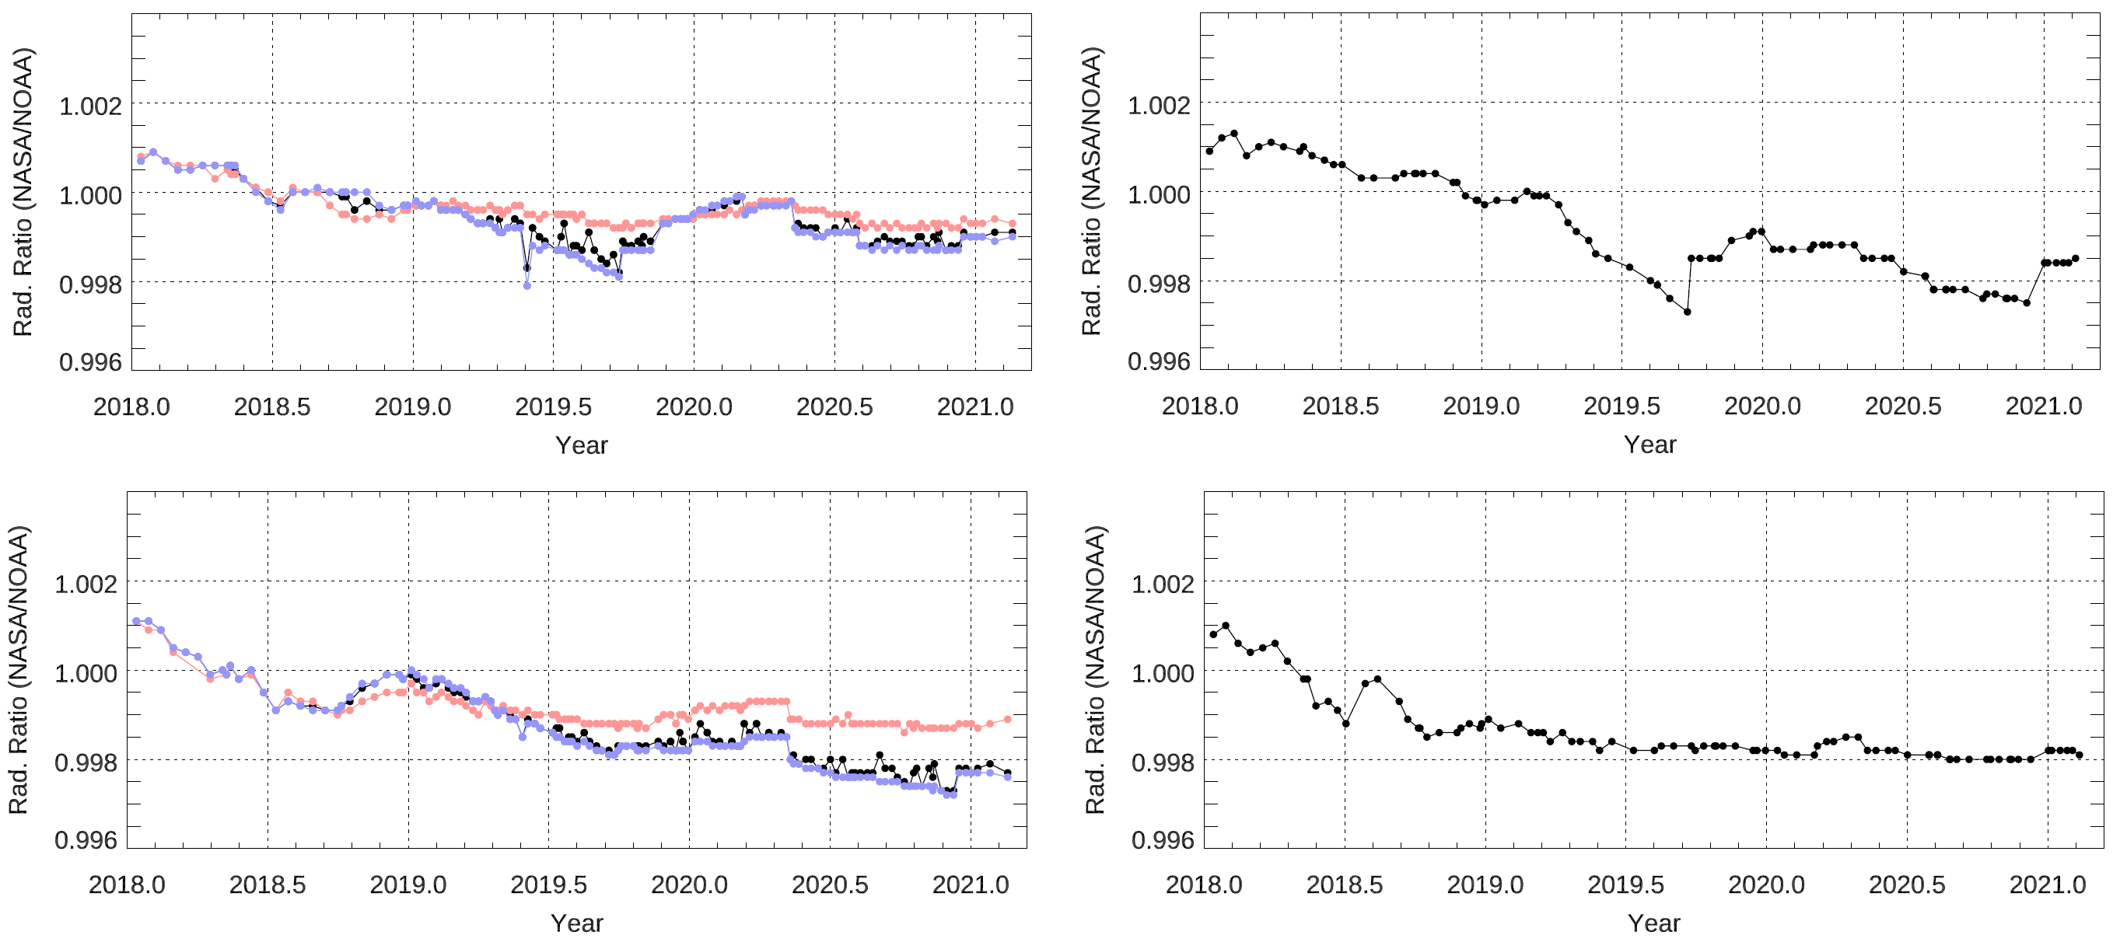
Comparing NOAA and NASA VIIRS Radiance (M5-7, I1-2)
LG HG Both
M5 (0.672 µm)
LG HG Both
I1 (0.640 µm)
M7 (0.865 µm)
I2 (0.865 µm)
LG and HG differences grows
NOAA and NASA radiance agrees to within 0.2% (except few exceptions for M7 and I1)
Similar to the blue and green bands, there are some discontinuities as observed in M5 and M7 due to NASA cal. updates.
M7 indicate growing differences between HG and LG after mid 2019 (requires further study, see slide 10).

Slide 8
Comparing NOAA and NASA N20 VIIRS Stability over DCCs
Objective: Independently quantify the stability trends (with uncertainty) for NOAA and NASA N20 VIIRS VIS/NIR SDRs using the daily DCC method.
Stability requirement for RSBs: 0.3% for mission long, more stringent for Ocean Color applications (0.1% desired)
NOAA-20 VIIRS data records are still short (3 years)
Challenging to quantity the small trends using most vicarious methods:
Limited data points are available so far for lunar cal, desert sites, SNO.
Daily DCC time series (Wang and Cao, 2020, IEEE JSTARS)
DCC mode time series are used for VIS/NIR individual band calibration stability analysis.

Slide 9
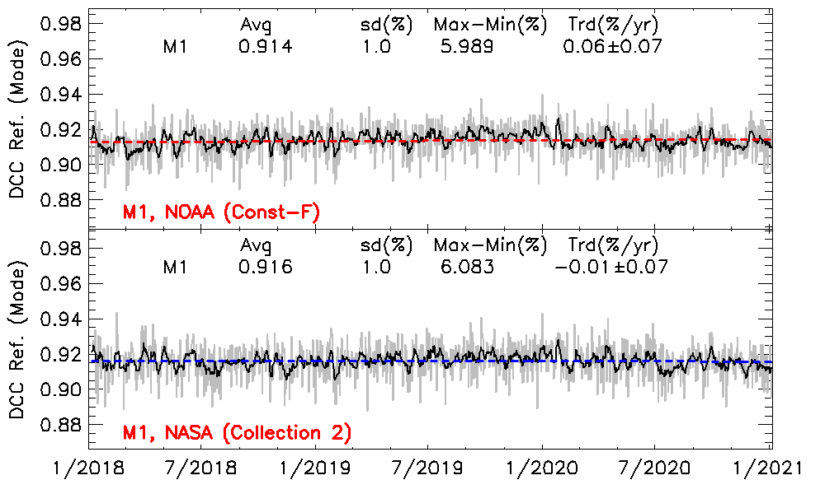
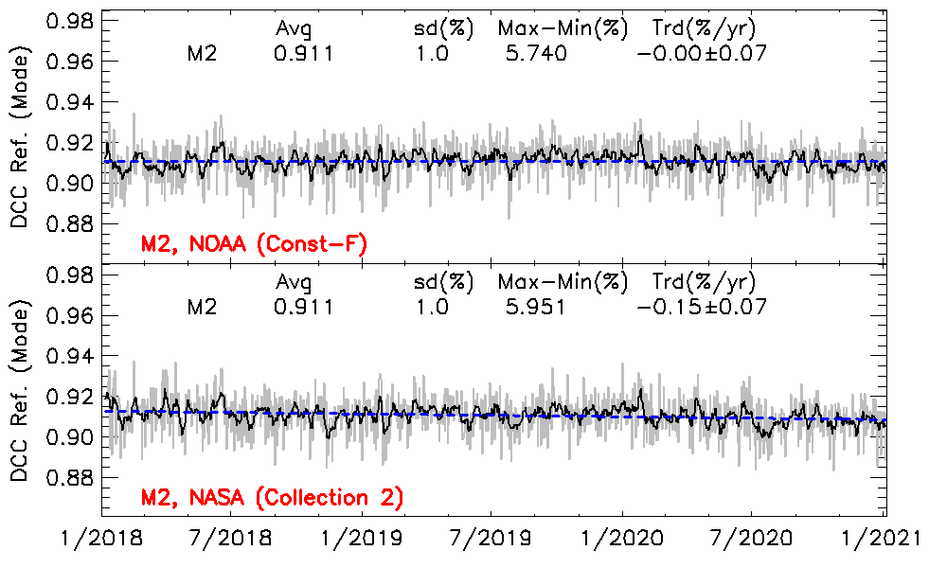
DCC Trending for M1 and M2
(0.412 µm)
(0.445 µm)
M1 calibration is very stable.
Trends are within the uncertainty level for both NOAA and NASA
NASA M1 shows very small trend (NASA: -0.01%; NOAA: 0.06%, uncertainty ±0.07%/yr with 95% CI).
NOAA M2 shows no trend whereas NASA M2 shows small downward trend of -0.15%/year (consistent with NASA F-factor trend)
Results for M3 & M4 are similar to M2.

Slide 10
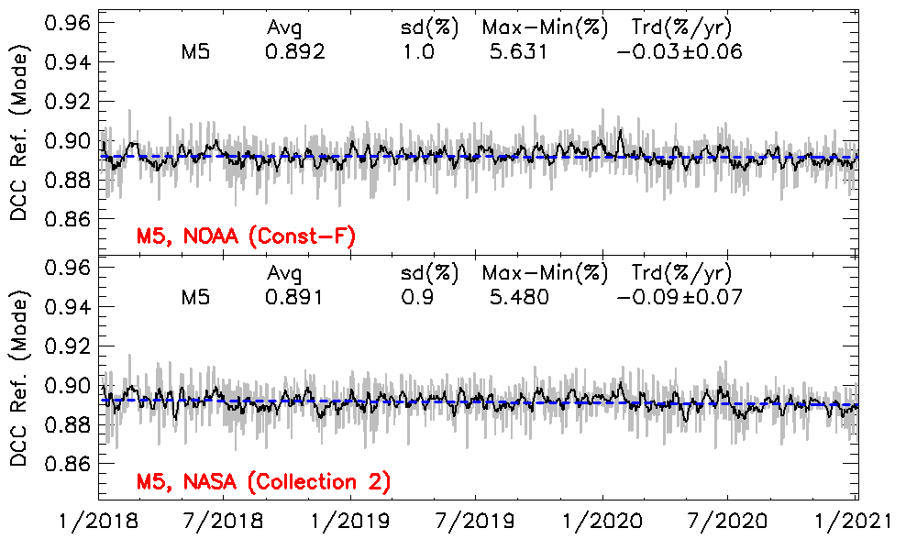
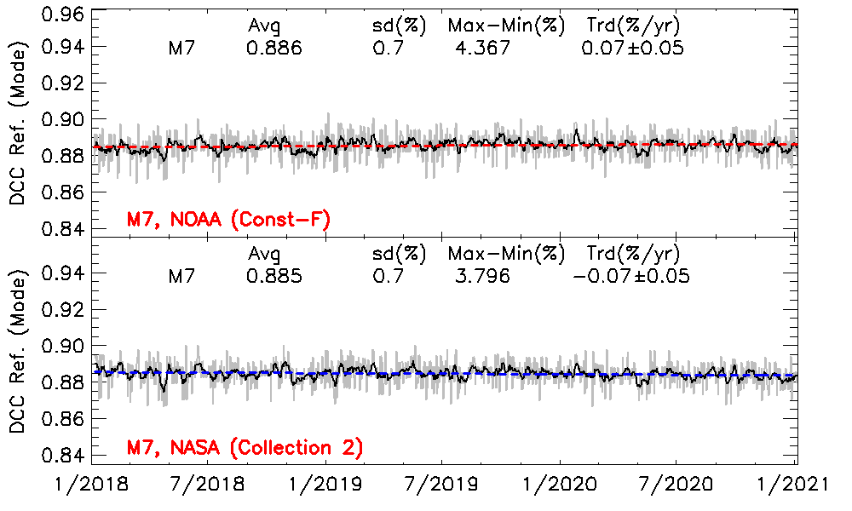
DCC Trending for M5 and M7
(0.672 µm)
(0.865 µm)
M5 calibration is stable.
Very small trends are observed relative to the uncertainty.
M7 suggests small trends in opposite directions:
NOAA: +0.07%/year; NASA: -0.07%/year (may be related to HG/LG uncertainties/divergence on slide 7)
Further collaborative study with VCST needed for this band.

Slide 11
DCC Validation Summary NOAA (Constant F) vs NASA (C2) (1/6/2018 – 1/5/2021)
 |  | NOAA(Const-F) | NASA (Collection 2)
VIS/NIR | M1 | 0.06 ± 0.07 | -0.01 ± 0.07
 | M2 | -0.00 ± 0.07 | -0.15 ± 0.07
 | M3 | 0.03 ± 0.07 | -0.13 ± 0.07
 | M4 | 0.01 ± 0.07 | -0.13 ± 0.07
 | M5 | -0.03 ± 0.06 | -0.09 ± 0.06
 | M7 | 0.07 ± 0.05 | -0.07 ± 0.05
Trend ± 95%CI Unit: %/year
https://ncc.nesdis.noaa.gov/NOAA-20/GSICS_on-orbit_Reference.php

Slide 12
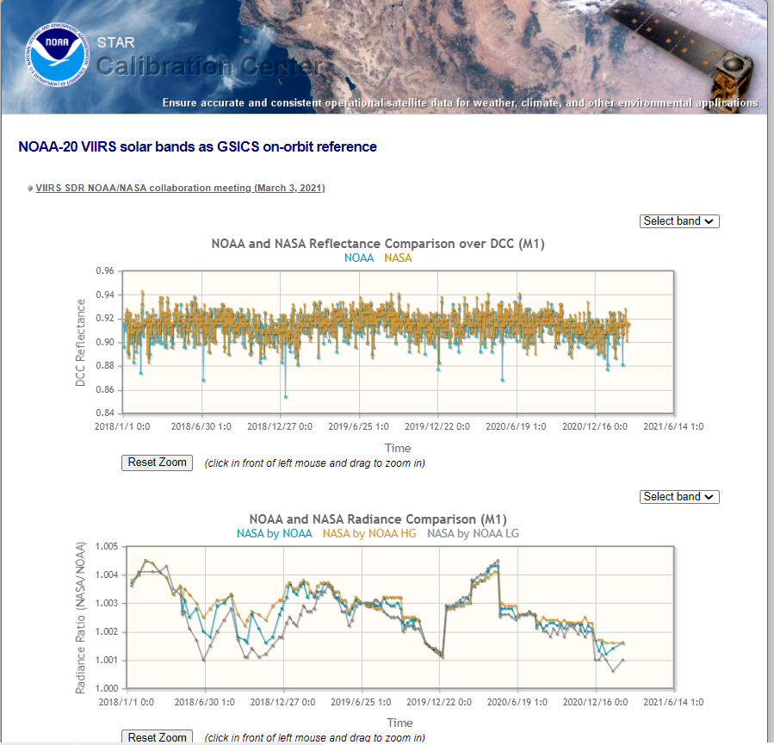
A Dedicated Webpage Developed
https://ncc.nesdis.noaa.gov/NOAA-20/GSICS_on-orbit_Reference.php

Slide 13
Summary
NOAA-20 VIIRS has been very stable with little degradation in responsivity since launch, as indicated by independent validation techniques such as lunar and DCC trending.
NOAA operational calibration has been using constant gains for VIS/NIR bands since April 27, 2018 as a result.
Comparison of VIIRS F-factors suggest that NOAA and NASA data agrees within 0.2%.
Comparison of VIIRS radiances also agree within 0.2% between NOAA and NASA, except for M1.
NASA M1 radiance is slightly higher than NOAA by ~0.3% on average (required absolute calibration uncertainty of 2%)
NOAA-20 VIIRS solar bands can be used as on-orbit reference given its stability proven by both NOAA and NASA studies.
NOAA VIIRS SDR team plans to continue work with NASA VCST to address any remaining discrepancies (such as reprocessing early orbit data; M7 discrepancies)

Slide 14
Disclaimer
The scientific results and conclusions, as well as any views or opinions expressed herein, are those of the author(s) and do not necessarily reflect those of NOAA or the Department of Commerce.

Slide 15
Backup slides

Slide 16
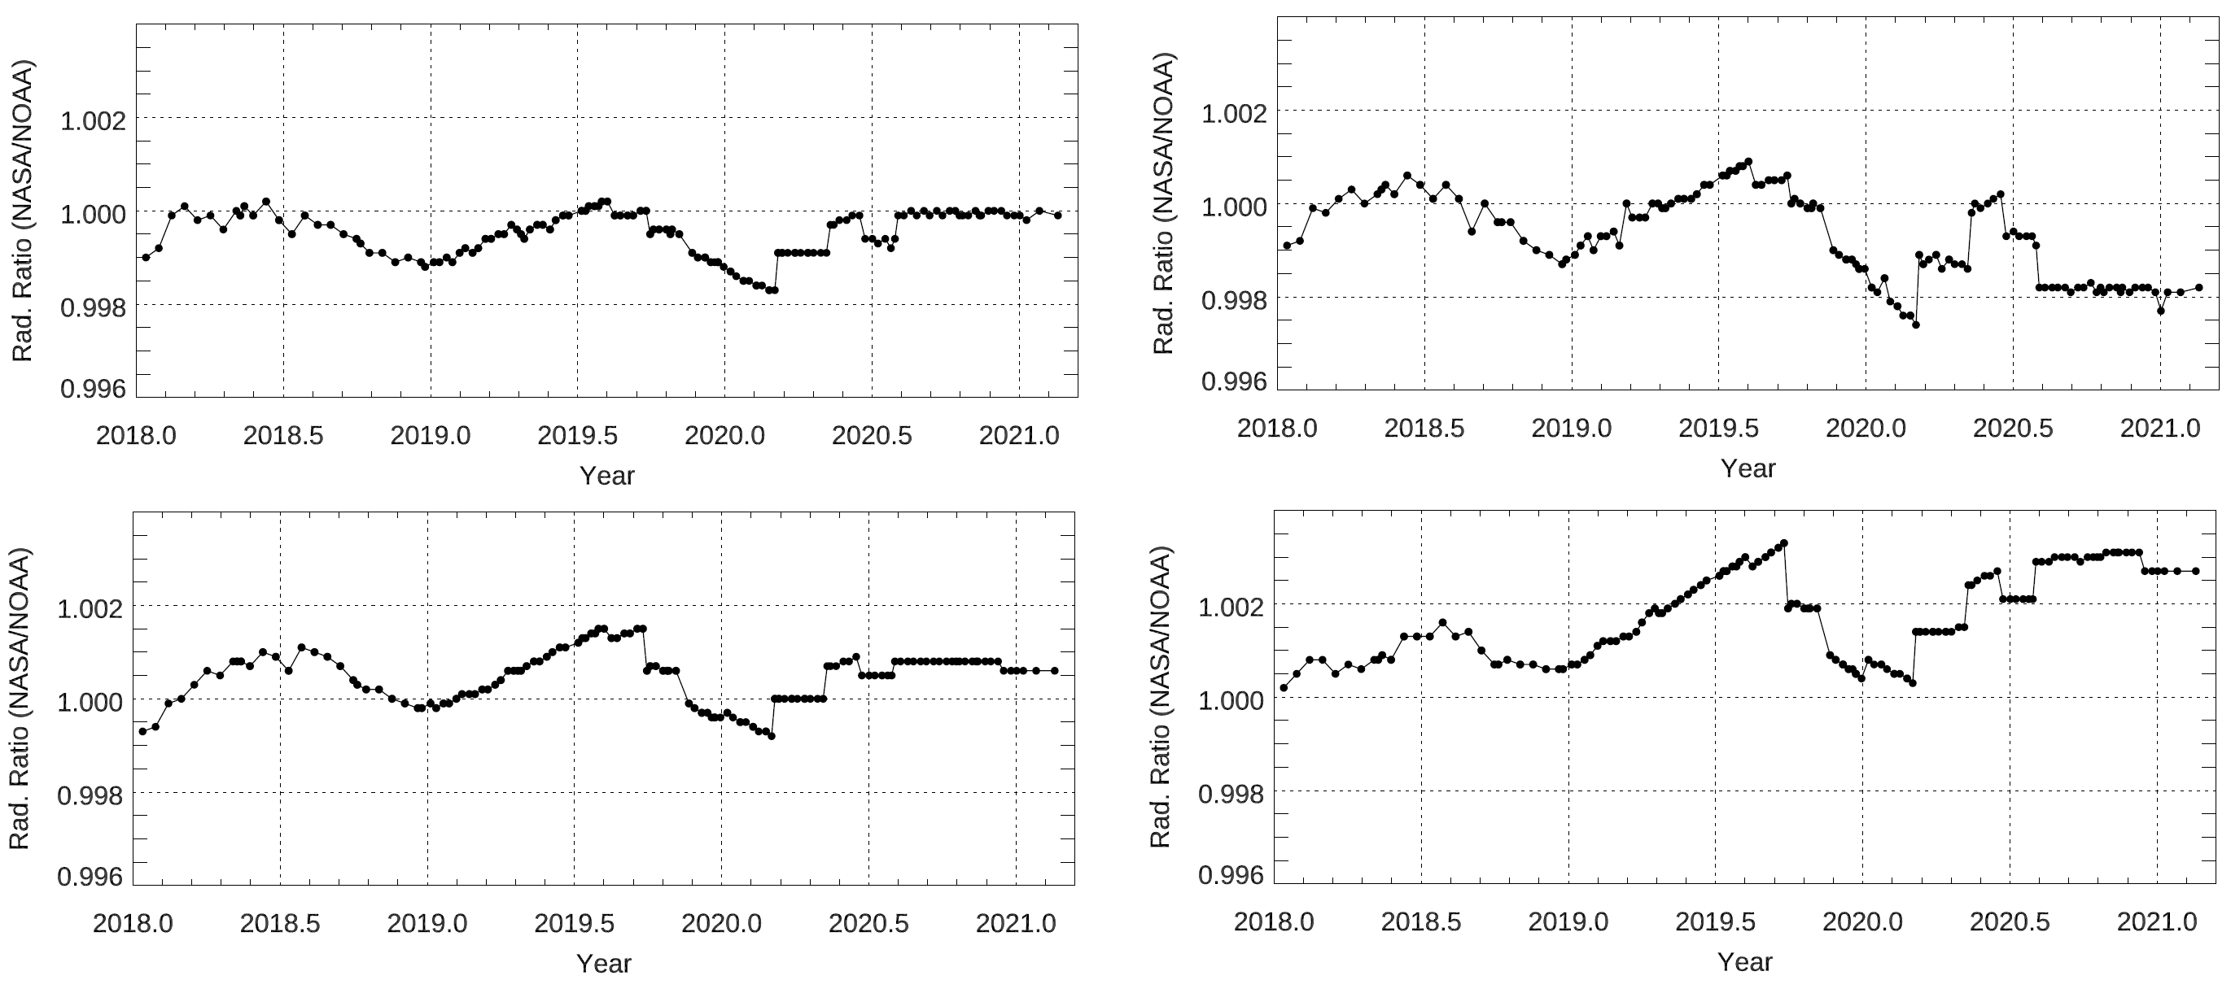
Comparing NOAA and NASA VIIRS Radiance (SWIR Bands)
M8
M9
M10
M11
SWIR bands between NOAA and NASA agree to within 0.2%.
Unlike VISNIR bands,
Oscillations appear in the ratio trending for all SWIR bands except I3.
multiple discontinuities observed in the trend (Due to NASA cal. updates).

