Slide 1
Research on UV solar reference spectrum based on MgII index for FY-3/OMS calibration
Li Yuan¹, Pei Guochao², Bai Tingzhu²
¹National Satellite Meteorological Center, CMA, China
²Beijing University of Technology, China
CMA, CNES, ESA, EUMETSAT, ISRO, IMD, JMA, KMA, NASA, NIST, NOAA, ROSHYDROMET, SITP/CAS, USGS, WMO
GSICS UVNS Spectrometer Subgroup Meeting, 1 April 2021, 12:00-15:00 GMT

Slide 2
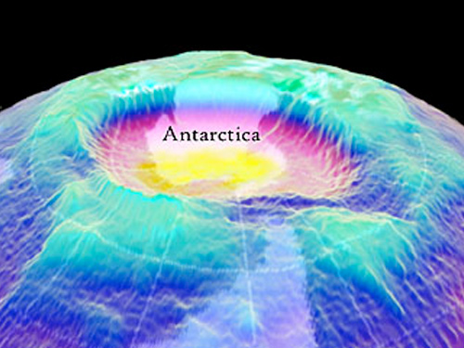
Basic information of FY-3F/OMS
FY-3F
Ozone Monitoring Suite (OMS)
Full name | Feng-Yun 3F
Satellite Description | operational meteorology
Orbit | Sunsynchronous orbit | Altitude | 836 km
Launch | ≥2022 | EOL | ≥2027
ECT | 10:00 desc
Payloads | OMS-Nadir |  | OMS-Limb
Manufacturer | CSSAR, CAS |  | CIOFMP, CAS
Purpose | Nadir Total amount | Nadir Profile | Limb Profile
Spectral range (nm) | 320-500 | UV1：250-310 UV2：300-320 | 290-500
Spectral resolution (nm) | 0.5-0.6 | UV1：~1.0 UV2：~0.5 | 0.6
Spatial resolution (km) | 7(Al.)×7(Ac.) | UV1: 21(Al.)×28 (Ac.) UV2: 7(Al.)×7 (Ac.) | ≤3@15-60km (Vertical), ≤150(Horizontal)
FOV | FOV: 112º | FOV: 112º | IFOV: 2.3º (Horizontal)×0.045º (Vertical)

Slide 3
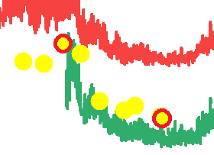
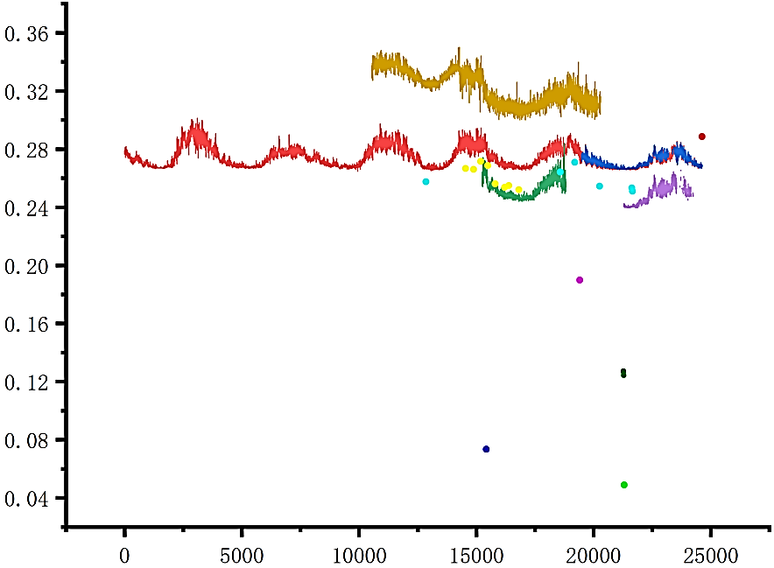
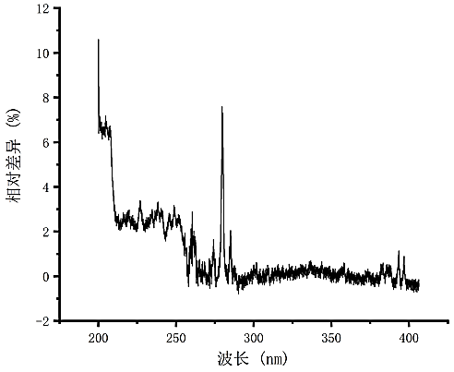
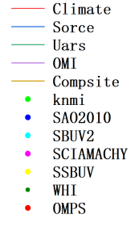
Why we need solar reference spectrum (SRS) for OMS in-orbit calibration
Differences between SRSs
The solar radiation changes obviously in the UV band
Temporal MgII Index by extremum method from 1950-1-1 to to 2016-6-17
The relative difference between the spectral radiation values of SSBUV in the 3rd and 8th flight times

Slide 4
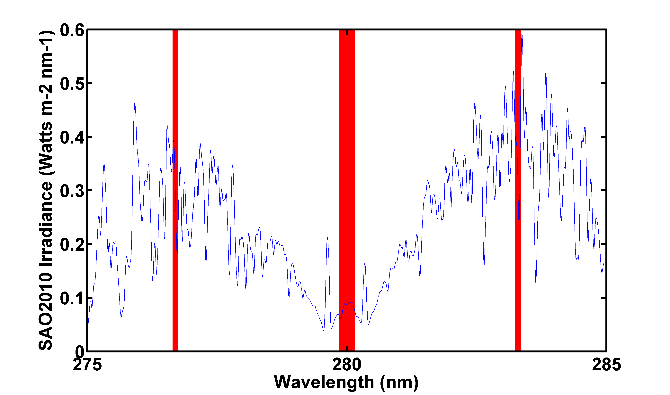
About MgII index
The MgII core-to-wing index was first developed for the Nimbus 7 SBUV as an indicator of solar UV flux temporal variation.
${Irr}_{c}$:279.7-280.3nm
${Irr}_{w1}$:276.6-276.8nm
${Irr}_{w2}$:283.2-283.4nm
Extremum method: Max(${Irr}_{w1}$), Max(${Irr}_{w2}$), Min(${Irr}_{c}$)
Integral method: Mean(${Irr}_{w1}$), Mean(${Irr}_{w2}$), Mean (${Irr}_{c}$)
$${Irr}_{w1}$$
$${Irr}_{w2}$$
$$MgII=\frac{2∗{Irr}_{c}}{{Irr}_{w1}+{Irr}_{w2}}$$
$${Irr}_{c}$$
SAO2010 spectra at 280 nm

Slide 5
Solar reference spectrum used
SRS | Wave(nm) | Resolution(nm) | Sampling(nm) | Date
OMI | 270-550 | 0.45-0.65 | 0.15-0.32 | 2008.04.15-2017.08.02
OMPS | 248-310 | 1 | 0.42 | 2017.06.04
UARS | 119.5-419.5 | 0.2-0.25 | 1 | 1991.10.03-2001.7.20
SCIAMACHY | 234-2383 | 0.24-1.1 | 0.2-1.3 | 2003.02.27
SORCE | 0-2400 | 7，1，0.25-0.33 | 0.25-0.35 | 2003.03.01-2017.06.17
SBUV/2 | 170-400 | — | 0.15 | 2000.11.10(8)
SSBUV | 200-406 | 1.1 | 0.15-0.2 | 1989.10-1996.01(8)
KNMI | 202.0-599.99 | 0.025 | 0.01 | 2008.06
SAO2010 | 200-1000 | 0.04 | 0.01 | 1992.03.29
WHI | 0.1-2400 | 0.1(UV)，1.5-30(VIS，IR) | 0.1 | 2008.04(3)
Climate | 115.5-749.5 | — | 1 | 1882.01.01-2016.12.31
Composite | 120.5-399.5 | 1 | 1 | 1978.11.08-2005.08.01

Slide 6
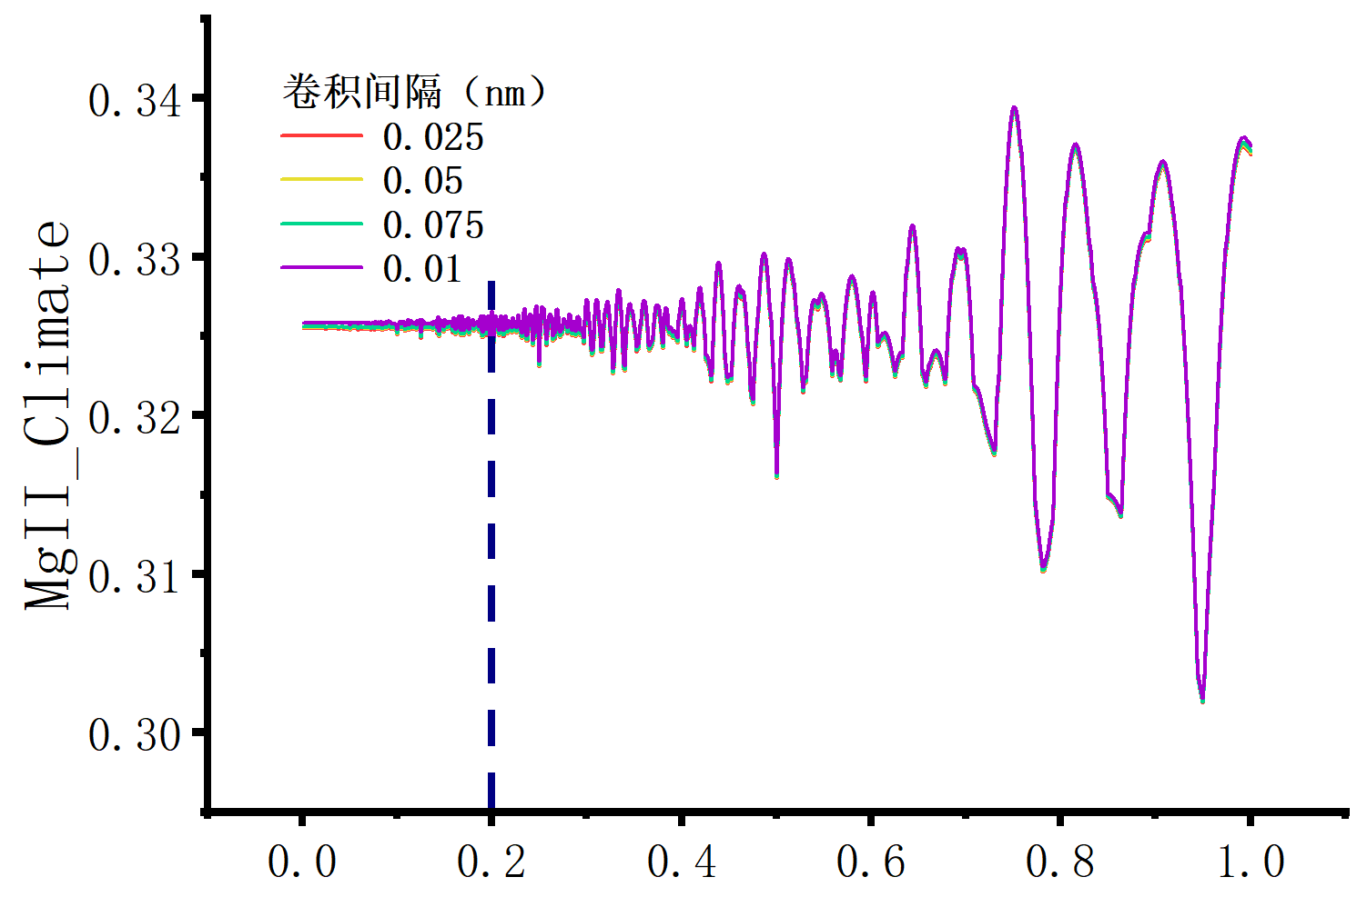
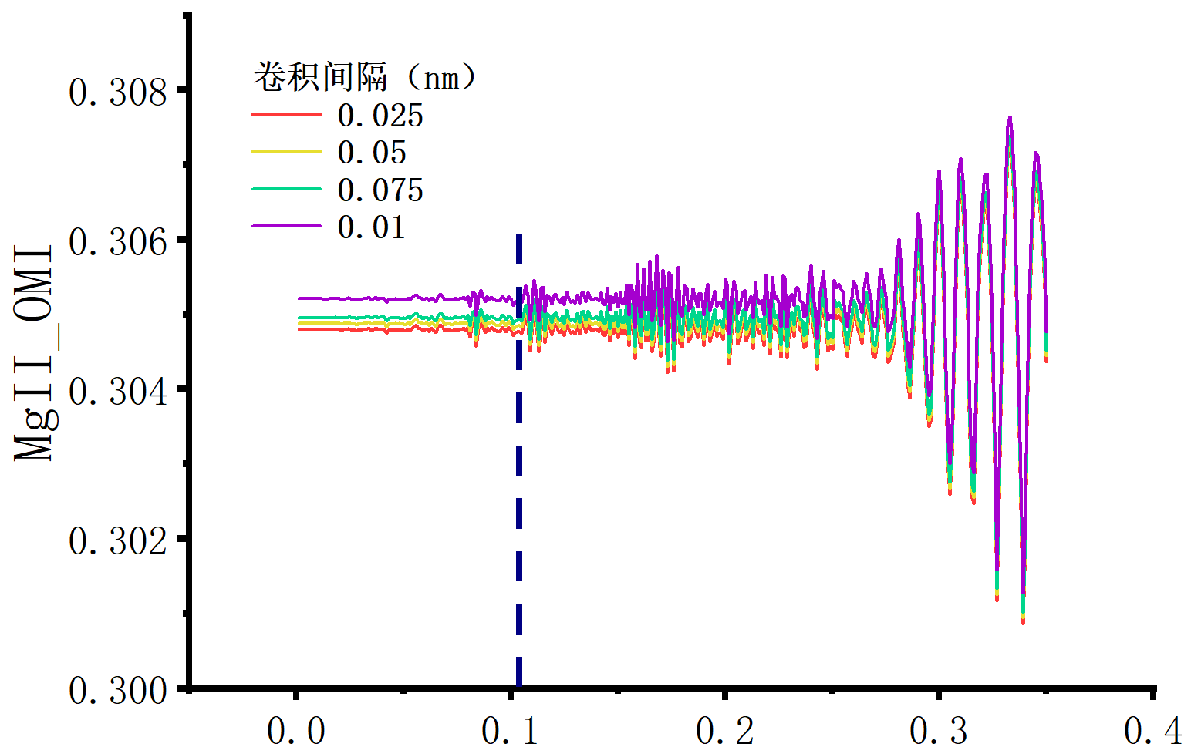
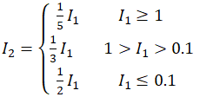
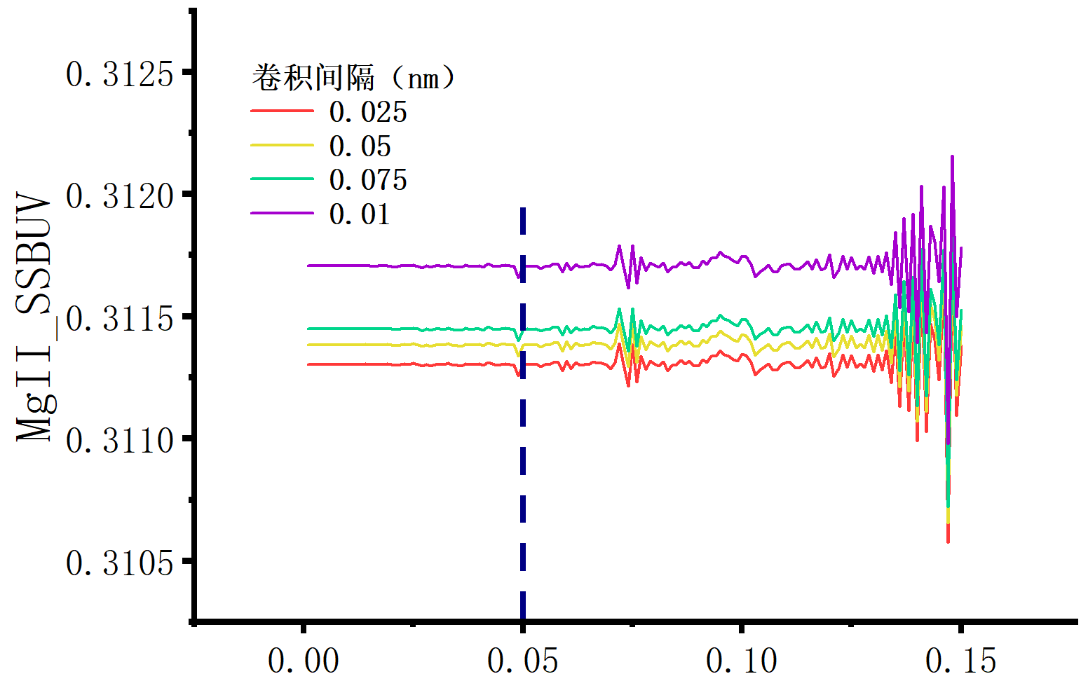
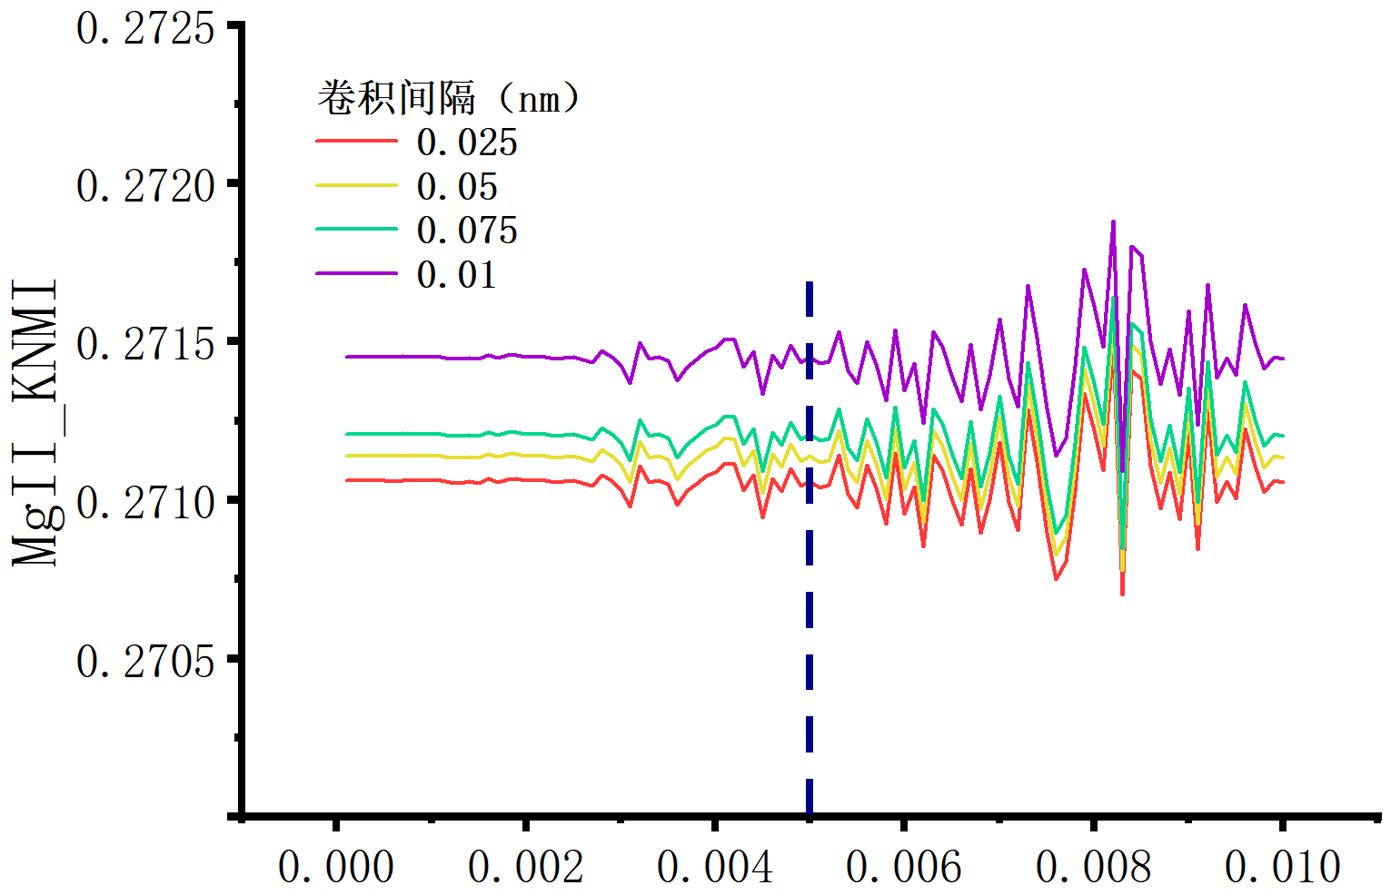
The influence of sampling and convolution intervals on MgII index
Even if the integral method was used, MgII index of high resolution and high sampling rate spectrum is still low.
The empirical formula of the best resampling rate for MgII was established.
I1 is the original sampling interval
I2 is the resampling interval.
The convolution intervals were all set to 0.1nm because the relative errors were similar (~0.024%)
Climate OS:1nm
OMI OS:0.35nm
SSBUV OS:0.15nm
KNMI OS:0.01nm
MgII index corresponding to different resampling (x axis) and convolution (color) intervals, OS: original sampling

Slide 7
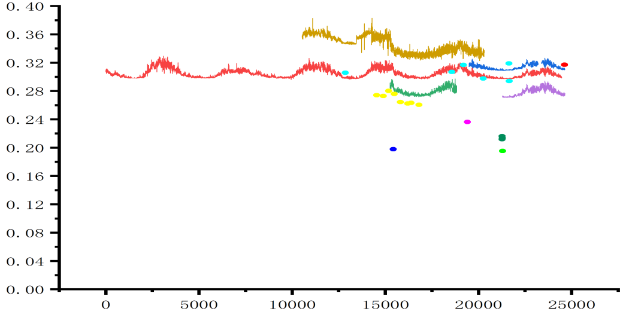
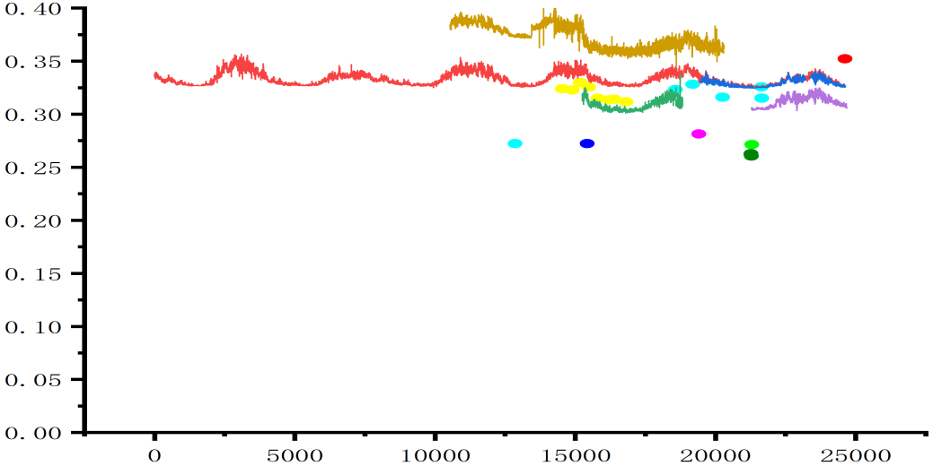
Extremum
Convolution
Resampling
 | Extremum | Convolution | Resampling convolution
Std | 0.0078 | 0.0025 | 0.0012
MgII comparison of different SRS, extremum method, convolution method and convolution method after resampling

Slide 8
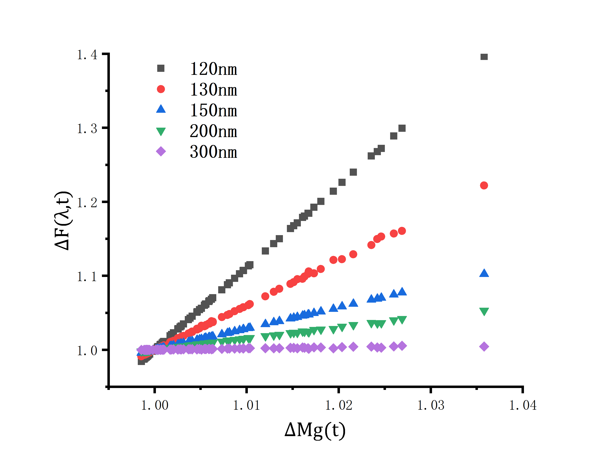
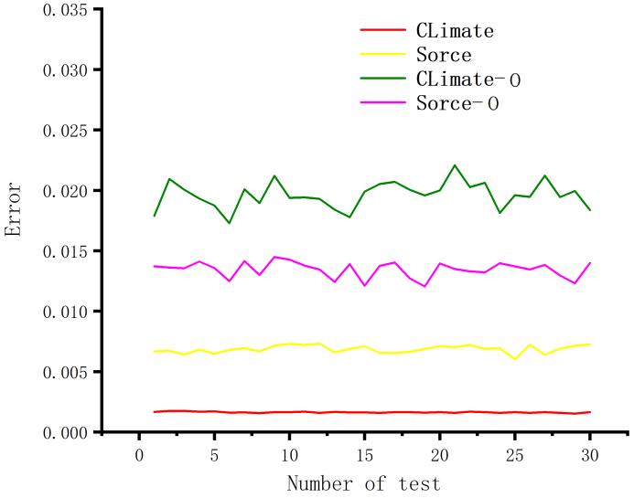
The algorithm of solar spectrum reconstruction
$F_{s}\left(λ\right)$ is conversion factor which do not affected by time
$$∆F\left(λ,t\right)=F_{s}\left(λ\right)∗∆Mg\left(t\right)$$
Based on the time variation at 280nm (MgII index), the solar spectrum at other wavelengths can be reconstructed.
$$∆F\left(λ,t\right)=k\left(λ\right)∗∆Mg\left(t\right)+b\left(λ\right)$$
Comparison of spectral reconstruction errors between original (O) and improved method of Climate(1.941% to 0.164%) and SORCE(1.427% to 0.677%) by randomly selected 30 groups of data.
Relationship between different wavelengths of Climate spectrum and MgII index

Slide 9
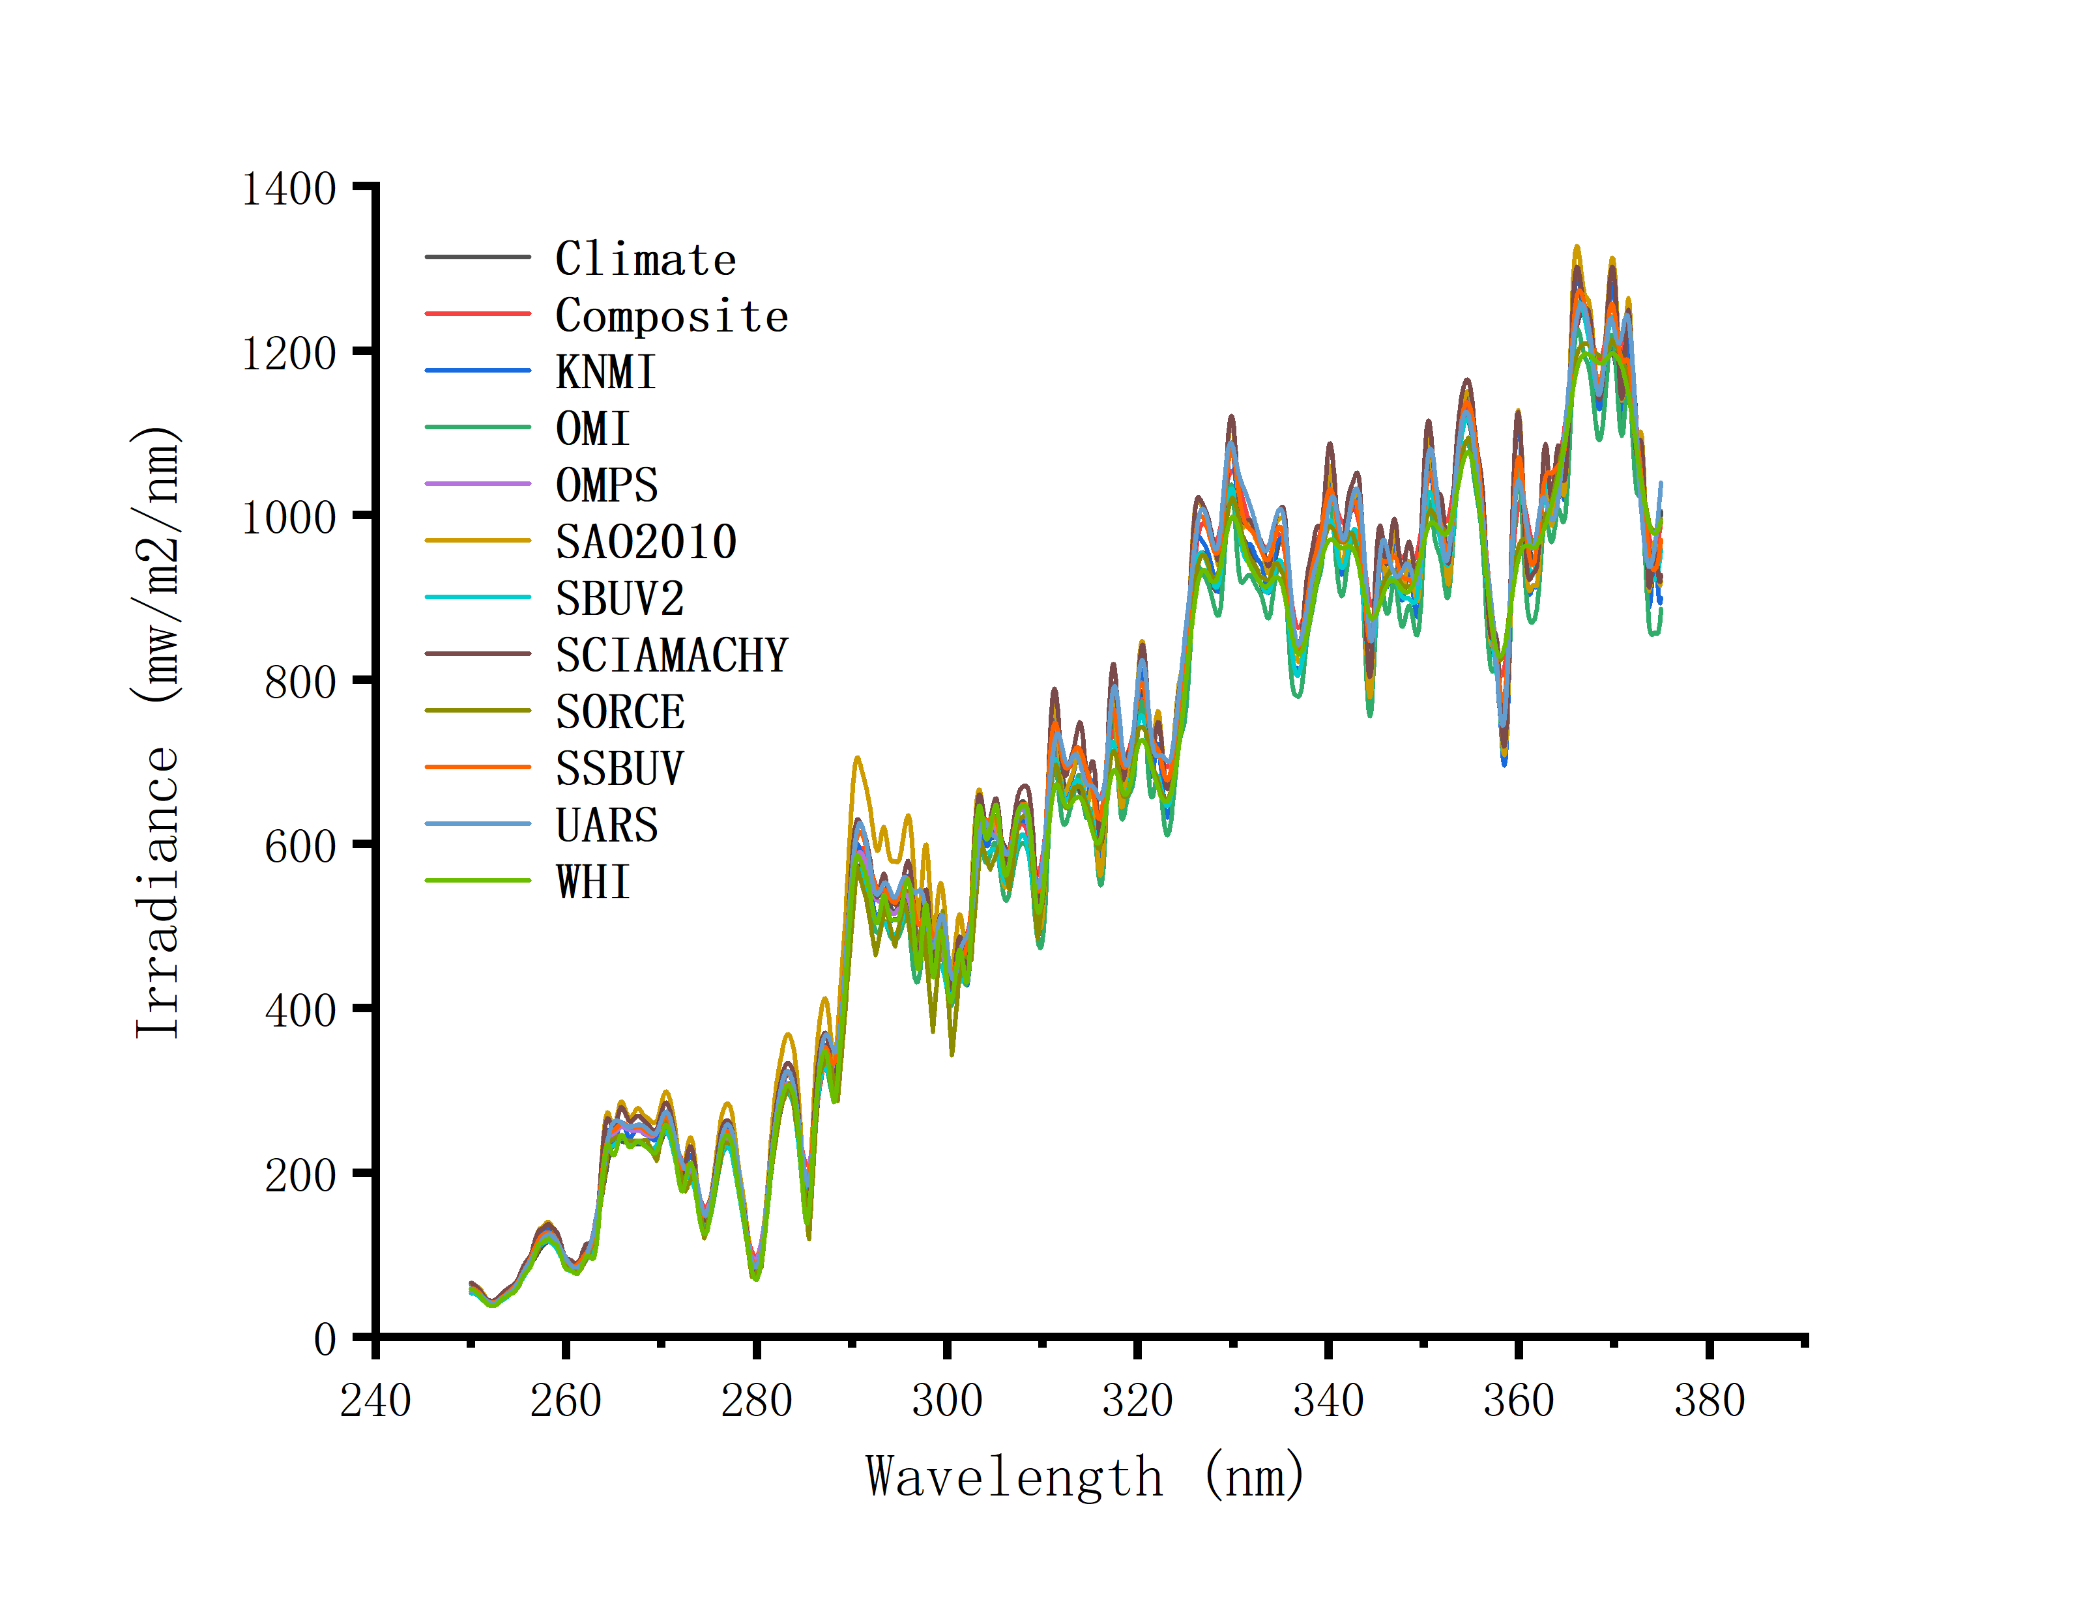
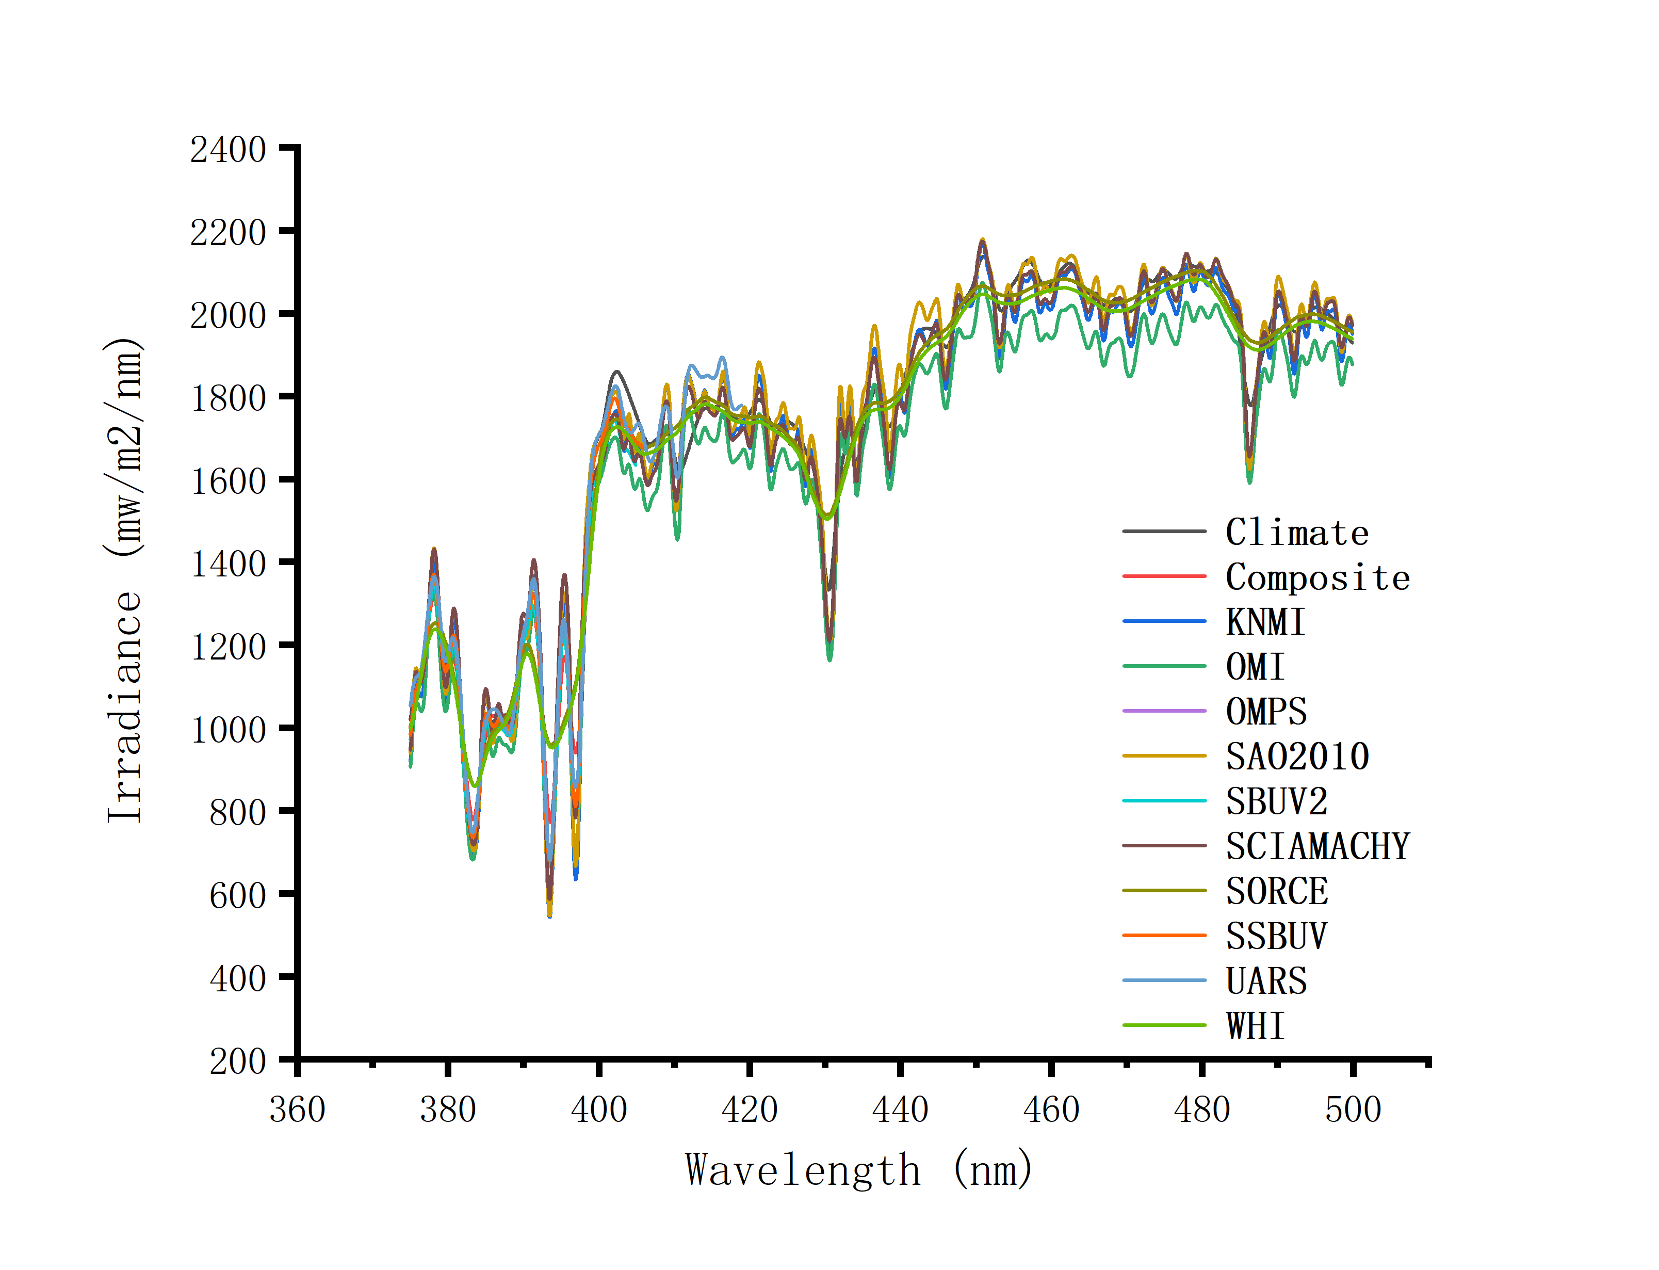
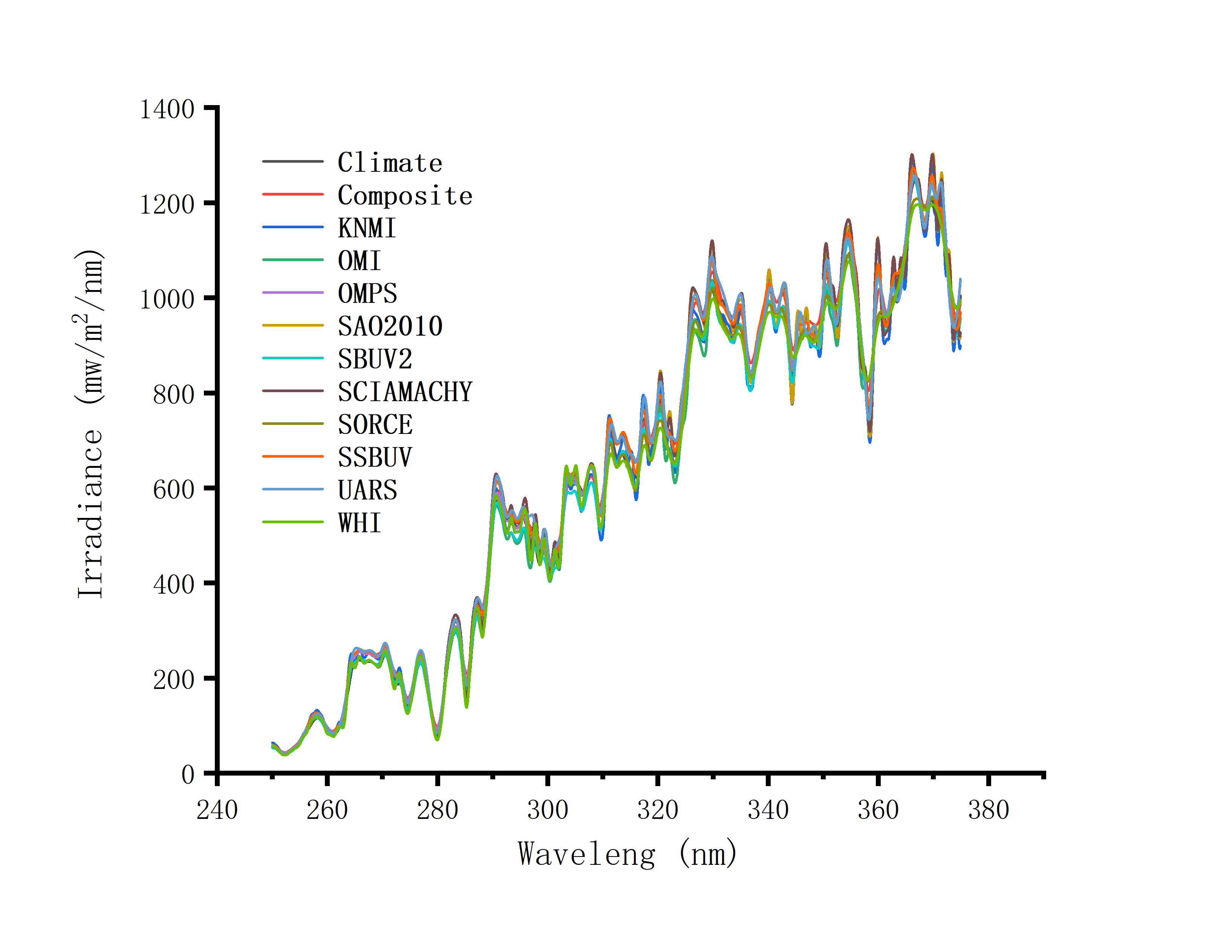
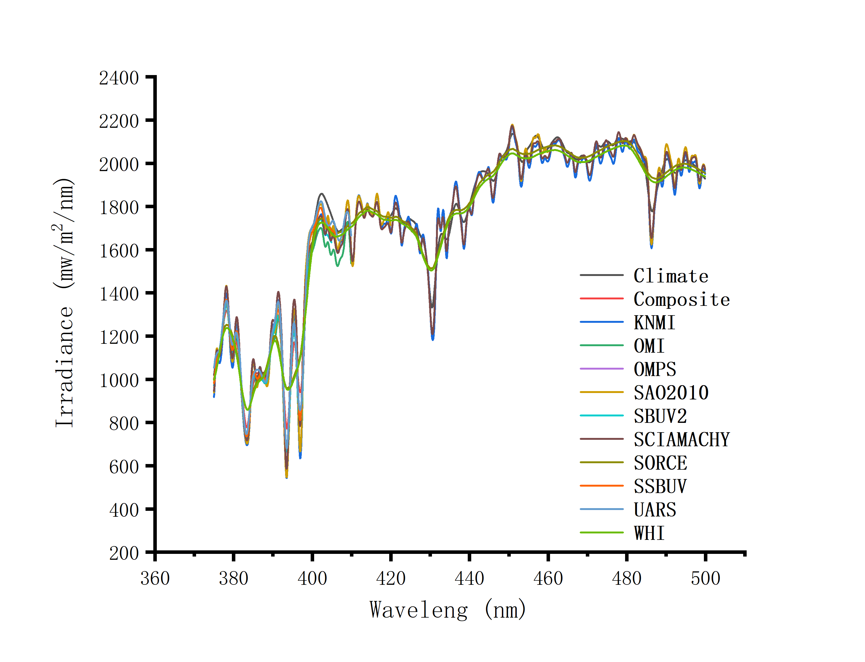
Calculation baseline SRS
The baseline SRS is obtained by averaging the selected SRS.
SRS was normalized to 2008/06/25 Using the improved reconstruction algorithm.
The spectral resolution was convoluted 0.04-1nm->1nm and the sampling rate is 0.1nm.
The spectrum with obvious deviation from the main body was removed by 10 nm interval.
There are 6 spectra that were not removed over the entire waveband, which are SBUV2, SSBUV, composite, climate, KNMI and OMPS.
Temporal ormalized SRS (2008/06/25) before (Std=2.814%, top) and after (Std= 2.139%, bottom) screening

Slide 10
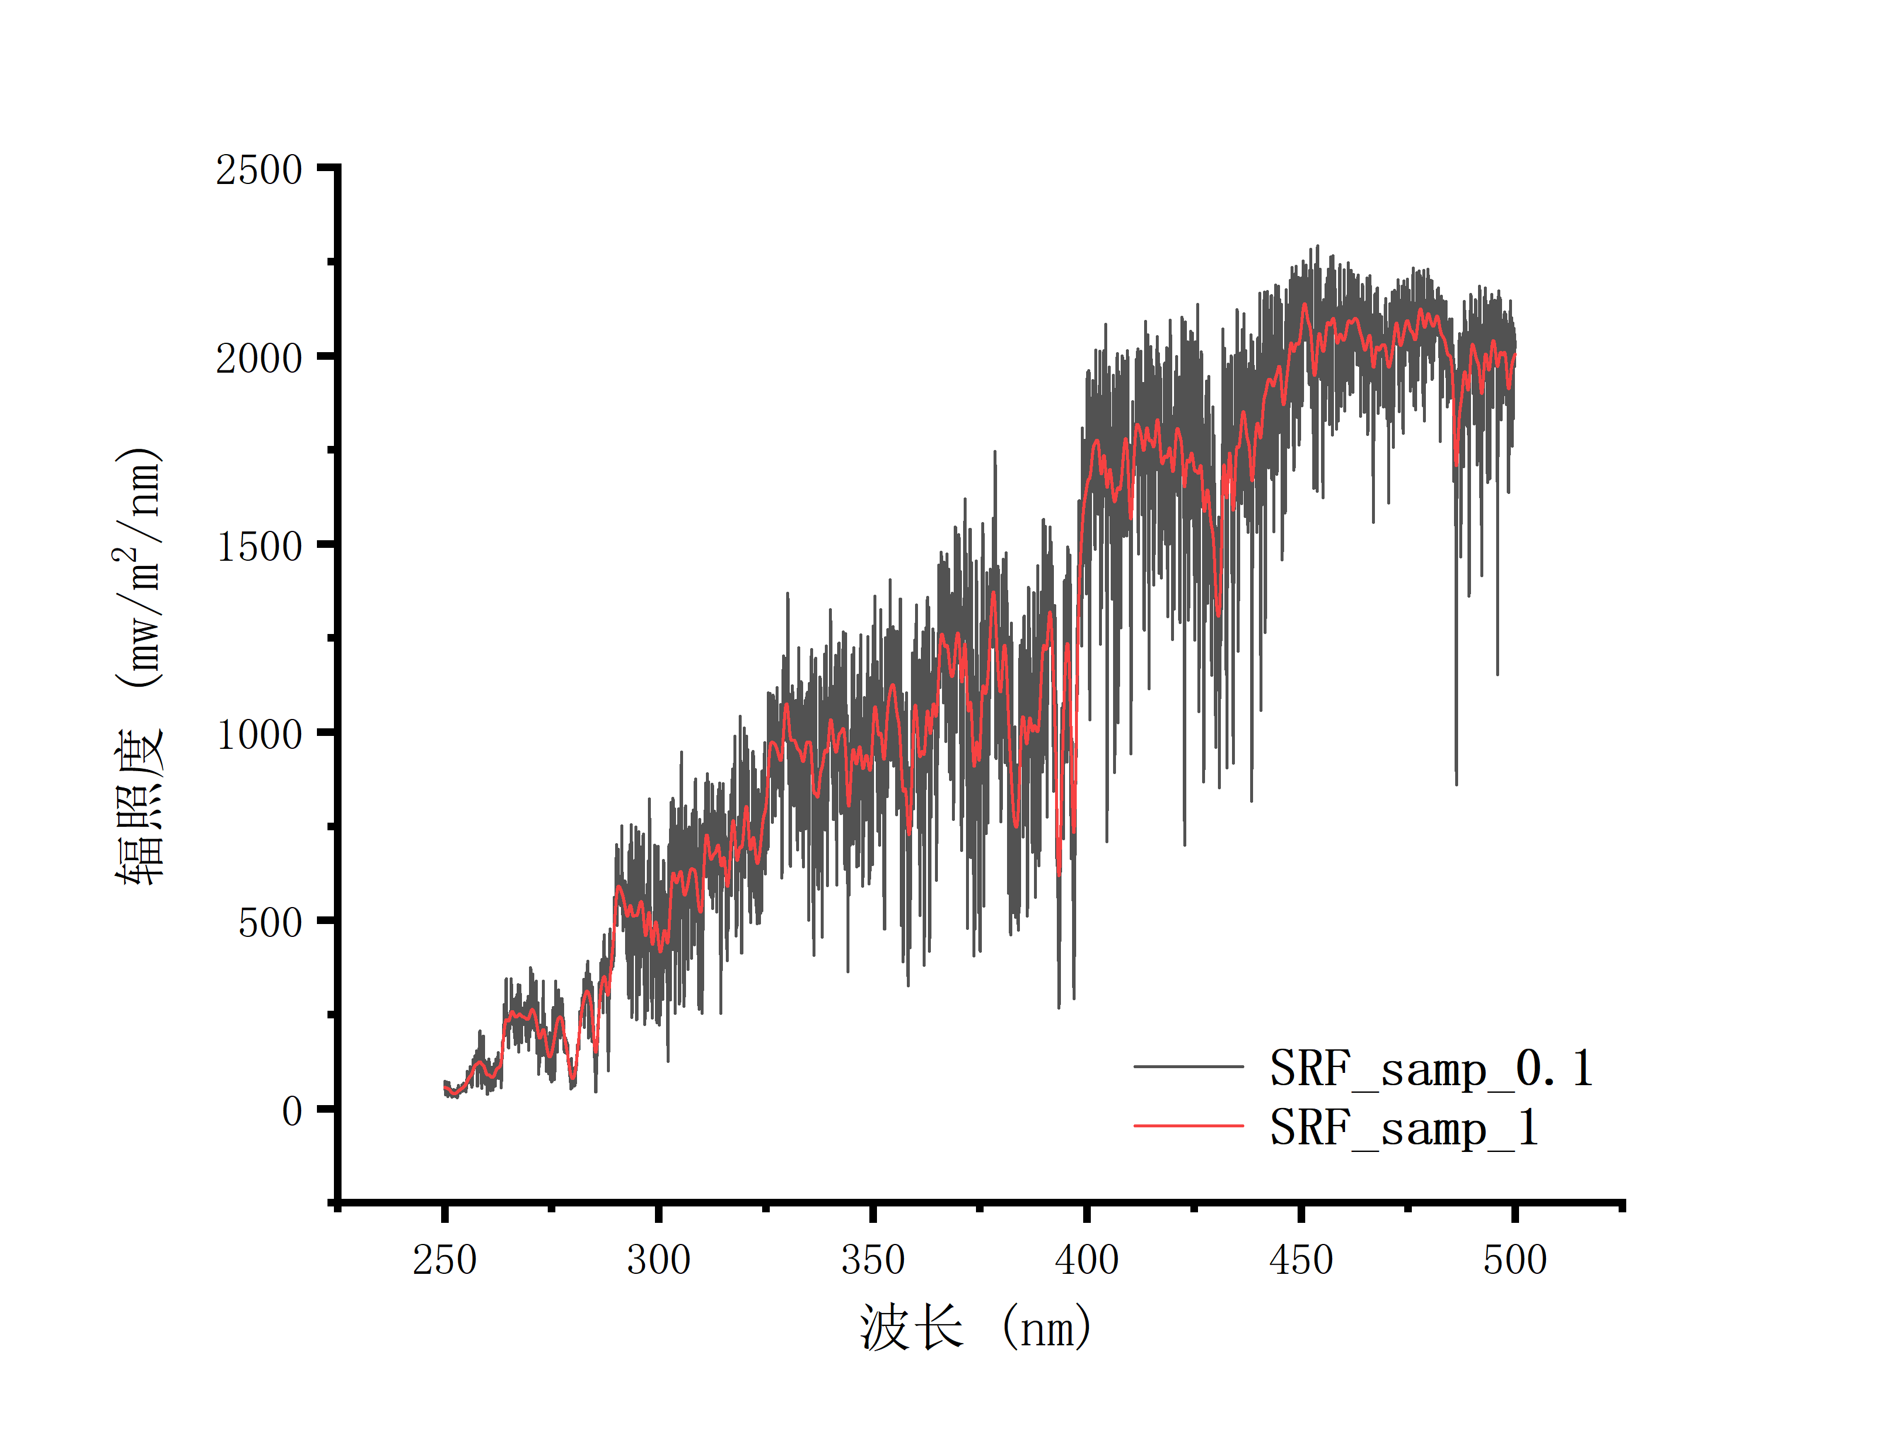
Improving spectral resolution of baseline SRS to meet the requirement of OMS
KNMI SRS has data on 2008/06/25, with spectral resolution of 0.025nm and sampling interval of 0.01nm. The resolution of baseline SRS was improved to 0.1nm resolution and 0.01nm sampling by proportional correction of KNMI SRS.
$${Irr_knmi}_{0.025}\underset{→}{△λ=1nm}{Irr_knmi}_{1}$$
□(〖𝐼𝑟𝑟_𝑘𝑛𝑚𝑖〗_0.025 →┴(△𝜆=1𝑛𝑚) )〖𝐼𝑟𝑟_𝑘𝑛𝑚𝑖〗_1
$${Irr_knmi}_{0.025}\underset{→}{△λ=0.1nm}{Irr_knmi}_{0.1}$$
□(〖𝐼𝑟𝑟_𝑘𝑛𝑚𝑖〗_0.025 →┴(△𝜆=0.1𝑛𝑚) )〖𝐼𝑟𝑟_𝑘𝑛𝑚𝑖〗_0.1
$${{Irr_knmi}_{1}}/{{Irr_base}_{1}}=R_{lowsamp}$$
〖𝐼𝑟𝑟_𝑘𝑛𝑚𝑖〗_1∕〖𝐼𝑟𝑟_𝑏𝑎𝑠𝑒〗_1 =𝑅_𝑙𝑜𝑤𝑠𝑎𝑚𝑝
$$Regrid\left(R_{lowsamp}\right)=R_{hisamp}$$
Regrid(𝑅_𝑙𝑜𝑤𝑠𝑎𝑚𝑝 )=𝑅_ℎ𝑖𝑠𝑎𝑚𝑝
$${{Irr_knmi}_{0.1}}/{R_{hisamp}}={Irr_base}_{0.1}$$
〖𝐼𝑟𝑟_𝑘𝑛𝑚𝑖〗_0.1∕𝑅_ℎ𝑖𝑠𝑎𝑚𝑝 =〖𝐼𝑟𝑟_𝑏𝑎𝑠𝑒〗_0.1
Baseline SRS (red) and upgrade baseline SRS (black) on 2008/06/25

Slide 11
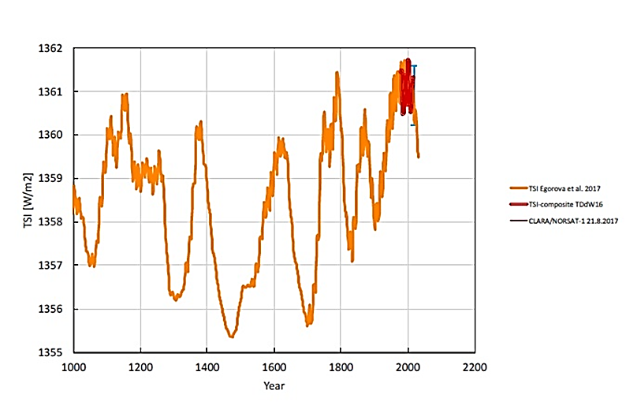
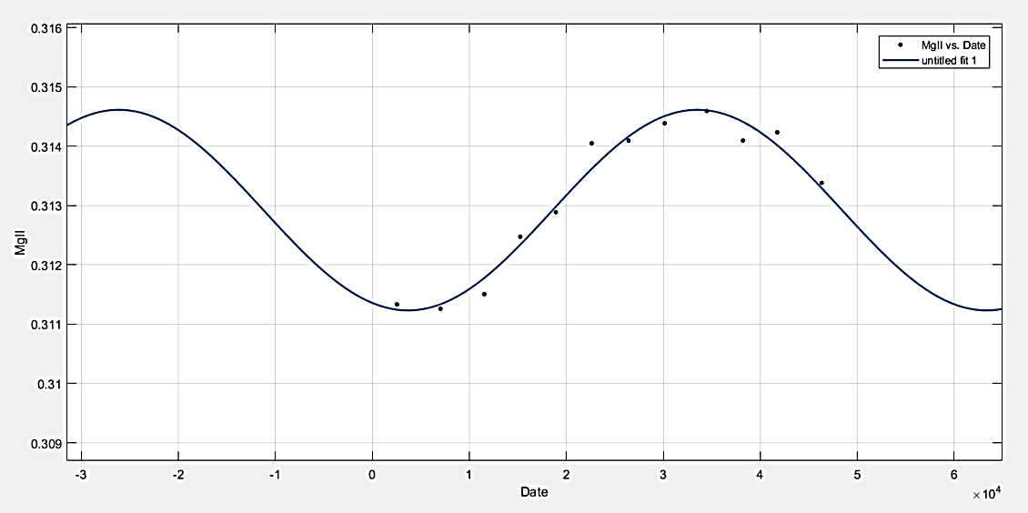
Prediction of MgII index changing with time
Separate fitting of principal component and high frequency component.
$$MgII={Mg}_{\text{principal}}+{Mg}_{\text{high}\text{_}\text{frequency}}$$
The principal component from 1882.1.1-2016.6.17 shows a slow solar cycle of about 150 years (left), which is consistent with the total solar irradiance simulation by Egorova 2018 (right)

Slide 12
R-square
of Fourier series function fitting
Term | R-square | Term | R-square
1 | 0.6149 | 5 | 0.6812
2 | 0.6451 | 6 | 0.6846
3 | 0.6412 | 7 | 0.7048
4 | 0.6693 | 8 | 0.7288
The high frequency component have no obvious regularity. When using function fitting, there will be outliers, which need to be constrained by the maximum and minimum limit.

Slide 13
The influence of solar activity on calibration accuracy
Generation of simulation spectrum
SORCE SRS (2003.03.01-2017.06.17) was used.
Spectrum + radiation shift were added artificially.
The updated baseline SRS (converted to corresponding date) and SAO2010 SRS (fixed date 1992.03.29, without time correction) were used to calibrate the simulated spectra at different solar activity days.
Compared with the time fixed SAO2010 SRS, the correlation coefficient can be increased by 2.4-3.2% after considering solar activity.
Different levels of solar activity
Correlation coefficient | Baseline | SAO2010
2009.4.24. | 0.9866 | 0.9575
2014.8.26 | 0.9861 | 0.9632
2015.8.11 | 0.9887 | 0.9646
Different seasons
Correlation coefficient | Baseline | SAO2010
2012.1.1 | 0.9832 | 0.9564
2012.4.1 | 0.9855 | 0.957
2012.7.1 | 0.9811 | 0.9506
2012.10.1 | 0.9824 | 0.9521

Slide 14
Publications related to the report
[1] Guo-chao Pei, Yuan Li*, Ting-zhu Bai. Temporal Variation Model of Ultraviolet Hyperspectral Solar Reference Spectrum[J]. Spectroscopy and Spectral Analysis, 2020,40(08):2332-2338. (in Chinese)
[2] Guo-chao Pei, Yuan Li*, Ting-zhu Bai, Li-hui Chen, "Research on prediction algorithm of solar activity base on MgII index for FY-3/OMS," Proc. SPIE 11566, AOPC 2020: Optical Spectroscopy and Imaging; and Biomedical Optics, 115660B (5 November 2020); https://doi.org/10.1117/12.2575958
[3] Guo-chao PEI. Research on Solar Reference Spectrum and UV Calibration Algorithm Based on MgII. M.S. thesis, Sch. Optics Photonics, BIT, Beijing, China,2020 (in Chinese)

Slide 15
Thank you for your attention
WMO GSICS Portal
http://gsics.wmo.int
GSICS Coordination Centre http://www.star.nesdis.noaa.gov/smcd/GCC/index.php
GSICS Product Catalog https://www.star.nesdis.noaa.gov/smcd/GCC/ProductCatalog.php
GSICS Wiki
http://gsics.atmos.umd.edu/wiki/Home

