Slide 1
VIS/NIR subgroup contribution to GRWG report
April 2, 2021

Slide 2
Key Activities & Achievements – VIS/NIR
Working with Odele Coddington (LASP) to recommend the TSIS-HSRS dataset as the GSICS VIS/NIR solar spectra
This was a GSICS initiated and promoted activity, started with first web meeting in December 2016
We had a productive discussion at the end of the VIS/NIR subgroup meeting and we will coordinate with the GSICS-UV group for final GSICS recommendation
To enable VIS/NIR radiance values to be consistent across reflectance based (solar diffuser) sensors
We will push to have the TSIS-HSRS widely adapted across the Earth remote sensing community, starting with CEOS
CLARREO PF (ISS 2023) and TRUTHS (launch 2026-2028) on-orbit VIS/NIR SI traceable sensors will soon provide an absolute calibration reference

Slide 3
Key Activities & Achievements – VIS/NIR
CERES Imager and Geostationary Calibration Group will work with other agencies to extend the DCC calibration ATBD to SWIR bands (needed for the next-generation GEO imagers)
DCC PDF inflection point stability in sparse sampling (Nicolas Lamquin)
N20-VIIRS is the next GSICS recommended on-orbit calibration reference for VIS/NIR bands
N20-VIIRS has very good on orbit stability and performance based on multiple assessments, including the Lunar observations
Calibration differences between the NASA and NOAA VIIRS datasets are very small (0.2%)
Band-specific radiometric scaling factors will be derived for the seamless transition from MODIS to VIIRS
See Winter 2021 GSICS quarterly newsletter
Rayleigh scattering calibration methodology proposed (Bertrand Fougnie, EUMETSAT)

Slide 4
Key Activities & Achievements – VIS/NIR
Lunar accomplishments
3rd GSICS/IVOS Lunar Calibration Workshop (virtual), 16-19 November 2020
Lunar model inter-comparison exercise started
Ongoing development of new lunar models, e.g. LIME, LESSSR

Slide 5
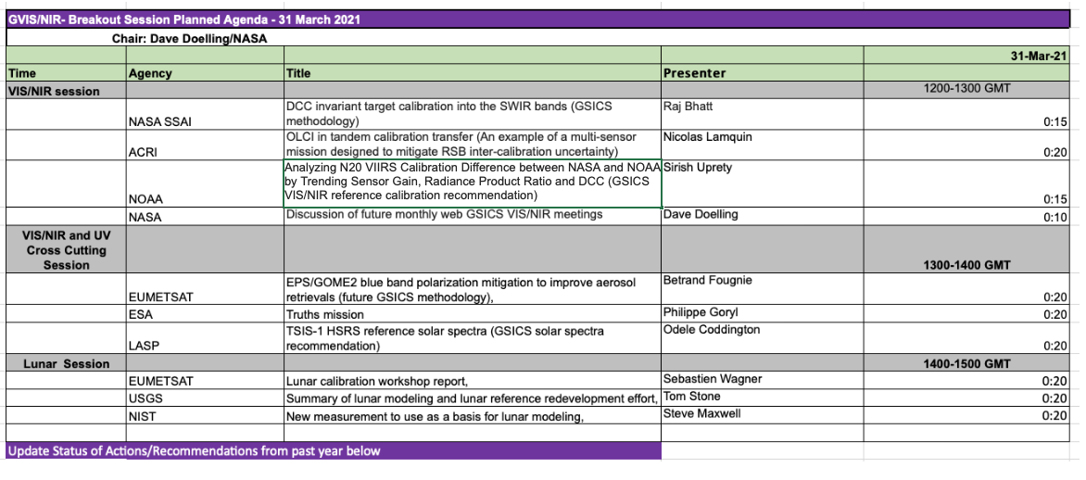

Slide 6
Plan to hold monthly VIS/NIR future web meetings
VIS/NIR group will have a monthly web meeting on a dedicated week of month
Day, week, and time will be finalized later after discussing with other group members.
Make sure we do not have the same day as another sub-group
If there are insufficient presentations in any month, the meeting can be cancelled.

Slide 7
Agency GSICS VIS/NIR presentations for future web meetings
Name | Agency | Title
Ling Sun | CMA | A Fengyun consistent VIRR calibration record for inheritable solar bands
Jing Wang | CMA | Pre-launch analysis of Rapid Scan Imager aboard FY-4B from TVAC test
Tae Hyeong OH | KMA | Lunar calibration of AMI visible channels using GIRO
Eunkyu KIM | KMA | AMI visible calibration results using MODIS and VIIRS
Jae-Hyun AHN | KMA | System vicarious calibration for the Geostationary Ocean Color Imager (GOCI)
Kazuki and Tanaka | JMA | DCC analysis for MTSAT-1R/2 to Himawari-8
Kodera Kazuki | JMA | Ray-matching analysis for Himawari-8
Vincent Leroy | Rayference | Eradiate, a 3D open-source radiative transfer model to support CalVal activities
Sindy Sterckx | VITO | The Belharmony approach for harmonization of PROBA-V, Landsat-8 and Sentinel-2 timeseries
Sindy Sterckx | VITO | Investigation into the impact of in-orbit temperature variation on the PROBA-V Vicarious Calibration Results
Ben Scarino | NASA | SBAF out of band tool feature

Slide 8
Future proposed VIS/NIR meetings
Follow up VIS/NIR meeting to allow presentations not presented at the annual meeting
Transitioning from Aqua-MODIS to N20-VIIRS
Agency-wise ray-matching methodology meeting to compile best practices
Rayleigh scattering methodology meeting joint with the UV group
DCC extension to the NIR and SWIR bands and DCC BRDFs
PICS or Earth invariant target (desert) calibration methodology to compile best practices
Journal paper on the DCC method and to promote DCC method from demonstration to operational mode

Slide 9
Future proposed VIS/NIR meetings
Lunar topics
results of the GSICS lunar model inter-comparison exercise
new lunar measurements and their comparisons to models
new lunar models development
lunar calibration results for Agency instruments (GEO, LEO group talks)
alternative uses of Moon imagery, e.g. MTF

Slide 10
Action Items

Slide 11
Action Items

Slide 12
Action Items

