Slide 1
EPS/GOME-2 PMD Radiometric Adjustment
over Rayleigh scattering
Soheila Jafariserajehlou and Bertrand Fougnie
Cloud and Aerosol Team
Remote Sensing and Products

Slide 2
Introduction
Space systems with/without their on-board calibration devices need validation, and regularly adjustment
Vicarious technics provide an intermediate step between the on-board system and the Earth observation
Many targets can be used. Rayleigh scattering (the deep blue sky) can be used for that. Mostly used over Open Ocean with very clear atmosphere.
  PARASOL: Fougnie et al., IEEE TGARS, 2016
  Sentinel-3: Fougnie et al. SPIE, 2016
The following work was not initially intended to be a calibration approach (and is still not).
The need was to describe the behaviour of the observation (especially with scan angle) to explain anomalies on the PMAp (EPS/GOME2) aerosol retrieval.
A reference signal from Rayleigh was used to investigate & understand the first order of the observed signal, then correct anomalies

Slide 3
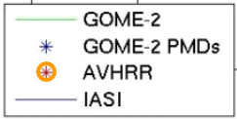
EPS sensors – creating a hyper-instrument
PMAp : Polar Multi-sensor Aerosol product from GOME-2, AVHRR and IASI
EPS : Polar orbit at 09:30 ECT – A/2006, B/2012, C/2018
3 redundant platform/instrument → 25 y. of operation
GOME-2, AVHRR, IASI
Spatial sampling
co-location
Combined Spectral information
TOA Radiance at 40 by 80 km²
(GOME-2) resolution
IASI spot AVHRR pixel
into the GOME footprint
AVHRR : 5 channels
1 km² resolution
  Product = AOD @550nm +
  aerosol type classification
  Fully operational product
  since Oct’14 (over ocean)
  Version 2 since Feb’17 (ocean & land)
  Version 2.2 released soon
IASI : ~8000 channels
12 km resolution
GOME-2 : ~4000 channels
GOME-2 PMDs :15 channels
40x10 km² resolution

Slide 4
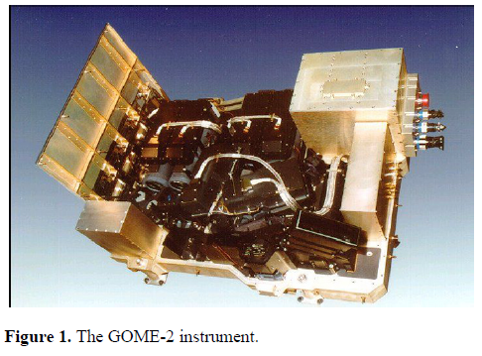
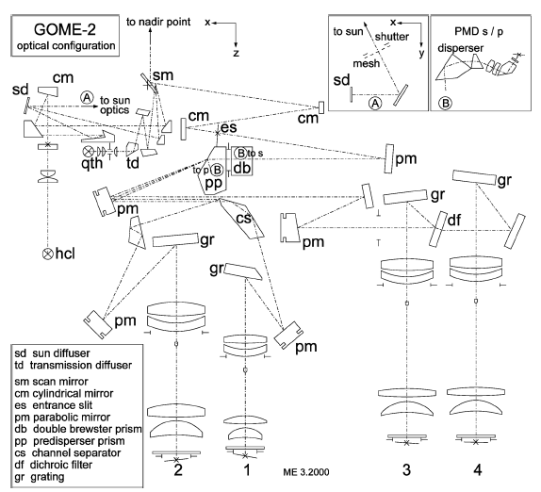
EPS sensors – GOME2
GOME-2 : Global Ozone monitoring Experiment 2
Across-track scanner A (5x40km², 960km) B/C (10x40km², 1920km)
Optical system sensitive to polarisation
PMD bands to measure –P/-S polarisation for 15 bands in 312-709nm
Earth
PMD
Detectors
From Munro et al., Atmos. Meas. Tech., 9, 1279–1301, 2016

Slide 5
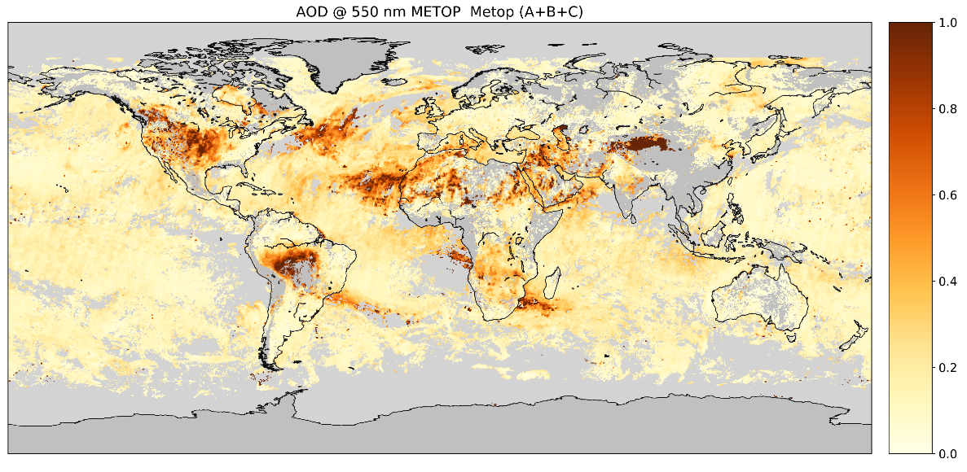
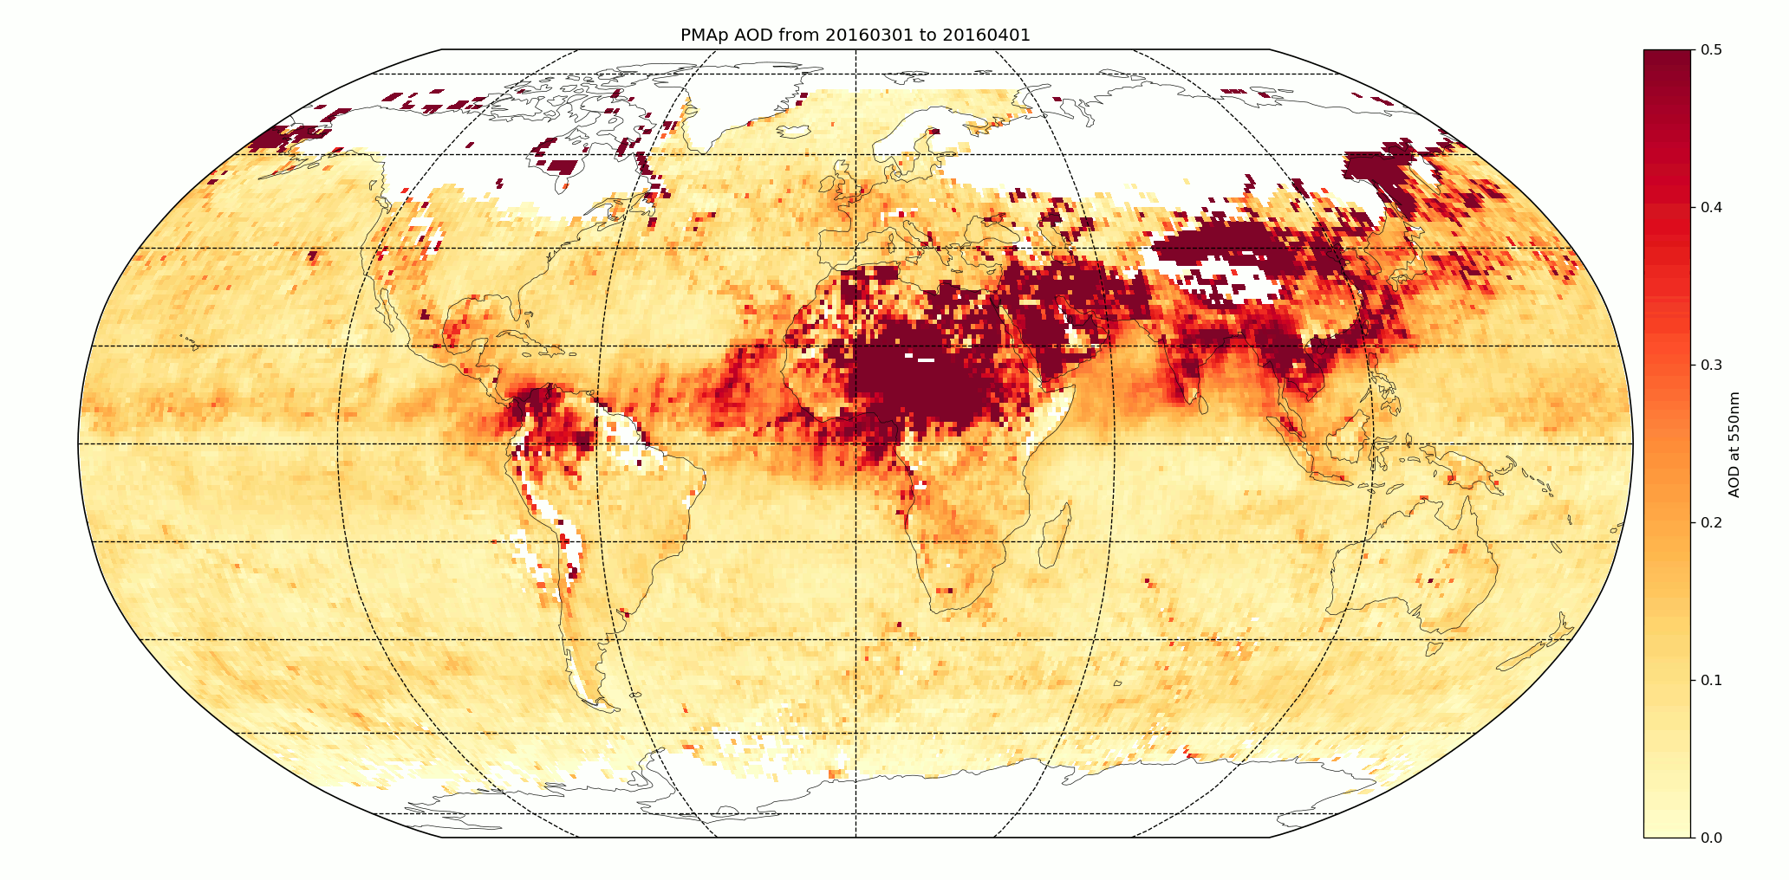
The PMAp aerosol product
PMAp AOD @550 nm, Metop (A+B+C)
17.09.2020-21.09.2020
California fire plume and transport across the Atlantic
PMAp // MODIS – March 2016
Amazon fire plume
Saharan dust and transport across the Atlantic
PMAp 2.2c
PMAp Aerosol Class, Metop (A+B+C)
No class
Ash cont. cloud
Aer. cont. cloud
Coarse
Vol. Ash S0₂
Vol. Ash
Dust
Biomass
Fine

Slide 6
Methodology
Artefacts on L2 retrieval
  High number of negative/null AOD
  Excessive cross-track East/West variation of AOD
  Differences between the 3 MetOps
  Mostly visible over lands (importance of blue bands on the retrieval)
Interpret and understand the L2 anomalies
Be sure the L1 TOA input signal is understood
  The observed variation (e.g. cross-track variation)
  The associated geometry
  The main contributors and their proportions
  The qualitative behaviour → why we started to have a look on Rayleigh
  The quantitative behaviour → why we developed a radiometric adjustment
Adjustment then testing of the improvement on L2 AOD

Slide 7
Construction of a reference signal
Calculation of a “CLEAR-SKY” reference signal including
  The Rayleigh contribution: theoretically accurate (ISRF and Pressure)
  The surface contribution: use of the GOME2 LER surface reflectance database (directional)
  Using the exact geometry of acquisition (sun and view angles)
Computation using 6S
  Uses the Successive Order of Scattering calculation which includes polarisation (vectorial calculation very accurate)
  Include the coupling with the surface signal (but no polarisation)
  Very easy to use with Py6S
1/ Direct comparison Observed / Simulated
2/ Statistical approach: Collect N days of measurements
  For now N=1 day
  Detected clear observations
  Minimize surface : surface reflectance from LER is < threshold
  Value of 0.035 at 410nm was used as initial value - Could reduce a bit more the value, but no obvious limitation

Slide 8
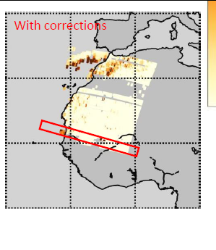
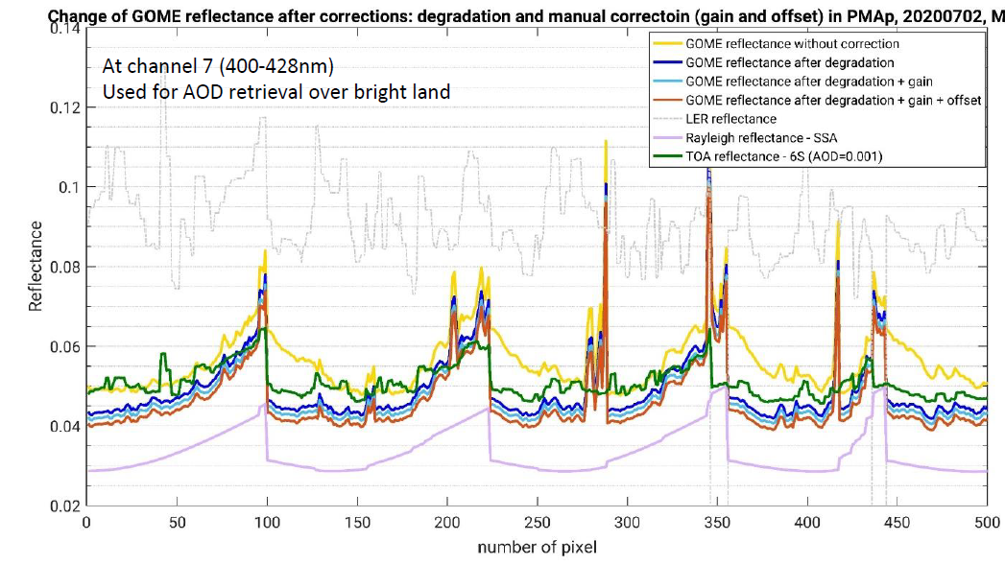
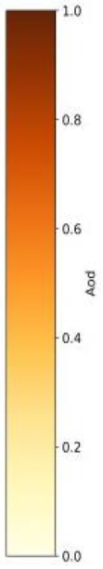
Understand the observed signal
1/ Direct comparison
GOME2 measurements < Clear-sky reference
Large portion of
Null AOD

Slide 9
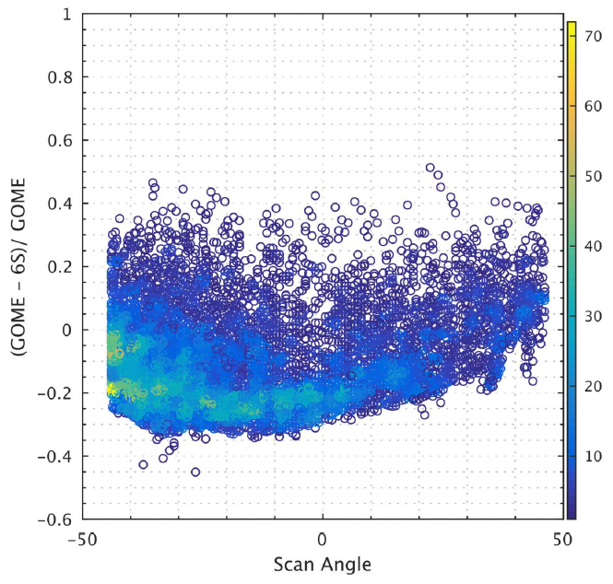
Interpreting the result
2/ Statistical approach: Relative difference (GOME2 - 6S)
Rayleigh+Surface is expected to provide a “minimum” limit
Any atmospheric turbidity = in general increase of signal
Uncertainty on surface = in general noise
Relative difference (OBS – SIM)
as a function of
Scan angle
Dispersion where
Aerosol > 0
Ch7-410nm
Minimum average limit for which
Surface ~ LER
Aerosol ~ 0
This is the Rayleigh asymptote
(surface & aerosol ~0)
Dispersion where
Surface ≠ LER
Aerosol ~ 0

Slide 10
2/ Statistical approach: Relative difference (GOME2 - 6S)
Very high proportion of Rayleigh 85-90%
Relative difference (OBS – SIM)
Ch7-410nm
as a function of
Scan angle
as a function of
%Rayleigh

Slide 11
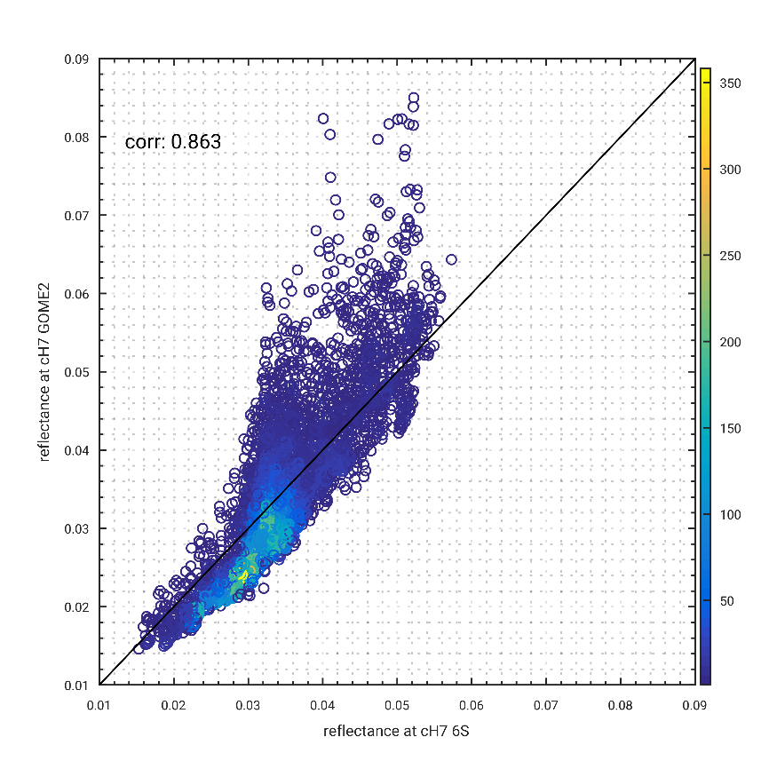
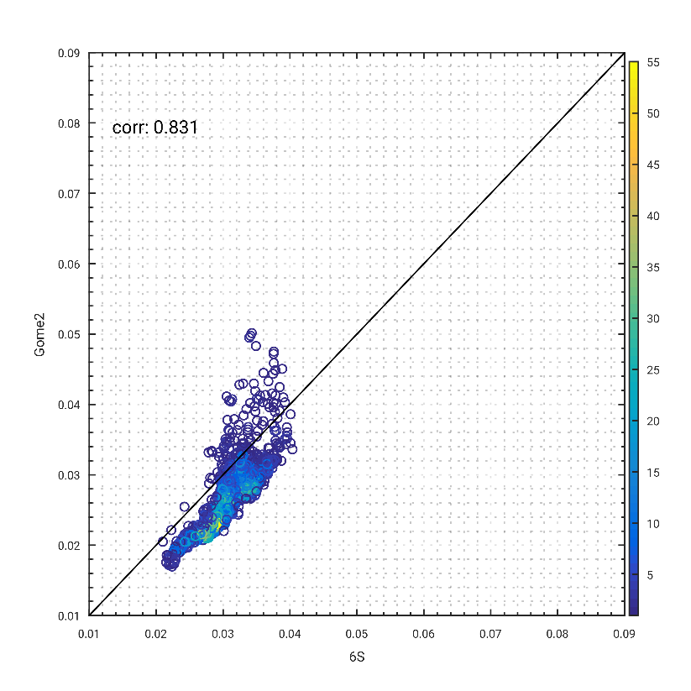
Filtering of the “turbid” observations
Any deviation wrt “pure Rayleigh polarisation” = atmospheric turbidity
Use of polarisation ratio q=Q/I from PMD bands
Different values tested: |q| < 0.015
Tests with q and Ip
Raw data After screening
Ch7-410nm

Slide 12
Radiometric adjustment
Tests with linear regression: Offset + Slope
Mostly offset influences significantly the cross-track anomaly (the smile)
Relative difference (OBS – SIM)
as a function of Scan angle
Ch7-410nm
Initial
+ Slope
+ Slope and Offset
→ Vertical shift
Vertical shift
And reduced smile

Slide 13
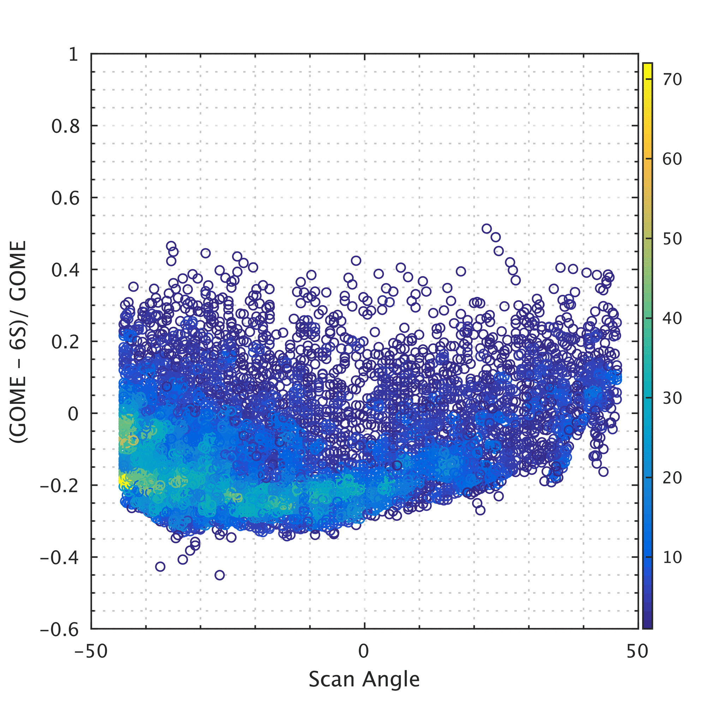
Radiometric adjustment
Tests with linear regression: Offset + Slope
Mostly offset influences significantly the cross-track anomaly (the smile)
Ch7-410nm
Relative difference (OBS – SIM)
as a function of Scan angle
Successive reduction of the “smile” by addition of an Offset

Slide 14
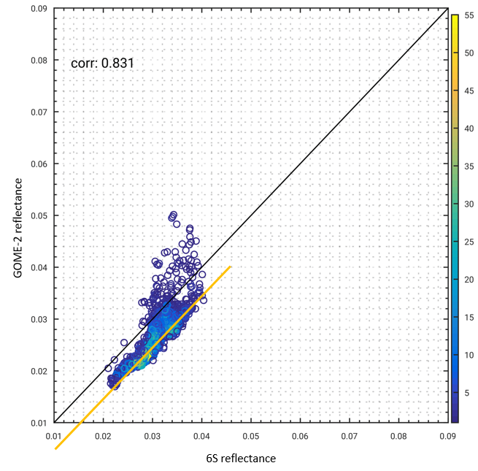
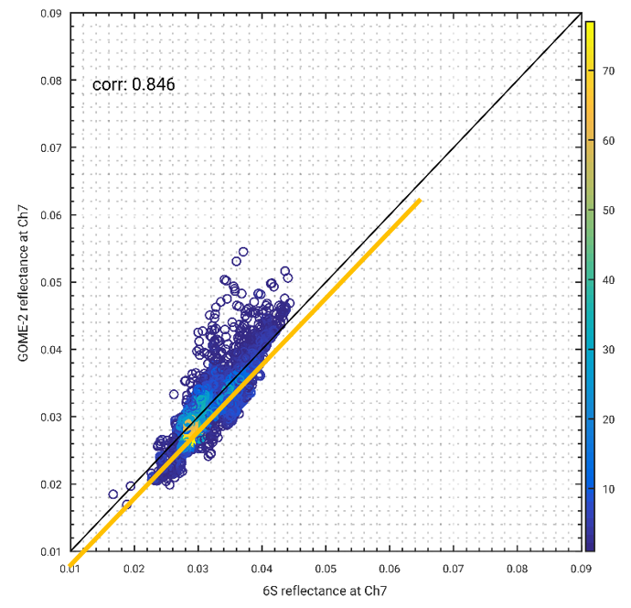
Radiometric adjustment
Done with linear regression: Offset + Slope
For GOME2 slope is assumed to remain equal to 1.0
Only offset is adjusted
  slope doesn’t influence significantly the cross-track anomaly
Ch7 – 410nm
MetOp-A (M02) MetOp-B (M01) MetOp-C (M03)

Slide 15

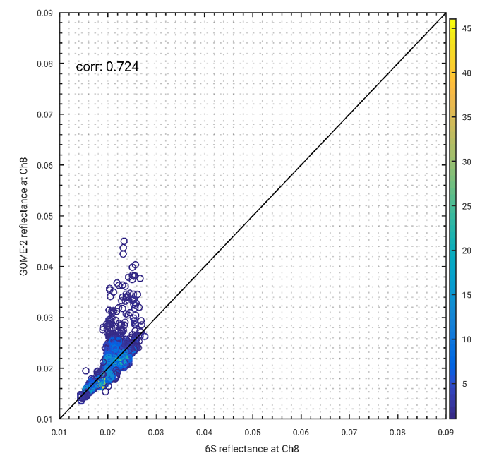
Adjustment of the offset
Metop-B (M01)
Same filtering applied to Ch8
Ch7-410nm Ch8-470nm

Slide 16
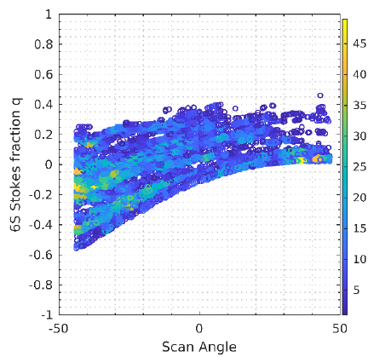
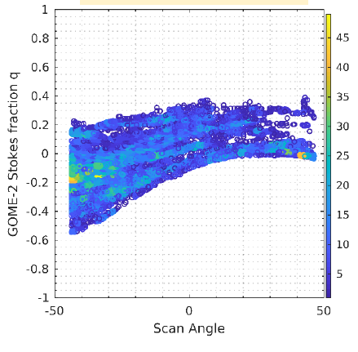
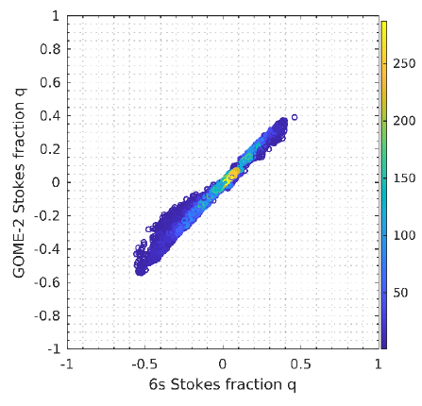
Potential for calibration of the polarisation
Stokes fraction q (=Q/I) is derived from 6S on the same matchups
  Excellent correlation with the GOME2 estimation
  Outliers probably correspond to turbid atmosphere: could try to filter
The observation in polarisation:
  Strongly reduces the influence of surface
  Enhance the contribution of Rayleigh scattering
Calculation
GOME2
Comparison

Slide 17
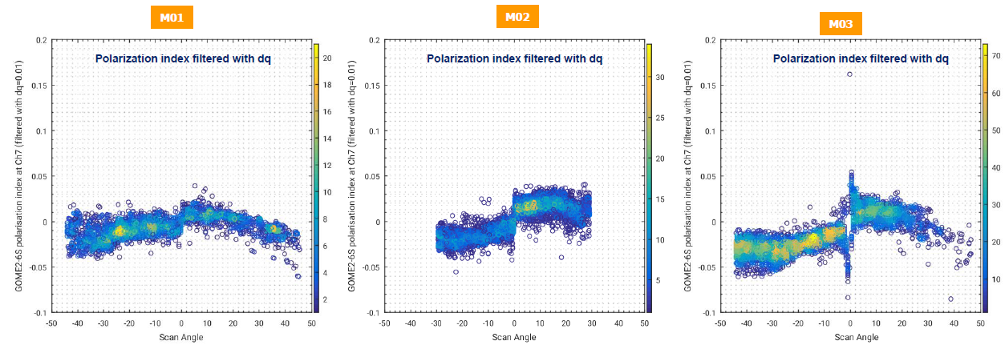
Potential for calibration of the polarisation
Absolute difference (qOBS – qSIM)
as a function of Scan angle
Ch7 – 410nm
MetOp-B (M01) MetOp-1 (M02) MetOp-C (M03)
OBS = SIM
+/- 0.05

Slide 18
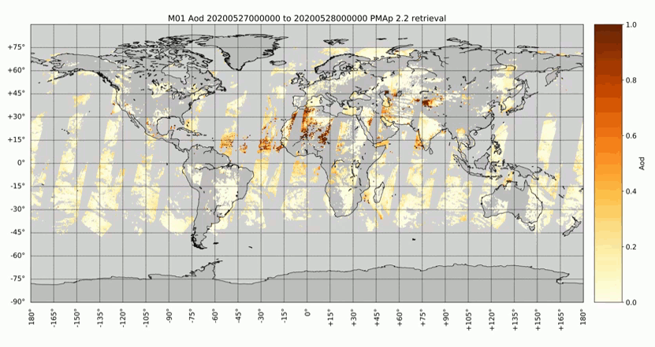
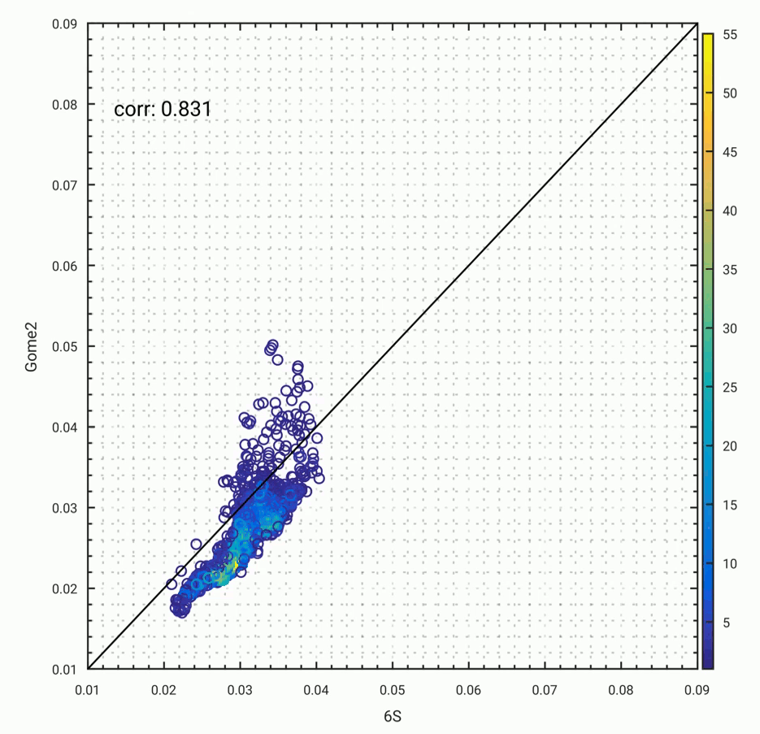
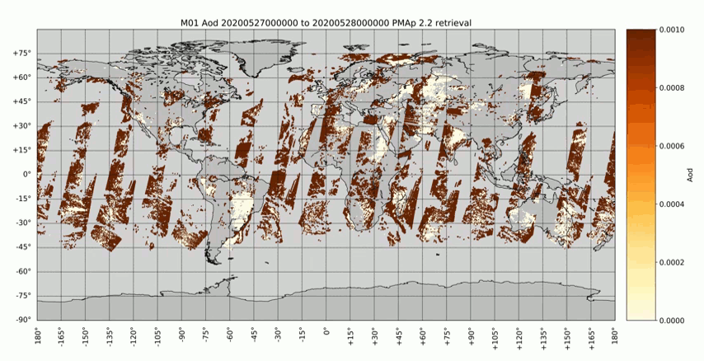
Example of improvements – M01
Ch7 – 410nm
GOME2
AOD
Reference
Improvements:
  Strong reduction of null values
  Much better spatial consistency
AOD null values in yellow

Slide 19
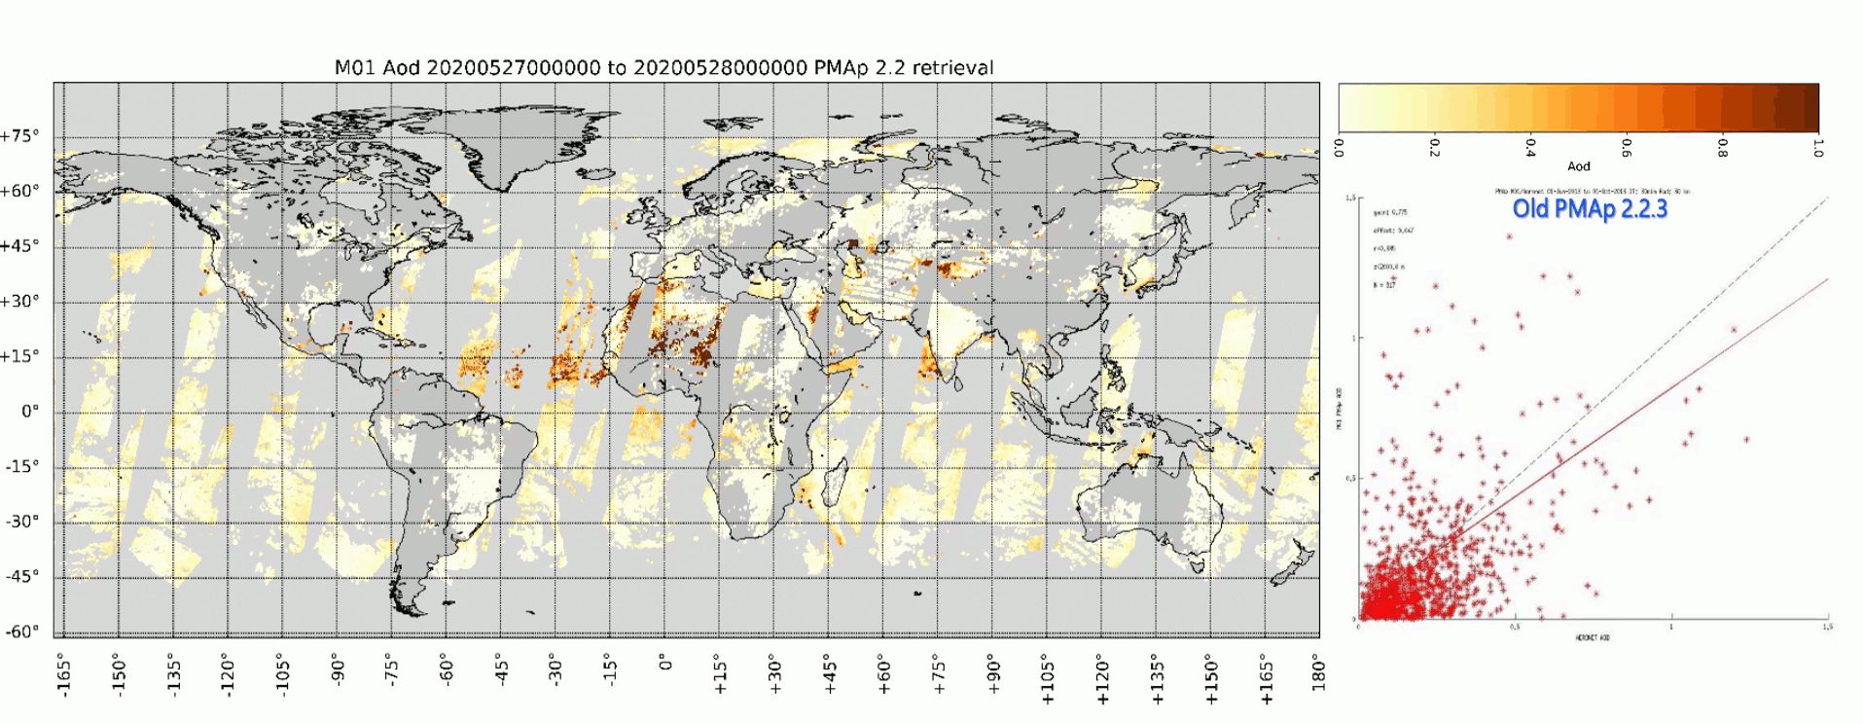
Example of improvements
Improvements:
  Confirmation of the improvements based on matchups with in-situ AERONET

Slide 20
Perspective
Definition of a reference based on Rayleigh scattering :
  here tested over dark surface for blue bands (usually tested over dark ocean - VIS bands)
Approach currently tested on GOME2-A, B, and C
  A certain level of radiometric adjustment is possible + stability with time
  Including instrumental polarisation
Limitations due to
  LER surface database
  Potential aerosol background level
  Detection of aerosol turbidity - not seen by polarisation due to geometry of aerosol signature
Improvement
  calculation of TOA, inc. extension toward “red” bands
  better document the performance:
    Experimental tests on OLCI blue bands (tracking of a 2% bias) may confirm either the added-value or the limitations for a more refined assessment
Later tested for diagnosis and monitoring of blue bands on: FCI, Metimage, VII, 3MI, CO2M-MAP…

