Slide 1
Specifications and methodologies of instrument performance monitoring systems Information for performance monitoring “specification and requirements”
Dohyeong Kim (KMA),
CMA, EUMETSAT, ISRO, JMA and NOAA

Slide 2
GSICS-EP Action-01
The Action is based on CGMS WGII Recommendation R43.4 (in 2015): CGMS operators to consider displaying instrument performance in a way similar to the ICVS
‘Specification and methodologies’ means the system configuration and how to generate monitoring information
Reference | Action Description | Actionee | Due date
EP-18.A01 | GRWG to prepare specifications and methodologies for CGMS agency development of operational instrument performance monitoring systems | GRWG | EP-19
Presented at 2018 GSICS annual meeting

Slide 3
Template based on ICVS
Template based on NOAA Integrated Cal/Val System (ICVS)
Monitors over 400 parameters for 28 instruments onboard NOAA/METOP/SNPP satellites
Spacecraft
Monitoring and trending GEOs/LEOs spacecraft parameters
Instruments
Monitoring and Trending instrument house-keeping and telemetry parameters
Anomaly events, automatically sending warning message
SDR(Sensor Data Records) data quality with respect to NWP(Numerical weather prediction model) simulations
State-of-the art Cal/Val sciences

Slide 4
Topics to decide
To introduce CGMS agencies (e.g. NOAA, CMA, EUMETSAT, JMA/KMA (internal ones)) systems
To prepare the GSICS recommendation of "specification and methodologies“
To consider
which parameters
which algorithms (SNR, NEdT …)
update frequency
range of x-axis (# orbits, 30 days, 1 years..)
data frequency (average of daily, monthly?…)
and so on

Slide 5
Spacecraft
Template Example
Parameters | Sub-parameters | Period
Spacecraft description | Launch data, orbit, design lifetime, channel, power, mass, etc.
Orbit State Telemetry | Beta Angle | Daily
CDH-RF Comm. Telemetry | Command RX Baseplate Temperature/Receiver Signal Strength/Receiver Loop Stress | Daily
HRD Transmitter Telemetry | HRD Tx RF Signal Strength, NB Tim Tx RF Signal Strength, SMD Tx RF Signal Strength, | Daily
Bus Critical Telemetry | PUMA* Bus Voltage/Total Bus Current/Battery Voltage,/Battery Pressure, Wheel speed/Direction, Gyro(TARA) Motor Current, Reaction Wheel Motor Current, System Pressure, Propulsion Deck –Z Temperature, Propulsion Tank Temperature, etc. | Daily
ADCS Housekeeping High Rate Telemetry | Star Tracker Maximum Residual, Total System Momentum, etc. | Daily
DSEP* Instrument Power Control Telemetry | DSEP Current(each sensor), 8s Second Separated, etc. | Daily
PUMA Configuration Telemetry | PUMA Payload Bus Current/Array Current/Array Temperature/Bus Voltage/Essential Bus Current/Safe Mode Bus Current/NEB&HZB Current, etc. | Daily
Temperature Telemetry | Temp. Telemetry TX Baseplate/HRD TX Baseplate/SMD TX Baseplate, etc. | Daily
ATMS/CrIS/VIIRS/OMPS/CERES S/C Telemetry Temperature | Each sensor 10-Day All indices (scan drive mechanism temp., Band RX Shelf Temp., Baseplate Temp., Survival Heater Temp., Telescope Motor Survival Heater Temp., Optics Housing Temp., Thermistor Temp., Detector Survival Temp., | Daily
Spacecraft Monitoring Parameters | Daily Scan Level Spacecraft Monitoring – Diary/Telemetry | -
* PUMA: Power Usage and Management Assembly
* DSEP: Distribution and Support Electronics Package

Slide 6
Sensors
Template Example
Parameters | Sub-parameters | Period
Instrument description | Mission, Channels, Wavelength, band pass, accuracy, SNR, FOV @ Nadir/EOS, SRF, Products, scan rate, scan type, service status, etc. | -
Instrument health status telemetry | Antenna drive motor current, signal processing voltage, phase lock loop voltage, electronic bias, Hot Pixel Percentage, Dark Current Average/Std. Dev., Readout Noise, Smear Average/Std. Dev., etc. | As provided…
Instrument Temperature | Mixer/IF Amplifier, Local oscillator, RF MUX, RF shelf, Scan motor, Current, etc. | Daily
Radiance/Tb or Image | & stability (Daily Avg.) | Daily
Radiance/Tb or Image NEdT | & stability (Forward/Reverse Avg./Maximal NEdN since Midnight) | Daily
Science Calibration Variables | Daily/Hourly ICT (BB/SD) Count and Temperature & Stability, Consistency, Trend (Daily Avg.) | Daily/Hourly
Warm Count / Space View Count | & NEdN | Daily
Gain | Calibration Gain | Daily
PRT Temperature | Valid PRT* Temp. Counts (Daily Avg.) | Daily
Data Product Quality Flags | Granule level, scan level, pixel level quality flags, etc. | Daily
Quality Flags | Overall, Scan Level, Radiometric, Spectral, Geo, RDR Invalidity, Imaginary Radiance, FCD Detection, Day/Night, Lunar Intrusion/Solar Eclipse flag, | Daily
Bias Characterization | Observation vs. RTM simulations | Daily
* RDR: Raw Data Records
* SDR: Sensor data Records
* TDR: Temperature Data Records
* PRT: Blackbody platinum resistance thermometer

Slide 7
Parameters that are not regarded as intersection portion among the instruments
ATMS | CrIS | CrIS FSR | VIIRS | OMPS
Receiver Shelf PRTs | RDR Housekeeping Variables | RDR Impulse Noise Count | SDR Granule version | Dark Look-up Table
Main Motor Position | Inteferogram Quality | SDR Fringe Count | SDR RSB H Factor
RDR 2-Wire PRT Temperature | OMA Structure Temp. (Hrly. Avg.), Stage Cooler Temp. (Hrly. Avg.), Beam Splitter/Scan Baffle/Telescope Temp. (Hrly Avg.), Servo Error daily or Avg. etc | ES ZPD Fringe Count | SDR RSB F Factor (ICVS vs. Oper) | SDR Table Version and ID
RDR Telemetry Health and Status (Scan drive,,,) | Allan NEDN ICT Real Orbital Avg. | ES ZPD Amplitude | SDR RSB F Factor (Oper vs. RSB Auto Cal) | Linearity Calibration Reference LED
TDR Data Quality Flag | Allan NEDN ICT Imaginary Orbital Avg. | Moving Window Size | SDR RSB F Factor (ICVS vs. RSB Auto Cal) | Solar Degradation
TDR Operational Mode Flag | Allan NEDN DS Real Orbital Avg. | Moving Window Spectral Stability | SDR RSB ICVS Det F Factor | Nadir System Operational State
TDR Daily Global O-B Bias (ECMWF) | Allan NEDN DS Imaginary Orbital Avg. | ES Spectral Radiance/BT | SDR RSB Lunar Band Ratio | Nadir System Table Version and ID
TDR Monthly Global O-B Bias(GPS-RO) | Gain Orbit Avg. | Calibration (Daily Avg. Normalized NEDN, 8s Avg. Normalized NEDN) | SDR TEB F Factor | Nadir System Temperature/Voltage/Currents
TDR Inter-sensor Bias (SNO) | Offset Orbit avg. |  | SDR DNB Trend | Suite Software Version Control/Operational State/Temperature/Voltages/Currents
RDR Dwell Telemetry | Mapped Variables |  | SDR Circuit Card Assembly Temperature | Mgll
GEO Quality Flag (QF1) | Quality Flag Scan Level/Overall/Radiometric/Spectral/Geo/RDR/Bit Trim/Imaginary Radiance/FCE Detection/FCE Correction/Day and Night/Impulse Noise Count/Fringe Count/ES ZPD Fringe Count/ES ZPD Amplitude |  | SDR Scan Cavity Baffle Temperature
GEO Misc | Moving Window Size |  | SDR TEB O-B (ECMWF)
Scan Drive Status | Moving Window Spectral Stability |  | GEO QF Status
 | ES Spectral Radiance/BT |  | RDR Scan Sync Loss
 | Calibration:(Daily Avg. Normalized NEDN, 8s Avg. Normalized NEDN) |  | * Presently unavailable
 | Processing log |  | * VIIRS Radiometric Calibration - H-factor: Solar Diffuser degradation factor - F-factor: Radiometric calibration coefficient
Notes:
VIIRS Radiometric Calibration
- H-factor: Solar Diffuser degradation factor
- F-factor: Radiometric calibration coefficient
F-factor Ratio Comparisons
- Operational F-factor vs. NOAA ICVS F-factor

Slide 8
Information for performance monitoring “specification and requirements”
Response to GSICS-EP-18.A01 and A.GRWG.2018.10b.1
GSICS-EP-18.A01 : GRWG to prepare specifications and methodologies for CGMS agency development of operational instrument performance monitoring systems
A.GRWG.2018.10b.1: GRWG Chair to coordinate each agency to provide to define minimum information for performance monitoring “specification and requirements” by 15 May 2018.
Presented at 2018 GSICS-EP-19 meeting

Slide 9
Summary
The report is based on ICVS(Integrated Calibration/Validation System) * ICVS monitors over 400 parameters for 28 instrument onboard(NOAA/MetOp/SNPP) Parameters can be categorized into a) Instrument Healthy Status, b) Radiometric and Geometric Calibration data/quality, c) Inter(Vicarious)-Calibration, d) Product(lv1b) data/quality and so on Status of Monitoring system - CMA: external system - EUMETSAT: external system(MetOp/IASI, GOME-2,ASCAT) - ISRO: could not find the web yet, but maybe internal - JMA: Internal(Maybe main)/External system - KMA: Internal(main)/External system - NOAA: ICVS, GOES calibration system
Reference used to collect information for performance monitoring
CMA | EUMETSAT | ISRO | JMA | KMA | NOAA
Monitoring System | Daily report | e-mail | Internal system (+e-mail) | Internal system | ICVS, GOES system (+e-mail)
http://gsics.nsmc.org.cn/portal/en/fycv/ipm.html | http://oiswww.eumetsat.org/epsreports/html/index.php |  | http://www.data.jma.go.jp/mscweb/en/operation/calibration_portal.html | http://nmsc.kma.go.kr/html/homepage/ko/chollian/Quality/selectQuality.do | https://www.star.nesdis.noaa.gov/GOESCal/index.php https://www.star.nesdis.noaa.gov/icvs/
9

Slide 10
Summary of information for performance monitoring
 |  | Parameters
Engineering | Spacecraft | Status (attitude, velocity, position, etc.)
 | Instrument | Temperature (Detector, Blackbody, Cooler, Radiator, Blackbody, Stage Outgas Htr, Optics, Loop Heat Pipe, Scan Mirror, Motor, Antenna, Optics, Power, FPM, etc.), Voltage (Power), scan rate, SRF, service status, *current(dark, motor, etc.)
Calibration | Calibration Coef. | Count and Temperature (Space, blackbody, solar diffuser), Coefficient(Gain, Intercept)
 | Radiometric Cal. Qual. | SNR, NEdT(NEdN), Trend(slope), Consistency, Stability
 | Geometric Cal. Qual. | Bias, stability, residual, band-to-band/pixel-to-pixel co-registration, #(valid) of landmark(or stars), Errors(striping) status
 | Cross/Vicarious/ Model O-B | GEO-LEO Tb Bias, Reflectance Ratio, Desert/DCC/Lunar calibration, O-B Bias
GDWG inputs |  | Implementing user notification function(e.g. alerting via email in case of calibration anomaly) Linking calibration event logging information
Product |  | Level1B data, Image Max/Min/Mean/Median/Invalid, stability
Discussion?
The scope of instrument performance monitoring?
- Radiance, Calibration, Engineering, Product, Spacecraft and SRF?
- Most agency also provide these information as well: Operational Status, Schedule, Service status, Event log etc
What about including the inter-calibration, comparison with model?
- For example, Inter-Calibration, CRTM O-B, DCC Mapping in NOAA, JMA
What about depth? E.g.) Relay Optics, Beamspliter? or anything else?
The period? E.g.) NRT, x-axis: 3days, 1month, 1year?
Common or specific based on sensor type? E.g.) imager, sounder, scatterometer etc
10
Notes:
Dark current?

Slide 11
Backup slides

Slide 12
CMA
FY-3B/3C | Parameters | Notes
MERSI | BB1Km_StdGran, BB250m_StdGran, BB_DN_average, Cool_Temperature, IR_Cal_Coeff, MoonAzimuthlnst, MoonZenithlnst, OBC_BB_Average_Temperature, Opt_Bracket_Temp, SV1Km_StdGran, SV250m_StdGran, SV_DN_average, SolarAzimuthlnst, SolarZenithlnst, VOC_DN_average, Kmirror_Motor_Temp, OBC_Bb_Temp_DN, VOC_Temperature
VIRR | BB_Temp, IR_CAL_Offset, IR_CAL_Slope, OBC-BB_Temp, Radiator, STD_BB_DN, STD_SV_DN, mean_BB_DN, mean_SV_DN
MWHS | Black_Body_View, Black_Body_View_Avg., Cal_coefficient, Cell_Control_Unit, FET_183GHZ_Amplifier_Tempera, lnst_Temp, Mixer_183GHZ_Temperautre, Motor_Temperature, Prt_Tavg, Space_View
MWRI | AGC_Control_Volt_Count, ANTENNA_BT_CALIBRATION_OFFSET, ANTENNA_BT_CALIBRATION_SCALE, Antenna_Horn_Temp_Count_Except, Antenna_TEMPERATURE, COLD_SKY_MIRROR, HOT_LOAD_PHYSICAL, HOT_LOAD_REFLECTOR, NEDN, RX_TEMP_Count, SCAN_COLD_OBSERVATION, SCAN_WARM_OBSERVATION, Scan_Period
IRAS | Calibration_Coef(slope, intercept), NEdN, Temprature(Baseplate, Blackbody, Colder, Filter_Wheel, Main_Optics, Medium_Optics, Modulator, Processor, Scan_Mirror), View_Count(Blackbody, bb-sp), Voltage(Power, colder_Temp_control)
TOU | Dark_current, Gain_of_dark_current, Gain_of_total_ozone, High_voltage_of_photomultiplier, Mercury_lamp, Mode, Scanning_mirror_position, Temperature_of_spectrometerion, speed_of_wavelength_selector | Pattern: ATM, CAA1, CAA2, WAVE
SIM | Therm_Avg_Solar, Therm_Avg_Space, Therm_Std_Solar, Therm_Std_Space
MWTS | AGC, Cal_Coefficients, Cold_Sky_Angle, Earth_Obs_Angle
SBUS | Into_the_shadows_count, Measurement_mode, Number_of_measurements, Out_the_shadows_count, Photometer_channel, Shadows_delay_minutes, Shadows_delay_ms, Standard_lamp_mode_cycle_count, Status_information, The_sun_mode_cycle_count, Wavelength_correction_direction, Wavelength_correction_steps, gain at the characteristics wavelength, Gain_Mode | ATM, DISX, LAMP, SOLA
SIM | Bal(Anlge, Det_Temp, Therm_Avg_Self, , Therm_Avg_Solar, Therm_Avg_Space, Therm_Std_Self, Therm_Std_solar, Therm_Std_Space), Coef(Angle, Au, Doppler), Fine(Tele_Temp, Tele_Temp_Diff), Ins(Mot_Temp, Pin_Temp, Rot_temp, Shell_Temp), Responsibility, Space Irradiance, Stand_V
ERM | Aperture_Temp_Scan, Base_Temp, Cal_Intercept, Cal_Slope, Cavity_Temo_Diff_Nadir, Cone_Temp_Scan, Englineering_Volt_Analog, Gain, Head_Temp_Nadir, HeatSink_Temp, Housing _Temp_Nadir, Lamp_Temp, Motor_Temp_Scan, Nadir_Lamp_on, Nadir_Short_Output_with_Lamp_Off/On, Nadir_Total_Output_with_BB, Nadir_with_BB, Non_Short_Noise_With, Non_Tatal_Noise_With_BB, Processor_temp, Scan_Short_Noise, Scan_Total_noise_With_BB, Scan_Lamp_On, Scan_Short_Output_With, Scan_Total_Outout_With_BB, Scan_With_BB, Scanner_Bridgen_Balance
GNOS | Distribution, Prediction, Statistic
12

Slide 13
EUMETSAT
MetOp | parameters
IASI | Data Quantity/Quality, Instrument modes
 | Comparing Radiance with modeled radiance (under clear sky situation over sea) and HIRS radiance
GOME-2 | Sequence counter, observation mode, temperature(PDP, Radiator), scan mirror position, PMD coolers status, PMD-P temperature, PMD-S temperature, FPA coolers status, FPA temperature, integration time, SAA warning, min/max/average/stdv signal,
ASCAT | Echo Data/Coverage, Integrated Transmitted Power, Integrated Reflected Powers, Integrated Calibration Power, SFE & ANT Temperature, Noise Power & Power Gain Product, RX Filter Shape average over sample number, Noise Power threshold exceeded, SZO Product(sigma0_trip coverage/Statistics/Outlier, Kp Coverage/Statistic/Outliers/flag
13

Slide 14
ISRO
Kalpana/INSAT parameters
Pre-launch: Analysis of lab calibration data for Sensor characterization Post-launch: · Sensor health/scan performance by telemetry monitoring - On board temperature diurnal variations: Blackbody, patch, EOM, mirror, filter wheel - Servo error in fast and slow scans · Raw(L0) data (sensor performance) - Noise from space look for IR channels (NEdT) - IR calibration slope and offset derived from Blackbody/space look (diurnal trend) * L1B product with system level corrections - Platform performance parameters for Day/Night - Geolocation error - Internal distortion - Residual roll pitch yaw · Band to Band registration - L1B product for radiometry (sensor performance) - MTF for visible/IR channels - Striping/Banding - Bad pixels/degraded response pixels - Out of range radiances - BT/Radiance stability monitoring at Uniform Sites like desert/ocean - Data product quality (L1C products) With DP corrections and calibration - Geolocation error - Internal distortion - BBR - BT/radiances stability over uniform sites - Residual striping banding - MTF at edges - Noise/SNR on uniform regions · Sensor calibration - Monitoring GSICS calibration Biases and raising alarms for anomalies - Monitoring integrated Moon disk radiance for radiometric calibration and stability (For vis/swir) - Undertaking vicarious and cross calibration exercise from time to time
14

Slide 15
JMA
Himawari-8/9 parameters
Orbit state: Semi-Major Axis, Eccentricity, Inclination, Right Asc. Of Asc. Node, Argument of Perigee, True Anomaly, Mean Anomaly, Eccentric Anomaly
Attitude state: Roll/Pitch/Yaw
Attitude correction for roll/pitch/yaw derived from landmark analysis, Band-to-Band co-registration correction for N-S/E-W derived from pattern matching of AHI imageries
Calibration coefficients: max/median/min slope and offset among detectors for each band
Lon./Lat. of SSP and nadir of AHI
SNR and NEdT
Sensor temperatures
Errors of image navigation and band-to-band co-registration (validation results using pattern matching approach) for L1B data (i.e. Himawari Standard Data)
# of error observation samples in L1B data (i.e. Himawari Standard Data)
15

Slide 16
KMA
COMS | Radiometric | Geometric
Parameter | IR General Coefficients (Side, Patch Status, Quadratic Term, Slope, Intercept)
 | VIS General Coefficients Coefficients (Side, Slope, Intercept)
 | Visible Normalization Coefficients (Alpha, Beta, Gamma)
 | IR Blackbody Calibration Coefficients (Blackbody Slope, Estimated Slope, Averaged Slope Component)
 | IR Normalization Coefficients (Alpha, Beta, Gamma, Apply Flag)
 | IR MBCC Coefficients (C0, C1, C2, Choice of Optics)
Correlation | Scan Mirror Temp_IR Slope | Number of Landmark
 | Narrow Range Temp_IR Slope | Residual Avg_ServoError Avg
 | Power Supply Temp_IR Slope | IMC Data_Servo Error Avg
 | Visible Intercept StdDev_PRNU | IMC data_Residual Avg
 | Wide Range Temp_IR Slope
 | Relay Optics Temp1_IR Slope
 | IR Slope_IR Radiance StdDev
 | Telescope Secondary Temp2-IR Slope
Environment | Primary Baffle Temp | Spacecraft Attitude
 | Cooler Housing,Radiator Temp | Spacecraft Velocity (at Image First, Center, Last)
 | IMC Input (EW, NS) | Spacecraft Position (at Image First, Center, Last)
 | Power Supply Temp | Image Scan Status (IMC Range, Electronics Side, Scan Motor)
 | IR Detector Temp (Wide, Narrow)
 | Thermal Control Current
 | Relay Optics Temp
 | Sensor Assembly Baseplate Temp
 | Blackbody Target Temp
 | Electronics Temp
 | Louver Radiator Temp
 | Patch Control Heater Voltage
 | Scan Mirror Temp
 | Servo current (EW, NS)
 | Telescope Primary, Secondary Temp
 | Vis Optics Temp
CPML | Detector Performance (Visible SNR, IR NEDT)
Quality | Visible General (Side, PRNU) | Number of Valid Landmarks
 | IR Radiance | Average EW, NS
 | Visible Imager Response (Moon) | Navigation Performance
 | SME Coefficient (C0, C1, C2) | Time Landmarks (Previous, Next IMG)
 | Visible Radiance | IMC (EW, NS)
 | Detector Performance (Visible SNR, IR NEDT) | Quadratic Distance
 | Visible Albedo Monitor Slope | Std. Dev. EW, NS
 | IR General Coefficients (Side, Patch Status, PRNU) | Processing Time
16

Slide 17
NOAA
GOES
Performance |  | accuracy, precision, and stability of key parameters (radiance and geolocation) that are required and estimated by vendor, pre-launch, post-launch, and annual update.
Calibration | Radiometric Cal. Qual. | L1b performance (bias and stability)
 | Geometric Cal. Qual. | L1b performance (bias and stability) , residuals, FFR, CCR, etc.
 | Calibration | counts from space / blackbody / solar diffuser, and gain and noise (SNR/NEdT) derived from them. Solar Calibration(Gain, Cal event Time and Angles), Striping –VNIR & IR
Engineering Data | Instrument Monitoring | various component temperature/voltage/amperage/, Striping Status, Trend, IR BT Image
Product |  | Min/Max/Mean/Median/Invalid of Albedo and BT *
SRF
POES(ICVS) | Sub-parameters
Instrument health status telemetry | Antenna drive motor current, signal processing voltage, phase lock loop voltage, electronic bias, Hot Pixel Percentage, Dark Current Average/Std. Dev., Readout Noise, Smear Average/Std. Dev., etc.
Instrument Temperature | Mixer/IF Amplifier, Local oscillator, RF MUX, RF shelf, Scan motor, Current, etc.
Radiance/Tb or Image | & stability (Daily Avg.)
Radiance/Tb or Image NEdT | & stability (Forward/Reverse Avg./Maximal NEdN since Midnight)
Science Calibration Variables | Daily/Hourly ICT (BB/SD) Count and Temperature & Stability, Consistency, Trend (Daily Avg.)
Warm Count / Space View Count | & NEdN
Gain | Calibration Gain
PRT Temperature | Valid PRT* Temp. Counts (Daily Avg.)
Data Product Quality Flags | Granule level, scan level, pixel level quality flags, etc.
Quality Flags | Overall, Scan Level, Radiometric, Spectral, Geo, RDR Invalidity, Imaginary Radiance, FCD Detection, Day/Night, Lunar Intrusion/Solar Eclipse flag,
Bias Characterization | Observation vs. RTM simulations
17

Slide 18
Thank you

Slide 19
NEdT
[Parameter Definition Example]
NE△T specification and monitoring for microwave sounders(2015,NWP SAF) includes 6 different methods:
1)NOAA/ATMS, 2)Met Office, 3)EUMETSAT, 4)NOAA STAR, 5)MWS, 6)Allan Deviation methods
EUMETSAT | NOAA STAR ICVS
Reference: NEdT specification and monitoring for microwave sounders, 2015, NWP SAF | Reference: 2015 STAR ICVS Instrument Performance Review ATMS/AMSU/MHS Anomaly Report, Ninghai Sun, NOAA/NESDIS/STAR
~2015
2015~
$j_{}:$ each scan line
($\overline{C_{k}^{2}}$, $\overline{C_{k}^{}}$): computed over 4 samples within a line (k)
$τ:$ integrating time
G: channel gain (counts/K
$C_{ch}^{w}$: warm counts per channe
$\overline{G_{ch}}$: averaged calibration gain
$N$: number of warm count views during each cycle
EUMETSAT: standard deviation based NEdT
NOAA : Allan deviation method since 2015

Slide 20
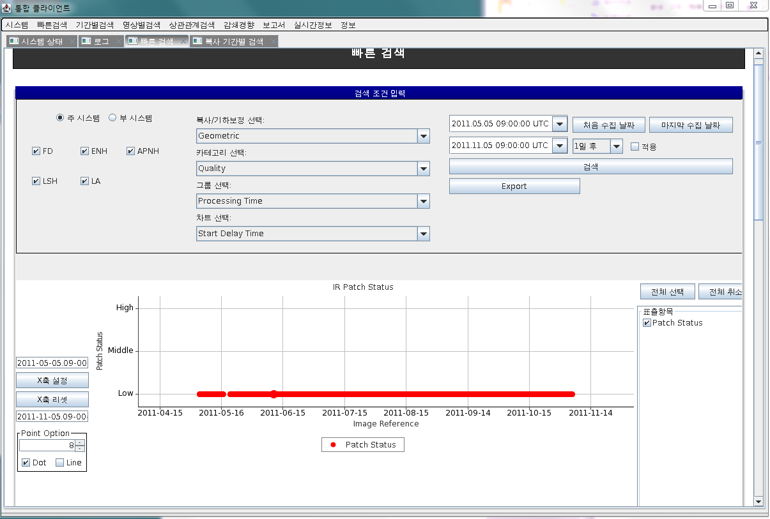
KMA
Internal system

Slide 21
KMA
Internal system
Radiometric | Parameter | IR General Coefficients (Side, Patch Status, Quadratic Term, Slope, Intercept)
 |  | VIS General Coefficients Coefficients (Side, Slope, Intercept)
 |  | Visible Nomalization Coefficients (Alpha, Beta, Gamma)
 |  | IR Blackbody Calibration Coefficients (Blackbody Slope, Estimated Slope, Averaged Slope Component)
 |  | IR Normalizatin Coefficients (Alpha, Beta, Gamma, Apply Flag)
 |  | IR MBCC Coefficients (C0, C1, C2, Choice of Optics)
 | Correlation | Scan Mirror Temp_IR Slope
 |  | Narrow Range Temp_IR Slope
 |  | Power Supply Temp_IR Slope
 |  | Visible Intercept StdDev_PRNU
 |  | Wide Range Temp_IR Slope
 |  | Relay Optics Temp1_IR Slope
 |  | IR Slope_IR Radiance StdDev
 |  | Telescope Secondary Temp2-IR Slope
 | Environment | Primary Baffle Temp
 |  | Cooler Housing,Radiator Temp
 |  | IMC Input (EW, NS)
 |  | Power Supply Temp
 |  | IR Detector Temp (Wide, Narrow)
 |  | Thermal Control Current
 |  | Relay Optics Temp
 |  | Sensor Assembly Baseplate Temp
 | CPML | Detector Performance (Visible SNR, IR NEDT)
 | Quality | Visible General (Side, PRNU)
 |  | IR Radiance
 |  | Visible Imager Response (Moon)
 |  | SME Coefficient (C0, C1, C2)
 |  | Visible Radiance
 |  | Detector Performance (Visible SNR, IR NEDT)
 |  | Visible Albedo Monitor Slope
 |  | IR General Coefficients (Side, Patch Status, PRNU)
Geometric | Correlation | Number of Landmark
 |  | Residual Avg_ServoError Avg
 |  | IMC Data_Servo Error Avg
 |  | IMC data_Residual Avg
 | Environment | Spacecraft Attitude
 |  | Spacecraft Velocity (at Image First, Center, Last)
 |  | Spacecraft Position (at Image First, Center, Last)
 |  | Image Scan Status (IMC Range, Electronics Side, Scan Motor)
 | Quality | Number of Valid Landmarks
 |  | Average EW, NS
 |  | Navigation Performance
 |  | Time Landmarks (Previous, Next IMG)
 |  | IMC (EW, NS)
 |  | Quadratic Distance
 |  | Std. Dev. EW, NS
 |  | Processing Time

Slide 22
EUMETSAT
[MSG1/2/3/4]
1) Orbit state: Epoch, X(Y/Z)-position, SRP coefficient, Semi-Major Axis, Eccentricity
Inclination, Right Asc. Of Asc. Node, Argument of Perigee, True Anomaly, Longitude at
epoch, Mean Longitude; The orbital parameters for all operational Meteosat spacecraft are distributed via a dedicated mailing list in the form of weekly email
2) Attitude state: Epoch, Spin Axis Right Asc., Spin Axis Declination, Spin Axis X(Y/Z)
3) Physical state: Epoch, Spin Rate, Total Mass, Fuel Mass, Oxidizer Mass
[Products]
- OSSI provides users with a near real-time view of the status of the operational service provided by EUMETSAT.
[Calibration]
- MSG/MFG Calibration
- Inter-calibration: Monitored instrument, reference instrument, status,GSICS product, documentation
Instrument Specification
Instrument Events (database of calibration related events)
Instrument Monitoring (database or documents with information on the instrument state)
Data Outgases (graphs with information on instrument outage dates)
Relevant Documents

Slide 23
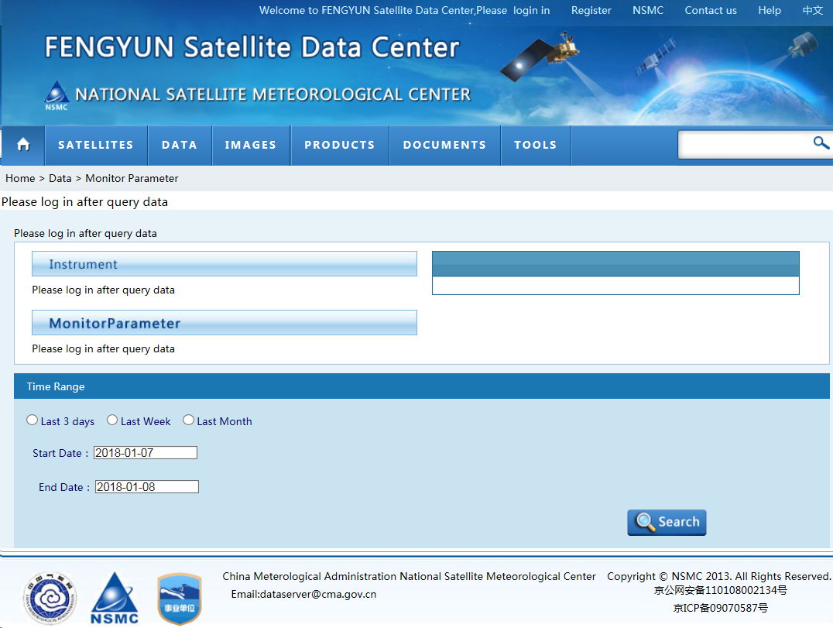
NSMC
satellite.nsmc.org.cn/PortalSite/gallery/monitorparameter.aspx
→ need to log-in

