Slide 1
Current status of inter-calibration activities in CGMS/SWCG for space-based space weather observation
Tsutomu NAGATSUMA (NICT), Elsayed Talaat (NOAA), and SWCG Task Force of Inter-calibration

Slide 2
Task Force Member
Andrew Monham, Kenneth Holmlund (EUMETSAT)
  Meteosat
Elsayed Talaat, Matthew Butler、Terry Onsager (NOAA)
  GOES-15,16 (SEM/EPS, SEISS/MPS)
Tsutomu Nagatsuma (NICT)
  Himawari-8,9 (SEDA)
Dohyeong Kim (KMA)
  GK-2A (KSEM/MEPD)
Jianguang Guo (CMA)
  FY-2E, 2G, 2H, 4A (SEM)
TBD (ROSCOSMOS) #contacting Alexander Karelin
  Electro-L N2 (GGAK-E/SKIF-6, GGAK-E/SKL-E, GGAK-E/GALS-E )
Any other? (ESA, ISRO, JAXA?)

Slide 3
Outline
Instrument
Product
How to inter-calibrate
Problems need to be discussed

Slide 4
Space-based space weather sensor onboard meteorological satellites
High energy electron
NOAA |  | ROSCOSMOS | CMA |  | JMA | KMA
GOES-15 | GOES-16 | Electro-L N2 | FY-2* | FY-4* | Himawari-8,9 | GK-2A
80-800 keV SEM/EPS | 0.03-30 keV SEISS/MPS | 0.05-20 keV SKIF-6
0.6-4 MeV SEM/EPS | 0.05-4 MeV SEISS/MPS | 0.15-1.0 MeV SKIF-6 | 0.15-1 MeV SEM(FY-2) | 0.4-4 MeV SEP-particles | 0.2-4.5 MeV SEDA | 0.1-2.0 MeV KSEM/MEPD
 |  | 0.2-20 MeV SKL-E
(from OSCAR/Space)
Each agency installs their own instruments for high energy electron observations. Although the coverage of energy range is almost same, but the specification of each instrument is different.
(number of channels, FOV, energy of each channels, etc.)

Slide 5
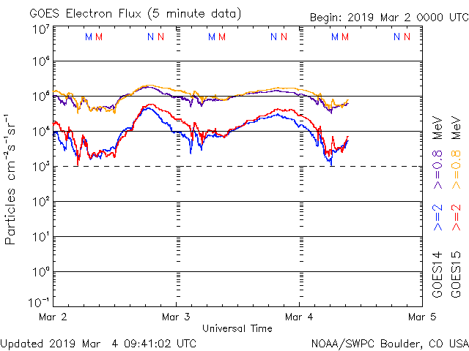
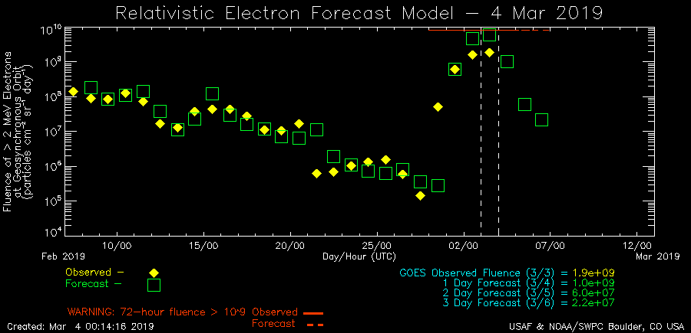
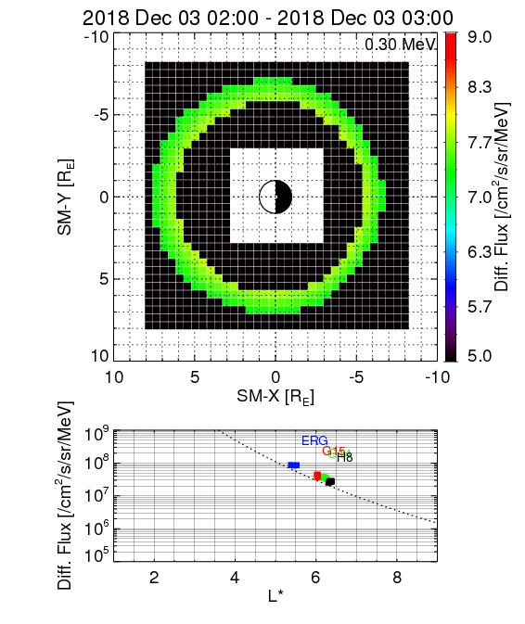
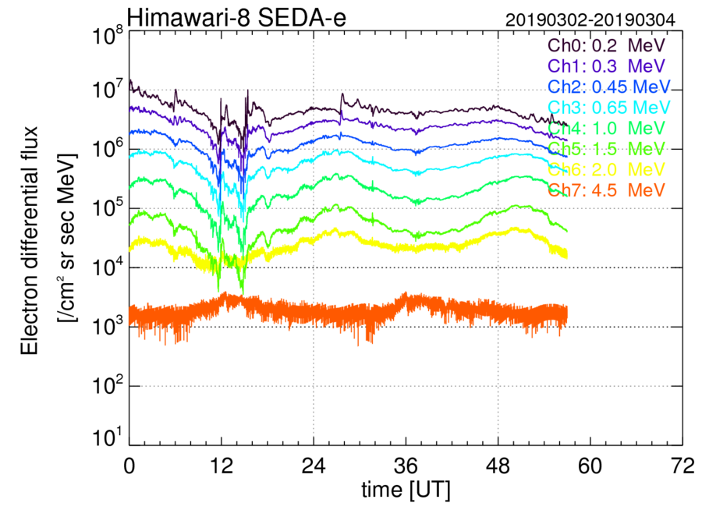
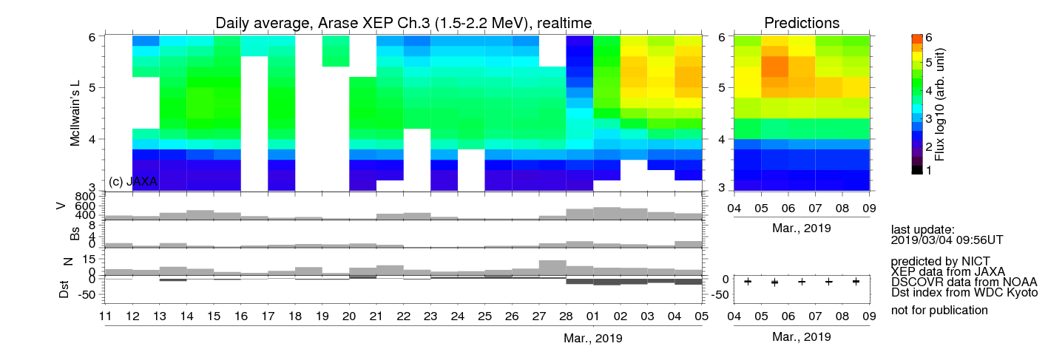
Product (example)
Line plots of differential flux
/ integrated flux
2D-distribution of
high energy electron diff. flux
(experimental)
Relativistic electron flux
forecast model at GEO
Relativistic electron flux forecast
model in the inner magnetosphere
(experimental)
Nowcast / Forecast products are produced
from high energy particle observations.

Slide 6
How to inter-calibrate
For high energy particle measurements, there is no absolute reference for calibrating instruments in space.
Basically, ground-based calibration table is used for observation.
Inter-calibration is important for comparing high energy particle data each other.
However, inter-calibration is not easy, even if it is observed on geostationary orbit (GEO).

Slide 7
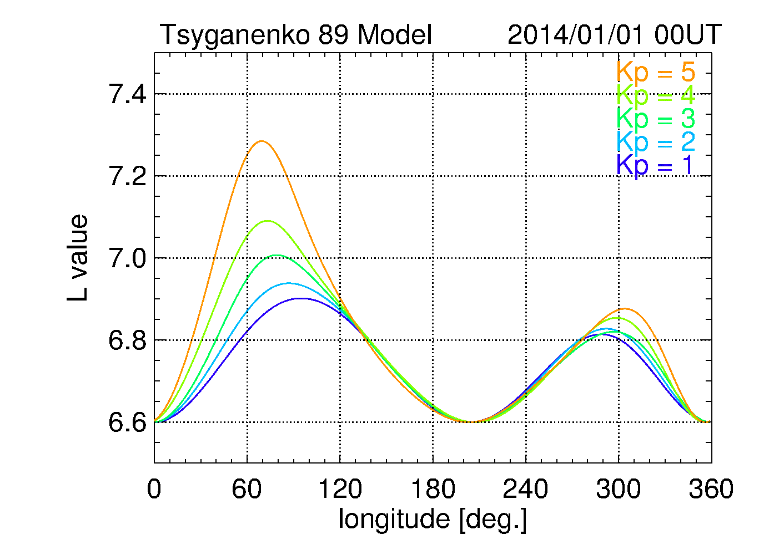
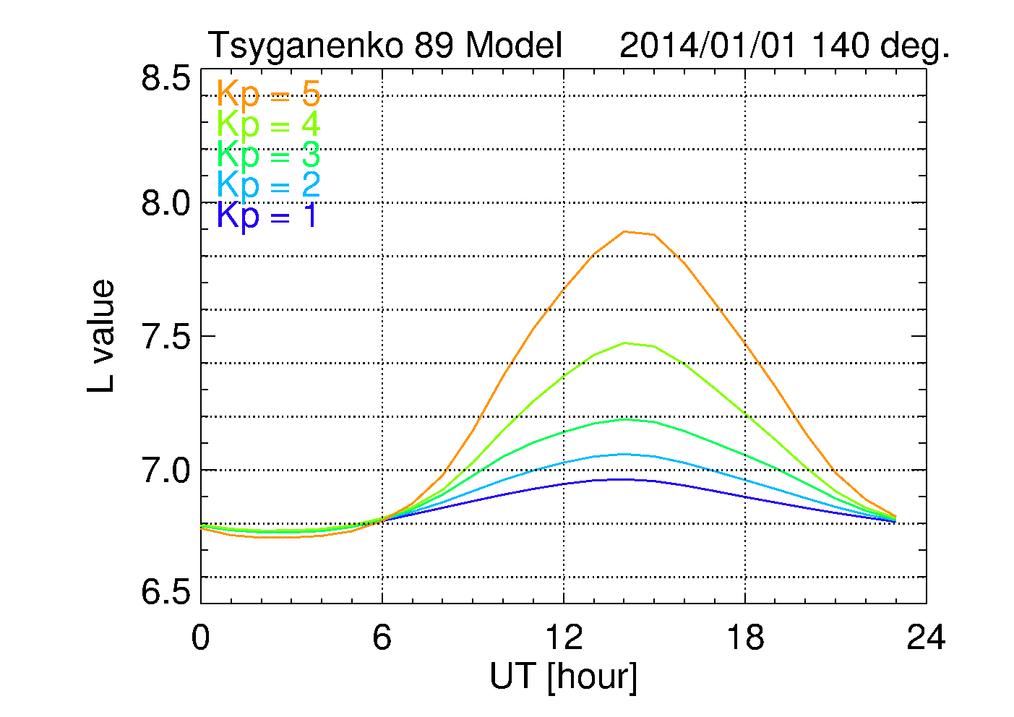
Geosynchronous Orbit
GOES13
GOES15
Dipole Geomag. Lat.
DRTS
Himawari
Geographic Longitude.
Geomagnetic latitude (L-Value) is different depending on ‘Geographic Longitude’.
L-value is changing depending on day, season, geomagnetic activity.
Particle flux is different depending on ‘Geographic Longitude’.

Slide 8
Procedure of inter calibration
Determination of L* conjunction
Interpolation for adjusting energy
  We use log-linear interpolation
Flux projected to geomagnetic equator
Comparison

Slide 9
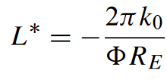
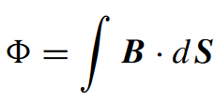
L* (Roederer’s L)
Indicator of particle drift shell
If L* is the same, both satellite observes the same drift shell of the particles.
L* is strongly depend on the magnetospheric model. (We use Olson-Pfitzer quiet model.)
k₀ : The Earth’s dipole moment.
R_{E} : Radius of the Earth

Slide 10
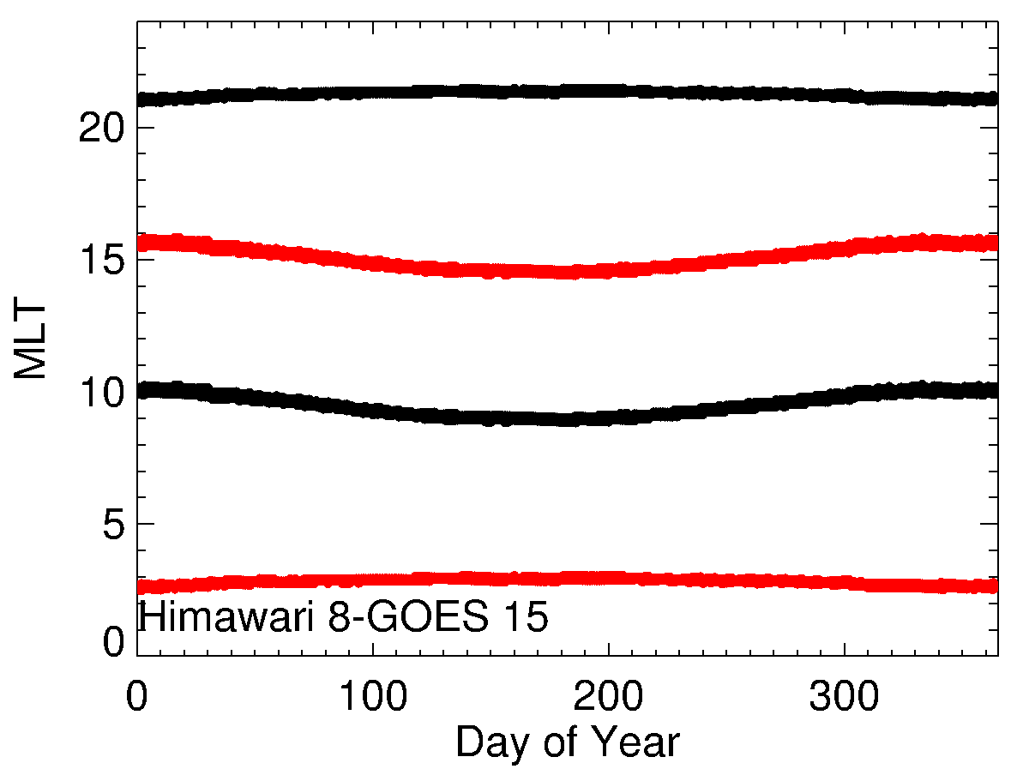
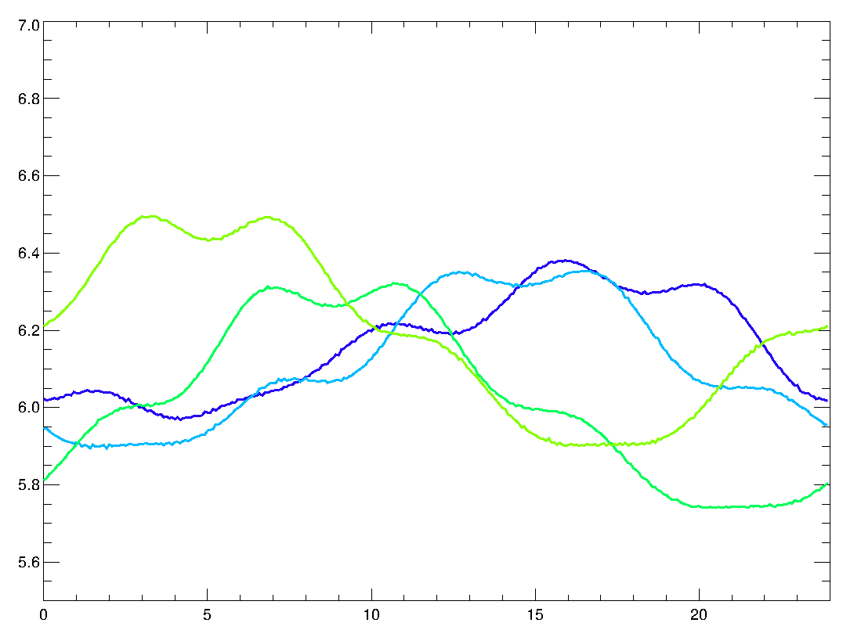
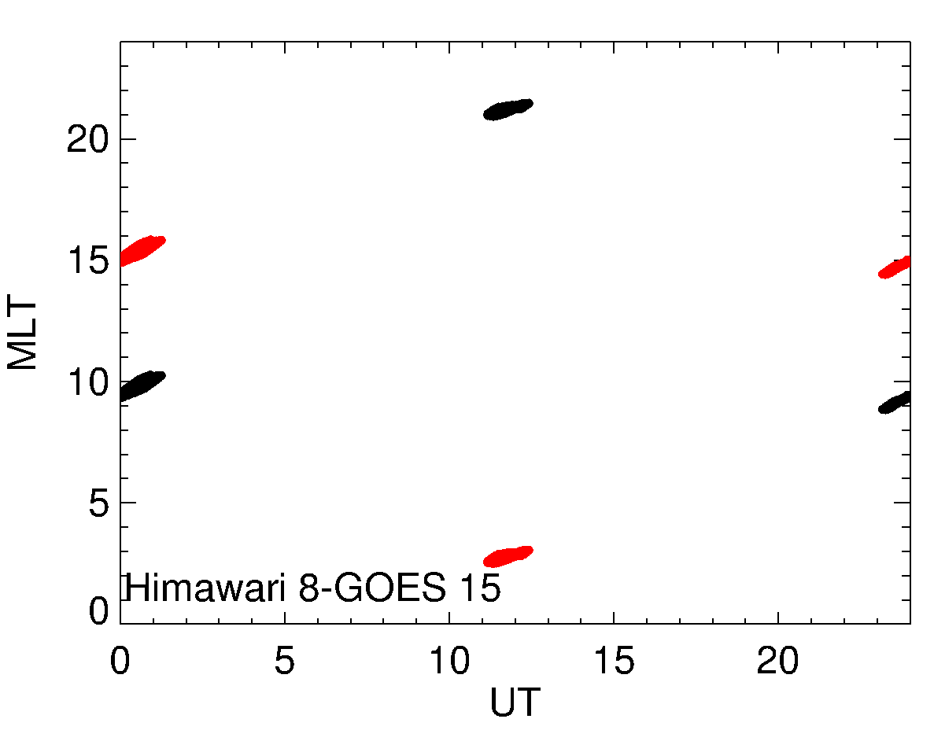
Process of inter calibration
Comparing particle data which observes particles in the same drift shell.
We should avoid magnetic local time (MLT) around midnicht and noon. [Friedel et al., 2005]
L* is calculated using IRBEM library.
Kodama
Himawari8
GOES13
GOES 15
Olson & Pfitzer quiet [1977]

Slide 11
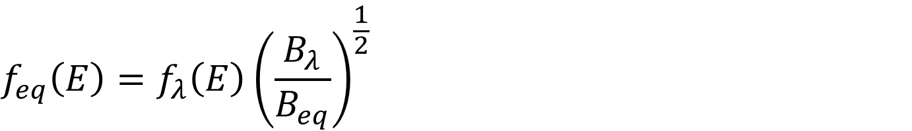
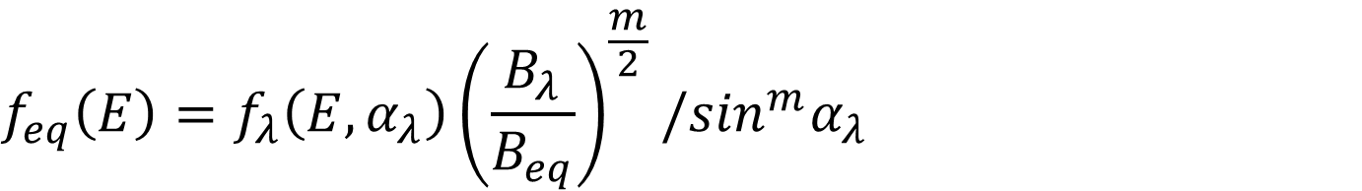
Flux projected to geomagnetic equator
$$f_{eq}\left(E\right)=f_{λ}\left(E,α_{λ}\right){\left(\frac{B_{λ}}{B_{eq}}\right)}^{\frac{m}{2}}/\sin^{m}α_{λ}$$
$$f_{eq}\left(E\right)=f_{λ}\left(E\right){\left(\frac{B_{λ}}{B_{eq}}\right)}^{\frac{1}{2}}$$
If m = 1
We assume isotropic flux distribution.

Slide 12
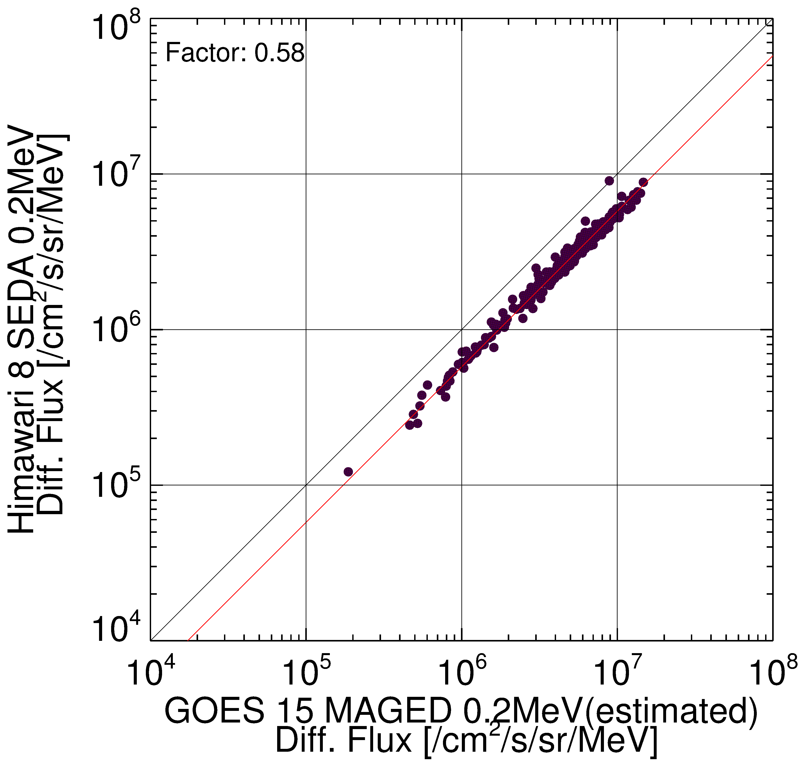
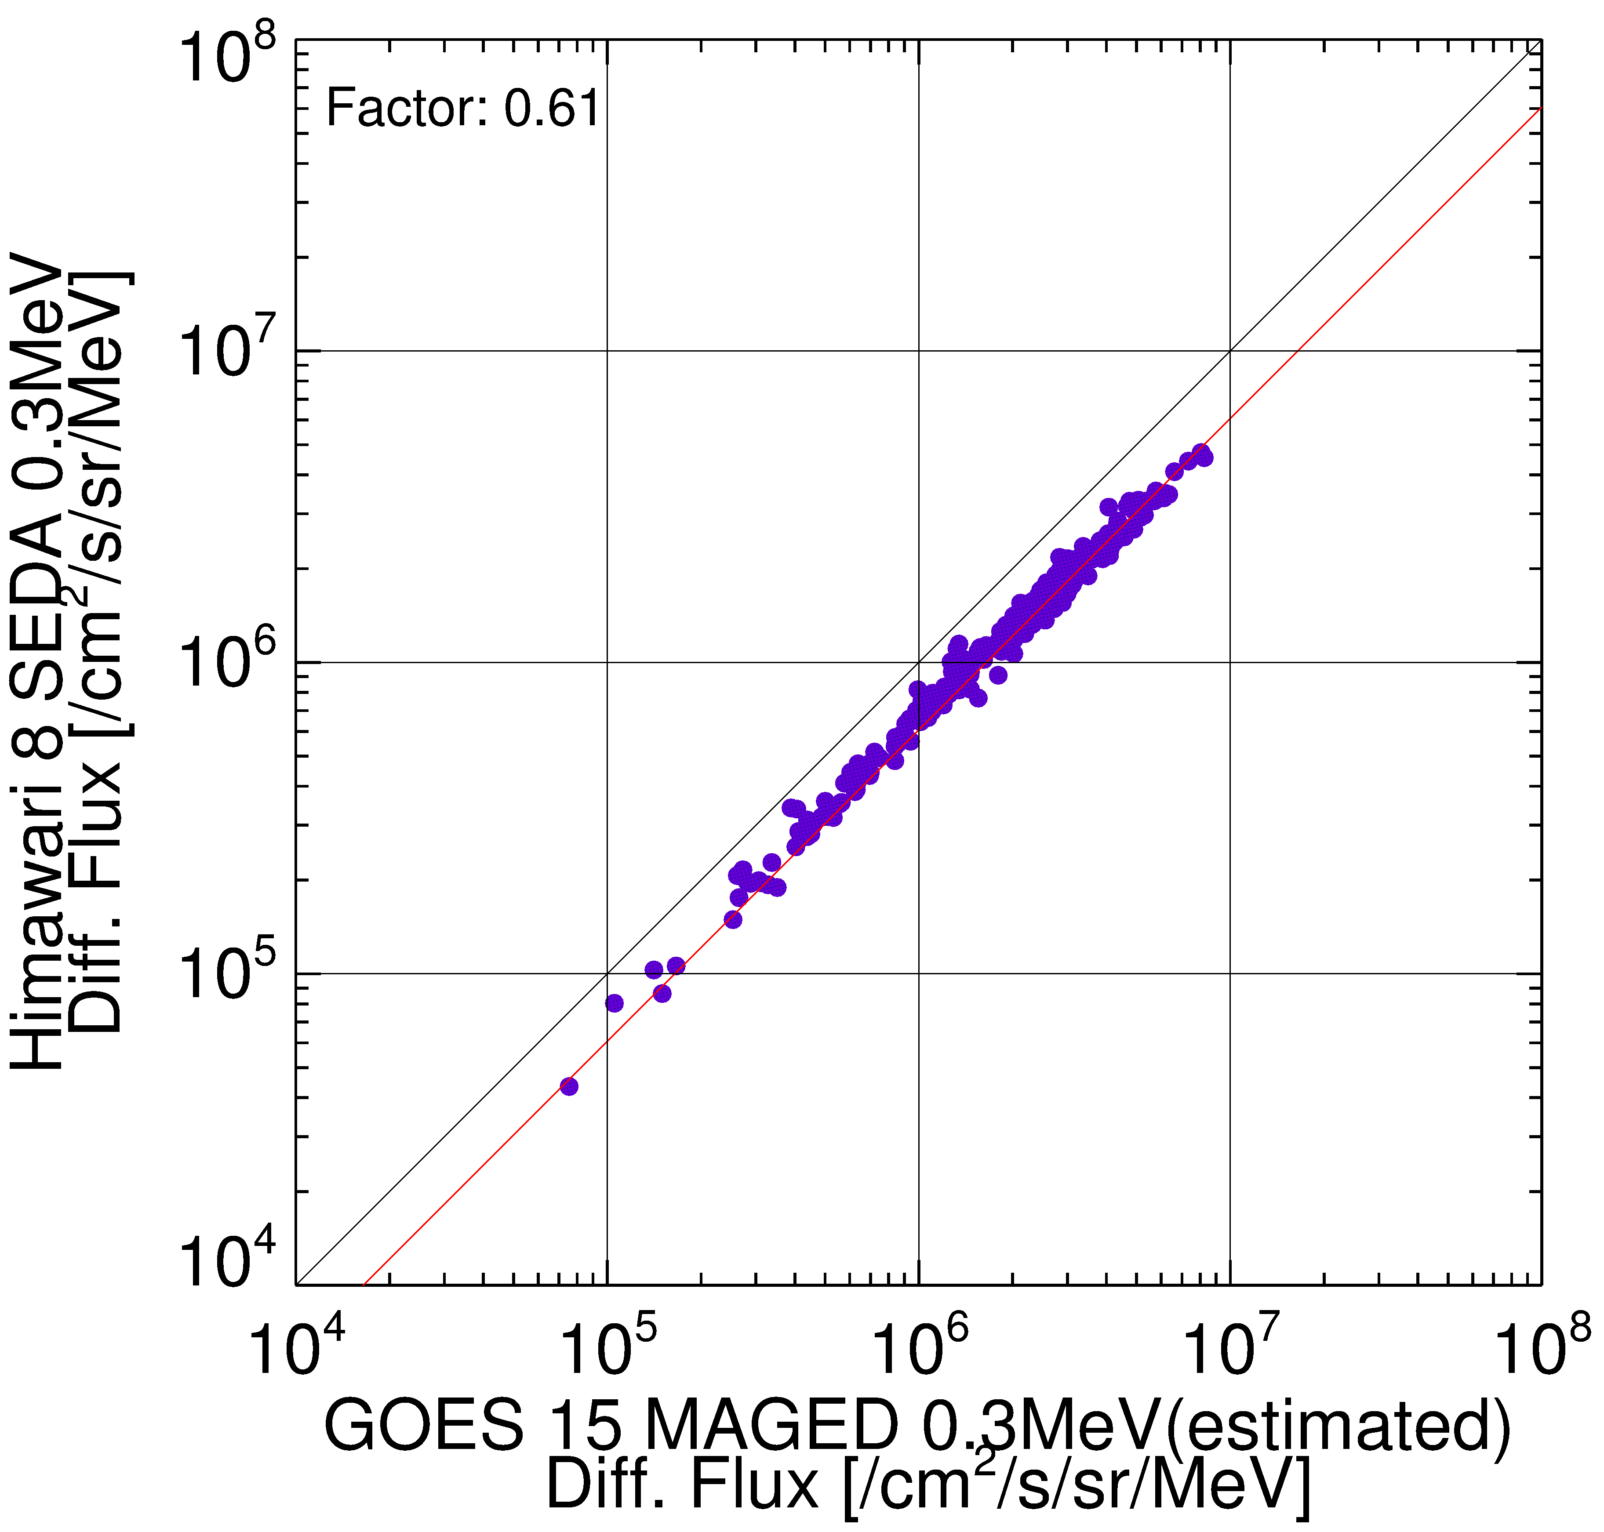
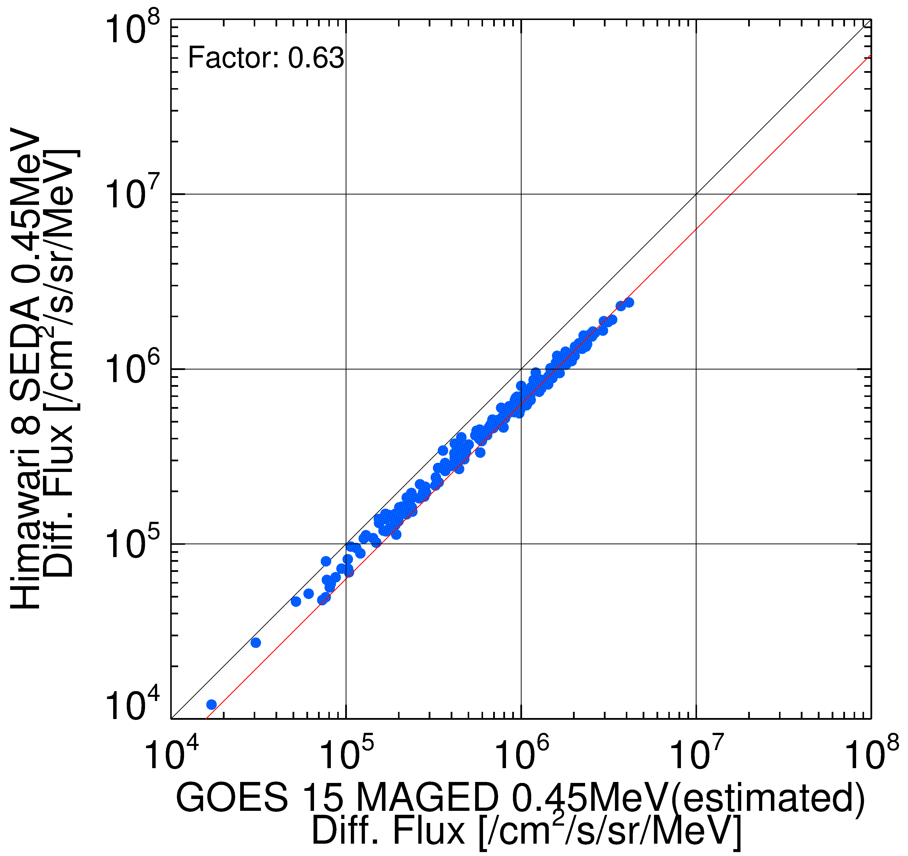
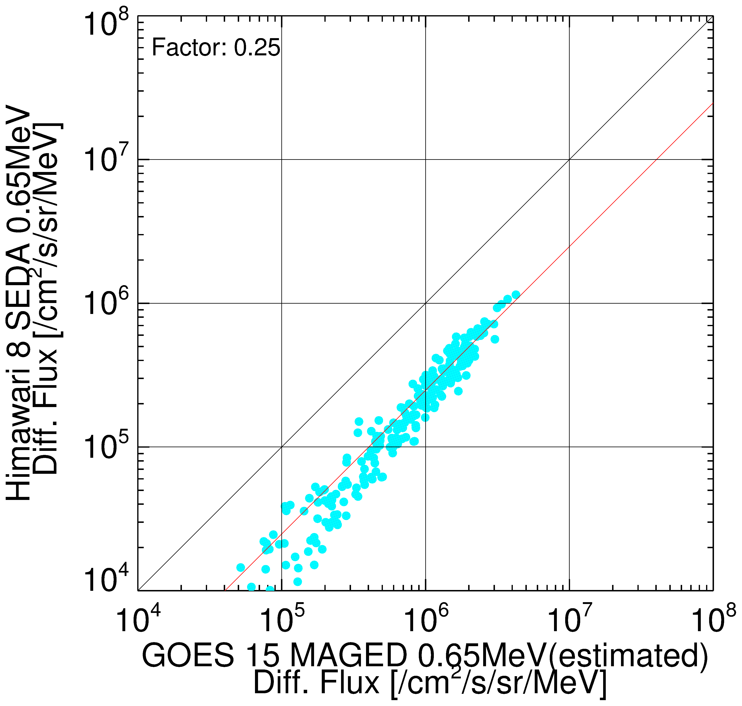
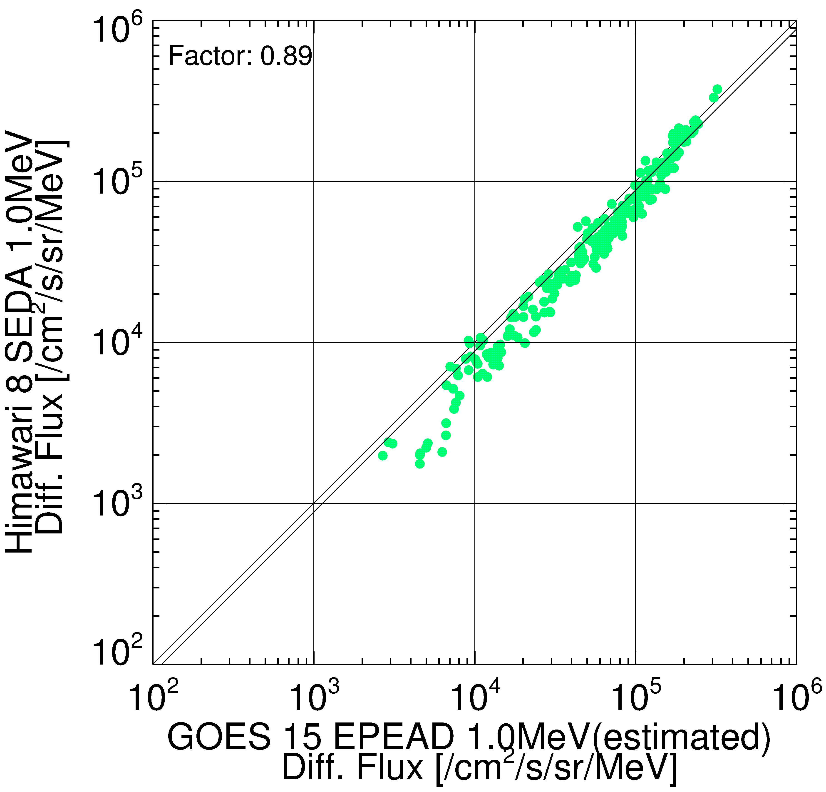
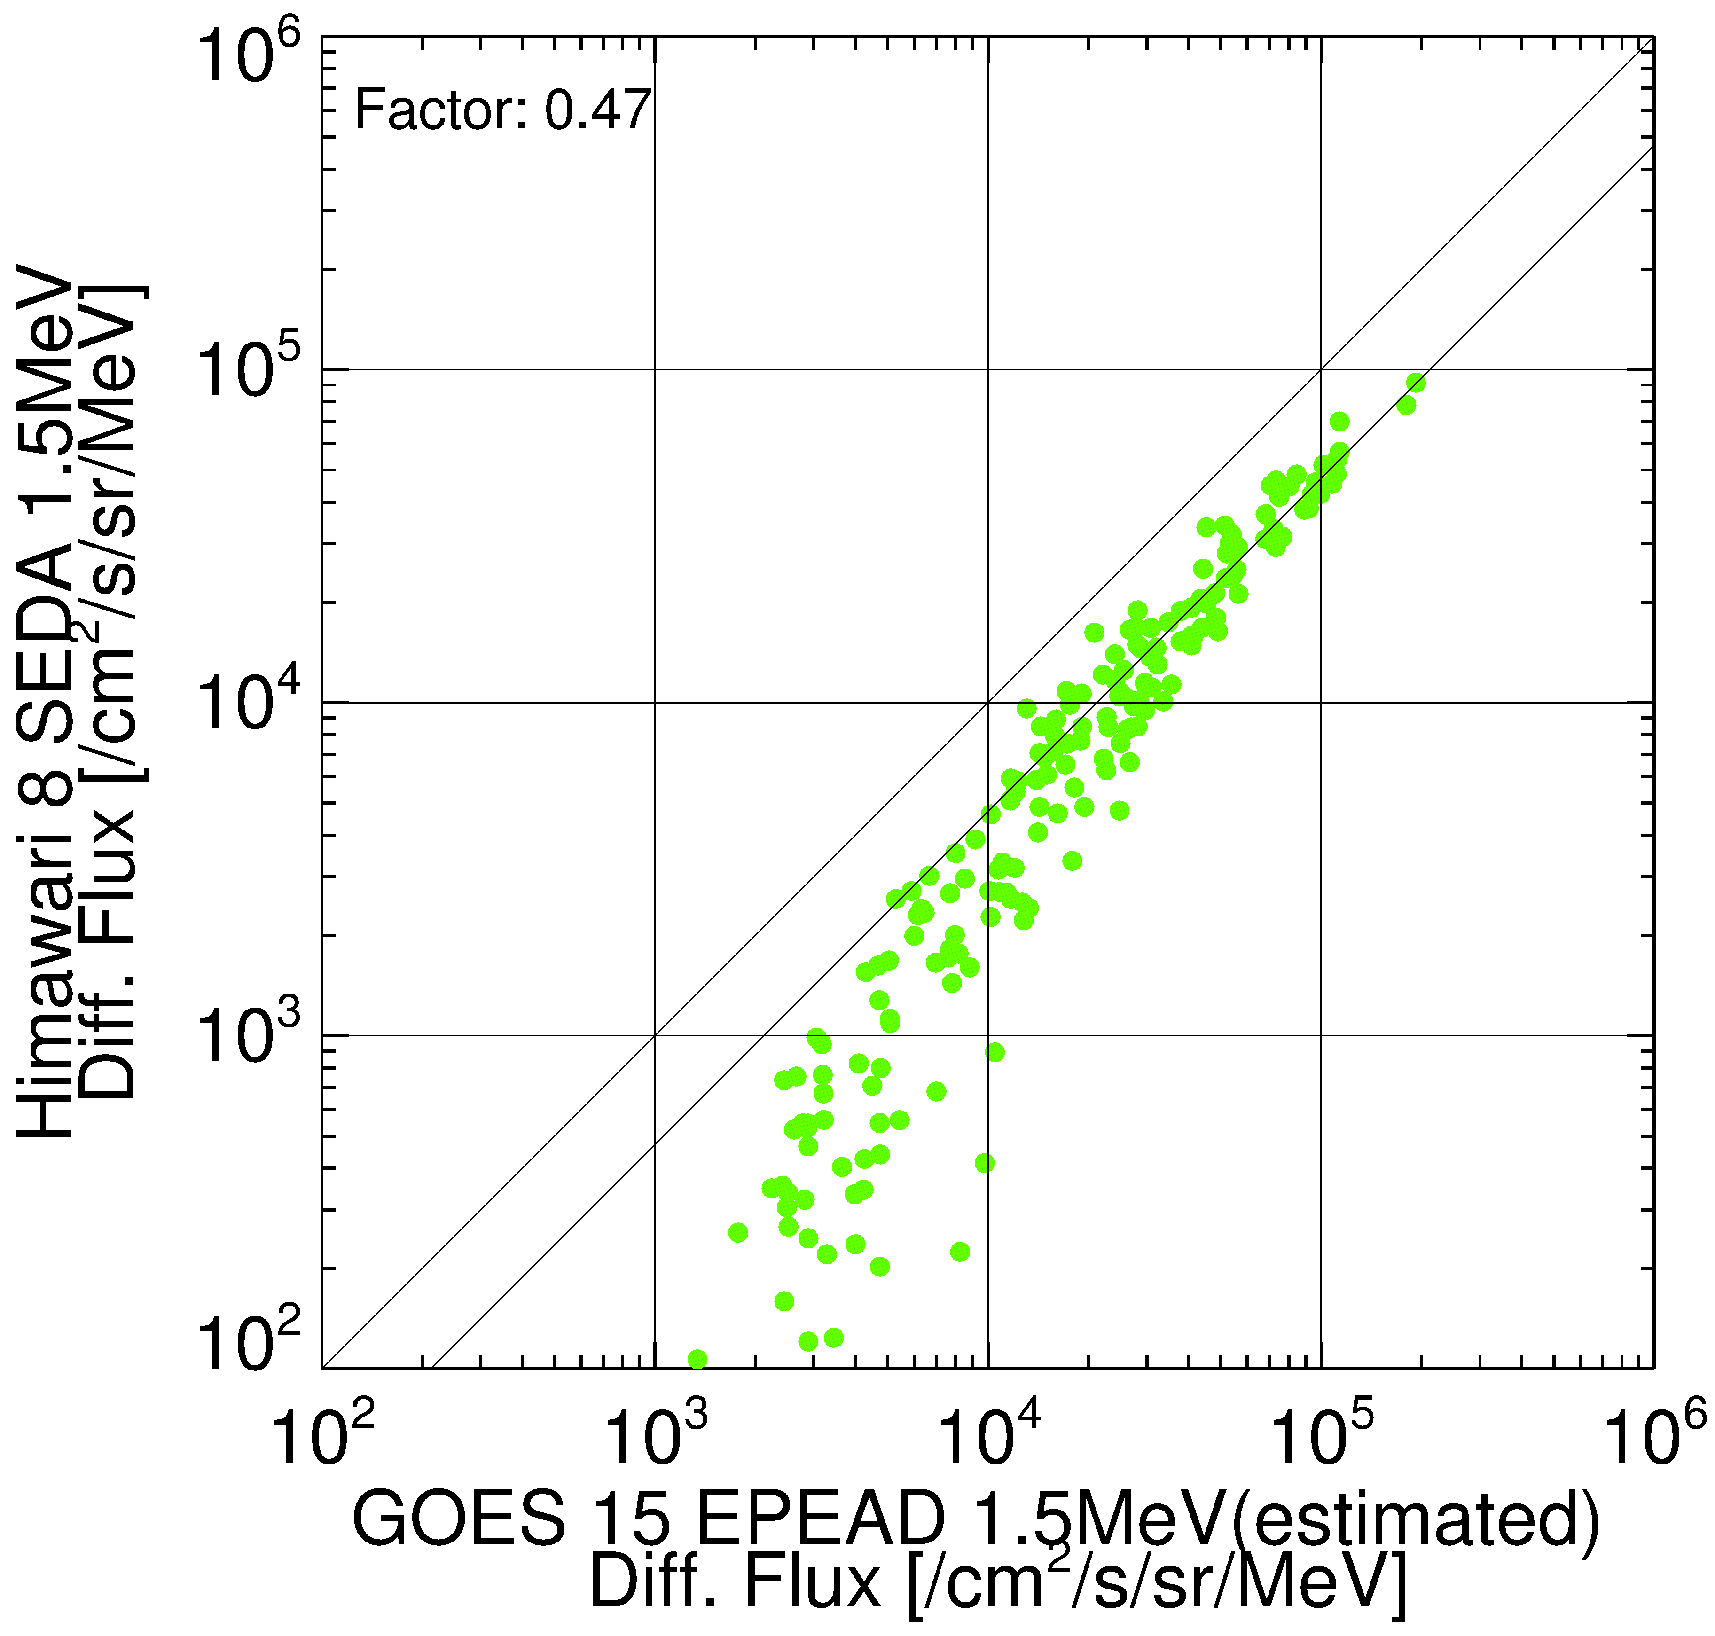
Comparison between Himawari-8 and GOES 15

Slide 13
Problems need to be discussed
How do we define standard method of inter-calibration for high energy electron measurements?
  Method of calibration
  How to compare high energy particle data which has different energy.
  We should refer a document published by COSPAR Panel on Radiation Belt Environment Modeling (COSPAR PRBEM).
How do we implement operational framework of inter-calibration for high energy electron measurements?
  We should learn GSICS framework for this.
We should start inter-calibration activities based on sharing specific period of data.

