Slide 1
Summary of 2019 GDWG breakout session
Masaya Takahashi (JMA)

Slide 2
Contribution to GDWG Session 5 ~ 10 attendees
CMA
ESA
EUMETSAT
ISRO
JMA
KMA
NOAA
ROSHYDROMET
USGS

Slide 3
Notable Meeting Highlights
13 Actions + 3 Recommendations Generated
3 ESA Talks
Mirko Albani: CEOS Working Group on Information Systems and Services (WGISS)
Andrea Della Vecchia: ESA Collaborative Environment for Cal/Val
Paolo Castracane: Introduction to EVDC (ESA Atmospheric Validation Data Centre)
Discussions
Websites, Collaboration Servers, Plotting Tool, PICS/SNO data sharing, Splitting user feedbacks into GRWG/GDWG actions, …

Slide 4
Discussions Summary (1) GSICS agencies’ websites
ROSHYDROMET New Website
A.GDWG.2019.6b.1: ROSHYDROMET to provide open access to their restricted areas on their website, to be discussed / confirmed in the EP meeting.
ESA
A.GDWG.2019.6c.1: ESA to consider preparing a GSICS website. If possible, present the progress at GSICS-EP-20 / future web meeting.

Slide 5
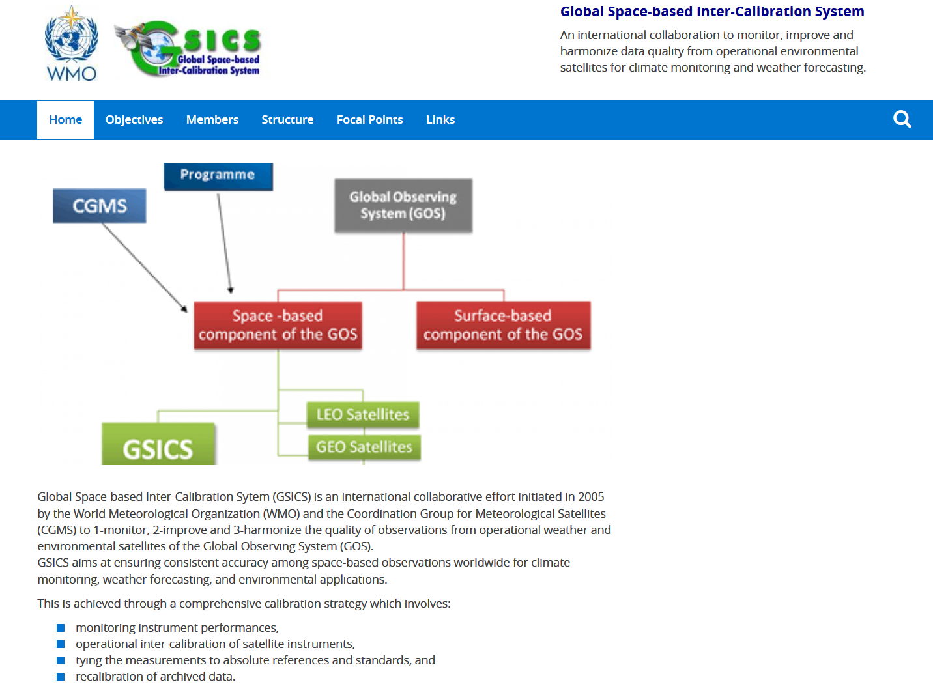
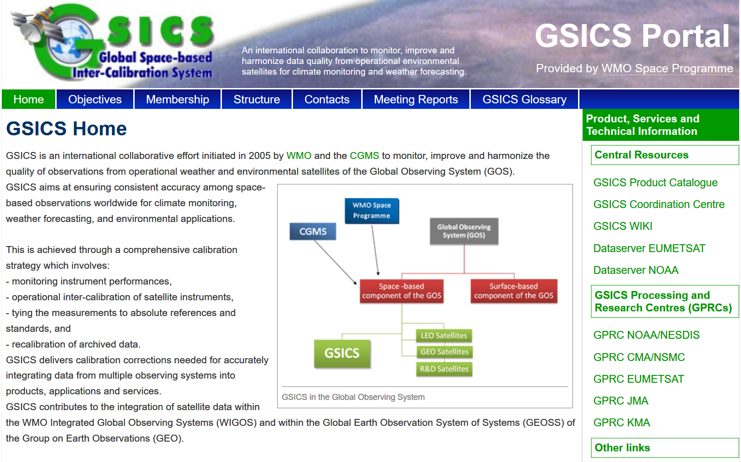
Discussions Summary (2) WMO GISCS Portal
A.GDWG.2019.6d.1: WMO to provide GDWG Chair with the user manual for updating WMO GSICS Portal and an account to familiarise with the system.
A.GDWG.2019.6d.2: GDWG Chair with the support from GDWG members to proposed how accounts are used based on the functionality implemented (updating logging, security concerns). The proposal is to be presented to EP for endorsement, documented in ToR.

Slide 6
Discussions Summary (3) GSICS Collaboration Servers
A.GDWG.2019.9b.2: CMA to work with ISRO to synchronise their RAC products between their servers to validate the synchronisation scripts.
A.GDWG.2019.9b.3: ISRO with support from EUMETSAT to update THREDDS configuration such that it is in-line with the other collaboration services.
A.GDWG.2019.9c.1: EUMETSAT to upload synchronisation perl and shell scripts to GitHub.

Slide 7
Discussions Summary (4) GSICS Plotting Tool
A.GDWG.2019.9b.1 KMA to work with ISRO to upload their plotting code and configuration onto the GSICS GitHub repository.
Future updates: integration of VNIR visualization on MICMICS

Slide 8
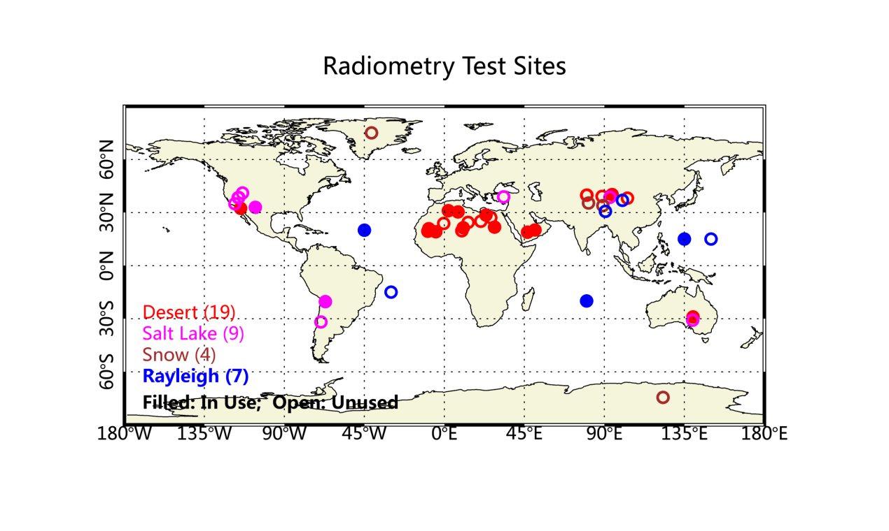
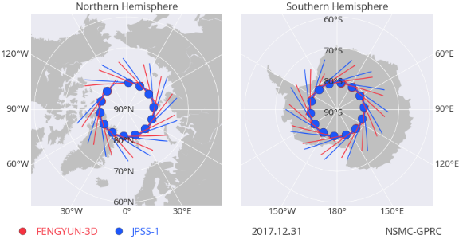
Discussions Summary (5) PICS/SNO L1 data sharing
CMA’s proposal
L1 subsets over PICS and SNO Prediction (filename list) on GSICS Collaboration Servers in near real time.
E.g. MODIS, VIIRS, GOME-2, SCIAMACHY, Hyperion
Sharing the Tools with GSICS community
A.GRWG.2019.9e.2: CMA (Lin Chen) EUMETSAT (Sebastien Wagner) to specify requirements and use cases for GSICS activities, and present them to GRWG see if this is useful for supporting GRWG activities.

Slide 9
Discussions Summary (6) Splitting user feedbacks into GRWG/GDWG actions
Feedbacks by Ken Knapp (NOAA) on Day-2 (3l)
Files behind a TDS are difficult to perform bulk downloads
It was not immediately clear what all the links were and which were useful and which were dead ends.
A.GDWG.2019.9p.1: EUM (Peter Miu) to create user guide for GSICS THREDDS.
A.GDWG.2019.9p.2: NOAA to provide EUMETSAT the download script for review to see if this can be provided to users to improve the downloading of GSICS products.
ATBDs are prominent but are less useful to end users (initially). User guides are especially helpful but are more difficult to access.
The adjustments provided do not also provide the calibration coefficients
Leaving the user wondering “Am I using the right calibration coefficients??”
A.GRWG.2019.9p.3: GRWG to consider improving the GSICS inter-calibration coefficients because they are difficult for the user to apply these corrections.

Slide 10
Discussions Summary (6) Splitting user feedbacks into GRWG/GDWG actions
Feedbacks by Ken Knapp (NOAA) on Day-2 (3l)
The GSICS websites appear to be developed for GSICS contributors
not users.
A.GCC.2019.9p.4: GCC to contact Ken Knapp to what website he refers regarding his comment on, and report this to the working group.
NRTC/RAC, Demo/PreOp/Op
for each satellite, provide one set of links with Status: Satellite Status GOES-13 pre-operational Near real time data Reanalyzed data User guide Meteosat-10 beta Near real time data Reanalyzed data User guide
Consider making a table of the above for each reference (e.g. IASI-A)
Consider including period of record in the tables
A.GCC.2019.9p.5: GCC to confirm with GRWG to release the next version of GSICS Product Catalogue URL.

Slide 11
GDWG WP 2019/2020
Synchronisation of GSICS Collaboration Servers
Interaction w/ CEOS WGISS
Sharing Plotting Tool codes on GitHub
Web Meetings
July 2019: THREDDS servers + Plotting Tool
Jan 2020: Progress meeting
Future chairing

Slide 12
Thank you for your attention

Slide 13
Action A.GDWG.2019.6a.1: CMA to take a lead in bringing the synchronisation script into operations. One done, the script can be rolled out to ISRO and NOAA.
Recommendation: There are a lot of old actions (2015…2017), GDWG members are requested to allocate time to completing their actions.
Action A.GDWG.2019.6b.1: ROSHYDROMET to provide open access to their restricted areas on their website, to be discussed / confirmed in the EP meeting.
Recommendation: all GSICS website, Wiki and WMO administrators are requested to refer to this presentation to update their websites.
Action A.GDWG.2019.6c.1: ESA to consider preparing a GSICS page for their website (please refer to presentation for minimal contents, this content may be updated for ESA's case as they do not develop calibration products). If possible, present in the next GSICS meeting / web meeting.
Action A.GDWG.2019.6c.1: Vice Chair (Pete) to check if GSICS membership is documented in the ToR, update if not.

Slide 14
Action A.GDWG.2019.6d.1: the WMO to provide the GDWG chair with the user manual for updating the WMO GSICS website and an account to familiarise with the system.
Action A.GDWG.2019.6d.2: the GDWG chair with the support from the GDWG members to proposed how these accounts are used based on the functionality implemented (updating logging, security concerns). The proposal is to be presented to EP for endorsement, documented in the ToR.
Action A.GDWG.2019.6e.1: Chair to present to recommendation to EP for endorsement and the update in ToR with the proposal. The chair shall coordinate the proposed update to the Common Table C-13 of the WMO manual on codes i.e. adding “SRF” string to the Data Designator table.
Action A.GDWG.2019.6e.2: WMO to provide the procedure for updating the Common Table C-13 of the WMO manual on codes to the GDWG chair so that the “SRF” string update can be performed.
Recommendation: WMO to consider the redesigning OSCAR/Space.

Slide 15
Action: A.GDWG.2019.9b.1 KMA to work with ISRO to upload their plotting code and configuration onto the GSICS GitHub repository.
Action: A.GDWG.2019.9b.2 CMA to work with ISRO to synchronise their RAC products between their servers to validate the synchronisation scripts.
Action: A.GDWG.2019.9b.3 ISRO with support from EUMETSAT to update their configuration such that it is in-line with the other collaboration services.
Action: A.GDWG.2019.9c.1 EUMETSAT to upload sync perl and shell scripts to GitHub.
Recommendation: CMA to submit CMA FY2 GEO-LEO-IR to GPPA.
Action: A.GDWG.2019.9e.1: Zhe Xu (CMA) and Peter Miu (EUMETSAT) to specify a product containing SNO/PICS and present this to the working groups for implementation if deemed to be useful.
Action:A.GRWG.2019.9e.2: Lin Chen (CMA) to specify requirements and use cases for GSICS activities, and present them to GRWG see if this is useful for supporting GRWG activities.

Slide 16
Action: A.GDWG.2019.9j.1 NOAA to reconfigure their GSICS server to following the THREDDS structure as agreed by the GDWG members (see: http://gsics.eumetsat.int/thredds/catalog.html, http://gsics.nsmc.org.cn/thredds/cmaProducts.html, http://gsics.nsmc.org.cn/thredds/isroProducts.html )
Action: A.GDWG.2019.9j.2 NOAA to check their links on the WMO website. See: https://gsics.wmo.int/en/product-services-and-technical-information
Action: A.GDWG.2019.9l.1 GDWG chair to provide GCC the recommendations for the actions tracker.
Action: A.GDWG.2019.9k.1 NOAA to present the options available for the Wiki migration to the GDWG member, and coordinate a way forward to present to the GSICS EP. Due by 30 April 2019.
Action: A.GDWG.2019.9p.1 Peter Miu (EUMETSAT) to create user guide for GSICS THREDDS.
Action: A.GDWG.2019.9p.2 NOAA to provide EUMETSAT the download script for review to see if this can be provided to users to improve the downloading of GSICS products.

Slide 17
Action: A.GRWG.2019.9p.3 GRWG to consider improving the GSICS inter-calibration coefficients because they are difficult for the user to apply these corrections.
Action: A.GCC.2019.9p.4 GCC is invited to contact Ken Knapp to what website he is referring to regarding his comment on its for contributors and not users, and report this to the working group.
Action: A.GCC.2019.9p.5 GCC to confirm with the GRWG to release the next version of the product catalogue address table concern from Ken

