Slide 1
GSICS Actions Tracker Live Demo
Manik Bali, Lawrence E. Flynn and Lori Brown
GSICS Annual Meeting 2019
Frascati, Italy , 3/8/2019

Slide 2
Outline
Introduction
What is Action Tracker
Google Cloud Solution
How to Use Action Tracker
Live Demo
Summary and Discussion

Slide 3
Introduction
Each year actions are generated in GSICS community.
These actions were previously monitored on the GSICS Wiki Page
Over the years activity in GSICS has increased as has the number of Actions generated in GSICS Annual, EP, UW and group and subgroup meetings.
GRWG placed a request to GCC-NOAA-GDWG to provide an alternative to the wiki actions page. Features that were requested.
Fast search.
Easy Action writing.
Easy updating.
Easy to understand layout.
New Category of actions ( For example, Lunar, Recommendation, Decision)
Some level of automation.
https://www.star.nesdis.noaa.gov/smcd/GCC/MeetingActions.php

Slide 4
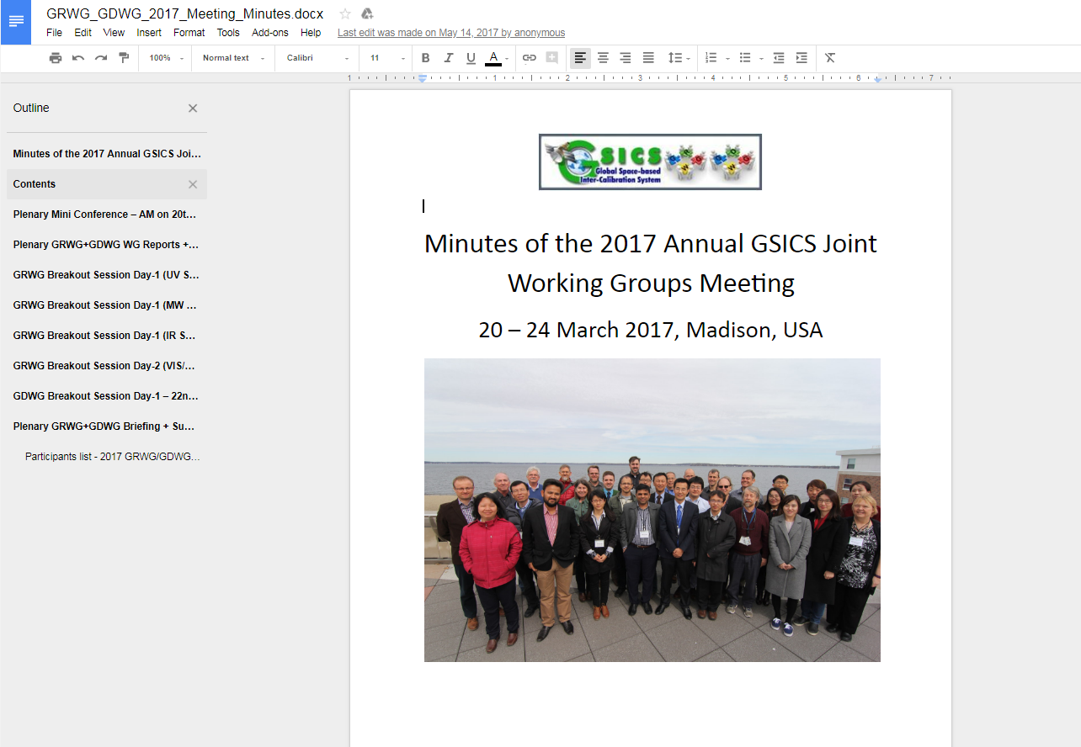
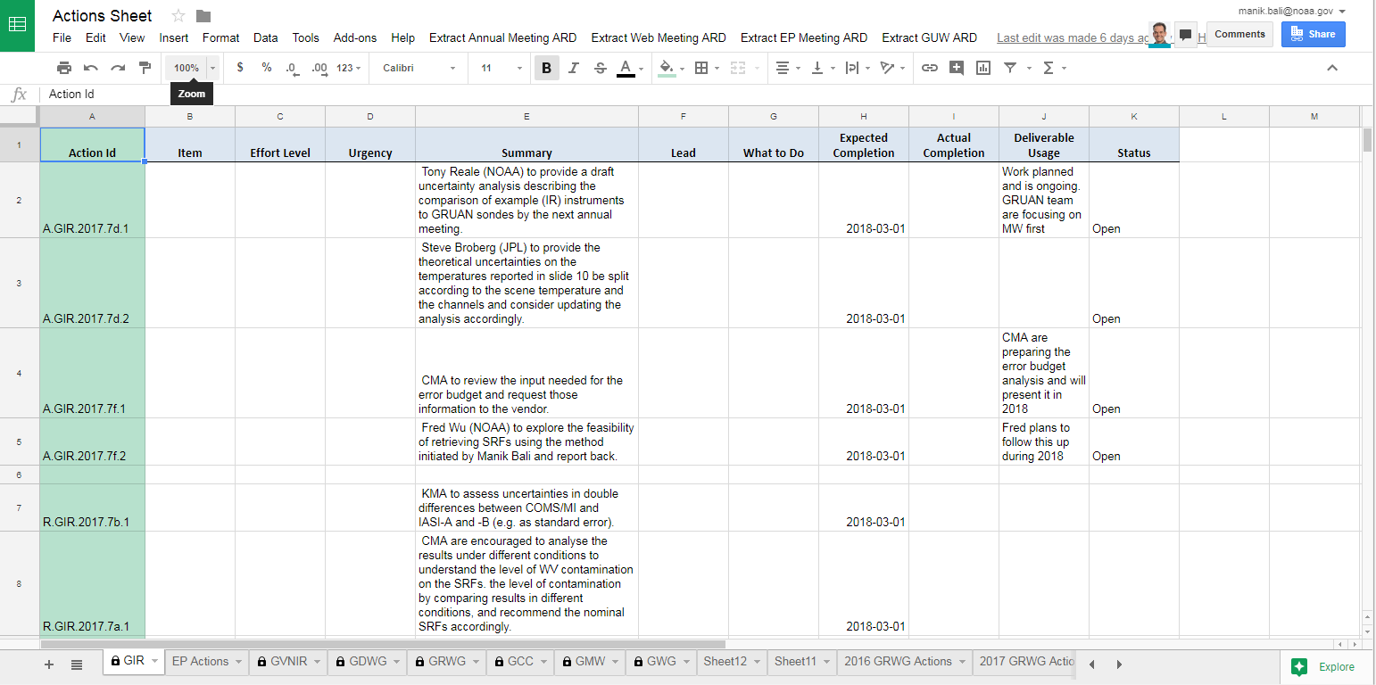
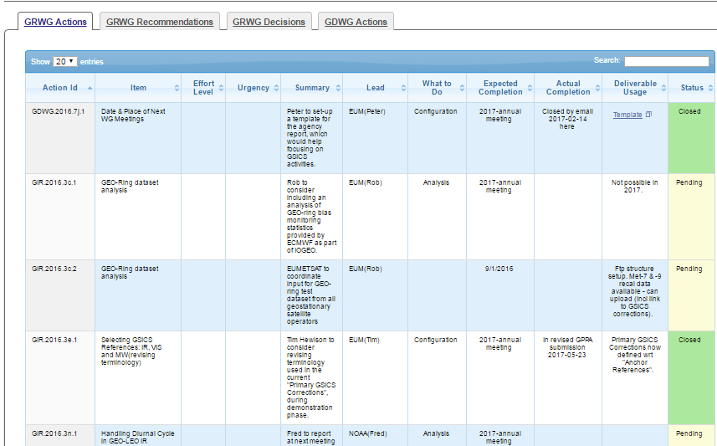
Approach - Google Cloud + Web

Slide 5
How to use Action Tracker and Demo Links
ARD Content
Where is the Action Tracker
Live Demo
Annual Meeting Document: GRWG_GDWG_2018_Meeting_Minutes
Web Meeting : http://gsics.atmos.umd.edu/bin/view/Development/20181114
EP Meeting document: GSICS-EP-19_Final-Report
How to use the Action Tracker has been summarized on the wiki
http://gsics.atmos.umd.edu/bin/view/Development/ActionTracker

Slide 6
Au
How to Use the Action Tracker
Automatically reads the Annual Meeting report Goodle Doc and extracts Actions/Recommendations/Decisions and puts them onto Google Sheet ( Direct Reduction of Overhead by 50% as compared to Wiki)

Slide 7
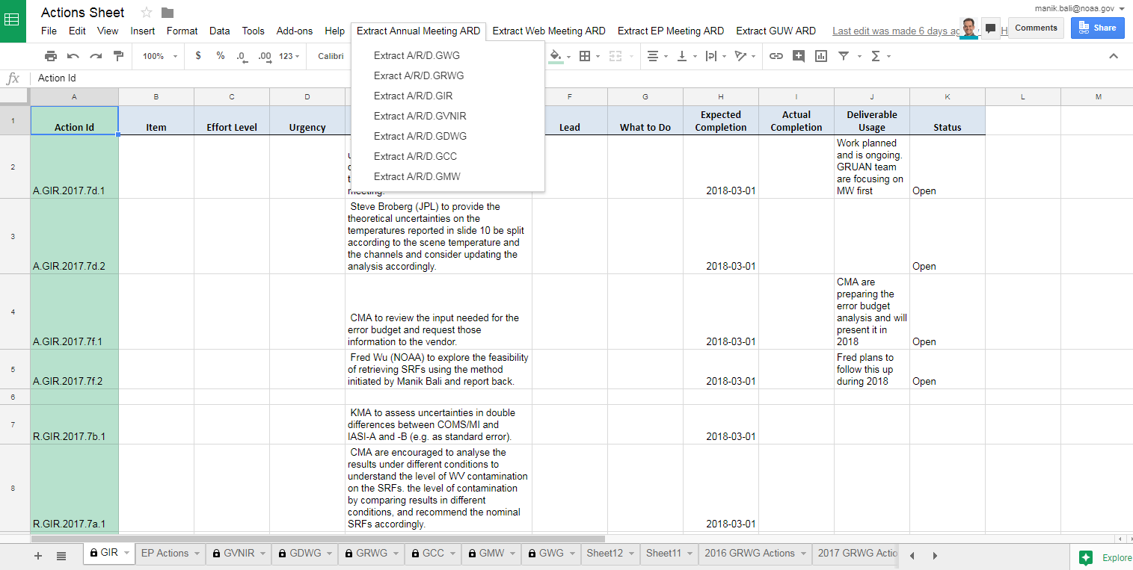
New Features
Dropdown Menu extracts Actions/Recommendations and Decisions from Annual GUW and EP meeting

Slide 8
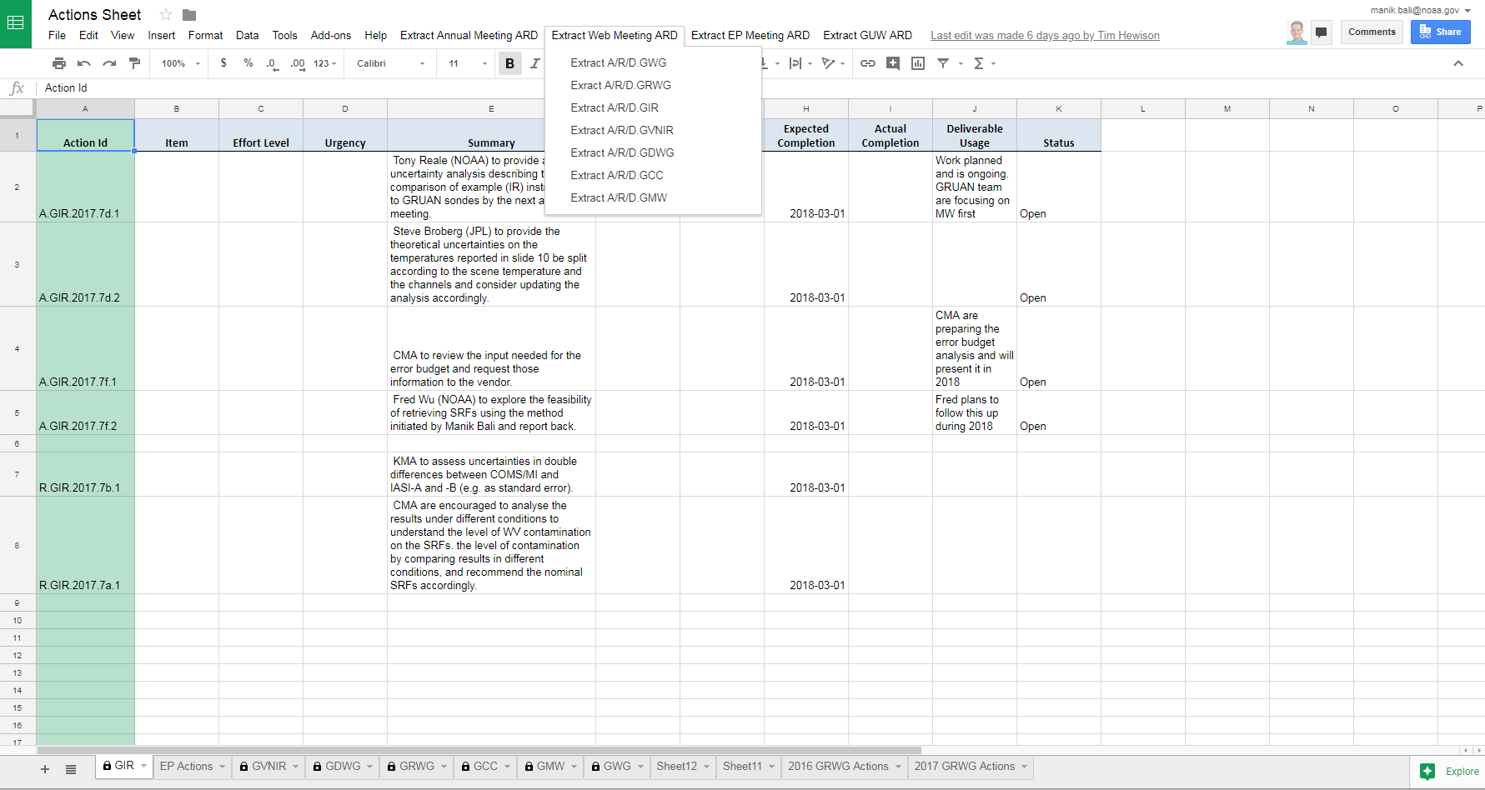
New Features
Dropdown Menu extracts Actions/Recommendations and Decisions from Annual GUW and EP meeting

Slide 9
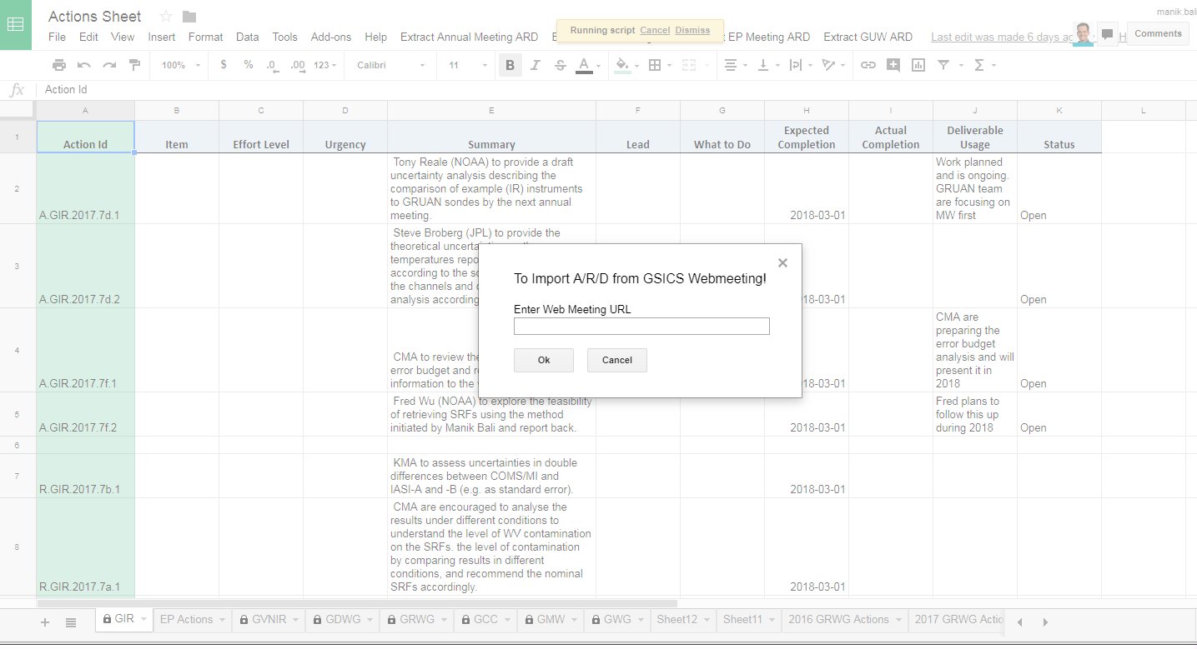
New Features
A new feature to extract Actions from Wiki page has been added and tested successfully.

Slide 10
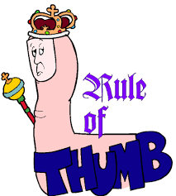
How to Use the Action Tracker
GCC creates a google Sheet for each type of action being tracked. The Sheet link is shared among GSICS members.
The actions are grouped into pages by year, each different type viewable on a separate tab. The content of the tables on the tabs are sortable and searchable.
If users need to add hyperlinks to any action sheet, users should use the ‘Activate Hyperlink’ button to activate on the google sheet to activate ithe hyperlink on the GCC Action Tracker website.
When users’ changes are saved, they are dynamically updated onto the correct Action Tracker page.
A.GroupID.YYYY.sessionID.Action number (Actions )
D.GroupID.YYYY.sessionID.Decision number (Decisions )
R.GroupID.YYYY. sessionID.Reccomendation number (Recommendations )
Always Use Actions/Recommendations/Decisions ID’s correctly
(Eg A.GDWG.2017.5a.8 )

Slide 11
ARD Format
A.GWG.2018.1g.1: Fred Wu (NOAA) to discuss with CMA potential sharing of GOES-R field campaign data for TANSAT validation.

Slide 12
Conclusion
A new Google based Action Tracker has been setup at NOAA.
The action tracker utilizes key features of the google sheets ( versioning, projects)
Tracker is fast and efficient
New features have been added to the tracker that streamline generated actions.
Utilizes the new Action naming convention.
New categories of actions have been created ( such as lunar, EP, Recommendation, Decisions)
Propose to migrate wiki from UMD to AE

