Slide 1
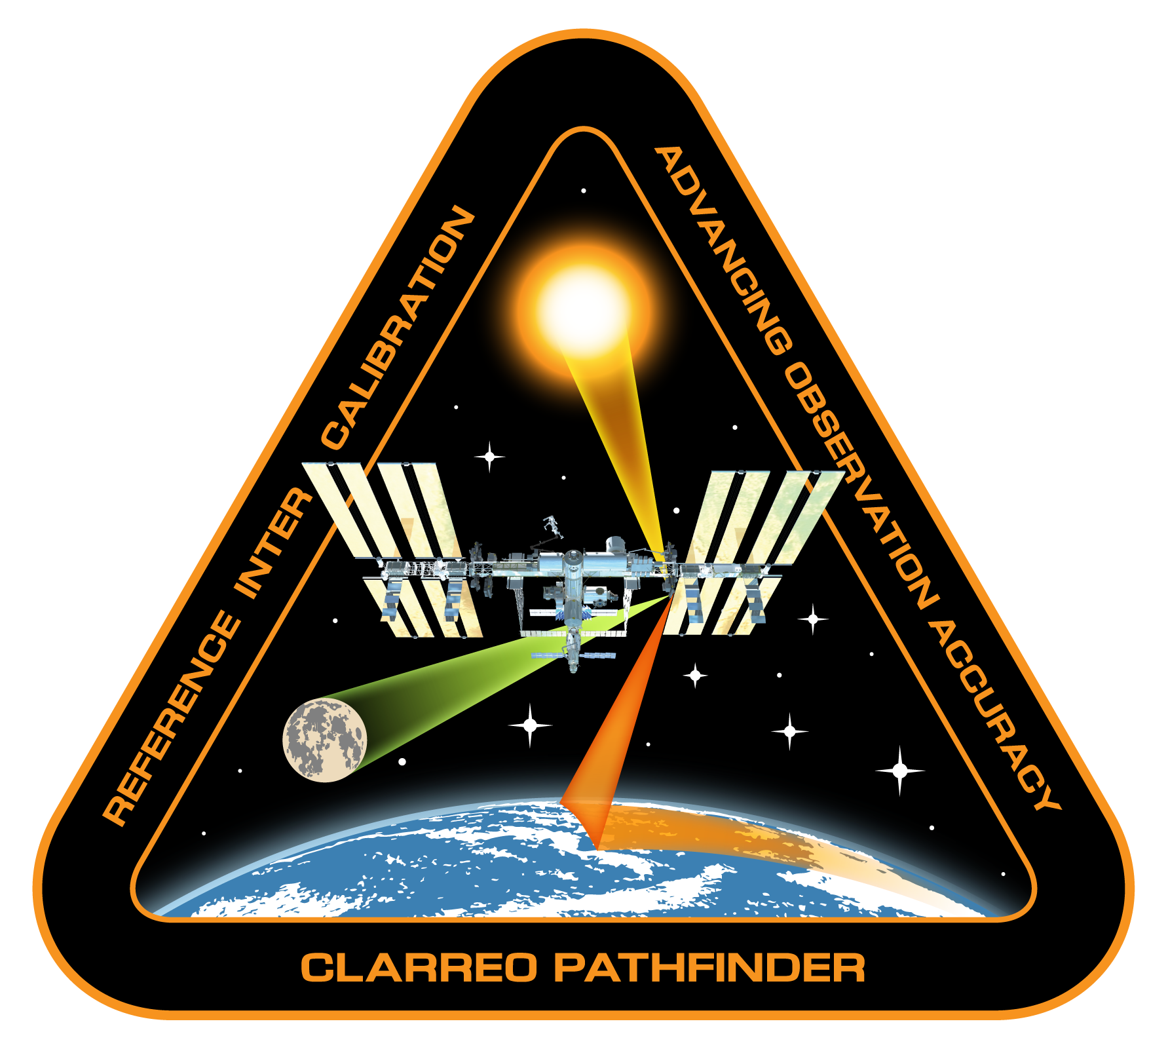
CLARREO Pathfinder Inter-calibration:
Requirements and Objectives
CLARREO Pathfinder Inter-Calibration Team
Presented by D. Doelling, NASA LARC

Slide 2
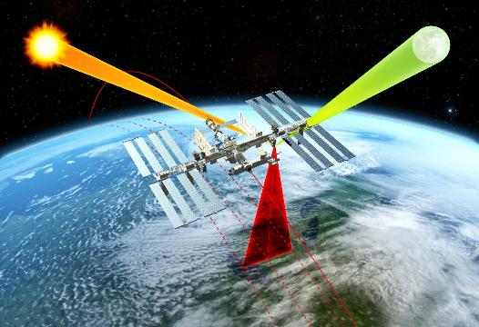
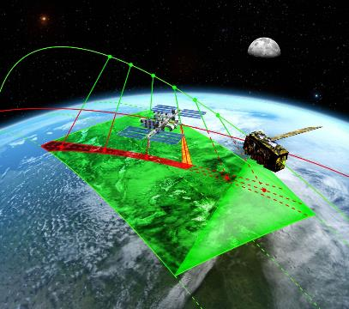
CLARREO Pathfinder: Baseline Mission Objectives
Demonstrate high accuracy SI-Traceable Calibration
Demonstrate Inter-Calibration Capabilities
Objective #1: Demonstrate the ability to conduct, on orbit, SI-Traceable calibration of measured scene spectral reflectance with an advanced accuracy over current on-orbit sensors using a reflected solar spectrometer flying on the International Space Station.
Objective #2: Demonstrate the ability to use that improved accuracy to serve as an in orbit reference spectrometer for advanced inter-calibration of other key satellite sensors across the reflected solar spectrum (350-2300 nm).

Slide 3
Inter-Calibration Requirements & Objectives
CLARREO Pathfinder will demonstrate essential technologies for high-accuracy measurement and inter-calibration within reflected solar spectral range:
  Aligned with ESAS 2017 funding of radiance inter-calibration being a targeted observable, and ESAS 2007 Tier-1 CLARREO mission
  Demonstrate on orbit, high accuracy, SI-Traceable calibration for measurement of Earth solar reflectance – 4 to 8 times more accurate than current best available sensors on orbit.
  Demonstrate ability to transfer this calibration to other on-orbit assets (VIIRS, CERES, and other assets as opportunities)
Reflected Solar (RS) Spectrometer, launched to the International Space Station (ISS)
Category 3 / Class D Mission, nominal 1-year mission life + 1 year science data analysis
Targeted for launch to ISS in early CY2023
Current status: Phase-B

Slide 4
CLARREO Pathfinder Mission Requirements
 | Measurement Uncertainty
Demonstration Parameter | Baseline Requirement* | Threshold Requirement**
Spectrally-Resolved Earth Reflectance (350 – 2300 nm): SI-Traceable, referenced to spectral solar irradiance | ≤ 0.3% (k = 1) | ≤ 0.6% (k = 1)
Spectrally-Integrated Earth Reflectance (350 – 2300 nm): SI-traceable broadband (350 - 2300 nm) spectrally-integrated Earth reflectance with spectral accuracy weighted using global average Earth spectrally reflected energy | ≤ 0.3% (k = 1) | ≤ 0.6% (k = 1)
On-Orbit Inter-Calibration***: Demonstrate the ability to Inter-Calibrate with CERES/RBI short wave channel and VIIRS reflectance bands | ≤ 0.3% (k = 1) | ≤ 0.6% (k = 1)
  *Baseline requirement is within a factor of 2 of full CLARREO Tier-1 Decadal Survey Mission
  Requirements
  **Threshold requirement is a factor of 2 (CERES) to 4 (VIIRS) better than current
  capabilities.
  ***Inter-calibration uncertainty are contributions from data matching noise

Slide 5
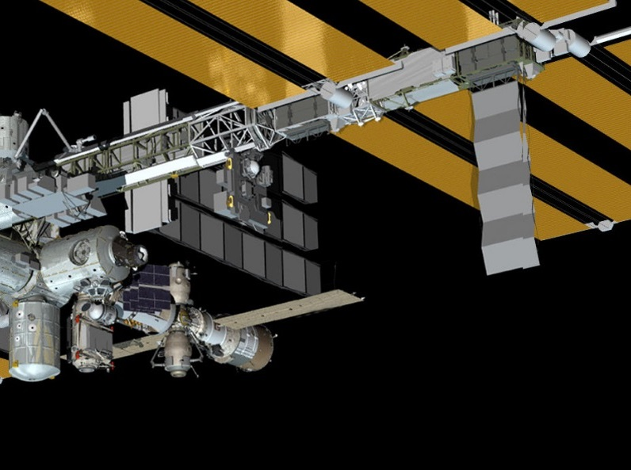
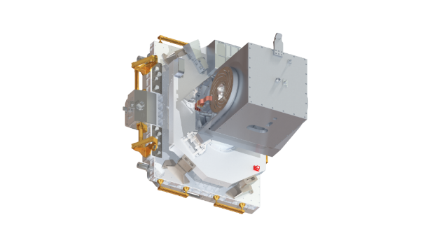
CLARREO Pathfinder Instrument: HySICS / LASP
Instrument: LASP Hyper Spectral Imager for Climate Science (HySICS):
  Field of View (cross-track swath): 10°
  IFOV: 0.2°
  Wavelength Range: 350 ‒ 2300 nm
  Wavelength Resolution: 6 nm, constant, Nyquist sampled
  Nominal frame rate: 15 Hz

Slide 6
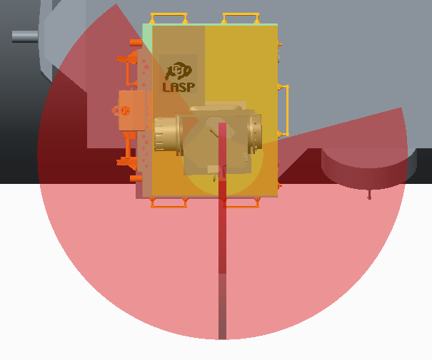
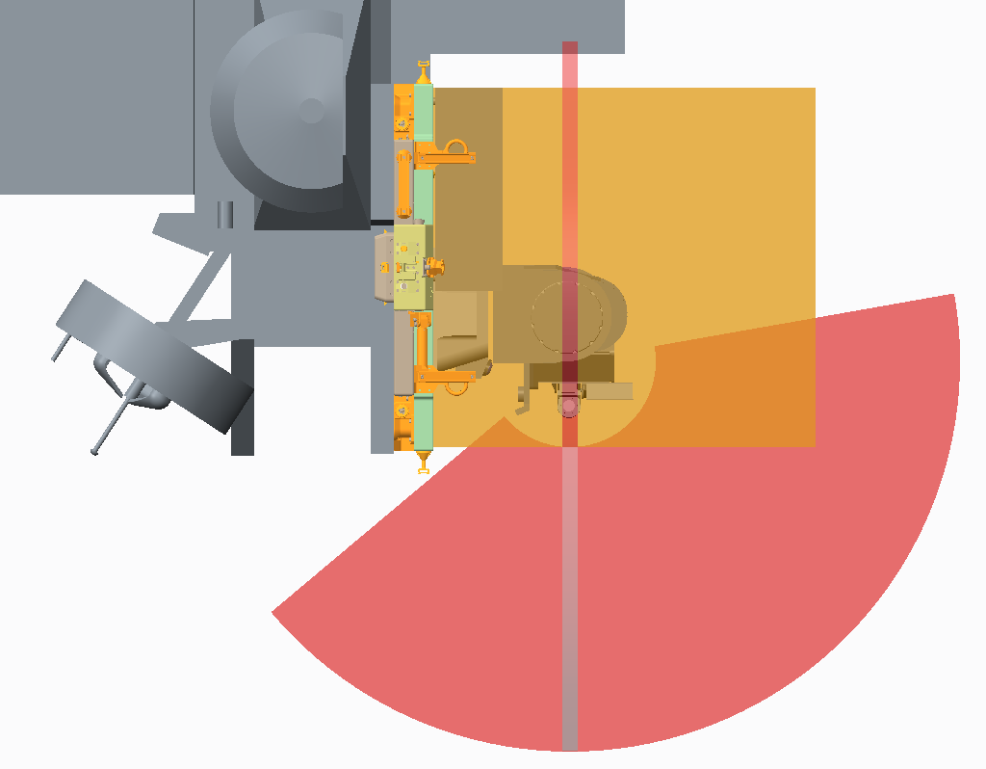
CPF Instrument Field-of-Regard from ELC-1 Site 3
Pitch
145º
Wake
Roll
-105º
Ram
Port
100º
100º
Starboard
+x
0º
+z
-50º
Accommodation studies by the CPF team
0º
+y
+z
Gimbal configuration: pitch - roll
Approximate gimbal range of motion at ISS ELC-1 Site 3.
Some FOR obscuration due to ISS accommodation.

Slide 7
CPF/CERES Inter-calibration: Algorithm sequence
Rectangles: data
Circles: algorithms
Data Inputs:
CLARREO Pathfinder Level-1B data
CERES Level-2 SSF data product
CERES Point Spread Function LUTs
PCRTM LUTs for SW broadband corrections
PCRTM LUTs or ADMs for SW angular correction (TBD)
Algorithms:
CPF convolution over CERES PSF (with stats)
Scene ID (clouds, aerosols) summary from SSF
SW broadband corrections in UV and NIR
Angular corrections (TBD)
Distributed and archived CPF data products (red)
For IC-SDS see presentation by Chris Currey

Slide 8
CPF/VIIRS Inter-calibration: Algorithm Sequence
Rectangles: data
Circles: algorithms
Data Inputs:
CLARREO Pathfinder Level-1B data
VIIRS Level-1 and Level-2 data products
PDMs LUTs (empirical and theoretical)
PARASOL Level-1 and Level-2 data for PDMs
PCRTM LUTs for angular corrections (TBD)
Algorithms:
CPF Level-1B convolution over PSF about 10 km
VIIRS Level-1B convolution PSF about 10 km
Convolution/Interpolation of VIIRS Level-2 data
- Cloud mask is convolved
- Cloud and aerosol parameter are interpolated to
the center of PSF
Spectral convolution of CPF over VIIRS RSRs
Polarization estimates
Multi-band angular corrections (TBD)
Distributed and archived CPF data products (red)
For IC-SDS see presentation by Chris Currey

Slide 9
Inter-calibration Event Prediction
Prediction of the inter-calibration events with CERES and VIIRS:
Prediction by orbital modeling
Assess the value for every event by modeling & analysis
Deliver event parameters to instrument operations team (CPOC)
Results from C. Roithmayr
Geolocation of the ISS ground track during each opportunity to take measurements for inter-calibrating JPSS cross-track sensors CERES and VIIRS.
Instrument FOV = 10º
Time matching 10 minutes
1308 inter-calibration opportunities over 1 year

Slide 10
Inter-calibration Sampling Estimates
Simulation ISS ELC-1 Site 3:
10 minutes time matching
Instrument field-of-regard
Instrument FOV = 10º
Instrument FOV obscuration = 0%
Event duration > 30 seconds
SZA < 75º
N good events = 1163
Required Sampling Monthly
VIIRS:
100 samples every 5 sec
(IC 10 km samples)
CERES:
3 FOVs every 5 sec
(conservative estimate)
Required Sampling Monthly
Margin: 44% for inter-calibration
operations not-available
CERES: requires 10 scan angle bins with 500 inter-calibration samples each
VIIRS: requires 10 scan angle bins with degree of polarization polarization < 0.1
500 inter-calibration samples each (factor of 4 due to low DOP)

Slide 11
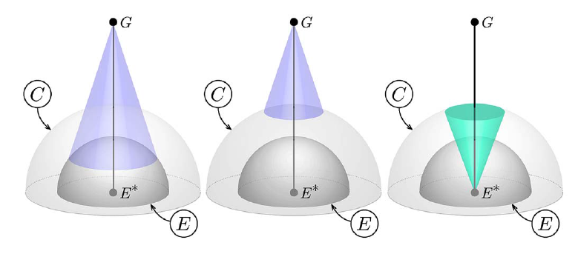
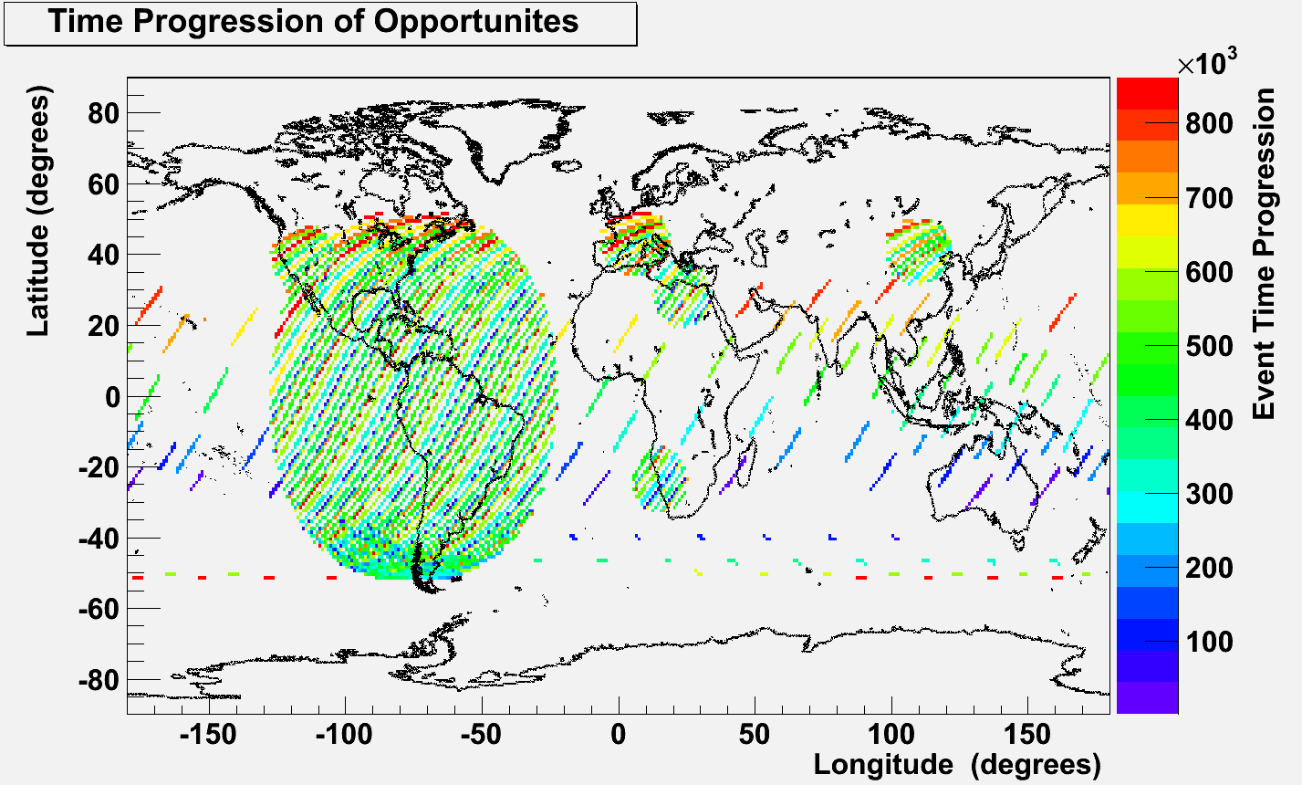
Inter-Calibration Opportunity: GEO imagers
Roithmayr et al., 2014
SENSORS:
GEO imagers (TBD):
- NOAA ABI on GOES-16
- EUMETSAT
- ESA GERB
Sampling example:
10 days for GOES 75 W
(from ISS orbit)

Slide 12
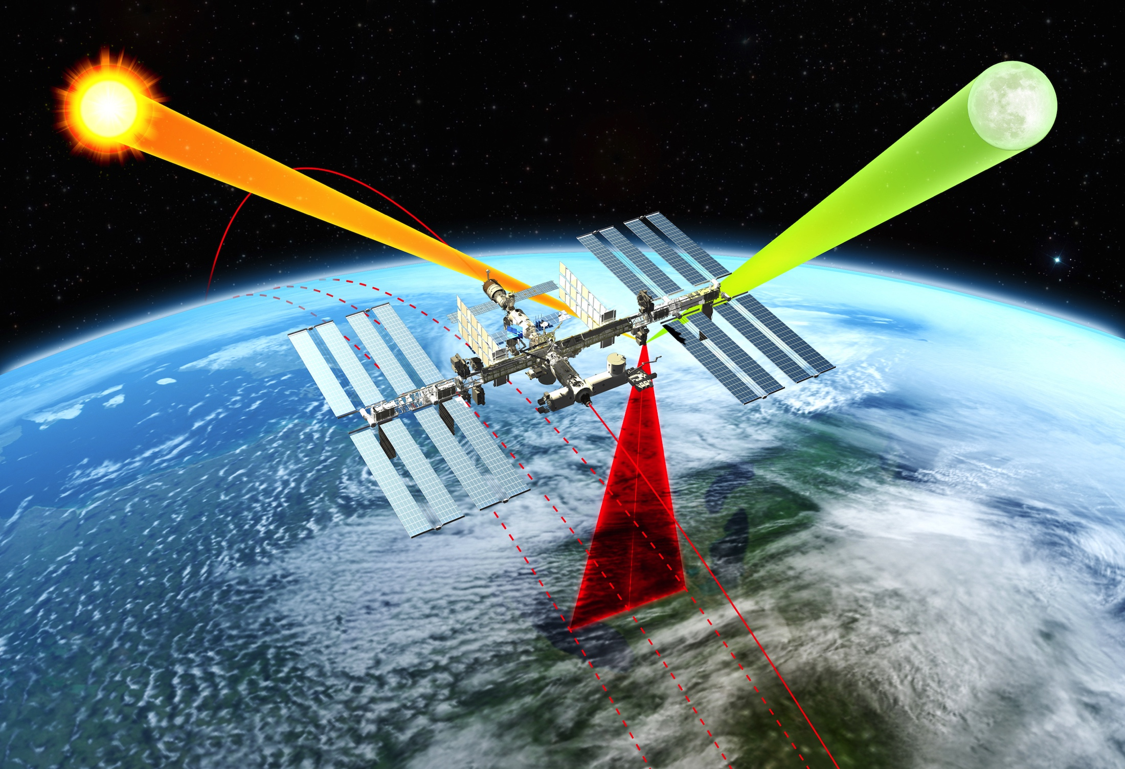
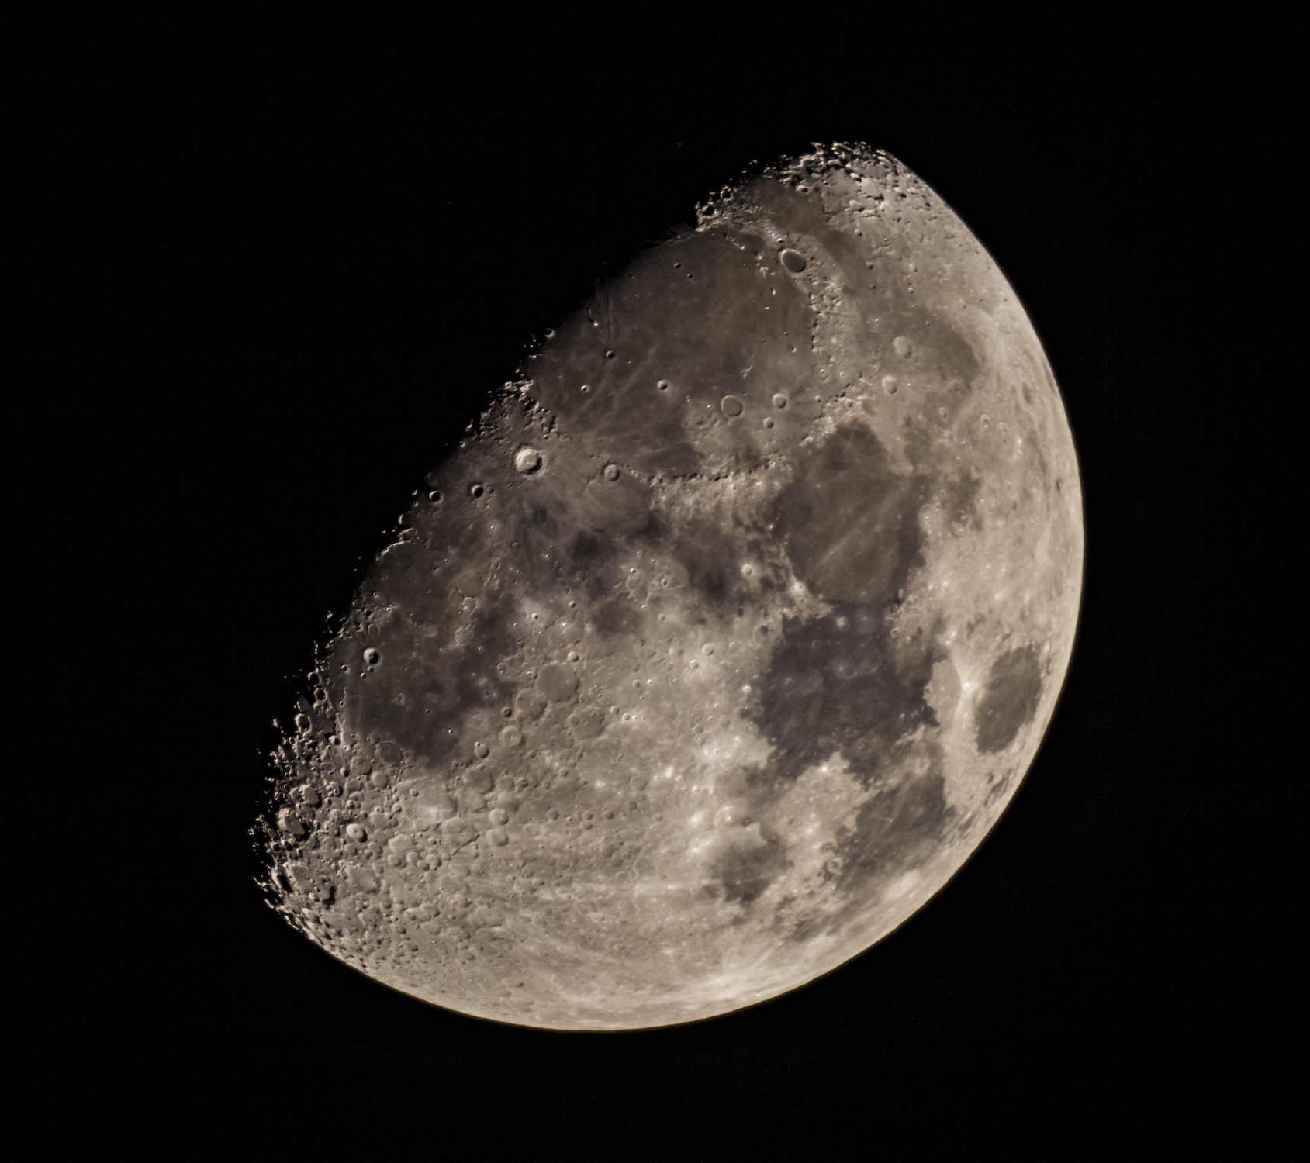
Inter-Calibration Opportunity: Lunar Reflectance
CALIBRATION TARGET:
Moon: improve accuracy of lunar spectral reflectance
Reflectance of Lunar surface stable to < 10⁻⁸
NOTE:
ARCSTONE is a parallel project funded by the NASA ESTO to calibrate Lunar spectral reflectance from space with cubesat implementation.
Currently at TRL3
Expected TRL5 in September 2019
© 2019, C. Lukashin

Slide 13
CLARREO Inter-Calibration: Key Publications
Roithmayr, C.M., and P.W. Speth, 2012: “Analysis of opportunities for intercalibration between
two spacecraft,” Advances in Engineering Research Vol. 1, Chapter 13, Edited: V.M.
Petrova, Nova Science Publishers, Hauppauge, NY, pp. 409 - 436.
Lukashin, C., B. A. Wielicki, D. F. Young, K. Thome, Z. Jin, and W. Sun, 2013: “Uncertainty
estimates for imager reference inter-calibration with CLARREO reflected solar spectrometer,”
IEEE Trans. on Geo. and Rem. Sensing, special issue on Intercalibration of satellite instruments,
51, n. 3, pp. 1425 – 1436.
Roithmayr, C. M., C. Lukashin, P. W. Speth, G. Kopp, K. Thome, B. A. Wielicki, and D.F. Young,
2014a: “CLARREO Approach for Reference Inter-Calibration of Reflected Solar Sensors:
On-Orbit Data Matching and Sampling," IEEE TGRS, v. 52, 10, pp. 6762 - 6774.
Roithmayr, C. M., C. Lukashin, P. W. Speth, D.F. Young, B.A. Wielicki, K. J. Thome, and G.
Kopp, 2014b, “Opportunities to Intercalibrate Radiometric Sensors from International Space
Station,” J. of Atm. and Oce. Tech., DOI: 10.1175/JTECH-D-13-00163.1.
Wu, A., X. Xiong, Z. Jin, C. Lukashin, B.N. Wenny, J.J. Butler, 2015: “Sensitivity of Intercalibration
Uncertainty of the CLARREO Reflected Solar Spectrometer Features,” IEEE TGRS, v. 53, 4741 - 4751,
10.1109/TGRS.2015.2409030
Sun W., C. Lukashin, and D. Goldin, 2015: “Modeling polarized solar radiation for CLARREO
inter-calibration applications: Validation with PARASOL data," J. Quant. Spectrosc. Radiat.,
v. 150, pp. 121 - 133.
Sun, W., R.R. Baize, C. Lukashin, and Y. Hu, 2015: “Deriving polarization properties of
desert-reflected solar spectra with PARASOL data,” Atmos. Chem. Phys., 15, 7725 - 7734,
doi: 10.5194/acp-15-7725-2015.

Slide 14
BACKUP SLIDES

Slide 15
CPF/CERES Inter-calibration: Data Products
External data dependency: CERES SSF data product
Note: Current CERES SSF product contains 50% of footprints (to reduce data volume)
Request the CERES team to process 100% of footprints for the CPF inter-calibration
Product | Contents | Resolution | Granule
CPF/CERES Level-1B Data Product | Calibrated and geo-located CPF observations matched on orbit to the CERES data: - Spectral reflectance - Spectral radiance - Uncertainties - Geolocation | Full spectral resolution Spatial resolution at 0.5 km | Each granule contains single CPF inter-calibration event (TBD)
CPF/CERES Level-4 Data Products | - Matched CERES footprint geolocation and radiance - CPF radiance convolved over CERES PSF for all matched CERES footprints. Cloud and Aerosol data from CERES SSF. - PCTRM Broadband SW corrections in UV and NIR) - Angular broadband SW correction (TBD) | CPF Level-1B data spatially convolved over CERES FOV’s PSF (about 2.6º) Integrated SW broadband radiance (from 200 nm to 5000 nm) | Each granule contains single CPF inter-calibration event (TBD)

Slide 16
CPF/VIIRS Inter-calibration: Data Products
External data dependency: VIIRS Level-1B and Level-2 data products
(reflectances, cloud mask, cloud parameters, aerosol parameters)
Note: The VIIRS Level-2 Clouds NASA data products are not operational yet (CPF-SER-015 by Y. Shea)
The VIIRS Level-2 Aerosol NASA data products start to be produced.
Current path forward is to use MODIS/Aqua data
Product | Contents | Resolution | Granule
CPF/VIIRS Level-1B Data Product | Calibrated and geo-located CPF observations matched on orbit to the VIIRS data: - Spectral reflectance - Spectral radiance - Uncertainties - Geolocation | Full spectral resolution Spatial resolution at 0.5 km | Each granule contains single CPF inter-calibration event (TBD)
CPF/VIIRS Level-4 Data Products | - CPF/VIIRS inter-calibration samples geolocation. - CPF/VIIRS reflectance convolved over sample PSF. - CPF reflectance spectrally convolved over VIIRS RSRs - Cloud and Aerosol data from VIIRS Level-2 products. - Angular narrowband corrections (TBD) - Polarization estimates | CPF Level-1B data spatially convolved over CPF/VIIRS PSF (about 10 km) Convolved reflectance over VIIRS RSRs (multi-spectral) | Each granule contains single CPF inter-calibration event (TBD)

Slide 17
Inter-Calibration: Current Work
CLARREO Pathfinder Phase-B work:
Refining inter-calibration planning and sampling:
- Orbital prediction and pointing
- ISS-related algorithms, obscuration, impact on pointing
- Definition of event priority and planning cycle
- Continue inter-calibration sampling studies
Definition of data products
PCRTM-based algorithms for angular and broadband modeling
Data product simulation for selected inter-calibration events
ATBD draft including:
- Required data inputs and interfaces
- Uncertainty budget for VIIRS inter-calibration
- Uncertainty budget for CERES inter-calibration
Theoretical and empirical PDM development and validation
PDM application software prototype
Coordination with DMT on algorithms implementation

