Slide 1
Introduction to Mini Conference & GSICS
Xiuqing Hu, Dohyeong Kim, Fangfang Yu
GRWG Chair

Slide 2
Overview of GSICS

Slide 3
Background of GSICS
The Global Space-based Inter-Calibration System (GSICS) :
initiated in 2005 by the WMO and the CGMS
was recognized in 2009-2011 as a Pilot Project in the Demonstration Phase of the WMO Integrated Global Observing System(WIGOS)
Satellites
& Sensors
Satellite
Data
Consistent
Calibrated
observations
Essential
Climate
Variables
User &
Organizations
GCOS
GSICS
SCOPE-CM

Slide 4
GSICS?
Why GSICS?
Space-based observations from various satellite missions must be precisely calibrated with similar methods against common references
Poor or inhomogeneous calibration results in degraded performance and lower benefits
CGMS members are collaborating within GSICS to develop and apply “best practices” for homogeneous calibration
What is GSICS?
Scope of GSICS?
ensures consistent calibration of satellite measurements and tie the measurements to SI reference standards
defines and implements procedures for operational, in-orbit satellite inter-calibration;
relates the measurements of one instrument to those of a reference instrument with a stated uncertainty.
The overlapping records of two satellite instruments can be compared once a number of effects, such as diurnal cycle, are taken into account.
GSICS inter-calibration allows biases to be removed among satellite measurements.
coordinates the systematic generation to correct the individual calibration(Level 1)
a range of activities related to:
Instrument Level 1 data monitoring
comparison with references
routine generation of corrections in near real-time
provision of algorithms enabling recalibration of archived data
traceability to absolute calibration standards
prelaunch instrument characterization
post-launch instrument validation
documentation on state-of-the-art calibration techniques

Slide 5
Who benefits from GSICS ?
Satellite operators
Sharing development effort and resources (calibration references, datasets, software tools)
Capacity building (best practices for instrument monitoring, traceability, sensor comparison and correction)
Improved instrument assessment, faster identification and correction of anomalies, facilitating commissioning and operation
Interoperability within the CGMS constellation
Satellite data users
Improved calibration
Interoperability through inter-calibration
Assessments, reports, for better understanding
Algorithms enabling to reprocess data records
GSICS leverages the value of individual missions

Slide 6
Evolving scope of GSICS
Started with IR calibration corrections (GEO-LEO)
Continued with VIS/NIR domain
Now addressing also the UV and MW domains
Started with Near Real-Time correction functions
Added Re-analysis corrections
Considering now a wider variety of deliverables depending on user requirements
New special session reprocessing/Recalibration will initiate in this annual meeting
Space weather instrument inter-calibration from CGMS-44 last year
And others…

Slide 7
GSICS Services and Tools
General information services
GSICS portal maintained by WMO (http://gsics.wmo.int)
GCC website maintained by the GSICS Coordination Center
GSICS related websites maintained by each member agency
GSICS User Messaging Service managed by the GCC
GSICS Product Catalogue
GSICS Quarterly newsletter
GSICS User Workshop
GSICS Wiki providing access to technical documentation (ATDB of each product and recording presentations from the GRWG and GDWG meetings)
Specific tools
GSICS Data and Products Servers (at EUMETSAT, NOAA, CMA)
GSICS product generation framework and products format checker
GSICS Implementation of the ROLO Model (GIRO) lunar calibration software and associated GSICS Lunar Observation Dataset
Various software tools(Bias plotting tool)
New tool is ready by CMA for extracting SNO and PICS sub-dataset from some typical instruments (MODIS, MERSI)

Slide 8
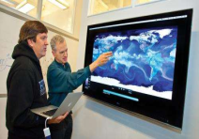
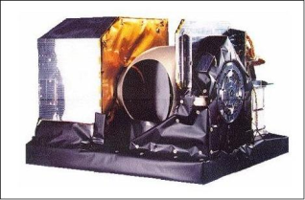
GSICS deliverables
Core GSICS inter-calibration products
Instrument behaviour assessment
Instrument correction algorithms
Near Real Time corrections
Time–centered corrections
Users
Monitored instrument
Bias adjustment sequences(archive)
Science resources
Solar & lunar spectra
Target characteristics
Calibration datasets
etc.
Spectroscopy database, RTM
Standards & procedures
References (benchmarks)
Metadata & Data Formats
Standard vocabulary
Procedures
etc.
GSICS tools
SNO matchup
Bias monitoring
Ray matching
Plotting, readers
etc.
User services
Registration, messaging
Product catalogue
Data servers
wiki, website
Documentation info, etc.

Slide 9
GSICS Members
WMO
EUMETSAT
ROSHYDROMET
CNES
USGS/NOAA
NASA/NIST
KMA
JMA/JAXA
CMA
IMD/ISRO
Obs. ESA, CEOS(WGCV)
ASSO. GPM X-cal
14 Members Worldwide

Slide 10
GSICS Structure
CGMS satellite operators
CGMS satellite operators
CGMS satellite operators
CGMS satellite operators
WMO
GSICS Exec Panel
GSICS Coordination Center
GSICS Research Working Group
GSICS Data Working Group
UV Sub-Group
IR Sub-Group
WGCV IVOS
WGCV MWSG
GPM X-CAL
WGCV ACSG
VIS/NIR Sub-Group
Microwave Sub-Group

Slide 11
Highlight of GSICS activities

Slide 12
IR Product Development within GSICS (IR)
GEO-LEO IR hyperspectral
Progress existing products to Operational Status
Promote new products to Demonstration Status
Application of Prime GSICS Correction concept
To merge multiple reference instruments
To allow corrections to cover diurnal cycle
Scope potential new GSICS products/deliverables
Alternative inter-calibration algorithms
Retrieved SRFs
GEO-GEO inter-calibration (part of GEO-ring)
LEO-LEO inter-calibration
Traceability of Reference Instruments
Plans for TANSO-FTS/2 & CLARREO
GSICS IR Reference Sensor Traceability and Uncertainty Report

Slide 13
DCC calibration Status (VIS/NIR)
Started in 2014
NASA Langley provided all GPRCs verification data to validate the proper implementation according to ATBD submitted in 2011
The DCC method has been implemented by all GPRCs by 2015 and reported on their status and issues of the implementation
The DCC methodology provides excellent estimate of the relative degradation of the monitored instrument, however the GEO domain specific DCC methodology noise can be reduced by adjusting DCC methodology components as needed
1) DCC BRDF
KMA has also evaluated RTM based method developed by SNU
CNES has defined the more Lambertian part of the BRDF
2) DCC deseasonalization
NOAA, EUMETSAT, CMA have developed methods
3) DCC statistics and identification (to provide sufficient sampling)

Slide 14
Improving the lunar reference
Improvement of the reference standard for lunar calibration
to improve absolute accuracy
to reduce residual geometry dependencies (phase, librations)
The reference irradiance is generated for each observation of the Moon taken by an instrument by computing the lunar model(ROLO, GIRO)
Requirements for Absolute Lunar Calibration Reference
reprocessing the ROLO telescope dataset using new algorithms
incorporating reliable new observational data e.g. PLEIADES
lunar radiometry e.g. SNPP VIIRS
collecting new radiometric measurements of the Moon
requirements:
high-accuracy, with traceability to SI
full spectral coverage at moderate spectral resolution
photometric geometry coverage (phase and librations) sufficient for high-precision modeling

Slide 15
Operational coordination
GSICS Procedure for Product Acceptance
(based on QA4EO, a series of reviews over period of ~1.5yr)
Development Phase
GOES-sounder, FY2E-2H, FY-4A
EUM (MET-7), JMA(Himawari-8), KMA(COMS), ISRO(INSAT-3D)
Pre-operational Phase
GOES-13, 15 (NRT&RAC). GOES-11, 12 (NRT)
Operational Phase
EUMETSAT(Meteosat 8-11/IASI)
Demonstration Phase

Slide 16
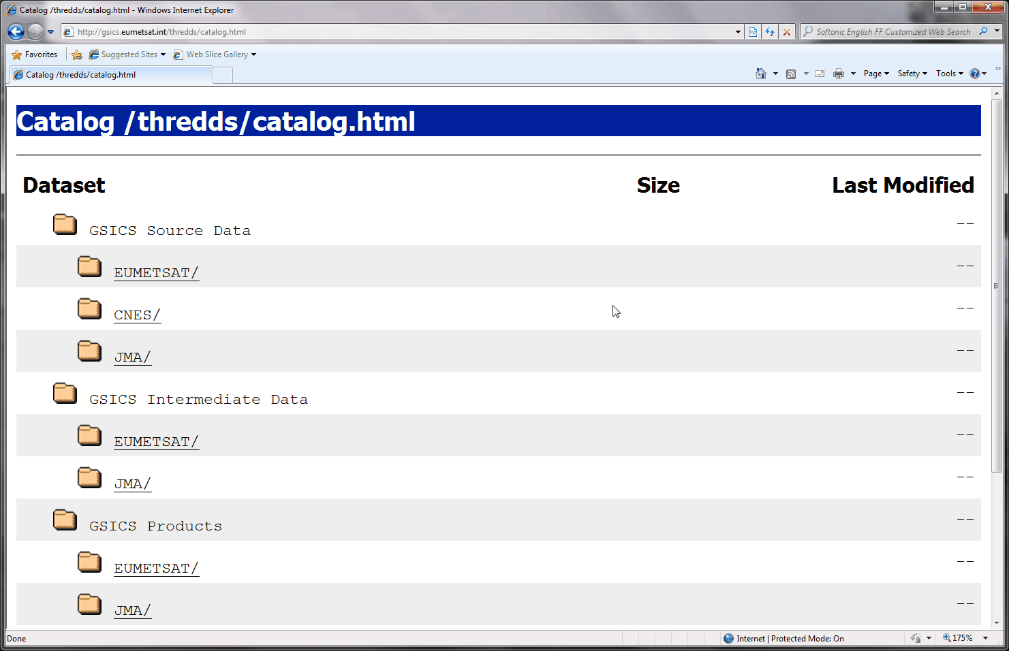
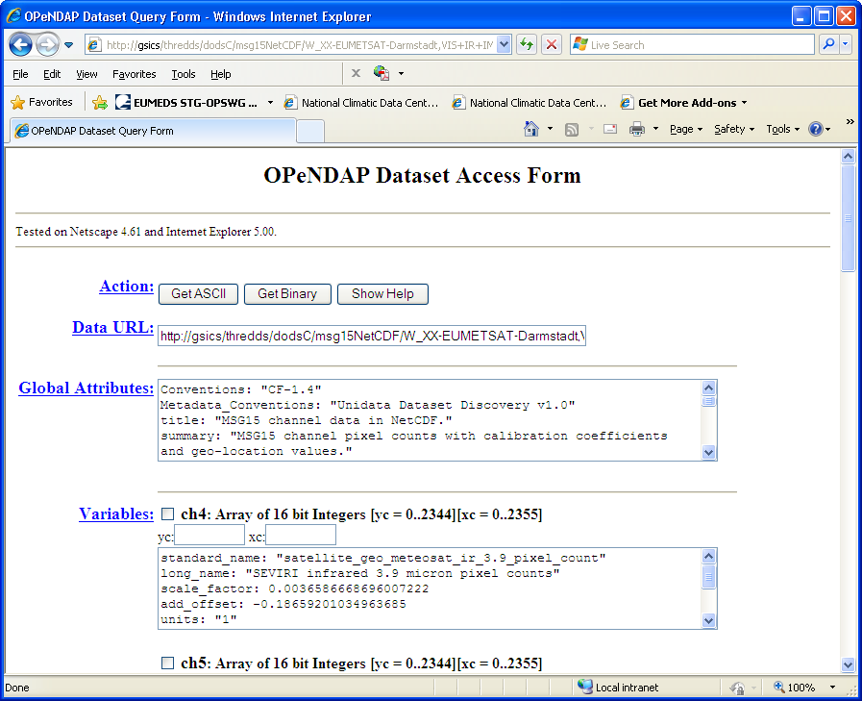
Where to get the data?
GSICS Bias Monitoring
Hosted on websites of GSICS Processing & Research Centres (GPRCs)
http://gsics.tools.eumetsat.int/plotter/
GSICS Corrections
− GSICS Data & Products Servers
− THREDDS-based system
− NetCDF format
− WMO GTS standard file names
− Unidata & CF conventions
See gsics.wmo.int for links
GTS = Global Telecommunication System
CF = Climate and Forecast

Slide 17
Conclusions
GSICS is maturing into a system for generating inter-calibration products
suitable for integrating into operational processing
First products have been declared operational
Continuing to develop new inter-calibration products
While cooperating with related activities
To integrate GSICS into WIGOS
To support Architecture for Climate Monitoring from Space
Today: Examples of potential future activities & interactions
Rest of the Week: Focus on development of GSICS deliverables

Slide 18
Mini Conference

Slide 19
Mon am | Mini Conference
 | Chair: Philippe Goryl, Minutes: XXX
8:10 | Coffee and Registration
8:25 | Mitch Goldberg | NOAA | GSICS |  | 0:05
8:30 | Philippe Goryl and Nicolaus Hanowski | ESA | Welcome address | 1a | 0:05
8:35 | Xiuqing (Scott) Hu | CMA | Introduction to Mini Conference & GSICS | 1b | 0:15
8:50 | Jerome Bouffard | ESA | Logistics information | 1c | 0:10
9:00 | Henri Laur | ESA | ESA EO Programme | 1d | 0:30
9:30 | Pascal Lecomte | ESA | ESA CCI (Climate Change Initiative) Programme | 1e | 0:15
9:45 | Xiangqian (Fred) Wu | NOAA | GOES-16/-17 ABI Calibration Performance and Updates | 1f | 0:15
10:00 | Philippe Goryl | ESA | Fiducial Reference Measurements Concept | 1g | 0:15
10:15 | Jonas Von Bismarck | ESA | Aeolus Mission Status | 1h | 0:20
10:35 |  |  | Coffee break |  | 0:25
11:00 |  |  |  | 1i | 0:20
11:20 | Jerome Bouffard | ESA | Toward FCDR and uncertainties information for Altimetry | 1j | 0:20
11:40 | Stefan Adriaensen | VITO | Lunar Calibration Update | 1k | 0:20
12:00 | Bill Bell | ECMWF | ECMWF Copernicus Activities Related to Inter-calibration | 1l | 0:30
12:30 | Nigel Fox | NPL | Quality Assurance for EO and CEOS Activities | 1m | 0:30

Slide 20
Notes to speakers
Please follow file naming convention: 1a_Hewison_Introduction.pptx/pdf/ppt
Presentations will be uploaded to the GSICS Wiki
Unless you tell me not to
All slots are strictly 20min
Please leave at least 5min for questions
The chair will give a warning after 13min
Thank you!

Slide 21
Thank you!

