Slide 1
LOGISTICS
Welcome to ESRIN Frascati !
Sentinel-2 atmospheric corrected CARD4L Feb 2019

Slide 2
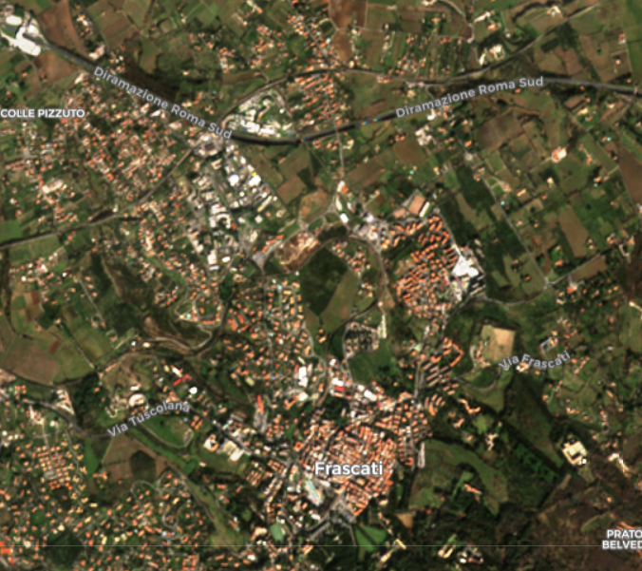
We are here

Slide 3
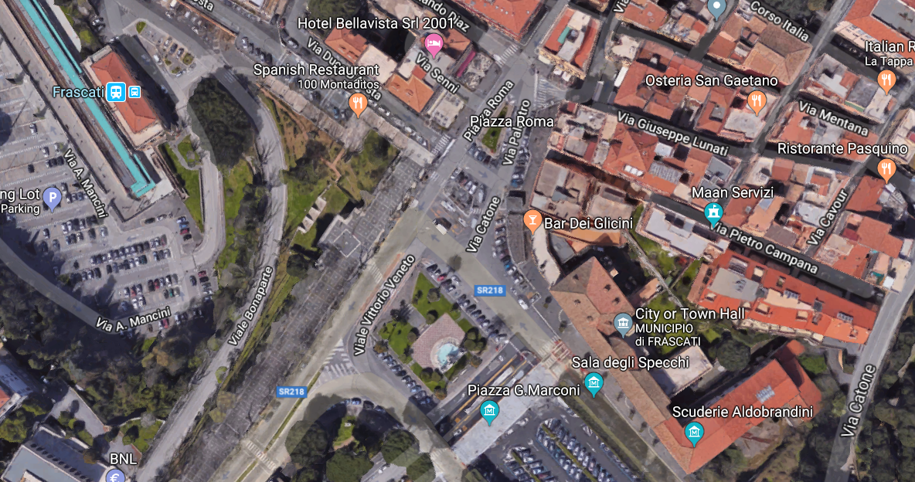
Bus transportation (Frascati – ESRIN)
BUS

Slide 4
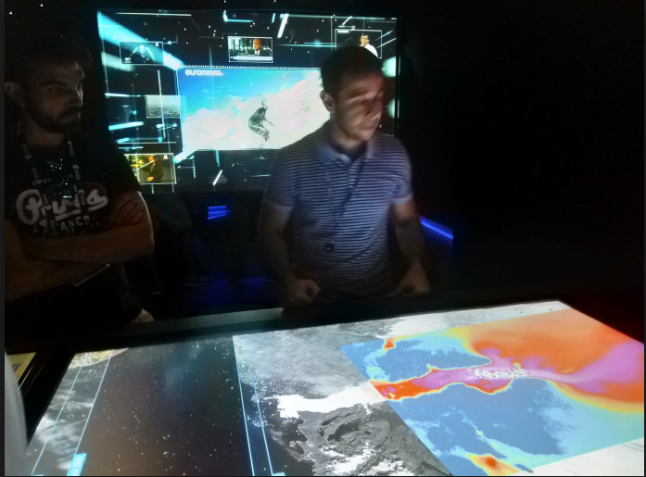
Bus Time Schedule
⬅ Change everyday
Monday:
07:20 from Frascati to ESRIN
20:00 from ESRIN to Frascati
Tuesday:
08:00 from Frascati to ESRIN
17:50 from ESRIN to Villa Grazioli
21:30 from Villa Grazioli to Frascati
Wednesday:
08:00 from Frascati to ESRIN
18:50 from ESRIN to Frascati
Thursday:
08:00 from Frascati to ESRIN
18:00 from ESRIN to Frascati
Friday:
07:30 from Frascati to ESRIN
Assistance for Taxi will be provided
Lunch will take place at the canteen
Only cash (no credit card)
Cash Machine close to the bar
ESRIN bar open at 08:00 and close at 16:30
Offered lunch on Friday in VIP room
Event
Monday:
Ice-Breaker in room James Cook at 18h30
Tuesday:
Offered dinner at Villa Grazioli
Wednesday:
Visit to Phi-Experience 12h20

Slide 5
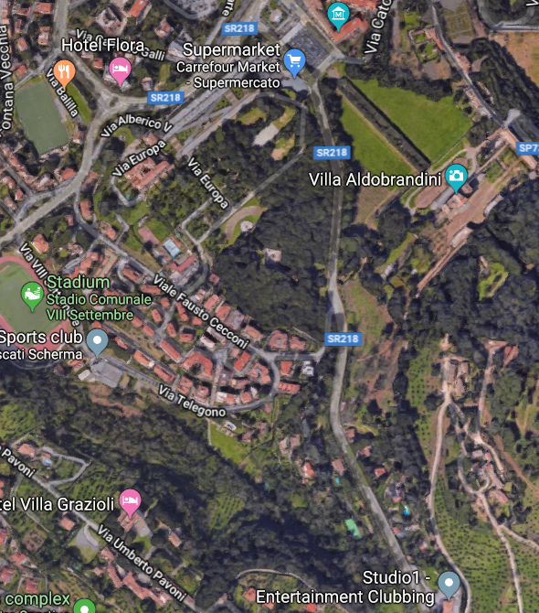
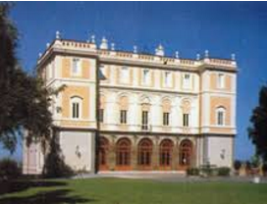
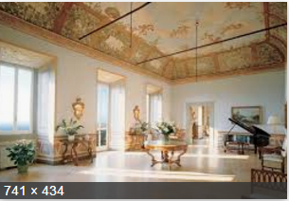
Offered dinner at Villa Grazioli (16th century)
(close to Frascati (3 km) )
on Tuesday.

Slide 6
Agenda online at: https://nikal.eventsair.com/QuickEventWebsitePortal/gsics-annual-meeting-2019/esa-esrin
Monday: Plenary in Magellan Room
Tuesday: Plenary in Magellan Room
Wednesday: GRWG: VIS/NIR sub-group in Magellan A
GRWG: MW sub-group Magellan B
GDWG: James Cook
Thursday: GRWG: IR sub-group in Magellan A
GRWG: UV sub-group Magellan B
GDWG: James Cook
Friday: Plenary in Magellan Room

Slide 7
Remote connection
Remote connection will be provided.
Please note that an excessive number of participants connected at the same time might cause problems in the system. Thus, we kindly invite to join the VMR only if you are a presenter.
If you are interested exclusively in viewing the meeting, please join the VMR in groups or for brief periods.

Slide 8
For logistic information about the event please contact the
ESA Conference Bureau events.organisation@esa.int T +39 06 94 180 912
For any other questions or assistance:
Rosalia.Fonseca@esa.int (T +39 06 94 180 615)
Philippe.Goryl@esa.int
Jerome.Bouffard@esa.int

