Slide 1
ABI Calibration Performance
X. Wu
NOAA/NESDIS/STAR and GOES-R CWG
2019-03-04
Photo courtesy GOES-R Program

Slide 2
Acknowledgement & Disclaimer
Mason Black, Changyong Cao, Jim Carr, Monica Coakley, Monica Cook, Frank DeLuccia, Jon Fulbright, Bruce Gibbs, Mat Gunshor, Song Guo, Dave Igli, Liz Kline, Vladimir Kondratovich, Dan Lindsey, Joel McCorkel, Frank Padula, Haifeng Qian, Alan Reth, Matt Seybold, Tim Schmit, Bin Tan, John van Naarden, Zhipeng Wang, Robert Wolfe, Hyelim Yoo, and Fangfang Yu
Personal opinion, not official positions, policy, or decisions of the NOAA or the U. S. Government.

Slide 3
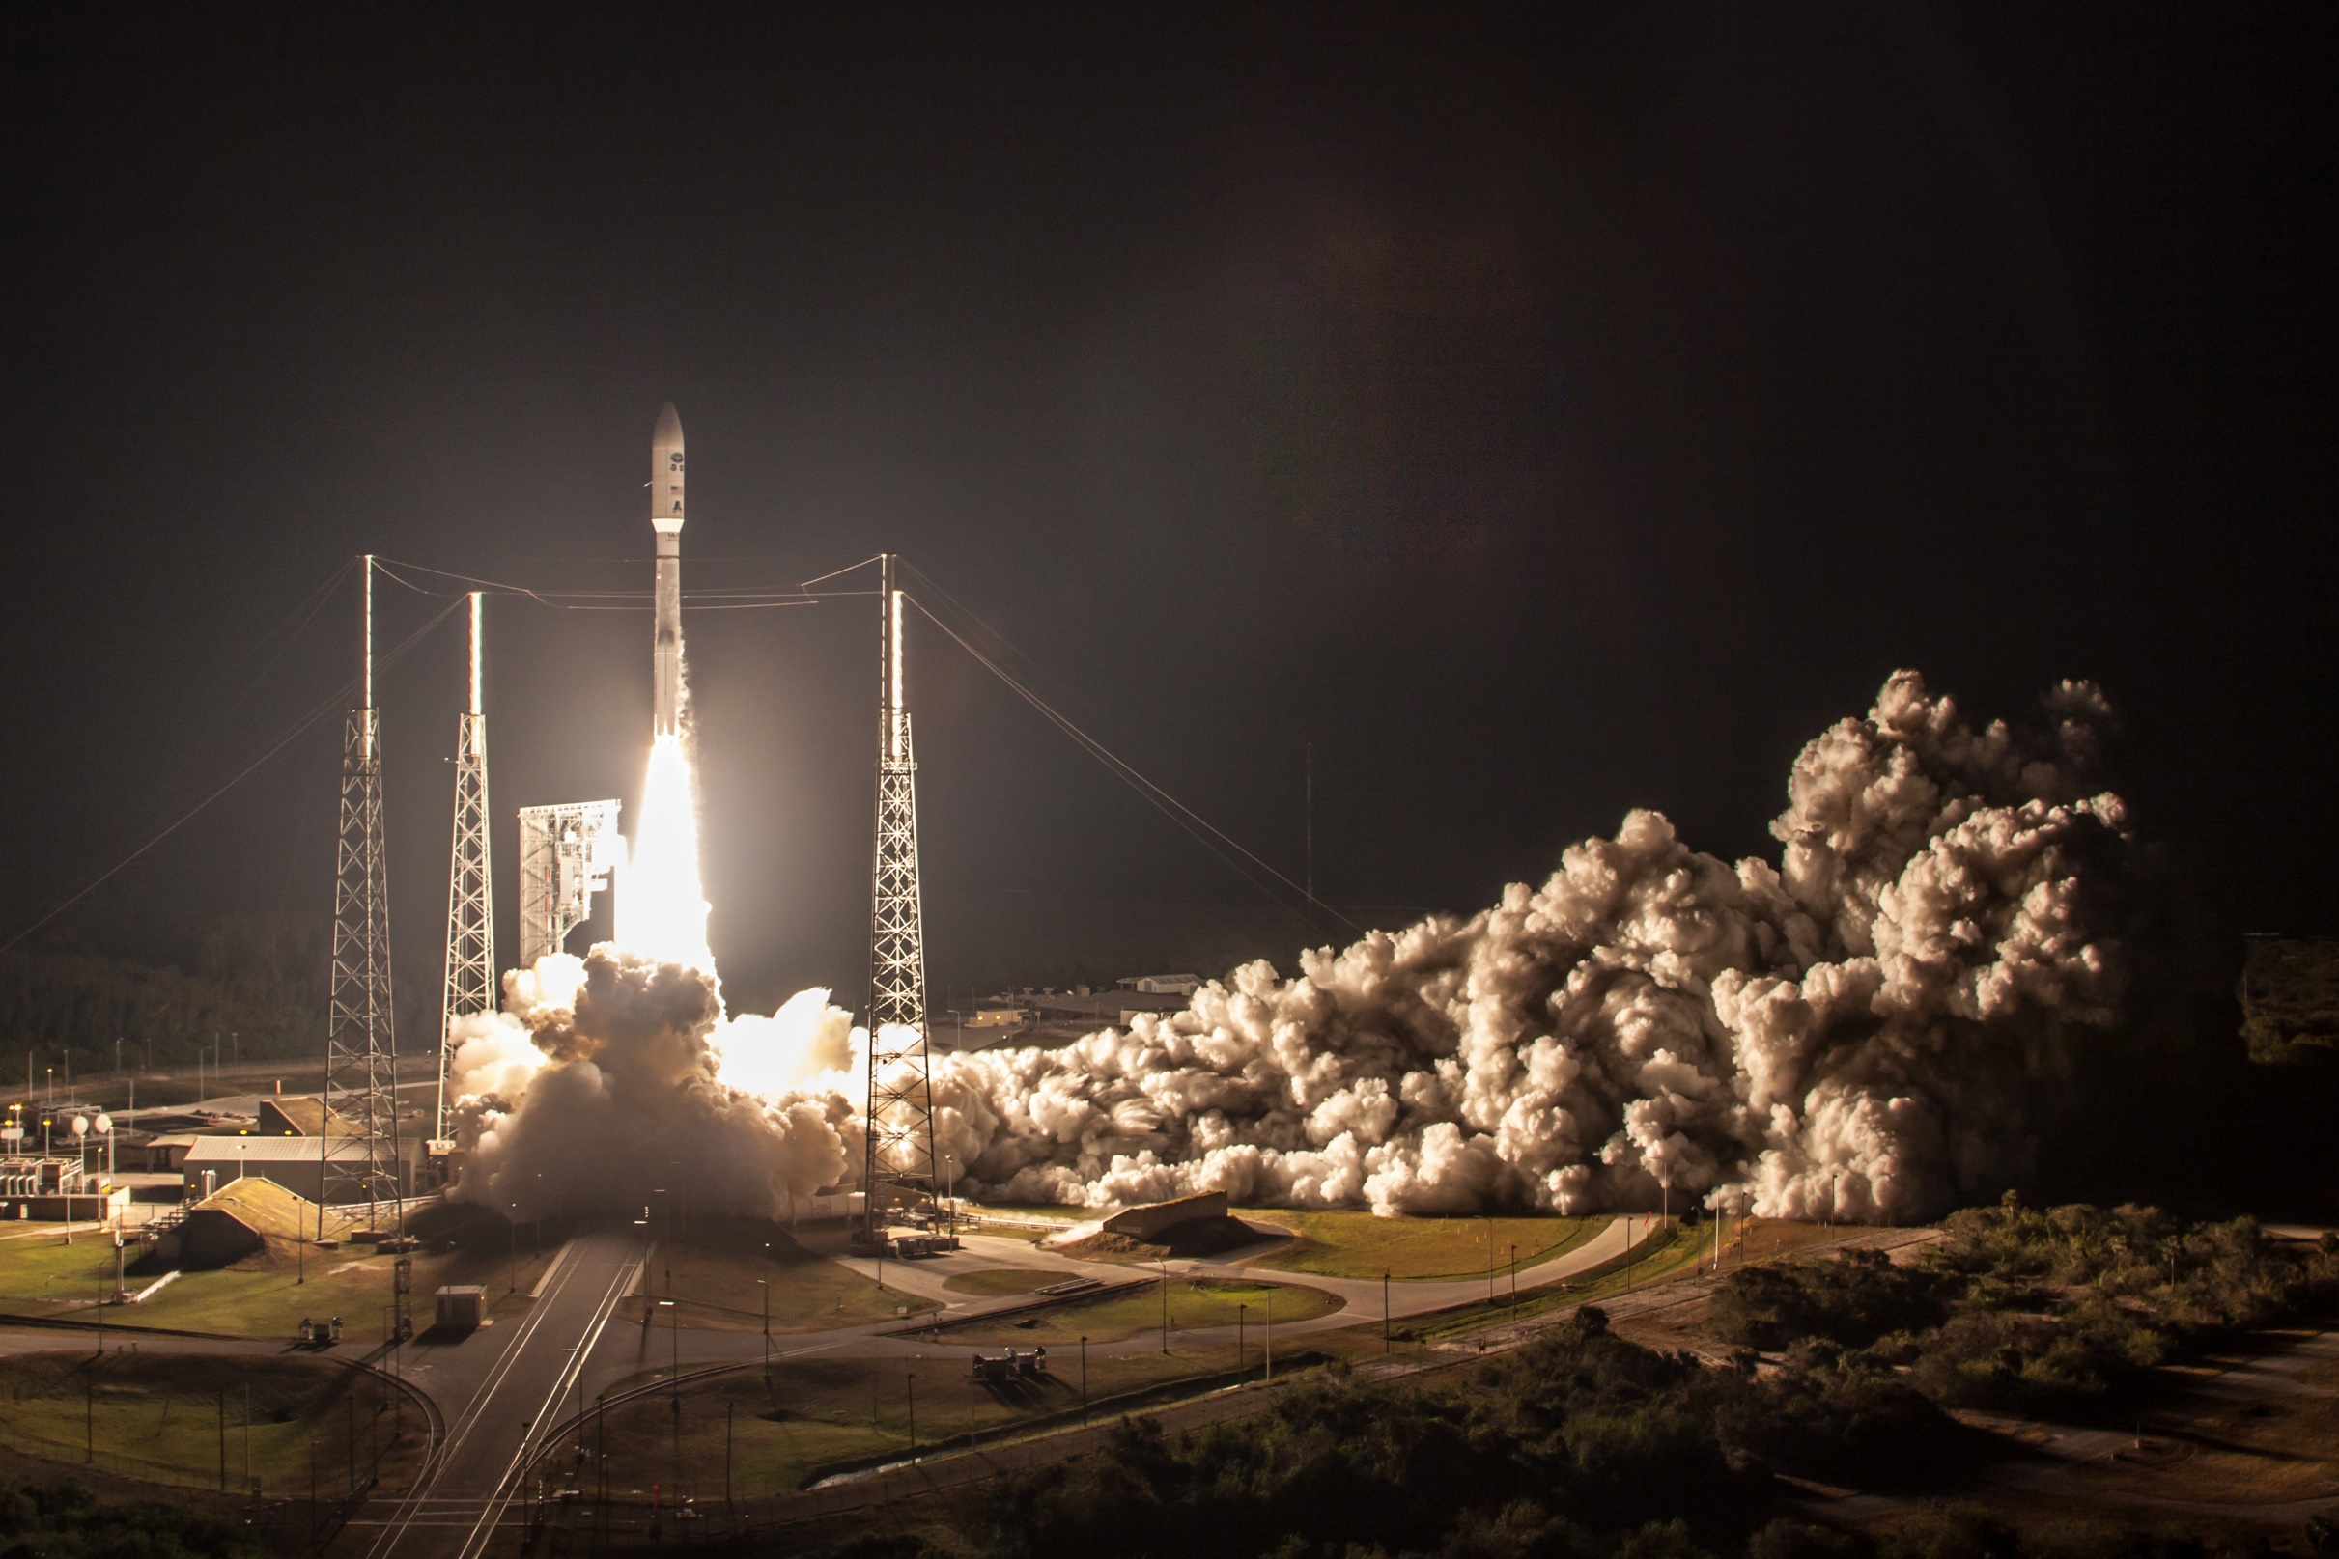
GOES-16 ABI Full Validation June 2018
Photo courtesy GOES-R Program

Slide 4
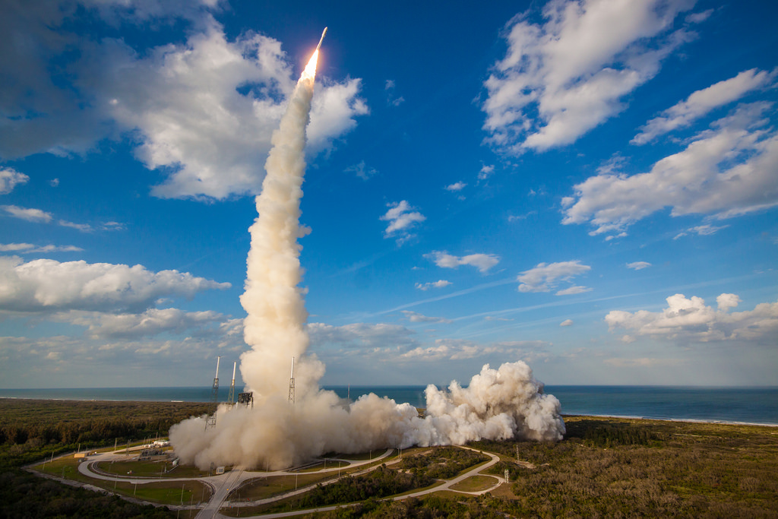
GOES-17 ABI Provisional Nov. 2018
Photo courtesy GOES-R Program

Slide 5
Outline
Start with GOES-17 ABI L1b Provisional:
A good summary of GOES-16 ABI performance since it was used as reference
Loop Heat Pipe (LHP) Anomaly
Geometric calibration – Not affected.
VNIR calibration – Not affected (well, not quite).
IR calibration – Seriously affected, so focus on the stable period first.
Progress since then
Estimate and actual performance
Predictive calibration
Dependence of VNR gain on FPM temperature
De-striping

Slide 6
Outline
Start with GOES-17 ABI L1b Provisional:
A good summary of GOES-16 ABI performance since it was used as reference
Loop Heat Pipe (LHP) Anomaly
Geometric calibration – Not affected.
VNIR calibration – Not affected (well, not quite).
IR calibration – Seriously affected, so focus on the stable period first.
Progress since then
Estimate and actual performance
Predictive calibration
Dependence of VNR gain on FPM temperature
De-striping

Slide 7
Navigation Accuracy
Met MRD.
Better than G16 @ Provisional (not shown) but not yet at par with G16 @ Full Validation.
Similar conclusions for accuracy during eclipse, Channel-to-Channel, Frame-to-Frame, and Swath-to-Swath co-registration (not shown).

Slide 8
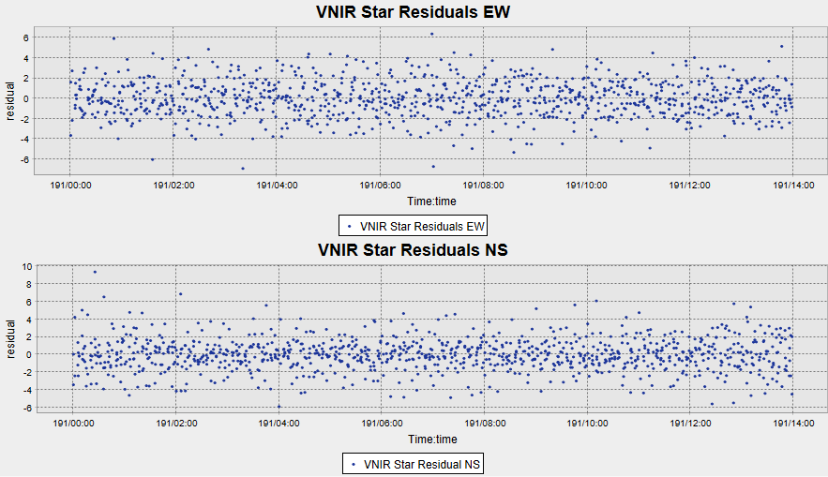
VNIR Stars Comparison (PM – CENRAIS, 7/10)
-0.07
2.5 m!
Verified the method of evaluation.
-0.55
Legend: VNIR star residuals by GRITT (blue) in EW (upper panel) and NS (lower panel) directions are in good agreement with the mean (solid) and 3-σ (dashed) of the CENRAIS-measured VNIR daily navigation residuals (in red).

Slide 9
Outline
Start with GOES-17 ABI L1b Provisional:
A good summary of GOES-16 ABI performance since it was used as reference
Loop Heat Pipe (LHP) Anomaly
Geometric calibration – Not affected.
VNIR calibration – Not affected (well, not quite).
IR calibration – Seriously affected, so focus on the stable period first.
Progress since then
Estimate and actual performance
Predictive calibration
Dependence of VNR gain on FPM temperature
De-striping

Slide 10
VNIR Noise
Band 1-3 are comparable to G16.
For Channels 4-6, means are comparable to G16, suggesting BDS issue.

Slide 11
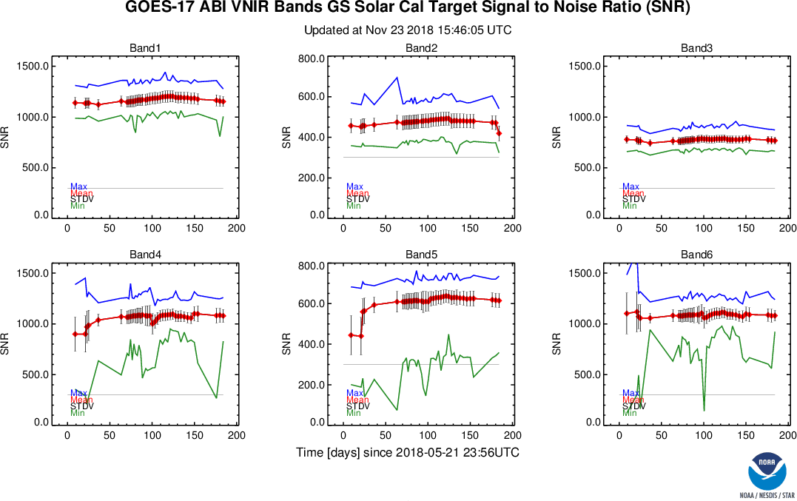
VNIR Noise Stability

Slide 12
VNIR Accuracy

Slide 13
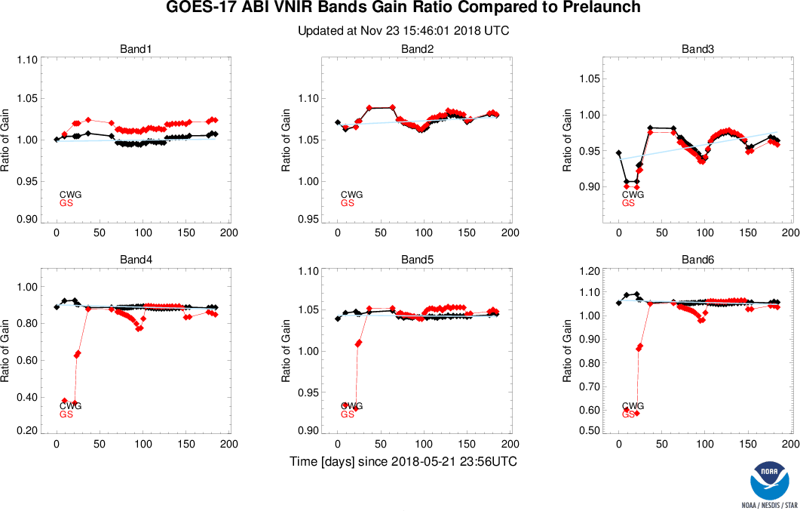
VNIR Accuracy Stability
Post-Drift
Gain Variation
Good Instrument.
Unstable Ground.

Slide 14
Outline
Start with GOES-17 ABI L1b Provisional:
A good summary of GOES-16 ABI performance since it was used as reference
Loop Heat Pipe (LHP) Anomaly
Geometric calibration – Not affected.
VNIR calibration – Not affected (well, not quite).
IR calibration – Seriously affected, so focus on the stable period first.
Progress since then
Estimate and actual performance
Predictive calibration
Dependence of VNR gain on FPM temperature
De-striping

Slide 15
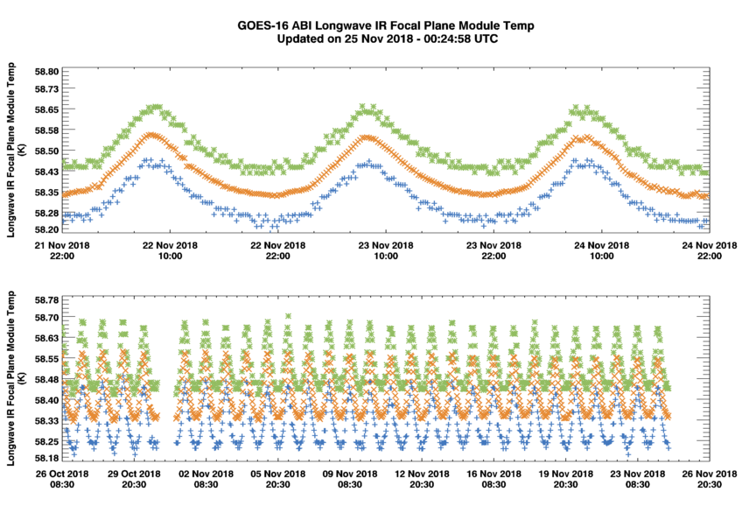
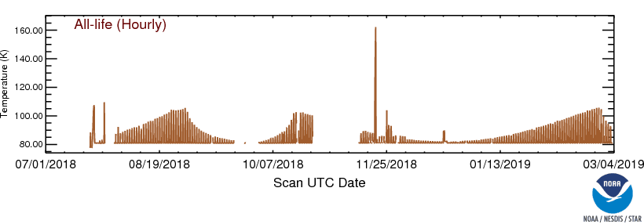
LHP Anomaly & FPM Temperature
And other optical parts, including
Internal Calibration Target
Scan mirrors.
GOES-16
58.3K – 58.5K
GOES-17
81K – 105K

Slide 16
IR Noise
All worse than G16, as expected.
Especially for longer wavelength channels.

Slide 17
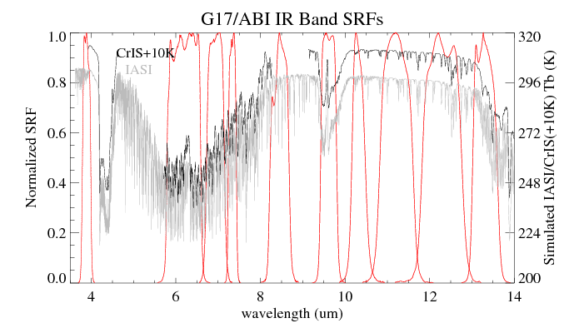
IR Bias under “Best” Condition
Limited coverage of ABI B07 & B08 by CrIS.
Overall within ~0.1K for most channels. Comparable with G16, except for B16

Slide 18
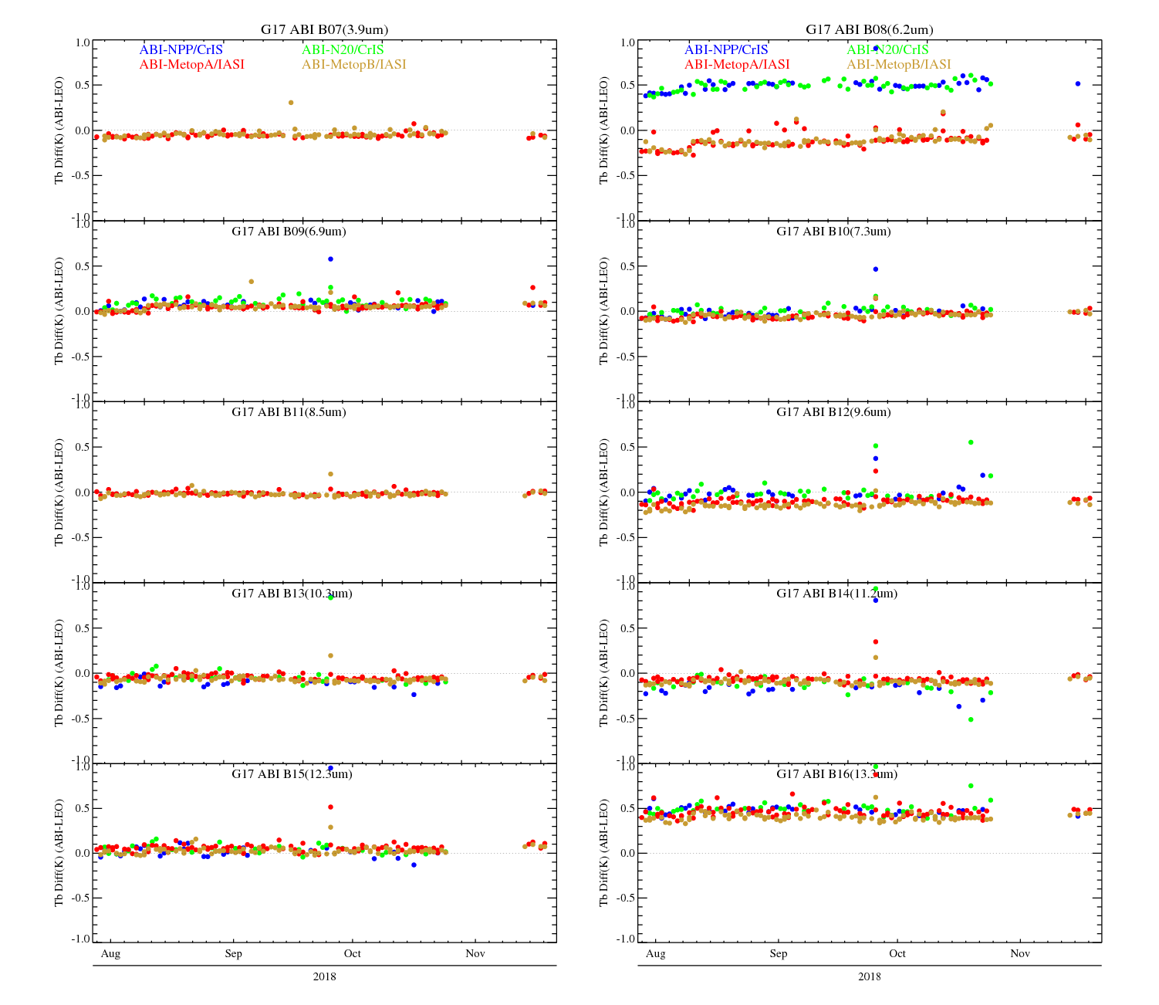
Time-Series of GEO-LEO IR Inter-Calibration (best condition: Gain Set=1, Night-time Collocations)
Long-term stable

Slide 19
Outline
Start with GOES-17 ABI L1b Provisional:
A good summary of GOES-16 ABI performance since it was used as reference
Loop Heat Pipe (LHP) Anomaly
Geometric calibration – Not affected.
VNIR calibration – Not affected (well, not quite).
IR calibration – Seriously affected, so focus on the stable period first.
Progress since then
Estimate and actual performance
Predictive calibration
Dependence of VNR gain on FPM temperature
De-striping

Slide 20
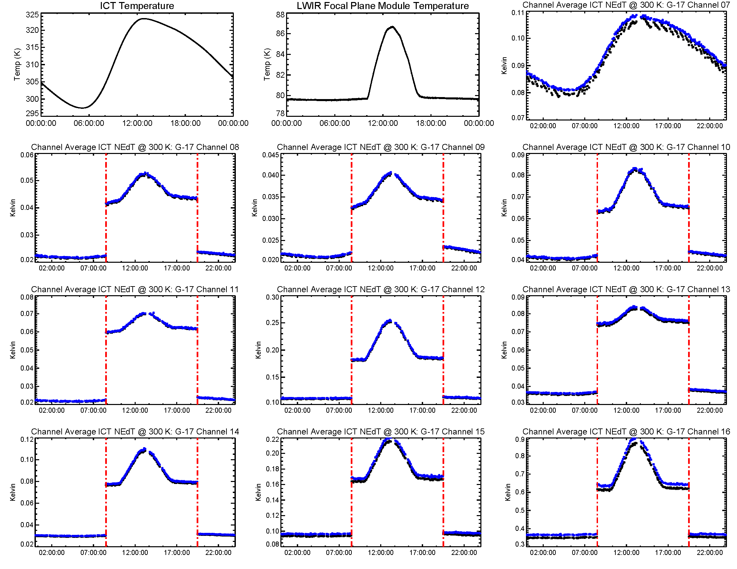
Typical GOES-17 ABI NEdT
The NEdT is converted to 300 k. Its ICT temperature dependency is clearly reduced for bands 8-15.
INST-CAL CWG

Slide 21
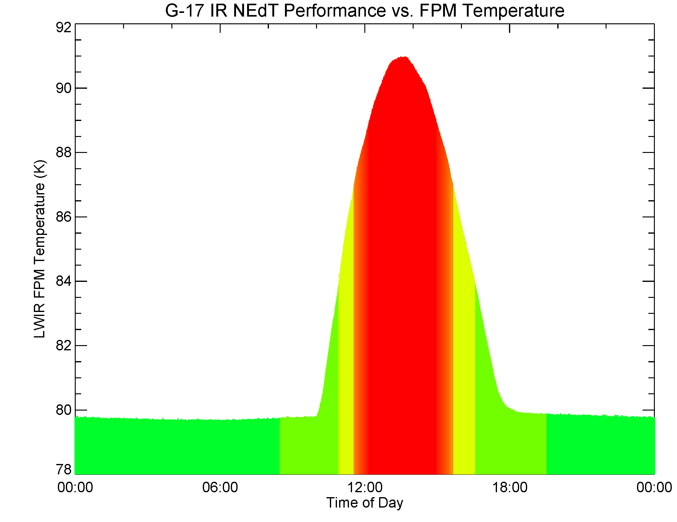
Typical G17 ABI FPM Temp and Performance
SL look saturation
ICT look saturation
NEdT exceed Spec.
Gain set III: increased NEdT
Gain set I
INST-CAL-ENG FPM temperature has known ~1.5 K cold bias

Slide 22
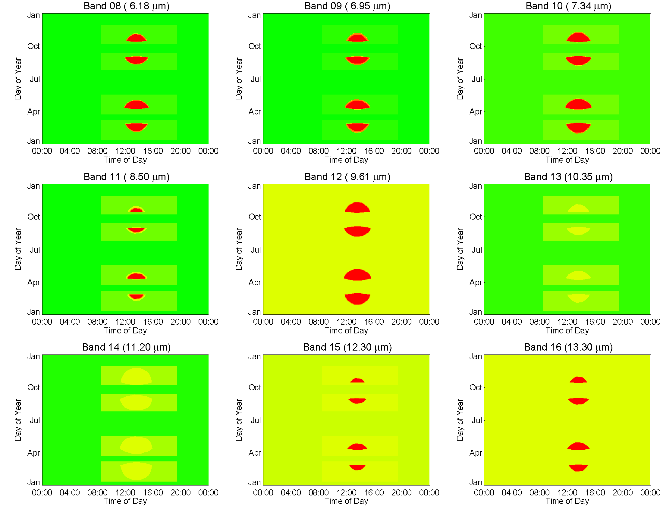
Estimate of G17 ABI Performance
Courtesy of Vendor-flight for modeled FPM temperatures

Slide 23
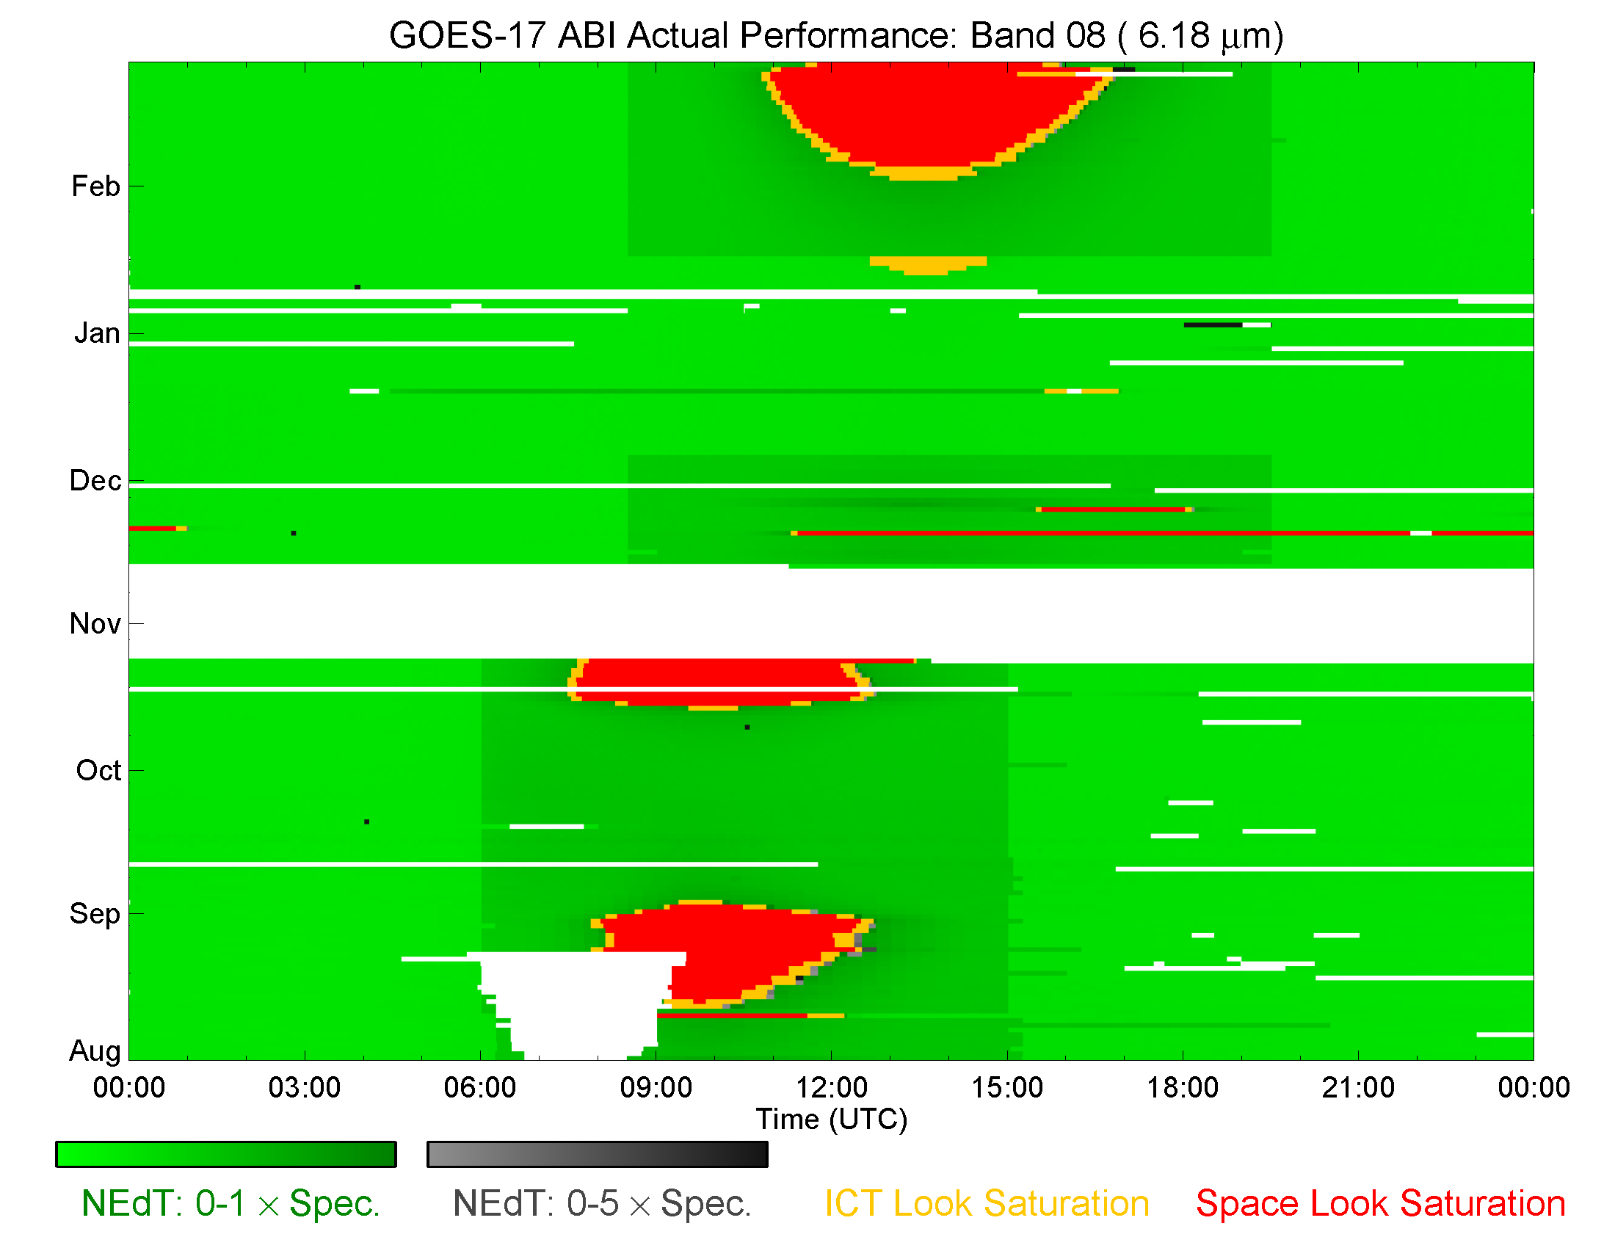
GOES-17 ABI Actual Performance Band 8
data gap
Late gain set III turned on
data gap due to orbit drift
cryocooler anomaly 1 & 2
scan mirror temperature LUT insufficiency
1

Slide 24
GOES-17 ABI Actual Performance All Bands

Slide 25
GOES-16 ABI Actual Performance All Bands

Slide 26
Outline
Start with GOES-17 ABI L1b Provisional:
A good summary of GOES-16 ABI performance since it was used as reference
Loop Heat Pipe (LHP) Anomaly
Geometric calibration – Not affected.
VNIR calibration – Not affected (well, not quite).
IR calibration – Seriously affected, so focus on the stable period first.
Progress since then
Estimate and actual performance
Predictive calibration
Dependence of VNR gain on FPM temperature
De-striping

Slide 27
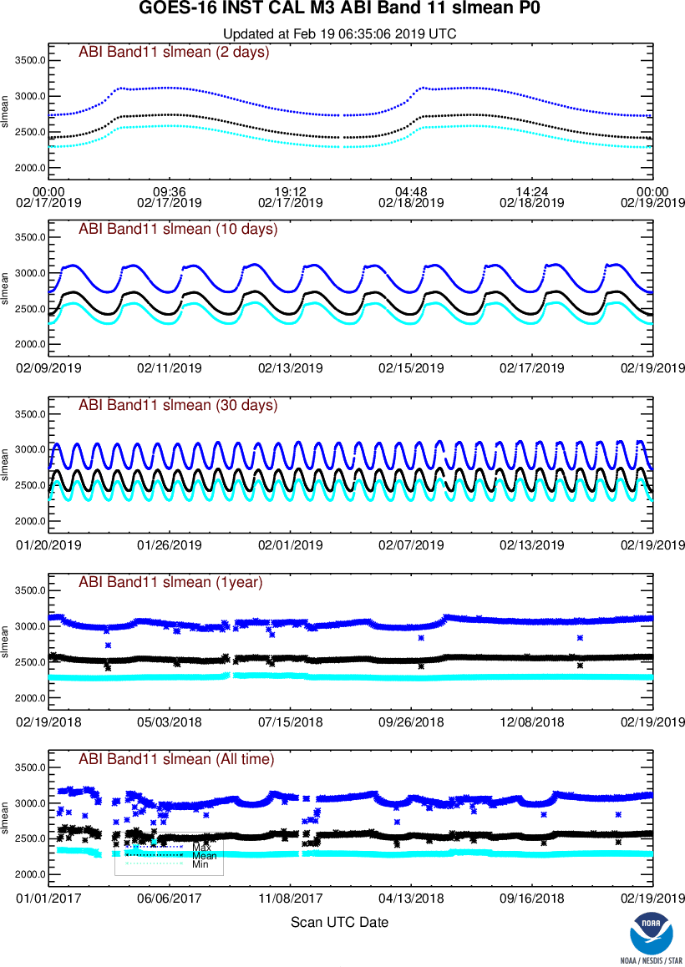
The Problem: Unstable Thermal
IR (and MW) sensors need frequent calibration.
Before the thermal environment has changed too much.
G17 thermal can change too fast.
Cannot be calibrated more frequently.
~300 counts in ~600 min. or 0.25 cnt/splk
~8000 counts in ~300 min. or 13 cnt/splk

Slide 28
The Solution: Predictive Calibration
Instead of using the last measurement until the new one is available, extrapolate the last two to a future time, i.e., predictive.
Other relevant information:
Wish to interpolate, but can’t wait.
Tried but abandoned nonlinear predictions.
Likely because of measurement noise.
Similar to those for Imager & Sounder since 1990’s.
Recovered significant amount of data (see next).

Slide 29
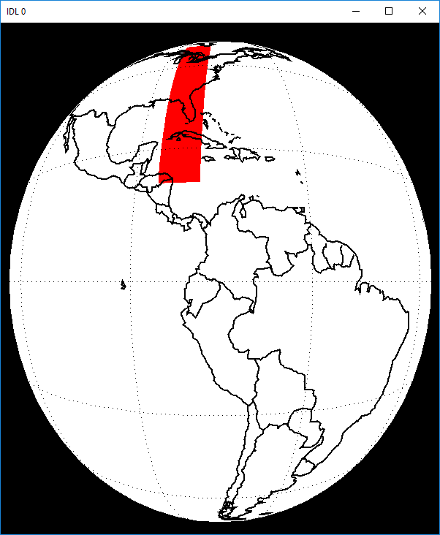
The Results: GEO-GEO Evaluation
2018-08-29 data.
CONUS (frequent comparison)
Cos(VZA) difference < 2%.
Pixel-to-pixel for the two satellites

Slide 30
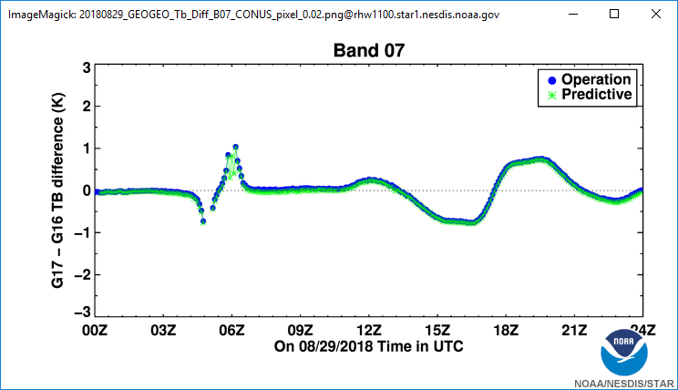
Stray light
Sun Glint
Forward and backward scattering
Excellent agreement, with the expected (and symmetric) differences.
Ignore for now whether and why predictive is cooler than operational.

Slide 31
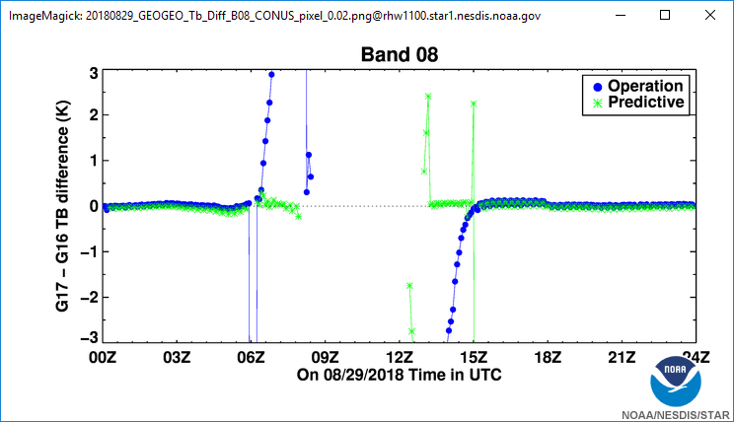
Effort to guess the gain when the blackbody look is saturated
Artifacts that can be corrected easily
Improved by the Predictive Cal

Slide 32
Outline
Start with GOES-17 ABI L1b Provisional:
A good summary of GOES-16 ABI performance since it was used as reference
Loop Heat Pipe (LHP) Anomaly
Geometric calibration – Not affected.
VNIR calibration – Not affected (well, not quite).
IR calibration – Seriously affected, so focus on the stable period first.
Progress since then
Estimate and actual performance
Predictive calibration
Dependence of VNR gain on FPM temperature
De-striping

Slide 33
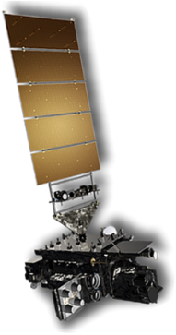
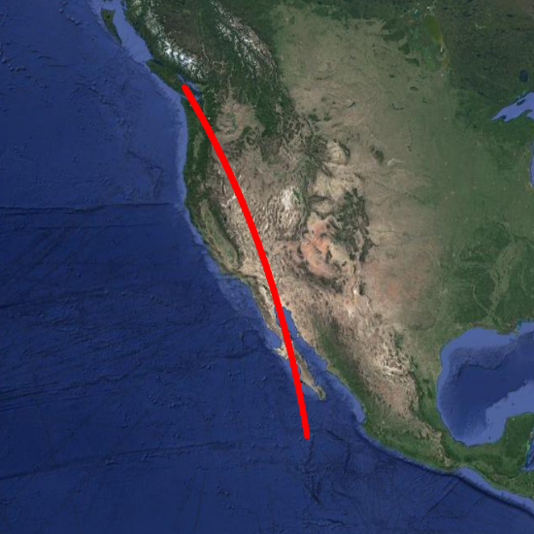
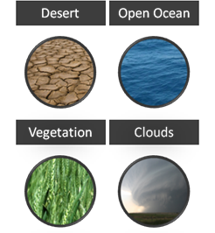
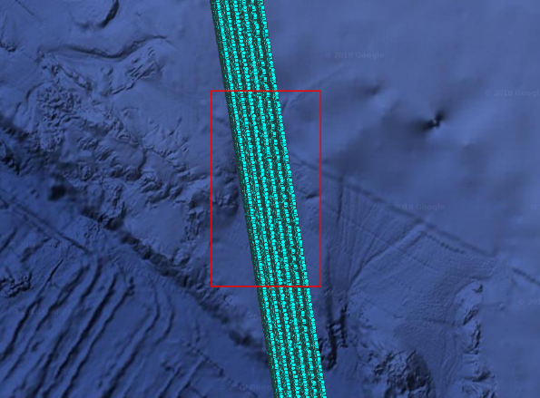
How It Works
Task ABI NSS
Conduct NSS Data Analysis
Derive Relative Gains
Apply g_{rel} to L1β
Improved Image Quality
Uniform Target
All Detectors Over a Given Target

Slide 34
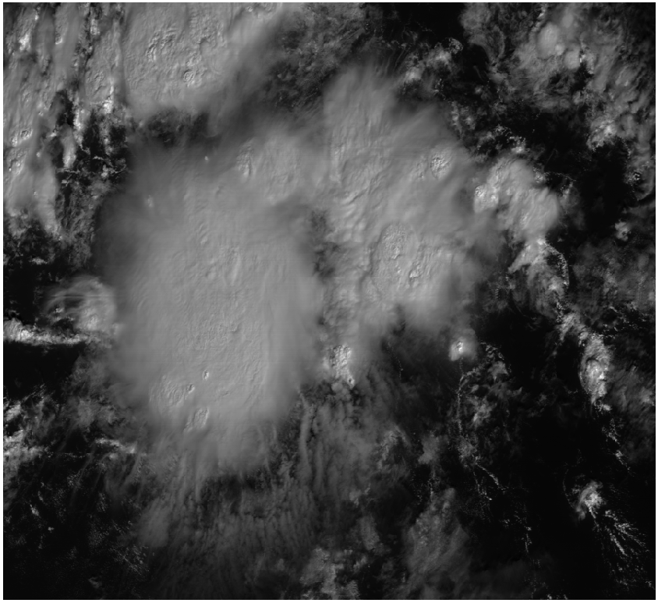
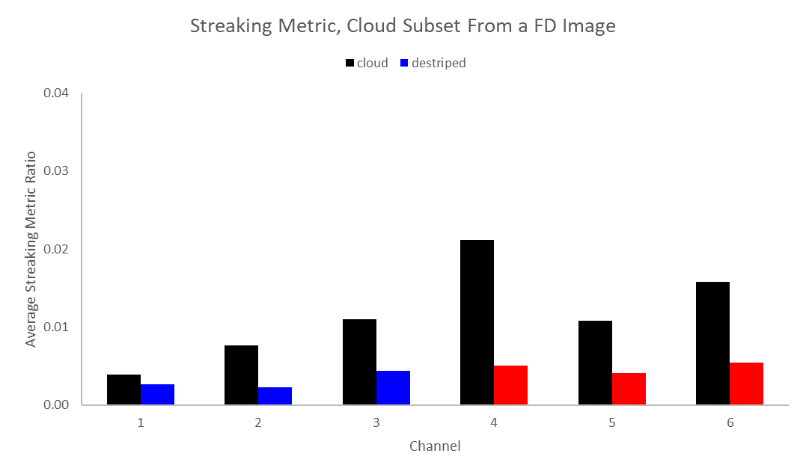
Channel 1
Original
Average Streaking Metric Ratio: 0.00390

Slide 35
Channel 1
Destriped
Average Streaking Metric Ratio: 0.00260

Slide 36
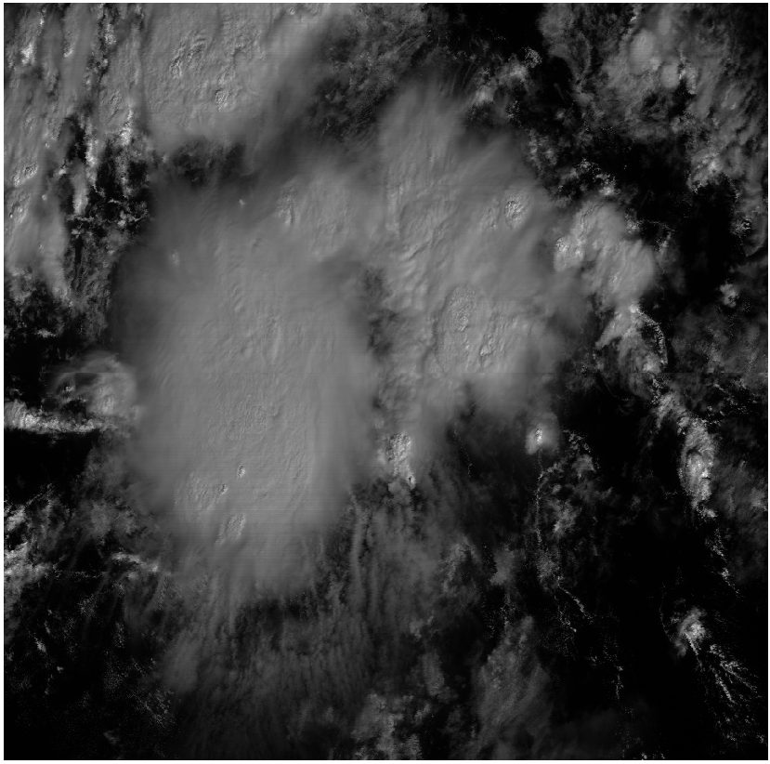
Channel 2
Original
Average Streaking Metric Ratio: 0.00768

Slide 37
Channel 2
Destriped
Average Streaking Metric Ratio: 0.00224

Slide 38
Channel 3
Original
Average Streaking Metric Ratio: 0.01096

Slide 39
Channel 3
Destriped
Average Streaking Metric Ratio: 0.00438

Slide 40
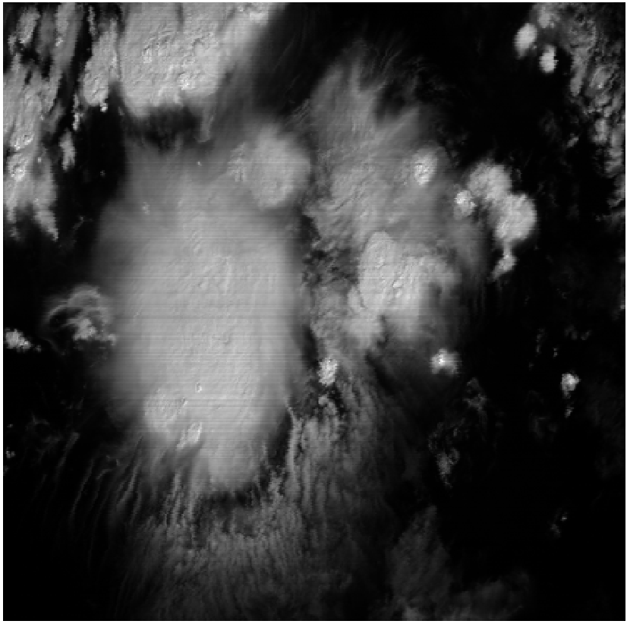
Channel 4
Original
Average Streaking Metric Ratio: 0.02118

Slide 41
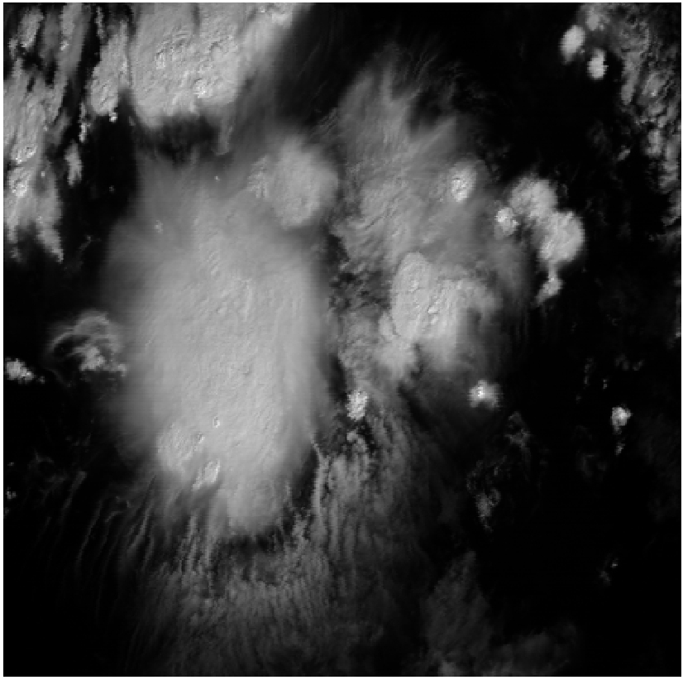
Channel 4
Destriped
Average Streaking Metric Ratio: 0.00505

Slide 42
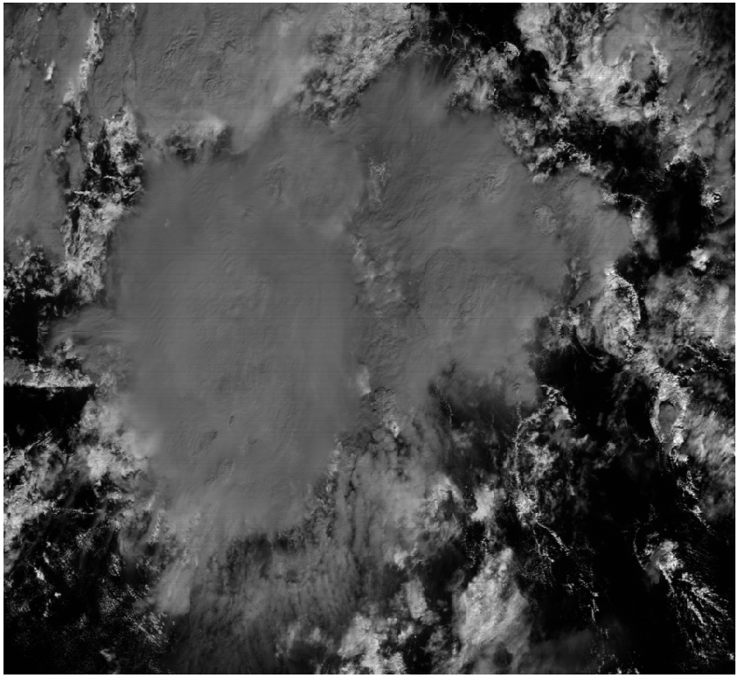
Channel 5
Original
Average Streaking Metric Ratio: 0.01078

Slide 43
Channel 5
Destriped
Average Streaking Metric Ratio: 0.00412

Slide 44
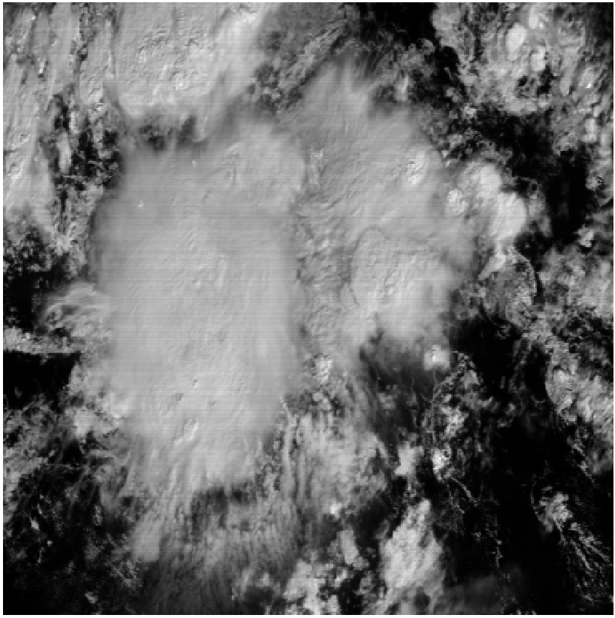
Channel 6
Original
Average Streaking Metric Ratio: 0.01575

Slide 45
Channel 6
Destriped
Average Streaking Metric Ratio: 0.00546

Slide 46
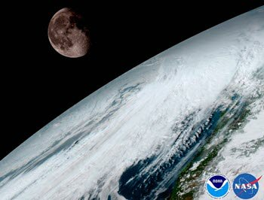
JARS Special Issue on INSTRUMENT CALIBRATION AND PRODUCT VALIDATION OF GOES-R
The R-Series of Geostationary Operational Environmental Satellite (GOES-R) is a new generation of satellite that the National Oceanic and Atmospheric Administration (NOAA) operates to provide continuous surveillance of the land, ocean, and atmosphere of the United States of America and its environment. GOES-R was launched in November 2016. It became operational as GOES-16 in December 2017, supporting NOAA’s GOES-EAST mission. GOES-S was launched in March 2018. It will become operational as GOES-17 in January 2019, supporting NOAA’s GOES-WEST mission. With the successful deployment of GOES-R instruments and dissemination of its products, the Journal of Applied Remote Sensing will devote a special section to document the instrument calibration and product validation of GOES-R sensors. Calibration of all instruments onboard the GOES-R are welcome, including Advanced Baseline Imager (ABI), Extreme Ultraviolet and X-ray Irradiance Sensor (EXIS), Geostationary Lightning Mapper (GLM), Magnetometer (MAG), Space Environment In-Situ Suite (SEISS), and Solar Ultraviolet Imager (SUVI). Validation of all GOES-R products are welcome, including Level 1b, Level 2, and beyond. Relevant studies of similar instruments and products, for example the Advanced Himawari Imager (AHI) onboard the Japan Meteorological Agency (JMA) satellites and the Advanced Meteorological Imager (AMI) onboard the Korea Meteorological Agency (KMA), are also encouraged to submit. To submit to this special section, please prepare the paper according to JARS guidelines and submit via the online submission system ( https://jars.msubmit.net). Cover letter should indicate that the submission is intended for this special section. Papers in this special section have the option of publishing with open access. Papers will be peer reviewed in accordance with the journal’s established policies and procedures. Peer review will commence immediately upon manuscript submission, with a goal of making a first decision within 6 weeks of manuscript submission. Special sections are opened online once a minimum of four papers have been accepted. Each paper is published as soon as the copyedited and typeset proofs are approved by the author.

Slide 47
Summary
G16 performs nominally.
Strong support for G17 evaluation via GEO-GEO.
G17 geometric calibration performs nominally.
Greatly helped by lessons learned from G16.
G17 VNIR calibration performs nominally overall.
Need to correct the dependence of VNIR gain on FPM temperature
G17 IR calibration is compromised by the LHP anomaly.
When the FPM temperature is stable:
Bias is comparable to G16 except for B16.
Noise is much higher than G16, sometime higher than requirements, but remain useful for many applications.
When the FPM temperature is unstable:
L1b cannot be generated for some channels during some hours of the day and day of the year.
Performance are being estimated and monitored.
Predictive calibration can recover some of the lost data.
Encouraging progress in de-striping using the NSS.

