Slide 1
Fiducial Reference Measurement Concept
GSICS Annual Meeting
ESRIN, 04 march 2019
Philippe Goryl

Slide 2
FIDUCIAL
fi·du·cial (adj) Regarded or employed as a standard of reference, as in surveying.
  [Late Latin fdcilis, from Latin fdcia, trust, from fdere, to trust; seebheidh- in Indo-European roots.]
Satellite cost → high; Each payload instrument is an accurate and precise scientific instrument
Maintaining quality is all about a regular stream of verification and validation data that can be used to check mission and product performance
Verification and validation data shall be of an equal and ideally a better quality than anything else
We shall validate satellites with standard data that we can trust → FIDUCIAL
We cannot do this without fundamental traceability and uncertainty budgets for all ground measurements used
Notes:
Running twelve-month averages of global-mean and European-mean surface air temperature anomalies relative to 1981-2010, based on monthly values from January 1979 to May 2017.
The darker coloured bars are the averages for each of the calendar years from 1979 to 2016.

Slide 3
FRM: definitions and scope
Fiducial Reference Measurements (FRM)
FRM definition :
“The suite of independent tailored and fully characterised measurements that provide the maximum Return On Investment (ROI) for a satellite mission by delivering, to users, the required confidence in data products, in the form of independent validation results and satellite measurement uncertainty estimation, over the entire end-to-end duration of a satellite mission.”

Slide 4
FRM: definitions and scope
Fiducial Reference Measurements (FRM)
The defining mandatory characteristics for FRM are:
FRM measurements should ideally have documented SI traceability (e.g. via round-robin characterisation and regular pre-and post deployment calibration of instruments) using metrology standards and/or community recognised best practices;
FRM measurements are independent from the satellite geophysical retrieval process;
An uncertainty budget for all FRM instruments, and derived measurements, is available and maintained;
FRM measurement protocols, procedures and community-wide management practices (measurement, processing, archive, documents, etc.) are defined, published and adhered to by FRM instrument deployments;
FRM are accessible to other researchers allowing independent verification of processing systems;
FRM are required to determine the on-orbit uncertainty characteristics of satellite geophysical measurements via independent validation activities.

Slide 5


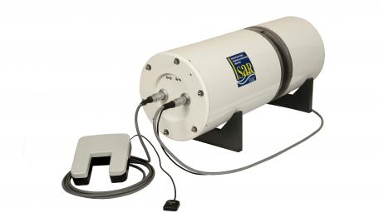
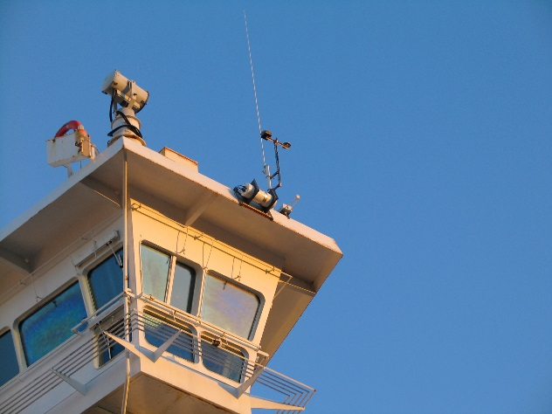
FRM: historical example
Sea Surface Temperature accuracy
Sea Surface Temperature accuracy experiences from Envisat
High quality, calibrated, radiometer mimicking satellite measurements (http://www.isar.org.uk )
Follows well defined calibration and measurement protocols
traceable to National Metrology Institutes (NMIs): NPL (UK), NIST (USA)
Deployed as self-contained packages on ferries
Pride of Bilbao (Bay of Biscay and English Channel)

Slide 6
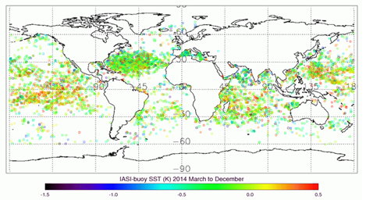
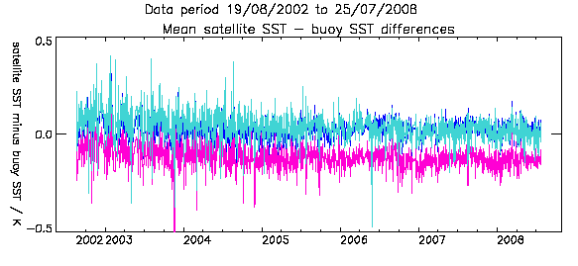
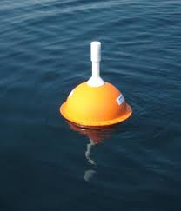
S3 FRM:
Improve drifting buoy SST for satellite validation
FRM: examples
Fact: Currently drifting buoys in the WMO GTS are not calibrated to traceable standards
The objective of TRUSTED (Eumetsat Copernicus contract) is to improve the Drifting Buoy Sea Surface Temperature measurements for Copernicus Sentinel-3 Validation:
  Improving the drifting buoys capability:
  → accuracies better than ±0.05K, traceable to SI
  Inclusion of near surface water pressure sensor as auxiliary information to understand depth and passage of drifter in water
  Coordinate with the WMO Data Buoys Coordination Body (DBCP) and manufacturers
  Coordinate with ESA QA4EO FRM4STS the development of new best-practice guidelines for drifting buoys calibration
  Assess the performance of Sentinel-3 with the OSI SAF SST Cal/Val activities in quasi-NRT
  and ultimately, establish drifting buoys as FRM for SST

Slide 7
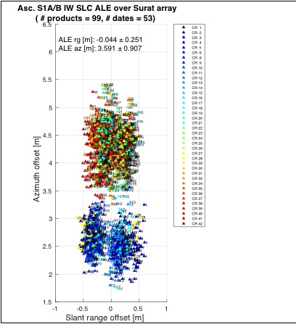
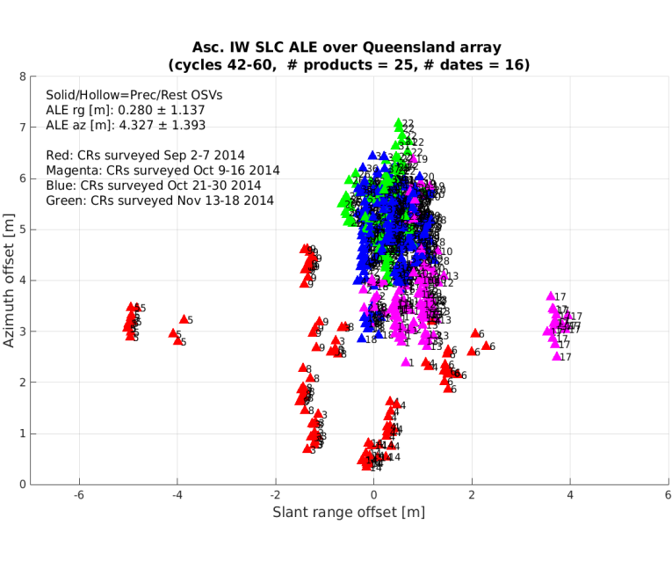
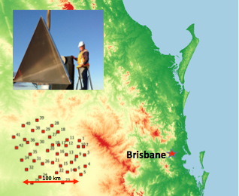
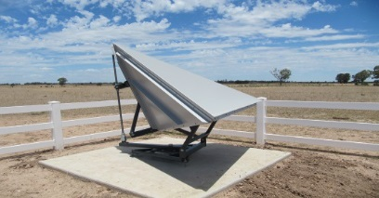
SAR products geometry
FRM: examples
FRM4SAR: multi-mission SAR products geometry
Best practice for deploying a reference site for accurate geometric calibration (and subsequent analysis). Following defined best practice → demonstrate that the Australian site is suitable for the requested accuracy → FRM4SAR (ESA contract with DLR).
Australian site will be maintained in the long term (multi-missions / multi frequencies) as part of the collaboration between ESA/DLR and geosciences Australia.
Need for
improvement
Colour code
Indicates the
Accuracy vs
deployement
Surat basin CR network
Notes:
Geolocation ameliorer grace au best practise qui corrige de plusieurs effet pour localiser les transponders (tectonique, earth tide, atmospheric effect…) → meilleures mesures.
2 blocks correspond to the swath (iw1, iw2) → still largely with spec, inherent to the algo and improving would be to costly (time processing, new algo…etc…)
(3 m in azimuth – while pixel spacing in azimuth about 20 m)

Slide 8
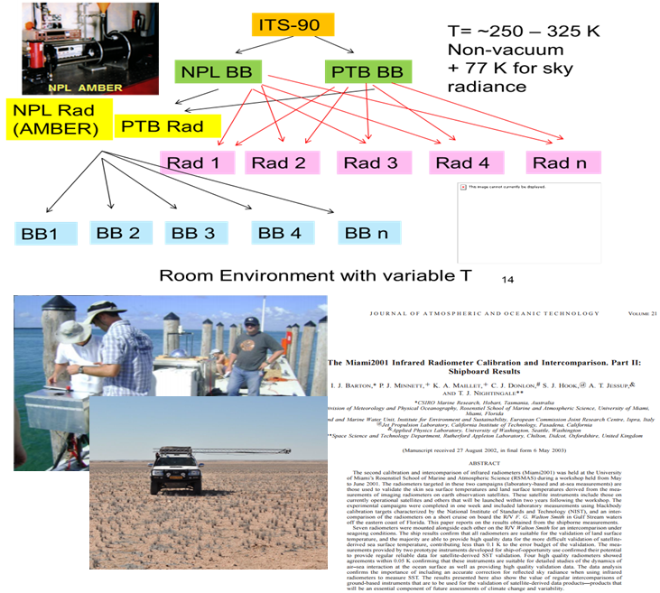
FRM characterisation
R&D → FRMs qualification.
Based on generic model following metrology approach
Best Practise, protocols → community agreement
Laboratory
Laboratory Calibration Exercise (LCE) →
SI traceability
Necessary for all participants to assess biases to SI under laboratory conditions
Field campaigns
Field Inter-comparison Calibration Exercise (FICE)
Analysis
Analysis
Discussion, Workshop
Publications
Notes:
Geolocation ameliorer grace au best practise qui corrige de plusieurs effet pour localiser les transponders (tectonique, earth tide, atmospheric effect…) → meilleures mesures.
2 blocks correspond to the swath (iw1, iw2) → still largely with spec, inherent to the algo and improving would be to costly (time processing, new algo…etc…)
(3 m in azimuth – while pixel spacing in azimuth about 20 m)

Slide 9





FRM4 Projects at ESA
http://www.frm4sts.org/ | Preparing ground truth radiometers and drifting buoy as FRM (SI Traceability) → SST, LST
https://frm4soc.org | Preparing above water radiometers and vicarious infrastructure for Ocean Colour FRM (SI Traceability) → OC
http://www.frm4alt.eu/ | Procedures and approached to maintain ground transponders with SI Traceability) → Topography
http://frm4ghg.aeronomie.be/ | The focus of the “FRM Ground-Based FTIR Greenhouse Gas Observations” (FRM4GHG) project is the intercomparison of instruments and harmonization of products and retrievals from ground based FTIR systems → Greenhouse Gas
http://frm4doas.aeronomie.be/ | The “FRM for Ground-Based DOAS Air-Quality Observations” project aims at the harmonization of the retrievals from UV-Visible ground based spectrometers (MAXDOAS or Pandora) -> the standards of FRMs for NO2 and ozone.
FRM4SAR (web site tbd) | Best practice for deploying an a site (and analysis) for accurate geometric calibration.
FRM4RADARhttp://www.geomet.uni-koeln.de/ | Establishing an observation network for validation, verification and calibration of EarthCARE cloud profile measurements and for any following up missions operating radars in space.
FRM4AQ (PANDONIA) http://pandonia.net/ | Pandonia is a ground-based remote sensing network. The main instrument of Pandonia will be Pandora-2S, which is currently being developed under this project as an evolution of the existing Pandora spectrometer system.
FRM4VEG https://frm4veg.org/ | Protocols for traceable in-situ measurements of vegetation-related parameters, to support the validation of Copernicus products from Sentinel-2, -3, and PROBA-V and optical Sensor TPMs. Characterisation of Sites.
FRM4lidar | Fiducial reference Measurement for Lidar
Notes:
NPL, DMI, DML, KIT, PTB, RAL, UoS
Tartu Observatory, University of Tartu (TO, Estonia), Royal Belgian Institute of Natrural Sciences (RBINS, Belgium), National Physical Laboratory (NPL, UK), Plymouth Marine Laboratory (PML, UK) and ACRI-ST (ACRI-ST, France).
Space Geomatica Ltd, GeoMatLab, DTU
Uni Bremen, BIRA-IASB, FMI, KIT, RUG, RAL, UOW
BIRA-IASB, Belgium,IUP-UB, Germany, KNMI, The Netherlands, UHEID, Germany, MPIC, Germany, BKS, Germany, and external Luftblick (Austria)
Technical University of Munich , DLR, Univeristy Of Zurich in cooperation with GeoScience Autralia
FMI, INOE2000,SMHI, Univ. Of Cologne
LuftBlick
NPL, EOLAB, UoS
Raymetrics

Slide 10
Example : FRM4SOC Achievements
International context
The FRM4SOC project, with funding from ESA, has been structured to provide support for evaluating and improving the state of the art in OC validation through a series of comparisons under the auspices of CEOS WGCV and in support of the CEOS OCR (Ocean Colour Radiometry) virtual constellation.
FRM4SOC also strives to help fulfil the IOCCG in situ OCR white paper objectives and contribute to the relevant IOCCG WGs and Task Forces (e.g. WG on uncertainty, ocean colour satellite sensor calibration task force); the European perspective and the importance of Copernicus and the Sentinel series of satellite sensors in general and in particular for ocean colour.
Very high accuracy requirements for ocean colour not currently achievable without post-launch vicarious calibration of sensor system (inc. retrieval algorithm) using reference buoys (MOBY/BOUSSOLE) and validation from networks like Aeronet-OC and ship campaigns: Infrastructure and protocols need to be SI traceable and consistent to ensure interoperability and meet the needs of users particularly Climate & Carbon actions
The results from the excellent work of the team have brought disruptive changes to the way the international ocean colour community works and has set the stage for new innovation and rigour (Craig Donlon).

Slide 11
Notes:
Development of Vicarious calibration System at EUMETSAT
Development of MOBY 2 PACE
Development of Hypernet

Slide 12
Developed protocols/good practice guides → IOCCG input
Final Workshop in NPL
The proceedings will be published in special issue of MDPI journal of remote Sensing
Submission of abstracts for the special issue is open here until 31 March 2019
Held an international workshop to consider long term Cal/Val strategies including criticality for reference buoys
  2 Field based measurements exercises in Italy (AAOT) and in Atlantic (AMT)
  2 Laboratory based measurements exercises in NPL (UK) and Tartu Observatory (Estonia)
Notes:
Development of Vicarious calibration System at EUMETSAT
Development of MOBY 2 PACE
Development of Hypernet

Slide 13
  Ultimate goal: FRM in space
→ An SI-Traceable Space-based Climate Observing System
A CEOS, WMO-GSICS Workshop
hosted by the UK Space Agency at National Physical Laboratory, London, UK, September 9-11, 2019
The state-of-the-art in establishing traceability in orbit: current technologies, methods, and missions
(e.g. CLARREO and its Pathfinder, TRUTHS, and Chinese and Indian counterparts)

Slide 14
FRM: Conclusion
In summary, Fiducial Reference Measurements (FRM) are tailored and fully characterized measurements in support for satellite Cal/Val, and may be considered a sub-set of ‘in-situ’ measurements. They are a prioritized (cost-benefit ROI) suite of measurements required to demonstrate that mission products meet the mission’s requirements.
The FRM are essential for the validation of satellite measured parameters, in particular for missions aiming to respond to long-term public needs (e.g. Sentinel missions, meteorological missions). The FRM shall meet specific mission requirements in terms of accuracy and traceability (i.e. fully characterized FRMs, operating throughout the lifetime of the mission under different weather conditions and varying geophysical areas, directly mimicking the satellite sensor measurements when possible).
The FRM also provide a means facilitate the inter-operability between sensors, to help bridge potential data-gaps, and anchor Fundamental Data Records (FDRs).

Slide 15

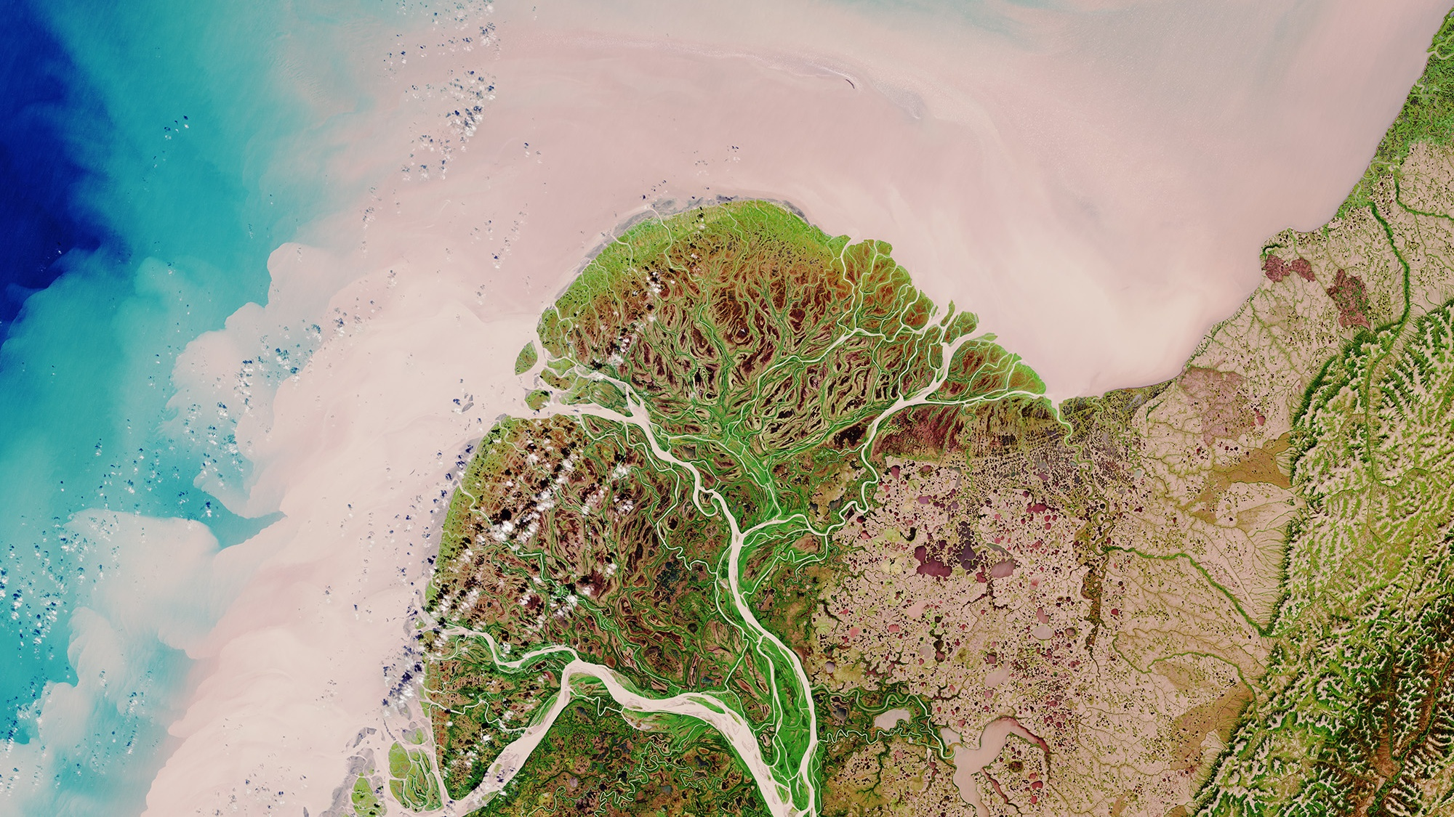
Thank you for your attention
Philippe.Goryl@esa.int

