Slide 1


Quality Assurance for EO and CEOS activities
Professor Nigel Fox
Head of Earth Observation, Climate and Optical, NPL
Chair CEOS WGCV IVOS sub-group
Google

Slide 2
CEOS WGCV IVOS: Vision
To facilitate the provision of ‘fit for purpose’ information through enabling data interoperability and performance assessment through an ‘operational’ CEOS coordinated & internationally harmonised Cal/Val infrastructure consistent with QA4EO principles.
Pre-flight characterisation & calibration
Test – sites - post-launch Cal/Val
Comparisons – satellites/validation systems
Agreed methodologies
Community Good Practises
Interchangeable/readable formats
Results/metadata - databases
Key Infrastructure to be established and maintained independent of sensor specific projects and/or agencies

Slide 3
Work plan
Structured into themes and led by ‘champions’
Look to develop good practises
  Organise comparisons
  Shared learning (research activities)
  Shared infrastructure / tools / Methods
  Recommendations as needed
THEMATIC AREAS
Land surface reflectance
Ocean colour (link to IOCCG, VC-OCR etc)
Surface Temperature (link to VC-SST, GHRSST)
Geo spatial image quality
Atmospheric Correction (Link to AC subgroup)
RT codes (context of IVOS use in calibration)
PROJECTS
RadCalNET
PICSCAR (with GSICS)
Lunar (with GSICS)
Surface Temperature Comparisons (with VC-SST & LPV)
Ocean Colour Comparison (with VC OCR) ARD (with LSI-VC)
Vocabulary
Harmonised Level 1 community reference (with GSICS)
SI traceable reference satellite (with GSICS)

Slide 4
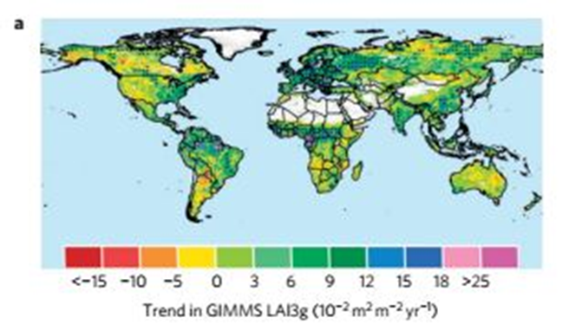
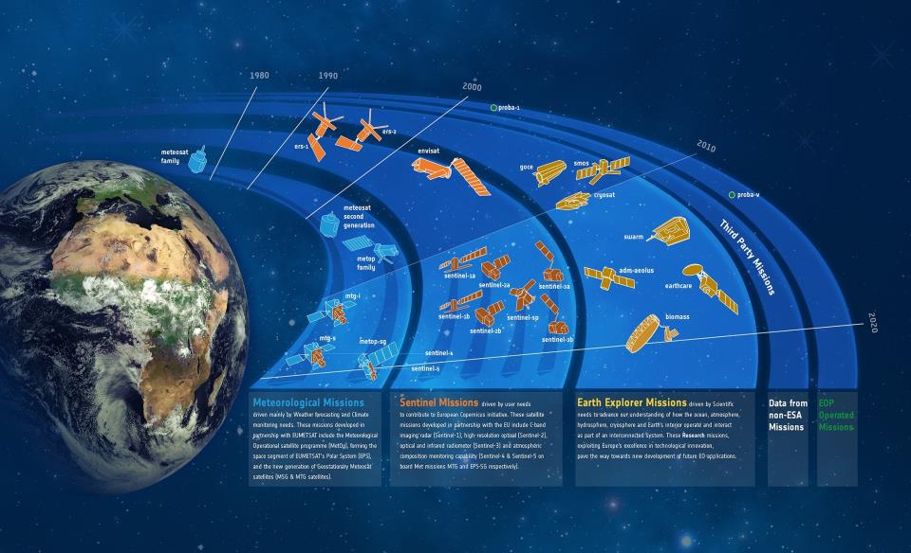
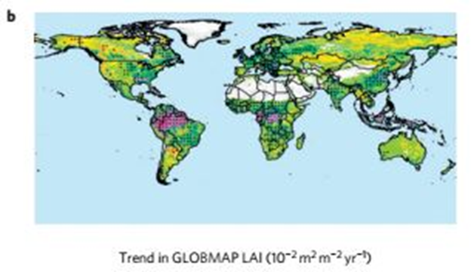
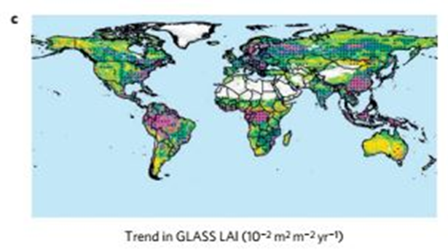
Satellite Data Products: Knowledge/information
Desire
Many sensors
Similar products
Observations on
demand’ (nano-sats)
Trustable for decades
User confidence
Challenges
Different algorithms
Limited validation data
Data similar but different
Scene/pixel dependent Uc
Lack of standardisation /
interoperability
Europe

Slide 5



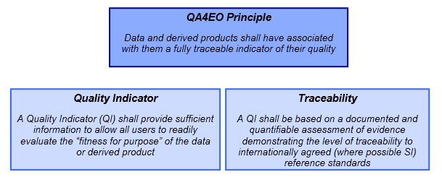
Core principles of CEOS QA4EO are starting to be implemented in new: missions, data sets and associated Cal/Val activities across all agencies (not necessarily using the name), although some additional metrological rigour at an early stage could reap major benefits in the future.
Significant effort still needed to ensure the principles can be fully implemented, particularly for Level 2 and higher.
and ins support of Analysis Ready Data, New space providers etc.
Sensor to sensor interoperability and short/long time series of data, not only for climate but other operational services, are of increasing importance. These require the creation of Fundamental (Climate) Data Records, F(C)DR ideally incorporating historic data from sensors which were developed prior to the Cal/Val rigour now expected.

Slide 6
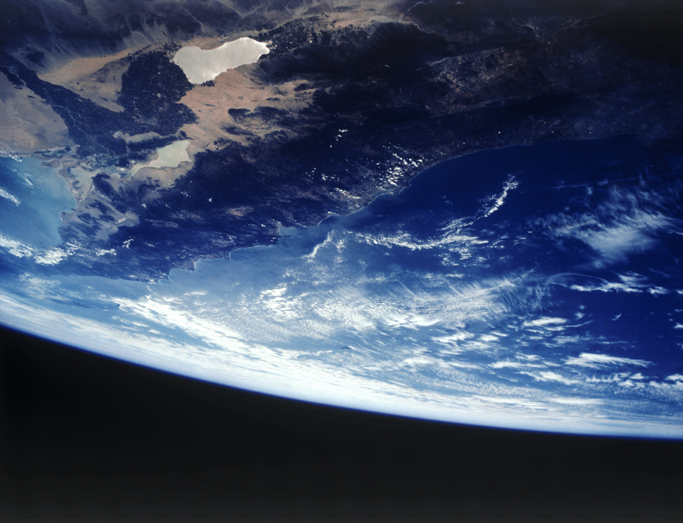
How to define a Fundamental
(Climate) Data Record? (FCDR)
(Draft definition under consideration by CEOS/CGMS Working Group Climate during 2018:) An FCDR consists of a long, harmonised record of uncertainty-quantified sensor observations that are calibrated to physical units and located in time and space, together with all ancillary and lower-level instrument data used to calibrate and locate the observations and to estimate uncertainty.
Note
The term Fundamental Data Record may be applied to records meeting similar standards to an FCDR, but which is either too short to be informative about climate variability and change, or whose contents are relevant for purposes not considered to be climate applications. (Logically, one should define FDR as the baseline concept and add climate-specific requirements to define FCDR, and this may yet be recommended.)

Slide 7
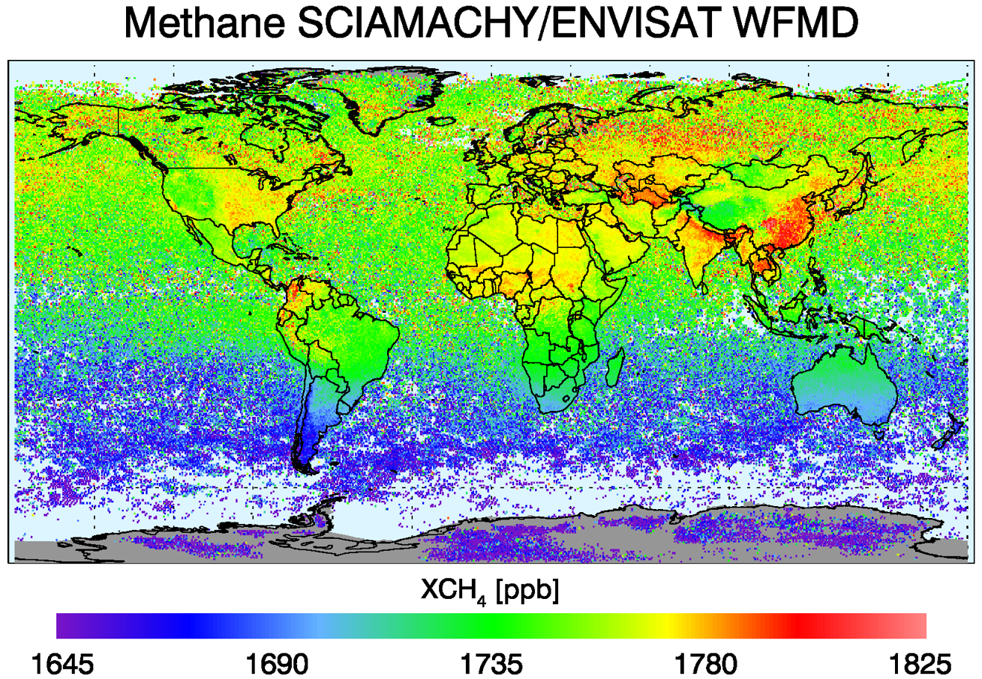
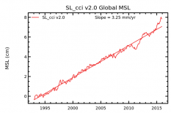
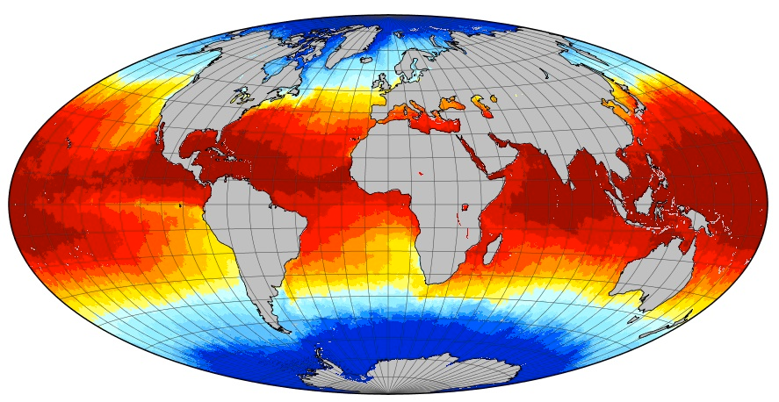

Fundamental Climate Data Records (FCDRs) are the foundation of all satellite derived climate information
Creating an FCDR
Raw satellite data (L0)
Calibrated radiances (L1)
Liability
Insurance
Decision
Climate index / information
Gridded CDR (L3)
Climate data record (L2)
Analysed / processed (L4+)
Raw satellite data (L0)
Calibrated radiances (L1)
Liability
Insurance
Decision
Climate index / information
Gridded CDR (L3)
Climate data record (L2)
Analysed / processed (L4+)
Raw satellite data (L0)
Calibrated radiances (L1)
Liability
Insurance
Decision
Climate index / information
Gridded CDR (L3)
Climate data record (L2)
Analysed / processed (L4+)
Liability
Insurance
Decision
Climate index / information
Gridded CDR (L3)
Climate data record (L2)
Analysed / processed (L4+)
Calibrated radiances (L1)
Raw satellite data (L0)
Raw satellite data (L0)
Calibrated radiances (L1)
Liability
Insurance
Decision
Climate index / information
Gridded CDR (L3)
Climate data record (L2)
Analysed / processed (L4+)
Through processing and analysis they are used to derive climate information for decision makers

Slide 8
Metrological rigour for climate data requires metrological processes for FCDRs
(Similar for FDRs used for other applications)
Flow of uncertainty from FCDR to final product
Raw satellite data (L0)
Calibrated radiances (L1)
Liability
Insurance
Decision
Climate index / information
Gridded CDR (L3)
Climate data record (L2)
Analysed / processed (L4+)
Raw satellite data (L0)
Calibrated radiances (L1)
Liability
Insurance
Decision
Climate index / information
Gridded CDR (L3)
Climate data record (L2)
Analysed / processed (L4+)
Liability
Insurance
Decision
Climate index / information
Gridded CDR (L3)
Climate data record (L2)
Analysed / processed (L4+)
Calibrated radiances (L1)
Raw satellite data (L0)
Raw satellite data (L0)
Calibrated radiances (L1)
Liability
Insurance
Decision
Climate index / information
Gridded CDR (L3)
Climate data record (L2)
Analysed / processed (L4+)
Raw satellite data (L0)
Calibrated radiances (L1)
Liability
Insurance
Decision
Climate index / information
Gridded CDR (L3)
Climate data record (L2)
Analysed / processed (L4+)
Traceable uncertainties allow trust in data
Uncertainties due to each processing step
Traceable Uncertainties

Slide 9
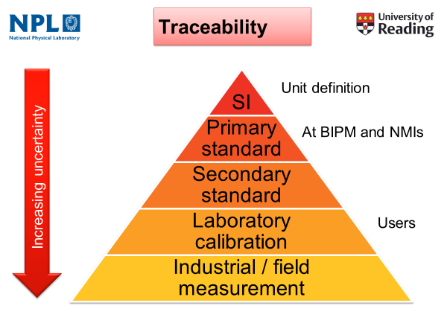
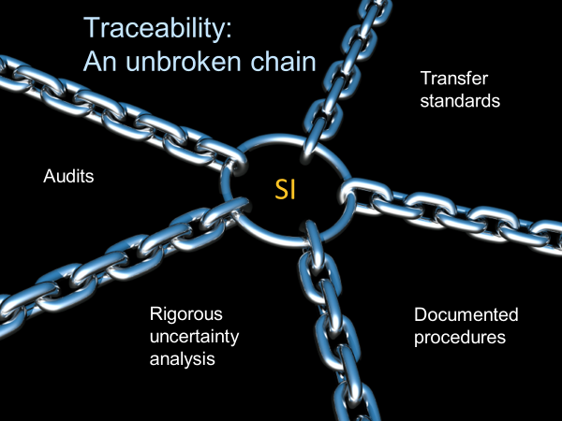

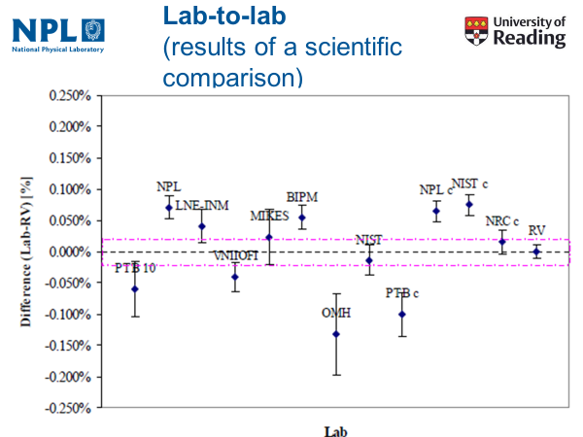
What is Traceability?
GUM
Documented evidence of degree of consistency with international std & Uc budget
i.e.COMPARISONS

Slide 10
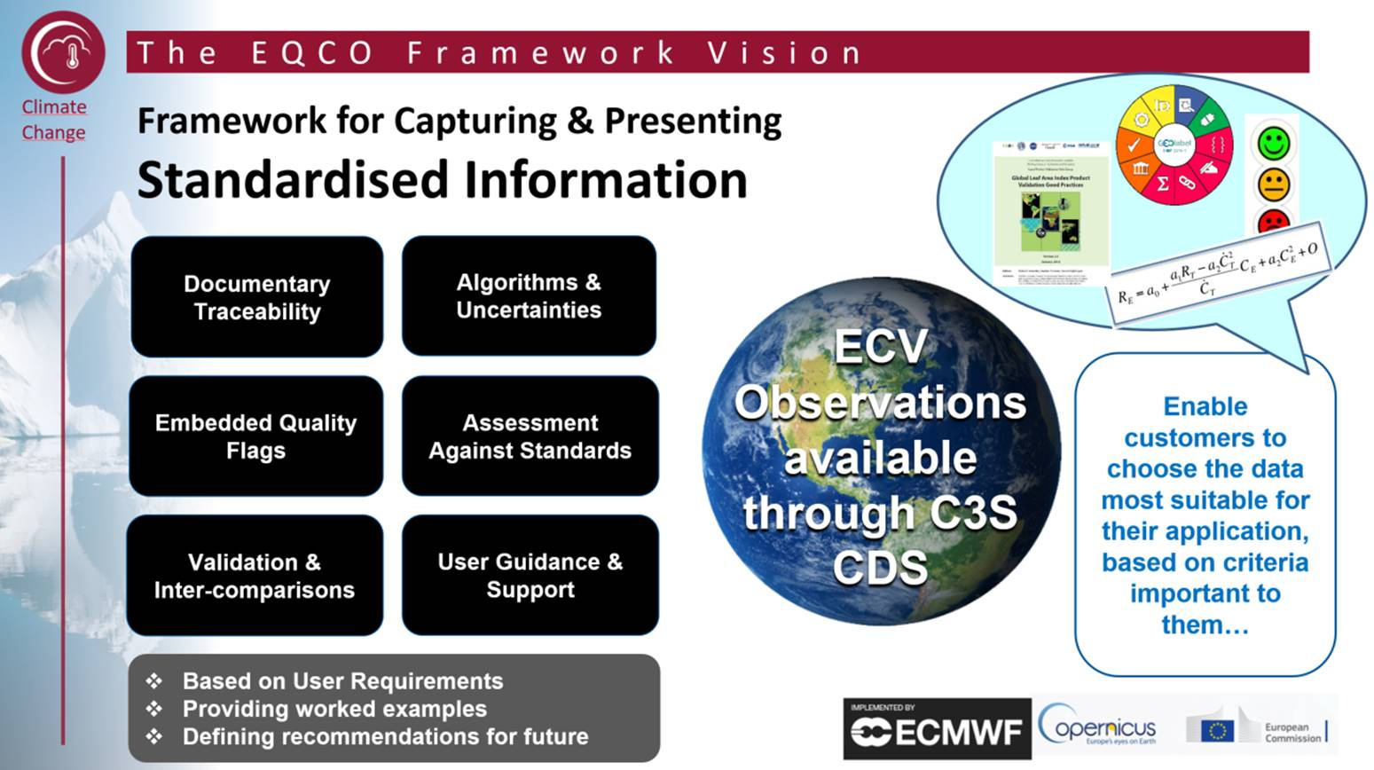
Lead project to establish QA framework for EU C3S

Slide 11
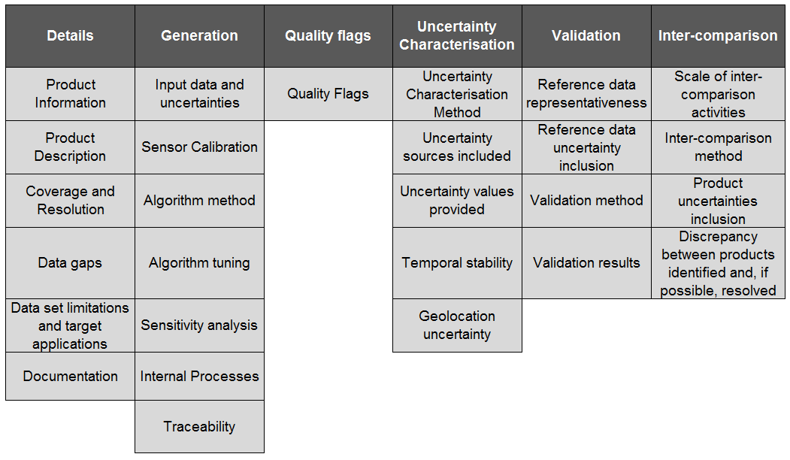

Quality Assurance Report
The QAR will document the type of uncertainty characterisation and its method:
through validation
partial algorithm propagation
statistical
fully metrologically propagated

Slide 12
Quality Assurance Report
Every measurement has an uncertainty.
To validate the satellite data, the satellite measurement and its uncertainty should be compared with the reference data and its uncertainty.
The confidence in each measurement allows you to compare the two more meaningfully.

Slide 13
Quality Assurance Report (QAR)
Why have a QAR?
Standardised form makes it easy for users to compare data products
Covers key product information and contains references to more detailed information
Aims to guide product producers on the information that should be provided with a data product

Slide 14
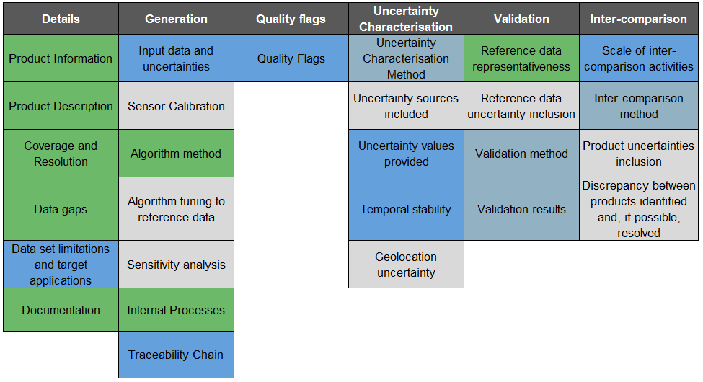
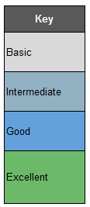
Quality Assurance Evaluation
-> To understand whether the product producer provides sufficient information to allow a user to fully understand the status of the data product and to determine if best practices are being followed in generating the product

Slide 15
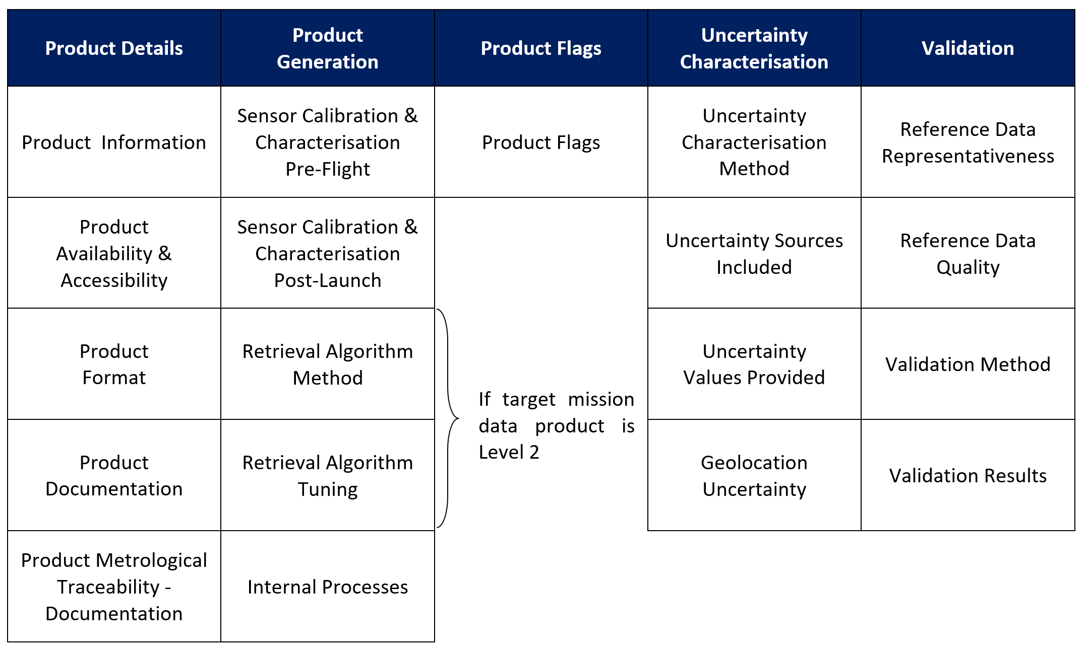
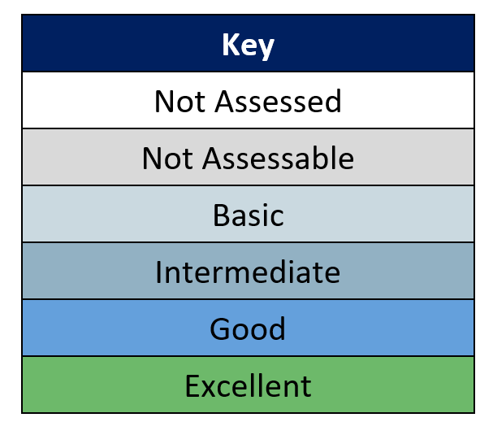

QA matrix adapted for Level 1 and 2 products

Slide 16
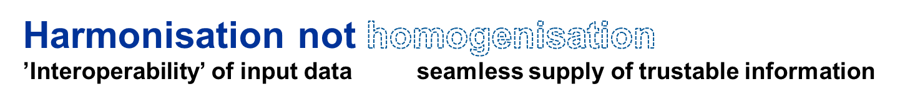
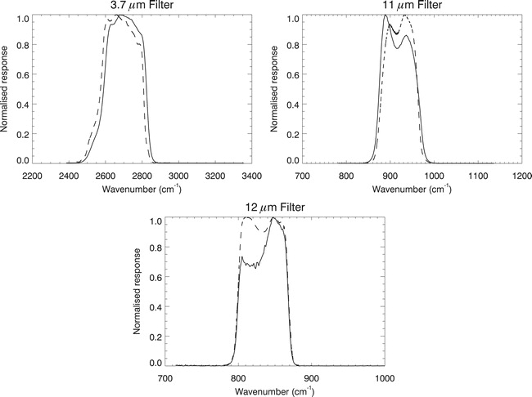
Band Integrated Radiance
Maintain sensor characteristics in viewing ‘reference’ do not force sensor A to appear to be sensor B otherwise likely to have scene dependent biases
Need to consider the measurement equation of sensor and how it interacts
Incorporating pre-flight information
Time (years)
Notes:
EMMA

Slide 17
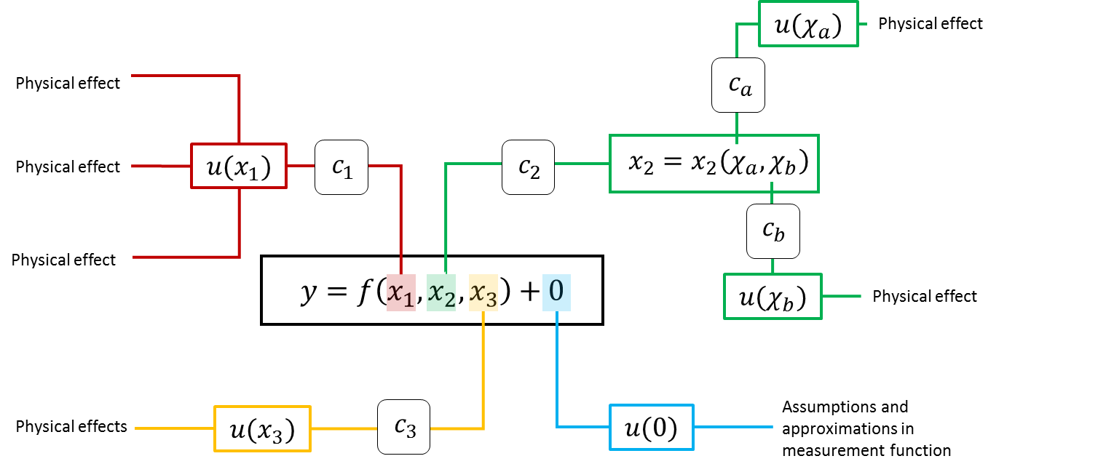
Measurement Function Analysis

Slide 18
Uncertainty Tree
Given the measurement equation we then need to investigate all the possible sources of uncertainty that feed into the final total
Involves thinking about each term in the measurement function and breaking it down into all sub-processes down to the originating process for uncertainty
We represent this process by an Uncertainty Tree Diagram

Slide 19

$$y=f\left(x_{1},x_{2},x_{3}\right)+0$$

Slide 20




Physical effect
$$u(x_{1})$$
$$c_{1}$$
Physical effect
Physical effect
$$y=f\left(x_{1},x_{2},x_{3}\right)+0$$
Physical effects
$$u(x_{3})$$
$$c_{3}$$

Slide 21


Physical effect
$$u(x_{1})$$
$$c_{1}$$
$$c_{2}$$
$$x_{2}=x_{2}\left(χ_{a},χ_{b}\right)$$
Physical effect
Physical effect
$$y=f\left(x_{1},x_{2},x_{3}\right)+0$$
Physical effects
$$u(x_{3})$$
$$c_{3}$$

Slide 22
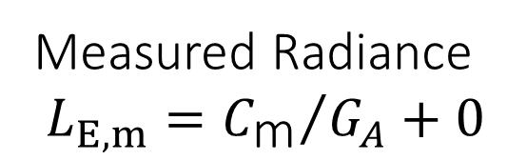


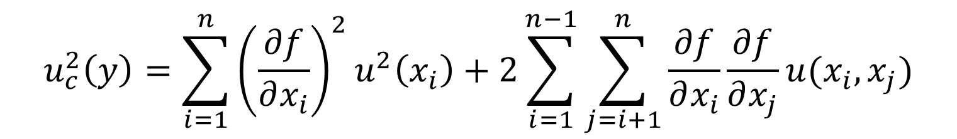
$$u(χ_{a})$$
Physical effect
Physical effect
$$c_{a}$$
$$u(x_{1})$$
$$c_{1}$$
$$c_{2}$$
$$x_{2}=x_{2}\left(χ_{a},χ_{b}\right)$$
Physical effect
$$c_{b}$$
Physical effect
$$y=f\left(x_{1},x_{2},x_{3}\right)+0$$
$$u(χ_{b})$$
Physical effect
Physical effects
$$u(x_{3})$$
$$c_{3}$$

Slide 23

$$u(χ_{a})$$
Physical effect
Physical effect
$$c_{a}$$
$$u(x_{1})$$
$$c_{1}$$
$$c_{2}$$
$$x_{2}=x_{2}\left(χ_{a},χ_{b}\right)$$
Physical effect
$$c_{b}$$
Physical effect
$$y=f\left(x_{1},x_{2},x_{3}\right)+0$$
$$u(χ_{b})$$
Physical effect
$$c_{3}$$
$$u(0)$$
Assumptions and approximations in measurement function
Physical effects
$$u(x_{3})$$

Slide 24
+0 Term
Appears in a number of places
Intended to force investigation of assumptions
  To think about and characterize known unknowns
  Mostly via Type-B uncertainty estimates
Not measured but via expert knowledge (including modelling)

Slide 25
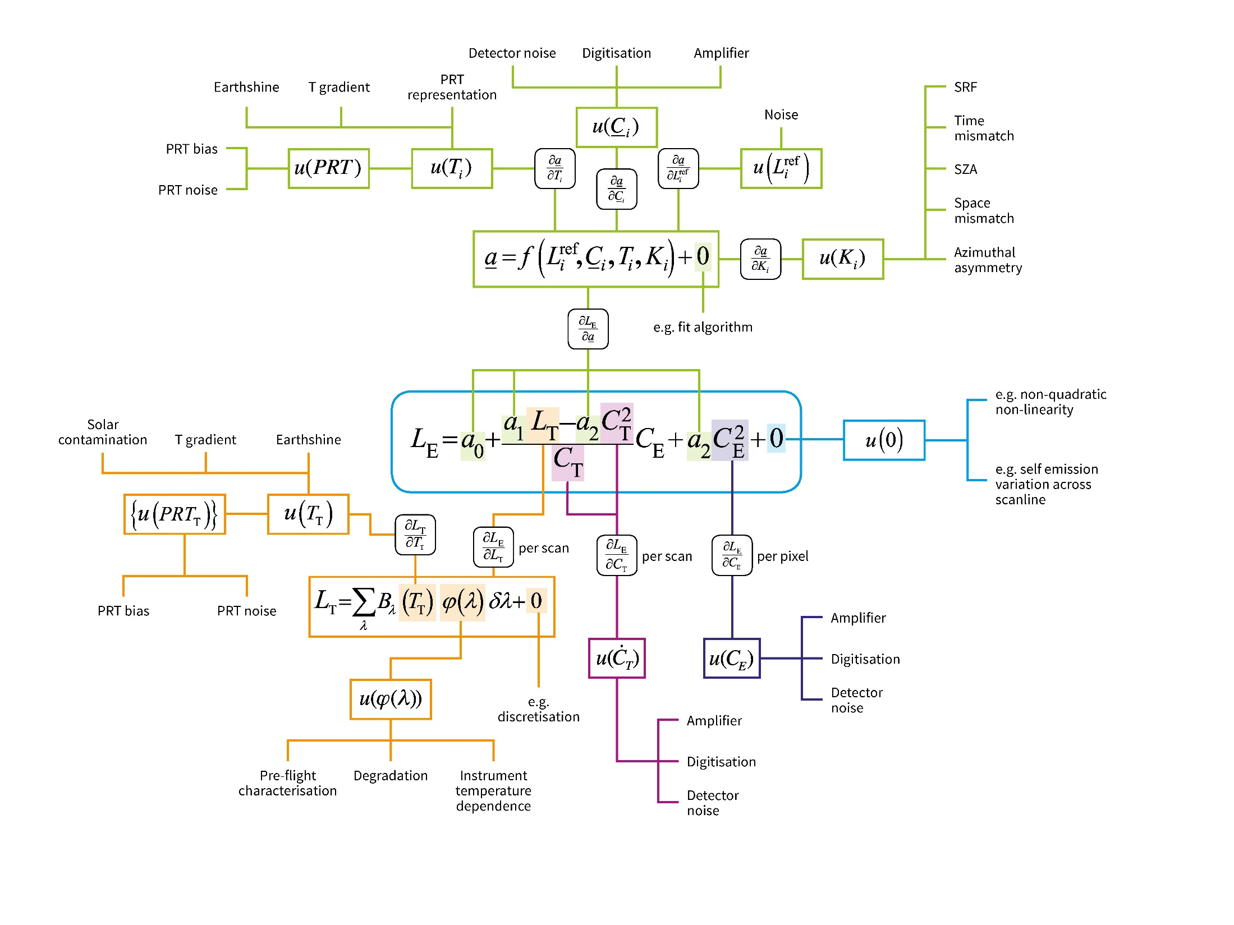
AVHRR

Slide 26
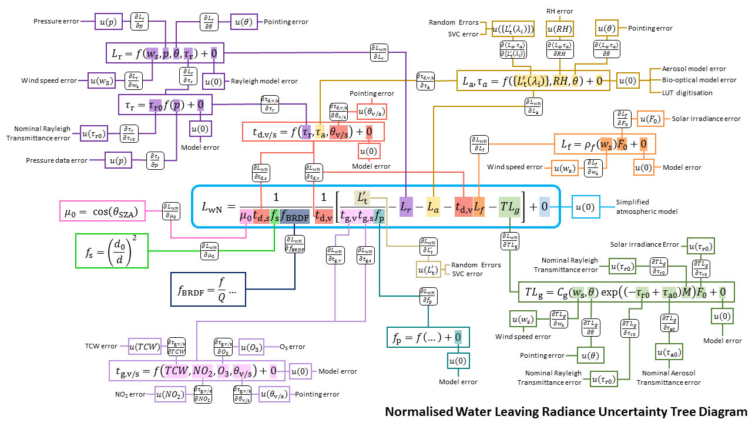
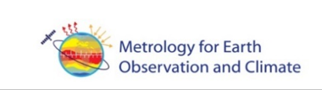

Water Leaving Radiance (System Vicarious Calibration for Ocean Colour Sensors

Slide 27
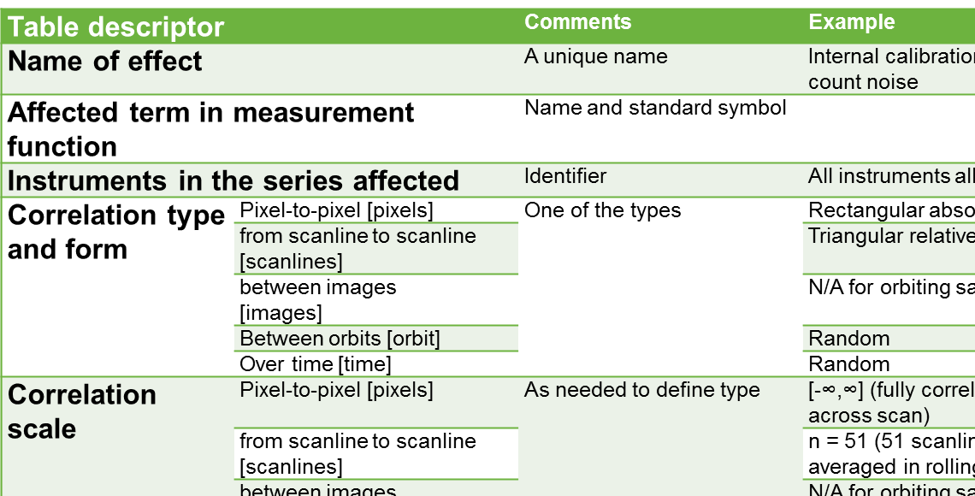
Effects Table Reporting

Slide 28
Table descriptor |  | Comments
Name of effect |  | A unique name
Affected term in measurement function |  | Name and standard symbol
Instruments in the series affected |  | Identifier
Correlation type and form | Pixel-to-pixel [pixels] | One of the types
 | from scanline to scanline [scanlines]
 | between images [images]
 | Between orbits [orbit]
 | Over time [time]
Correlation scale | Pixel-to-pixel [pixels] | As needed to define type
 | from scanline to scanline [scanlines]
 | between images [images]
 | Between orbits [orbit]
 | Over time [time]
Channels/bands | List of channels / bands affected | Channel names
 | Error correlation coefficient matrix | A matrix
Uncertainty | PDF shape | Functional form
 | units | Units
 | magnitude
Sensitivity coefficient |  | Value, equation or parameterisation of sensitivity of measurand to term
Notes:
What you end up with is a report that contains the uncertainty tree diagram and then an effects table for each of error effect identified, with required explanation

Slide 29
L1 interoperability
VISION;
To work towards establishing a community agreed reference (s) (potentially, to reflect different applications/observation characteristics) for level 1 TOA radiances/reflectances and the means of how sensors can and should link to it and subsequently communicate results
Objective is to provide a ‘reference’ which allows satellite operators and potentially their customers to readily obtain information relating to the radiometric calibration (initially Level 1) of a sensor and its relationship with others in a consistent manner but interpretation (and any other actions) is responsibility of individual agencies who have appropriate expertise
Users
  satellite operators (public agencies and commercial) – informing them on calibration status
  Users of L1 data products (e.g. L2 data producers, producers of data cubes, climate data records ..) to help obtain consistency across sensors and between bands – over time and for sensor independent products

Slide 30

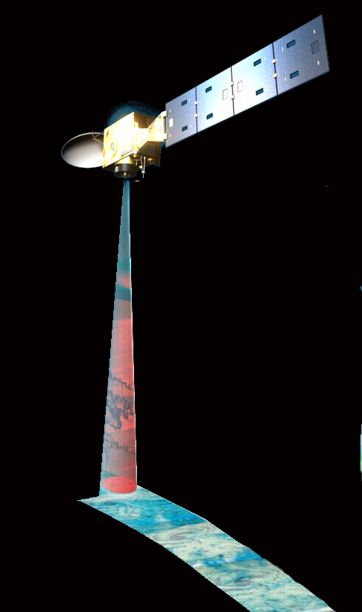
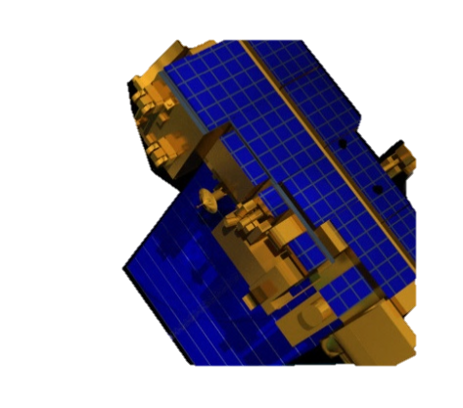

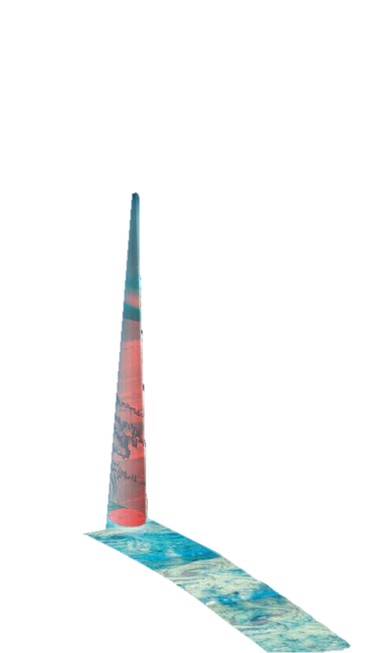
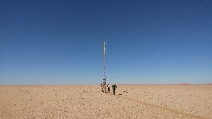

A to B via C How? Uc?
Moon/PICS
Defined Ref sensor?
B
C
A
Transfer of comparisons
“Chains of comparisons”
Combining all available data
?
PICS?

Slide 31
What are the elements of a system to deliver?
Understanding user needs and the characteristics of sensors that would use the ‘service’
- who wants it?, why? and what must it be able to do?
- data cubes, ARD, FCDR creation, data gaps, constellations
A means to formulate a reference (s) and assign its associated uncertainty
– Internationally acceptable standard (proxy for SI)
- Test-site, Reference sensor, virtual sensor, combo….
The means to link sensor measurements to the reference and its associated uncertainty (‘Comparison’) – The process
    Tools to achieve (SBAFs, Ref. Solar Irradiance, Mathematics…),
Communication of information (data, results and methods)
– Useability and awareness
Governance, review mechanisms, quality control, maintenance…
.- Community acceptance

Slide 32
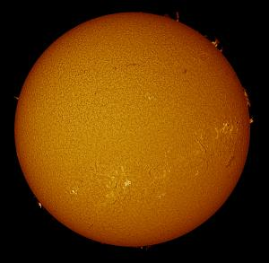

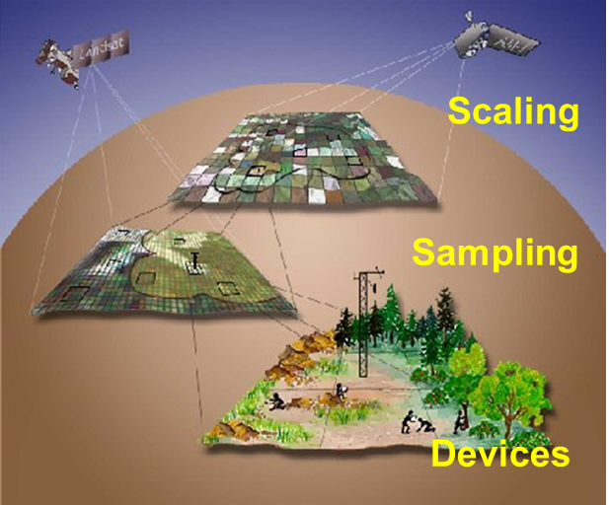

Spectral response function
Atmospheric transfer
- standardise?
- comparison (ASIX)
- New ‘community code’
‘Eradiate’
’
Solar Irradiance
TOA reflectance/
radiance
Angles of illumination
and observation
Spectral BRDF of ground
- high resolution spectral reflectance
TOA spectrometer / measurements?
- Community model? Parametrisation inputs
PICSCAR
PICSCAR
Then consider the ‘real world’

Slide 33

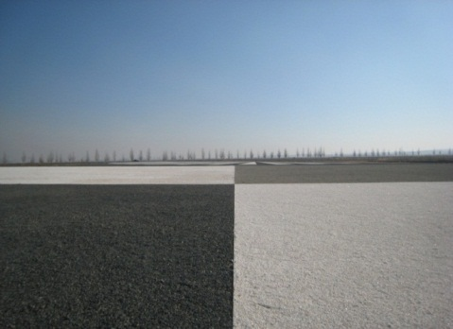
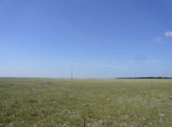
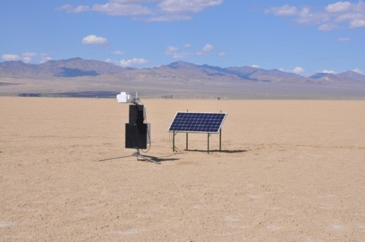
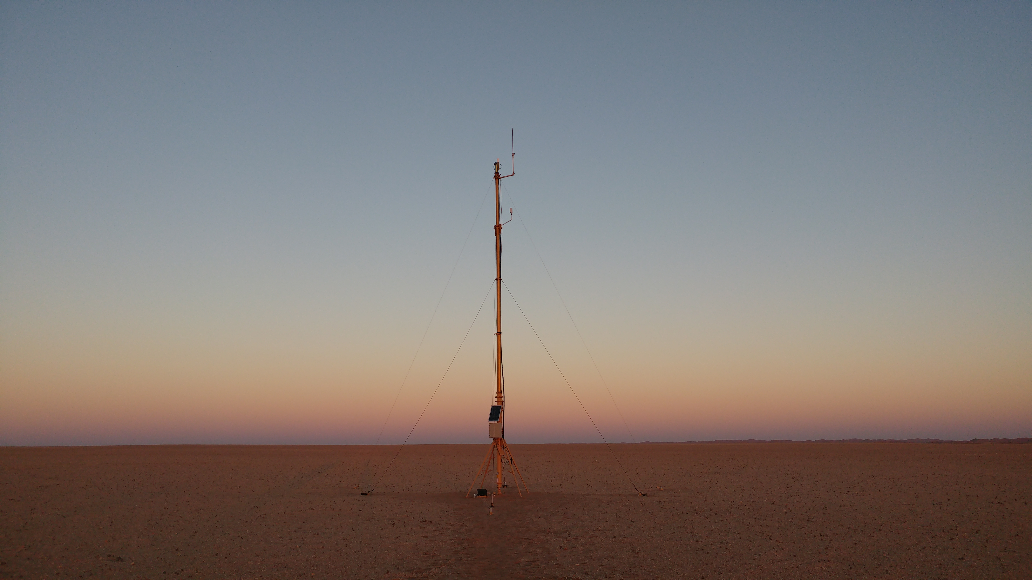



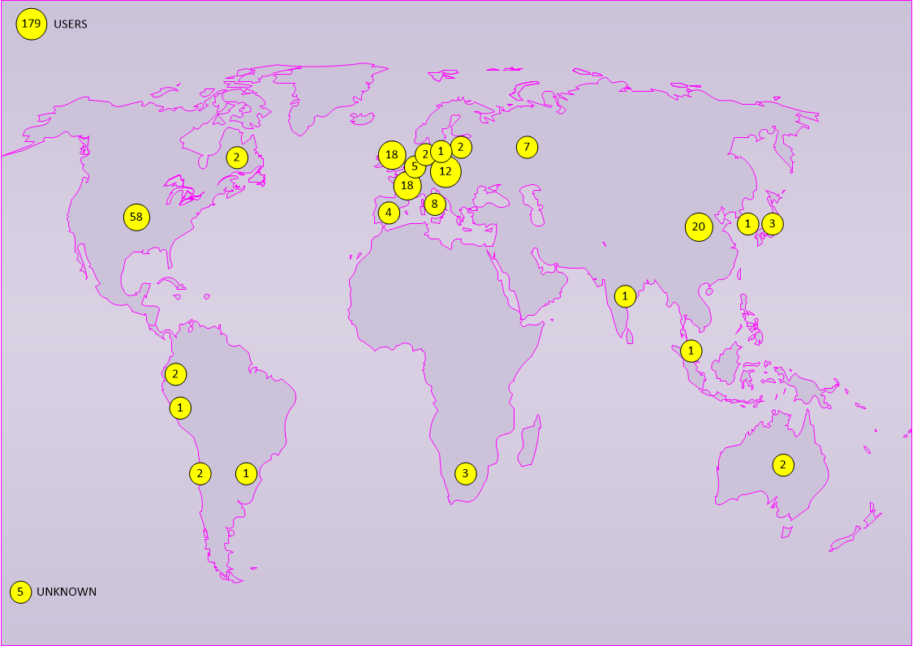
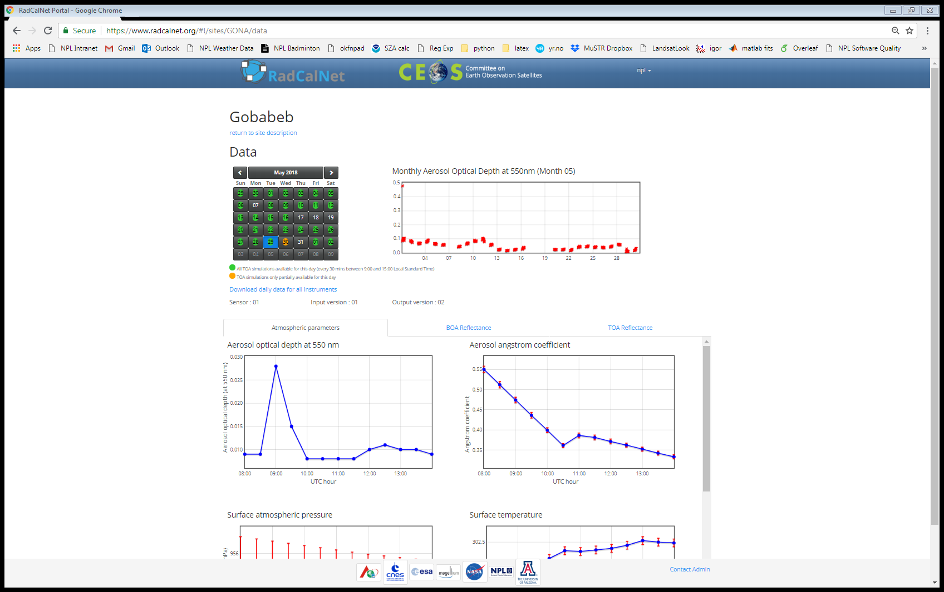



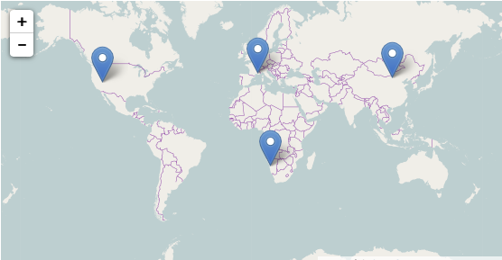

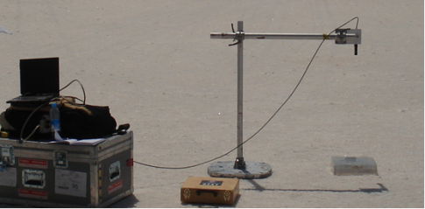
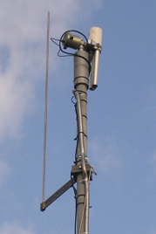
RadCalNet
TOA nadir-view hyperspectral (400 - 2350 nm) reflectance every 30 minutes Individual site measurements documented & traceable
Baotou
La Crau
Railroad Valley
Gobabeb
Operational and open to public In July 2018
First two week 16 new users,
13 countries
26 downloads
Now >200 users
Site Characterisation
Site permanent monitoring (radiometry and atmosphere/weather)
Modelling of TOA nadir-view reflectance

Slide 34

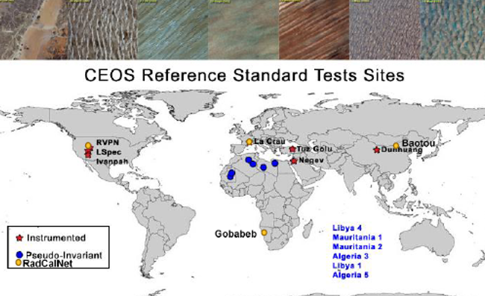

PICSCAR
Project to collaborate on characterising PICS for monitoring stability and sensor
to sensor comparison, also linkable to RadCalNet for traceability
- BRDF model (use of and development)
- Spectral characteristics
- Atmosphere
- Homogeneity
Much community interest
~ 20 participants in workshop:
Comparisons with standardised data
Comparisons with different
surface BRF models
Spectral characteristics to allow tailoring for sensor spectral
bands
- Sat spectrometer data
      - measuring sand samples

Slide 35
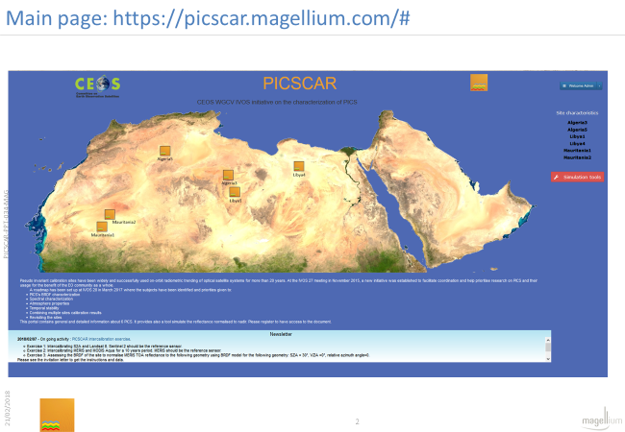
PICSCAR portal to be linked from Cal/Val portal

Slide 36
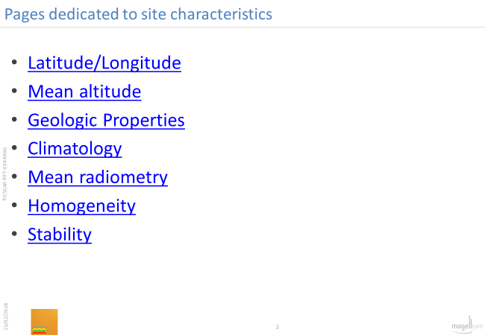
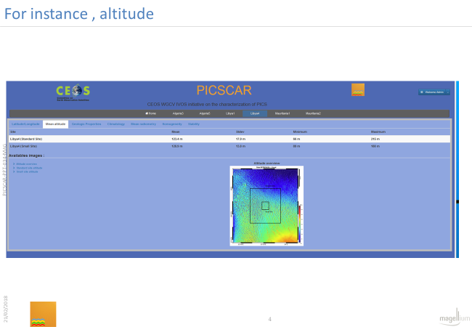
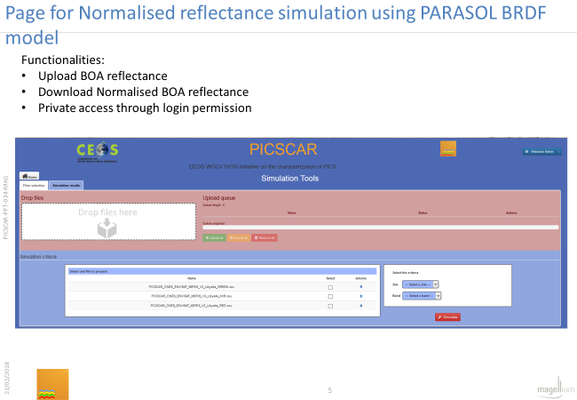
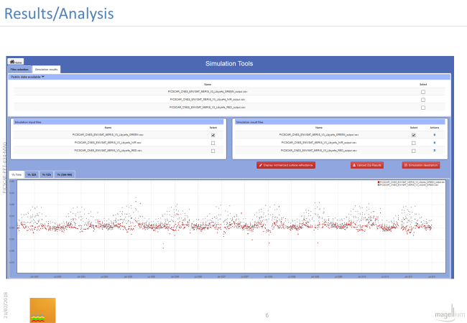
PICS characteristics/results
Comparison tools

Slide 37
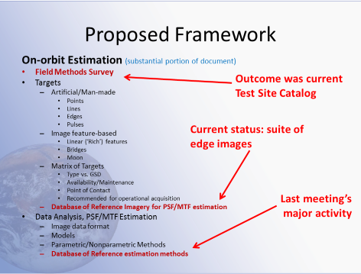
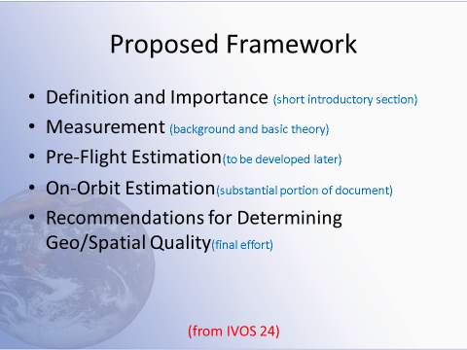


Establish good practise and community references (MTF)

Slide 38












Achieving SI Traceable Cal infrastructure /methods
PICS
For each method dominant source of uncertainty is systematic ‘absolute level’
and
often unknown effects caused by time differences of observations (e.g. atmosphere, solar/view angle etc
Much of latter can be randomised by multiple observations/corrections <<1%
SNO (or angle matched) can reduce random component significantly minimising number of match-ups needed
Dome C
Establish minimal set of references/methods
Target: Combine information weighted by Uc for particular sensor and application noting individual sensor characteristics
TRUTHS/CLARREO/
China
Ocean Colour
SI
Anchors absolute level of methods at TOA constraining models to reduce uncertainties.
RadCalNet
SI
Natural Phenomena

Slide 39




















SI traceable validation (FRM4…) mitigate against data gaps & test/anchor FDRs
Fiducial Reference Measurements (FRM) are a sub-set of ‘in-situ’ measurements of satellite measured parameters (L1/L2) that can be compared to those independently derived from a satellite to:
Validate the sensor performance and any processing chain
Provide a means to bridge any potential data-gaps
Facilitate interoperability between sensors and
anchor/establish FDRs
    Providing they are of sufficient accuracy!
    (Noting that the comparison process has its own uncertainty)
    FRMs MUST:
    Have documented evidence of metrological traceability to SI (or appropriate international community standard) including full uncertainty budget (instrumentation and useage), which must be at a level commensurate with the application.
    be independent of any satellite geophysical retrieval process.
    Be carried out following community agreed protocols
FRM4SAR

Slide 40

Importance of comparisons
Use guidance and best practises of NMIs

Slide 41















WGCV supported by
Has delivered to CEOS agencies and sub-bodies
10 types of comparison with 12 participants from 4 continents
8 best practices or protocols
Improved confidence, reliability and global consistency in validation of satellite derived Surface Temperature (Ocean, Land and Ice)
Community Improved knowledge of uncertainty evaluation
Legacy database to store future results
www.FRM4STS.org

Slide 42


2016 Radiometer comparison
Miami University (USA)
ONERA (France)
University of Valencia (Spain)
University of Southampton (UK)
Qing Dao (China) -1
Qing Dao (China) -2
RAL (UK)
CSIRO (Australia)
KIT (Germany)
DMI (Denmark)
GOTA (Canary Islands
JPL NASA (USA)
Ian Barton (Australia)
MAERI (UofM) viewing NPL ammonia Heat pipe
240 K to 318 K
SISTER (RAL) viewing NPL
ammonia Heat pipe

Slide 43




Selection of Results of Lab
Radiometer comparison to SI

Slide 44



WST comparison
University of Valencia (Spain)
University of Southampton (UK)
Qing Dao (China) -1
Qing Dao (China) -2
RAL (UK)
CSIRO (Australia)
KIT (Germany)
DMI (Denmark)
GOTA (Canary Islands)
JPL NASA (USA)
Day & night measurements
Vagaries of UK weather!

Slide 45



Difference from mean for SST designed radiometers only

Slide 46



Comparisons of instruments
www.frm4soc.org
Ensuring measurements validating of Ocean colour
Are internationally consistent and traceable to SI
Uncertainty analysis with support
Ocean platforms and ship transects

Slide 47
Terminology
Uncertainty
is not
the same as
Error
But also many terms have different interpretations e.g. Harmonisation, bias, Ancillary data ……
IVOS Activity: Also to support wider CEOS WGCV initiative NPL is creating and administering a ‘Wikki’ web page (via Cal/Val portal) to discuss/define terminology and establish ‘thesauras’ of definitions as necessary also with simple graphic/videos to make clear concepts. Incorporating other initiatives such as H2020: FIDUCEO
Small international task group established

Slide 48



Conclusion: FCDRs & FDRs
With more than 35 years of Earth Observation heritage there are many potential FCDRs,
A metrological approach will provide older sensor data with improved accuracy, uncertainties and traceability enabling backward extension of FDRs
Implementing a metrological approach in the near term will provide the next generation of sensors with traceability to ensure ‘fitness for purpose’, multi-reuse of data and risk mitigation
International interoperability through a common transparent QA framework for both agencies and commercial providers will maximise utility & societal benefit.

