Slide 1
CMA Agency Report 2019
Xiuqing Hu, Na Xu
National Satellite Meteorological Center(NSMC), CMA
2019 GSICS Annual Meeting, Frascati, Italy,
04-08, March, 2019

Slide 2
Overview
  CMA's GSICS Activities, Action & Achievements Summary
  CMA's support to GRWG Activities
  CMA's support to GDWG Activities
  Agenda items reported by CMA

Slide 3
  CMA's GSICS Activities & Achievements Summary
The commissioning Test of FY-3D was finished, MERSI II ,HIRAS, and MW sensors are all showing well performances than its former sensors.
Under the GSICS framework, the baseline IR intercalibration methodology was updated by applying Likun Wang's accurate collocation and Hui Xu's spectral gapfilling methods (7h,7i,7t).
Integrated Vicarious calibration was applied for MERSI II RSBs postlaunch calibration and degradation monitoring.
GSICS IR intercalibration was implemented to FENGYUN's new multispectral and hyperspectral sensors including FY-4A/AGRI,GIIRS, FY-3D/MERSI-II,HIRAS and microwave sensors based on CMA GSICS platform (7c, 7e, 7i)
MW group has made remarkable progresses on SNO intercalibration, O-B, and its contributions to calibration process correction(5j,5w).
The retrospective recalibration for FY FCDR was fully carried out, and achieved stage results(3a, 5a).
Initiate Long term observation with automatic control by remote and local Maintenance and New instruments is being developed ( 4d)
Notes:
FY-2H was successfully launched on 6 June 2018 located at 94°E. The developing of its GSICS validation products is ongoing.
CMA and EUMETSAT worked together to synchronize GSICS products across the servers,.developed and standardized PICS&SNO data extraction procedure

Slide 4
Statuses of CMA Major Actions
GRWG (Actions )
A.GIR.2018.4f.1 | CMA to apply Likun Wang’s collocation method to LEO-LEO cases. | Closed. will show process in this meeting
A.GIR.2018.4b.2 | Xu Na (CMA) to prepare ATBD and other information to submit to GCC for the demonstration FY-2 products | Ongoing, the doc has been finished and being revised.
A.GIR.2018.4c1 | JMA(Masaya)/CMA(Xu Na) to work together on making GEO-GEO inter-comparison, using IASI | Open, Will be discussed in this meeting
A.GIR.2018.4d.1 | Xu Na (CMA) to compare with the JMA gap filling methods. To report at the next web meeting in 2-3 months. | Closed. has reported the progress at GRWG web meeting on 2018-06-05
GDWG (Actions)
A.GDWG.2018.5d.1 | CMA and EUMETSAT to work together to synchronize GSICS products across the servers. | Closed. XU Zhe has reported that at GDWG web meeting on 2019-01-23
A.GDWG.2018.5d.2 | CMA to check if their NetCDF format checking tool can be shared in GSICS. | Closed. CMA GDWG confirm can share NetCDF format checking tool's script.
A.GDWG.8b.1 | Zhe Xu to provide their Data needs to GDWG chair for presenting to EP chair to present to CGMS to see if agencies can provision of support to this data exchange request. | Open, Will be discussed in annual meeting 2019

Slide 5
  CMA's support to GRWG Activities

Slide 6
FY-3D commissioning
Tests for satellite platform have been finished August, 2018, the results show the functions and performances meet the requirements;
Field campaigns for FY-3D Vicarious calibration and validation were conducted at Simao rainforest in March 2018, Dunhuang desert in April 2018, and Qinghu Lake in August 2018.
All 10 instruments onboard FY-3D have finished the three-round tests for evaluating the key performances which all meet with specification.
8 instrument payloads, i.e. MERSI-II, HIRAS, GNOS, MWTS, MWHS, MWRI, SEM, and IPM have begun operation since Jan 1, 2019 with L1 data dissemination and L2 generation test.
Trial data of Sounding instruments （ HIRAS, GNOS, MWTS, MWHS, MWRI）were delivered to outsides such as ECWMF, EUMETSAT, Metoffice, Wisconsin University and CAS for L1 quality evaluation and data assimilation test

Slide 7
FY-3D Cal/Val long term monitoring
Operational Instrument Performance Monitoring for long term based on OBC complete telemetry parameters
GSICS SNO or SNOx monitoring using reference instruments (IASI, CrIS, MODIS,VIIRS) and Intercomparison with EUMETSAT partner sensors such as IASI, Sentinel 3 OLCI/+SLSTR, GOME-2.
MERSI-II Calibration trend monitoring using PICS sites and ground-based automatic measurements at Dunhuang site
Integrated calibration system which combines earth targets, moon, DCC and RT simulation

Slide 8
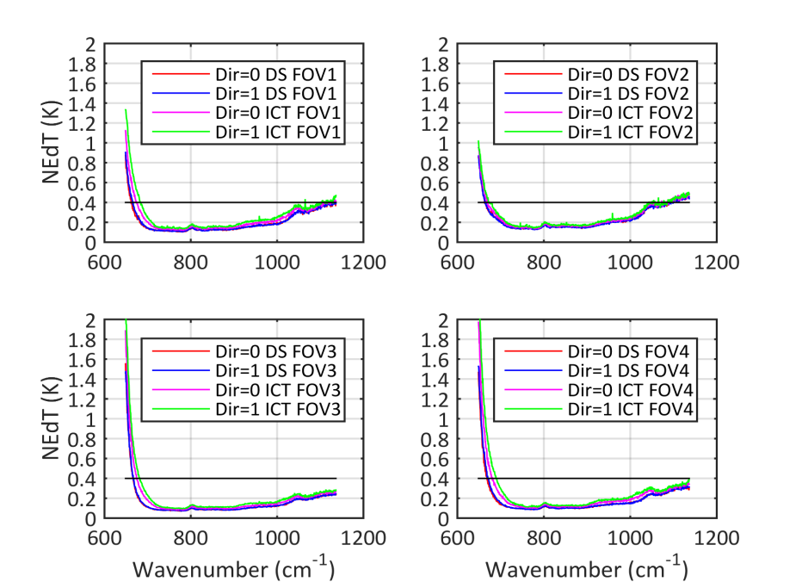
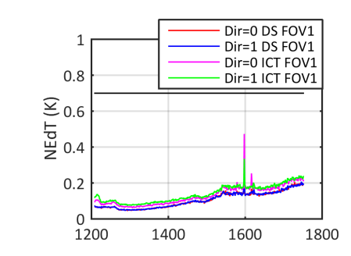
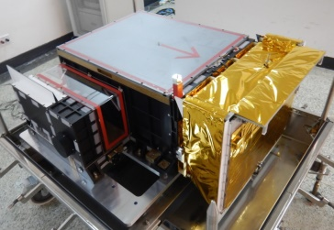
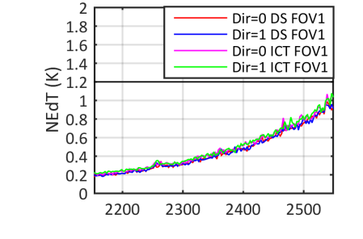
HIRAS performance and GSICS validation
LW @ 0.625cm-1 Res
MW @ 1.25cm-1 Res
NEdT
SW @ 2.5cm-1 Res
Noise performance: derived from DS and ICT measurements
NEdTs derived from DS and ICT are consistent.
NEdTs in forward and reverse sweep direction are consistent.
Meet requirements.

Slide 9
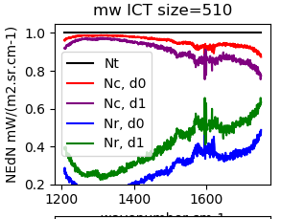
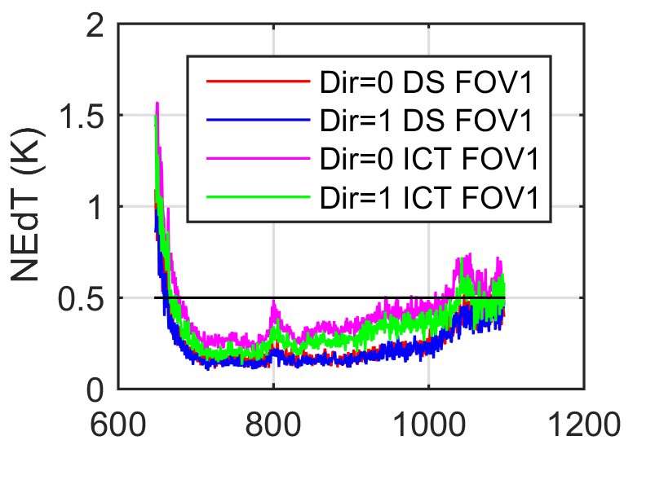
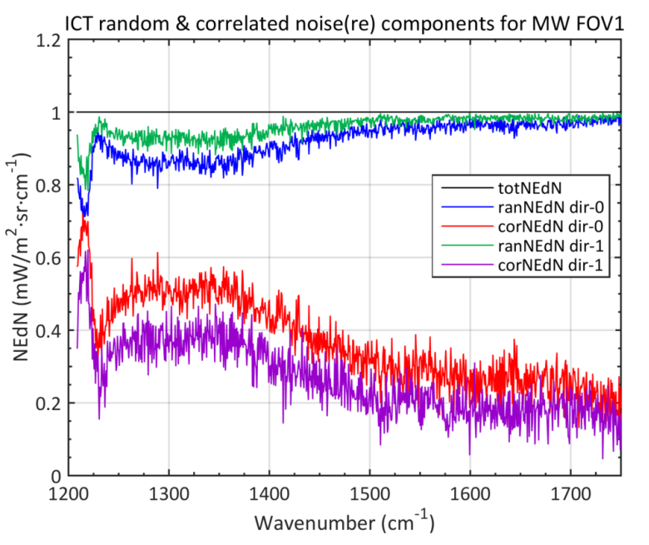
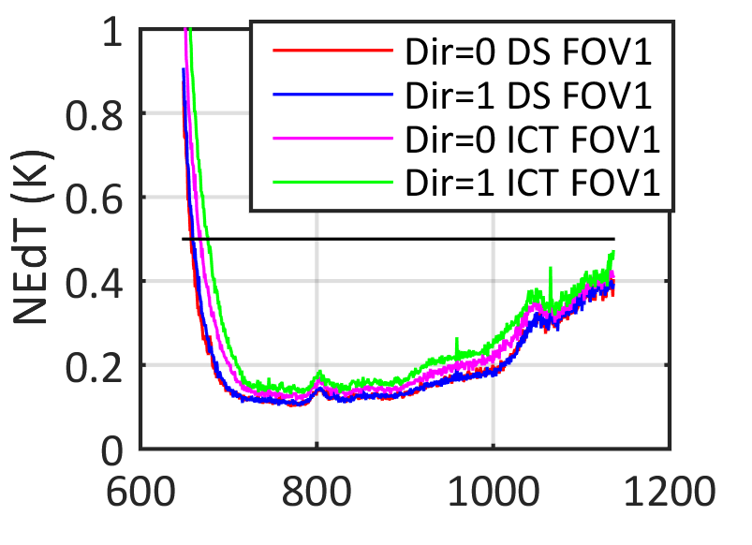
After fine optic alignment，noise dominated by random noise
Before fine alignment
After fine alignment
April 20, 2018
Notes:
得到高精度辐射产品，灵敏度足够高。创新利用。。，发射初期相关噪声很高，灵敏度不同干涉方向、不同目标不一致，仪器进行定镜精确校正，相关噪声得到很强抑制，随机噪声占主导，灵敏度不同方向和目标达到一致，满足指标。

Slide 10
Spectral bias vs LBLRTM simulation
Spectral accuracy within 2ppm,
But we also find the small shift on orbit for long term.
Spc Bias mean（ppm） | FOV1 | FOV2 | FOV3 | FOV4
LW | -3.06 | -0.67 | 1.05 | 1.58
MW | -3.76 | -1.02 | -1.17 | -2.60
SW | -1.38 | 1.05 | 1.61 | 2.39

Slide 11
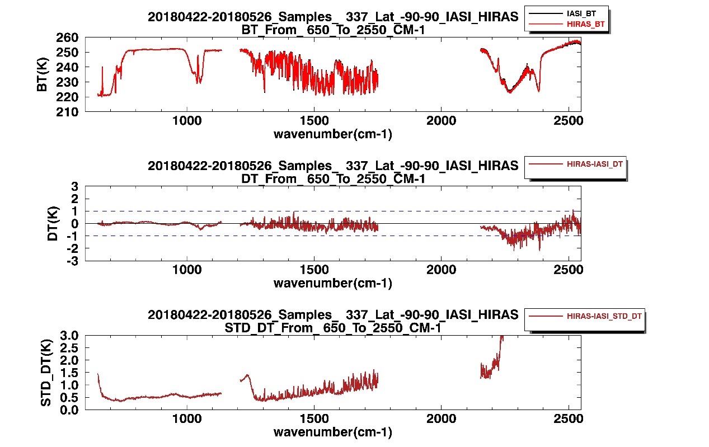
Calibration bias with respect to IASI
Data:2018.04.22-2018.05.26 17 days
LW bt bias better than 0.5K，MW bt bias less than 0.7K；
LW bias std less than 0.5K， MW bias std in 0.5~1K， SW window and weak absorption region meet 0.5K ；

Slide 12
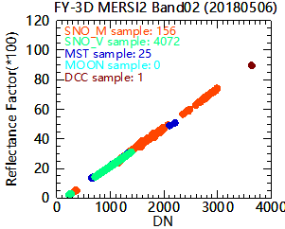
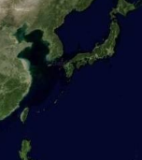
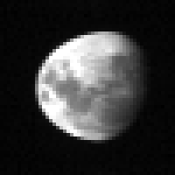
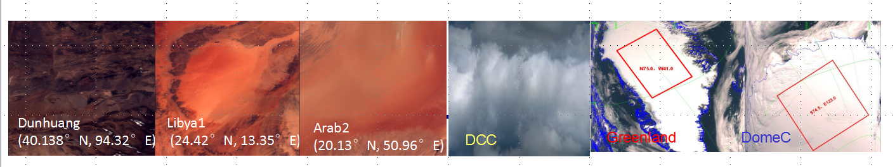
MERSI-II IVC calibration(operational)
RSBs Integrated Vicarious calibration
Integrated Vicarious Calibration method was implemented to MERSI II for Wide Dynamic calibration by combining various stable targets and SNO pixels
Sea
<5%
Moon
5-10%
Desert
20-30%
Ice sheet
50-80%
DCC
>90%
Radiance
Notes:
高光谱、高精度月球辐照度模型
地基观测和卫星观测手段结合
DCC反射率模型
宽动态稳定目标联合
基准卫星轨道设计，在多目标同时获得高交叉频次
保证基于不同目标的基准传递定标一致性

Slide 13
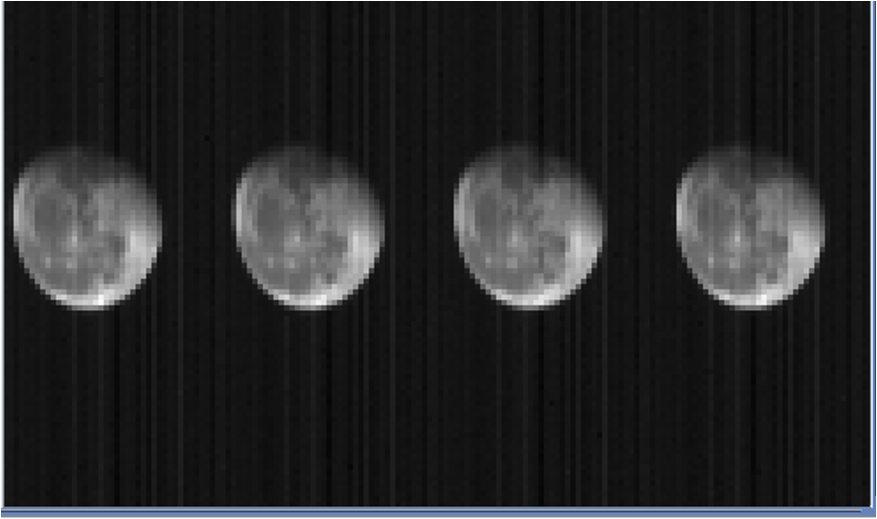
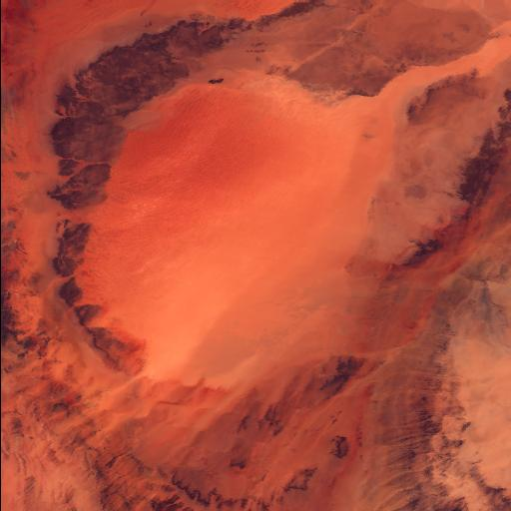

Combined Degradation Monitoring
MERSI-II calibration monitoring
Moon
Libya
DCC

Slide 14
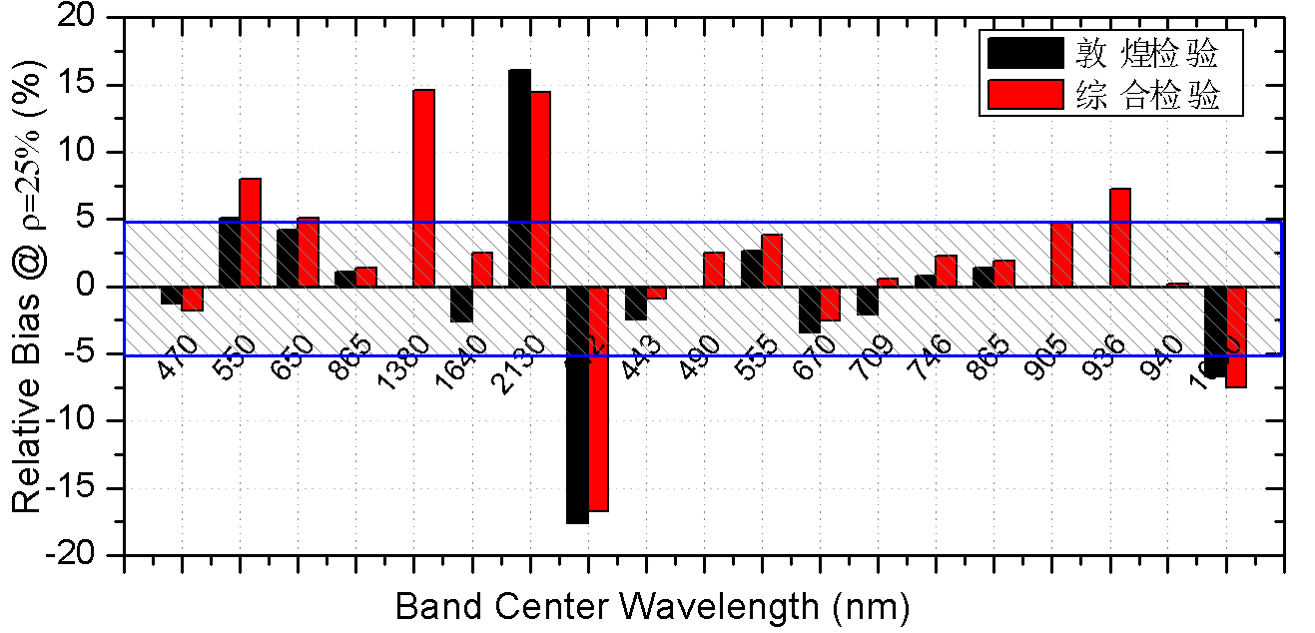
GSICS Validation using Dunhuang
Prelaunch calibration On-orbit validation based on vicarious calibration (VC)
band | Center Spectral nm | Integrated-VC % | Dunhuang Insitu VC %
1 | 470 | -1.79 | -1.28
2 | 550 | 7.99 | 5.09
3 | 650 | 5.14 | 4.22
4 | 865 | 1.37 | 1.12
5 | 1380 | 14.63 | NaN
6 | 1640 | 2.47 | -2.6
7 | 2130 | 14.42 | 16.08
8 | 412 | -16.72 | -17.63
9 | 443 | -0.91 | -2.48
10 | 490 | 2.49 | -0.06
11 | 555 | 3.82 | 2.62
12 | 670 | -2.52 | -3.46
13 | 709 | 0.59 | -2.11
14 | 746 | 2.27 | 0.83
15 | 865 | 1.92 | 1.36
16 | 905 | 4.74 | NaN
17 | 936 | 7.22 | NaN
18 | 940 | 0.19 | NaN
19 | 1030 | -7.52 | -6.67
Prelaunch laboratory calibration perform well on-orbit, and the biases of most bands are within 5%. The two independent validation results show good consistency.
Dunhuang VC
Integrated VC
Dunhuang VC
Integrated VC
Validation results comparison between integrated vicarious calibration (without insitu measurement) and Dunhuang site insitu calibration（2018.05）

Slide 15
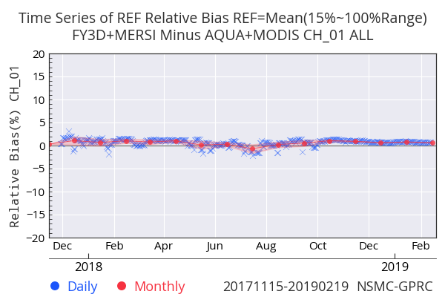
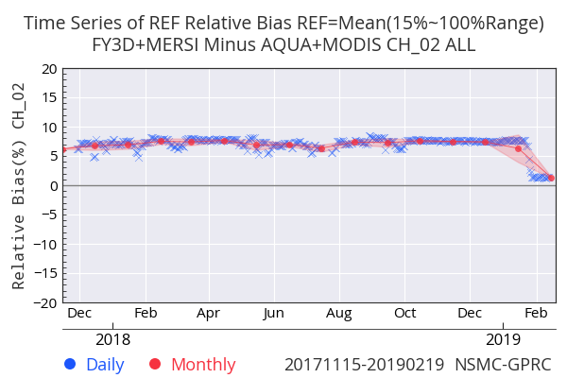
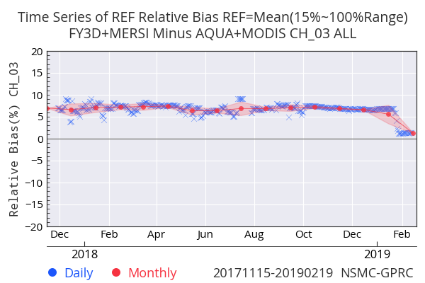
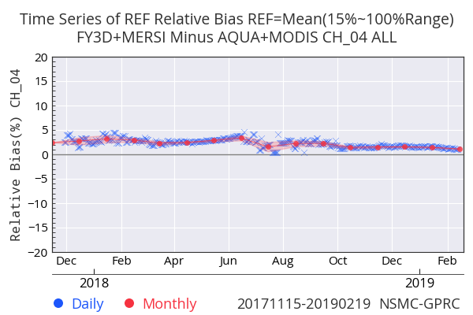
MERSI-II monitoring using MODIS
RSBs Calibration Bias Monitoring w.r.t. AQUA/MODIS
CH1~4
The data stability of MERSI II is greatly improved, no obviously degradation was found since launched；
The relative differences between MERSI II and MODIS can be kept within 2%(ref=25%) based on the new calibration coefficients。
Calibration Coeff. Update
Calibration Coeff. Update
Degradation Evaluation of FY-3A MERSI

Slide 16
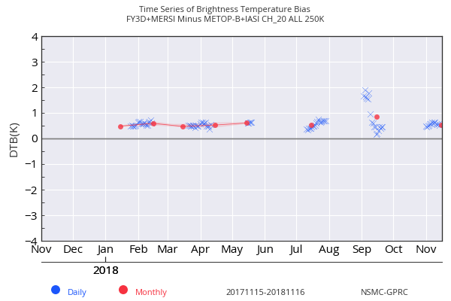
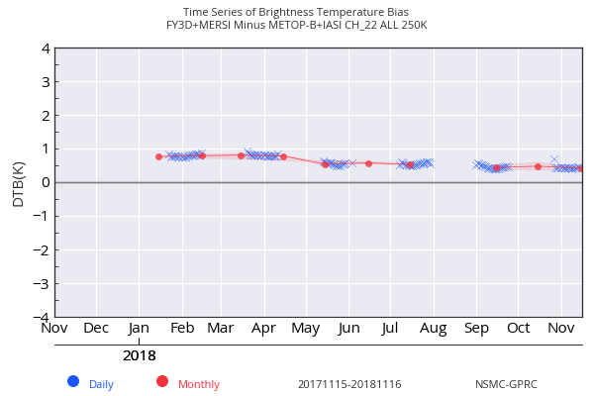
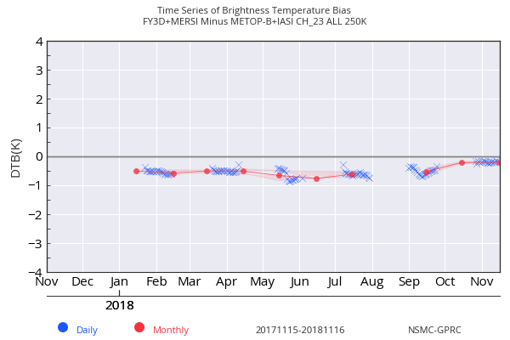
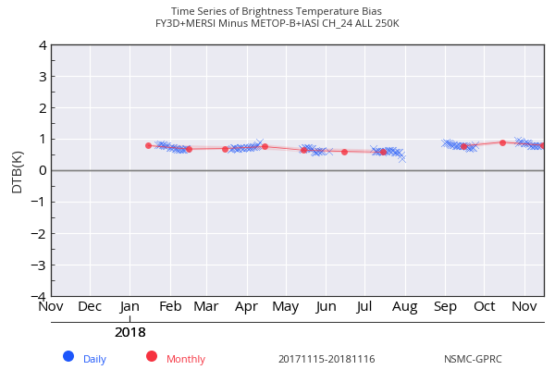
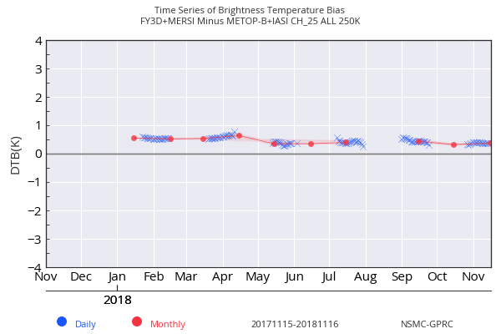
MERSI-II IR GSICS Monitoring
TEBs Calibration Bias Monitoring w.r.t.METOP-B IASI
MERSI II IR Biases are less than 0.5K for B20/22/23/25, and about 0.8K for B24；
The time sequence of TB biases is stable.
B20(3.8μm)
B22(7.2μm)
B23(8.5μm)
B24(10.8μm)
B25(12μm)
Time sequence of FY-3D MERSI II TB Biases

Slide 17
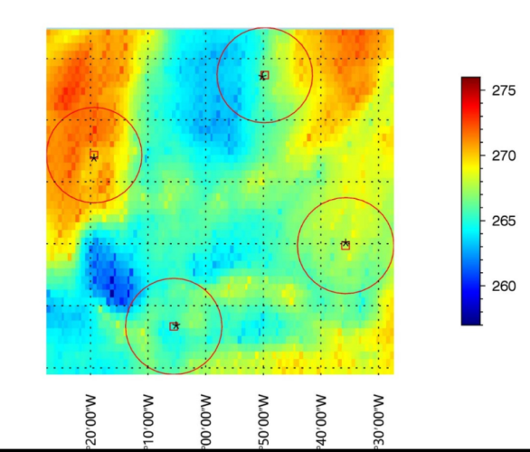
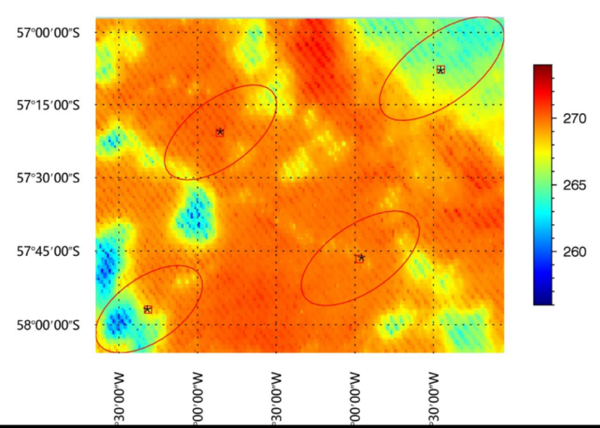
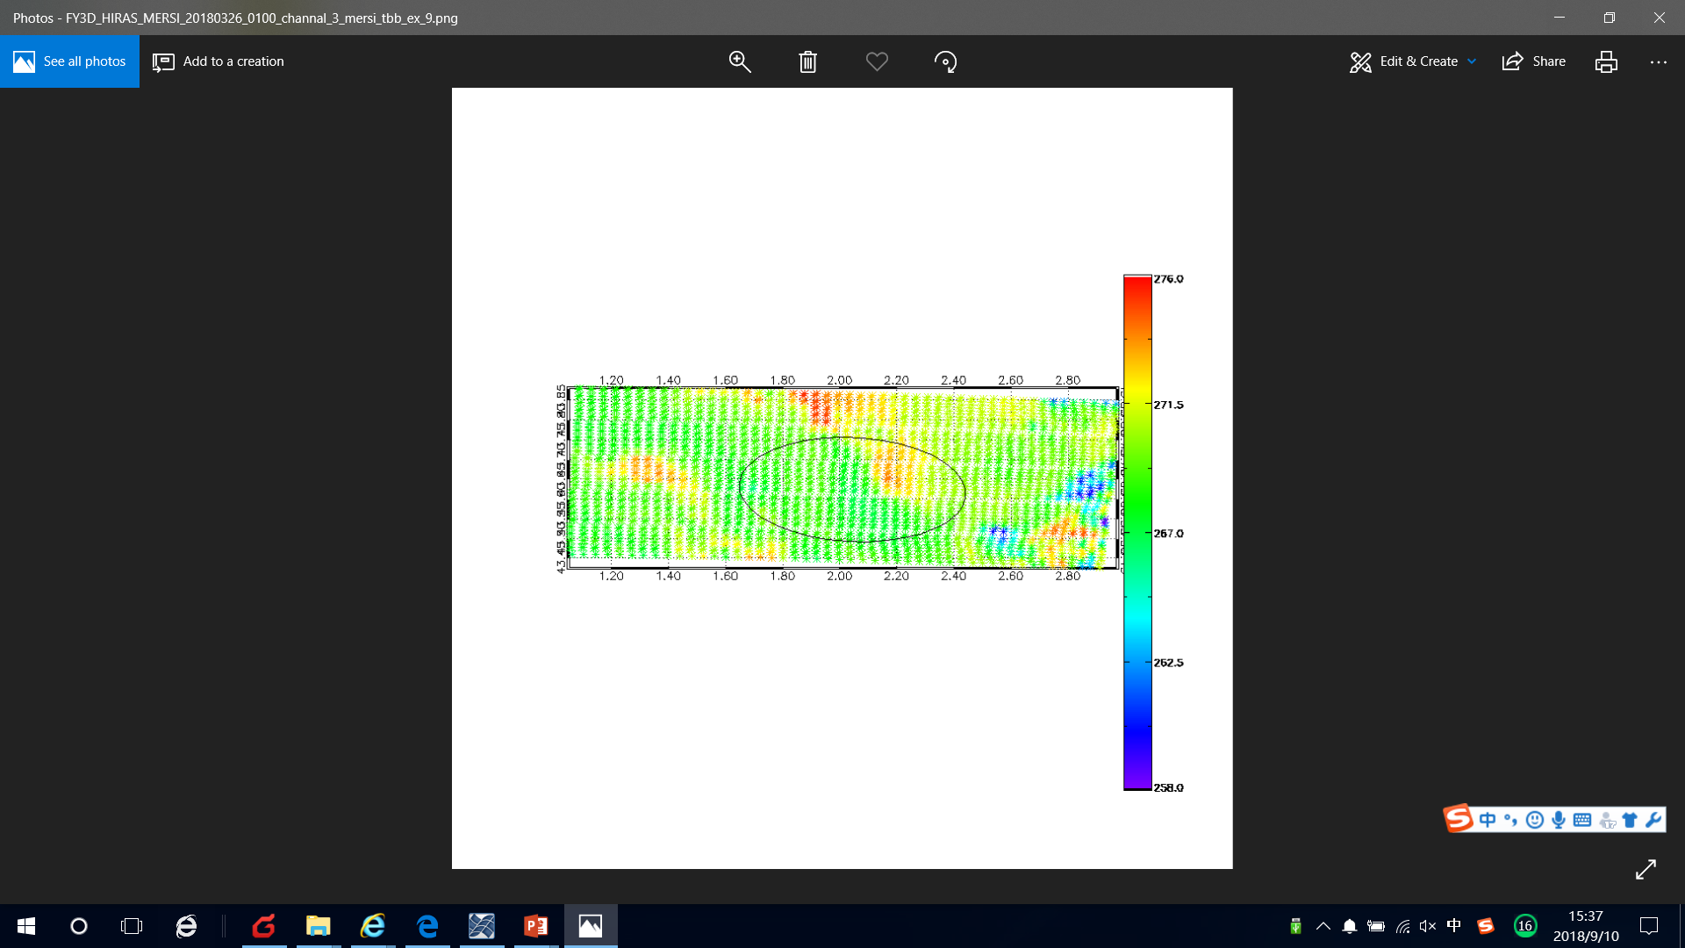
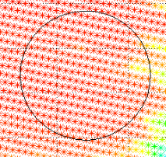
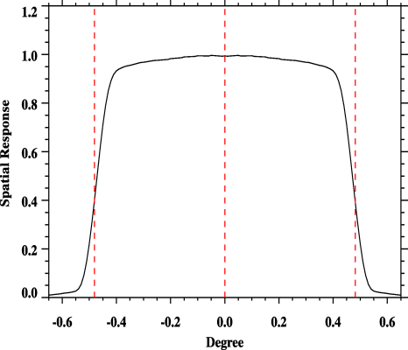
MERSI & HIRAS Intra-platform Comparison under GSICS framework
Accurate collocation method based on line-of-sight pointing vectors from GSICS is used for inter-calibration on the same platform. (Wang et al., 2013,2016).
HIRAS FOVs variation along scan
Satellite
P
Nadir
Off-nadir
29 km
wang et al.,2015
55km
16km

Slide 18
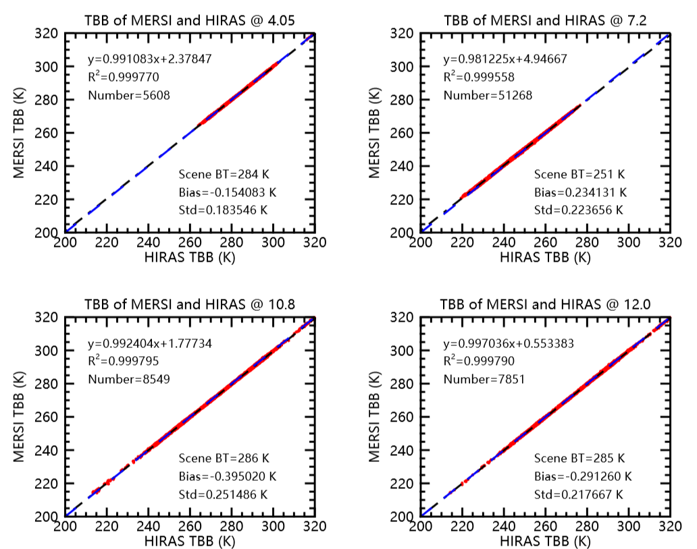
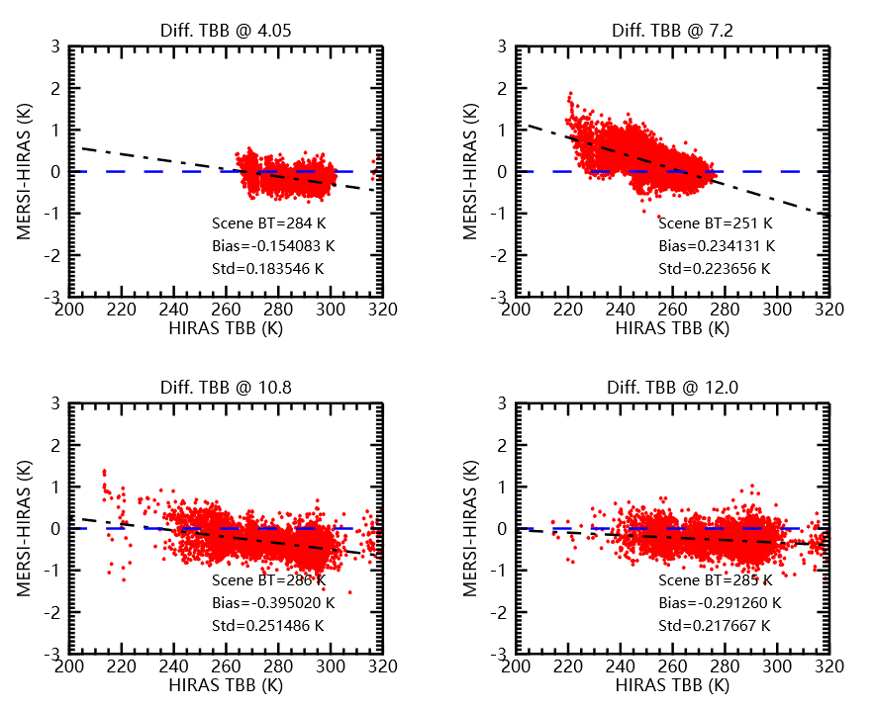
MERSI-II/HIRAS Inter-calibration
using accurate collocation
MERSI and HIRAS have a good consistency;
Biases show scene-dependent feature due to nonlinear response;
MERSI Ch | 4.05 | 7.2 | 10.8 | 12.0
Scene_bt(K) | 284 | 251 | 286 | 285
Mean bias(K) | -0.90 | 0.68 | 0.74 | 0.26

Slide 19
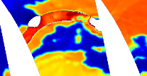

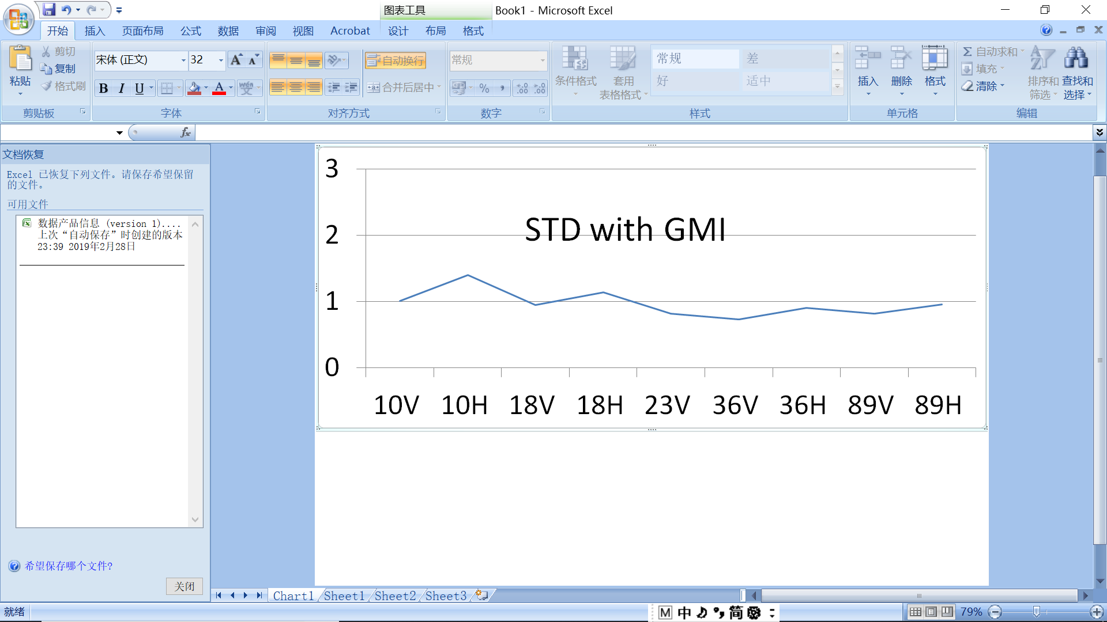
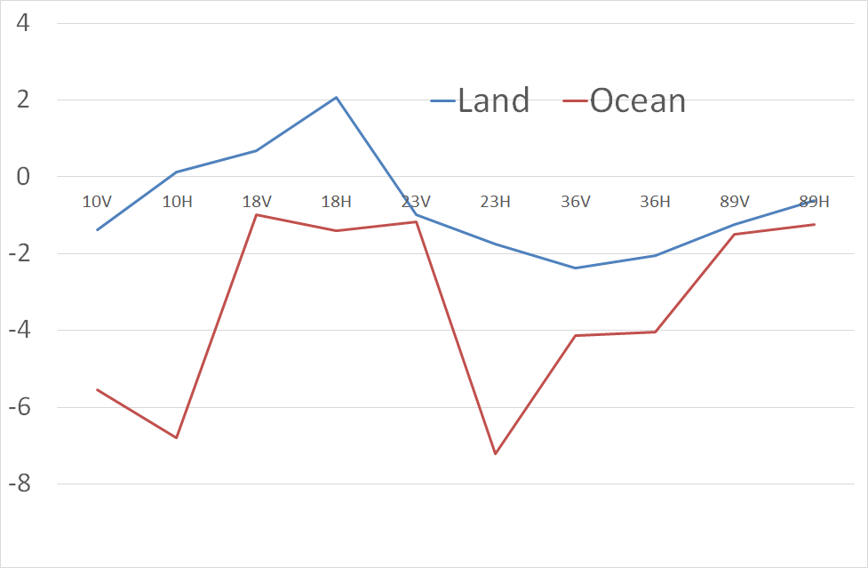
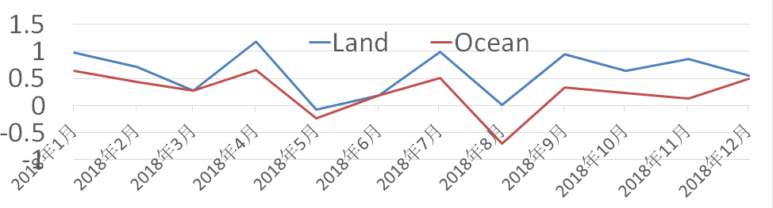
MW sensors performance and GSICS validation
MWRI
1, Improvement on the A/D Bias, using O-B result to decrease the A/D Bias to less than 0.5 K in average.
2, Improvement on the cold sky mirror noise filter, especially on the television transmission satellite of EU and US, 10G and 19G.
3, Inter calibration with GMI, 1-2K bias in ocean and 2-4K in land for most channels, std for all channel are ~1K or less.
Bias with GMI

Slide 20
MWTS and MWHS wrt NPP/ATMS
MWTS
MWTS
The FY3D-MWTS channel bias is better than 0.6 K except channel 5 , and the middle and upper layers have higher accuracy; Bias std has higher accuracy in the middle atmosphere and better than 0.5 K.
MWHS Bias Std for five humidity sounding channels are less than specification and the performance of MWHS II onboard FY3D (green bar) and FY3C (blue bar) is almost similar.
MWHS

Slide 21
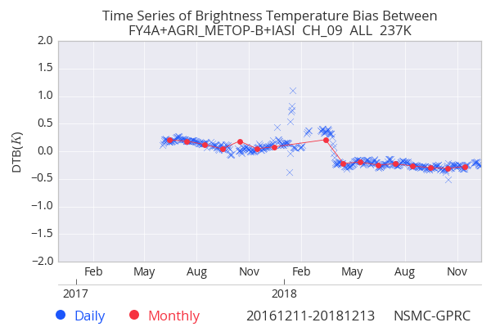
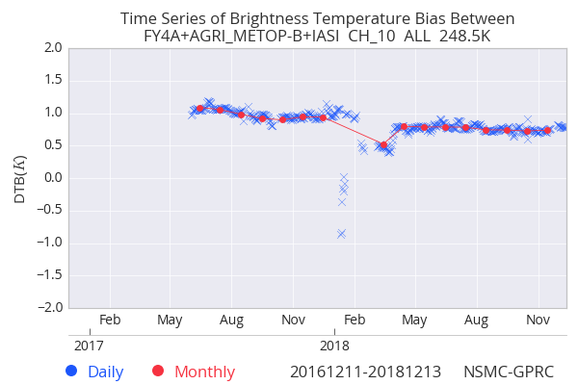
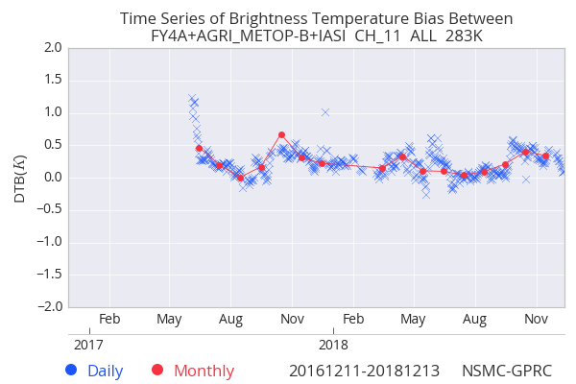
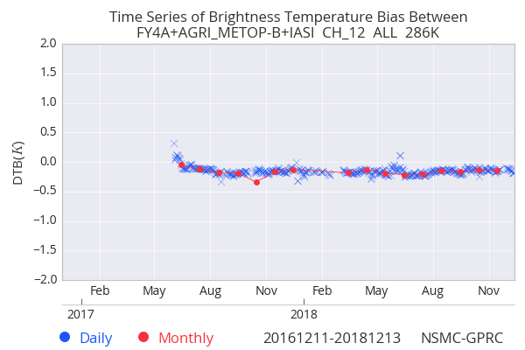
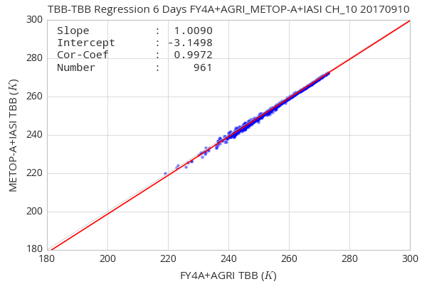
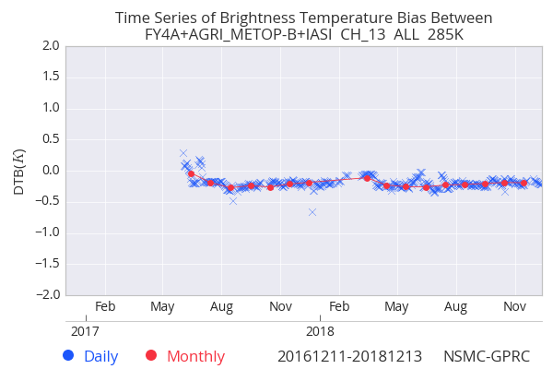
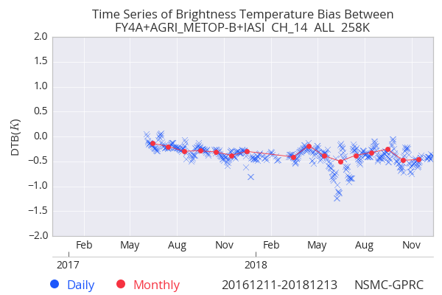
FY-4 GSICS IR Inter-calibration
FY4/AGRI VS METOP-B/IASI
AGRI IR Biases are less than 0.5K for B9/11~14, and about 0.8K for B10；
The stability of B11 and B14 is slight worse than other bands.
B9：~0.3K
B10：~0.8K
B11：~0.5K
B12：~-0.2K
B13：~-0.2K
B14：~-0.4K

Slide 22
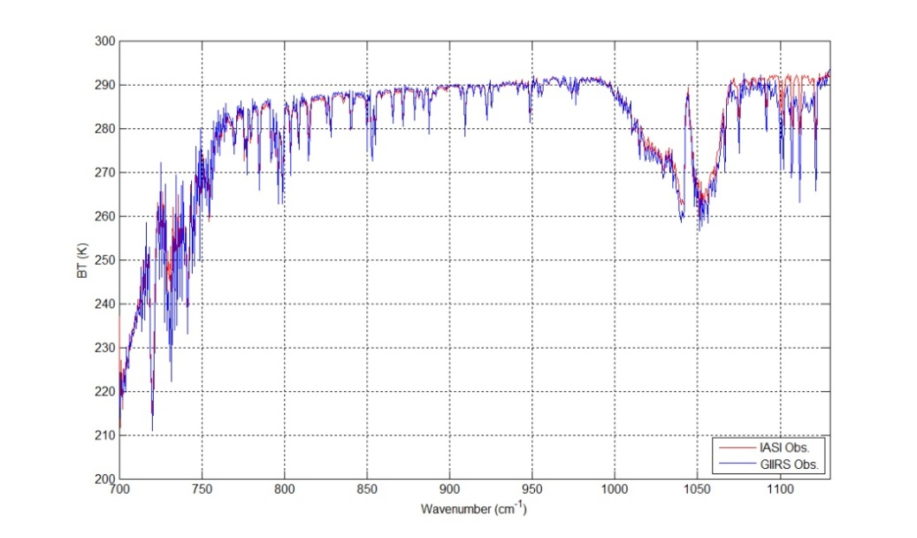
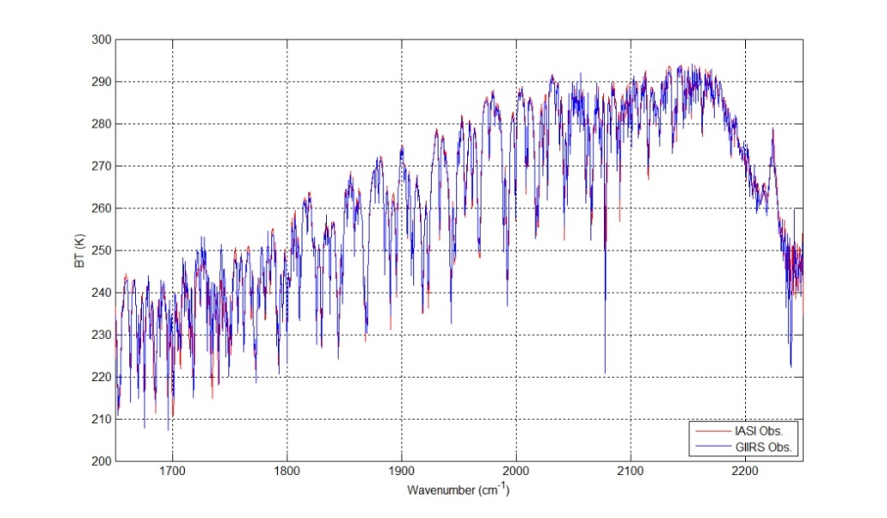
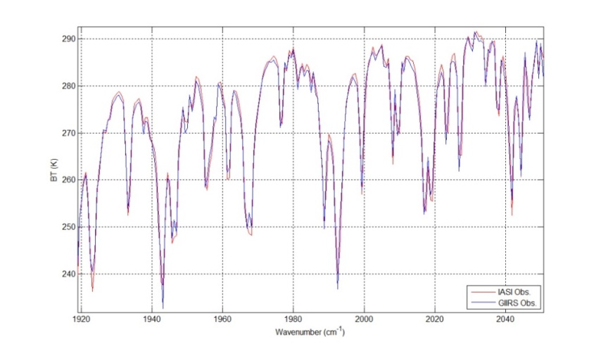
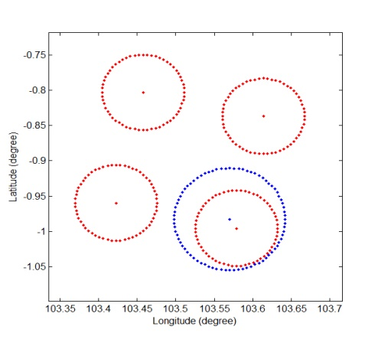
Latest update of FY4/GIIRS VS IASI
Examples of paired spectra between GIIRS and IASI at UTC 0230, 30 January, 2018
(Notes: red line for IASI, blue line for GIIRS)
For a period between August 2017 and March 2018, the averaged absolute monthly biases of GIIRS are assessed to be 0.25K and 0.42K for the two uncontaminated spectral coverages (i.e. 760-1050 cm⁻¹ and 1800-2188 cm⁻¹) respectively, while the annual variation feature of monthly biases appears clearly.

Slide 23
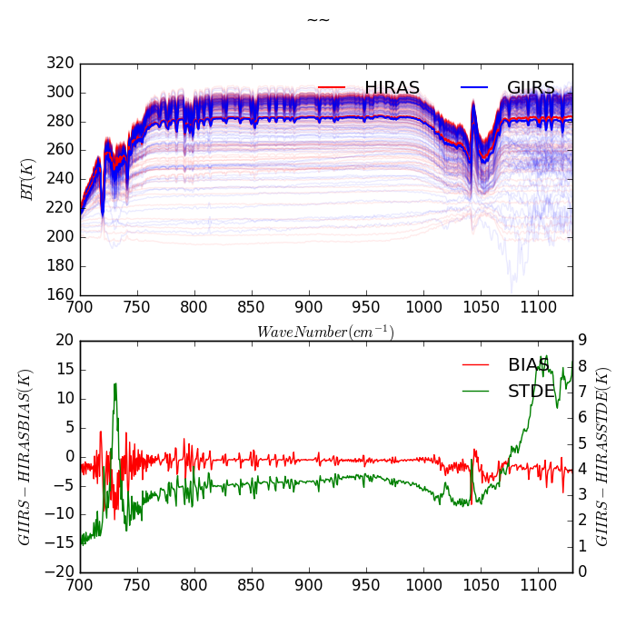
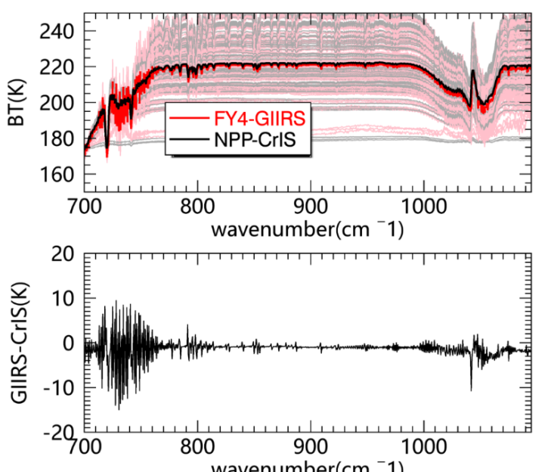
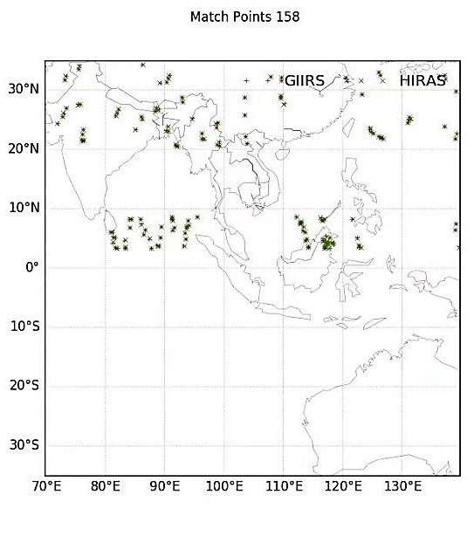



FY4/GIIRS VS CrIS&HIRAS wthin CMA GEO-LEO hyperspetral intercomparison
Comparison Results between hyperspectral sounders on GEO and LEO
GIIRS and CrIS
GIIRS and HIRAS
GIIRS Bias -0.2K
Wrt HIRAS
Period: 20190209-20190214
Matched Number: 158
Period: 20180201-20180205
Matched Number: 240
We can also check the HIRAS with CrIS using double difference

Slide 24





CMA lunar ground measurement
Lijiang
  Realization of Long term observation with automatic control by remote and local Maintenance
Location：100°2′33”, 26°45′40”
Atitude：3175km
Press：695.75hpa
Aerosol AOD：0.05
High opportunity of cloud free
No light contamination
New lunar hyperspectral imager was test Dec, 2018

Slide 25



On-ground Moon Observation System (OMOS) is being established at Daocheng, Sichuan province
OMOS Airscape Map
Bowa Mountain (~4700m),
Dao City, Sichuan, China
Telescope

Slide 26


Ground-based Lunar Imager
Main Specifications
Off-axis Optics with Φ=500mm
Band | Spectral Range | SNR/NEDT
VIS | 0.55~0.625μm | ≥6@ρ=1%
 | 0.675~0.697μm | ≥6@ρ=1%
 | 0.662~0.671μm | ≥6@ρ=1%
 | 0.686~0.703μm | ≥6@ρ=1%
 | 0.697~0.714μm | ≥6@ρ=1%
 | 0.71~0.75μm | ≥6@ρ=1%
 | 0.55~0.75μm | ≥6@ρ=1%
NIR | 1.58~1.64μm | ≥6@ρ=1%
 | 1.626~1.650μm | ≥6@ρ=1%
SIR | 2.104~2.159μm | ≥6@ρ=1%
 | 2.232~2.280μm | ≥6@ρ=1%
 | 2.10~2.35μm | ≥6@ρ=1%
MIR | 3.70~4.75μm | 50mK@300K
LIR | 10.3~11.3μm | 50mK@300K
 | 11.3~12.5μm | 50mK@300K
Rotation Mechanism for Band Filtering
Currently, 15 channels; Maximum: 39 channels

Slide 27



Primary Selection for Historical Global and China Reference Sites
Retrospective calibration for FY FCDR
Previous Global PICS Sites
China Sites Selection based on MODIS
No. | Site name | Center Latitude | Center Longitude | Type
1 | Dunhuang | 40.14 | 94.32 | desert
2 | Taklamakan | 39.83 | 80.17 | desert
3 | Wuwei | 38.10 | 102.97 | desert
4 | Milan | 39.12 | 88.73 | desert
5 | Tumushuk | 39.77 | 80.02 | desert
6 | Chaidamu | 38.58 | 93.12 | salt
7 | Qinghai Lake | 36.88 | 100.15 | lake
8 | Namco Lake | 30.65 | 90.57 | lake
9 | Kunlunfeng | 35.37 | 81.06 | snow
10 | Purog | 33.88 | 89.15 | snow
11 | Qira | 36.85 | 80.9 | desert
12 | Alxa Right Banner | 40.146 | 101.021 | desert
13 | Golmud | 36.35 | 94.69 | desert
14 | Dali lakeside grassland | 43.444 | 116.659 | sparse grass
15 | Caka Salt Lake | 36.675 | 99.097 | salt

Slide 28




Consistent Calibration of VIRR Reflective Solar Channels Onboard FY-3A, FY-3B, and FY-3C Using a Multisite Calibration Method
Time series of the nadir (viewing angle within 10°) reflectance data in RSBs over Libya 4 from January 2009 to December 2017. (a,b) Operational calibration results; (c,d) recalibrated results using the MST calibration method
Trends in the VIRR normalized calibration slopes for (a) FY-3A, (b) FY-3B, and (c) FY-3C.
Ling Wang, Xiuqing Hu , Lin Chen, et al. . Remote Sensing, 2018, 10(9), 1336.

Slide 29
Summary
JMA GSICS algorithm was applied to FY-2G IR1-3 (10.8, 12.0, 6.95 μm) w.r.t. Metop-A/IASI to find the root cause of discrepancies between CMA-GSICS and GeoCAVS results.
Results/findings in this study (3-month validation for MJJ 2017)
Original IR2 SRF is used in CMA-GSICS
JMA-GSICS and CMA-GSICS: good agreement (0.1K) for IR1-IR3 under the condition of averaging during the 3-month period
GSICS and GeoCAVS: general agreement ( 0.3 K) for IR1 & IR2 under the condition of averaging during the 3-month period
GSICS Algorithm: negative bias in IR3 (> 1 K) compared with GeoCAVS
  Need for further investigation to find the root cause(s)
  Future tasks/collaborations: to be discussed in next slide

Slide 30
Collaborative Research of Applying JMA's GSICS Approach to FY-2G IR Channels w.r.t. Metop-A/IASI
JMA GSICS algorithm was applied to FY-2G IR1-3 (10.8, 12.0, 6.95 μm) w.r.t. Metop-A/IASI to find the root cause of discrepancies between CMA-GSICS and GeoCAVS results.
Results/findings in this study (3-month validation for MJJ 2017)
Original IR2 SRF is used in CMA-GSICS
JMA-GSICS and CMA-GSICS: good agreement (0.1K) for IR1-IR3 under the condition of averaging during the 3-month period
GSICS and GeoCAVS: general agreement ( 0.3 K) for IR1 & IR2 under the condition of averaging during the 3-month period
GSICS Algorithm: negative bias in IR3 (> 1 K) compared with GeoCAVS
  Need for further investigation to find the root cause(s)
  Future tasks/collaborations: to be discussed in this meeting

Slide 31
  CMA's support to GDWG Activities

Slide 32


CMA GPRC Website Operation
Content: GPRC Information, CMA GSICS product sharing, Instrument Operation Status
CMA GRWG: Content provider
CMA GDWG: Website construction and maintain
Integrated into NSMC Web Portal, Servers operated by NSMC IT Dep.
Notes:
GSICS Processing and Research Centers (GPRC)

Slide 33
Preservation of GSICS Products
Preservation of GSICS Products, Re-Analysis Corrections (RAC) only was GSICS EP endorsed and preservation approaches were accepted:
  Collaboration Servers are expected to replicate all RAC products between themselves
CMA Task 2018： Test EUMETSAT Sync Code
  CMA replicate EUMETSAT RAC product successfully since 2017
  2018 meeting: CMA solution and script are shared to the community
  EUM: Re-engineered the CMA script for downloading all RAC oper products.
  CMA GDWG test EUM code (2 versions)
  Conclusion:
    EUMETSAT Sync code +XML configuration file is convenient to users, easy to learn ,deploy, and integrated in local application;
    CMA recommend for other GDWG members to use it in GPRC for sync RAC product;
    Thanks Peter.Miu (EUMETSAT)’s contribution on Sync code development.
Notes:
GSICS Processing and Research Centers (GPRC)
响应EP的指示，备份RAC产品. CMA在2018年已经实现了对EUM产品的备份，2018年年会将备份方案共享给全体GDWG成员，年会后的任务是，EUM根据CMA的脚本编写代码，然后由CMA测试
（EP要求GDWG实现三大数据中心RAC产品互备）

Slide 34
Suggestion to GSICS/GDWG
PICS/SNO data extraction function and data dissemination
Building the public platform for predicting SNO cross-points or PICS targets. The public platform will not only be available for GSICS member but also for public research user.
  CMA could provide prediction -tool or platform.
  Some demo, including the PICS/SNO Prediction Timetable, L1 filename and PICS extraction data, are available on CMA GSICS THREDDS sever.
PICS extraction data exchange on GSICS THREDDS for cutting data volume and transfer time.
  ~8000MB(before PICS extraction) VS ~200MB(after PICS extraction) per day

Slide 35
Agenda items reported by CMA
GRWG (9 Reports)
  VIS/NIR Sub-Group (Day-3)
    Update on Lunar Measurements in China [4d]
  MW Sub-Group (Day-3)
    FY-3 MWRI - Calibration and time series record [5j],
    WIGOS: Strawman outline draft of a plan to develop inter-calibration products for microwave imagers [5w]
  IR Sub-Group (Day-4)
    FY-3D HIRAS measurement validation and monitoring [7c],
    First Geostationary Infrared Hyper-spectral Measurements: In-orbit Validation Method for Radiometric Accuracy and its Preliminary Results [7e],
    Mutual Evaluation between the imager and hyperspectral sounder at the same platform FY-3D and FY-4A [7h],
    IR inter-calibration update in CMA including GEO-LEO and LEO-LEO [7l],
    SBAF requirements for GEO-GEO comparisons [7o],
    Application and evaluation of New NOAA gap filling for CMA IR hyperspectral instruments [7t]

Slide 36
Agenda items reported by CMA
GDWG (4 Reports)
  FY historical Big Data Reprocessing system establishment and sharing [6k, Day-3]
  Updates on GSICS Collaboration Servers [9c, Day-4]
  PICS/SNO data extraction function [9e, Day-4]
  Data Dissemination [9f, Day-4]

Slide 37
Thank you for your attention

