Slide 1

CNES agency report
Clémence Pierangelo and CNES DSO/SI/SA
Aimé Meygret and CNES DSO/SI/MO
GSICS annual meeting
4th-8th march 2019, ESRIN

Slide 2
OVERVIEW
CNES Personnel supporting GSICS
CNES Instruments Updates & Planned launches
CNES GSICS Activities
CNES GSICS actions

Slide 3
CNES Personnel supporting GSICS
GSICS executive board : Pierre Tabary / Patrice Henry
GRWG :
VIS/NIR : Aimé Meygret and CNES DSO/SI/MO team (Camille Desjardins…)
TIR : Clémence Pierangelo and CNES DSO/SI/SA team (Denis Jouglet, Elsa Jacquette…)

Slide 4
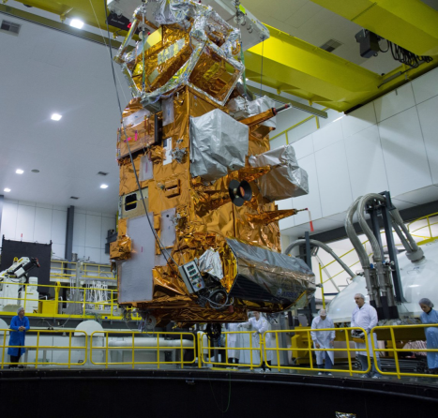
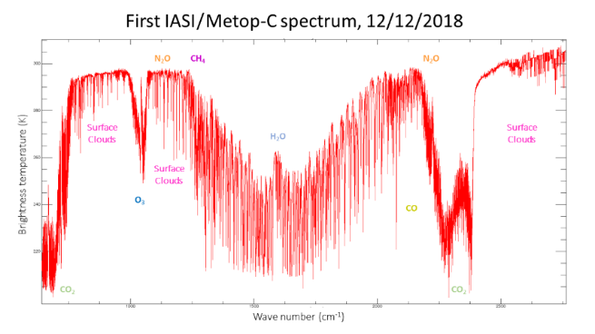
CNES Instruments Updates
IASI-C on Metop-C
Similar to IASI-A and IASI-B:
  3 bands for continuous spectral coverage: 3.62-15.5 µm,
  8461 channels, spectral resolution: 12 to 0.66 nm,
  2x2 pixels (12km)
  CNES/EUMETSAT partnership
Launch sucessful 6th november 2018 from Kourou
Cal/val started december 2018, in progress
End of cal/val foreseen in june 2019

Slide 5
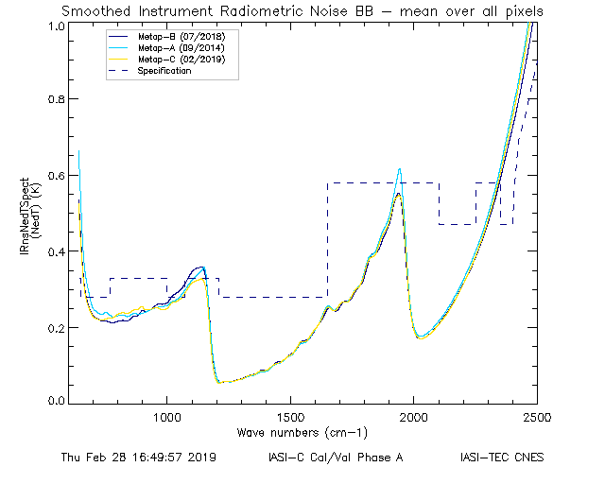
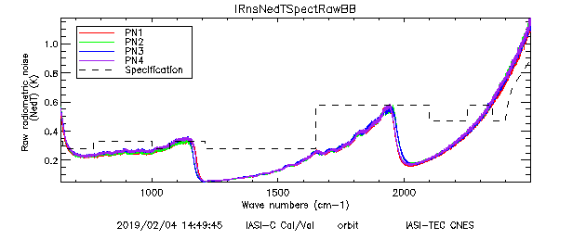
CNES Instruments Updates
IASI-C on Metop-C
MetopA and B : after decontamination
MetopC : before decontamination
Radiometric noise of IASI-C is similar to IASI-A and B (even slightly better in 800-1200 cm-1 range)

Slide 6
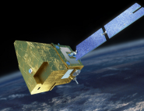
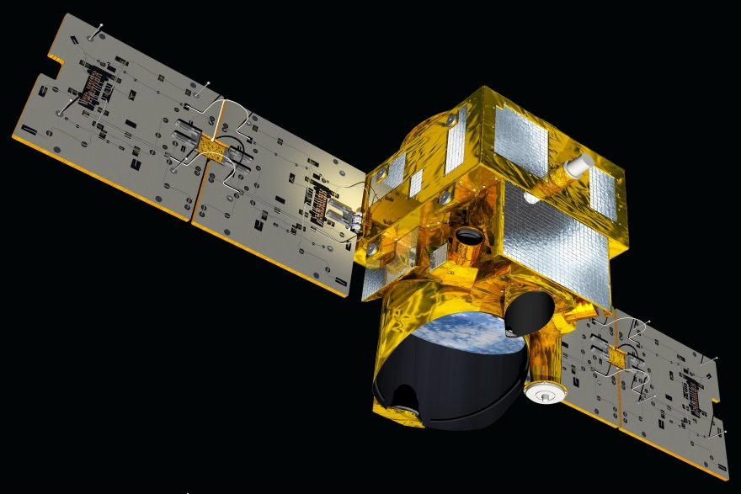
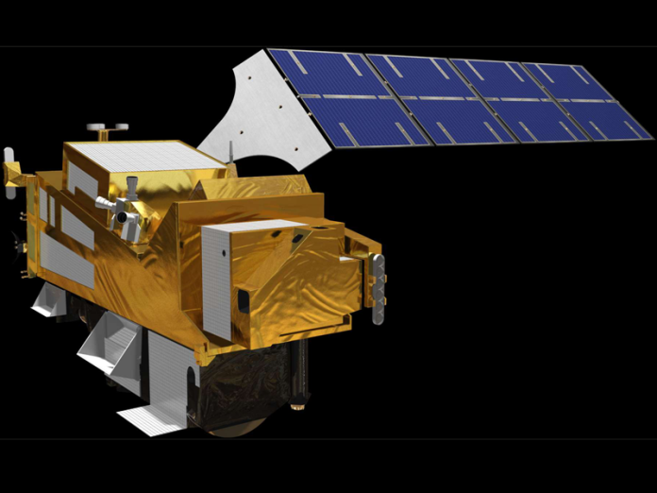
CNES Instruments Updates: in development
IASI-NG –on-Board METOP-SG
CNES
EUMETSAT
Mission goal: Continuity and improvement of IASI mission for meteorology, atmosphere chemistry and climate
performances: Spectral resolution and SNR improved by a factor of 2 / IASI
Instrument concept: Mertz interferometer with field compensation, many technical innovations.
Launch: 2022, 3 models ➔ 2040
MicroCarb
CNES
UKSA, EUMETSAT
Mission goal: Mapping of sources and sinks of carbon dioxide (CO₂) on a global scale
performances: total column concentration of CO2 with a precision of 1 ppm and a pixel size of 4.5 km x 9 km ➔ high spectral resolution and SNR.
Instrument concept: grating spectrometer, 4 bands NIR and SWIR
Launch: 2021
MERLIN
CNES
DLR
Mission goal: Mapping of sources and sinks of methane (CH₄) on a global scale
performances: XCH₄ better than 1% (random error) and 0.2% (systematic error) .
Instrument concept: First spaceborne integrated path differential absorption LIDAR instrument (laser wavelength around 1.645 μm)
Launch: 2024

Slide 7
CNES GSICS Activities
Vicarious calibration of VIS/NIR imagers
  Focus on ROLO moon albedo model correction
Inter-comparisons of IASI-A/B/C with other infrared sounders (AIRS, CrIS)
  inter-comparisons with CRIS
  IASI-B non linearity correction impact
R&T study about moon calibration in the TIR domain
Preparation of Cal/val campaigns for Greenhouse gases missions

Slide 8
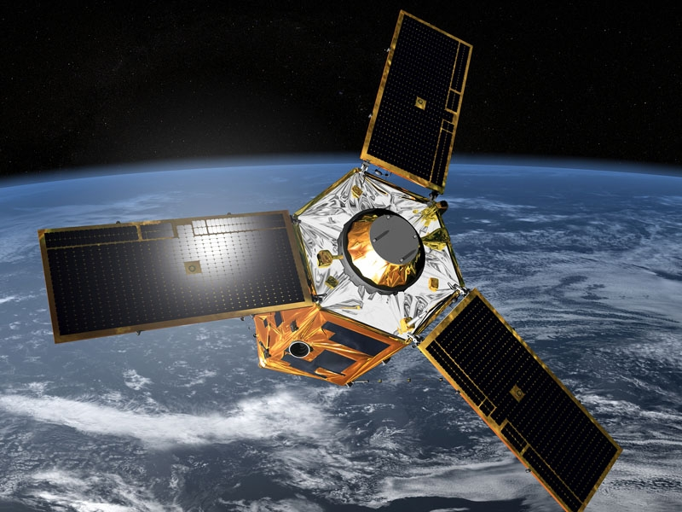
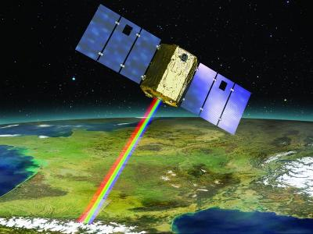
Calibration Monitoring of CNES in-Flight Missions
PLEIADES 1A & 1B (Very High Resolution Imaging)
          • Accurate geometric and MTF calibration monitoring
          • Radiometric calibration monitoring (moon, PICS, test sites)
IASI A & B (IR Atmospheric Sounding)
          • Spectral and radiometric calibration
          • Intercalibration activities : IASI-A/IASI-B ; IASI/AIRS ; IASI/CRIS
Megha-Tropiques: Saphir (MW Sounder), Scarab (optical scanning radiometer) calibration monitoring
Venµs
+SMOS, CFOSAT…

Slide 9
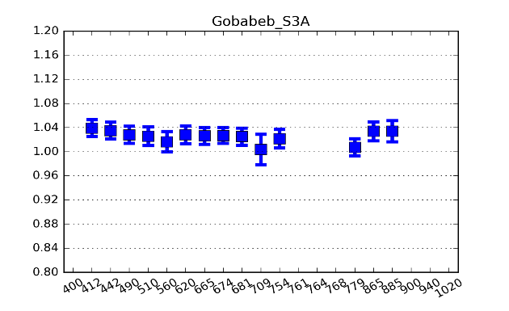
Participation in other Missions Calibration Monitoring
Airbus D&S SPOT-6&7 satellites
          • Calibration monitoring using PICS and test sites (La Crau and Gobabeb)
Support to ESA for SENTINEL-2 and SENTINEL-3 calibration
          • In-orbit tests and routine monitoring
          • All calibration methods: La Crau (S2) and Gobabeb (S2&S3),
          deserts (S2&S3), Rayleigh scattering (S2&S3), sun glint (S3),
          clouds (S2&S3), Antarctica (S3)
Support to GISTDA for THEOS calibration
          • Calibration monitoring using PICS
Exchanges with NASA for LANDSAT-8 and MODIS calibration
          • PICS and moon calibration monitoring
Support to EUMETSAT for 3MI (Multi-channel Multi-viewing Multi-polarisation Imager) ground characterization and future in-flight calibration

Slide 10
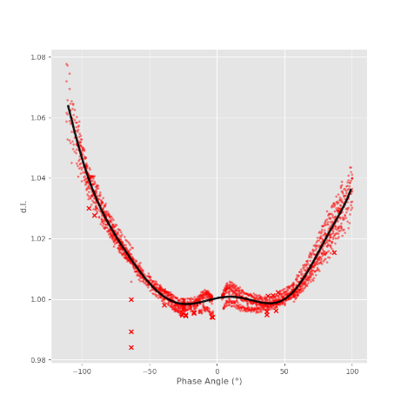
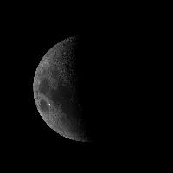
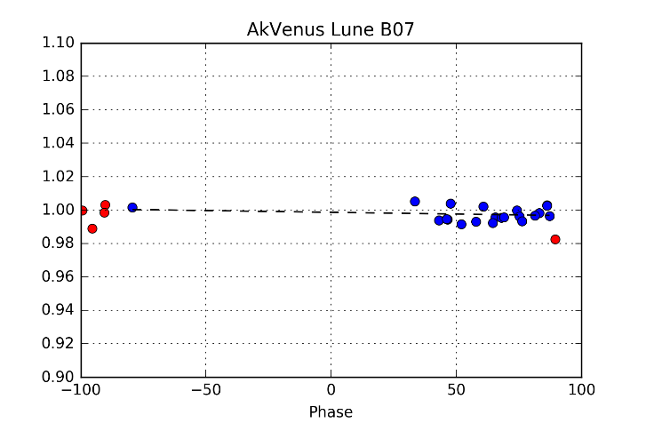
ROLO moon albedo model correction
      PLEIADES-1B used to correct ROLO moon albedo model for its phase depencency:
  Use of 6 complete moon cycles from december 2012 to june 2013, 867 images, with less than 1° phase angle variation
I_PHR-1B/I_ROLO
I_VENµS / I_ROLO_corrected
➔ No more phase dependecy, new model is OK

Slide 11
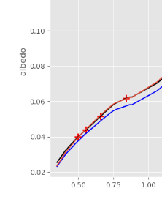
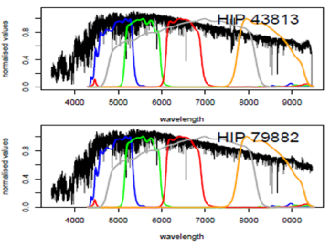
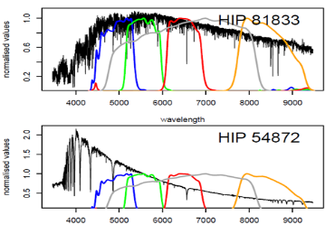
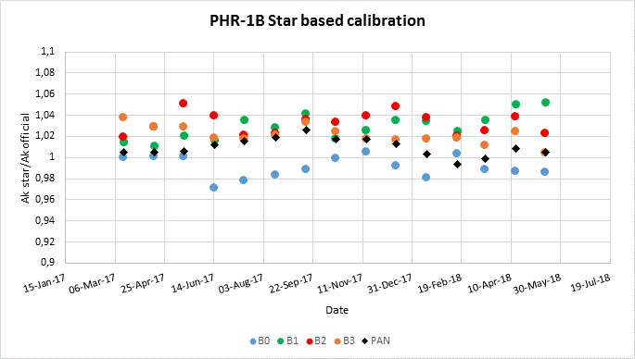
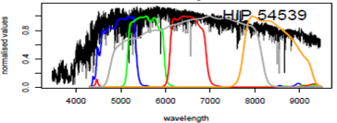
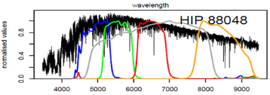

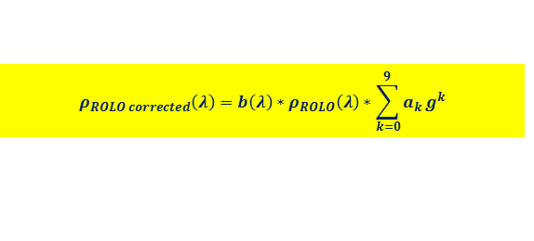
ROLO moon albedo model correction
      PLEIADES-1B used as a transfer radiometer to correct ROLO moon albedo model for its spectral bias using stars
ROLO corrected model*:
$$ρ_{ROLO corrected}\left(λ\right)=b\left(λ\right)∗ρ_{ROLO}\left(λ\right)∗\sum_{k=0}^{9}{a_{k}}g^{k}$$
Spectral correction
Phase angle correction
* Improving ROLO lunar albedo model using PLEIADES-HR satellites extraterrestrial observations,
A. Meygret, G. Blanchet, S. Colzy, L. Gross-Colzy, SPIE 2017, San Diego, USA

Slide 12
Inter-calibration of the IASI instruments with CrIS-NPP and CrIS-N20
Method:
Selection of stable and homogeneous scenes with Simultaneous Nadir Overpasses (SNO) of IASI and CrIS.
Compute IASI CrISN20 like spectra with the convolution method.
Compute the radiometric statistics between IASI-A/IASI-B/IASI-C and CrIS-N20 but also with CrIS-NPP for comparison.
Data: IASI-A and CrIS-N20 spectra for the period from 14/1/2019 to 21/1/2019 (8 days).
Instrument | IASI-A Number of SNO | IASI-B Number of SNO | IASI-C Number of SNO
CrIS-NPP | 40 | 57 | 21
CrIS-N20 | 76 | 79 | 94

Slide 13
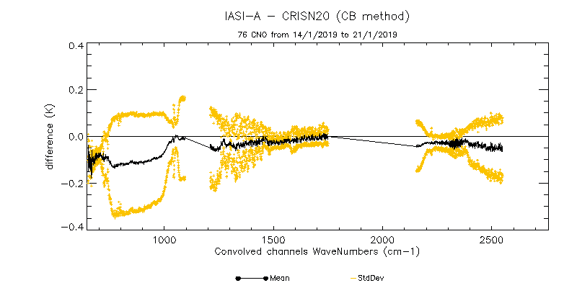
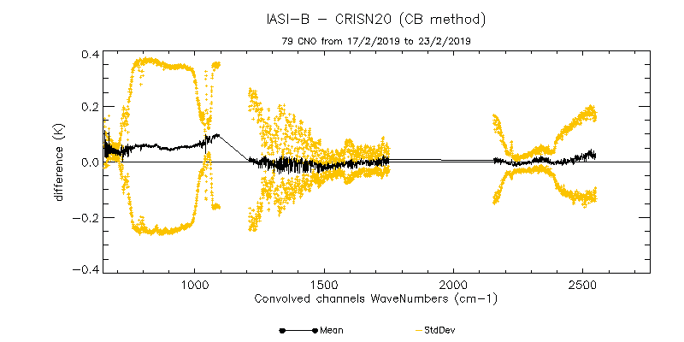
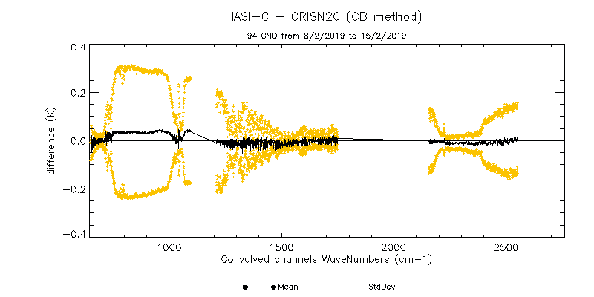
Inter-calibration of the IASI instruments with CrIS-N20:
IASI-A
IASI-B
expressed in NEDT@280K.
IASI-C
The radiometric inter-calibration bias between IASI-A, IASI-B, IASI-C and CrIS-N20 stays always below 0.2 K in band 1 and below 0.05 K in band 2 and 3

Slide 14
Non linearity correction for IASI-B
IASI-B – IASI-A intercomparisons showed a 0.1K bias in B1
An improved non linearity correction scheme has a stronger impact in B1 for IASI-B (~0.2K) than IASI-A (~0.1K)
IASI-A
IASI-B
➔ Change of onboard table for non linearity correction for IASI-B: 2nd August 2017

Slide 15
Non linearity correction for IASI-B
Method requires as many “A before B” as “A after B”: Effect of residual time gap may differ for surface channels and stratospheric channels?
Next step : correction for IASI-A planned after IASI-C Cal/val…
IASI-C already includes new correction scheme

Slide 16
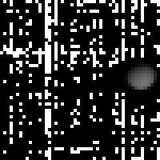
In study: Moon calibration in thermal infrared
Moon calibration could be useful for relative calibration :
  Same moon view seen by 2 different satellites
  2 successive views seen by the same instrument
Moon data have been acquired during Cal/Val of IASI-A and IASI-B with full moon seen in the second cold space view.
Moon radiometric model for TIR is currently being developed:
moon surface temperature from LRO/DIVINER product GCP L4
Emissivity estimated from LRO/DIVINER ‘rock abundance’ product in order to separate maria/recent craters and highlands.
Evaluation of moon calibration accuracy in progress
Notes:
Jack Xiong, NASA utilise observations lune pour MODIS dans l’IRT.

Slide 17
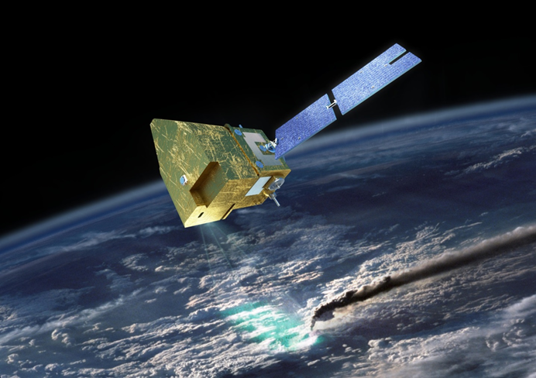
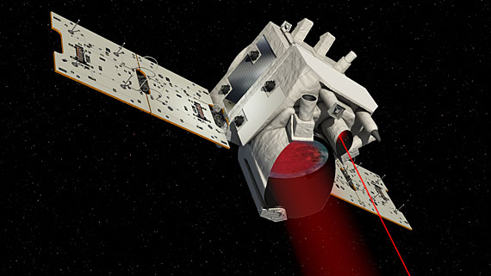
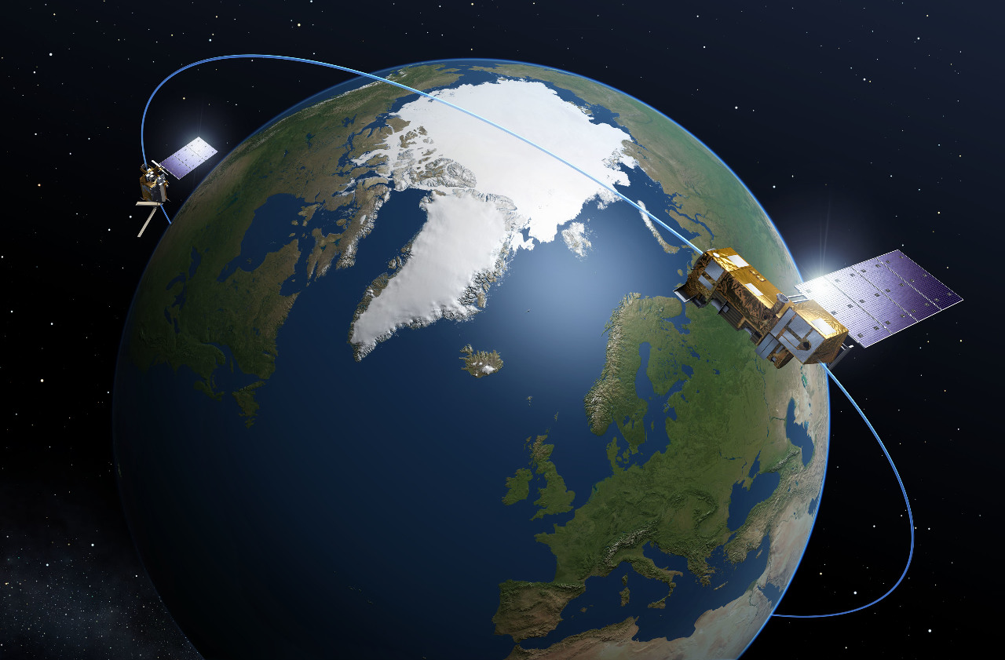
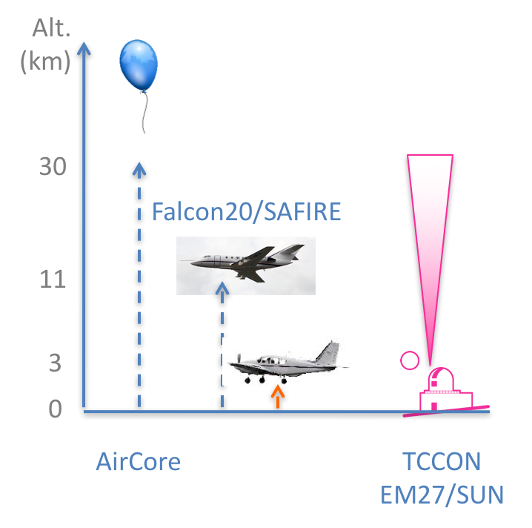
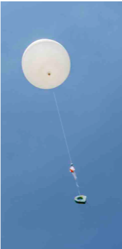


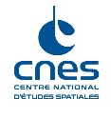
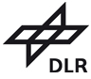




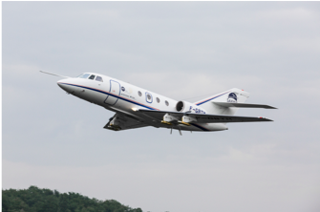
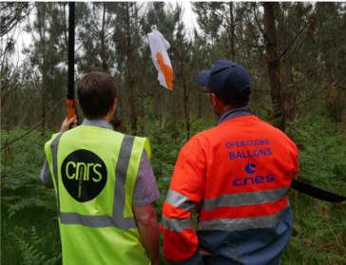
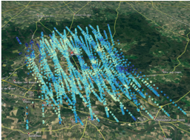
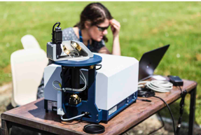

The MAGIC campaigns
MAGIC: Monitoring of Atmospheric composition and Greenhouse gases through multi-Instruments Campaign
Objectives:
better understanding distribution of GHG and other atmospheric variables.
Preparing validation activities for future GHG missions (Merlin, MicroCarb and IASI-NG).
First campaign in may 2018, in synergy with DLR COMET campaign:
  40 scientists + CNES teams + SAFIRE planes
  2 planes, 19 balloons (Aircore, Amulse, radiosoundings), 4 ground spectrometer, OCO-2 and IASI satellites
MicroCarb
Merlin
IASI-NG
©CNES/A. Hollier
AirCore
Amulse
Radiosondes
©CNES/A. Hollier
© G. Osterman
©CNES/A. Hollier
©C. Bès

Slide 18
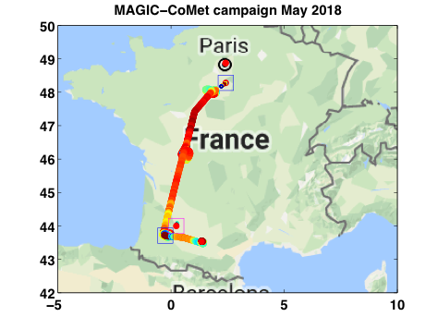
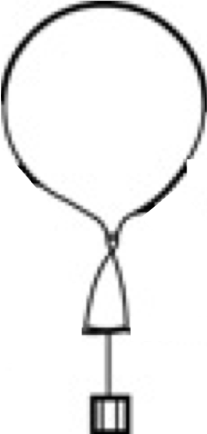
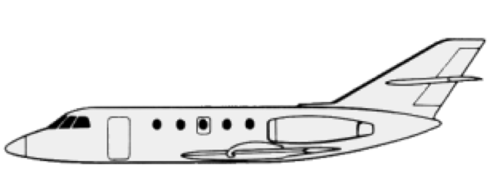

The MAGIC Campaigns
Trainou
A first look at joined aircraft-balloon CH₄ measurements
Cognac
Forward 24 May 2018
Return 24 May 2018
ASA
Francazal
Altitude (km)
Altitude (km)
Also available for CO₂, CO, T, H₂O
ASA
Cognac
ASA
Trainou (12:00)
Trainou (13:30)
Francazal (9:30)
Francazal (16:00)

Slide 19
CNES GSICS actions
GVNIR.2016.4h.1 | Lunar surface target selections & auto-mapping | Bertrand to investigate if this is possible for CNES to provide NOAA with Pleiades Moon data in order to support the characterization of uniform target sites. | CNES(Bertrand) | 2017-annual meeting | Pending – Pléiades being a commercial mission, it is not possible to access a very high number of image (may be required for BRDF characterization purpose). Would require huge processing by CNES… If still needed, contact aime.meygret@cnes.fr
GIR.20160908.1 | Reference Instrument Traceability Report | Denis Jouglet (CNES) to apply spectral averaging method to calculate static weightings for generating 10cm-1 pseudo channels for AIRS-IASI comparison over 3 year period (2013-03-01/2016-03-01) - and consider application for CrIS -IASI comparisons. | CNES(Denis) | 2017-annual meeting | Done, presented during a GRWG IR Sub-Group Web Meeting 2016-09-08
GIR.2016.3p.3 | Hyperspectral IR comparisons - including TANSO-FTS/2 - 17:05 | EUM + CNES (POC: Denis Jouglet (CNES) and Dorothee Coppens (EUM)) to work on the inter-comparison between CrIS and TANSO-FTS. | EUM(Dorothee), CNES(Denis) | 2017-annual meeting | Not yet a priority for CNES, propose to close the action unless of a very strong interest.

Slide 20
Thank you!
For more information:
Aime.meygret@cnes.fr, clemence.pierangelo@cnes.fr

Slide 21
Back-up slides

Slide 22
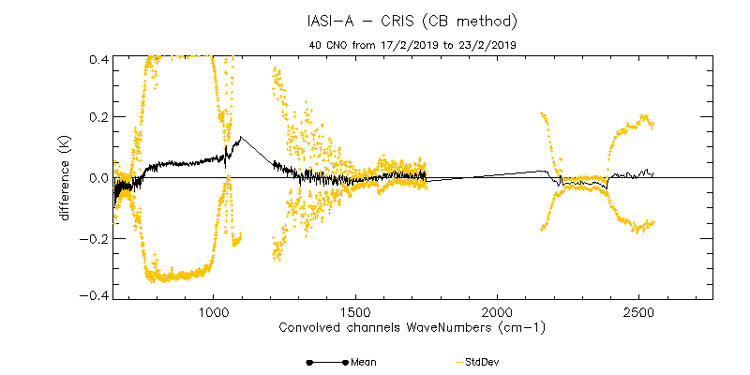
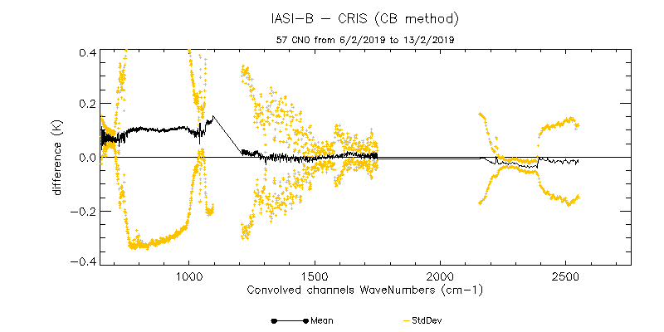
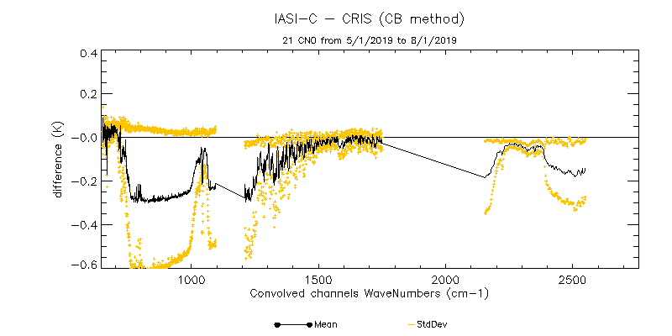
Inter-calibration of the IASI instruments with CrIS-NPP:
IASI-A
IASI-B
expressed in NEDT@280K.
IASI-C
⬅Only 21 CNO for the considered period

