Slide 1
EUMETSAT Agency Report
2019
Tim Hewison, Peter Miu, Dorothée Coppens, Rose Munro, Sébastien Wagner, Rob Roebeling, Alessandro Burini

Slide 2
Presentation Overview
Introduce/Confirm the Agency’s Personnel supporting GSICS
Agency’s Instruments Updates & Planned launches – relevant to GSICS if any
Agency’s GSICS Activities, Action & Achievements Summary
Agency’s support to GDWG Activities
Agency’s support to GRWG Activities
Agency’s GSICS activities to be discussed in this joint meeting

Slide 3
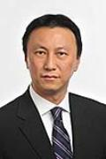
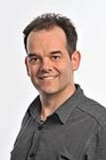
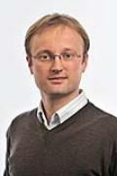
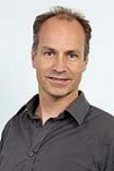
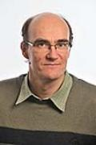
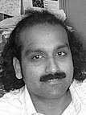
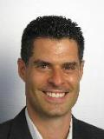
Current official EUMETSAT support for GSICS (bold = formally nominated members)
Executive Panel
Ken Holmlund | EUMETSAT representative
Data Working Group
Peter Miu | Vice-chair + Data management expert
Simon Elliott | Formats Expert
Research Working Group
Tim Hewison | Vice-chair IR sub-group + MW Sub-Group PoC
Sébastien Wagner | VIS/NIR + Lunar calibration
Rob Roebeling | Climate records + SCOPE-CM + Event logging
Rosemary Munro | Chair UV sub-group
Dorothée Coppens | Hyperspectral IR expert
Jörg Ackermann | Microwave Sub-Group Member
Supported by
Viju John | Infrared (Meteosat - HIRS) + MW
Frank Ruethrich | Visible (Meteosat)
Alessandro Burini | Sentinel-3 (SLSTR & OLCI)
Rüdiger Lang | UV/VIS/SWIR Spectrometers
Bertrand Fougnie | VIS/NIR
Point of Contact for Operational Matters
Harald Rothfuss

Slide 4
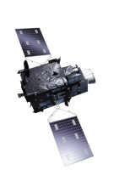
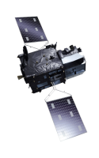
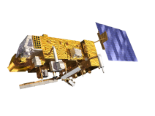
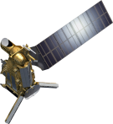
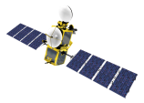
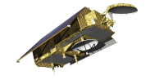
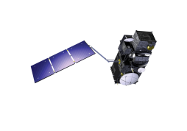
EUMETSAT Mission Planning
YEAR...
03
04
05
06
07
08
09
10
11
12
13
14
15
16
17
18
19
20
21
22
23
24
25
26
27
28
29
30
31
32
33
34
35
36
37
38
39
40
METEOSAT SECOND GENERATION
METEOSAT-8
METEOSAT-9
METEOSAT-10
METEOSAT-11
METEOSAT THIRD GENERATION
MTG-I-1 : IMAGERY
MTG-S-1: SOUNDING
Mandatory Programmes
MTG-I-2: IMAGERY
MTG-I-3: IMAGERY
EUMETSAT POLAR SYSTEM (EPS)
MTG-S-2: SOUNDING
METOP-A
MTG-I-4: IMAGERY
METOP-B
METOP-C
EUMETSAT POLAR SYSTEM SECOND GENERATION (EPS-SG)
METOP-SG A: SOUNDING AND IMAGERY
METOP-SG B: MICROWAVE IMAGERY
JASON (HIGH PRECISION OCEAN ALTIMETRY)
JASON-2
Optional
Programmes
JASON-3
SENTINEL-6 (JASON-CS)
COPERNICUS
SENTINEL-3 A/B/C/D
Third Party
Programmes
SENTINEL-4 ON MTG-S
YEAR...
03
04
05
06
07
08
09
10
11
12
13
14
15
16
17
18
19
20
21
SENTINEL-5 ON METOP-SG A
22
23
24
25
26
27
28
29
30
31
32
33
34
35
36
37
38
39
40

Slide 5
Update on EUMETSAT 2018 Actions
Action Id | Summary | Expected Completion | Actual Completion | Deliverable Usage | Status
A.GDWG.2018.5c.1 | Peter Miu and Masaya Takahashi to organise a web meeting with ISRO and GDWG member to discuss bringing the ISRO server into the GSICS collaboration network. | 3/1/2019 |  |  | Open
A.GDWG.2018.5c.3 | Peter Miu to specify a technical note to propose several methods for the implementation of passive and active GSICS products access service such as RSS on THREDDS. Technologies to consider should be available to all GPRC; RSS, EUMETSAT UNS, SMS, WeChat, … | 3/1/2019 |  |  | Open
A.GDWG.2018.5c.4 | Peter Miu to update the GSICS product moving process on the EUMETSAT GSICS server to ignore products being uploaded with .TEMP, .temp, .etc. This is to avoid zero size products to be served to users. | 3/1/2019 |  |  | Open
A.GDWG.2018.5c.5 | Peter Miu to implement a product upload timer to provide a report on how long it takes to received products from the product producers. | 3/1/2019 |  |  | Open
A.GDWG.2018.5d.1 | CMA and EUMETSAT to work together to synchronise GSICS products across the servers. | 3/1/2019 |  |  | Open
A.GDWG.2018.5d.2 | CMA to check if their NetCDF format checking tool can be shared in GSICS. | 3/1/2019 |  |  | Open
A.GDWG.2018.5j.1 | Rob Roebeling to make a proposal for the WMO OSCAR/Space Instrument Pages for review by the GDWG so that a recommendation can be presented to WMO to improve the usability of these pages. | 3/1/2019 |  |  | Open
A.GDWG.2018.5j.2 | GDWG members to take the event logging white paper to see whether their organisation can do with regards to implementing such a system and report back to GDWG by 30 April 2018. Lead: GDWG Chair. | 3/1/2019 | 4/30/2018 | EUM and JMA provided feedbacks | Closed

Slide 6
Update on EUMETSAT 2018 Actions - cont
Action Id | Summary | Expected Completion | Actual Completion | Deliverable Usage | Status
A.GDWG.2018.8i.1 | Peter Miu to contact ISRO to discuss future collaboration through visiting data management expert exchange. | 3/1/2019 |  |  | Open
A.GIR.2018.4p.1 | Tim Hewison (EUMETSAT) to organise a web meeting on IRRefUTable in September 2018. | 3/1/2019 | 11/14/2018 | Web meeting | Closed
A.GIR.2018.4t.1 | Tim Hewison (EUMETSAT) to set up web meeting to review different GEO-LEO IR inter-calibration algorithm evolutions and invite Tim Trent to give update on results. | 3/1/2019 |  |  | Open
A.GMW.20180718.2 | Tim and Qifeng to develop circulate strawman for MW imager NRT products and will present this at CEOS WGCV meeting at EUMETSAT in late August. | 3/1/2019 | 29/8/2018 | WGCV-44 minutes | Closed
A.GRWG.2018.10g.1 | Tim Hewison (EUMETSAT) to setup planning web meeting for the workshop on CLARREO-like reference instruments by September 2018. | 3/1/2019 | 13/9/2018 | Web meeting | Closed
A.GRWG.2018.10k.1 | Tim Hewison (EUMETSAT) to invite a member of the FIUCEO project to attend the 2019 GSICS annual joint meeting. | 3/1/2019 | 1/4/2019 |  | Closed
A.GRWG.2018.10o.1 | Tim Hewison (EUMETSAT) to check if remote access is available for the RTM workshop at JRC. | 3/1/2019 | 4/1/2019 | None available | Closed
A.GRWG.2018.10o.2 | Sebastien Wagner (EUMETSAT) to report on the RTM Workshop to the GSICS working groups. | 3/1/2019 | 19/2/2019 | Email to gsics-dev | Closed
A.GVNIR.2018.7s.1 | Bertrand Fougnie (EUMETSAT) to organize a web meeting before June 30 on Rayleigh scattering calibration. | 3/1/2019 |  |  | Open
R.GDWG.2018.5g.1 | EUMETSAT to take into account the use of GitHub for updating the Plotting Tool. | 3/1/2019 |  |  | Open

Slide 7
Update on EUMETSAT 2017 Actions
Action Id | Summary | Expected Completion | Actual Completion | Deliverable Usage | Status
A.GDWG.2017.5a.8 | Peter Miu to document formats of the GEOLEOIR products (example high level definition of the GIRO I/O [EUM/TSS/TEN/14/753739]). | 9/30/2017 |  |  | Open
A.GDWG.2017.5a.9 | Peter Miu to contact Unidata to see if branches can indicate data is available, hyperlink to logo and home at top of screen. | 4/30/2017 |  |  | Open

Slide 8
Update on EUMETSAT 2017 Actions - cont
Action Id | Summary | Expected Completion | Actual Completion | Deliverable Usage | Status
A.GDWG.2017.5a.8 | Peter Miu to document formats of the GEOLEOIR products (example high level definition of the GIRO I/O [EUM/TSS/TEN/14/753739]). | 9/30/2017 |  |  | Open
A.GDWG.2017.5a.9 | Peter Miu to contact Unidata to see if branches can indicate data is available, hyperlink to logo and home at top of screen. | 4/30/2017 |  |  | Open
A.GDWG.2017.5d.3 | CMA to investigate the timeliness of the product replication by checking for an update, before calling the replication script (EUMETSAT to support). | 12/31/2017 |  |  | Open
A.GDWG.2017.5e.2 | Simon Elliott to request these new designators e.g. “SRF” to be included in the WMO Common Table C-13. VISIR is optional and does not be included in the code. | 5/31/2017 |  |  | Open
A.GDWG.2017.6a.1 | GDWG members to consider to add “Calibration related documents” on their landing pages. | 12/31/2017 |  |  | Ongoing
A.GDWG.20171108.3 | Rob Roebeling (EUMETSAT) to update the URLs of all the instrument event logging pages and each agency to confirm the URLs. | 3/1/2018 |  |  | Ongoing
A.GRWG.2017.4c.1 | Rose to investigate what tasks and tools are needed to pursue the work presented by Larry in the broader context of the UV Subgroup and in particular to identify resources needed with the aim of bringing this to the attention of the EP. | 3/1/2018 |  |  | Open
A.GWG.2017.2i.2 | EUMETSAT (P. Miu) to investigate hosting ISRO GSICS products on the EUMETSAT GSICS collaboration server. | 3/21/2018 |  |  | Open

Slide 9
Support to GDWG Activities
EUMETSAT provide Vice-Chair support to the new Chair (JMA).
EUMETSAT developed synchronisation scripts to replicate operational GSICS products between the GSICS collaboration servers.
This was provided to CMA and ISRO for testing
Task is in progress for 2019
EUMETSAT has supported ISRO in the configuration of their GSICS collaboration server.
Presentations in 2019 GDWG meeting:
Event Logging (#6k)
How EUMETSAT’s pathfinder activities would benefit GSICS (#6e)
GSICS Collaboration Servers - History, Updates (#9a)
Automated validation tool for candidate GSICS products (#9m)

Slide 10
Support to GRWG Activities – VIS/NIR
GSICS VNIR:
Lunar Calibration:
GIRO: no new developments
GLOD still to be consolidated
GIRO and GLOD licensing:
JMA, USGS, KMA, JAXA, CNES, ESA signed agreement (to date)
VITO being processed
No news from IMD
Draft license sent to ASI (PRISMA mission due to launch early March)
External study on developing a Moon Reflectance model
S3B OLCI lunar data preparation and calibration (#4b)
DCCs:
Demo products for Meteosat-8 (41.5° E) & Meteosat-11 (0°)
Rayleigh scattering:
algorithm definition for GEO & LEO imagers (#4v)
Extract from OLCI Moon image

Slide 11
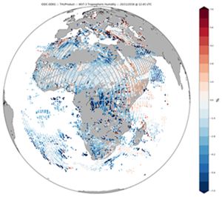
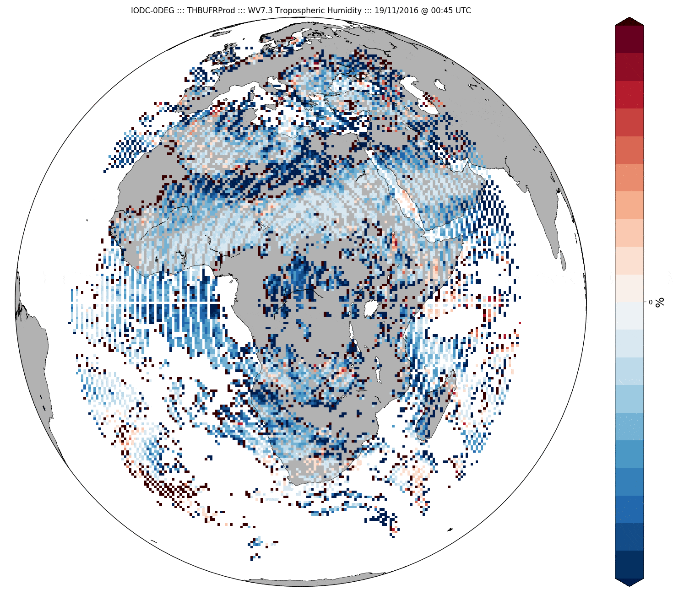
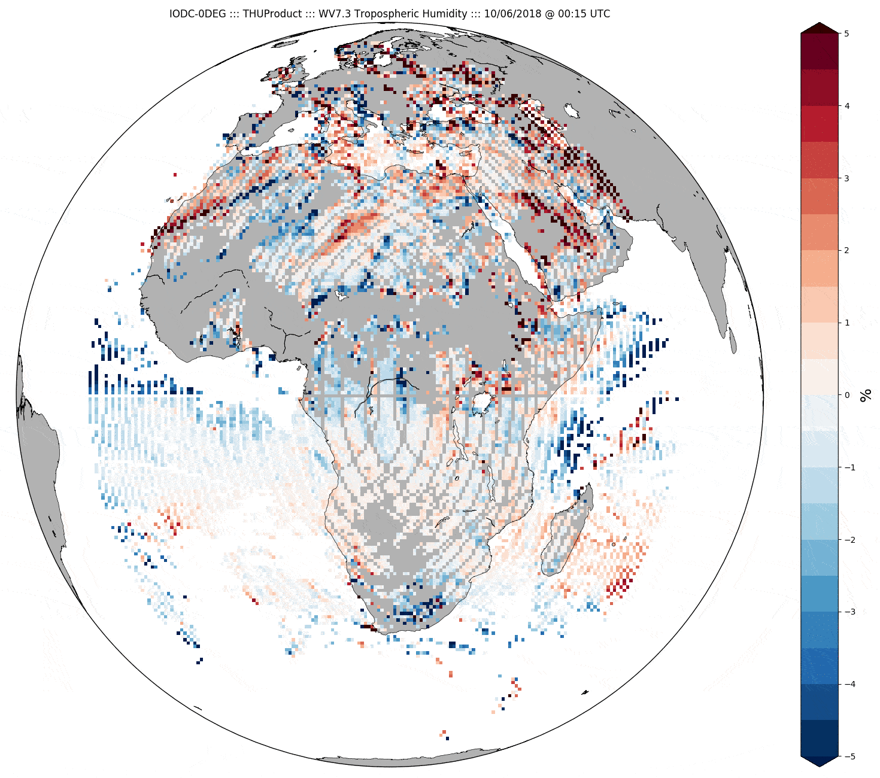
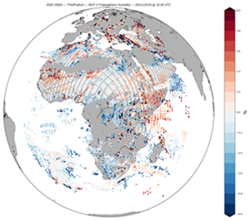
Support to GRWG Activities – IR
GSICS IR:
GEO-LEO IR:
Tested impact of GSICS Corrections on Level 2 Products
Reported at EUMETSAT Conference 2018 (PPT):
Small impact – but reduced inter- Meteosat differences
Generated test datasets for IOGEO GEO-ring (#3j)
Update on IASI-C Cal/Val activities (#7d)
Implementation of IASI-C as additional reference in 2019
GEO-LEO IR Product Progress (#7a)
LEO-LEO IR:
New implementation of SLSTR-IASI comparisons (#7o)
as part of MICMICS (#10g)
Based on GEO-LEO IR algorithm
with refined 2-step collocation method
IRRefUTable:
IR Reference Traceability and Uncertainty Report (#7e)
Difference of THU WV7.3 from Met8-Met10
20 Nov 2016 12:45 UTC before GSICS Correction (above)
After GSICS Correction (below)
Difference of THU WV7.3 from Met8-Met10
19-21 Nov 2016 animation before GSICS Correction (above)
After GSICS Correction (below)

Slide 12
Support to GRWG Activities – MW & UV
GSICS MW:
MetOp-C AMSU-A/MHS Status (#5e)
Near-Real Time Inter-calibration products for Microwave Imagers (#5t):
Member of task team to define requirements
GSICS UV:
As chair of UV Sub-Group:
Current status and future outlook for the UV Sub-group (#8d)
Special Session on "Strategy for incorporating inter-calibration of SWIR spectrometers“ (#8i)

Slide 13
Agency’s GSICS activities to be discussed in this joint meeting
…in addition to above:
Special session on re-calibration/re-processing
FIDUCEO Summary (#3i)
GEO-Ring: SCOPE-CM/IOGEO (#3j)
Cross-group activities:
Mission-Integration Calibration Monitoring & Inter-Calibration System (MICMICS) (#10g)
Support for joint GSICS-WGCV workshops (#10b):
SI-Traceable Climate Observing System Workshop: (CLARREO-like instruments)
London, 9-11 Sept 2019
Scientific Organising Committee member: Tim Hewison
Pre-launch Calibration/Characterisation Workshop:
Toulouse, Feb 2020 (TBC)
Scientific Organising Committee members: Rose Munro, Tim Hewison

Slide 14
Current Status of EUMETSAT GSICS Products
Monitored Instrument | Product Type / Band | Reference Instrument | GSICS NRT Correction | GSICS Re-Analysis Correction | GSICS Bias Monitoring
Meteosat-8-11 SEVIRI | GEO-LEO IR | Metop-A/IASI Metop-B/IASI | Operational | Operational | Plots RAC
Meteosat-8-11 SEVIRI | GEO-LEO IR Prime | IR Anchor |  | Demo | Plots RAC Need to plot Double Diffs
Meteosat-8/10/11 SEVIRI | GEO-LEO VIS | Aqua/MODIS | Demo | Demo | Need to plot RAC
Meteosat-8/10/11 SEVIRI | GEO-LEO VIS/NIR | Aqua/MODIS SNPP/VIIRS | In development | In development

Slide 15
Thank you for your attention
WMO GSICS Portal
http://gsics.wmo.int
GSICS Coordination Centre http://www.star.nesdis.noaa.gov/smcd/GCC/index.php
GSICS Product Catalog https://www.star.nesdis.noaa.gov/smcd/GCC/ProductCatalog.php
GSICS Wiki
http://gsics.atmos.umd.edu/wiki/Home

