Slide 1
ROSHYDROMET
Agency Report
Web – presentation by Alexey Rublev
State Research Center “PLANETA”, ROSHYDROMET
Russia
GSICS Annual Meeting 2019, Frascati, Italy
04 March 2018

Slide 2
Roshydromet Personnel supporting GSICS
Executive Panel
Alexander Uspensky | Roshydromet representative | uspensky@planet.iitp.ru
Research Working Group
Alexey Rublev | Roshydromet member | rublev@planet.iitp.ru
Data Working Group
Sergey Uspensky | Roshydromet member | uspenskys@planet.iitp.ru
Supported by
Julia Kisileva | GPRC website / Calibration Landing Page http://planet.rssi.ru/calval | kiseleva@planet.iitp.ru
Point of Contact for Operational Matters
Zoya Andreeva | z.andreeva@meteorf.ru

Slide 3
Satellite/Instrument Summary - LEO
GSICS Quarterly: Winter Issue 2018, Volume 12, No. 1, 2018. doi: 10.7289/V5/QN-GSICS-12-1-2018

Slide 4
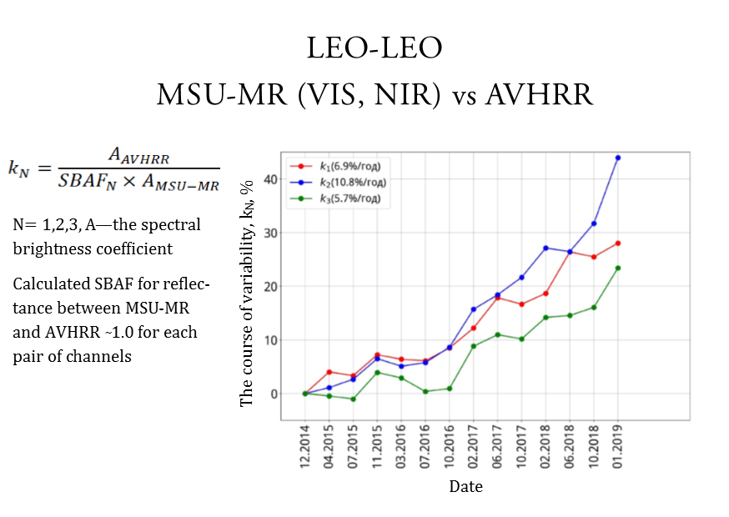
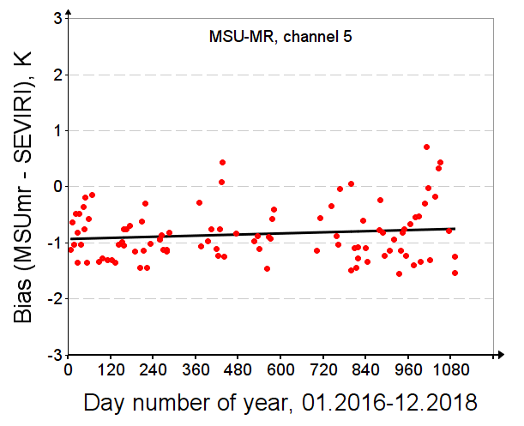
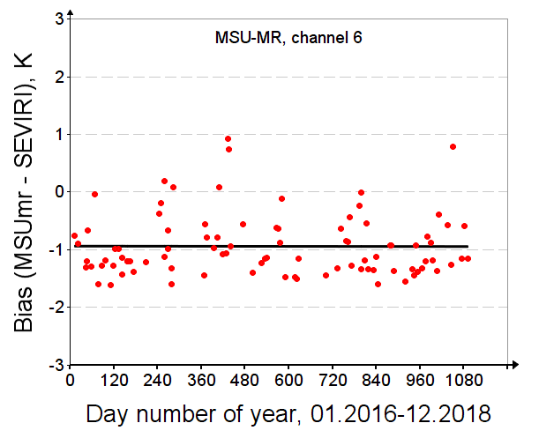
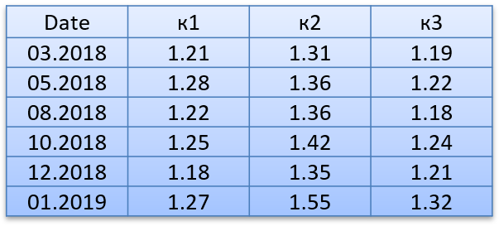
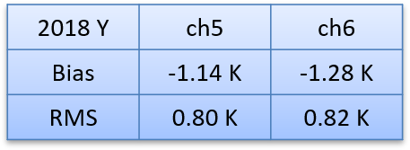
Calibration Performance: MSU-MR
Shortwave channels vs AVHRR/Metop-A
IR channels vs SEVIRI/Meteosat-10 (-11)
N= 1,2,3, A—the spectral brightness coefficient
Calculated SBAF for reflectance between MSU-MR and AVHRR ̴1.0 for each pair of channels

Slide 5
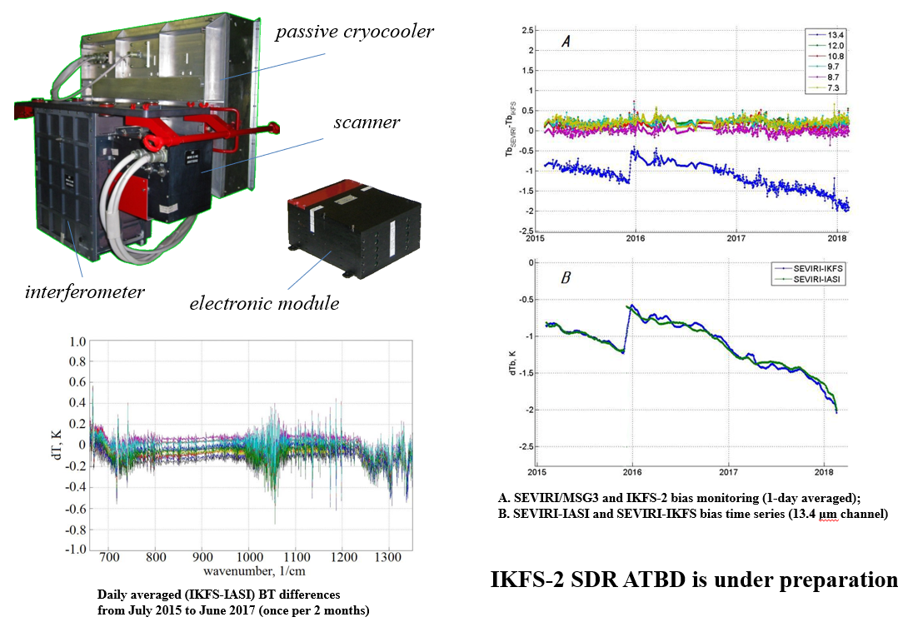
Infrared Fourier-Transform Spectrometer
IKFS-2 (4.5 years on orbit)
Hyperspectral Infrared Atmospheric Sounder IKFS-2 on "Meteor-M" No. 2 – four years in orbit, J. QSRT, Submission no: JQSRT_2019_49

Slide 6
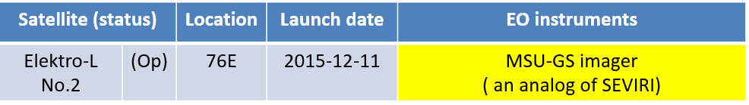
Satellite/Instrument Summary - GEO
The MSU-GS instrument is functional with limitations (12 μm channel is absent).
Absolute calibration is completing.
Front. Environ. Sci., 27 November 2018 https://doi.org/10.3389/fenvs.2018.00142

Slide 7
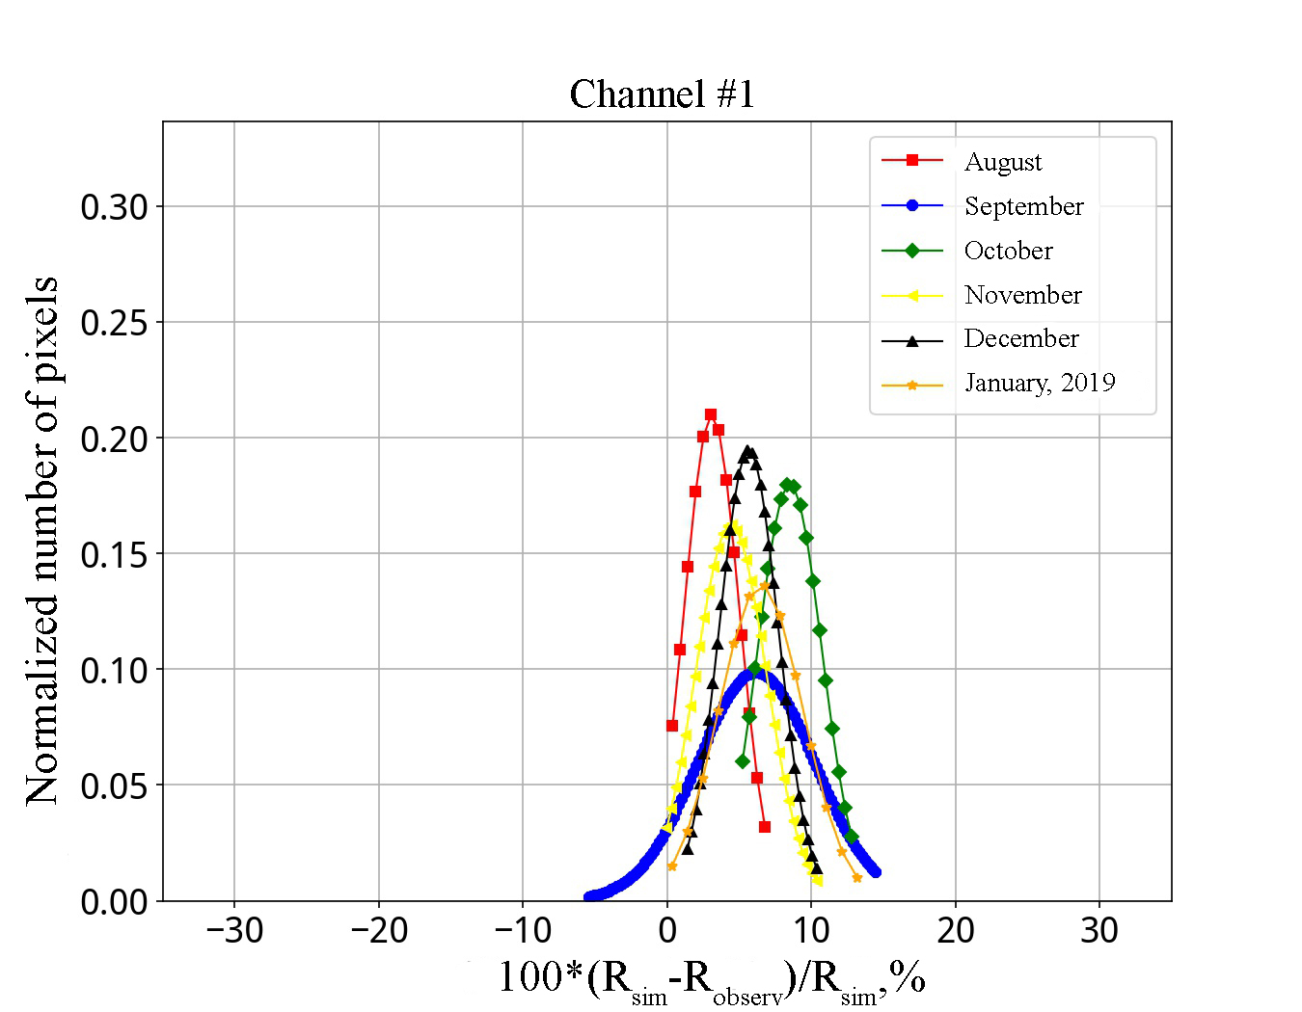
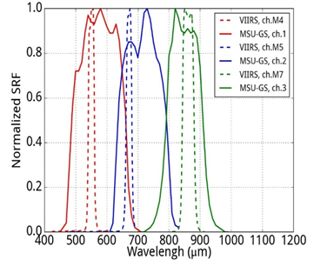
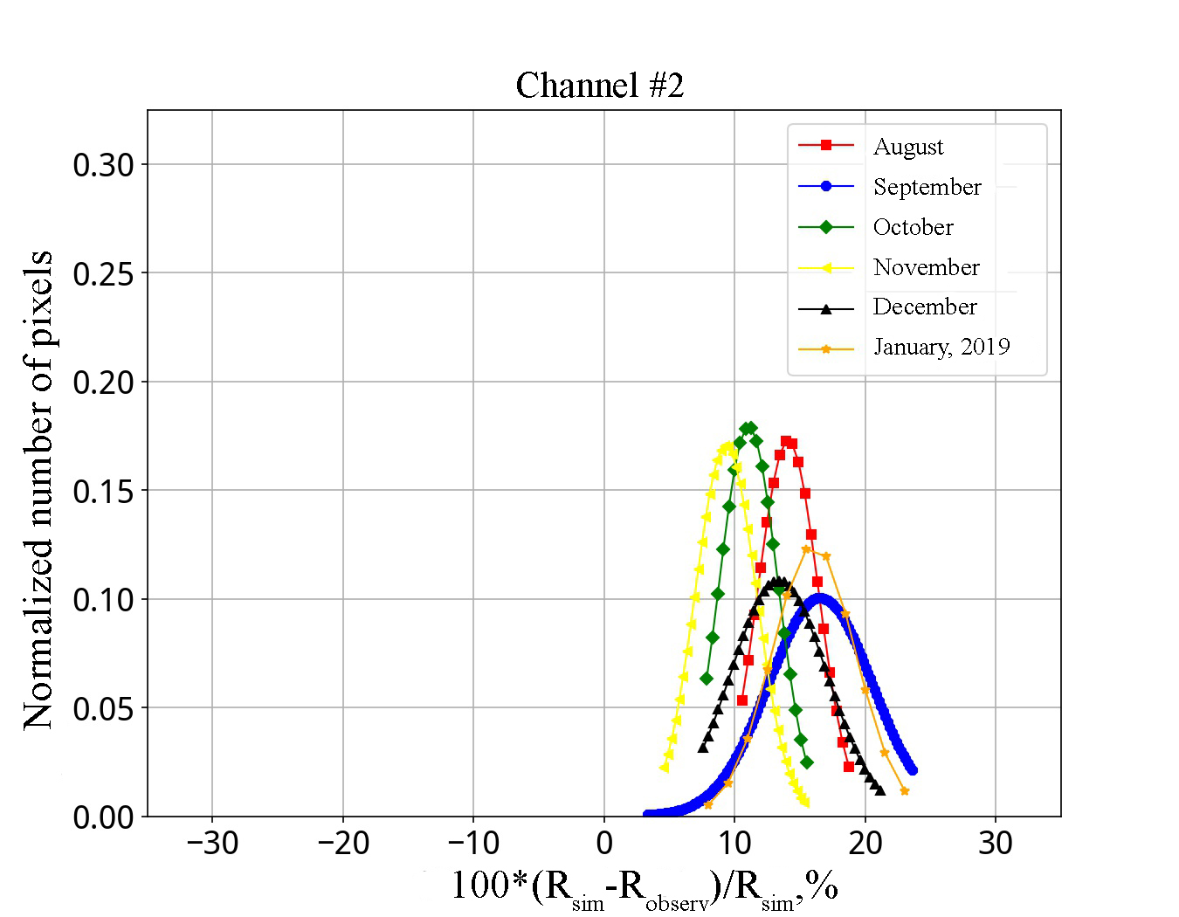
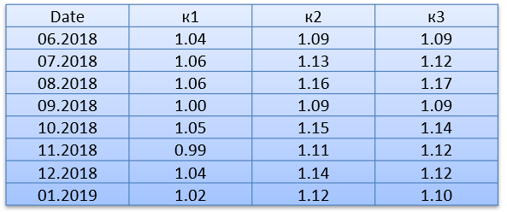
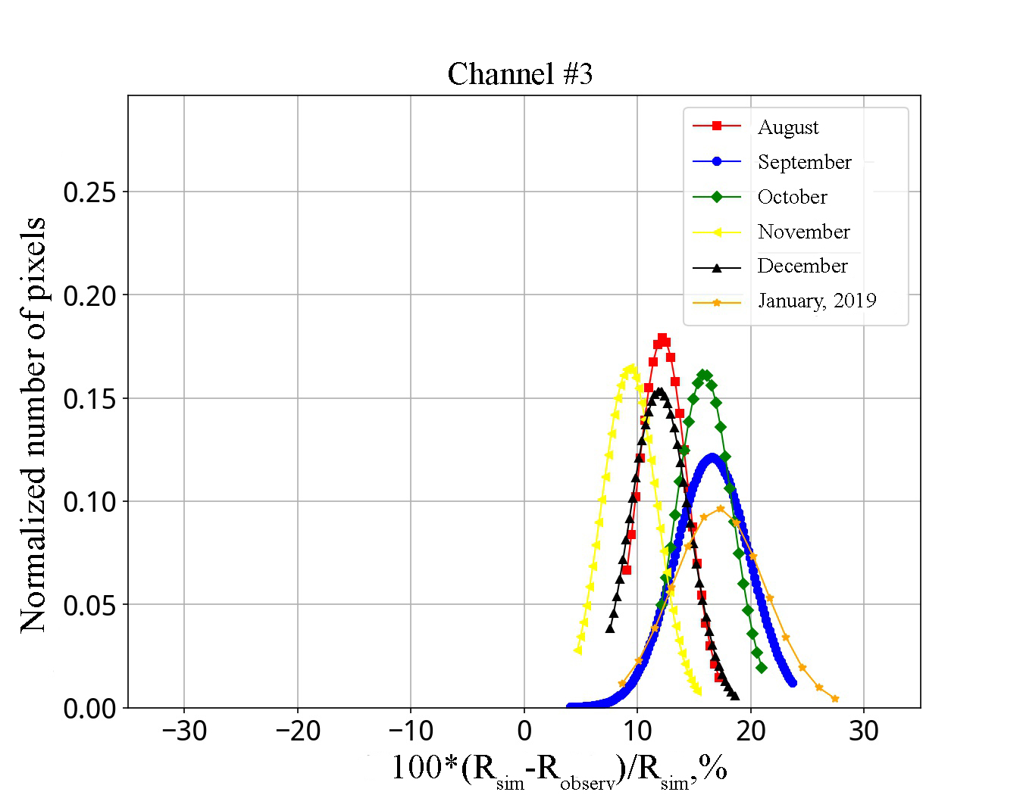
Calibration Performance of MSU-GS: Visible/Near-Infrared Channels
Inter-calibration of MSU-GS shortwaves channels
versus the VIIRS/Suomi NPP
Comparison above
deep convective clouds
over the Indian Ocean
± 20° North/South and East/West of Elektro-L #2 sub-satellite point (76 °E)
Calculated SBAF between
MSU-GS and VIIRS ~1.0
for each pair of channels

Slide 8
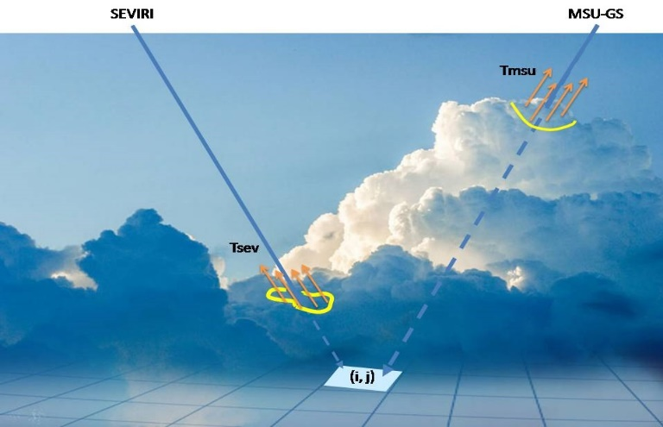
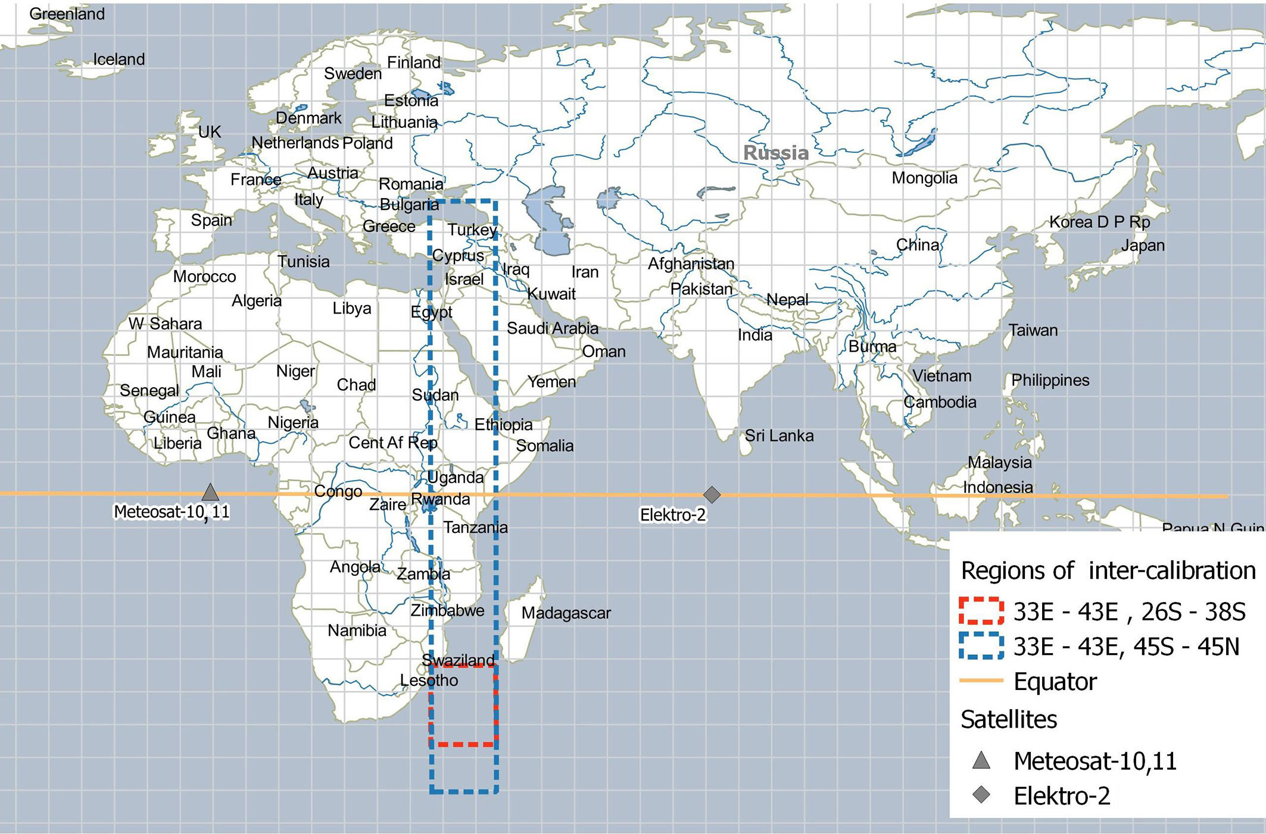
GEO-GEO inter-calibration
of IR channels of Russian MSU-GS/Elektro-L#2 imager using SEVIRI /Meteosat-10, 11
When it is required:
to calibrate IR imager channels at a frequency to identify daily calibration course;
to inspect the amplitude functions of channels in the wide dynamic range of measured brightness temperatures (BTs).
Problems:
at pixel-to-pixel comparison, low temperatures (~200K) measured, for example, by MSU-GS from the tops of deep convection clouds are much less then BTs measured by SEVIRI for the same pixels that are cloudless for SEVIRI or shadowed from it by low clouds;
the calibration errors due to the unequal daily course of land surface temperature observed from both satellites in opposite directions;
geolocation errors.
Key points of GEO-GEO inter-calibration:
the determination of the two inter-calibration fields of regard for hot and cold BTs in the middle between sub-satellites points;
establishment of a one-to-one correspondence between subsets of uniform image fragments from both satellites;
correction of geolocation errors;
obtaining regression relationships for inter-calibration in a wide range of BTs.

Slide 9
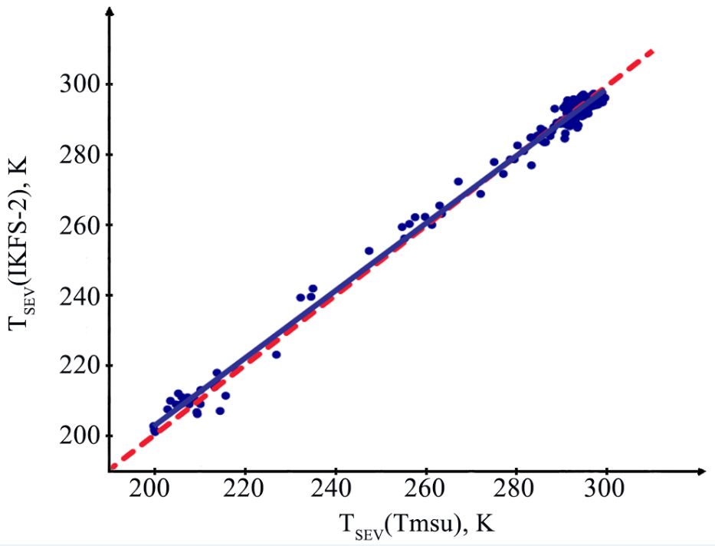
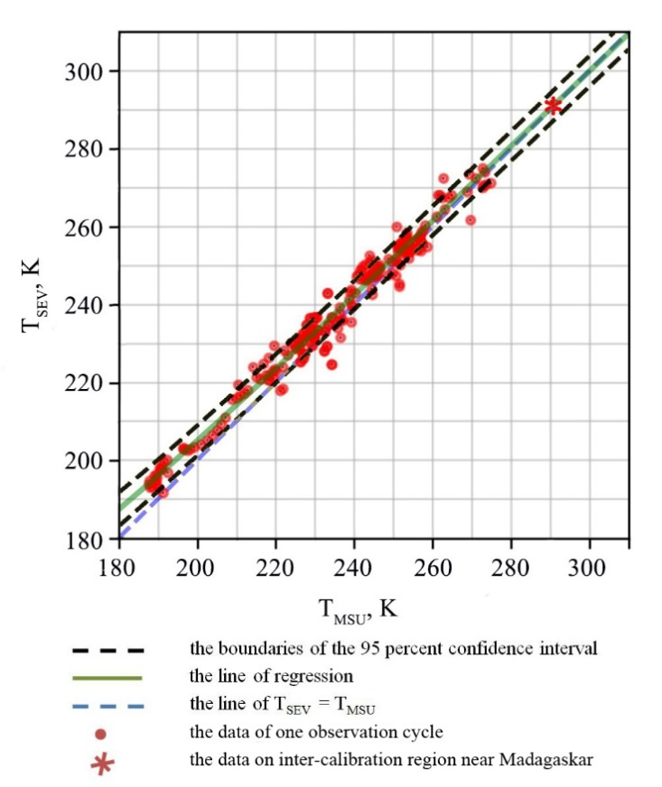
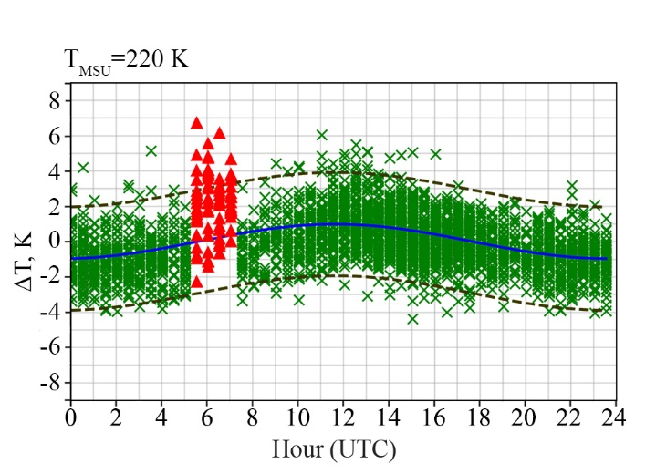
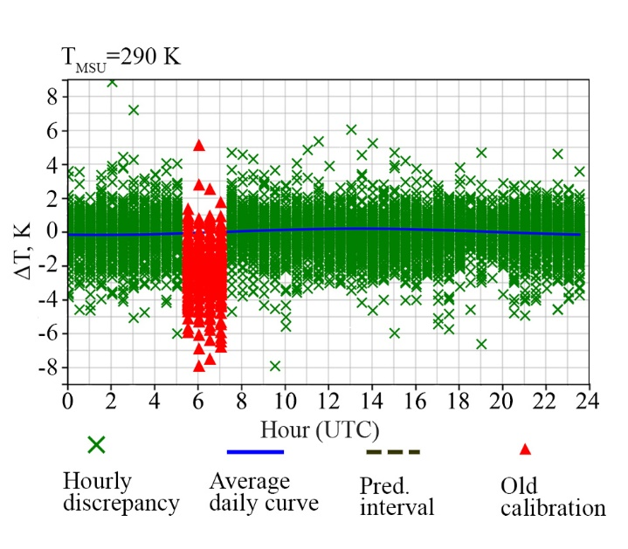
Results of inter-calibration
for MSU-GS channel #9 (10.7 μm )
Amplitude of the daily calibration course less 0.2° for BTs ~ 300K and gradually increases to 1° for BT~200K
Validation of GEO-GEO inter-calibration using GEO-LEO
Example of regression T_{SEV} (T_{MSU}), May 7, 2018, 14:30 UTC
Comparison of Madagaskar region images (10.7μm) after inter-calibration
SEVIRI MSU-GS

Slide 10
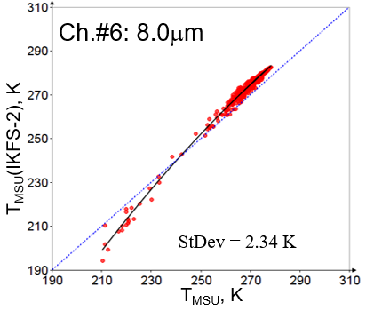
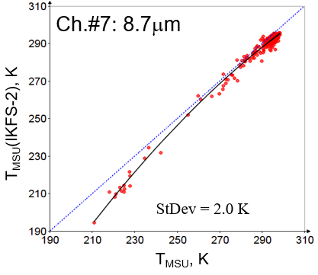
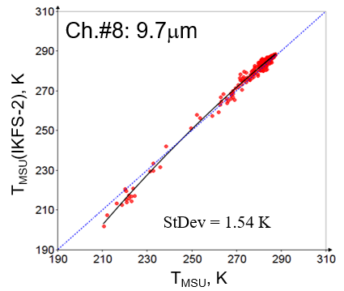
LEO-GEO Inter-Calibration of IR MSU-GS channels using IKFS-2
November 2018 ÷ January 2019

Slide 11
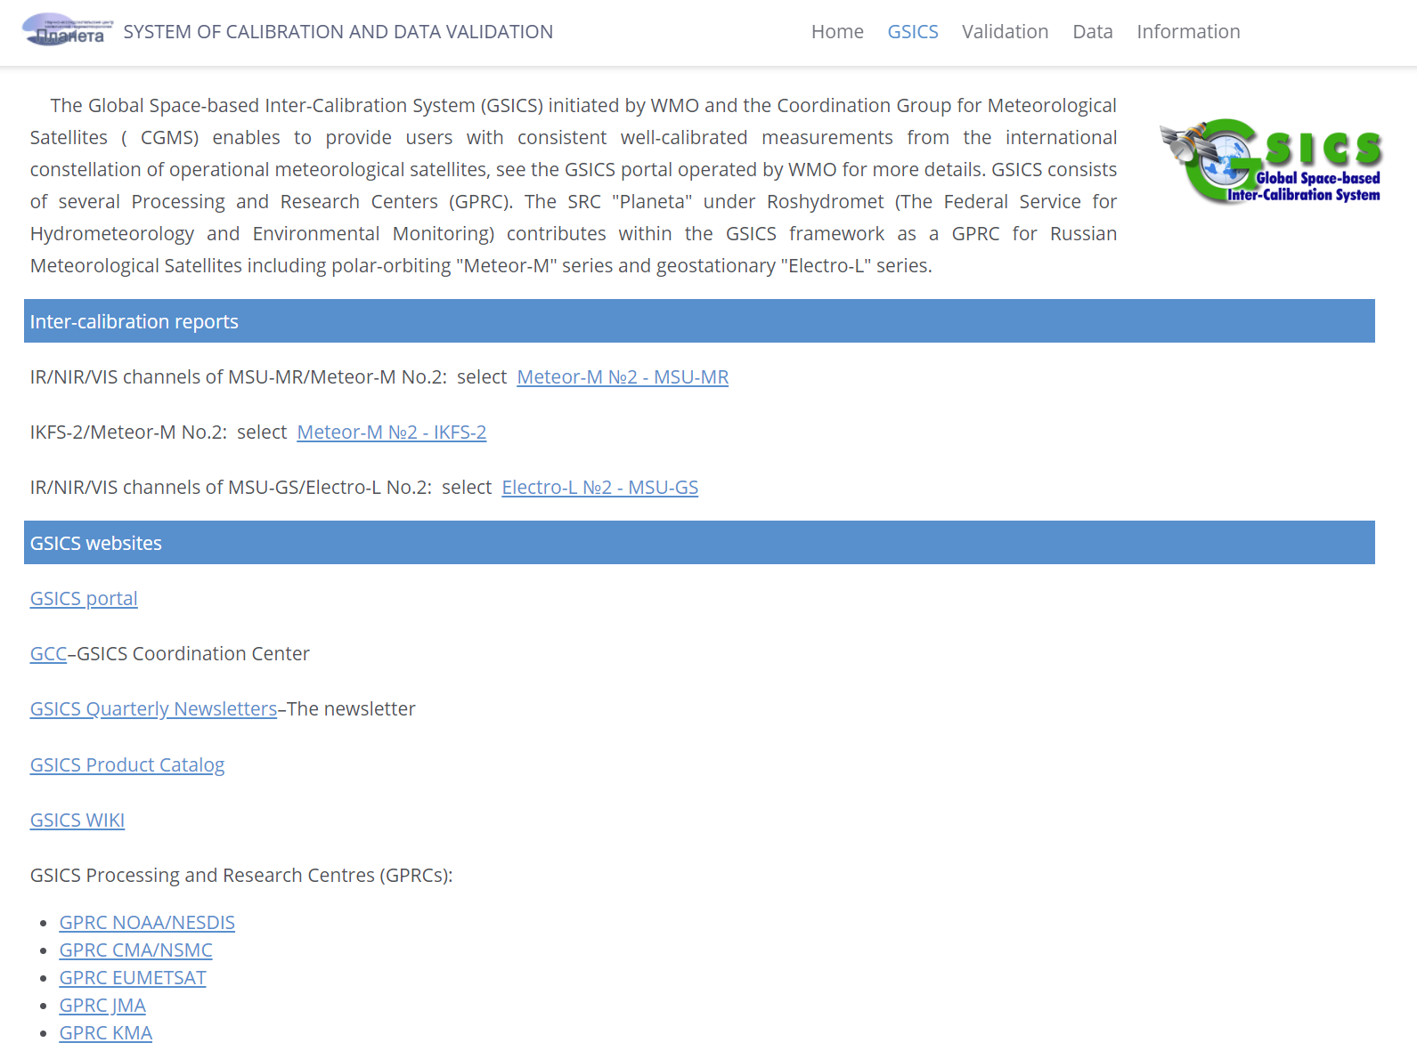
Cal/Val portal of Russian hydrometeorological instruments & data
http://planet.rssi.ru/calval
Special report will be made by Alexander Uspensky on GDWG session
(March 6, 9:00)

Slide 12
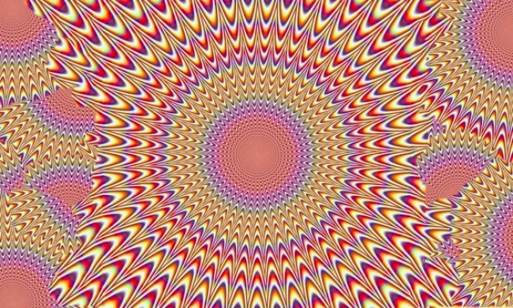
Thank you for your attention

