Slide 1
Report from ISRO Annual Meeting of GRWG/GDWG, Frascati, Italy 4-8 March 2019
Pradeep Thapliyal, Munn Shukla, Nitant Dube
Space Applications Centre (ISRO)
India

Slide 2
ISRO Current satellites for Earth Observations
YEAR...
00
01
02
03
04
05
06
07
08
09
10
11
12
13
14
15
16
17
18
19
20
21
22
23
24
25
26
27
28
29
30
GEO
KALPANA-1 (VHRR)
INSAT-3A (VHRR, CCD)
INSAT-3D (IMAGER & SOUNDER)
INSAT-3DR (IMAGER & SOUNDER)
INSAT-3DS (IMAGER & SOUNDER)
GISAT (MX-VNIR, HyS-VNIR, HyS-SWIR, MX-LWIR)
Atmosphere & Ocean
Oceansat-2 (OCM, SCAT, ROSA)
LEO
CNES-ISRO
MT (MADRAS, SAPHIR, ScaRaB, ROSA)
CNES-ISRO
SARAL (ALTIKA, ARGOS)
NEMO-AM (MADPI)
SCATSAT-1 (Scatterometer)
Oceansat-3 (OCM, LWIR, SCAT)
NASA-ISRO
NISAR
Land & Water
Resourcesat-2 (LISS-3/4, AWiFS)
RISAT-1 (C-SAR)
Resourcesat-2A (LISS-3/4, AWiFS)
Cartographic
CARTOSAT-1 (Stereo PAN)
CARTOSAT-2 (PAN)
CARTOSAT-2E (PAN)
CARTOSAT-3 (PAN)
YEAR...
00
01
02
03
04
05
06
07
08
09
10
11
12
13
14
15
16
17
18
19
20
21
22
23
24
25
26
27
28
29
30

Slide 3
Main contribution to GDWG actions
GSICS Website development – Demo version operational (web page address: https://mosdac.gov.in/gsics - need to be corrected at WMO site)
INSAT-3DR NRTC demo products added in GSICS Website
THREDDS server setup completed (Webex meeting on 23 Jan 2019)
GSICS Plotting tool under development – awaiting RAC products

Slide 4
Main contribution to GRWG actions
Intercalibration procedure established for INSAT-3D Imager and Sounder (NRTC) –Demo phase
Intercalibration procedure is operational for INSAT-3DR Imager
INSAT-3D/3DR RAC products - under development
Results from vicarious calibration of INSAT-3D/3DR radiances using in-situ upper air observations over ISRO cal-val site Kavaratti island were analysed.
GEO-GEO inter-comparison of INSAT-3D/3DR and MSG-SEVIRI carried out
INSAT-3D/3DR Visible channel calibration using DCC method is in implementation phase – in collaboration with Dave Doelling, NASA
INSAT-3D/3DR Visible channel calibration using ray-tracing method is in near completion phase.

Slide 5
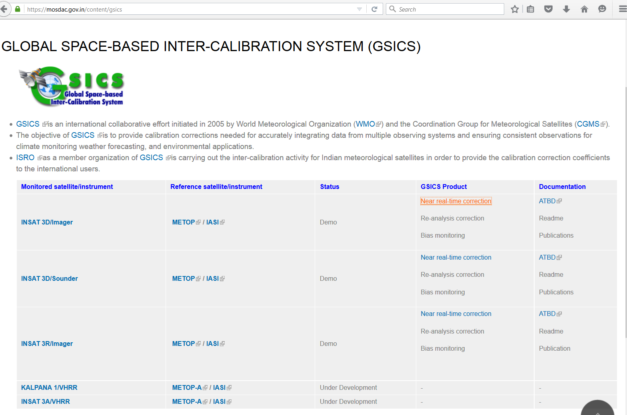
ISRO GSICS website

Slide 6
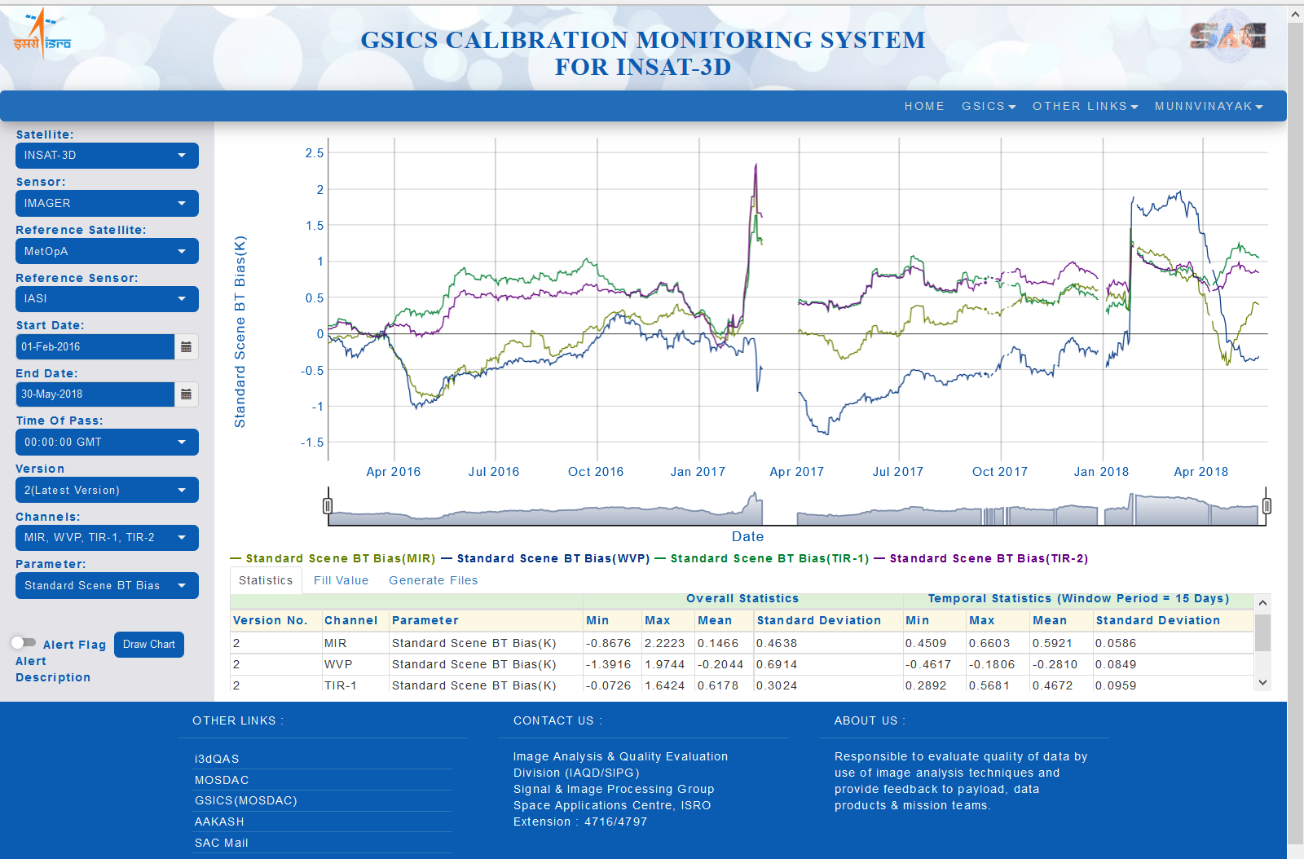
ISRO GSICS Plotting Tool (INSAT-3D)

Slide 7
Issues
Retention of residual biases after GSICS correction
Currently diagnosing the problem
Exploring effect of conversion in radiance unit
Non-linearity in the GSICS correction – exploring various possibility to incorporate the non-linear correction

Slide 8
Thanks

