Slide 1
JMA Agency Report 2019
Masaya Takahashi, Yusuke Yogo and Kazuki Kodera
Meteorological Satellite Center, Japan Meteorological Agency

Slide 2
Personnel supporting GSICS
GRWG
Masaya Takahashi
IR, Lunar, GEO-GEO
Yusuke Yogo
VNIR vicarious calibration (ocean/desert/clouds) using RTM and LEO, GSICS DCC
Kazuki Kodera
VNIR Ray-matching
GDWG
Masaya Takahashi (Chair)
Other member supporting JMA GSICS activity
Tasuku Tabata
1-year visiting scientist (Mar. 2017- Feb. 2018) at EUMETSAT Climate team
WV/IR Inter-calibration of heritage GEO imagers under SCOPE-CM/IOGEO

Slide 3
Support to GRWG Activities
To implement VNIR/IR GSICS inter-cal. ATBDs to Himawari-8/9 AHI
IR: Type-B unc. analysis is delayed
VNIR
GSICS DCC: under-implementation
Lunar: delayed
To develop/improve inter-cal. for GSICS methods
AHI VNIR vicarious cal. using LEO obs. (incl. Rayleigh scattering)
Migration of reference LEO from MODIS to VIIRS [4o]
AHI-VIIRS VNIR ray-matching
Impacts of VIIRS M05/I01 on AHI Band03 (0.64 μm) [4p]
GEO-GEO: delayed
To compare re-calibrated GEO imagers with GSICS inter-cal.
Collaboration with SCOPE-CM/IOGEO

Slide 4
Statuses of GRWG Actions
A.GRWG.2018.10a.1 | JMA to provide the template to GRWG to define attributes to show instrument's radiometric performance in a short report that is to be prepared by satellite operators on an annual basis. | Closed (provided for 3q)
A.GIR.2018.4b.1 | Masaya Takahashi (JMA) to report double differences with of IASI and CrIS (using AHI). | Closed
A.GIR.2018.4c1 | JMA (Masaya Takahashi) / CMA (Na Xu) to work together on making GEO-GEO inter-comparison, using IASI. | Delayed
A.GIR.2018.4c.2 | Yusuke Yogo (JMA) to make comparisons between JMA SBAF and NASA SBAF tool. | Delayed

Slide 5
Support to GDWG Activities
To coordinate/develop specifications of GSICS deliverable formats/ tools
GSICS Annual Calibration Report (Annual State of Observing System validated by GSICS inter-calibration approaches)
GSICS SRF netCDF Convention
To review GSICS deliverables from a data management perspective
COMS/MI GEO-LEO-IR for Pre-Op Phase in GPPA

Slide 6
Statuses of GDWG Actions
GDWG.2016.5b.1 | JMA to include invalid_hours in the agreed conventions once the time format has been checked that it follows ISO 8601 format. | Delayed
A.GDWG.2017.5e.1 | JMA to update Wiki with a proposal of NetCDF SRF, including a new international data category in Data Designators category. | Closed
A.GDWG.2017.5e.3 | JMA to produce a prototype of the new NetCDF SRF for review by the GDWG; a template and an instance of the template with data. | Closed
A.GDWG.2018.5a.2 | Masaya Takahashi to upload the SRF format conversion script to GitHub. | Delayed
A.GDWG.2018.5b.1 | Masaya Takahashi to update minimum requirements for GPRC website and inform WMO of the changes; addition of ISRO website. | Closed
A.GDWG.2018.5j.2 | GDWG members to take event logging white paper to see whether their organisation can do with regards to implement such a system. | Closed
A.GDWG.2018.5j.3 | GDWG Chair to prepare a reply to “R45.05: Calibration Events Logging Task Team be folded formed under GSICS as a task team” for CGMS-46. | Closed
A.GDWG.2018.8a.1 | Masaya Takahashi to update action identifier definition for GSICS-EP. | Closed
A.GDWG.2018.8h.1 | GDWG Chair to propose a refinement of GDWG ToR to GSICS-EP. | Closed
A.GDWG.2018.8k.1 | Masaya Takahashi to circulate GDWG Fact Sheet to GDWG members to get feed backs and report to EP. | Closed

Slide 7
Instruments Updates
Himawari-8 (operational since Jul. 2015)
Advanced Himawari Imager (AHI) with 16 spectral bands
Full-disk observation every 10 min + regional observations every 2.5/0.5 min
2019-02-19: maintenance of Himawari-8 (~2 hours)
Himawari-9 (in-orbit standby since Mar. 2017)
Feb. 2018: back-up operation of Himawari-8 for 2-days
Feb. 2019: no back-up operation because:
Duration of Himawari-8 maintenance was short enough.
Impacts of GOES-17/ABI LHP problem on Himawari-9/AHI needs to be investigated in detail.
JFY 2010 2015 2018 2022 2029
Himawari-8 Himawari-9
Launch
Operational
In-orbit standby
Manufacturing
In-orbit standby
Operational
Launch

Slide 8
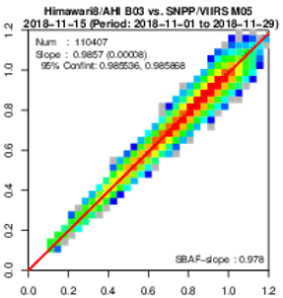
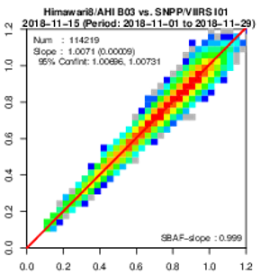
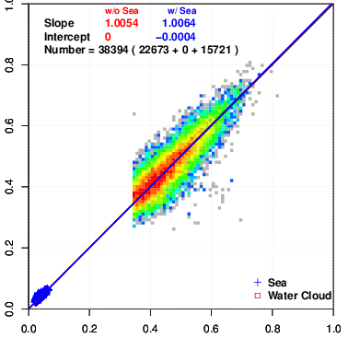
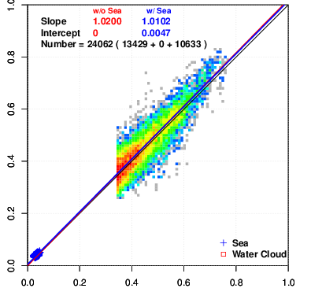
Use of VIIRS as reference for AHI VIS/NIR inter-calibration
Vicarious calibration (Y. Yogo)
Migration from MODIS
Ray-matching (K. Kodera)
Use of smaller data size channel: M05 rather than I01 for 0.6 μm
Simulated reflectivity
by Aqua/MODIS
Simulated reflectivity
by S-NPP/VIIRS
AHI B03 (0.64 μm) obs
2.1% difference
Slope: 0.986
Slope: 1.007
AHI B03 (0.64 μm) obs. AHI B03 (0.64 μm) obs.
S-NPP/VIIRS M05 S-NPP/VIIRS I01
DCC (Y. Yogo)
Calculation of DCC BRDF using RTM was just started.

Slide 9
Agenda items reported by JMA
Plenary (Day-2)
Re-calibrating WV/IR channels of GMS/MTSAT imagers using HIRS/2/AIRS/IASI [3k]
GSICS Annual Report - way forward (e.g. incl. LEO and reference instruments) [3q]
GSICS Server Upgrade - requirements for new deliverables [3s]
GRWG
VNIR (Day-3) : Use of VIIRS in AHI vicarious calibration [4o]
VNIR (Day-3) : Impacts of I01/M05 of S-NPP/VIIRS on AHI-VIIRS ray-matching [4p]
IR (Day-4) : Collaborative research w/ CMA to apply JMA GSICS method to FY-2G-IASI inter-calibration [7k]
GDWG
GSICS Convention for Spectral Response Function files [6d]
Visualization of GSICS Products on GSICS Plotting Tool - Current Status and User Requirements [9g]

Slide 10
Thank you for your attention!

