Slide 1
KMA GSICS Agency Report
2019
Dohyeong Kim,
Eunkyu Kim, Tae-Hyeong Oh, Jin Woo and Minju Gu
KMA

Slide 2
Overview
KMA’s GSICS Activities & Action Summary
Support to GDWG Activities
Support to GRWG Activities
Instrument update
Introduce the KMA’s Personnel supporting GSICS
GSICS activities to be discussed in this joint meeting

Slide 3
KMA’s GSICS Activities &
Progress Summary
Current Status of KMA activities
  Demonstration phase of COMS/MI IR channel with IASI/AIRS
  Update VI calibration in ray matching method and GSICS DCC based NASA algorithm
  Prepare to implement GSICS inter-calibration system of GK2A/AMI
Progress Summary
  COMS will be operational until March 2020
  GK2A status is under in-orbit-test and will be operational July 2019
    Radiometric calibration was over and monitors the long-term trending
    Image Navigation and Registration is on-going
  Preparation for the AMI radiometric calibration during commissioning period based on GSICS inter-calibration

Slide 4
KMA’s GSICS Actions
Action Ref | Description | State | Remark
A.GVNIR.2018.7u.1 | Dave Doelling(NASA) to review KMA’s implementation of the DCC method |  | 2j
A.GDWG.2017.5a.7 | KMA to review NOAA website contents and update website reviewing slides | Closed | 6c
A.GDWG.2017.5i.1 | KMA to set up a GitHub project for GDWG activities and document how this is done such that another GPRC can take over the administration of the GitHub project. | Closed | 6m
A.KMA.20180601.2 | KMA to provide the inter-calibration comparison results of COMS/MI using before and after reprocessed CrIS data |  | 7g

Slide 5
Support to GDWG Activities
Summary of the tasks of KMA’s supports in the GDWG
  Set up and operate a GitHub project for GDWG activities
  Review GPRC websites
  - Including one newly registered GPRC website(Roshydromet)
  Build a plotting tool development environments in KMA
Overview of the resources and time taken for this support
  2 members(Jin Woo, Hyunjong Oh), 30 days/year
Issues
  Encourage GDWG members to create the accounts
  (except KMA, JMA, EUMETSAT, CMA)

Slide 6
Support to GRWG Activities
Summary of the tasks of KMA’s supports in the GRWG
  Inter-comparison of COMS/MI with before and after reprocessed CrIS
  Develop GEO-GEO direct comparison for both IR and visible channel
    Application of SBAF, COMS vs AHI
  Develop and update calibration approaches
    Lunar calibration, ray matching method, GSICS DCC with NASA algorithm
Overview of the resources and time taken for this support
  Minju Gu, Taehyeong Oh, Eunkyu Kim, Hyeji Yang (all time)
  Dohyeong Kim
Issues
  Focused on GSICS based inter-calibration for GK-2A

Slide 7
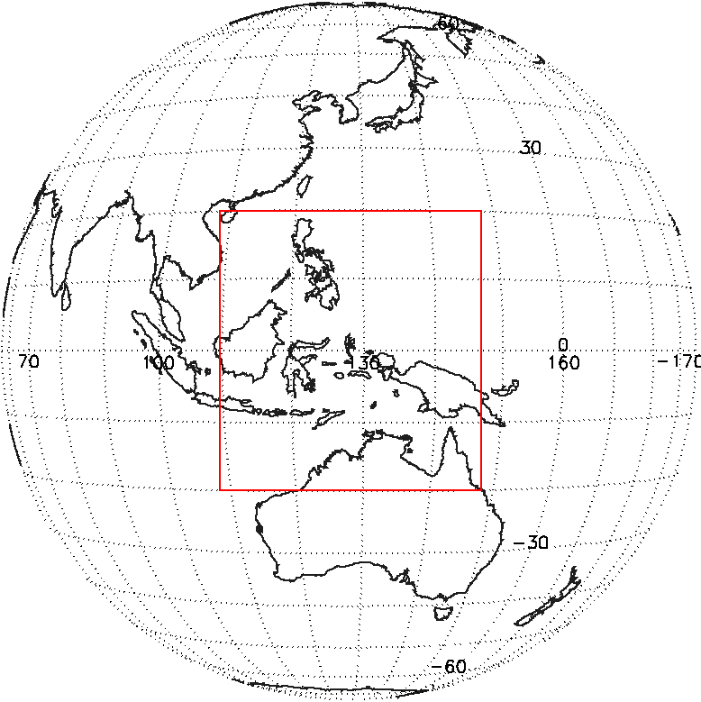
Visible Calibration Method Using DCC Targets
Response to A.GVNIR.2018.7u.1
Three Methods Using DCC Targets
  Results from April 2011 to December 2018.
    Ray matching(DCC): Inter-calibration(GEO-LEO) method(0.1°ⅹ0.1° grid data)
    RTM DCC: Compared with observation and RTM(SBDART)
    GSICS DCC: Monthly statistic results comparison method(Using Hu BRDF model).
Method | Thresholds | Reference Values
Ray Matching (DCC) | 0.1°ⅹ0.1° Grid (Lat/Lon) SZA < 40°, VZA < 40° IR_TB ≤ 205°K Homogeneity checks - Bin Spatial homogeneity < 90% (90#/110#) - STDV(IR_TB) ≤ 1°K - STDV(VIS_Rad)/Mean(VIS_Rad) ≤ 0.03% | MODIS (MOD021KM, MOD03)
RTM DCC | IR_TB ≤ 190°K Homogeneity checks - STDV(IR_TB) ≤ 1°K - STDV(VIS_Rad)/Mean(VIS_Rad) ≤ 0.03% | SBDART (Santa Barbara DISORT Atmospheric Radiative Transfer)
GSICS DCC | IR_TB ≤ 205°K Same as RTM DCC Homogeneity checks | MODIS (MYD02SSH)
  <Research Area>
  Latitude: ± 20°
  Longitude: ± 108.2 ° E ~ 148.2 ° E

Slide 8
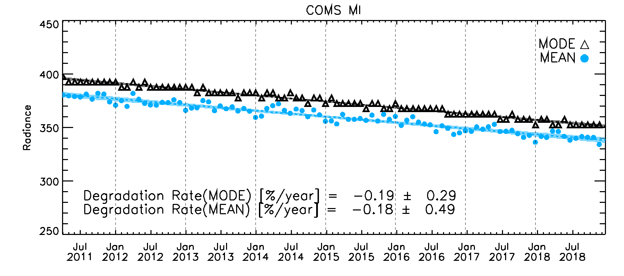
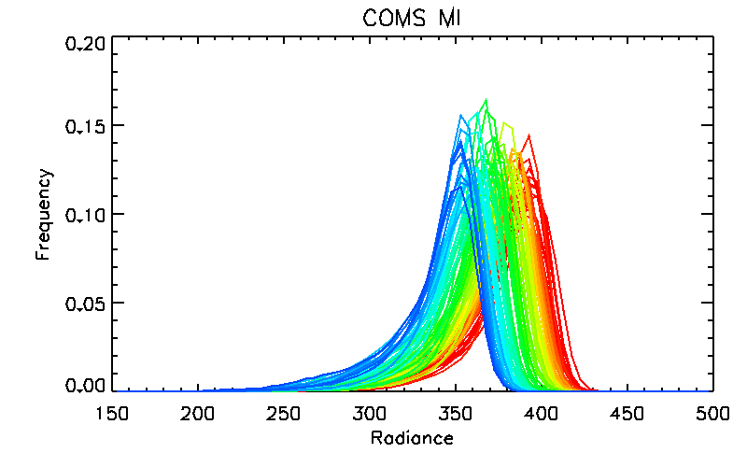
Update of KMA GSICS DCC Results
Response to A.GVNIR.2018.7u.1
Implementation of GSICS DCC method
  To select DCC pixels using TB(IR) and homogeneity checks
  TB(IR) < 205°K; STDV(TB) < 1°K; STDV/Mean(rad) < 0.03%
  Use Hu BRDF model to consider the DCC reflectance
To investigate degradation rate using MODE and MEAN of monthly DCC pixels
Stable MODE and MEAN.
*Shading area: 3 sigma values
GSICS DCC COMS MI Radiance Frequency
Blue
(2018)
Red
(2011)
Annual Drift(MODE)
Annual Drift(MEAN)
= -1.44 ±0.07 [%/year]
= -1.45 ±0.13 [%/year]
KMA appreciates the huge support of Dave Doelling !!!

Slide 9
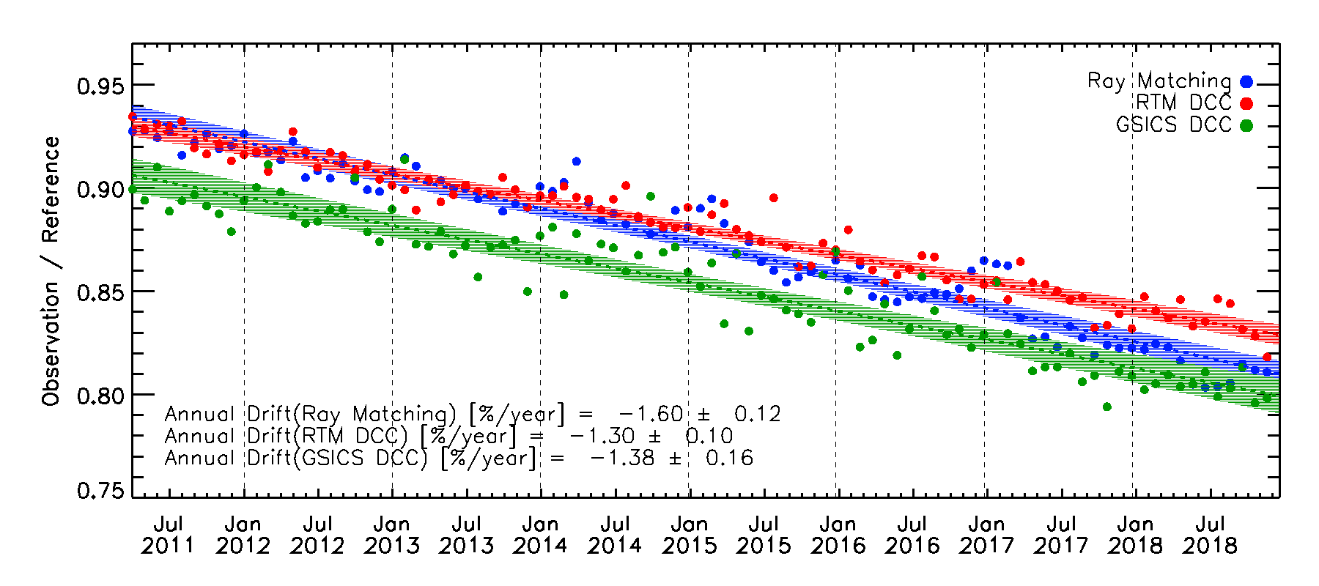
Three types of visible calibration methods using DCC conditions
Response to A.GVNIR.2018.7u.1
Comparison among Ray-matching, RTM DCC and GSICS DCC
*Shading area: 3 sigma values
Annual Drift(Ray Matching)
Annual Drift(RTM DCC)
Annual Drift(GSICS DCC)
= -1.60 ±0.12 [%/year]
= -1.30 ±0.10 [%/year]
= -1.38 ±0.16 [%/year]

Slide 10
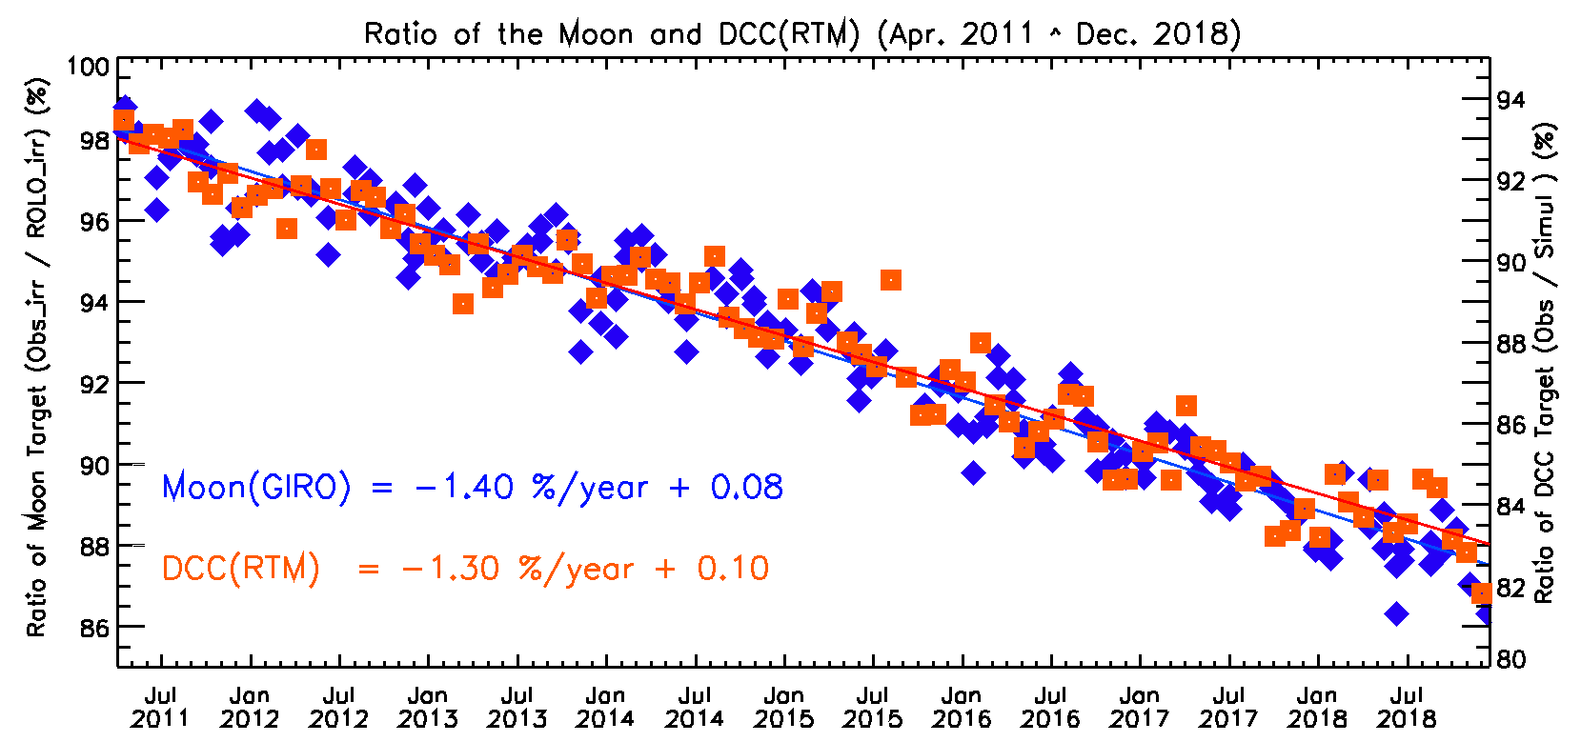
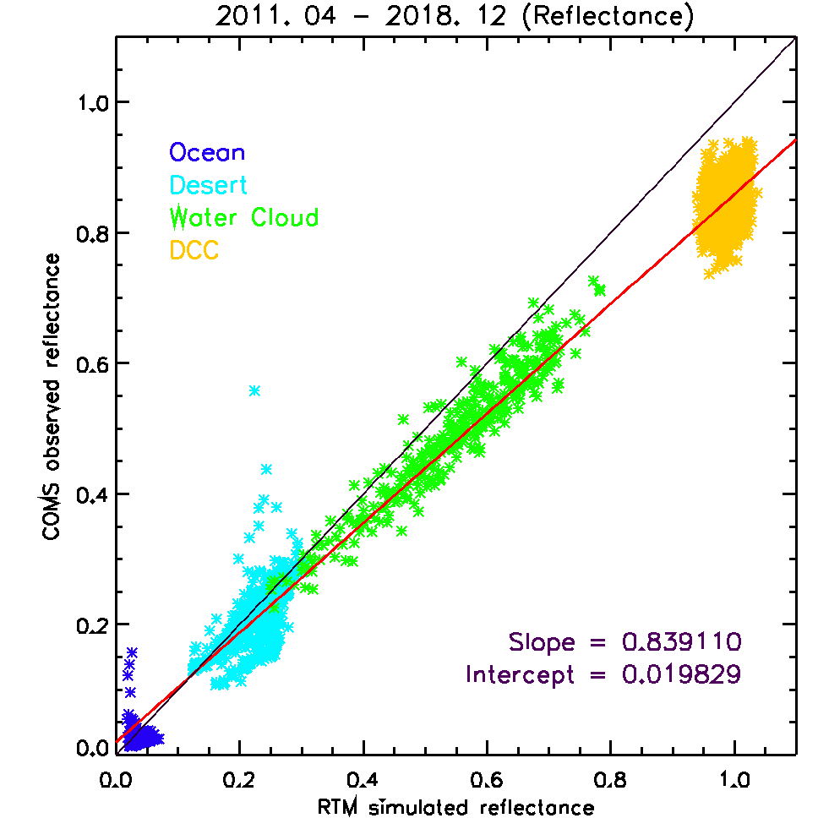
Visible Calibration
Scatter plot
using ocean/desert/WC/DCC
Results of Moon and DCC (RTM)
Apr.2011~ Dec. 2018 Moon : -10.75%(1.40%/year) DCC(RTM) : -9.74%(1.27%/year)
Year | DCC | Moon
2011 | -3.05 | -3.21
2012 | -0.98 | -2.27
2013 | -0.18 | -1.55
2014 | -2.02 | -1.08
2015 | -2.91 | -2.03
2016 | -2.31 | -1.03
2017 | -2.33 | -1.84
2018 | -1.45 | -1.31
for all data until now
  slope= 0.84
  intercept= 0.02

Slide 11
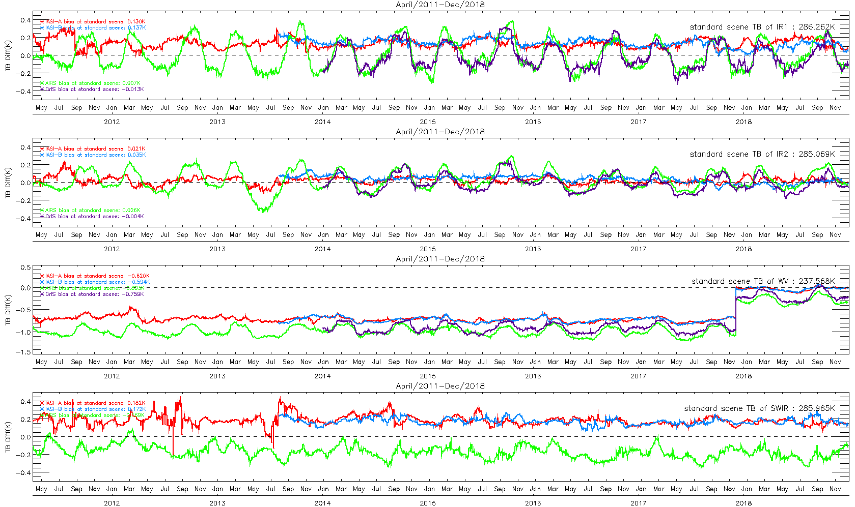
IR Calibration
Time series for TB bias using RAC data of IASI-A (April 2011 - Dec. 2018), IASI-B (Aug. 2013 - Dec. 2018), AIRS (April 2011 - Dec. 2018) and CrIS (Jan. 2014 - Dec. 2018) at standard scene
WV SRF shift

Slide 12
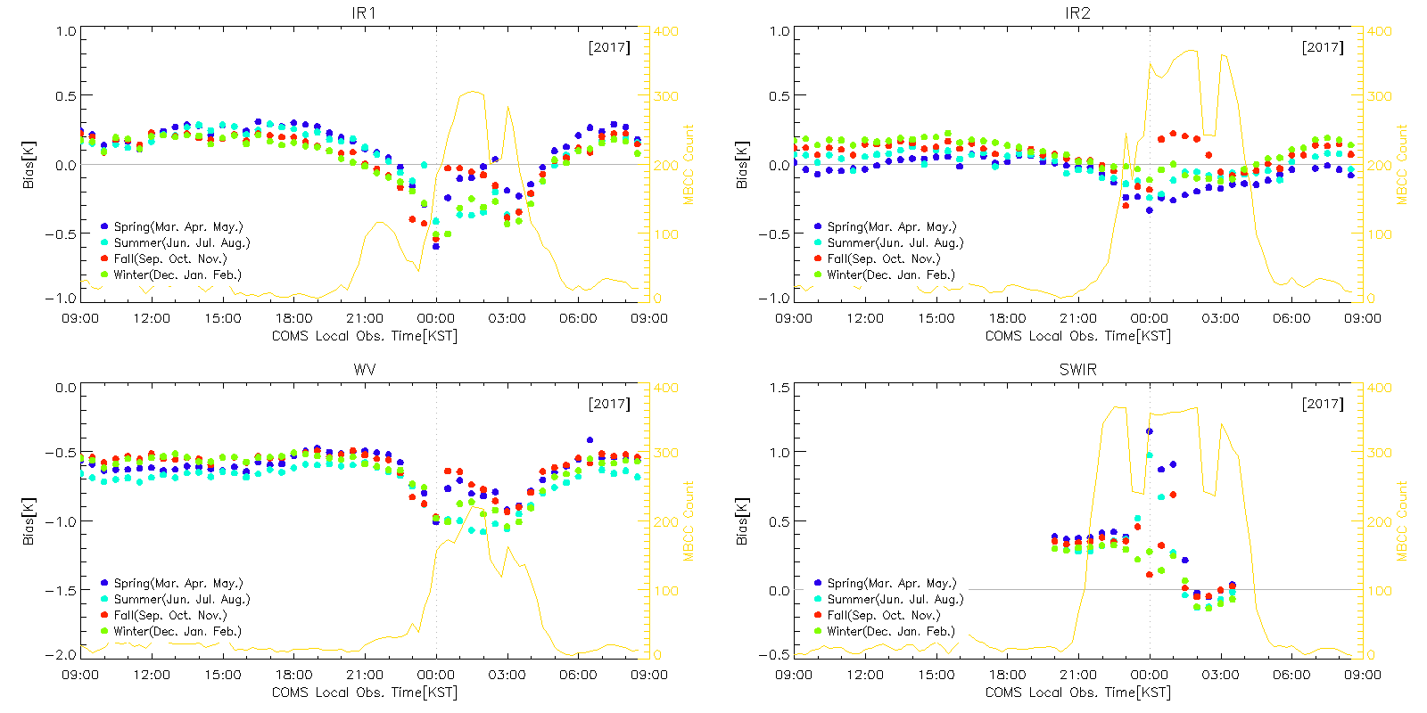

GEO-GEO (COMS/MI vs. AHI)
The results (biases) are dependent on SZA, scene temperature
Diurnal variation pattern of TB biases (GEO-GEO) is similar with that of (GEO-LEO)
It could provide diurnal (short-term) variation of inter-calibration between nearby GEOs
Notes:
입력자료: level1b Tb, 30분간격(00분, 30분), 5ºS~10ºN
결과
미치는 영향:
- SZA 경곗값인 1% 이내에서 SZA가 편차에 미치는 영향 적어 무시할 만 함
- Lat에 의한 영향이 큼(온도경도에 비례해 나타나는 현상)
- Time은 일변화와 계절변화
2) 편차는 자정부근에 커지며, 변동폭은 네 채널 모두 가을철(빨간점)에 가장 크게 나타남. 오른쪽 축은 MBCC 보정횟수를 누적한 값을 의미함
3) MI-LEO 일변화와 비교 결과, SWIR 채널을 제외한 세 채널에서는 차이가 거의 없음. MI-LEO와의 차이는 계절별로 일정함

Slide 13
KMA’s Instruments Updates
Geo-KOMPSAT-2A
  Geo-KOMPSAT-2A was launched on December 4, 2018(21:37:07 UTC)
  Early In-Orbit-Test from 2018 to June 2019
  Preparation of GK2A /AMI visible and IR GSICS-based inter-calibration
    Implement and validate the GSICS based calibration system
    Science plan to validate L1B radiometric calibration
  GK2A/KSEM will collaborate with Europe(NGRM/EDRS-C) and US(GOES) for global monitoring of Space Weather events
April 2018
December 2018
June 2019
April 2020
COMS | Operation | Operation extension
GK-2A |  |  | In-Orbit-Test | Operation
 |  |  |  | Joint Operation
GK-2A launch

Slide 14
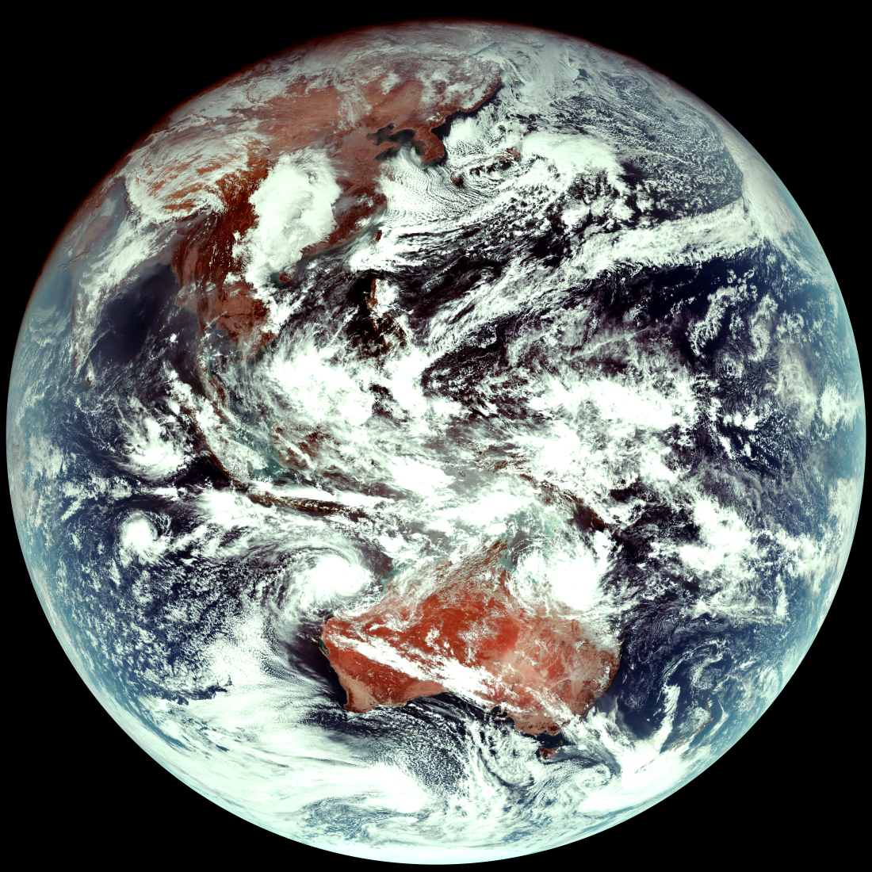
Geo-KOMPSAT-2A AMI First Images
GK-2A AMI
True Color (RGB) images
(2019. 1. 26 03:10 UTC)

Slide 15
Introduce KMA’s Personnel supporting GSICS
EP
Dohyeong Kim
GRWG
Dohyeong Kim (vice-Chair)
Minju Gu, Taehyeong Oh, Eunkyu Kim, Hyeji Yang
GDWG
Jin Woo , Hyunjong Oh
Member | GRWG | GDWG | GEO-LEO | DCC RTM | Moon | GEO-GEO
Dohyeong Kim (Mr.) | Y |  | Y | Y | Y | Y
Minju Gu (Ms.) | Y |  | Y
Taehyeong Oh (Mr.) | Y |  |  |  | Y
Eunkyu Kim (Mr.) | Y |  |  | Y
Hyeji Yang (Ms.) | Y |  |  |  |  | Y
Jin Woo (Ms.) |  | Y
Hyunjong Oh (Mr.) |  | Y

Slide 16
KMA’s GSICS activities to be discussed in this joint meeting
GRWG
  IR Sub-Group (Day-4)
    Inter-calibration results of COMS using before and after reprocessed CrIS data[7i]
    Inter-calibration results of COMS using with and without MBCC[7n]
GDWG
  GDWG Baseline Reviews-website, products metadata and structures[6c]
  Use of GitHub for GSICS developments[6m]

Slide 17
Thank you for your attention
WMO GSICS Portal
http://gsics.wmo.int
GSICS Coordination Centre http://www.star.nesdis.noaa.gov/smcd/GCC/index.php
GSICS Product Catalog https://www.star.nesdis.noaa.gov/smcd/GCC/ProductCatalog.php
GSICS Wiki
http://gsicswiki.net/wiki

Slide 18
GK-2A AMI IOT
Status and Future Plan
Dohyeong Kim
KMA

Slide 19
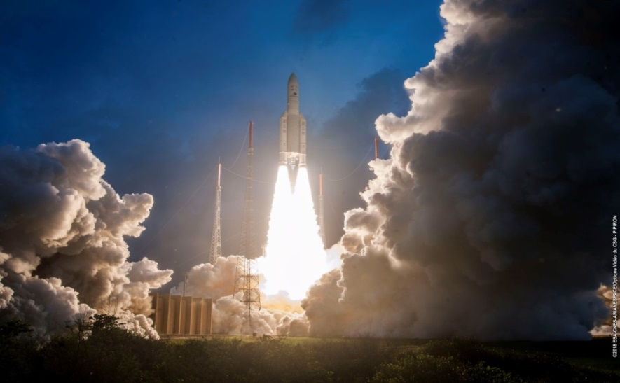
Geo-KOMPSAT-2A Is launched
21:37:07 UTC 4 December 2018 | GK-2A is launched in French Guiana About 33min later from launch, GK-2A is separated and entered GTO
12 December 2018 | GK-2A is entered drift orbit(119°E) after 5 LAE Burn
04:48 UTC 20 December 2018 | GK-2A is located on its operational longitude (128.2°E) and start outgassing mode of GK-2A AMI
03:10 UTC 26 January 2019 | GK-2A AMI is observed the First Image (16 channels)
  AMI/KSEM commissioning will be continued until June 2019
  The operation and public release will be mid July of 2019

Slide 20
GK-2A Schedule toward Operation
Apr 2018
Dec 2018
July 2019
Apr 2020
COMS | Operation | Operation extension
GK-2A |  |  | In-Orbit-Test | Operation
 |  |  |  | Joint Operation
GK-2A launch
(5 Dec. 2018)
April 2018 ~ March 2020 : COMS MI operation extension
5 December 2018: GK-2A launch
26 December 2018 : The first light image
In-Orbit Test (NOW)
July 2019 : Full Operation

Slide 21
GK-2A AMI In-Orbit-Test
Performed AMI Radiometric IOT (21 January ~ 22 February 2019 )
 | Side 1 BDS data collection (not BDS map update) Performed Solar Cal. and IR Cal. Data collection for the Scan mirror emissivity analysis
24 January | Switch side 1 to side 2 IOT is progressed using AMI side 2 as a primary
26 January | GK-2A AMI First Light Images
 | BDS data collection and BDS map update for side 2 Performed Solar Cal. and IR Cal. Data collection for the Scan mirror emissivity analysis SME coefficients update Run timeline ID #1 ( FD 1 + ELA 5 + LA 5, 10 min.) Analyzed AMI Radiometric Performance

Slide 22
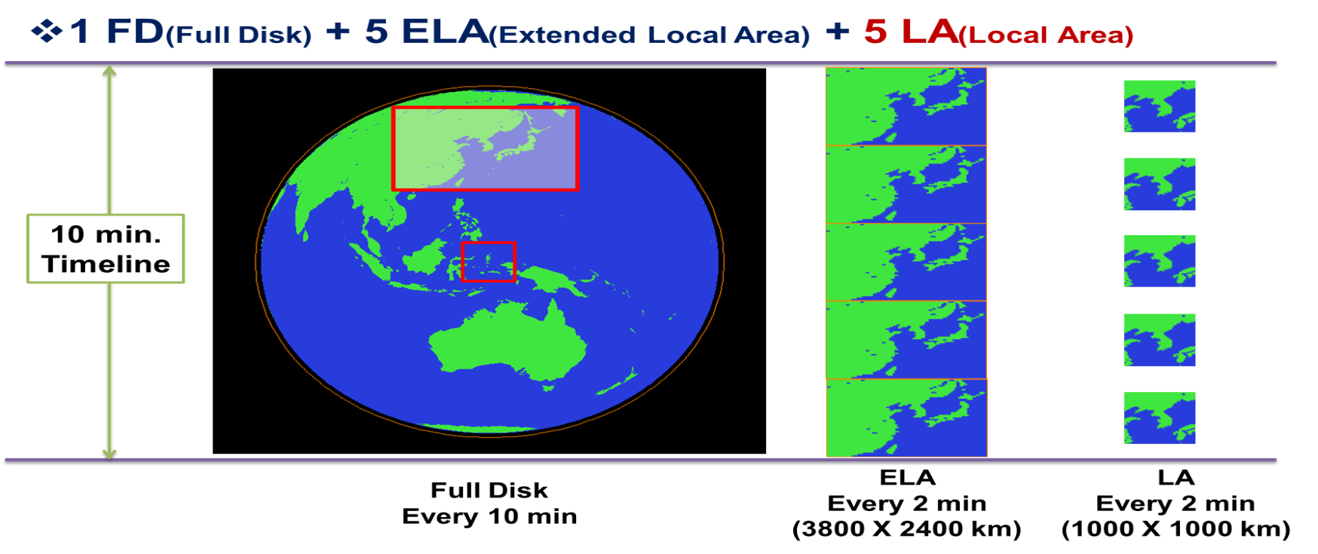
AMI Observation Area and Schedule (I)
  1 FD + 5 ELA + 5 LA : 10 min (Timeline ID #1)
  Full Disk (FD)
  Extended Local Area (ELA) : 3800 km X 2400 km (EW X NS)
  Local Area (LA) 1000 km X 1000 km (target observation)

Slide 23
AMI specification
 |  | GK-2A (AMI) |  |  |  | COMS (MI) |  | GOES-R (ABI) | Himawari-8 (AHI)
Bands |  | Center wavelength [um] | Resolution [km] | # of Detectors (*) | Quantization of digital count [bit] | Center wavelength [um] | Resolution [km] | Center wavelength [um] | Center wavelength [um]
VNIR | VIS0.4 | 0.479 | 1 | 676 | 11 |  |  | 0.47 | 0.46
 | VIS0.5 | 0.5175 | 1 | 676 | 11 |  |  |  | 0.51
 | VIS0.6 | 0.6394 | 0.5 | 1460 | 12 | 0.675 | 1 | 0.64 | 0.64
 | VIS0.8 | 0.8705 | 1 | 676 | 13 |  |  | 0.865 | 0.86
 | NIR1.3 | 1.3740 | 2 | 372 | 12 |  |  | 1.378
 | NIR1.6 | 1.6092 | 2 | 372 | 11 |  |  | 1.61 | 1.6
 | NIR2.2 |  |  |  |  |  |  | 3.35 | 2.3
MWIR | IR3.8 | 3.8316 | 2 | 332 | 14 | 3.75 | 4 | 3.90 | 3.9
 | IR6.3 | 6.2104 | 2 | 332 | 12 |  |  | 6.185 | 6.2
 | IR6.9 | 6.9413 | 2 | 332 | 13 | 6.75 | 4 | 6.95 | 7.0
 | IR7.3 | 7.3266 | 2 | 332 | 13 |  |  | 7.34 | 7.3
 | IR8.7 | 8.5881 | 2 | 332 | 13 |  |  | 8.50 | 8.6
LWIR | IR9.6 | 9.6210 | 2 | 332 | 13 |  |  | 9.61 | 9.6
 | IR10.5 | 10.3539 | 2 | 408 | 13 | 10.8 | 4 | 10.35 | 10.4
 | IR11.2 | 11.2288 | 2 | 408 | 13 |  |  | 11.2 | 11.2
 | IR12.3 | 12.3664 | 2 | 408 | 13 | 12.0 | 4 | 12.3 | 12.3
 | IR13.3 | 13.2791 | 2 | 408 | 13 |  |  | 13.3 | 13.3

Slide 24
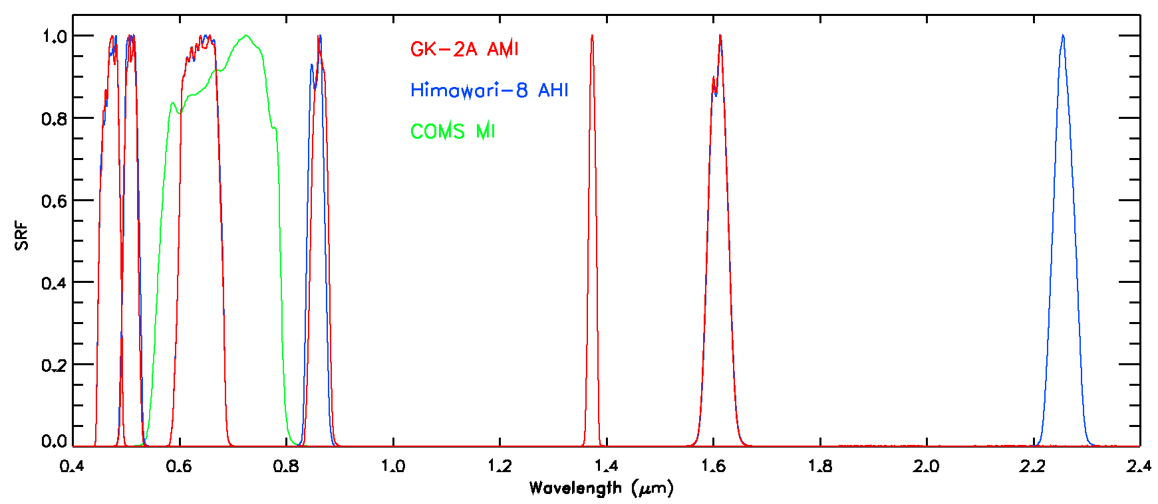
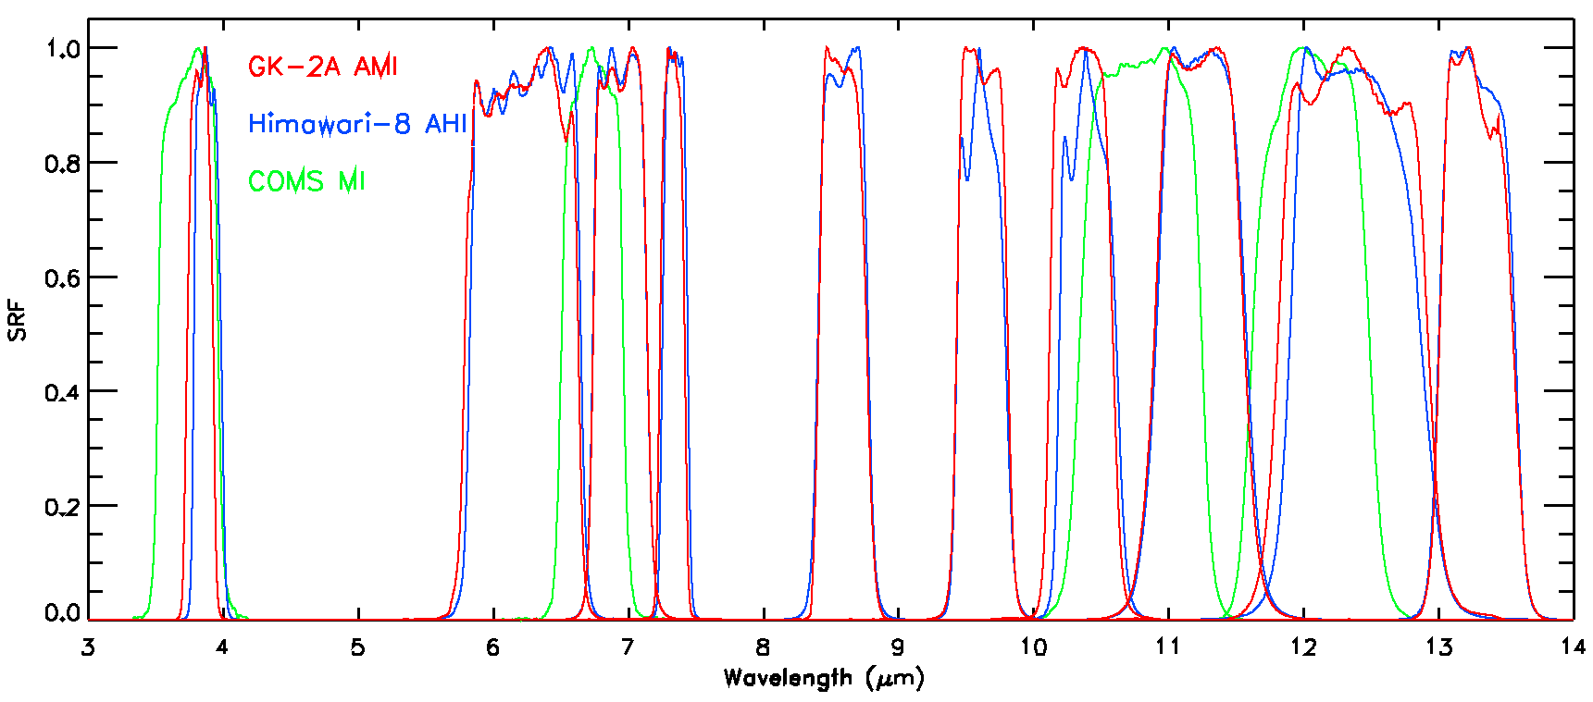
GK-2A AMI SRF

Slide 25
GK-2A AMI First Image
GK-2A AMI
True Color (RGB) image
(2019. 1. 26 03:10 UTC)

Slide 26
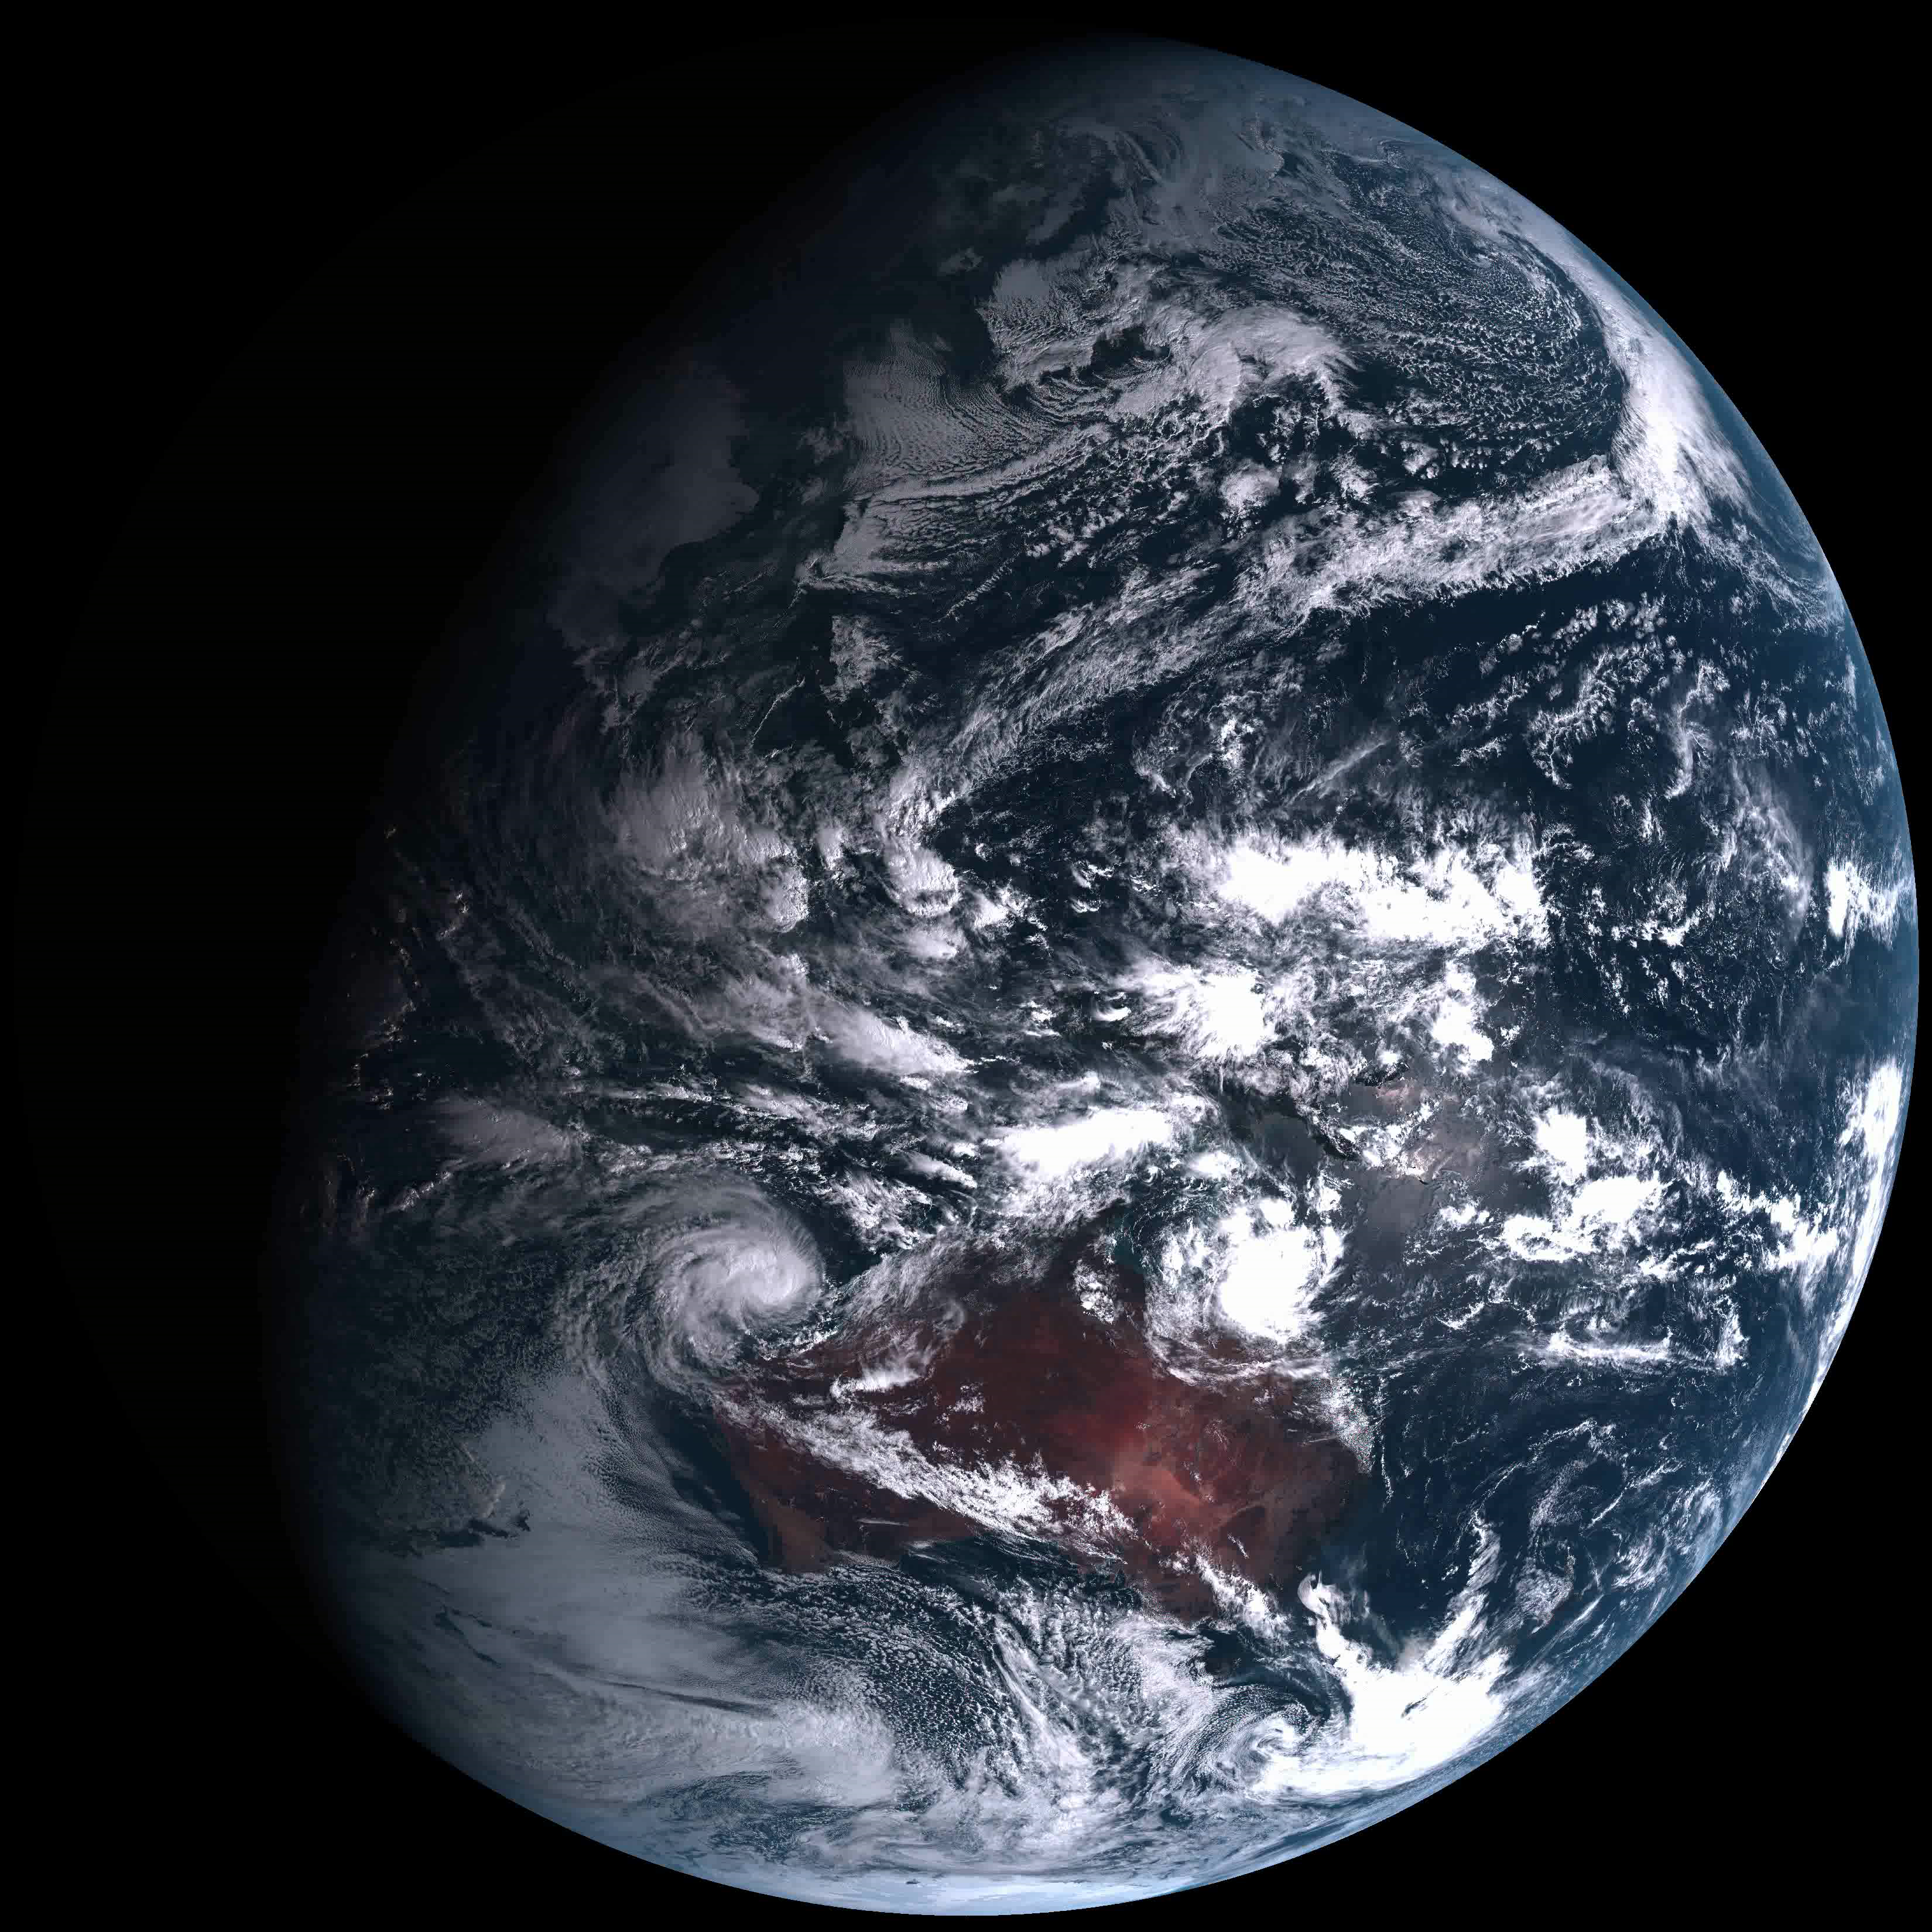

Slide 27
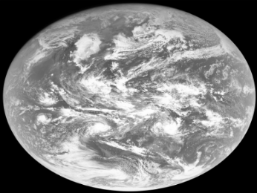
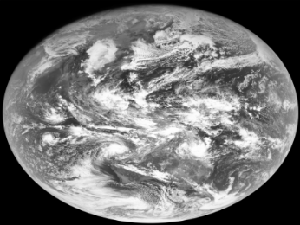
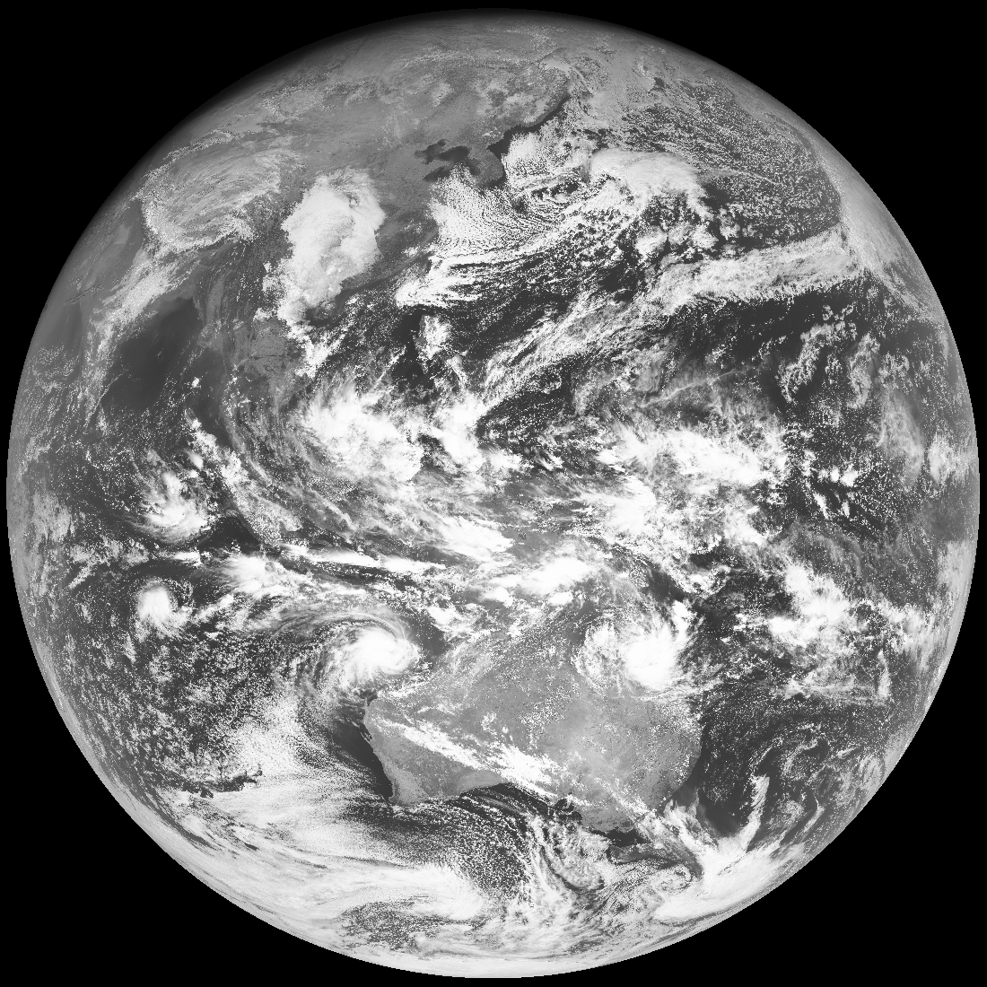
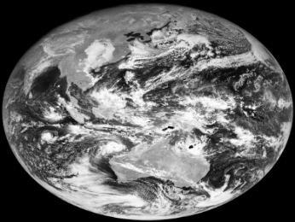
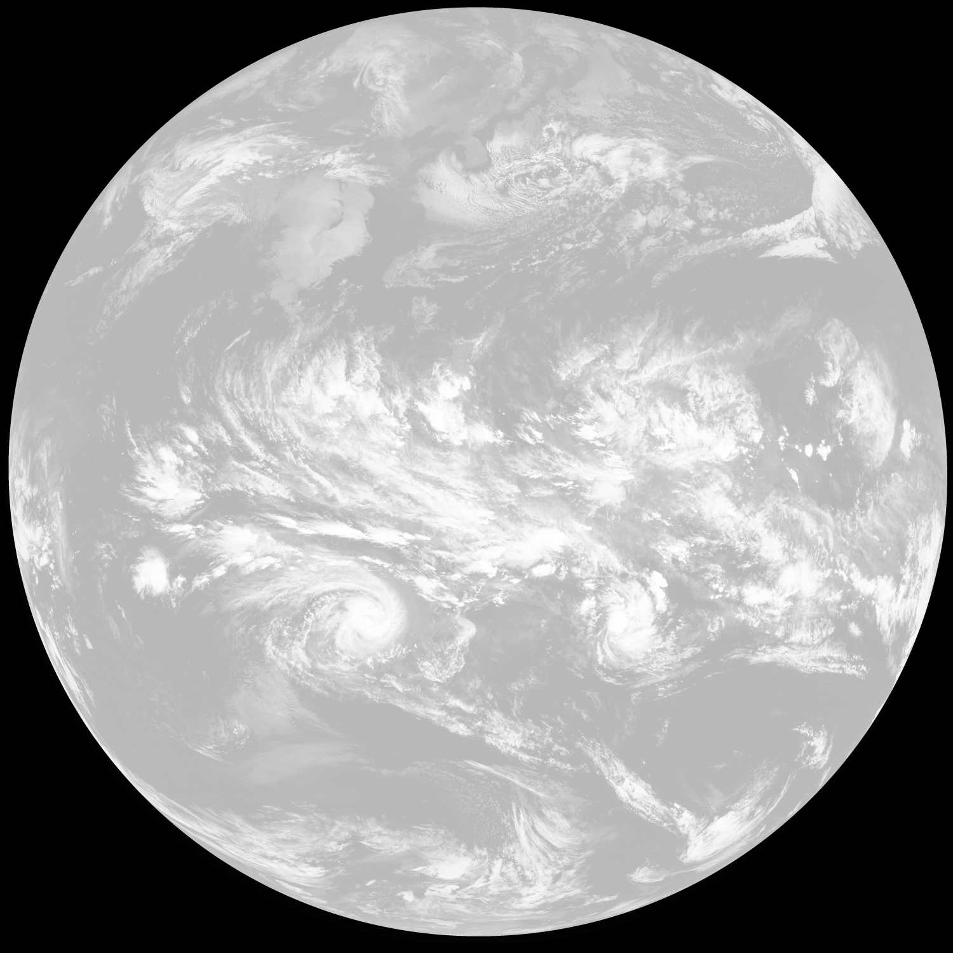
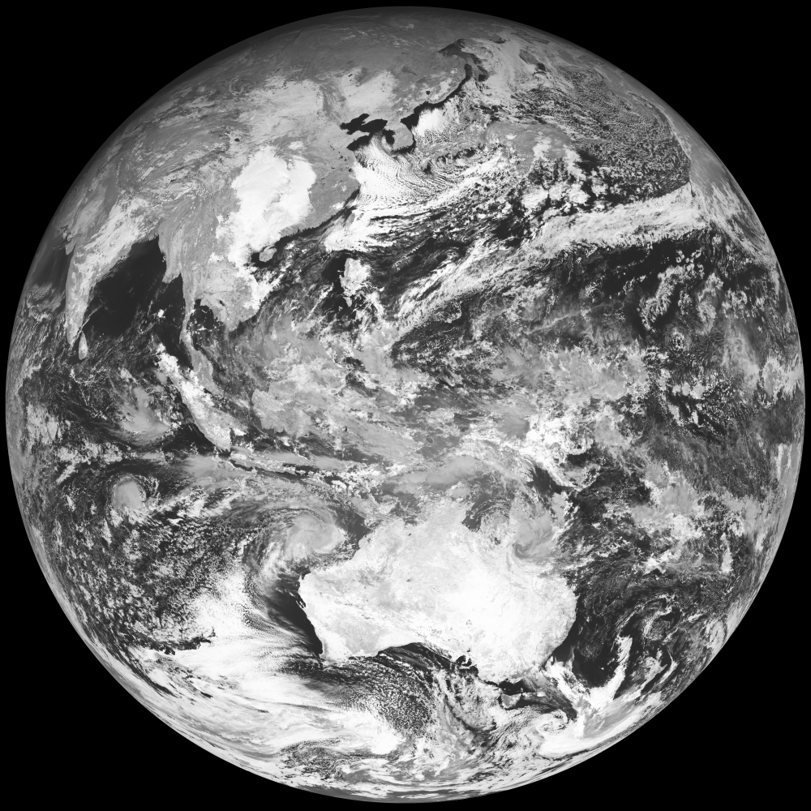
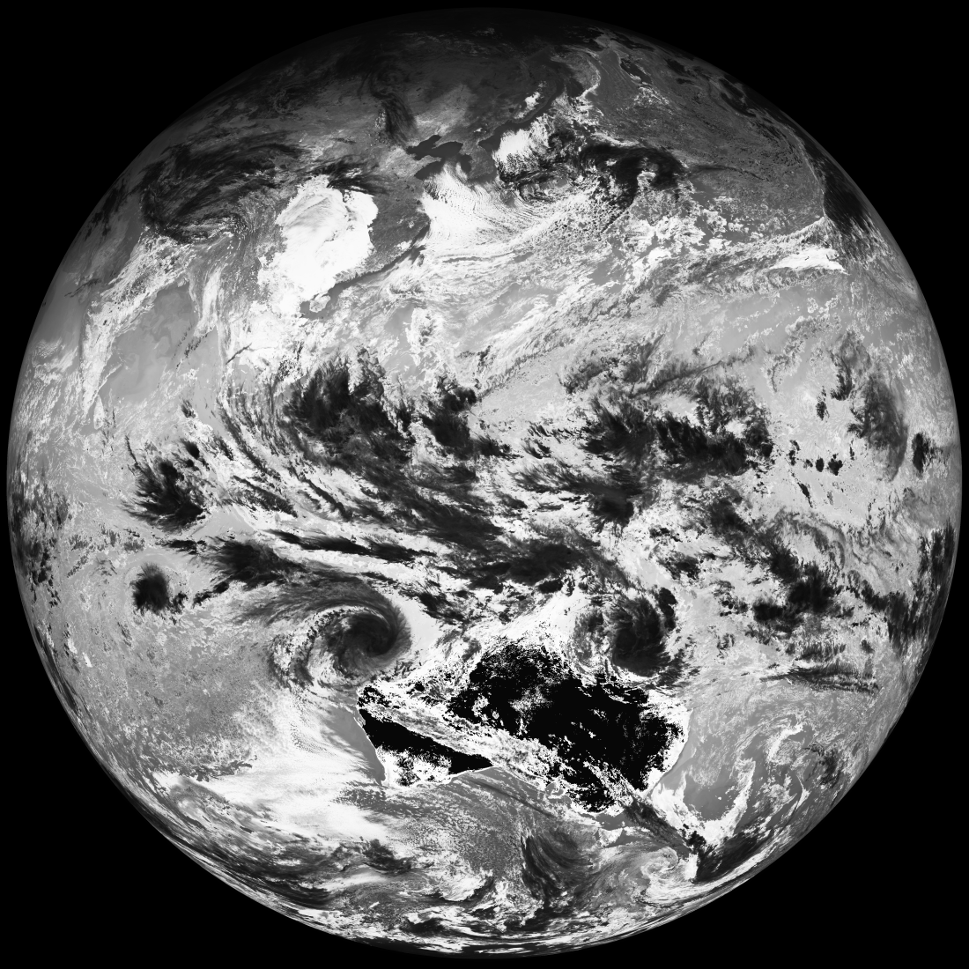
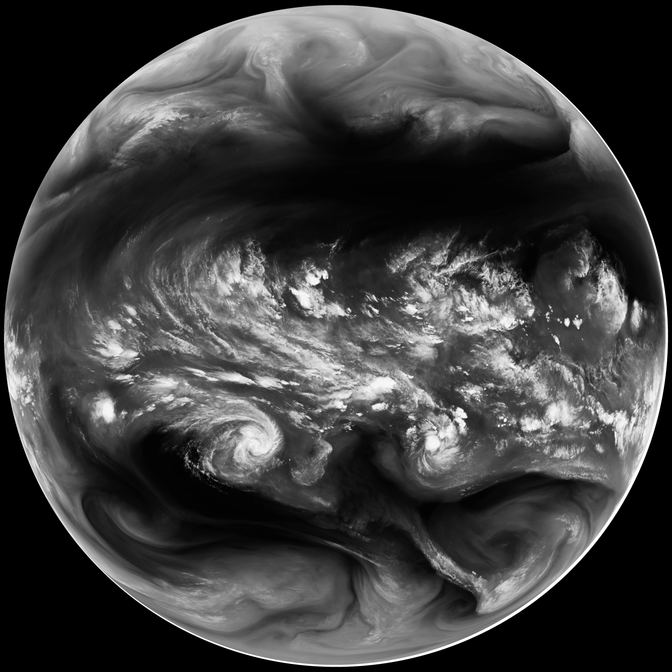
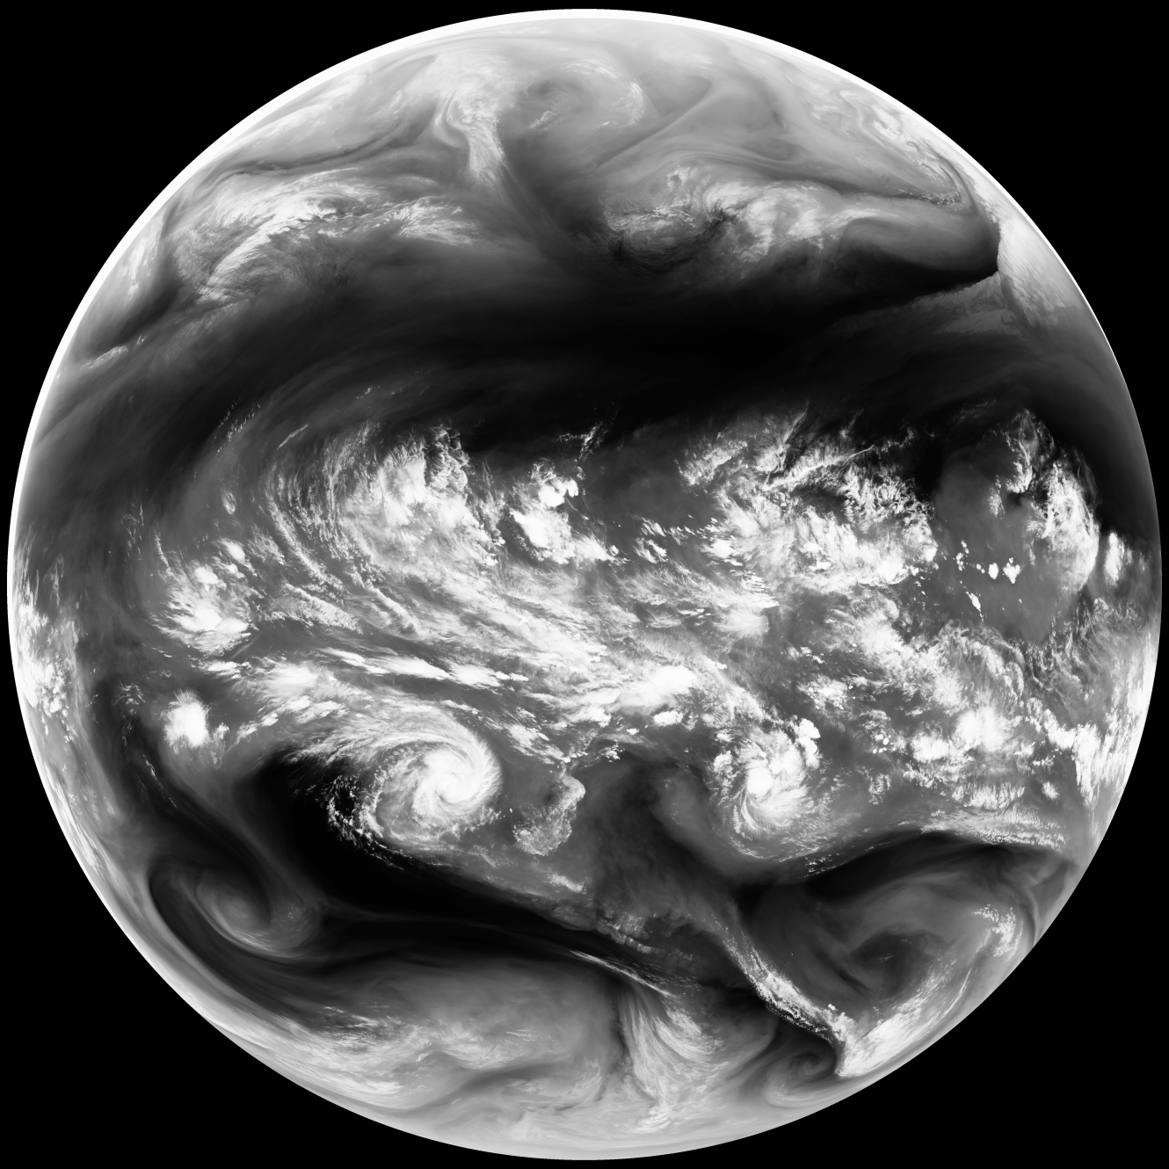
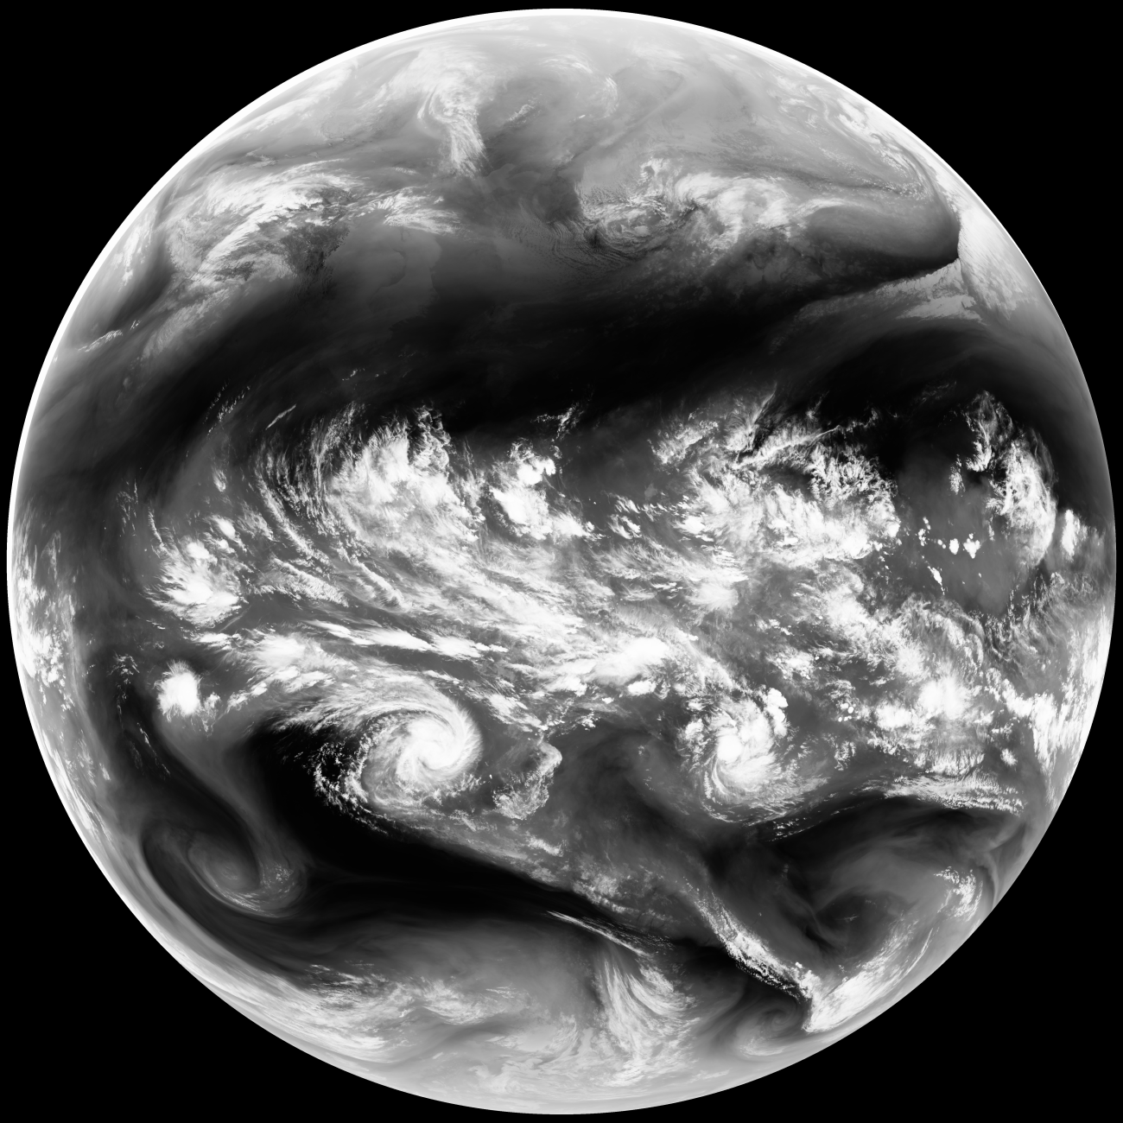
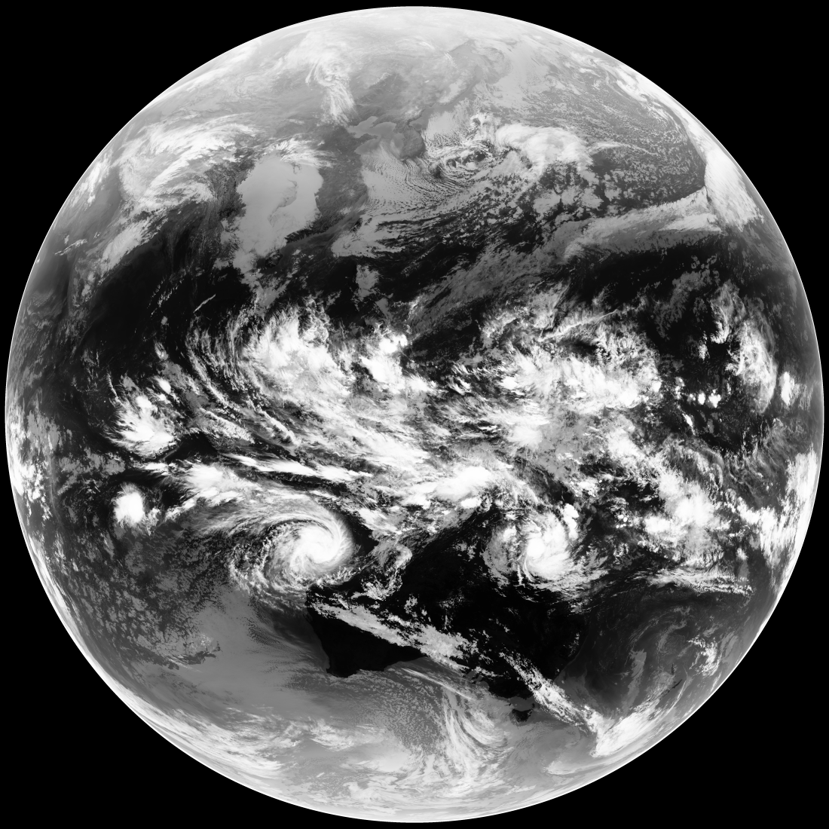
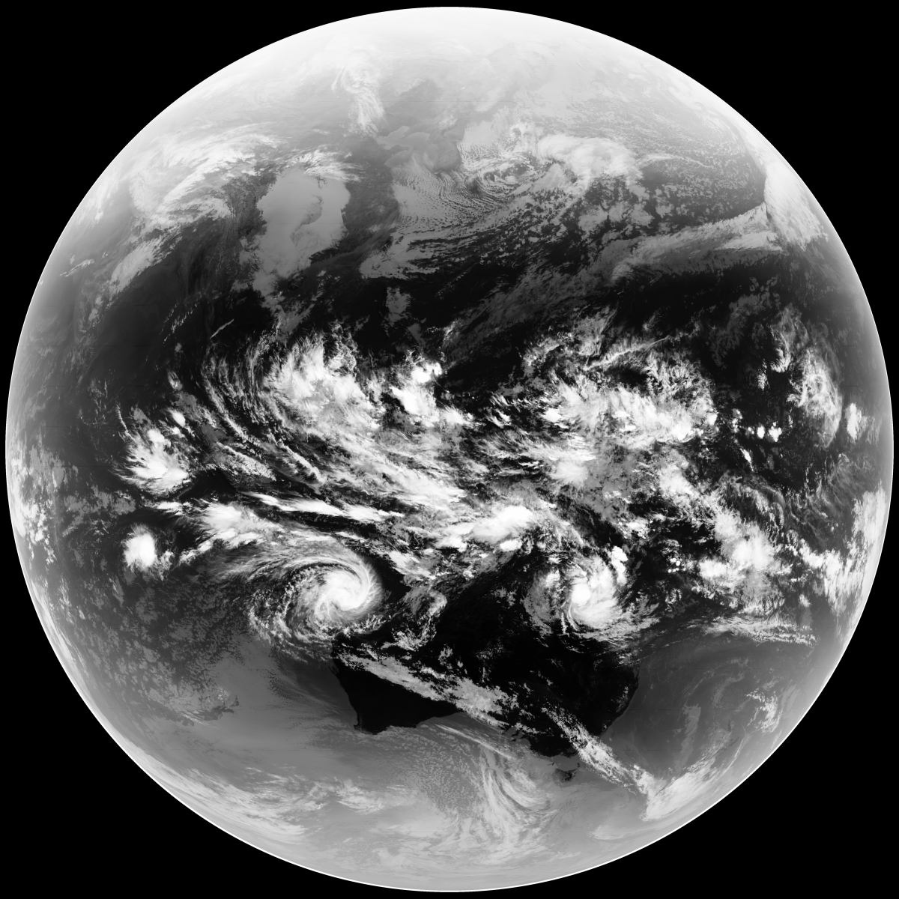
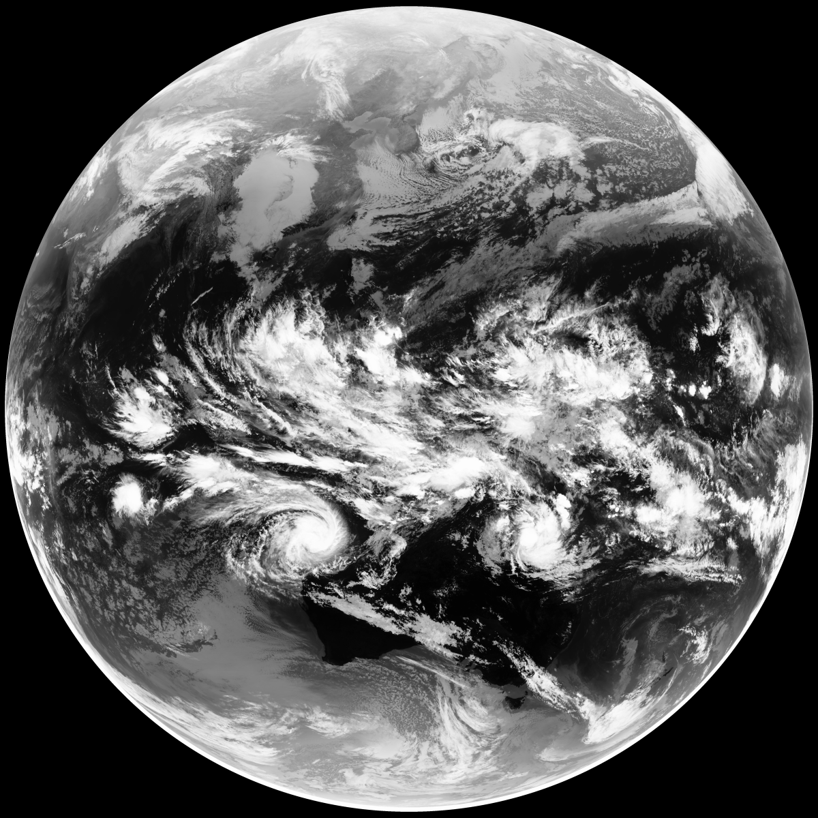
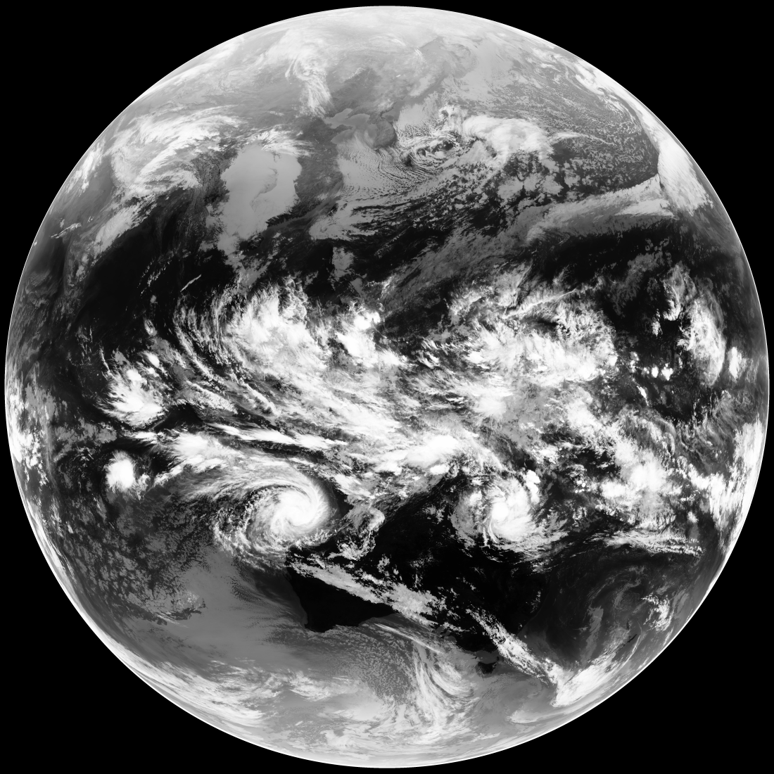
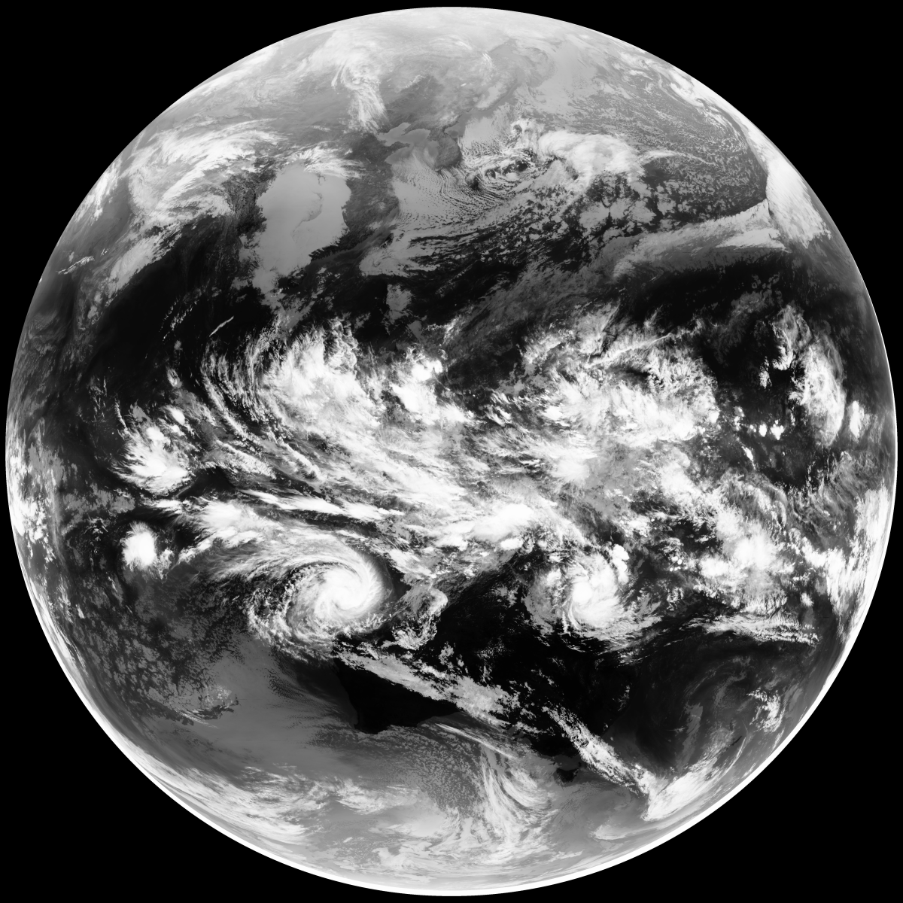
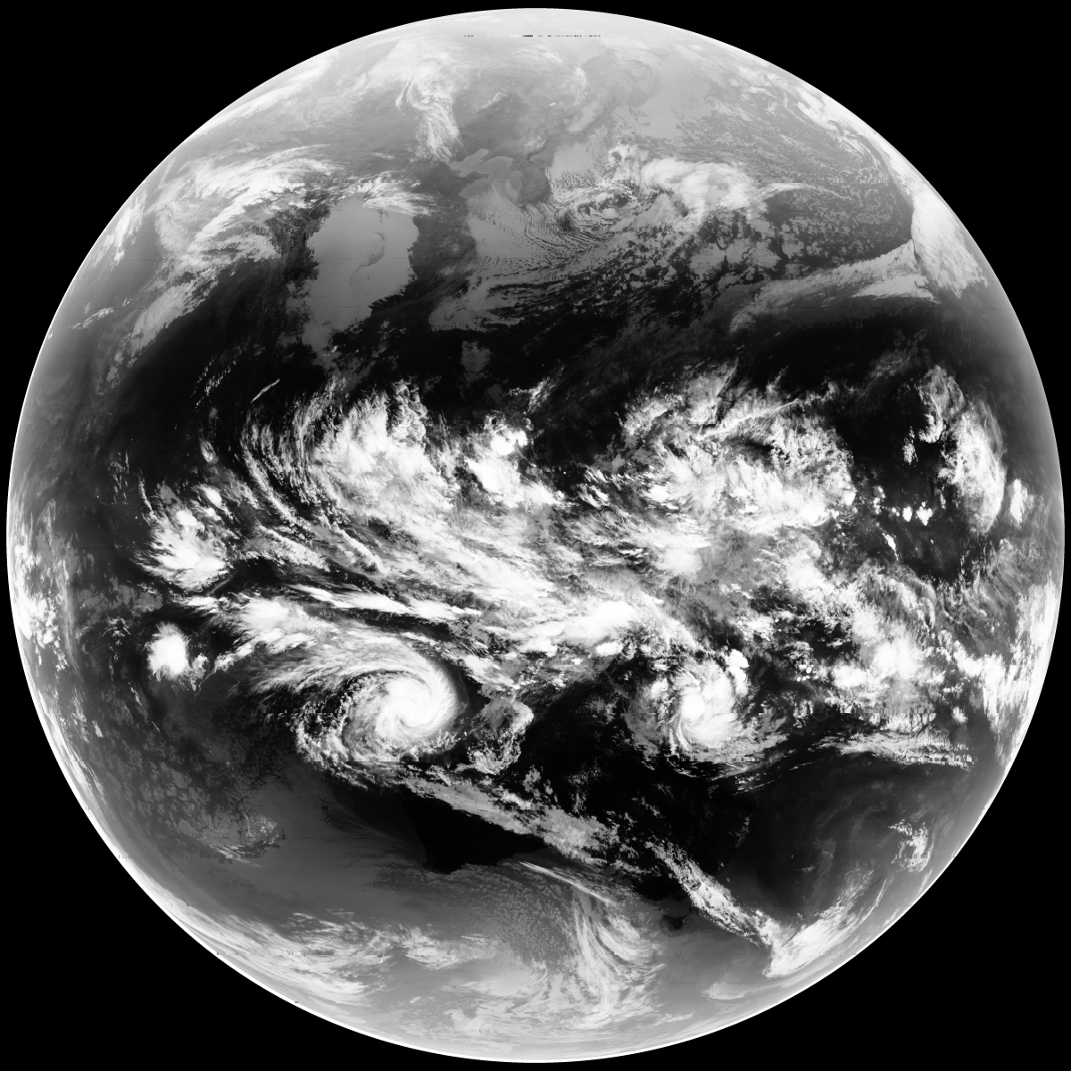
GK-2A AMI First Images
VIS 0.4
VIS 0.5
VIS 0.6
VIS 0.8
(26 Jan. 2019 03:10 UTC)
NIR 1.3
NIR 1.6
SWIR 3.8
WV 6.3
WV 6.9
WV 7.3
IR 8.7
IR 9.6
IR 10.4
IR 11.2
IR 12.3
IR 13.3

Slide 28
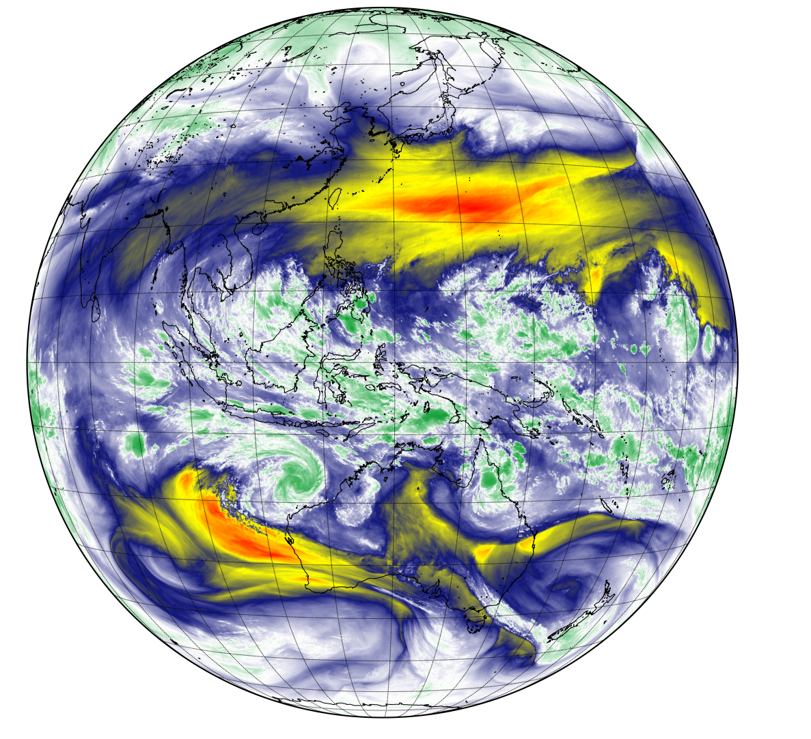
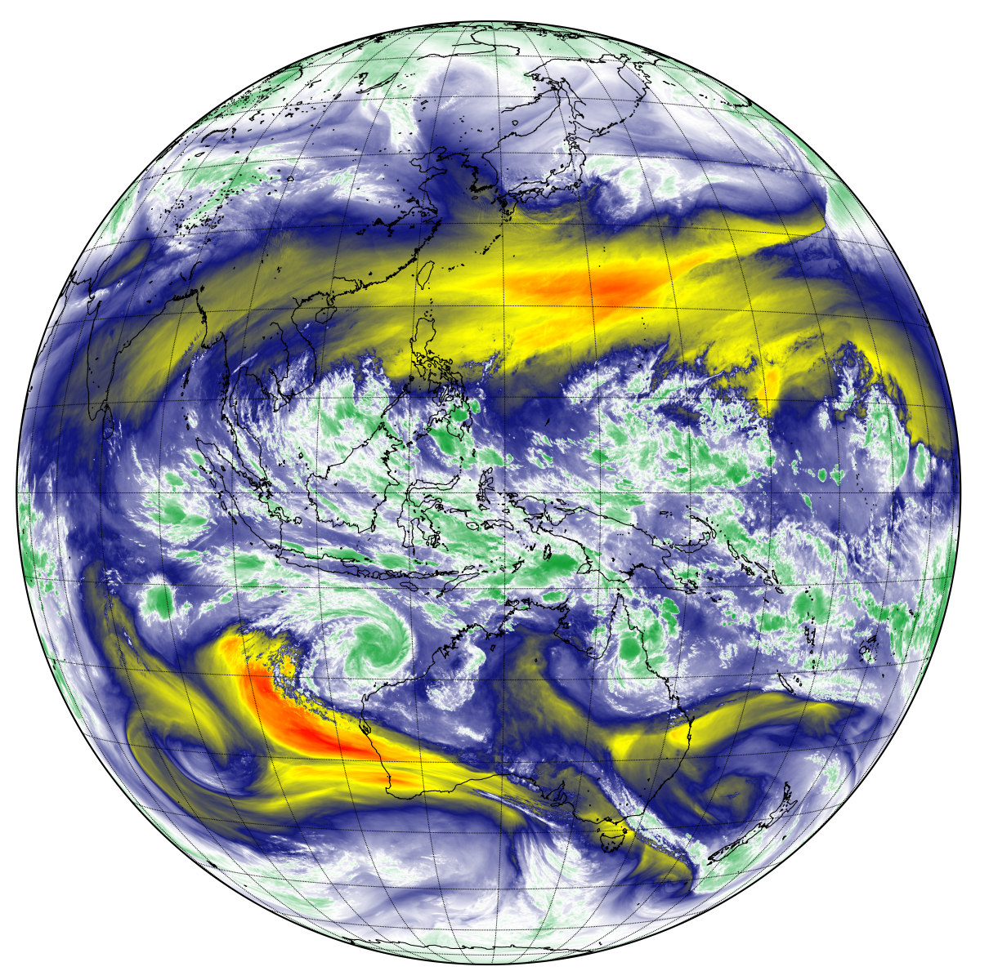
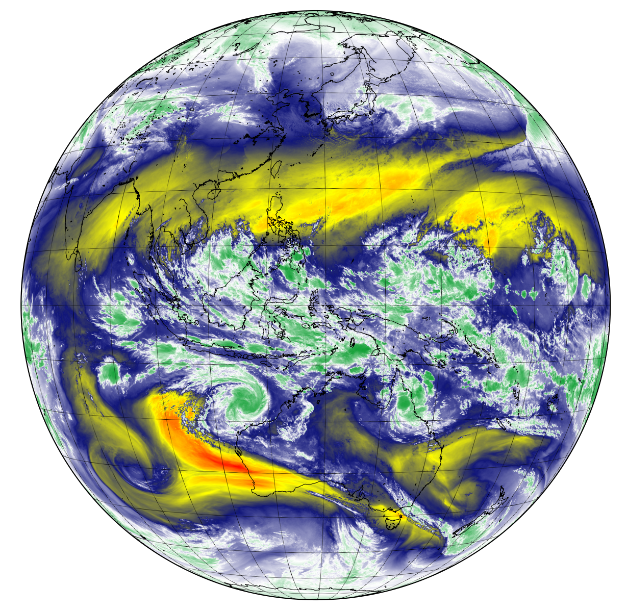
GK-2A AMI WV channels
WV 6.3
WV 6.9
WV 7.3

Slide 29
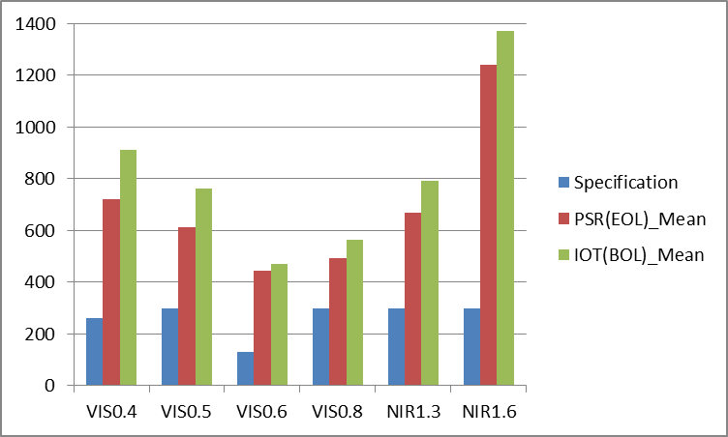

AMI IOT Results - SNR
  SNR @ 100% albedo
AMI Side 1
AMI Side 2
Preliminary results

Slide 30
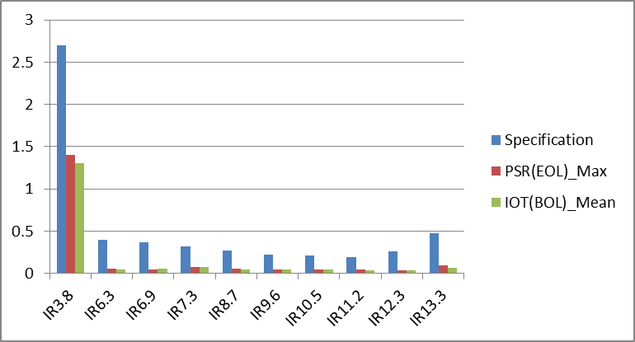
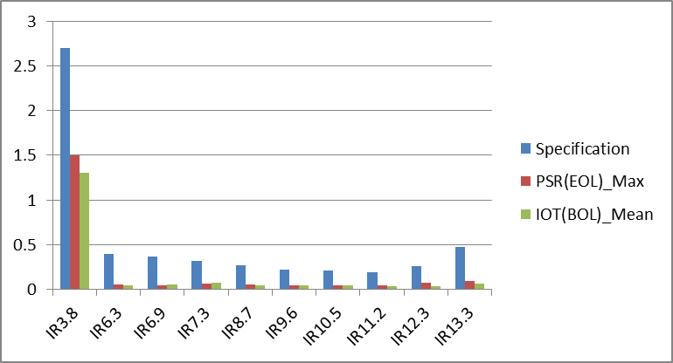
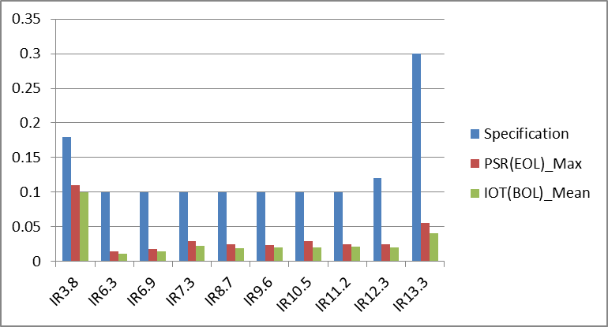
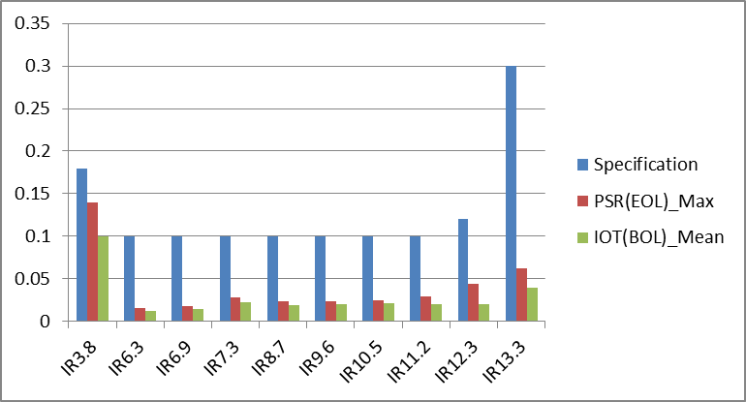
AMI IOT Results - NEdT
AMI Side 1
AMI Side 2
@240K
@240K
@300K
@300K
Preliminary results

Slide 31
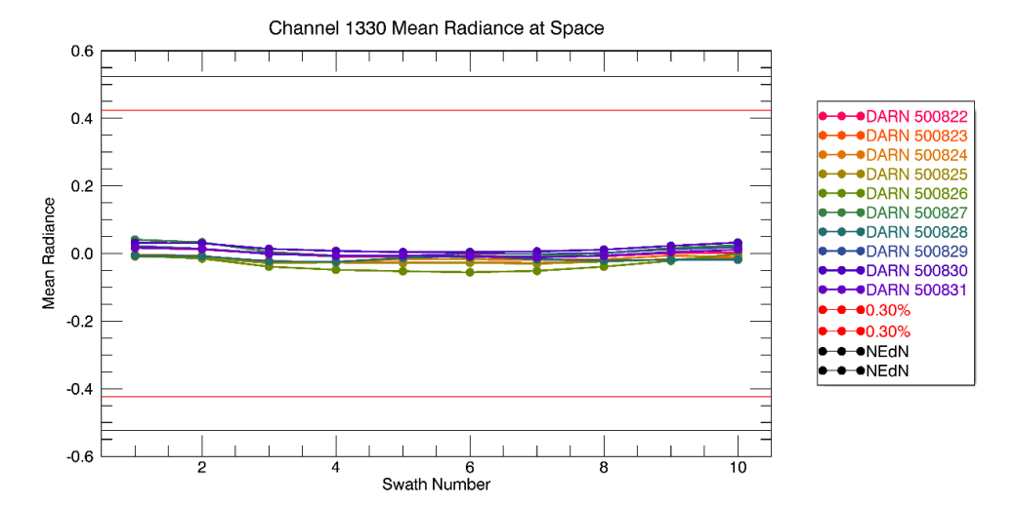
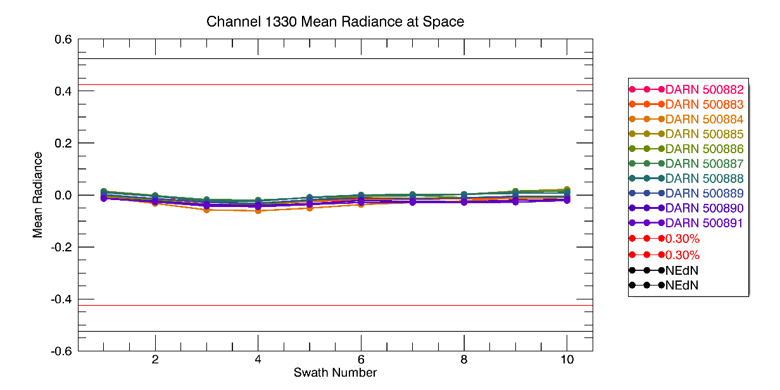
AMI IOT Results – SME coeff.
  Update Scan Mirror Emissivity Coefficients - IR 13.3
Residual using updated SME coefficients
side2
side1
Residual using pre-launch SME Coeff. - side2
DARN = Data Analysis Run Number (simply a way Harris uses to track analysis results)
NEdN = noise-equivalent delta radiance (sometimes called NEdL)
Preliminary results

Slide 32
AMI INR IOT Plan
Perform AMI INR IOT (25 February ~ mid. of June 2019)
25 February ~ end of April (60 days) | INR characterization and trending Star observability and image processing characterization Star-based navigation filter characterization LMK processing and LMK-based navigation filter characterization Re-sampler characterization INR performance evaluation Run Timeline ID #1 or ID #18 (with lunar observation)
May ~ June (50 days) | INR characterization and trending INR characterization
 | Performance Verification Solar calibration interval determination IR radiometric performance evaluation Long term trending analysis and Anomaly resolution
 | Final Pre-Operational Updates Perform scanner calibration at end of IOT Solar calibration

Slide 33
GK-2A AMI GSICS plans
  Radiometric calibration/comparison of COMS/MI and GK-2A/AMI
GK-2A/AMI (2019-2029)
Central Wavelength [µm] | Solar Diffuser | Black Body | GSICS (IR) | GSICS (DCC) | GSICS (Moon) | Vicarious method (RTM) | Ray matching | GEO-GEO
0.47 | Y |  |  | Y | Y | Y | Y | (Y)
0.51 | Y |  |  | Y | Y | Y | Y | (Y)
0.64 | Y |  |  | Y | Y | Y | Y | Y
0.86 | Y |  |  | Y | Y | Y | Y | (Y)
1.3 | Y |  |  | Y | Y | Y | Y | (Y)
1.6 | Y |  |  | Y | Y | Y | Y | (Y)
3.8 |  | Y | Y |  |  |  | (Y) | Y
6.2 |  | Y | Y |  |  |  | (Y) | Y
6.9 |  | Y | Y |  |  |  | (Y) | (Y)
7.3 |  | Y | Y |  |  |  | (Y) | (Y)
8.7 |  | Y | Y |  |  |  | (Y) | (Y)
9.6 |  | Y | Y |  |  |  | (Y) | (Y)
10.4 |  | Y | Y |  |  |  | (Y) | Y
11.2 |  | Y | Y |  |  |  | (Y) | Y
12.3 |  | Y | Y |  |  |  | (Y) | Y
13.3 |  | Y | Y |  |  |  | (Y) | (Y)
COMS/MI (2010-2020)
Central Wavelen. [µm] | Albedo monitor | Black Body | GSICS (IR) | GSICS (DCC) | GSICS (Moon) | Vicarious method (RTM) | Ray matching | GEO-GEO
0.68 | (Y) |  |  | Y | Y | Y | Y | Y
3.8 |  | Y | Y |  |  |  | (Y) | Y
6.8 |  | Y | Y |  |  |  | (Y) | Y
10.8 |  | Y | Y |  |  |  | (Y) | Y
12.0 |  | Y | Y |  |  |  | (Y) | Y
Onboard calibration
Inter-calibration/comparison, vicarious calibration
(Y): applicable, but not planned yet

Slide 34
AMI IOT Primary Results
  The AMI thermal system is executing well on both sides
    Both Loop Heat Pipes starting on the first attempt
    Flow through all 5 legs demonstrated
    The loops are sharing the load
    The Cryocoolers are both able to effectively cool the detectors to the desired Focal Plane Module temperatures throughout the day while still remaining in control with significant capability margin.
  The Optical Port Cover successfully deployed
  Timelines were successfully executed, and first images generated for public release
  IR Calibration shows consistent repeatability and performance
  Solar Calibration shows day to day repeatability
  Scan Mirror Emissivity tests were able to generate refined Scan Mirror Coefficients
  Best Detector Select (BDS) collects were successfully performed and new BDS maps generated and uploaded for AMI side 2.
  SNR and NEdT results show significant margin against requirements

Slide 35
Thank you
for your attention

Slide 36
AMI IOT Primary Results – Side 1
  Successful start of both Loop Heat Pipes on first attempt
    Maintained control at 270K
    60/40 load sharing, all 5 condenser legs show flow
  Successful deployment of Optical Port Cover
    Confirmed by image (VNIR channels)
  Cryocoolers successfully cool detectors
    VNIR – 169.6K, MWIR – 59.5K, LWRI – 59.6K
    Final stabilized condition
      67% drive level
      77W total compressor power
  Solar Calibration results
    Changed Integration Factor 10 to Integration Factor 9
    No saturation

Slide 37
AMI IOT Primary Results – Side 2
  Both LHPs powered on with first attempt
    Maintained control at 270K
    50/50 load sharing , all 5 condenser legs show flow
  Cryocoolers successfully cool detecotrs
    VNIR – 170.3K, MWIR – 59.3K, LWRI – 59.6K
    Final stabilized condition
      71% drive level
      84W total compressor power
  Collect First light images
  Collect BDS data / Create DBS map upload
  Solar Calibration results
    Integration Factor 10 → 9

Slide 38
AMI Observation Area and Schedule (I)
  1 FD + 5 ELA + 5 LA : 10 min (Timeline ID #1)
  Full Disk (FD)
  Extended Local Area (ELA) : 3800 km X 2400 km (EW X NS)
  Local Area (LA) 1000 km X 1000 km (target observation)

Slide 39
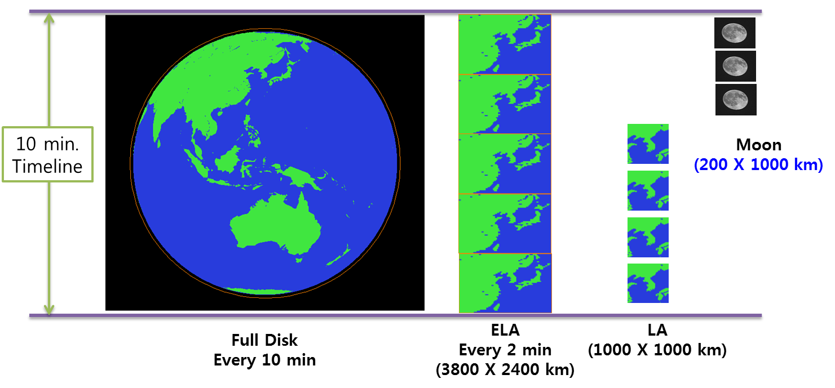
AMI Observation Area and Schedule (II)
  1 FD + 5 ELA + 4 LA + 3 Moon : 10 min (Timeline ID #18)
  3 moon observations using 1 LA (3 swaths)

Slide 40
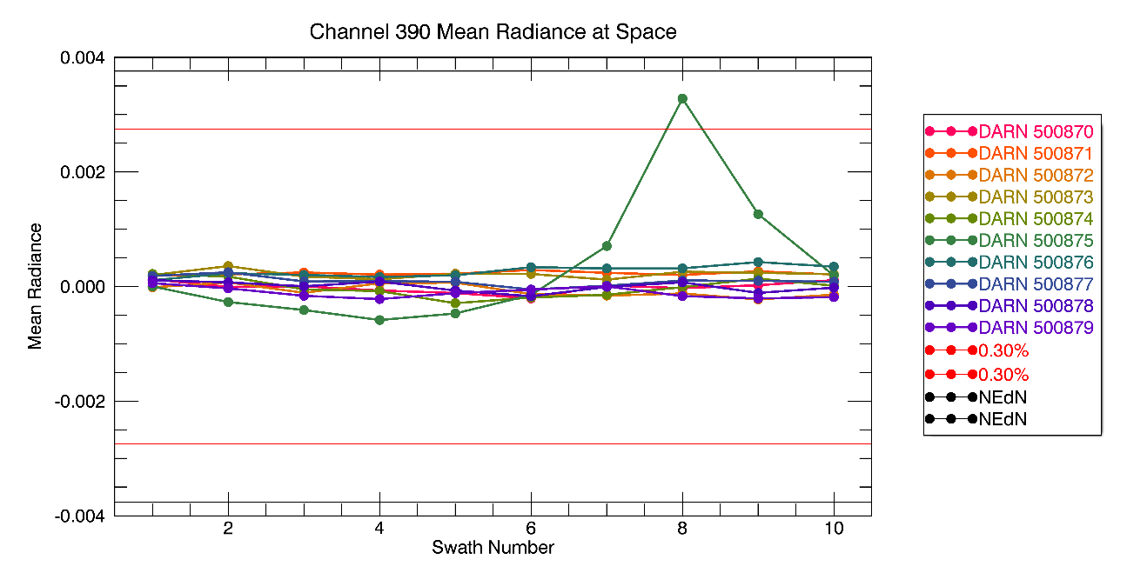
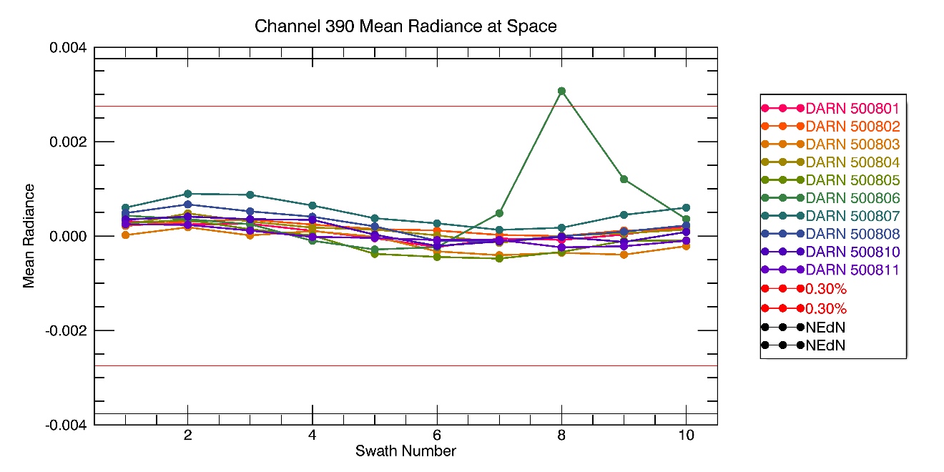
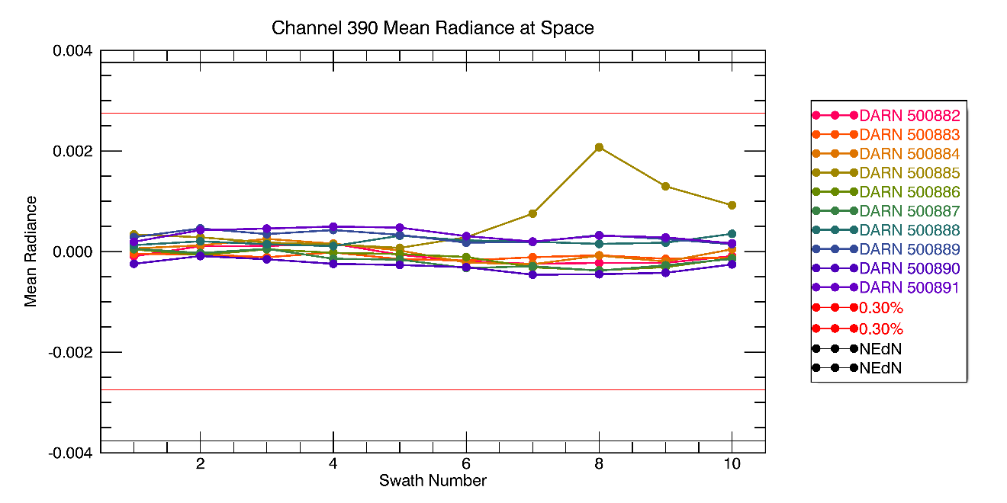
AMI IOT Results – SME
  Update Scan Mirror Emissivity Coefficients - IR 3.8
Residual using updated SME coefficients
Residual using pre-launch SME Coeff. - side2
side2
side1
the anomalous plot (red circle) is due to stray light from the sun.
Hence, as was similarly done on the GOES instruments, that collection was not used in the optimization nor in assessing the goodness of the updated coefficients.
DARN = Data Analysis Run Number (simply a way Harris uses to track analysis results)
NEdN = noise-equivalent delta radiance (sometimes called NEdL)

Slide 41
GK-2A AMI SRF

Slide 42
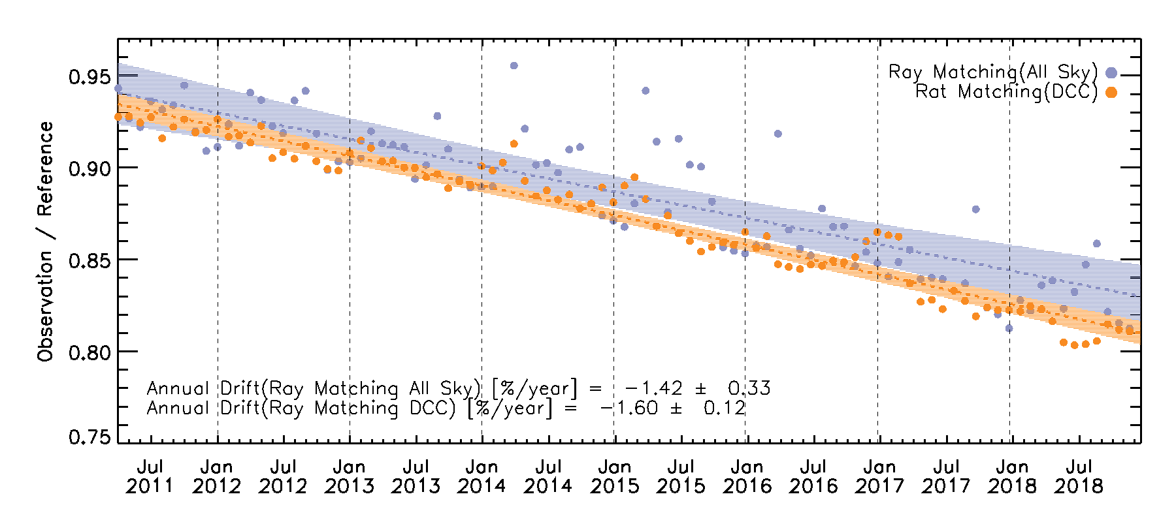
Two types of ray matching methods
Method | Thresholds
Ray Matching (DCC) | 0.1°ⅹ0.1° Grid (Lat/Lon) SZA < 40°, VZA < 40° IR_TB ≤ 205°K Homogeneity checks - Bin Spatial homogeneity < 90% (90#/110#) - STDV(IR_TB) ≤ 1°K - STDV(VIS_Rad)/Mean(VIS_Rad) ≤ 0.03%
Ray Matching (All Sky) | 0.1°ⅹ0.1° Grid (Lat/Lon) SZA < 40°, VZA < 40° SZA Diff. < 5° VZA Diff. < 10° VAA Diff. < 10° Bin Spatial homogeneity < 90% (90#/110#)
DCC ray matching method have high annual drift values compare with other methods.
  All Sky Ray Matching method have similar annual draft. But uncertainty is higher than other methods.
*Shading area: 3 sigma values
Annual Drift(Ray Matching_All Sky)
Annual Drift(Ray Matching_DCC)
= -1.42 ±0.33 [%/year]
= -1.60 ±0.12 [%/year]

