Slide 1
NIST Agency Report
2019
NIST Sensor Science Division Staff Involved in topics related to environmental satellite cal/val:
David Allen
Brian Alberding
Steven W. Brown
Tom Germer
Steven Grantham
B. Carol Johnson
Thomas Lucatorto
Stephen Maxwell
Joe Rice
Ping-Shine Shaw
Eric Shirley
Charles Tarrio
John Woodward IV
Yuqin Zong

Slide 2
Agency’s GSICS Activities, Action & Achievements Summary
  Lunar calibration
    Stephen Maxwell, John Woodward IV, Steven W. Brown
  Stellar calibration
    John Woodward IV, Joe Rice
  Continued support of water-leaving radiance cal/val at the MOBY site, for NOAA VIIRS, and other ocean-color related activities
    B. Carol Johnson, Thomas Larason, Heather Patrick
  Radiometric indications of vegetation activity
    David W. Allen, the NIST Special Programs Office, Taylor Jones @ Harvard
  Support of calibration of Orbiting Carbon Observatory #3 (OCO-3)
    Stephen Maxwell, Carol Johnson
  Innovation in lamp-plaque radiance responsivity calibration modeling, including lamp angular nonuniformity and plaque radiance nonuniformity
    Eric Shirley, Carol Johnson, Yuqin Zong, Thomas Germer, David Allen, et al.

Slide 3
Agency’s GSICS Activities, Action & Achievements Summary
  Cal/val and consultative support for the NASA GSFC GLAMR facility (similar to NIST’s SIRCUS) and the OCI Project
    Joe Rice, Steve Brown, John Woodward IV, Carol Johnson, Ping-Shine Shaw, Brian Alberding
  Support of EXIS (GOES) and Solar Dynamic Observatory at NIST’s Synchotron Ultraviolet Radiation Facility III – ongoing calibrations for both programs
    Thomas Lucatorto, Charles Tarrio, Mitchell Furst
  Continued support of VIIRS and CriS calibration for ongoing JPSS launches
    Joe Rice, Steven W. Brown
  Consultative support for CLARREO Pathfinder
    Joe Rice et al
  Extensive continual employment of NIST calibration services of many kinds to government and instrument-vendor customers
Notes:
Surf can cover far infrared to soft x-ray

Slide 4
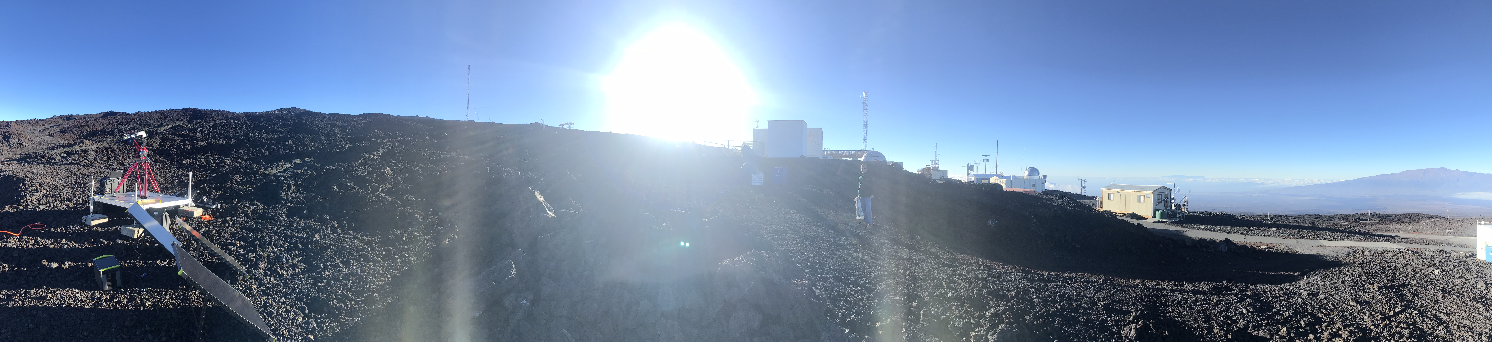
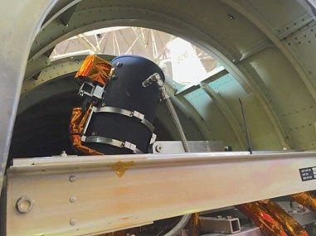
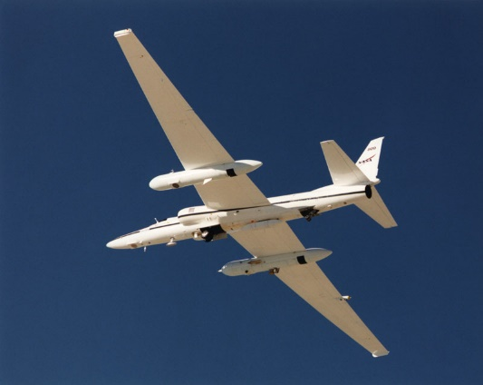
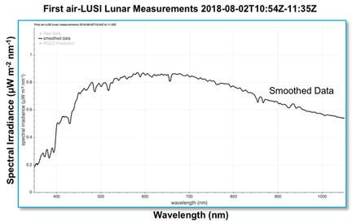
Lunar Calibration
Stephen Maxwell, John Woodward IV, Steven W. Brown
Two current thrusts of NIST effort:
Development and Installation of a NIST-traceable lunar observatory to complement ROLO
Mauna Loa Observatory, 3-5 year trajectory to results
Development of an airborne, high-altitude (~21 km) measurement system: air-LUSI
NASA: Kevin Turpie NIST: John Woodward, Steve Brown, others USGS: Tom Stone U Guelph: Andrew Gadsden

Slide 5
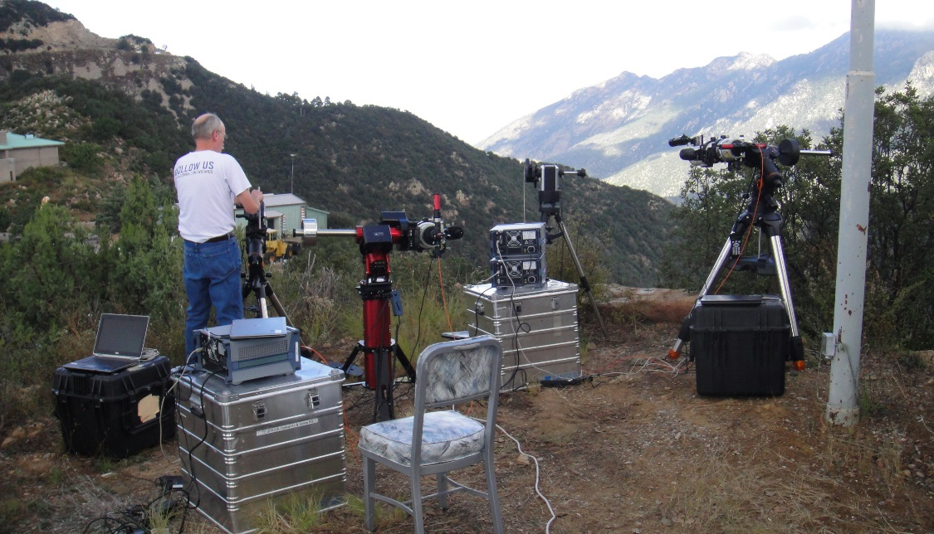
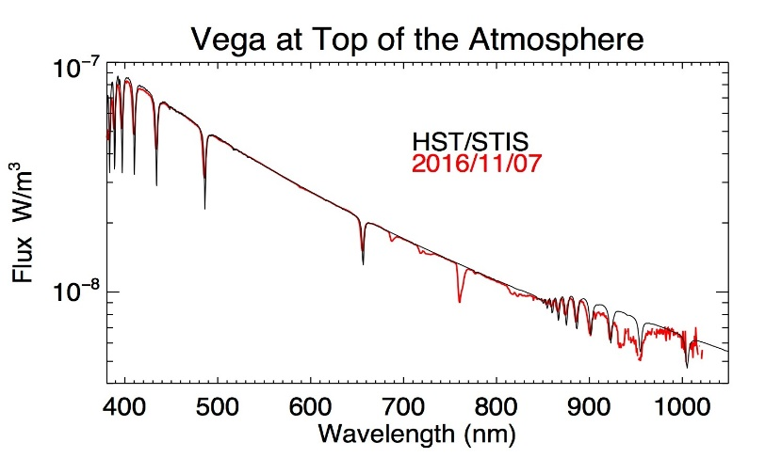
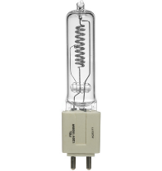
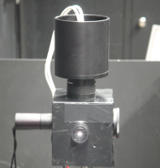

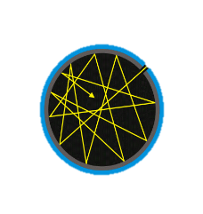
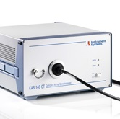
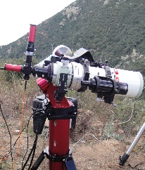
Stellar Calibration (NIST Stars)
John Woodward IV, Joe Rice
    Measurement of spectra of stars for astronomy and for use in EO satellite calibration
    Measurements have been made at Mt. Hopkins (Arizona)
    A long term program at ESO Paranal is now under development.
    NIST: John Woodward and Joe Rice, STScI: Susana Deustua
NIST Stars
Calibration Chain
FEL Lamp Irradiance
Cal Source Irradiance
Stellar Irradiance
SI-traceable, top-of-the-atmosphere, spectral irradiance at the < 1% uncertainty level.
High Temperature Blackbody
Spectrograph Transfer Standard
Telescope System Sensitivity

Slide 6
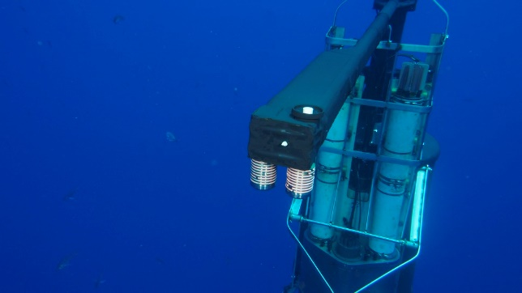
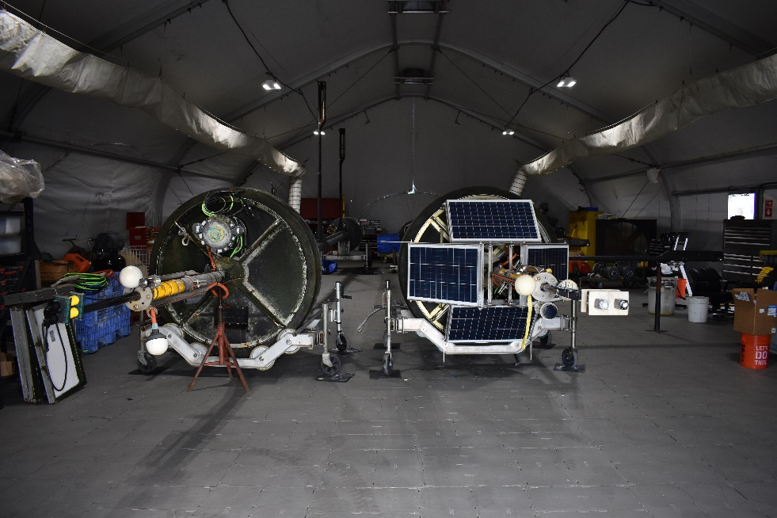
MOBY (ocean color calibration)
B. Carol Johnson,Thomas Larason, Heather Patrick
Work on MOBY-NET
transportable buoys, optical system more easily calibrated
Ongoing support of MOBY
PI: Kenneth Voss, Physics Dept., Univ of Miami
Characterization of BRDF of reference plaques
Publication forthcoming
Notes:
Co-I’s: Carol Johnson (NIST), Mark Yarbrough (MLML), Art Gleason (UM)
Objective: Develop a vicarious calibration instrument which can return MOBY level Lw data from alternate sites and meets the recent IOCCG white paper goals of developing multiple vic/cal sites with:
A) identical instrumentation
B) centrally, and consistently characterized and calibrated
C) consistent and uniform data processing
D) Work with commercial vendors for a path towards additional instruments when required.
Specific Project: Develop a prototype MOBY-NET buoy that has:
A) a buoy hull with the major structure similar to MOBY but can fit in a 40’ container and be able to accept a modular optical system.
B) a modular, stable, optical system allowing installation and removal from buoy hull as one intact piece with appropriate capabilities.
C) A separate stable source and radiometer, transported with the MOBY-NET optical system with sufficient stability to verify system performance pre/post deployment at the chosen remote site.
system would take advantage of the work to update and enhance the current MOBY instrument.

Slide 7
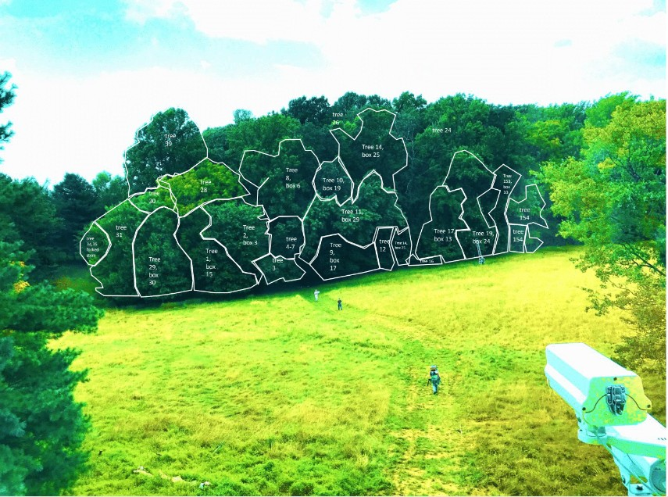
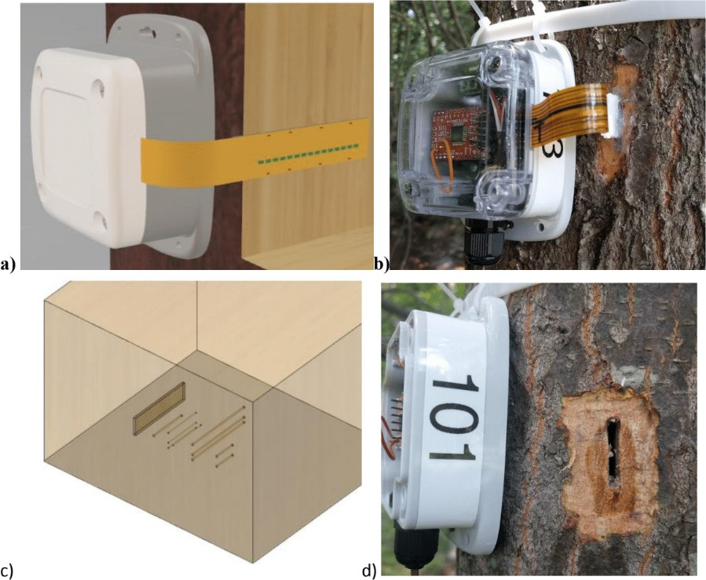
Radiometric indications of
vegetation activity
David Allen
Project to understand how forest fragmentation affects tree behavior.
Combines many types of measurements, including:
hyperspectral imaging
solar-induced fluorescence (SIF)
PAM fluorescence
LiDAR
soil respiration
stem respiration
…
sap flow!
focus on getting very good ground truth

Slide 8
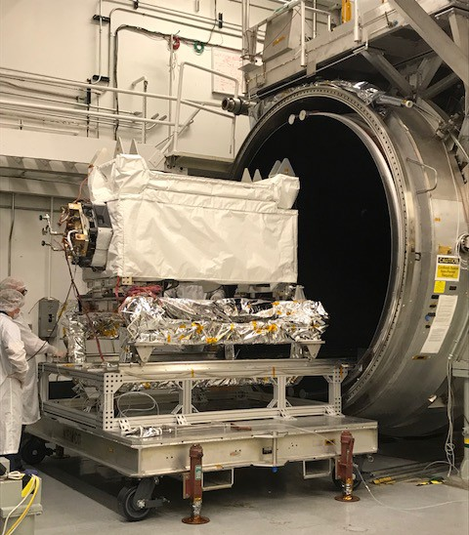
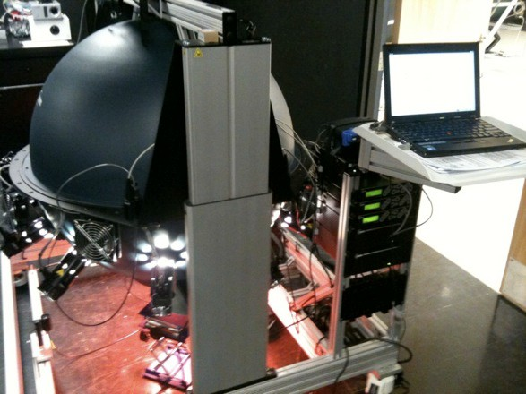
OCO-3 Support
Steve Maxwell, Carol Johnson
Provided radiometric calibration support for pre-launch work
Launch date April 25, 2019

Slide 9
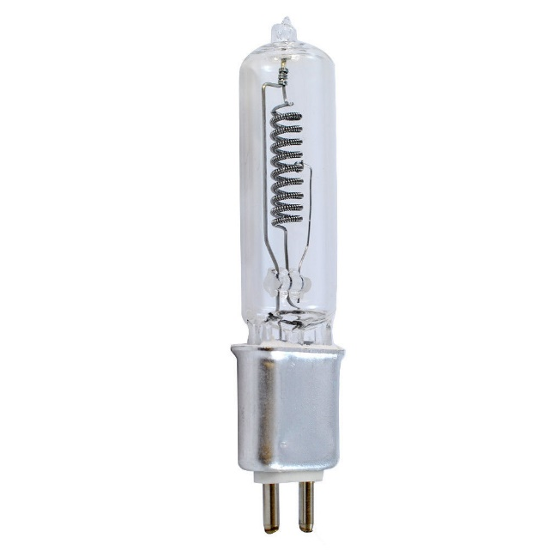
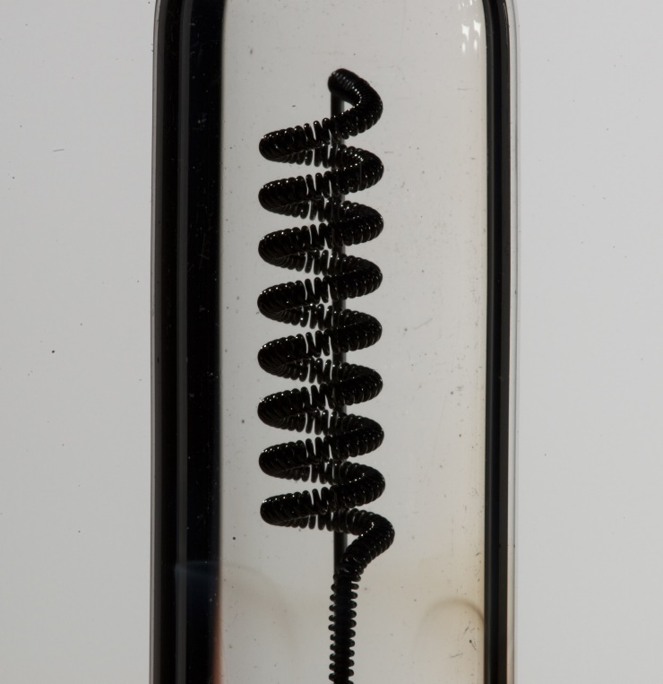
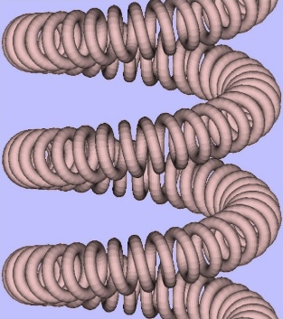
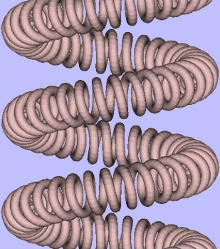
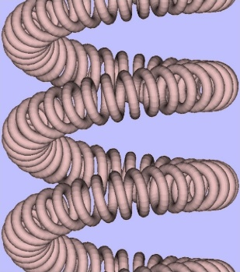
Lamp/plaque modeling
Eric Shirley et al
Detailed understanding of irradiance spatial distribution via modeling the filament

Slide 10
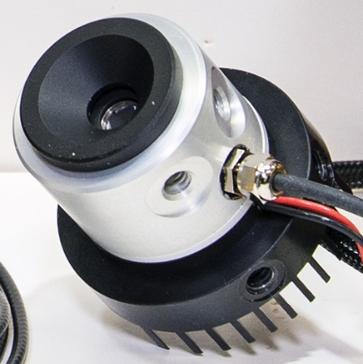
    Support of OCI and NASA GLAMR
    Joe Rice, Steve Brown, John Woodward IV, Carol Johnson, Ping-Shine Shaw, Brian Alberding
Improved accuracy in the SWIR at NIST’s SIRCUS facility
(uncertainty <0.2%)
Pyro
Absolute Irradiance Responsivity Tie Point
Pyroelectric transfer standard
Notes:
Background: The electrical-substitution cryogenic radiometer Primary Optical Watt Radiometer (POWR) calibrates transfer standard trapped silicon photodiodes in underfilled aperture mode to well below 0.05 % standard uncertainty in Vis/NIR. Fitted with a precision aperture and overfilled in SIRCUS, such a trap is used in irradiance mode with standard uncertainty of 0.06 % in the Vis/NIR.
Problem: SIRCUS (NIST) and GLAMR (NASA) applications require overfilled aperture calibrations (irradiance & radiance) in the SWIR having standard uncertainty of 0.2 %. SWIR photodiodes (& trapped SWIR photodiodes) are not of sufficient quality to reach the level of accuracy required.
Solution under Development: A pyroelectric detector (pyro) is used as a spectral transfer standard from Vis/Near to SWIR. The absorptance of the black detector coating, which is proportional to the response of the detector, is equal to 1–reflectance, nearly spectrally flat, and the spectral reflectance can be measured accurately. Absolute irradiance responsivity tie point(s) against the standard POWR-calibrated trapped irradiance photodiode (uncertainty < 0.1 %) in the Vis/NIR at NIST SIRCUS are then used to convert the relative spectral responsivity curve into absolute spectral irradiance responsivity, extending the scale to the SWIR with uncertainty below 0.2 %. Results so far show this is possible.

Slide 11
Introduce/Confirm the Agency’s Personnel supporting GSICS
  Eric Shirley continues to be a POC for NIST-GSICS communications
  Any NIST staff mentioned here can be contacted

