Slide 1
NOAA Agency Report 2019
Xiangqian Wu and Fangfang Yu
With contributions from
Manik Bali, Travor Beck, Changyong Cao, Ralph Ferraro, Larry Flynn, Mitch Goldberg, Flavio Iturbide, Quanhua Liu, Tony Reale, Sirish Uprety, Bomin Sun, Likun Wang, Chengzhi Zou, and many scientists at:
NOAA/NESDIS/STAR

Slide 2
Presentation Overview
Agency’s GSICS Activities, Action & Achievements Summary
Agency’s support to GDWG Activities
Agency’s support to GRWG Activities
Agency’s Instruments Updates & Planned launches – relevant to GSICS
Introduce/Confirm the Agency’s Personnel supporting GSICS
Agency’s GSICS activities to be discussed in this joint meeting

Slide 3
Support to GDWG Activities
Mirroring GSICS Product: All GSICS products currently copied on NOAA servers routinely. Work underway to put it online via ftp (discussion in 9d)
New Action Tracker-> Action Tracking on Cloud (discussion in 9k)
Updates on Action Tracker (Parser for EP Meetings, Activate Link option added, Column Width adjusted to browser)
New GSICS Product Catalog Prototype developed that has capability of Product Monitoring and product Visualization. Click here (discussion in 9i)
Developed Fortran interface for IASI-EPS reader, provided it to GRUAN community.
GOES-13/15 [01/18/2010- 17/12/2017] NOAA now accessible via GSICS Products Catalog (Process underway to make other NOAA products online )

Slide 4
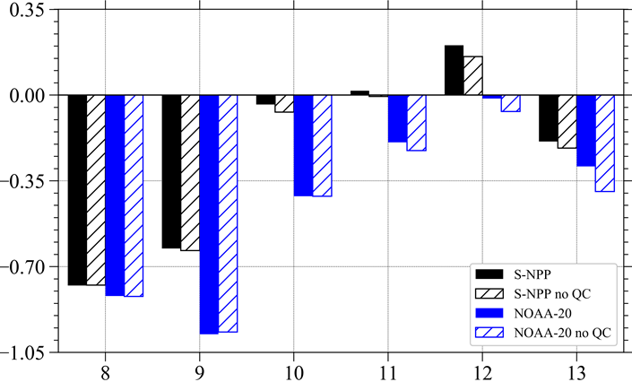
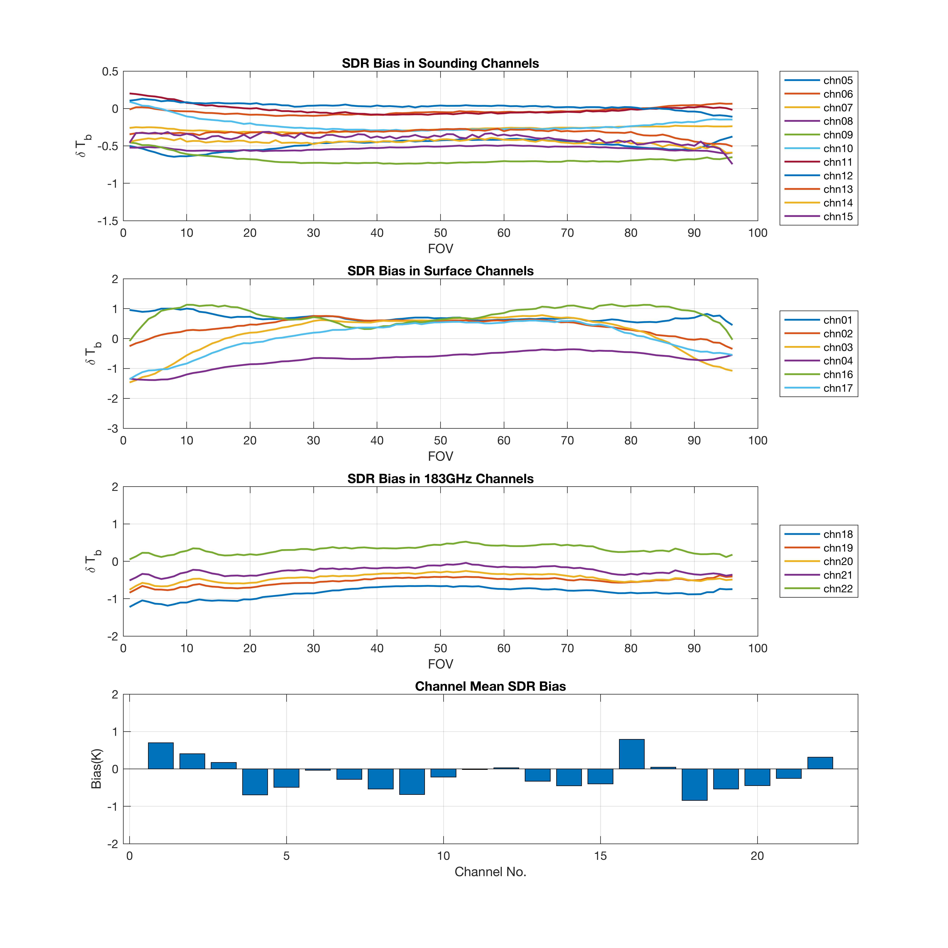
Support to GRWG Activities - MW
ATMS biases compared to GRAS RO
Courtesy X. Zou, Univ. of Maryland
NOAA co-chairs the MW subgroup (R. Ferraro) and has several key members in the group:
M. Bali, C-Z. Zou, T. Reale, M. Liu, H. Meng, B. Ho
Several other affiliates involved
Major activities include:
Extending membership to the group from the international community
MW related articles in the quarterly newsletter
Interacting with other calibration communities: CEOS, GPM, etc.
ATMS calibration
Major achievements in the past year:
Convened four meetings of the MW subgroup
Closing the loop on SNO best practices and MWI LUT’s
NOAA actions include:
RTM intercomparison leveraging GRUAN colocations
Best practices
MW calibration references – GPSRO, AMSU CDR’s
N20 ATMS SDR Biases
Courtesy H. Yang, Univ. of Maryland

Slide 5
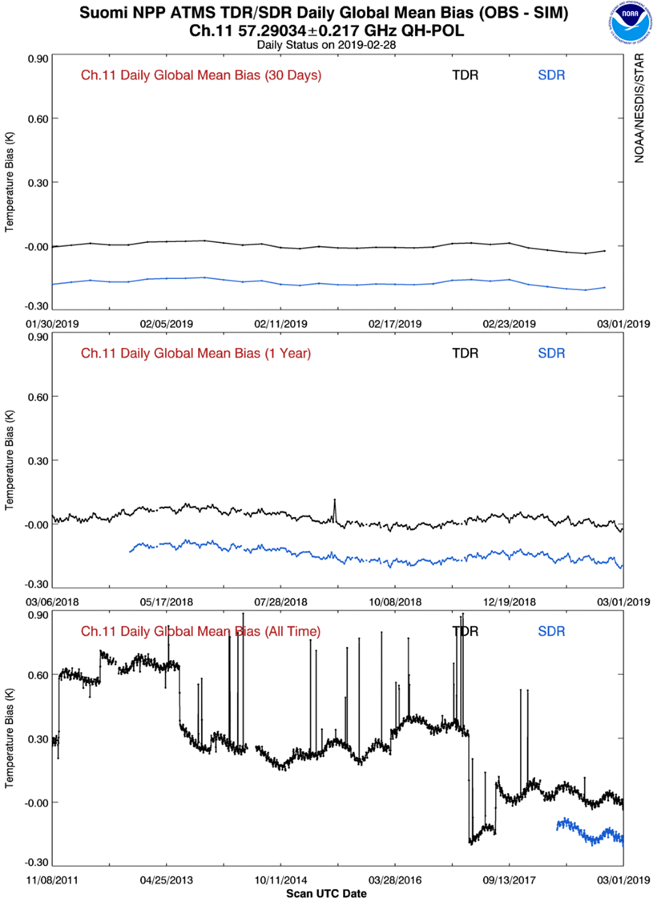
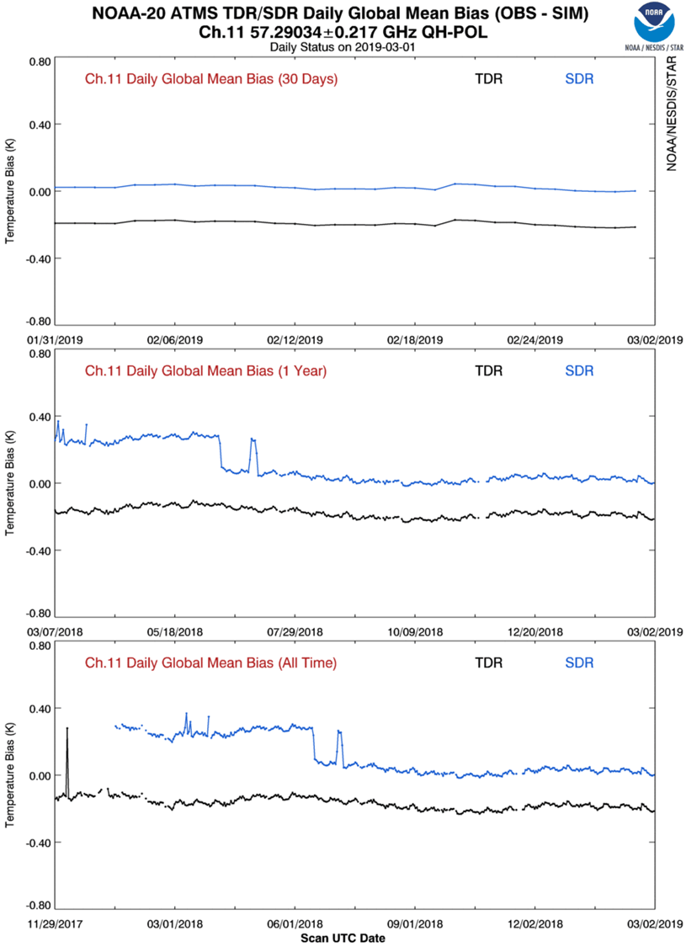
NOAA GPRC – quantifying differences between ATMS and AMSUs
Example of SNPP-NOAA-20 ATMS CH11 difference
TDR Double difference NPP – NOAA-20 ~ 0.20 K
USING ECMWF AS A REFERENCE FOR DOUBLE DIFFERENCE

Slide 6
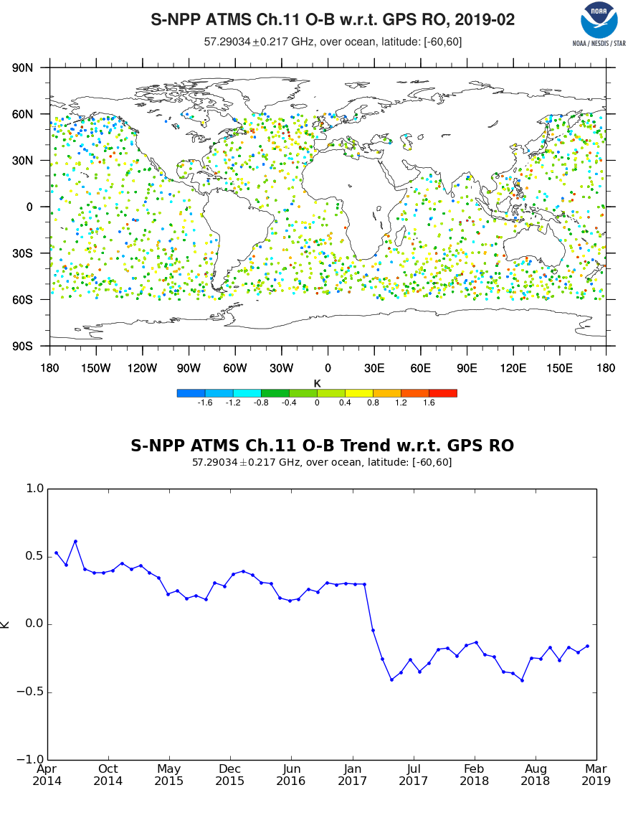
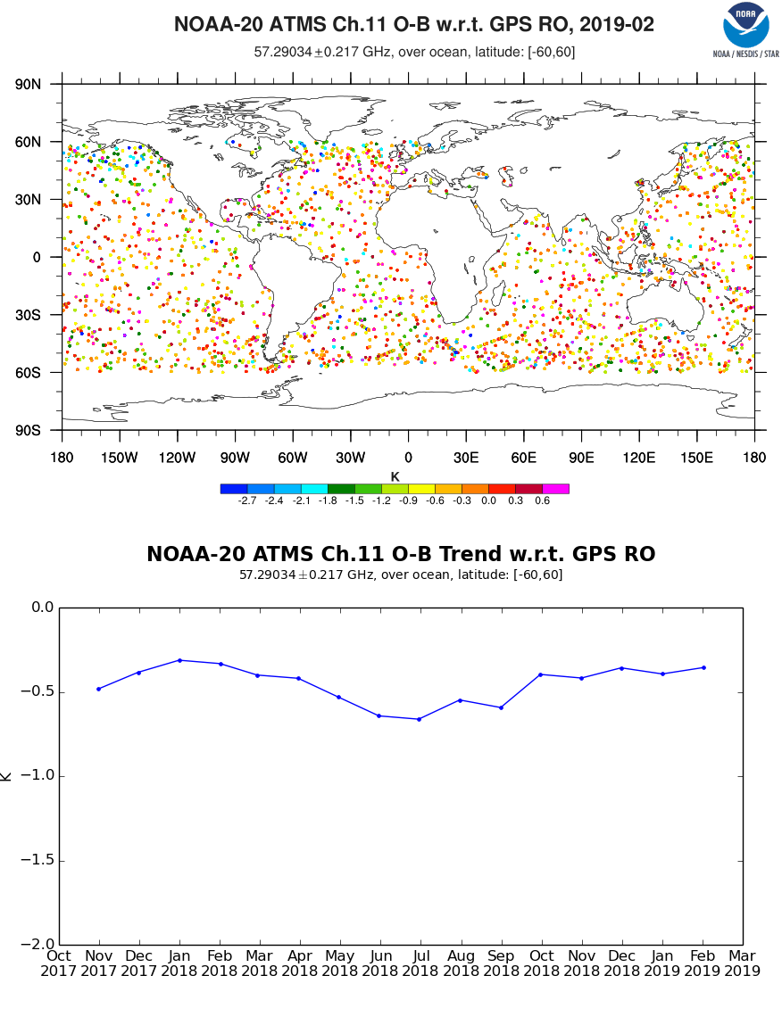
Difference between ECWMF and GPSRO in Double Difference Calculation is ~ 0.05
Using GPSRO - Double difference ~ 0.25
TDRs
~-0.5
~-0.25
USING GPSRO AS A REFERENCE FOR DOUBLE DIFFERENCE

Slide 7
Support to GRWG Activities IR Subgroup
Chairing IR Sub-Group
Hosted and co-chaired the webmeeting on spectral gap filling (WebEx in June 2018)
Contribute to the report on Reference Sensor Traceability and Uncertainty
Supported CrIS as one of the GSICS reference instruments
Extended the GEO-LEO IR inter-calibration methods to the four hyperspectral radiometer measurements, including Metop-A/IASI, Metop-B/IASI, SNPP/CrIS and NOAA-20/CrIS, for GOES-16/17 ABI calibration validation and monitoring (NOAA GEO agency report)
Continue exploring the applications of GEO-GEO inter-comparison for the instrument calibration validation and anomaly detection (talk 7p)
Investigated the possible root causes to the GEO-LEO bias at ABI/AHI B07 cold scenes (talk 7s)
Collected new GOES Imager data for the MBCC correction (GIR.2016.3n.1)

Slide 8
LEO-LEO Inter-Calibration
Dave Tobin

Slide 9
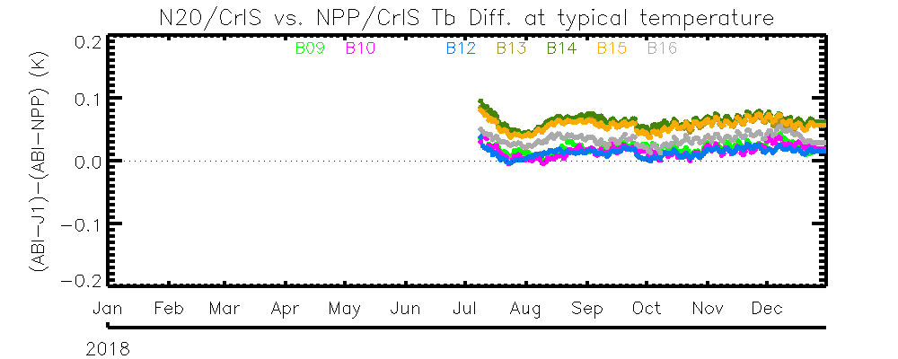
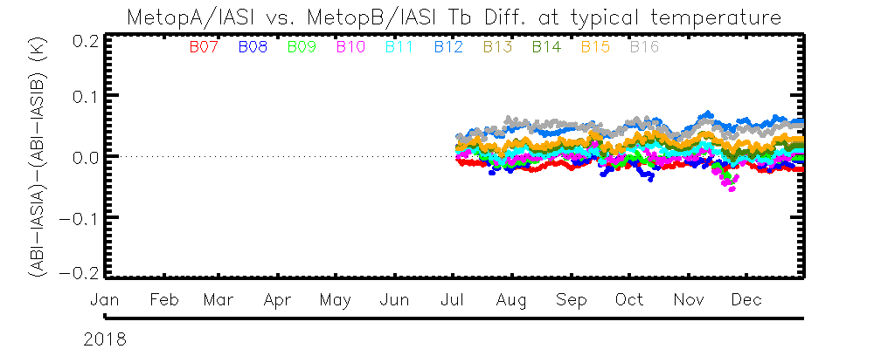
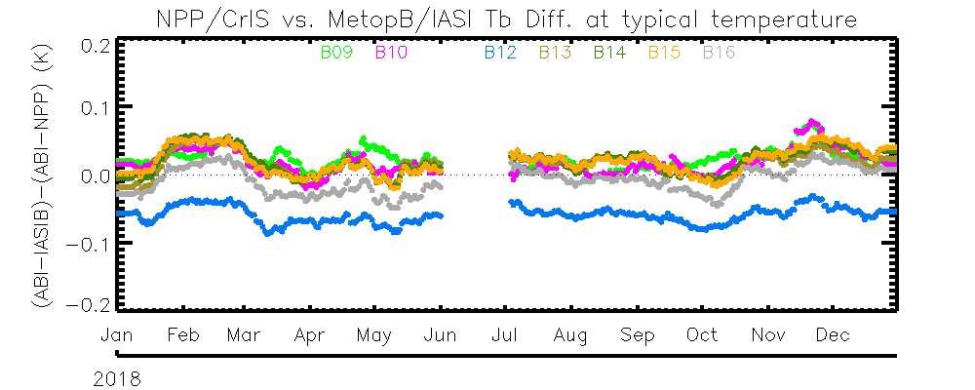
GEO-LEO: Double Difference Using G16 ABI as the Transfer
N20/CrIS, NPP/CrIS, Metop-A/IASI and Metop-B/IASI are all stable within the study period.
The calibration difference is less than 0.1K among the four reference instruments
N20/CrIS is slightly warmer than NPP/CrIS.
N20/CrIS is slightly warmer than NPP/CrIS
Double Difference between N20 and NPP CrIS
Double Difference between IASIA and IASIB
Metop-A/IASI and Metop-B/IASI is in general well with ~±0.1K
Double Difference between NPP/CrIS and IASI-B
Metop-B/IASI and SNPP/CrIS is in general within ~±0.1K

Slide 10
Support to GRWG Activities UV Subgroup
NOAA is participating in all four UV Subgroup projects
Leading the Ozone Profile Measurement residual comparison study – currently working with NOAA SBUV/2 and OMPS NP instruments. We are creating time series to track the V8Pro initial residuals for the nine profile channels from 253 nm to 313 nm for operational and reprocessed data sets.
Participating in the UV reflectivity channel comparison study – currently working with NOAA OMPS NM and EUMETSAT GOME-2. We are tracking statistics on reflectivity and UV absorbing aerosol index values over the Equatorial Pacific. We are looking forward to working with the Vis Subgroup and their Rayleigh calibration project.
Participating in the solar reference and comparison study. We are modelling OMPS solar measurements with comparison to proxies from multiple sources. We are creating Mg II Index time series from OMPS NP and GOME-2 products.
Participating in the Best Practices for Calibration project. L. Flynn is working on a NESDIS Technical Report to capture the experiences and lessons learned from trending and error analysis of hyperspectral UV instrument measurements.
NOAA is providing monitoring of our Level 2 and Level 1 products at
https://www.star.nesdis.noaa.gov/smcd/spb/OMPSDemo/proOMPSbeta.TOZ_N20_V8.php
https://www.star.nesdis.noaa.gov/icvs/status_N20_OMPS_NP.php

Slide 11
Support to GRWG Activities - VNIR
Support VIIRS as a GSICS reference (talks 3m, 4k, and 4n)
Reprocessing v2 SNPP VIIRS data with improved calibration suitable to be used as GSCIS reference
Contributed articles to quarterly newsletter (Uprety et al. 2018, Choi et al., 2018)
Presented VIIRS calibration updates to GSICS team (July 2018)
Interactions with GSICS VNIR chair (Dave Doelling) and members on using VIIRS as a reference sensor (Webex meeting in July 2018, JPSS annual meeting 2018)
Applications of VIIRS SDR as reference
Using SNPP/VIIRS as the reference to validate and monitor the GOES-16/17 ABI visible and near-infrared channels
Applications of the GIRO model
ABI and VIIRS L1B radiance trending
Instrument anomaly investigation (talk 4e)
Exploring new GSICS applications
Prototype for MTF using the Moon (talk 4f)

Slide 12
Update on NOAA GRWG Actions
Action Id | Summary | Lead | Expected Completion | Actual Completion | Status
GIR.2016.3n.1 | Handling Diurnal Cycle in GEO-LEO IR. | NOAA(Fred) | 2017-annual meeting |  | New data collected
GVNIR.20161206.4 | Fred Wu (NOAA) to consider coordinating a summary of new space-based Moon observations (since the last workshop). | NOAA(Fred) | 2017-annual meeting | 2017-Nov. 2nd lunar calibration workshop | Closed
GIR.2018.3j.1 | Fangfang Yu (NOAA) and Masaya Takahashi (JMA) to investigate radiance dependence of ABI 3.9 micron channel |  | 2019-annual meeting |  | talk on Thursday
GIR.2018.4d.2 | Likun Wang (NOAA) to set up web meeting to discuss comparisons of gap-filling methods and plan way forward by June 2018 | NOAA(Likun) | 2019-annual meeting | June 2018 | Closed
GIR.2018.4d.3 | Hui Xu to apply gap-filling method to IASI following to preview comments | NOAA(Xu Hui) | 2019-annual meeting |  | Talk on Thursday
GRWG.2018.10m.2 | Fred Wu(NOAA) to set up a web meting for MTF characterization on the moon & invite IVOS to participate | NOAA(Fred Wu) | 2019-annual meeting |  | Talk on Wednesday
… | … | … | … | … | …

Slide 13
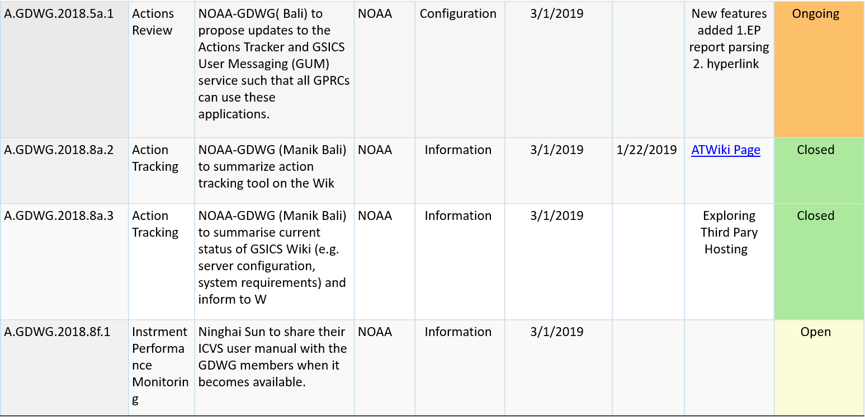
NOAA-GDWG Actions Status

Slide 14
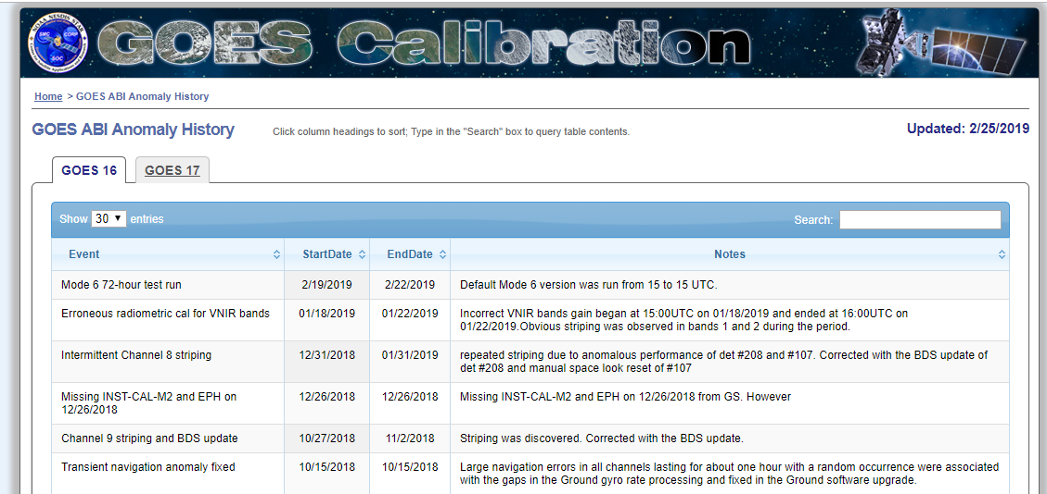
Satellite/Instrument Summary - GEO
Satellite (status) |  | Current Location | Launch Date | Operation Date
GOES-15* | (Op) | 128W | 2010-03-04 | 2011-12-06
GOES-16 | (Op) | 75.2W (GOES-East) | 2016-11-19 | 2017-12-18
GOES-17 | (Op) | 137.2W (GOES-West) | 2018-03-01 | 2019-02-12
* GOES-15 drifted from 135W on 2018-10-23 and arrived the new operating location of 128W on 2018-11-07. GOES-17 and GOES-15 will operate in tandem for 6 months from their respective locations of 137.2W and 128W.
GOES-16/17 ABI Calibration Event Log:
https://www.star.nesdis.noaa.gov/GOESCal/goes_SatelliteAnomalies.php

Slide 15
Satellite/Instrument Summary - LEO
Satellite | Launch Date | Instrument | Status | Operation Date
SNPP | 2011-10-28 | ATMS | Op | Dec. 2013
 |  | CrIS | Op | Dec. 2013
 |  | OMPS | Op | Aug. 2015
 |  | VIIRS | Op | Dec. 2013
NOAA-20 | 2017-11-18 | ATMS | Op | 2018-07-05
 |  | CrIS | Op | 2018-08-14
 |  | OMPS | P. | March. 2019 (expected)
 |  | VIIRS | Op | March 2018
SNPP Integrated Calibration and Validation System monitoring:
https://www.star.nesdis.noaa.gov/icvs/status_NPP_XXX.php
NOAA-20 Integrated Calibration and Validation System monitoring:
https://www.star.nesdis.noaa.gov/icvs/status_N20_XXX.php

Slide 16
Personal supporting GSICS
EP: Mitch Goldberg (GSICS Chair)
GCC: Lawrence Flynn (director) and Manik Bali (deputy)
GDWG: Manik Bali (NOAA GDWG member)
GRWG: Ralph Ferraro (WM sub-group vice chair), Lawrence Flynn (NOAA UV sub-group member), Likun Wang (IR sub-group chair), Xiangqian Wu (NOAA GPRC chair), Fangfang Yu (Deputy of NOAA GPRC chair, vice-chair of GRWG) and many many other scientists at NOAA/STAR

Slide 17
Visiting Scientist Program
Between NOAA and EUMETSAT
Two scientists from the NOAA ABI calibration working group (CWG), Drs. Vladimir Krondratovich and Xiangqian Wu were invited to visit EUMETSAT on the collaboration of the next-generation of GEO weather instrument calibration for two and one week in 2018, respectively.
NOAA is going to host 2-3 visiting scientists from EUMETSAT in 2019.
Between NOAA and KMA
Several NOAA ABI calibration scientists are going to visit KMA on ABI-AMI calibration collaboration in the early summer of 2019.

Slide 18
Thank you for your attention
WMO GSICS Portal
http://gsics.wmo.int
GSICS Coordination Centre http://www.star.nesdis.noaa.gov/smcd/GCC/index.php
GSICS Product Catalog https://www.star.nesdis.noaa.gov/smcd/GCC/ProductCatalog.php
GSICS Wiki
http://gsics.atmos.umd.edu/wiki/Home

