Slide 1
USGS Agency Report to GSICS
March 4, 2019
Tom Stone — USGS Flagstaff Science Center
Greg Stensaas — USGS Earth Resources Observation and Science (EROS) Center
Cody Anderson — USGS Earth Resources Observation and Science (EROS) Center

Slide 2
Overview
GSICS Activities and Actions
  GIRO validation
  3rd Lunar Calibration Workshop
Landsat Mission Status
  Landsat 8 status
  Landsat 7 status
  Landsat 9 and beyond: Sustainable Land Imaging program
Other Activities of Interest to GSICS
  EROS Calibration Center of Excellence (ECCOE)
  Joint Agency Commercial Imagery Evaluation (JACIE)
  Cross-calibration of Landsat 8 OLI and earlier Landsat MSS instruments
USGS Personnel Supporting GSICS

Slide 3
GSICS Activities and Actions
GIRO validation against ROLO
  identified code modifications needed for both GIRO and ROLO
  modifications to GIRO code requires rebuilding the benchmark
  ROLO revision requires reprocessing all instruments’ lunar data
  no report this year
Planning for 3rd Lunar Calibration Workshop
  schedule every ~2 years indicates it should be held late 2019
  location TBD, discussion Friday morning (talk 10b - Scott)
GSICS Actions:
Informal actions from 2018 GSICS Annual meeting:
  Does USGS wish to become a GPRC for Landsat?
  Does USGS wish to have a representative on the GDWG?

Slide 4
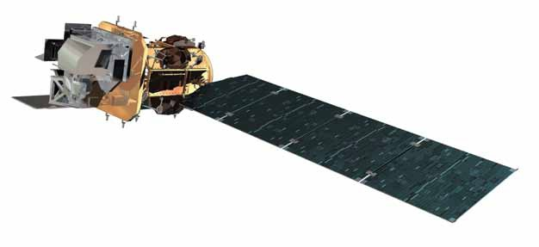
Landsat 8 Observatory Status
  Launched 11 February 2013
  705 km, Sun sync 10:12 AM
Operational Land Imager
Propulsion Subsystem
- Service Line/Valve Temp Instability
Thermal Control System
- May 2016 Rwheel-4 thermostat instability began
- PDM out of family temperature increase under
watch/discussion
Attitude Control System
- July 2015 CSS-9 &12 current instabilities began
- Oct 18-21 2017 CSS-10 current instabilities seen
(reappeared in late Mar 27 2018)
- Mar 22-23 2018 CSS-11 current instabilities seen
RF Communications
Thermal Infrared Sensor
- Mar 2015 - Side-A SSM Encoder degraded, switched to B side
- Aug 2015 - Side-B Encoder degradation, powered off 29 Oct 2015
(now only used for bi-monthly cals ALT CON OPS)
Command & Data Handling System
- May 2015 SSR Ghost file errors began accumulating
- Sept 2015 Toggled SSR low power, Ghost files ceased
- Mar 2017 SSR HKDB CEC Error Count Trend Increase
Electrical Power System
- Average Battery Pressure under watch conditions

Slide 5
Landsat 8 On-board Calibrators
OLI
Shutter
Two Diffusers
  Working – weekly
  Pristine – twice/year
Three Lamp Pairs
  Working – daily
  Backup – every two weeks
  Pristine – twice/year
Lunar
  Once/lunar cycle, near Full Moon
  All 14 focal plane arrays
TIRS
Blackbody
Deep Space

Slide 6
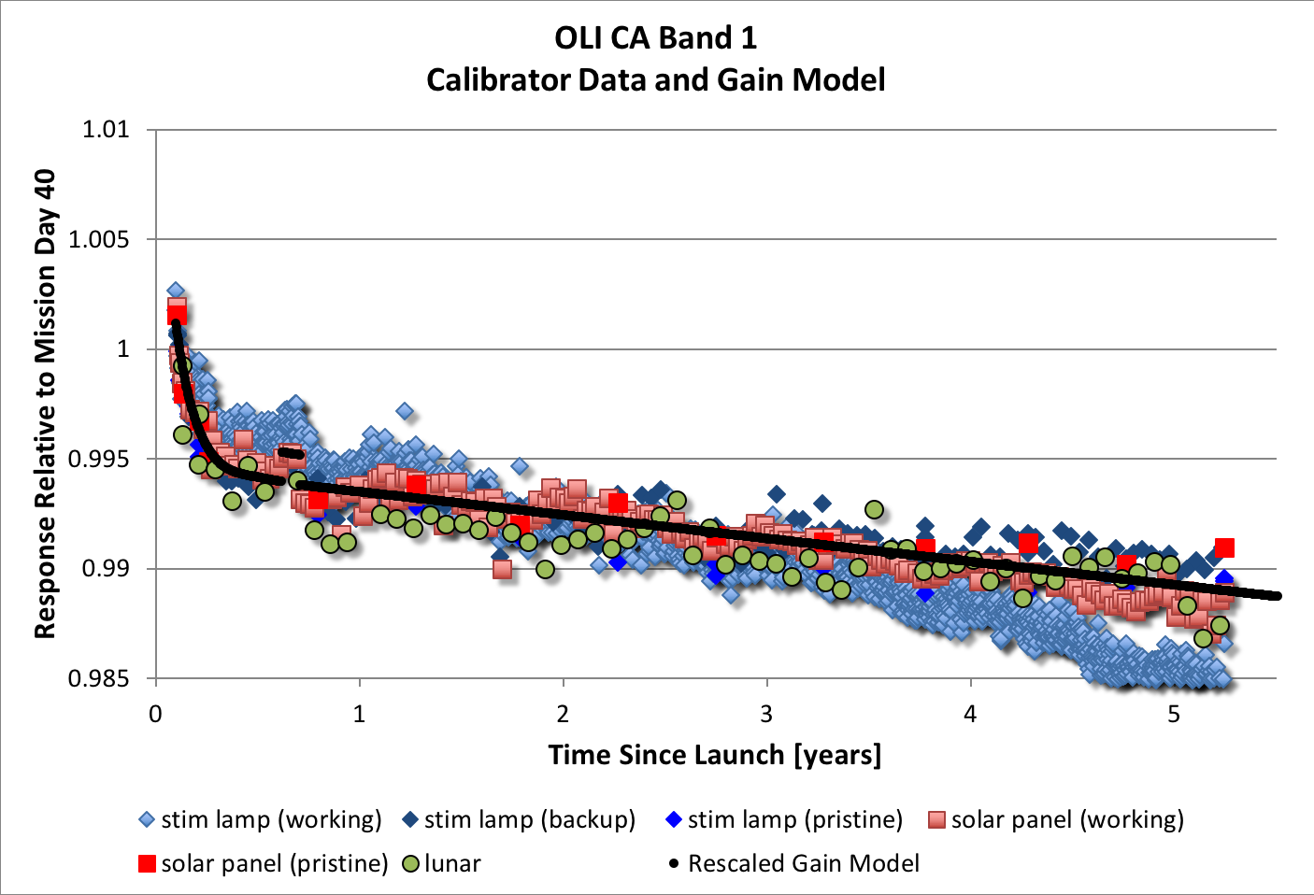
OLI Responsivity Trends
Coastal Aerosol
band: 442 nm
Degradation ≈ 0.24% per year
NASA-GSFC Landsat cal/val group

Slide 7
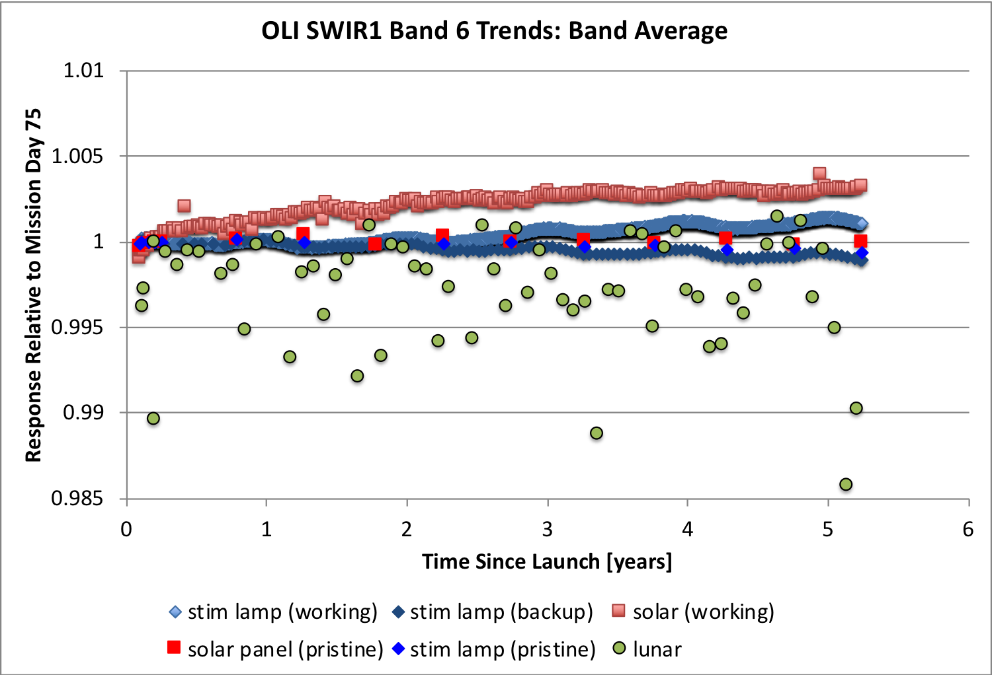
OLI Responsivity Trends
SWIR-1 band
1609 nm
Degradation < 0.1% per year
NASA-GSFC Landsat cal/val group

Slide 8
TIRS Responsivity Trends
Side A Side B
Band 10 10.8 μm 0.21% 0.06% per year
Band 11 12.0 μm 0.9% 0.02% per year
r = (Q_{BB} – Q₀) / (L_{BB} - L_{space})
NASA-GSFC Landsat cal/val group

Slide 9
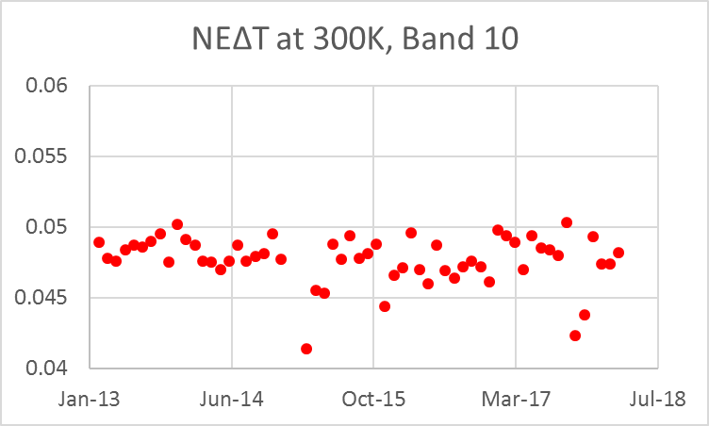
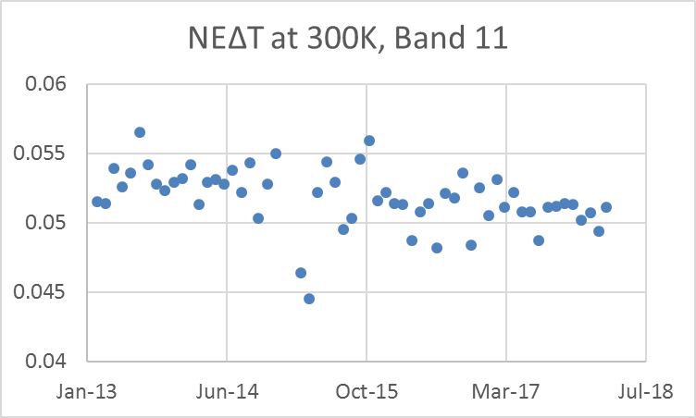
TIRS Noise Equivalent ∆Temperature (NEdT)
Band averages at 300K (Requirement: NEΔT < 0.4K):
  B10: 0.048 K
  B11: 0.052 K
NASA-GSFC Landsat cal/val group

Slide 10
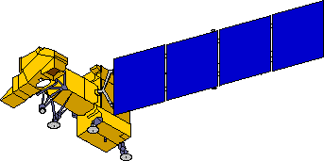
Landsat 7 Observatory Status
On orbit since April 1999
Final orbit maneuver Feb 2017
Electrical System
Attitude Control System
•10/18/2014 Clock Generator Circuit failure
•Battery performance nominal
Solar Array
•05/05/2004 Gyro 3 Shut Off
•1-gyro control system in development
5/14/2002 Circuit #14 Failure
5/16/2005 Circuit # 6 Failure
8/13/2008 Circuit #14 recovery
14 circuits remain operating
no impact to ops
Enhanced Thematic Mapper +
•5/31/2003 SLC Failure
•4/01/2007 Bumper mode
Reaction Control System
1/07/04 Fuel line #4 thermostat #1a failure
2/24/05 Fuel line #4 thermostat failure;
Primary heater circuit disabled
4/25/13 Fuel line #2 thermostat failure;
Redundant heater circuit disabled
Remote Tlm Cmd (RTC) Box
•09/27/2014 RTC A Failover
Solid State Recorder
11/15/1999 SSR PWA #23 Loss
02/11/2001 SSR PWA #12 Loss
12/07/2005 SSR PWA #02 Loss
08/02/2006 SSR PWA #13 Loss
03/28/2008 SSR PWA #22 Loss
09/03/2008 SSR PWA #23 Recovered
10/12/2013 SSR PWA #11 Loss
Each PWA is 4% loss of launch capacity
Boards are likely recoverable
X-band System
Performance nominal
S-band System
Performance nominal

Slide 11
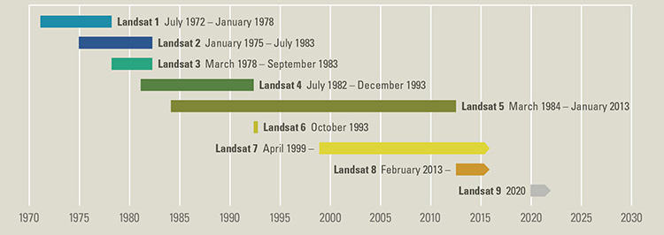
Landsat 9
Nearly identical copy of Landsat 8, part of Sustainable Land Imaging (SLI) Program
  Operational Land Imager (OLI-2)
  Thermal Infrared Sensor (TIRS-2)
Fast-tracked for December 2020 launch; on schedule
  Sun-sync orbit, phased 8 days from L8 for better temporal coverage
  Spacecraft CDR: 2/2018; Ground System PDR: 3/2018; Mission CDR: 4/2018

Slide 12
Other Activities of Interest to GSICS
EROS Calibration/Validation Center of Excellence (ECCOE)
established in 2017, for: “improving the accuracy, precision, and efficiency of radiometric, geometric, and spatial characterization, calibration, and cross-calibration of optical remote sensing systems to achieve the highest degree of interoperability of remote sensing data products.”
2nd annual workshop: Sept. 2018 at NOAA in College Park, MD
  focus theme: compare and contrast calibration and data quality between big, government-sponsored satellites and inexpensive, numerous commercial smallsats
  perceptions/trends:
    smallsat operators look to govt agency satellites for calibration references
    smallsat data providers emphasize (low) latency over accuracy
    potential paradigm shift for land imaging

Slide 13
Other Activities of Interest to GSICS
Joint Agency Commercial Imagery Evaluation (JACIE) program
Co-sponsored by USGS, NASA, NOAA and the U.S. Dept. of Agriculture
Performs product analysis of commercial and other remote sensing data and information products
  Provides independent characterizations of image and image-derived end products
  Provides independent verification of commercial imagery data quality
Provides Earth scientists with awareness of commercial imagery
  Annual workshops, next is 24-26 September 2019
  ECCOE workshops held in conjunction with JACIE (23 Sept. 2019)
  https://www.usgs.gov/land-resources/eros/calval/jacie

Slide 14
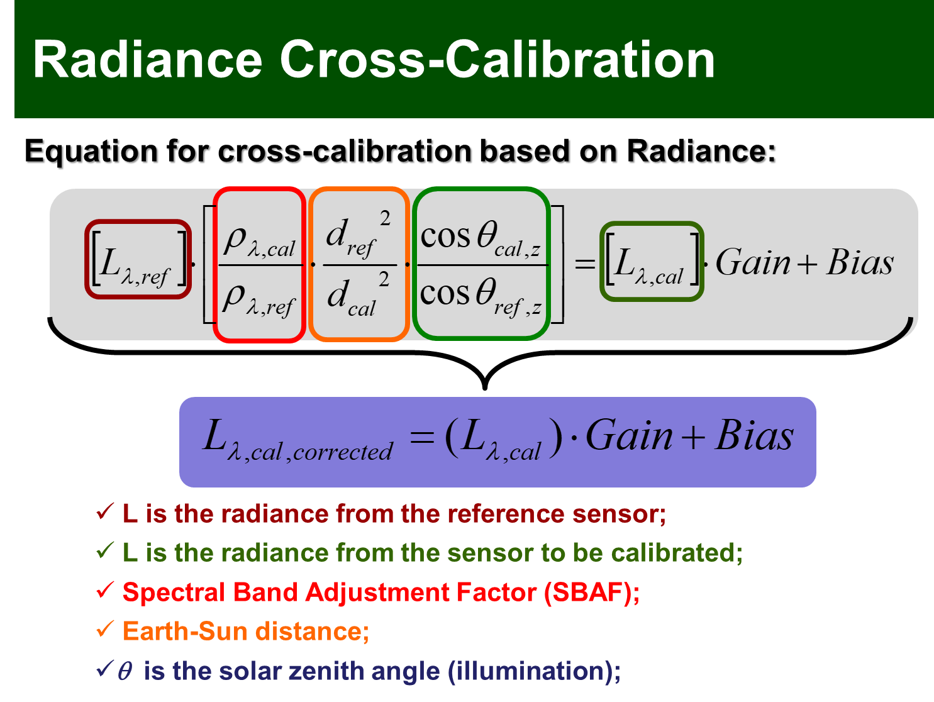
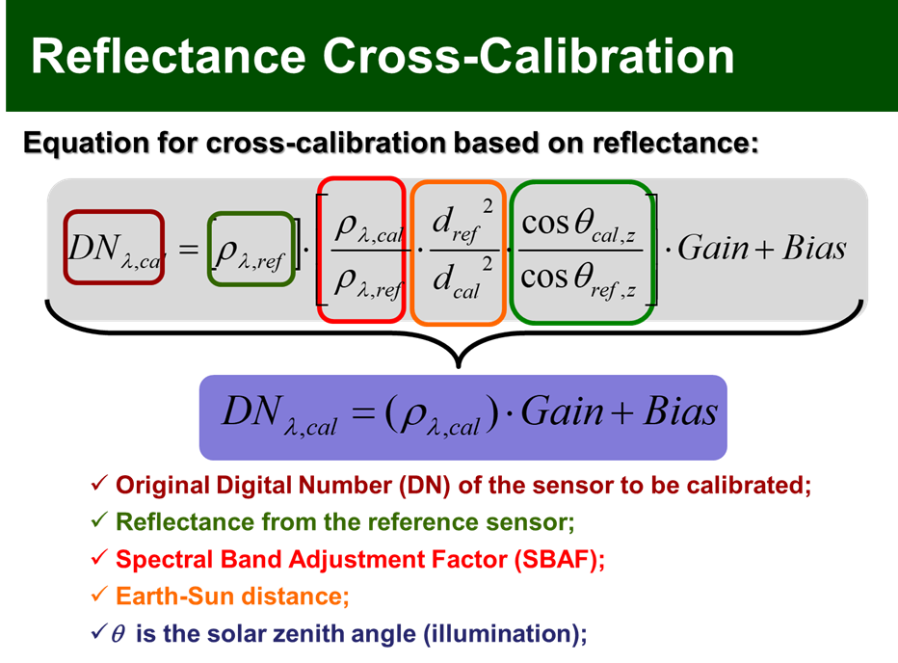
OLI-MSS Cross-Calibration Approach

Slide 15
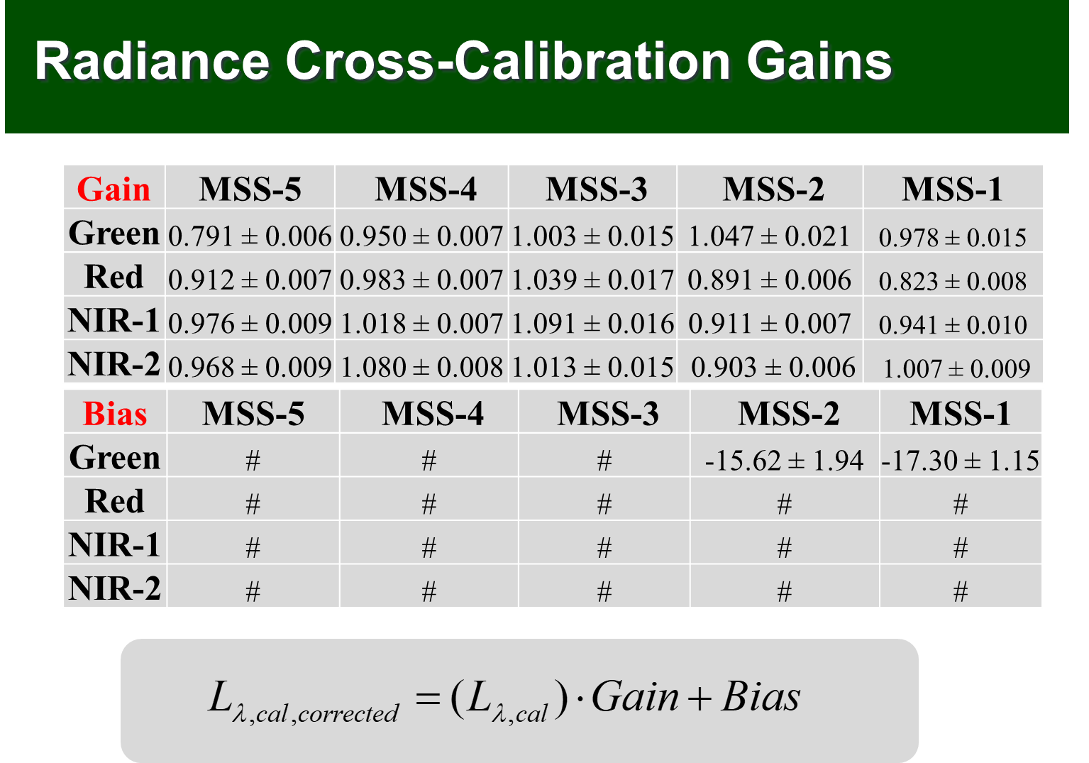
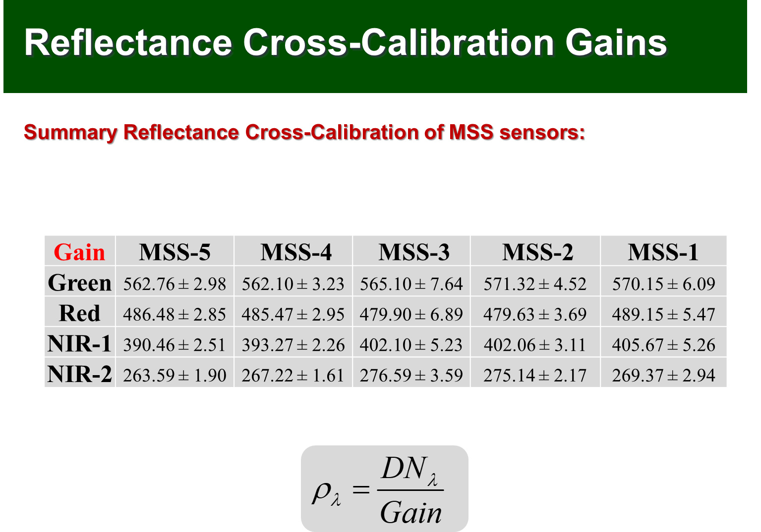
OLI-MSS Cross-Calibration Results
South Dakota State University results

Slide 16
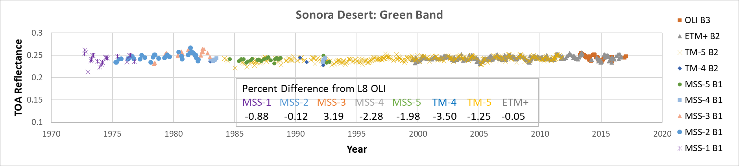
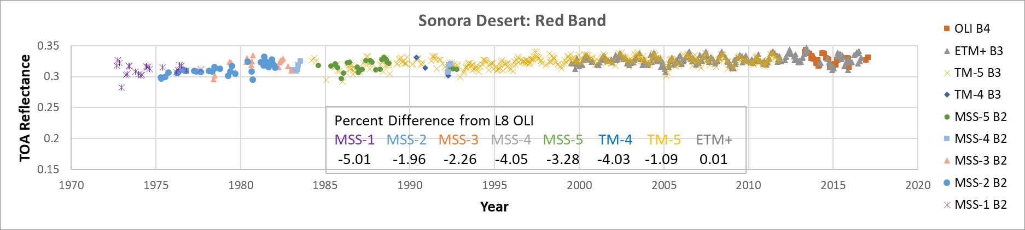
MSS Validation from L8 OLI
USGS-EROS results

Slide 17
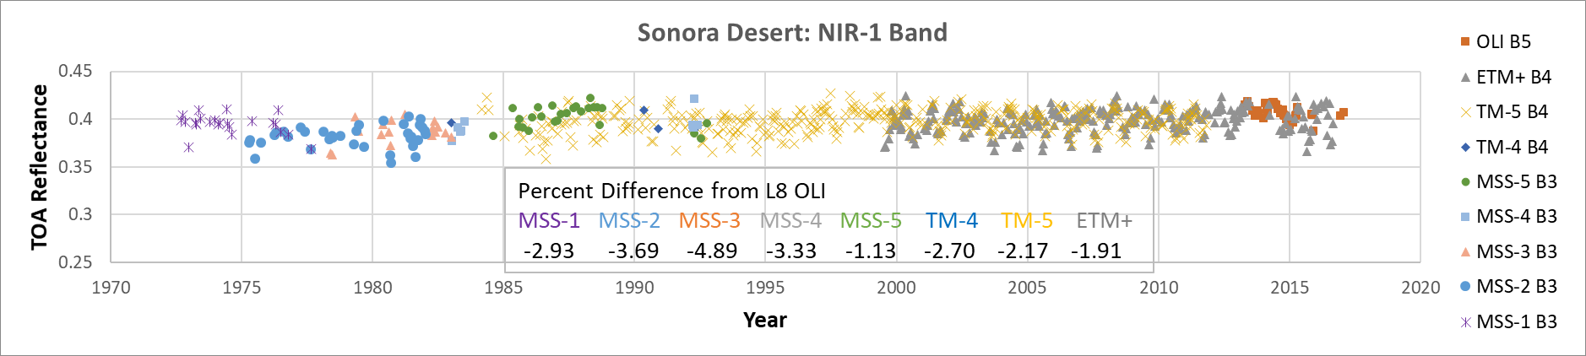
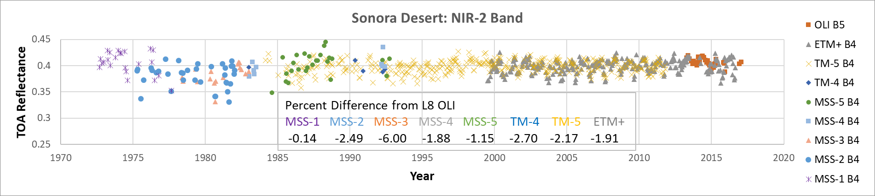
MSS Validation from L8 OLI
USGS-EROS results

Slide 18
USGS Personnel Supporting GSICS
Tom Stone — GRWG
  USGS Lunar Calibration Project Scientist, co-developer of the ROLO model
  key collaborator on development of the GIRO
Greg Stensaas — EP
  USGS Remote Sensing Technologies Project Manager
no GDWG representative – USGS is open to discussion of need
NOTE: WMO GSICS web pages (www.wmo.int/pages/prog/sat/GSICS/ and gsics.wmo.int) show Ron Morfitt as a GRWG representative — Ron is no longer with USGS.

Slide 19
Thank You!

