Slide 1
GSICS Coordination Centre (GCC) Report for 2018-2019
Larry Flynn & Manik Bali
5th March 2019
2019 Annual Meeting
Frascati Italy

Slide 2
Disclaimer
"The contents of this presentation are those of the authors and do not necessarily reflect any position of the US Government or the National Oceanic and Atmospheric Administration."

Slide 3
Outline
Introduction
GCC Activities
Global participation in GSICS activities
GSICS Quarterly Newsletter
Meeting Support
GSICS Product Status
New products accepted in past year
Proposed deliverables
GSICS Action Tracker
New Feature added on Product Catalog
Near Term Goals
Review of WMO Documents
Summary

Slide 4
GCC Activities – Participation in GSICS Activities
Interest in GSICS activities continues to grow

Slide 5
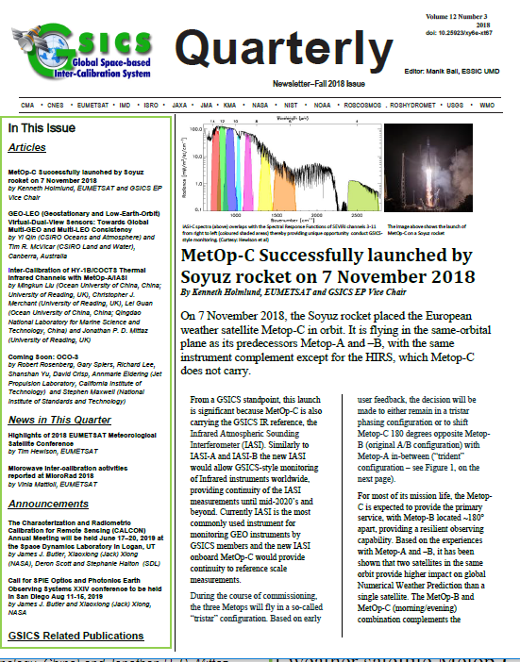
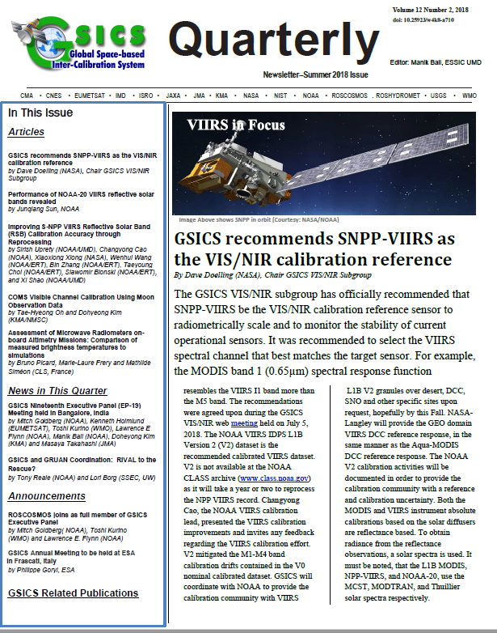
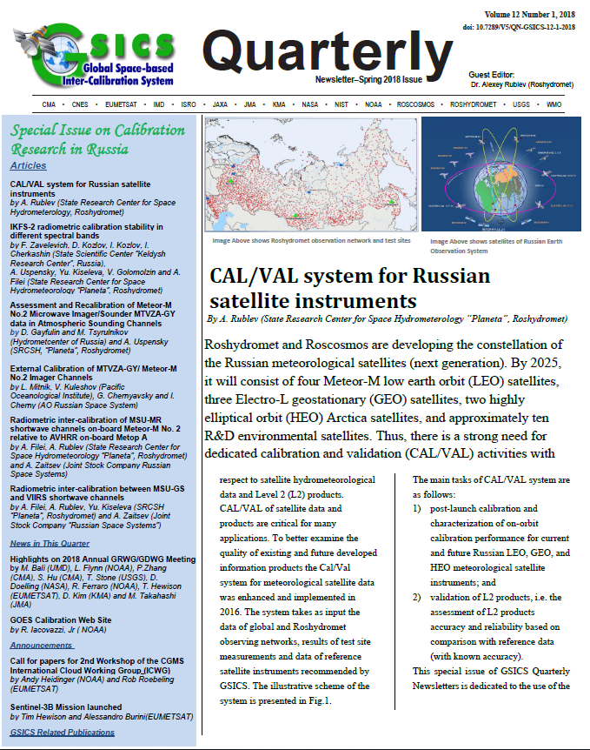
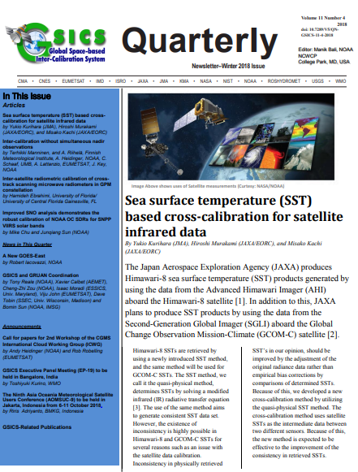
GSICS Activities-GSICS Newsletter https://www.star.nesdis.noaa.gov/smcd/GCC/newsletters.php
Over the last year, we published four New Issues of the GSICS Newsletter
Over 22 Research Articles, 15 Topics of News to which
Nearly 70 Scientists contributed as Authors & Co-Authors.
Contributions from non GSICS members has increased.
Special issue on CAL/VAL in Russia well received.
GSICS Newsletter Editorial Board
Manik Bali, Editor
Lawrence E. Flynn, Reviewer
Lori K. Brown, Tech Support
Fangfang Yu, US Correspondent.
Tim Hewison, European Correspondent
Yuan Li, Asian Correspondent
Reviewers in the past year
Lawrence E. Flynn, NOAA
Tim Hewison, EUMETSAT
Sri Harshara Madhavan, SSAI/NASA
Tony Reale, NOAA
Alexy Rublev, ROSHYDROMET

Slide 6
GSICS Activities-Meeting and Collaboration Support
Meeting Support
12 Web-meetings
GSICS Session at AOMSUC-9
Organized by ROSHYDROMET
http://aomsuc9.bmkg.go.id/
Supported GSICS discussions in ICWG- Wisconsin (Dave Doelling VIS/NIR Chair).
Supported WIGOS-TTQM in support of GSICS –WIGOS integration
Support the 3G (GRUAN-GSICS-GPSRO) collaborative activities

Slide 7
GSICS Products Status
New Products
Four MSG-4/IASI (two RAC and two NRT) products were accepted in Demo phase and later assigned Pre-Op Maturity (Under Family-of-Instruments rule)
Total 56 Products presently delivered via the GSICS Product Catalog
Operational 4 product [4 EUMETSAT]
Preoperational 8 products [4 NOAA, 4 EUMETSAT]
Demonstration 42 products [10 EUMETSAT, 17 NOAA, 12 JMA, 1 KMA, 2 ISRO]
Prototype 2 products [ 2 EUMETSAT]
Would like to thank the GRWG/GDWG Subgroup Chairs, the product developers and the GPAT and non GPAT experts for their extensive support of the GPPA process.
Notes:
Four demonstration products (NOAA) have ended production.
There are two prototype products.

Slide 8
GSICS Deliverables Status
GCC has initiated a process to accept the following four entities as GSICS deliverables:
Spectral Response Function (SRF) netCDF: SRFs used in GIRO in NetCDF format (Author: Masaya Takahashi, JMA)
GEO-LEO-IR Collocation netCDF: Intermediate Collocation data Himaware, METSAT 1R/2 Vs AIRS/IASI/MODIS (Author: Masaya Takahashi, JMA)
LEO L1 netCDF: IASI Reference Radiances (Author: Masaya Takahashi, JMA)
Level 1C inter calibration tables: Inter-Cal tables for Microwave Radiometers, e.g., SSMI series TRMM Constellation and GPM Radiometers (Author: Wes Berg, CSU)
***Detailed discussions will take place in session 3r
Notes:
Four demonstration products (NOAA) have ended production.
There are two prototype products.

Slide 9
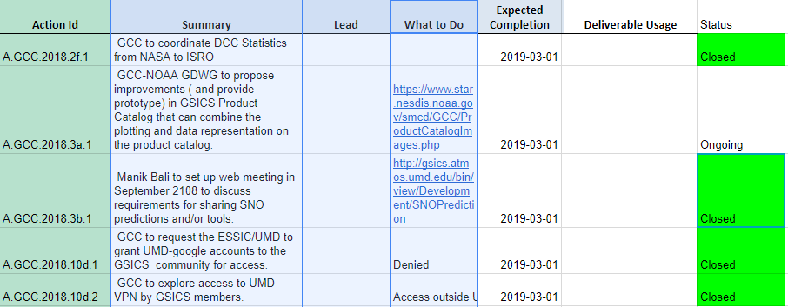
NOAA-GCC Action Status

Slide 10
Presentations by GCC
L. Flynn | GCC | GCC Report | 3a
M. Bali | GCC | Product outreach/promotion of new GSICS Products/Deliverables and updates of GSICS Product Catalog | 3r
M. Bali / R. Kroodsma | GCC | GPM X-Cal LUT's/Deliverable | 5l
M. Bali | GCC | GSICS Action Tracker- A User Guide | 10f
L. Flynn | GCC | GSCIS Users Workshop and outreach | 10j
M. Bali/ M. Goldberg / R. Ferraro | GCC | Review of white paper outline and develop writing team WIGOS/IPWG | 5o
GCC Would cover topics relevant to supporting GSICS activities in Product Reviews, Deliverables, Action Tracker and WIGOS.
Suggestions are welcome

Slide 11
Actions Webpage https://www.star.nesdis.noaa.gov/smcd/GCC/MeetingActions.php
New Features added to action tracker
Replaces the wiki actions page
New Parser for EP meetings
Column width adjusted to browser
Active links can be inserted in text
Features
Faster searches.
Chairs groups/subgroups and Co-Chairs can directly key in and update the actions.
Significant reduction in overhead on Chairs and GCC.

Slide 12
New Feature in the GSICS Product Catalog (Prototype)
Following Actions to improve GSICS Product Catalog in 2018 Annual Meeting, GCC-NOAA-GDWG has added new features to the Catalog
https://www.star.nesdis.noaa.gov/smcd/GCC/ProductCatalogImages.php
Product Type | Algorithm Type | Data Producer | Maturity Level | Monitored Instrument | Reference Instrument | Version | Data Start Date | Data End Date | Docs / Data Links
Prime Re-analysis correction | GEO-LEO Prime IR | EUMETSAT | Demonstration | MSG-1 SEVIRI | IASI-A | 0 | 6/1/2008 | Present | Docs Data
Prime Re-analysis correction | GEO-LEO Prime IR | EUMETSAT | Demonstration | MSG-2 SEVIRI | IASI-A | 0 | 6/1/2008 | Present | Docs Data
Prime Re-analysis correction | GEO-LEO Prime IR | EUMETSAT | Demonstration | MSG-3 SEVIRI | IASI-A | 0 | 8/12/2012 | Present | Docs Data
Prime Re-analysis correction | GEO-LEO Prime IR | EUMETSAT | Demonstration | MSG-4 SEVIRI | IASI-A | 0 | 9/8/2015 | Present | Docs Data
Re-analysis Correction | GEO-LEO IR | EUMETSAT | Demonstration | MSG-1 SEVIRI | IASI-A | 3 | 6/1/2008 | Present | Docs Data

Slide 13
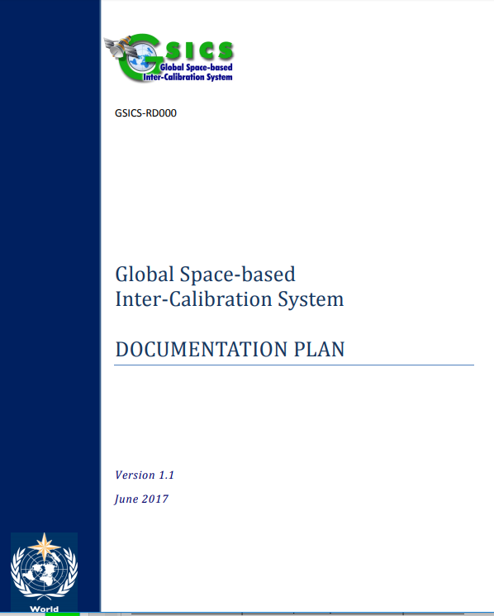
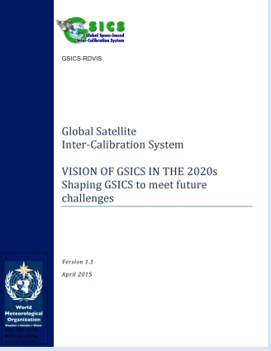
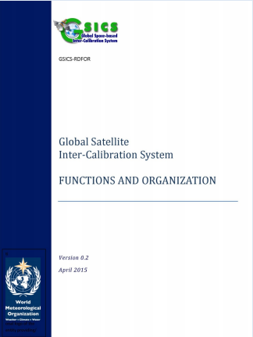
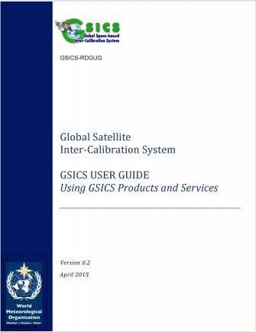
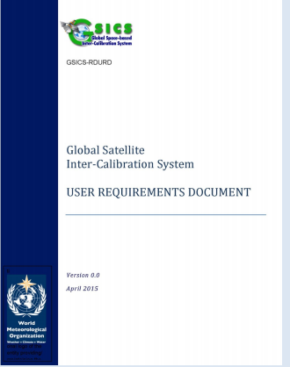
GSICS Documents for review
The integration of GSICS into the WIGOS system is underway.
GSICS has contributed to documents that are up for review by the WIGOS.
Documents related to meetings, vision plan, requirements, products, etc. are being developed.
Please Review GSICS Documentation. The creation of an editorial board to review and maintain documents has been proposed. Detailed discussions in Cross-cutting session by Larry Flynn & Toshi Kurino.
Documents provided by GSICS to WIGOS for review

Slide 14
Near-term 2019-2020 Goals
Coordination
Continue to coordinate efforts to establish the GSICS baseline algorithms, especially those for the GEO solar reflective channels,
Continue to provide communication between the developing group and users
GSICS Quarterly
Continue to compile, edit and distribute this important link to the GSICS community.
Support the inclusion of new products in the GPPA, and conduct reviews of GSICS Products, Deliverables and Resources
Meeting Support
10th GSICS Users’ Workshop as part of ITSC Saint-Sauveur, Québec, Canada
CEOS WMO-GSICS Workshop on SI Traceable Space–based Climate Observing System (9-11 Sept, 2019)
Pre-Launch Characterization Workshop (Details being worked out with GSICS EP Chair Mitch Goldberg)
Gather additional User Requirements
Support the migration of the GSICS Wiki to ESSIC/UMD
Continue collaborative development of the Action Tracker.
Improve outreach to potential Users of GSICS Products

Slide 15
Summary
The GSICS Coordination Center continues to support and coordinate exchanges of ideas within GSICS.
New features were added to actions tracker (e.g., direct extraction of actions from minutes).
Four new products were accepted in the GSICS Product Catalog.
Four proposed deliverables are circulating.
GCC continues to publish the Newsletter.
GCC continues to support the collaboration and planning of GSICS research and other activities with complementary groups such as GRUAN, GNSS and WIGOS.

Slide 16
Thank You

Slide 17
Backup

Slide 18
Request for Creation of an Editorial Board to Review WMO GSICS Documents
RD001: Introduction to GSICS
RD002: Vision of GSICS
RD003: Guide to GSICS Products and Services
RD004: Terms of Reference of GCC, EP, GDWG and GRWG
RD005: GSICS Service Specification
RD006: GIRO and GLOD Dataset Usage Policy
Other Documents and WMO Content
Commission for Instruments and Methods of Observation (CIMO) Guide
Observing System Capability Analysis and Review (OSCAR) Pages

Slide 19
LEO L1 netCDF Deliverable
1. Objective of the Deliverable Some GSICS agencies need to use reference LEO L1 subsets for their GEO-LEO collocation to generate GSICS inter-calibration products. 2. How it was created Data provider (e.g., IASI L1C by EUMETSAT) creates and makes it available on the GSICS Collaboration Server based on user's requests. 3. How to use it To use the file as an input for inter-calibration as given in ATBD. 4. References: EUMETSAT GSICS Collaboration Server: http://gsics.eumetsat.int/thredds/catalog.html

Slide 20
GEO-LEO-IR Collocation netCDF Deliverable
1. Objective of the Deliverable Input for deriving inter-calibration coefficients, which is mainly used by producers of GSICS products, but may be useful for other users 2. How it was created Created by producers of GSICS Products (e.g., JMA) 3. How to use it The data are used by the producers to generate GSICS Correction. Other users may want to replicate the process, or use them for their research purpose. 4. References:
Convention (template): http://gsics.atmos.umd.edu/bin/view/Development/NetcdfConvention#Collocation_Data Data (example of JMA's data): http://gsics.eumetsat.int/thredds/jmaIntermediate.html
(Data transfer was stopped in 2018 due to slow FTP connection: root causes are under investigation)

Slide 21
SRF netCDF Deliverable
1.Objective of the Deliverable To support GSICS activities such as Lunar Calibration using GIRO (GSICS Implementation of the ROLO model) 2.How it was created GDWG Chair basically has created these based on users' requests, but some users also generate the files by themselves by referring to the following Convention or document. 3. How to use it To use as an input file to execute GIRO and other applications for GSICS research. 4. References: Convention (document is attached on the page): http://gsics.atmos.umd.edu/bin/view/Development/SrfNcdfConvention Document for GIRO: http://gsics.atmos.umd.edu/pub/Development/LunarWorkArea/GSICS_ROLO_HighLevDescript_IODefinition.pdf

Slide 22
GSICS and WDQMS -Moving ahead into the Future
WIGOS Action on GSICS
NOAA commented that GSICS already contains monitoring capabilities from which WDQMS could benefit. Further discussion revealed that incident management aspects should be included as well. An action on WMO was raised to address these (CGMS-46 Final Report).
Action CGMS-46 | (WMO) To liaise with GSICS on implementing GSICS monitoring capabilities in WDQMS, to include incident management capabilities, and report back to WG-IV, proposing a way forward CGMS-47 | WMO Secretariat | EP-19 | In progress: WIGOS will refer the GSICS documents into WIGOS document
GSICS Action on WIGOS
A.WMO.20160602.4 | WMO Secretariat to invite comments on the GSICS Basic Documents from WIGOS community - GSICS FUNCTIONS AND ORGANIZATION - GSICS USER GUIDE Using GSICS Products and Services - GSICS USER REQUIREMENTS DOCUMENT | WMO Secretariat | EP-19 | In progress: WIGOS will refer the GSICS documents into WIGOS document
GSICS has prepared the following documents
GSICS FUNCTIONS AND ORGANIZATION
GSICS USER GUIDE Using GSICS Products and Services
GSICS USER REQUIREMENTS DOCUMENT
GSICS Vision 20/20 Document
Idea is to synergize GSICS monitoring capabilities, its processes ( documents above) and its plans with WIGOS. To do this we invite WIGOS to review our GSICS mission documents( see Action A.WMO.20160602.4)

