Slide 1
JAXA Agency Report
2019
Hiroshi Murakami, Misako Kachi, Takashi Maeda,
Kei Shiomi, Takeo Tadono, Yuki Kaneko, Kosuke Yamamoto
JAXA

Slide 2
Presentation Overview
Agency’s GSICS Activities, Action & Achievements Summary
Agency’s support to GDWG Activities
Agency’s support to GRWG Activities
Agency’s Instruments Updates & Planned launches – relevant to GSICS if any
Introduce/Confirm the Agency’s Personnel supporting GSICS
Agency’s GSICS activities to be discussed in this joint meeting.

Slide 3
Agency’s GSICS Activities, Action & Achievements Summary
Current GSICS Activities
  GCOM-C/SGLI lunar calibration using GIRO
  GOSAT-2 was launched on October 29, 2018; GOSAT-2/CAI-2 lunar calibration using GIRO
  Cross-calibration between GCOM-C and AHI
  Cross-calibration among passive microwave imagers (AMSR2, AMSR-E, GMI, TMI)
  Cross-calibration between TRMM/PR and GPM/DPR
Action Status
  None

Slide 4
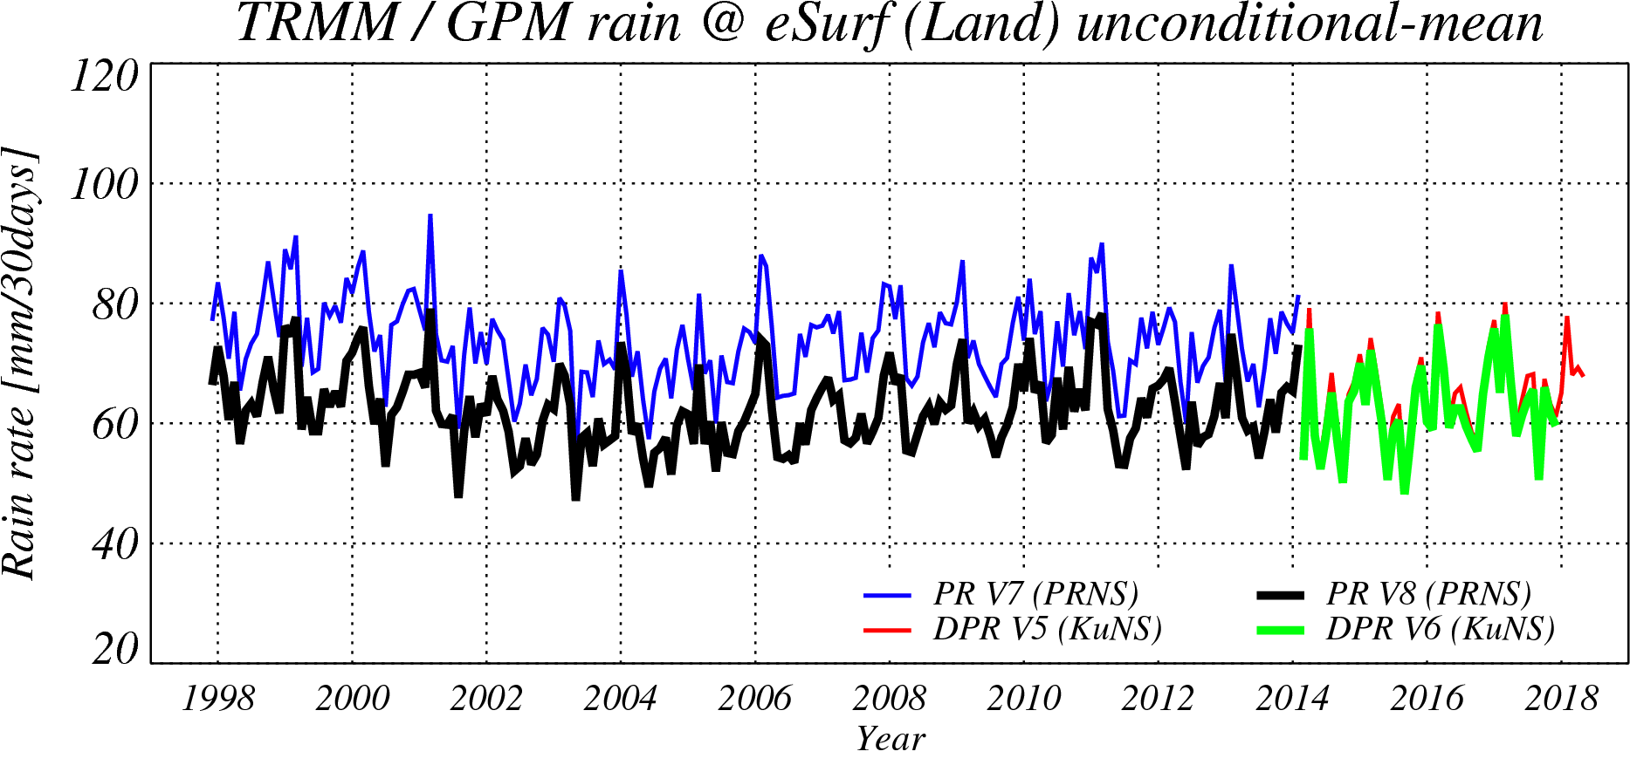
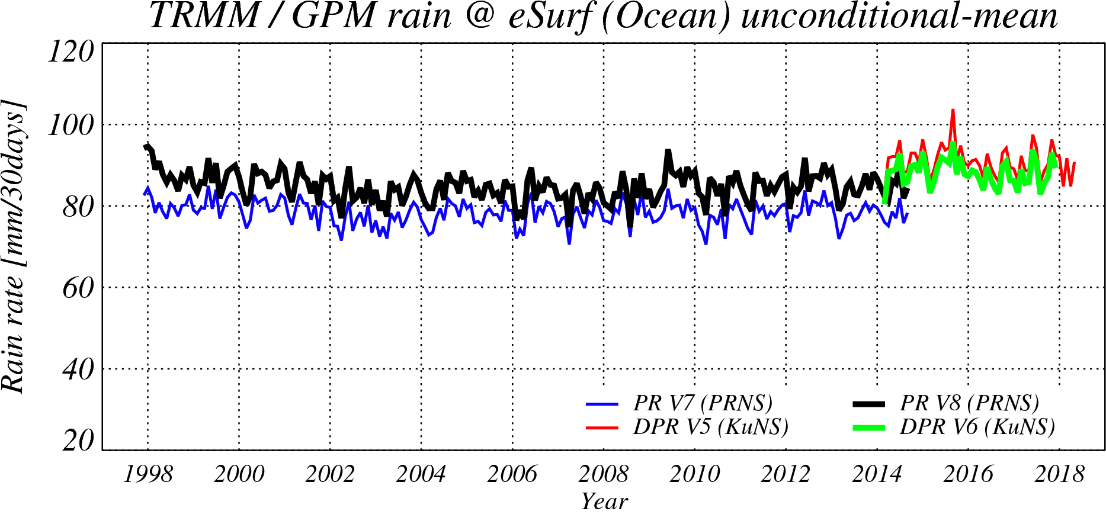
Continuity of the GPM/DPR and the TRMM/PR
Both GPM/DPR’s calibration factors and TRMM/PR’s calibration factors were changed in 2017.
After the algorithm update in Oct. 2018, the GPM/KuPR V06 and the TRMM/PR V8(GPM TRMM V06) show better continuity on surface precipitation rate.
Over-land surface precipitation rates averaged in 35S-35N.
Over-ocean surface precipitation rates averaged in 35S-35N.
PR V7
KuPR V5
KuPR V5
PR V8
PR V7
KuPR V6
PR V8
KuPR V6

Slide 5
Support to GRWG Activities
Main contribution to GRWG actions
  GCOM-C/SGLI lunar calibration using GIRO
    all SGLI GLOD data (once/month in Jan 2018 –Jan 2019) have been submitted)
    (the details will be presented in the VIS/NIR Sub-Group session tomorrow);
  GOSAT-2/CAI-2 lunar calibration using GIRO
    GOSAT-2 was launched on October 29, 2018.
    CAI2 first lunar calibration on December 23, 2018
  GCOM-C/SGLI thermal infrared cross calibration with sounders
    AIRS, IASI, CrIS
  GCOM-C/SGLI cross calibration with Himawari-8/AHI
    Over the ocean and water-cloud
  Participation to MW SubGroup (telecons and presentations)

Slide 6
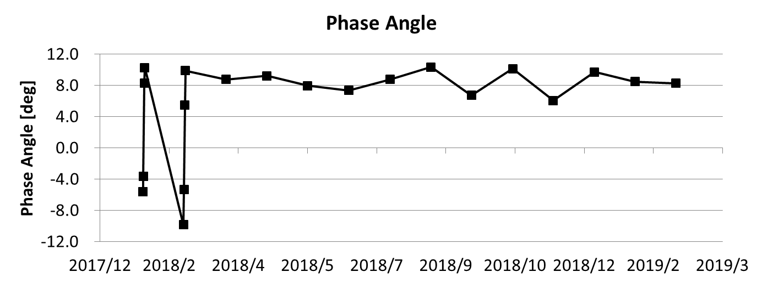


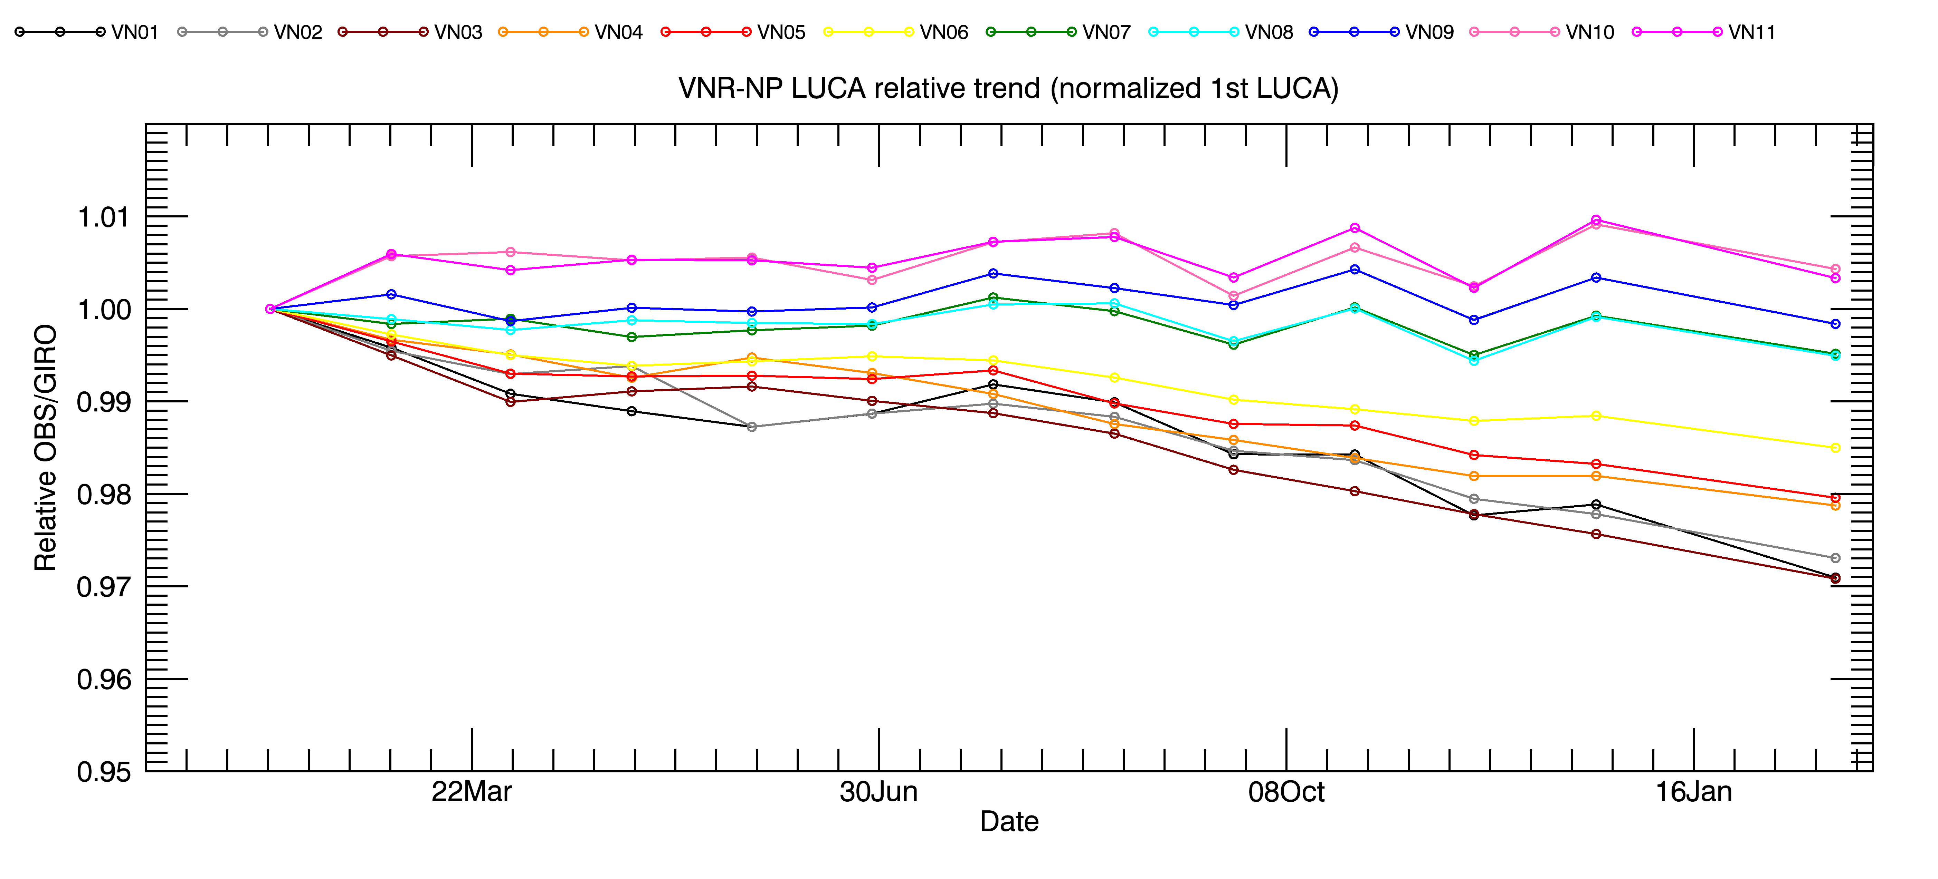
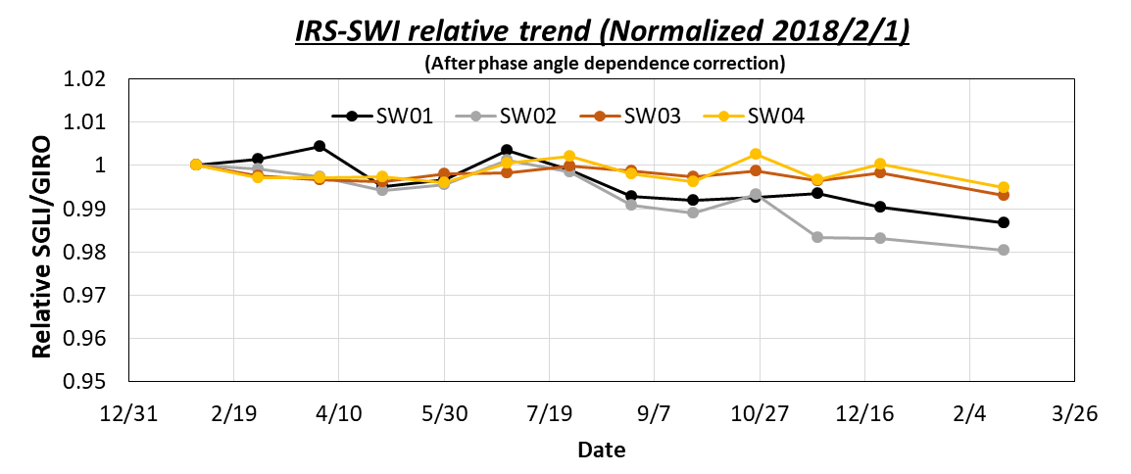
SGLI Lunar CAL by GIRO
VNR-NP
(push-broom type)
IRS-SW03(1.6um)
(whisk-broom type)
+7±3deg
Launch
2018/9/25
2018/9/25
VNR-NP Nadir relative trend (Normalized 2018/2/1)
[only Roll angle =0 or +1deg]
IRS-SWI relative trend (Normalized 2018/2/1)
(After phase angle dependence correction)
1.01
1.00
0.99
0.98
0.97
0.96
0.95
Relative SGLI/GIRO
Relative SGLI/GIRO
the details will be presented by Mr. T. Hashiguchi in the VIS/NIR Sub-Group session tomorrow

Slide 7
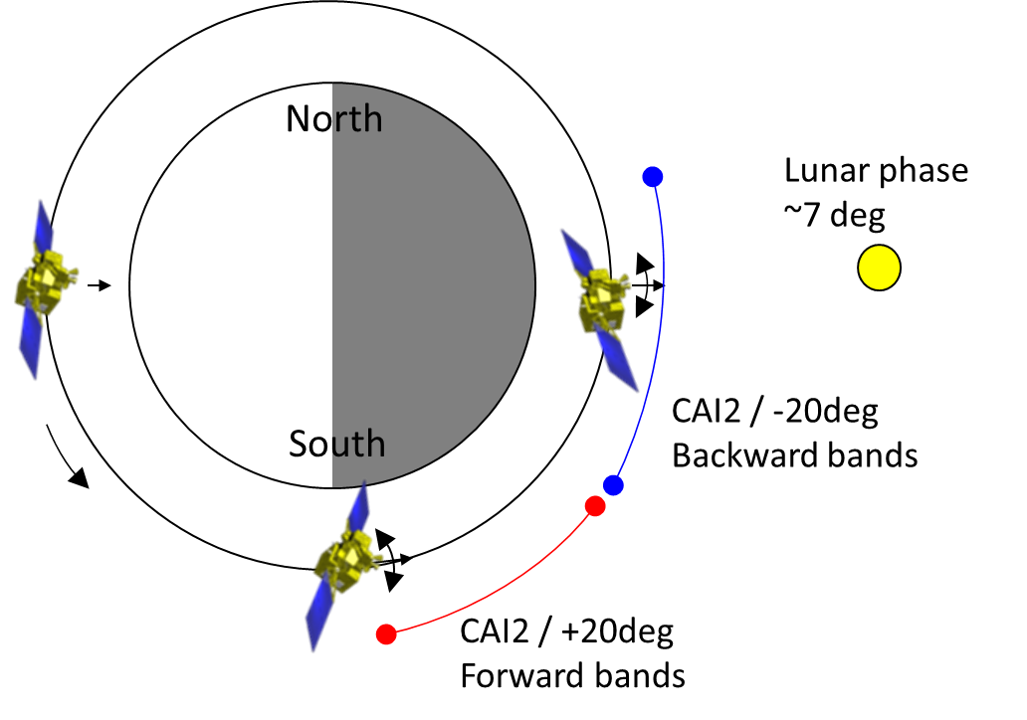
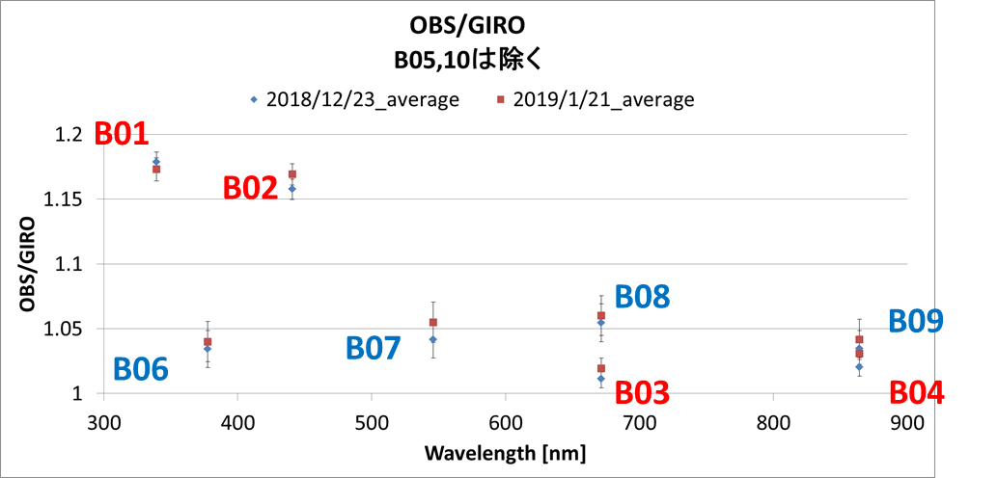
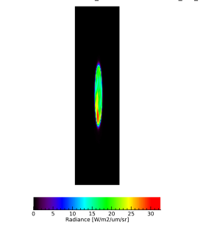
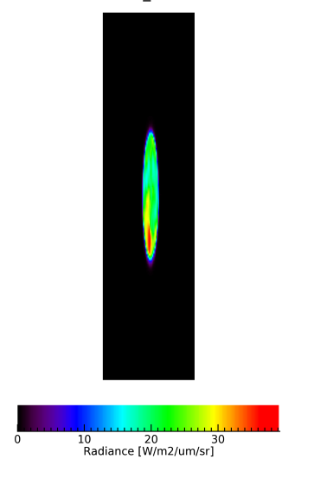
GOSAT-2 Lunar CAL by GIRO
GOSAT-2 was launched on October 29, 2018.
CAI2 has been operated the lunar calibration for radiometric calibration by along-track (AT) scans (satellite pitch rotations) once a month since December. The lunar phase angle is targeted around 7 deg.
CAI2 observes at 340, 380, 440, 550, 670, 870, and 1630 nm and compered with GIRO. 340nm is compared with the extrapolated model.
Illustration of GOSAT-2 lunar calibration
Band1 (340nm)
Band6 (380nm)
CAI2 radiance compared with GIRO (Very Preliminary)
We will investigate the pitch rate from a satellite attitude, image lines and an IRU rate.
CAI2 first lunar calibration by AT scan on December 23, 2018

Slide 8
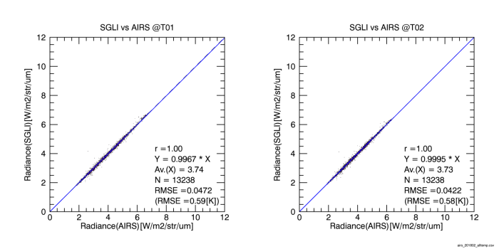
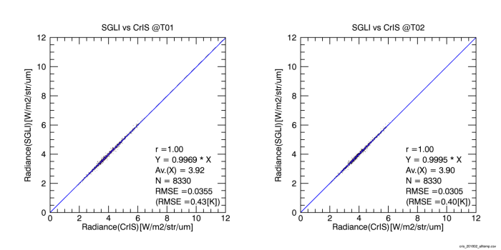
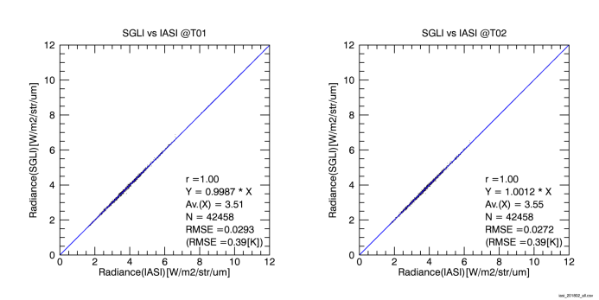
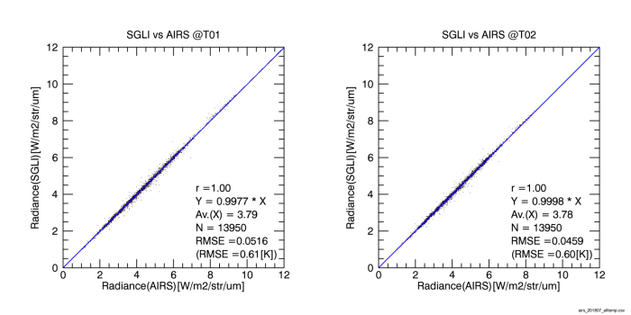
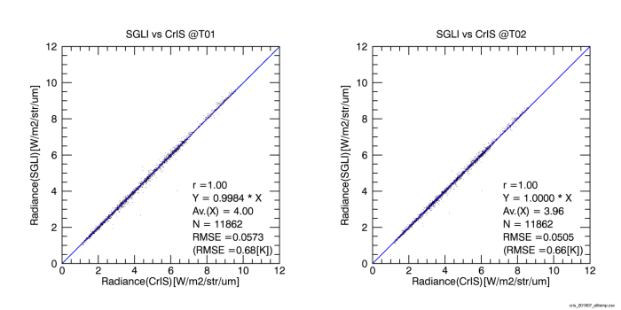
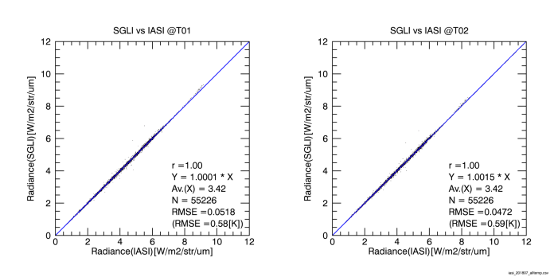
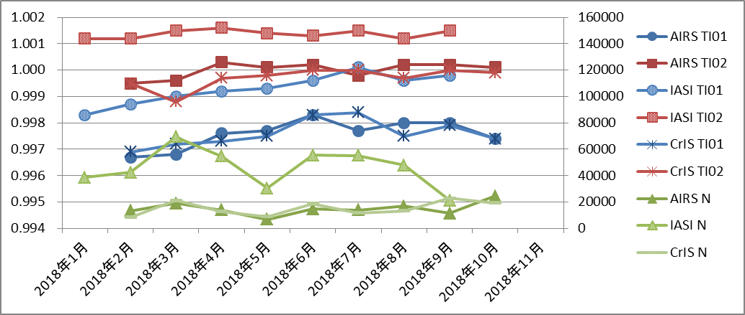
SGLI CAL: TIR cross calibration by satellite sounders
11μm
AIRS
12μm
11μm
CrIS
12μm
11μm
IASI
12μm
Feb
Jul
 | AIRS |  |  | IASI |  |  | CrIS
 | TI01 | TI02 | N | TI01 | TI02 | N | TI01 | TI02 | N
2018/1 |  |  |  | 0.9983 | 1.0012 | 38758
2018/2 | 0.9967 | 0.9995 | 13238 | 0.9987 | 1.0012 | 42458 | 0.9969 | 0.9995 | 8330
2018/3 | 0.9968 | 0.9996 | 18933 | 0.9990 | 1.0015 | 69500 | 0.9972 | 0.9988 | 21338
2018/4 | 0.9976 | 1.0003 | 13972 | 0.9992 | 1.0016 | 54608 | 0.9973 | 0.9997 | 12859
2018/5 | 0.9977 | 1.0001 | 6697 | 0.9993 | 1.0014 | 30452 | 0.9975 | 0.9998 | 9044
2018/6 | 0.9983 | 1.0002 | 14585 | 0.9996 | 1.0013 | 55470 | 0.9983 | 1.0000 | 18759
2018/7 | 0.9977 | 0.9998 | 13950 | 1.0001 | 1.0015 | 55226 | 0.9984 | 1.0000 | 11862
2018/8 | 0.9980 | 1.0002 | 16852 | 0.9996 | 1.0012 | 47999 | 0.9975 | 0.9997 | 13417
2018/9 | 0.9980 | 1.0002 | 11516 | 0.9998 | 1.0015 | 21362 | 0.9979 | 1.0000 | 22953
2018/10 | 0.9974 | 1.0001 | 24509 |  |  |  | 0.9974 | 0.9999 | 19213
IASI
AIRS
SGLI/sounders
IASI
AIRS
Sample number
Jan 2018
Apr. 2018
Jun. 2018
Jul. 2018
Sep. 2018
Oct. 2018
Nov. 2018
Feb. 2018
Mar. 2018
May. 2018
Aug. 2018
Difference<±0.003% (~0.24K@300K*)
*10W/m²/sr/um(@300K) *0.003 *8K/(W/m²/sr/um)=0.24K

Slide 9
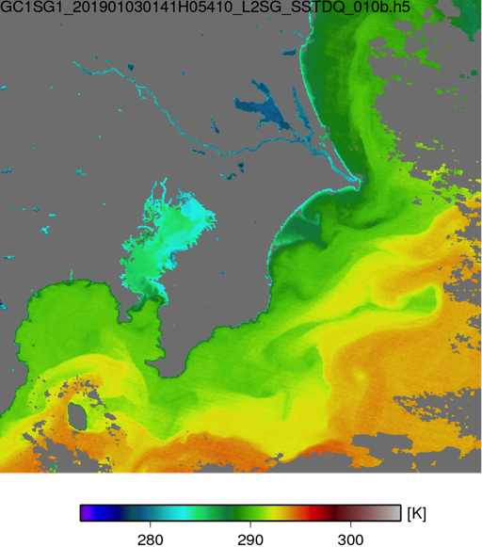
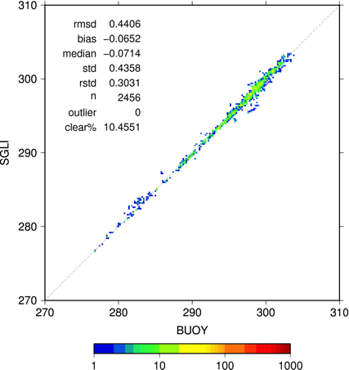
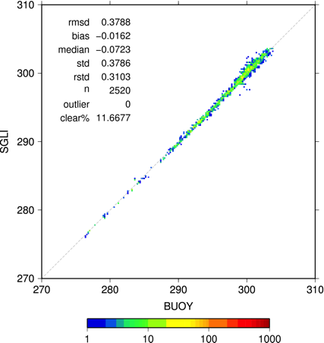
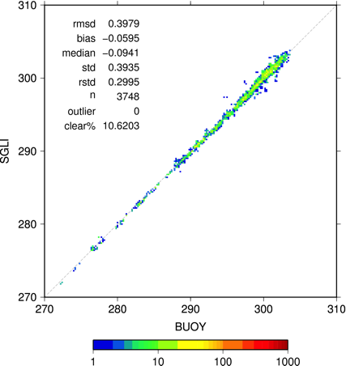

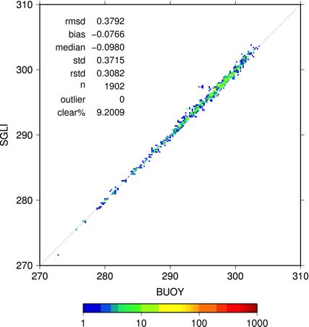
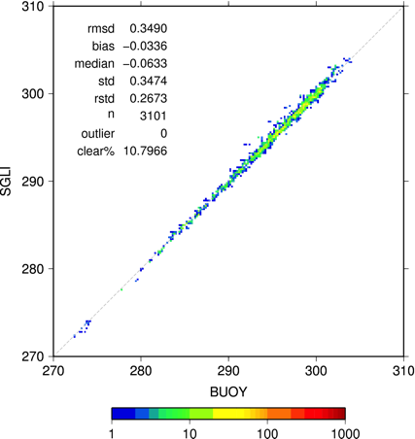
SGLI SST (TIR)
Tokyo
July 2018
August
September
October
November
December
SGLI SST is derived by a radiative transfer algorithm (Kurihara et al., 2016) simplified by local linearity (not adjusted by SGLI and buoy).
Good accuracy (RMSD: 0.3~0.4 K/monthly) suggests well calibrated SGLI/TIR.
Monthly statistics (daytime, 2018) derived by comparison with buoy (iQuam) data.

Slide 10
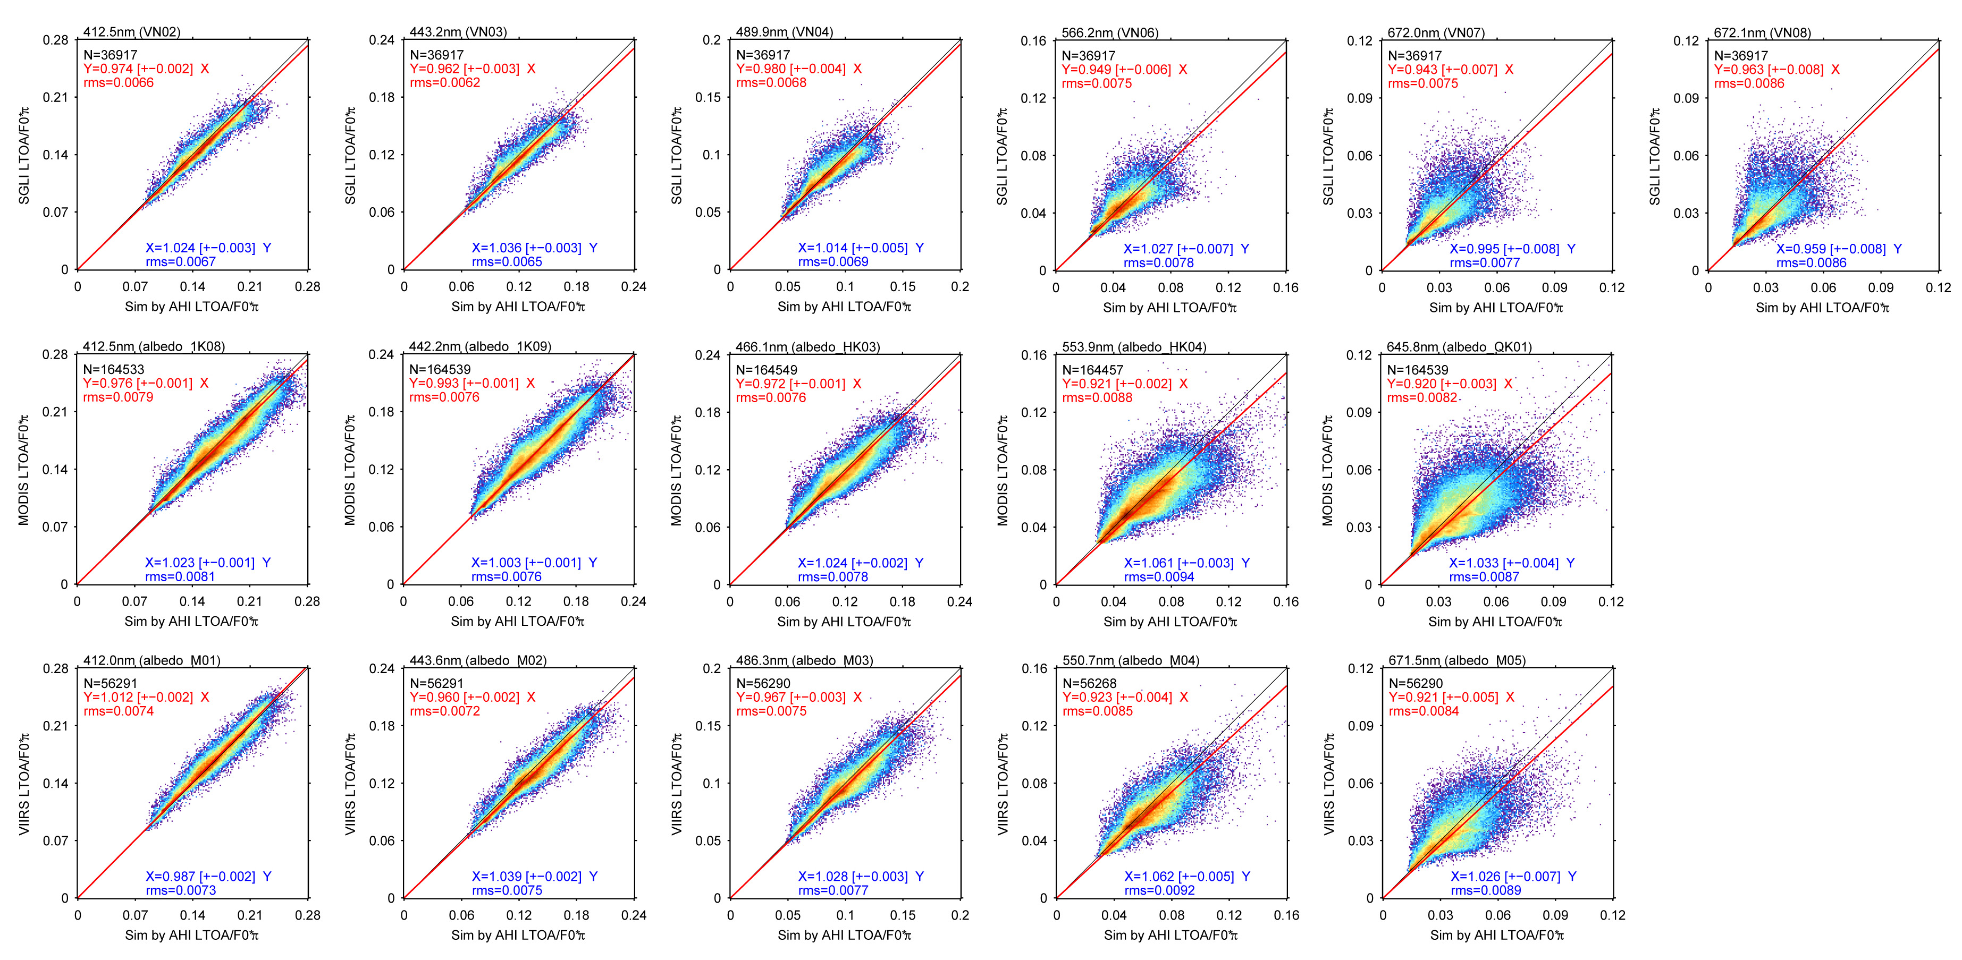
Cross-cal among SGLI/MODIS/VIIRS through AHI (Ocean area)
SGLI L_{TOA}
GEO AHI L_{TOA}
Other LEO L_{TOA}
Δt<10min
Δt<10min
Aerosol
Aerosol
Wavelength by IOP spectra
BRDF by Morel’s model
SGLI R_{W}
RT model
Other R_{W}
R_{W}
AHI R_{W}
AHI R_{W}
R_{W}
SGLI
A-MODIS
VIIRS
1-day global data on 1 Jan 2019
10

Slide 11
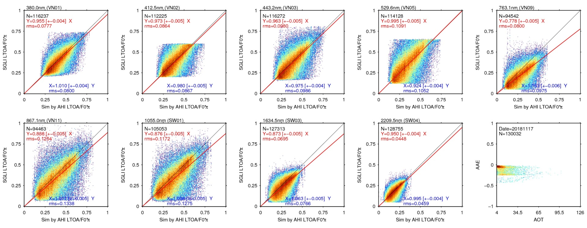
Cloud/Cross-cal of SGLI and AHI (water-cloud over the ocean)
SGLI L_{TOA}
GEO AHI L_{TOA}
Δt<10min
RT model
Cloud
(COT, CER)
RT model
SGLI saturation level
SGLI saturation level
Preliminary results
 | nm | 380 | 412 | 443 | 530 | 763 | 867 | 1050 | 1630 | 2210
SGLI /AHI | avg | 0.995 | 0.973 | 0.963 | 0.995 | 0.778 | 0.888 | 0.876 | 0.873 | 0.950
 | RMS | 0.078 | 0.086 | 0.098 | 0.109 | 0.080 | 0.125 | 0.117 | 0.070 | 0.045
Preliminary results

Slide 12

JAXA’s Instruments Updates &
Planned launches
Current in operation
  GOSAT: Launched in 2009. Latest version 201.202 was released in 2016
  GCOM-W: Launched in 2012. Latest version 3 was released in March 2017
  GPM: Launched in 2014. Latest version 5 was released in May 2017
  ALOS-2: Launched in 2014. Data release in November 2014
  GCOM-C: Launched in Dec. 2017. Data have been released in Dec. 2018
  GOSAT-2: Launched in Oct. 2018.
Forthcoming launches
  EarthCARE (JFY 2021)
  High resolution optical (ALOS-3) (JFY 2020), SAR (ALOS-4) (JFY 2020)
Other major events
  JAXA Himawari Monitor system (http://www.eorc.jaxa.jp/ptree) is updated in August and October 2018. Updated geophysical products (aerosol property, daily & monthly products), and released new products (model output SST and aerosol).
  GOSAT3(incl. AMSR-3) Phase-A (pre-project phase) in Sep. 2018

Slide 13
Introduce/Confirm the JAXA’s
Personnel supporting GSICS
GRWG Members
  Hiroshi Murakami (optical & IR imager, GCOM-C/SGLI, Himawari-8)
  Misako Kachi (MW imager, Aqua/AMSR-E, GCOM-W/AMSR2)
  Takashi Maeda (MW imager, Aqua/AMSR-E, GCOM-W/AMSR2)
GDWG Members
  None
Others who provide supports if needed
  Yuki Kaneko, Kosuke Yamamoto (precipitation radar, TRMM/PR, GPM/DPR)
  Kei Shiomi (GOSAT, GOSAT-2)
  Takeo Tadono (high resolution optical imager & SAR: ALOS, ALOS-2, ALOS-3, and ALOS-4)

Slide 14
Thank you for your attention
WMO GSICS Portal
http://gsics.wmo.int
GSICS Coordination Centre http://www.star.nesdis.noaa.gov/smcd/GCC/index.php
GSICS Product Catalog https://www.star.nesdis.noaa.gov/smcd/GCC/ProductCatalog.php
GSICS Wiki
http://gsics.atmos.umd.edu/wiki/Home

