Slide 1
GRWG Microwave Sub-Group Briefing
Ralph Ferraro (NOAA/NESDIS) and Qifeng Lu (CMA) (Co-Chairs)
(and entire MW Subgroup)

Slide 2
Outline
Scope of MW Subgroup
Membership/Co-chairmanship
Focus for past/upcoming year
Status of Action Items
Quarterly Meetings/Highlights
Upcoming MW Session (Wed)
Summary of Accomplishments & Ongoing Endeavors

Slide 3
Members Signed up as of March 2019
Over 60 members!
NOAA (and affiliates) - Ralph Ferraro (Co-Chair)*, Huan Meng, Cheng-Zhi Zou, Tony Reale, Mark Liu, Bomin Sun, Ben Ho, Manik Bali (Univ. Maryland), Isaac Moradi (Univ. Maryland), Hu (“Tiger) Yang (Univ. Maryland), Wenze Yang (Univ. Maryland), Johnny Luo (City College New York), Xaiolei Zou (Univ. Maryland), Lin Lin (Univ. Maryland), John Yang (Univ. Maryland), Yalei You, Bob Iacovazzi
EUMETSAT (and affiliates) – Tim Hewison, Karsten Fennig, Viju John, Jörg Ackermann, Sabatino DiMichele, Sante Laviola, Vinia Mattoli, Sreerekha Thonipparambil, Christophe Accadia, Timo Hanschmann, Martin Burgdorf (Hamburg Univ.), Imke Hans (Hamburg), Ralf Bennartz (Vanderbilt Univ.), Bruno Picard (CLS)
NASA (and affiliates) – Ed Kim (GSFC), Tanvir Islam (JPL), Linwood Jones (Univ. of Central Florida), Rachael Kroodsma (Univ. of Maryland), Wes Berg (Colorado State Univ.), Thomas Holmes (GSFC), Carl Mears (RSS)
NIST – Derek Houtz, Dazhen Gu
NWI – Thomas Lavergne
ECMWF – Steve English, Heather Lawrence
UKMO – Bill Bell, Fabien Carmenati, Elizabeth Good, Rob King, Christoforois Tsamalis
CMA (and affiliates) –Qifeng Lu (Co-Chair), Lin Chen, Hu Yang, Xiaolong Dong, Shengli Wu, Xiuqing Hu
KMA (and affiliates) – Jun Park, Dong-Bin Shin (Yonsei University, South Korea), Dohyeong Kim, Minju Gu
JAXA (and affiliates) - Misako Kachi, Takashi Maeda
IISC – Ram Ratan
*Stepping down during 2019 – replacement to be discussed at MW session

Slide 4
Scope of Microwave Sub-Group
Understanding the users’ requirements for inter-calibration products for microwave instruments
Imagers + sounders – passive only (initially, but eventually consider active if there is a need…)
Retrospective calibration (CDR’s and their components like geolocation, scan biases, inter-satellite)
Forward looking calibration (near-real time uses)
Identifying existing products that could meet those requirements, but first….
Need to define criteria…Reference standards (sensor(s), models, calibration methodologies….)
And then a process that adheres to GSICS principles
We should also focus on tools/algorithms like SNO, Double Difference, RTM, etc.
Near term goals?
Define data standards (jointly with GDWG)
Coordination with other groups (e.g., CEOS WGCV MW, GPM X-Cal) would also be required to generate standards and best practices
Address special requests/actions from CGMS

Slide 5
Focus Topics for 2018-2019
Defining CLEAR PATH for GSICS MW products, algorithms, tools, deliverables
Methodologies (Jun Park, Rachel Kroodsma)
SNO, Double difference, etc.
Reference Standards (Manik Bali, Isaac Moradi, Derek Houtz)
A particular sensor? Likely to be wavelength dependent (e.g., window, O₂, H₂0); A RTM?
LUT/Correction Tables (Karsten Fennig, Cheng-Zhi Zou, Viju John)
Near real-time and climate; they will be different
Tying together other groups/opportunities
GPM X-Cal (Wes Berg, Rachel Kroodsma)
CEOS MW subgroup (Cheng-Zhi, Xiaolong Dong, Qifeng Lu, Tim Hewison)
Expanding active participation (Manik Bali, Ralph Ferraro)
CGMS - SCOPE-CM (Karsten Fennig); IPWG (Ralph Ferraro)
GRUAN (Tony Reale, Cheng-Zhi Zou)
FIDUCEO (Martin Burgdorf, Bill Bell, Fabien Carminati)
GAIA-CLIM (Heather Lawrence/Steve English)
Address special requests/actions from CGMS
WIGOS2040
Gap Mitigation
Continued participation by subgroup at meetings of relevance:
GSICS; CEOS;CALCON, Microrad, AMS Sat. Met, EUMESAT Satellite, etc.

Slide 6
2018 MW Session
Thu pm | GRWG: MW Sub-Group
 | Chair : Ralph Ferraro
13:00 | Ralph Ferraro | NOAA | Introduction and Action Item/Discussion | 9a | 0:30
13:30 | Shenli Wu | CMA | Development of FY-3/MWRI Calibration on warm/cold targets and reflector emissivity | 9b | 0:20
13:50 | Yang Guo | CMA | Calibration and validation of Microwave Humidity Sounder onboard FY-3D satellite | 9c | 0:20
14:10 | Hao Liu | NSSC | Consideration of the on-board calibration of interferometric synthetic aperture microwave radiometer, | 9d | 0:20
14:30 | Xiaolong Dong | NSSC | Development and Standardization of the Guidelines for Prelaunch Calibration of Microwave Sensors - Activities of the CEOS WGCV | 9e | 0:20
14:50 | Ninghai Sun | NOAA Affiliate | ATMS SDR NOAA-20 and NPP ATMS calibration update | 9f | 0:20
15:10 | Coffee break |  |  |  | 0:20
15:30 | Ralph Ferraro | NOAA | Introduction: Radio Occultation as a MW standard/calibration source | 9g | 0:10
15:40 | Lin Lin | NOAA Affiliate | Mutual Validations of Observations between lifetime S-NPP ATMS and GPS ROs from COSMIC, MetOp and KOMPSAT (Provided by Xiaolei Zou) | 9h | 0:15
15:55 | All |  | RO Discussion | 9i | 0:30
16:25 | Scott Hu | CMA | ATMS Cal/Val evaluation using FY-3C/GNOS profile standard | 9j | 0:15
16:40 | Manik Bali | NOAA Affiliate | Proposed Best Practices | 9k | 0:30
17:10 | Ralph Ferraro | NOAA | NASA GPM X-Cal Updates (provided by Wes Berg and Rachel Kroodsma) | 9l | 0:20
17:30 | Manik Bali | NOAA Affiliate | GRUAN (Provided by Tony Reale) | 9m | 0:30

Slide 7
Recent Meetings of Microwave Sub-Group
Mostly web meetings
Max 2.5hr; try to hold in the 1100 – 1400 UTC timeframe
Materials and minutes always posted on Wiki
23 May 2018
22 June 2018
24 October 2018
17 January 2019
Some side-bar meetings:
GRUAN - RTM
Best practices
Passive MWI gap mitigation

Slide 8
Open & New Action Items (1/2) Details in backup slides in presented Wed MW session
Action Id | Item | Summary | Lead | Expected Completion | Actual Completion | Status
A.GMW.2017.6g.1 | MW RTM comparison | MW co-chair to develop set of specific tasks to be performed by the Subgroup to intercompare RTM output over static references and surface models. Tasks to be identified within 6 months (Sep. 2017). | Isaac Moradi | 2019-08-31 |  | Moradi working with Reale (NOAA) on using colocated GRUAN and NOAA-20/S-NPP data. Initial results have been generated and will be shown in MW session
A.GMW.20170725.2 | http://gsics.atmos.umd.edu/bin/view/Development/20170725 | Can we define short-term and long-term goals? Short term would be what we could accomplish within the next year - seems like "best practices" might be something to strongly consider. Cheng-Zhi and Karsten to think more closely about their products/practices and define some starting points. |  | 2018-03-01 | 11/1/2018 | Close - no longer relevant/replaced by other actions
A.GMW.2018.9a.1 | MW CDR GSCIS product | Are diurncal cycle affects included in the NOAA MSU/AMSU CDR time series generated by NESDIS (Cheng-Zhi Zou)? If not, then its a candidate for a GSICS product. | Manik Bali | 10/1/2018 | 11/1/2018 | Closed. Diurnal cycle is accounted for in this data set.
A.GMW.2018.9e.1 | MW ISO | GSICS (C. Zou) and CEOS WGVC (X. Dong) to coordinate on best practice for MW Sensors and coordinate on the development of a MW ISO sensor document (similar to other wavelengths) lead by Dong’s group. | Cheng-Zhi Zou | 3/1/2019 | 1/17/19 | According to Ed Kim on 1/17/19, this dcoument has been generated. So action is most likely closed.
A.GMW.2018.9g.1 | MW GPSRO reference | GPSRO focal points (X. Zou/Lin and S. Hu) to further evaluate their results for effects of cloud water and cloud ice and report back to the group within 6 months. | Scott Hu | 10/1/2019 |  | Open – Have received some information from Zou/Lin. Will be discussed at MW session.
A.GMW.2018.9k.1 | MW Best Practices | In order to determine best practice for pre and post-launch (include best practices for MW SNO inter-comparisons) best practices and share proposed best practices matrix with MW members and develop consensus. | Manik Bali | 2/1/2019 |  | Open. Manik has developed matrix and is undergoing review. Will be discussed at this meeting.
A.GMW.2018.9k.2 | MW Best Practices | Manik will survey existing satellite operator monitoring pages and present finding within 6 months. | Manik Bali | 10/1/2018 | 10/1/2018 | Closed
A.GMW.2018.9k.3 | MW Best Practices | Manik will ask around to find these websites and make them available. | Manik Bali | 10/1/2018 | 10/1/2018 | Closed
A.GMW.2018.9k.5 | MW CDR as an in-orbit reference | To determine if the NOAA CDR (MSU/AMSU/ATMS) is a viable in-orbit reference, Zou and Bali will report back to the group after a forthcoming paper is published. | Cheng-Zhi Zou | 3/1/2019 |  | Open. To be discussed in MW session.
A.GMW.2018.9l.1 | MW in-orbit reference | Collect and document "best practices" from NASA GPM X-Cal group to see if GMI can serve as an in-orbit reference. | Ralph Ferraro | 12/31/2018 | 12/18/2018 | Closed
A.GMW.20180718.1 | http://gsics.atmos.umd.edu/bin/view/Development/20180718 | Manik to obtain and determine SNO parameters for all MW channels but also work with a smaller tiger team to plan some sensitivity studies for NRT vs. climate SNO. | Manik Bali | 3/1/2019 |  | White paper developed. Undergoing review. To be discussed in MW session.
A.GMW.20180718.2 | http://gsics.atmos.umd.edu/bin/view/Development/20180718 | Tim and Qifeng to develop circulate strawman for MW imager NRT products and will present this at CEOS WGCV meeting at EUMETSAT in late August. | Tim Hewison | 3/1/2019 | 9/1/2018 | Closed
A.GMW.20180718.3 | http://gsics.atmos.umd.edu/bin/view/Development/20180718 | Ralph to follow up with Mitch Goldberg (NOAA rep on CGMS and also GSICS EP chair) about expectations for the MW imager gap meeting. | Ralph Ferraro | 3/1/2019 | 12/18/2018 | Closed
A.GMW.20180718.4 | http://gsics.atmos.umd.edu/bin/view/Development/20180718 | Qifeng and Cheng-Zhi to co-lead activities with WGCV/X. Dong. | Qifeng Lu | 3/1/2019 |  | Open. To be discussed in MW Session

Slide 9
Open & New Action Items (2/2)
Action Id | Item | Summary | Lead | Expected Completion | Actual Completion | Status
A.GMW.20180718.5 | http://gsics.atmos.umd.edu/bin/view/Development/20180718 | Bruno to provide the group with URL's for CLS sensor monitoring and relevant papers |  | 3/1/2019 | 1/15/2019 | Closed
A.GMW.20181024.1 | http://gsics.atmos.umd.edu/bin/view/Development/20181024 | Follow up on RTM Comparison | Isaac Moradi and Tiger Yang | 1/17/2019 |  | Open
A.GMW.20181024.2 | http://gsics.atmos.umd.edu/bin/view/Development/20181024 | Plans for MW dedicated session at 2019 Annual Meeting | Ralph Ferraro and Tim Hewison | 1/17/2019 | 12/18/2018 | Closed. There will be a dedicated all day session.
A.GMW.20181024.3 | http://gsics.atmos.umd.edu/bin/view/Development/20181024 | GPM X-Cal Deliverable | Manik Bali and Ralph Ferraro | 1/17/2019 | 2/1/2019 | Closed. Deliverable made by Wes Berg; Bali developed test web page that is undergoing evaluation. Upon completion, it will be recommened to the EP. See A.GMW.20190117.4
A.GMW.20181024.4 | http://gsics.atmos.umd.edu/bin/view/Development/20181024 | SNO paper on Best Practices | Manik Bali | 11/30/2018 | 1/17/2019 | Closed - See A.GMW.20190117.3
A.GMW.20181024.5 | http://gsics.atmos.umd.edu/bin/view/Development/20181024 | GSICS engagement with IPWG | Ralph Ferraro | 1/17/2019 | 11/10/2019 | Closed. A short presentation was given at IPWG. No specific feedback received.
A.GMW.20190117.1 | http://gsics.atmos.umd.edu/bin/view/Development/20190117 | WIGOS2040 | Manik Bali | 3/31/2019 |  | Open. We have a session on this topic on Wed’s MW session
A.GMW.20190117.2 | http://gsics.atmos.umd.edu/bin/view/Development/20190117 | MW Imager Constellation Gap | Ralph Ferraro | 3/31/2019 |  | Open. Qifeng Lu will chair session at 2019 Annual meeting.
A.GMW.20190117.3 | http://gsics.atmos.umd.edu/bin/view/Development/20190117 | Complete SNO Best Practices (same as A.GMW.2018.9k.1) | Manik Bali | 2/17/2019 |  | Open.
A.GMW.20190117.4 | http://gsics.atmos.umd.edu/bin/view/Development/20190117 | GPM X-Cal Deliverable | Manik Bali/Wes Berg | 3/31/2019 |  | Replaces A.GMW.20181024.3
WGI actions open from previous plenary sessions (at CGMS-46)
Actionee | AGN item | Action # | Description | Action feedback/closing document | Deadline | Status | HLPP ref
GSICS | F | A46.xx | On passive microwave observations: GSICS is requested to organise an expert meeting on the intercalibration of operational PMW sensors to meet the WIGOS 2040 targets for a coordinated effort to share information on current and future PMW instruments and report to CGMS-47 (CGMS-46-EUM-WP-14) |  | CGMS-47 | OPEN

Slide 10
Meeting Highlights (1/4)
Tim Hewison, 23 May 2018
Bruno Picard, 18 July 2018
Assessment of MW Imagers
Vicarious calibration at CLS

Slide 11
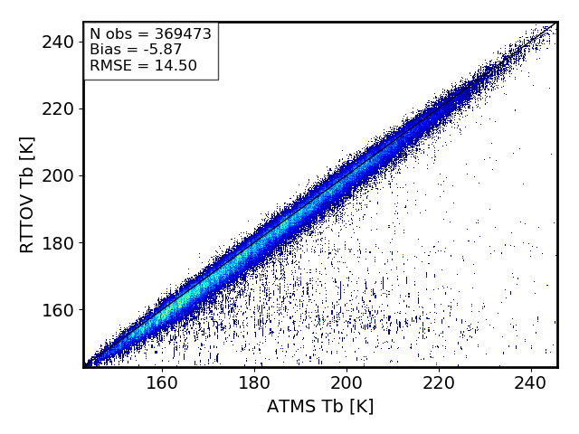
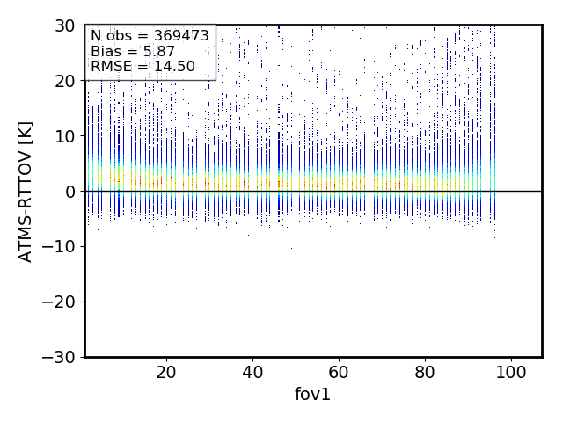
Meeting Highlights (2/4)
Isaac Moradi, 24 October 2018
Timo Hanschmann, 18 July 2018
MW Humidity Sounder FCDR for C3S
MHS, MWHS, ATMS
Comparison of MW RT Models
CRTM vs. ATMS – Channel 1 (23 GHz)
RTTOV vs. ATMS – Channel 1 (23 GHz)

Slide 12
Meeting Highlights (3/4)
Qifeng Lu, 24 October 2018
Fabien Carminati, 17 January 2019
Use of FY-3C in NWP
Characterization of NWP biases for improved satellite cal/val
MWHS-2 and MWTS-2 vs. ATMS

Slide 13
Meeting Highlights (4/4)
Martin Burgdorf, 17 January 2019
Hu (Tiger) Yang, 24 October 2018
Check of lunar TB models with MHS
ATMS Calibration

Slide 14
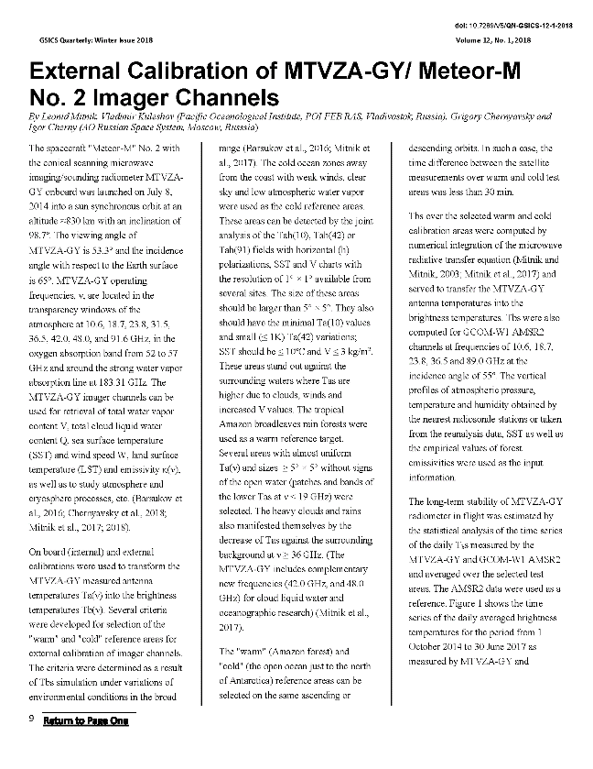
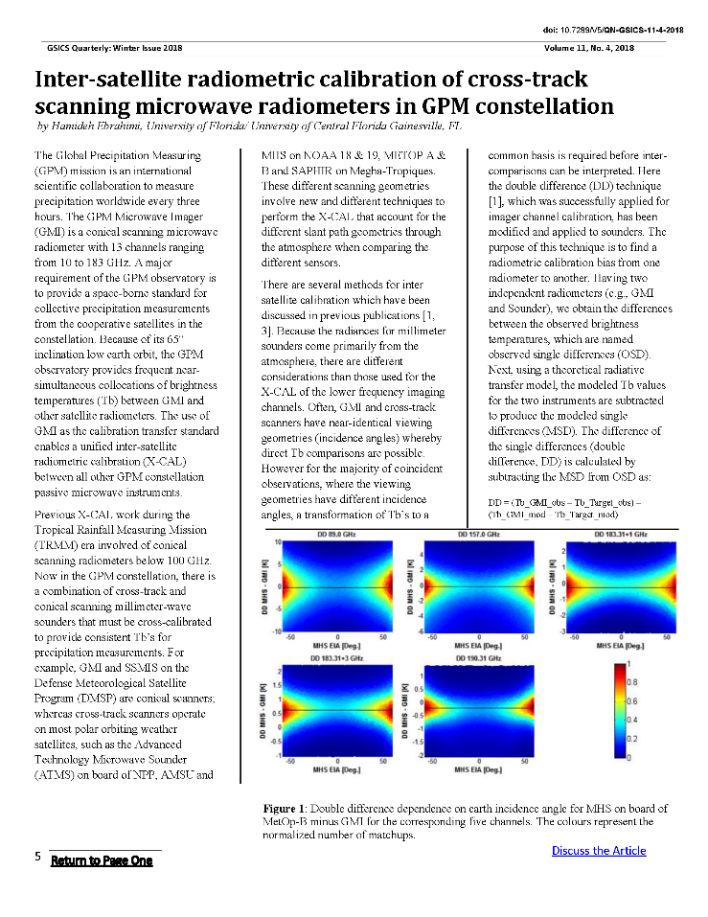
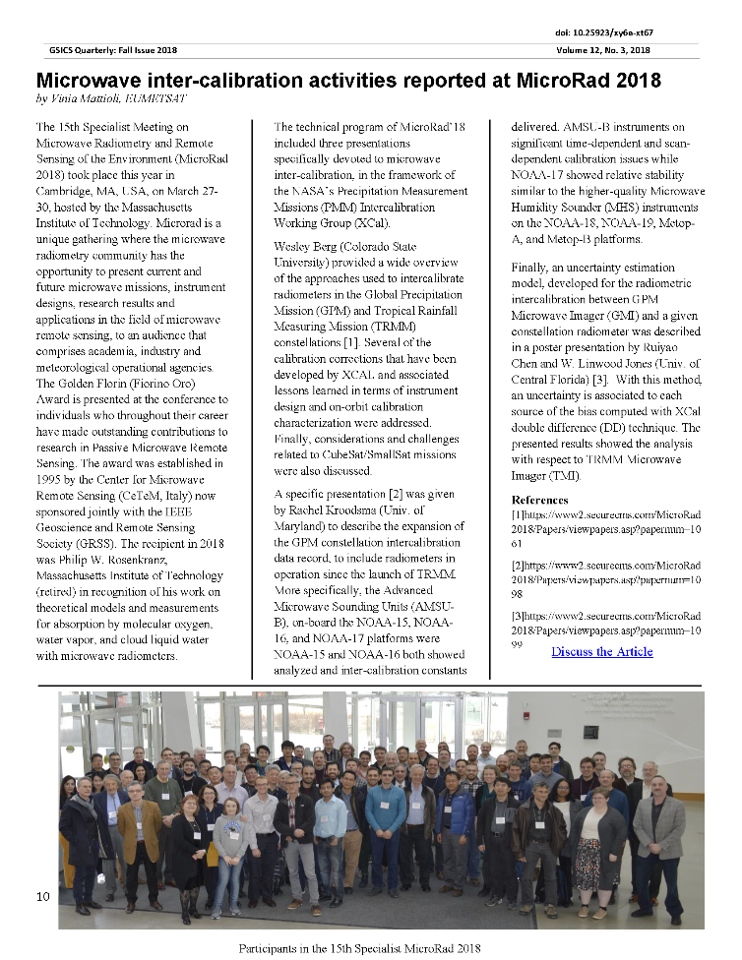
Newsletters – MW Topics

Slide 15
2019 MW Session
Wed am | GRWG: MW Sub-Group
 | Chair: Ralph Ferraro, Minutes: Cheng-Zhi Zou
8:30 | Ralph Ferraro | NOAA | Round Table Introduction, Objectives, Agenda | 5a | 0:10
8:40 | Raffaele Crapolicchio | ESA | SMOS Cal/Val Activities | 5b | 0:15
8:55 | Roberto Sabia | ESA | SMOS Geophysical Products | 5c | 0:15
9:10 | Bill Bell | ECMWF | EU's C3S | 5d | 0:15
9:25 | Tim Hewison | EUMETSAT | MetOp-C AMSU-A/MHS Status | 5e | 0:10
9:35 | Ed Kim | NASA | NOAA-20 ATMS Status | 5f | 0:15
9:50 | Mikaso Kachi | JAXA | AMSR-2/AMSR-3 Update | 5g | 0:15
10:05 | Ed Kim | NASA | MW Calibration Targets | 5h | 0:20
10:25 |  |  | Coffee Break |  | 0:20
10:45 | Jeiying He and Qifeng Lu | NSSC/CAS | Joint activities with CEOS: Initial progress and example from FY3-MWHS2 | 5i | 0:20
11:05 | Shengli Wu | NSMC/CMA | FY-3 MWRI - Calibration and time series record | 5j | 0:15
11:20 | Cheng-Zhi Zou | NOAA | Possible MW sounder references and their use for re-calibration of other satellites | 5k | 0:15
11:35 | Ralph Ferraro | NOAA | Review of Action Items/Ongoing Activities - Session will be a 'round table' addressing each action item - briefings by actionee expected | 5l | 0:10
11:45 | Bomin Sun/Cheng-Zhi Zou | NOAA | Progress with GRUAN observations | 5m | 0:15
12:00 | Lunch Break + Visit to the PHI-Experience |  |  |  | 2:00
Wed pm | GRWG: MW Sub-group - Continuation of Action Items
14:00 | Manik Bali/Rachel Kroodsma | NOAA/NASA | GPM X-Cal LUT's/Deliverable | 5n | 0:20
14:20 | Isaac Moradi | NOAA/UMD | Inter-comparison of fast radiative transfer models and microwave observations | 5o | 0:20
 | GRWG: MW Sub-Group - MWI Constellation Gap
 | Chair: Qifeng Lu; Minutes: Ralph Ferraro
14:40 | Mitch Goldberg | NOAA | The importance of a healthy microwave imager constellation | 5p | 0:20
15:00 | Alan Geer | ECMWF | NWP application - title TBC | 5q | 0:20
15:20 | Fabien Carminati | ECMWF | Current and future use of microwave imager observations in the Met Office NWP system | 5r | 0:20
15:40 |  |  | Objectives/Goals & Discussion | 5s | 0:40
16:20 |  |  | Coffee Break |  | 0:20
16:40 | GRWG: MW Sub-Group - WIGOS 2040
 | Chair: Manik Bali, Minutes: Tim Hewison
16:40 | Manik Bali | NOAA | Review of white paper outline and develop writing team WIGOS/IPWG | 5t | 0:30
17:10 | Mitch Goldberg | GSICS EP | WDQM | 5u | 0:20
17:30 | Toshi Yukirino | WMO | GSICS Document review byWIGOS | 5v | 0:20
18:00 | Qifeng Lu | CMA | WIGOS: Strawman outline draft of a plan to develop inter-calibration products for microwave imagers | 5w | 0:20
18:20 | All | All | Discussion and wrap up | 5x | 0:10
18:40 | Ralph Ferraro |  | Co-Chairmanship | 5y | 0:10
18:50 | END

Slide 16
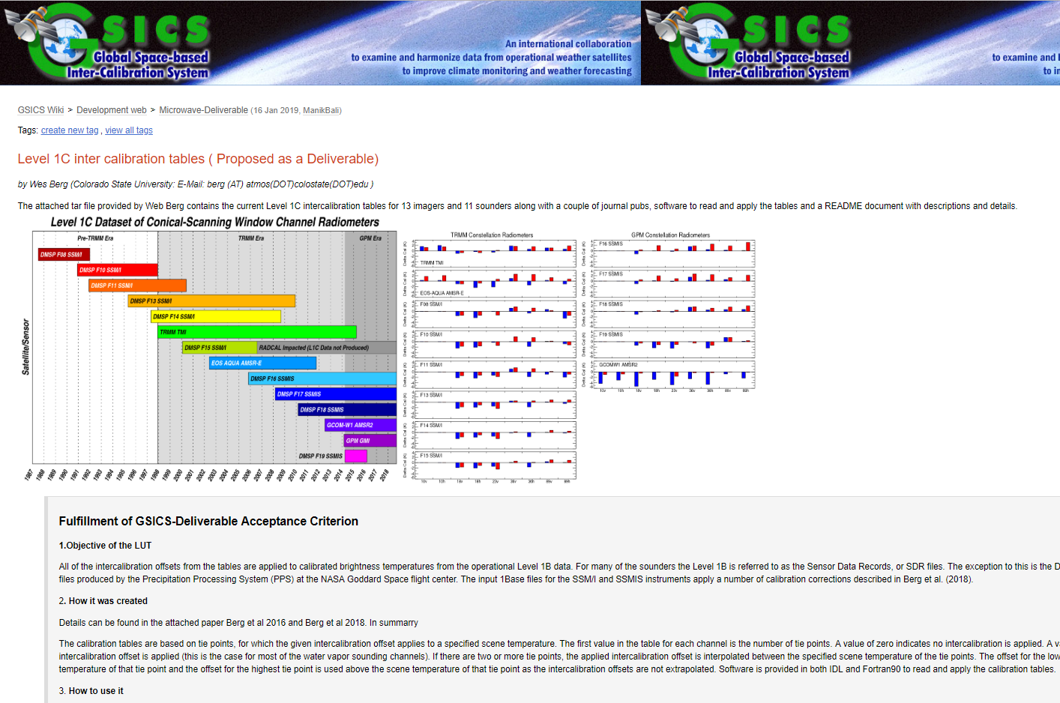
Summary and ongoing endeavors
Continued expansion of group
More ideas and new collaborations
Engagement with other communities
CGMS ISWG’s, CEOS, GPM
Examining methods to characterize MW sensors
Continued MW topics in Newsletter
All Day-MW session
Science topics
Action items
MWI Gap – GSICS view point
WIGOS2040 – Calibration aspect
GSICS Best Practice – MW SNO
GSICS Deliverable Matrix/GPM MWI LUT’s

Slide 17
Backup material

Slide 18
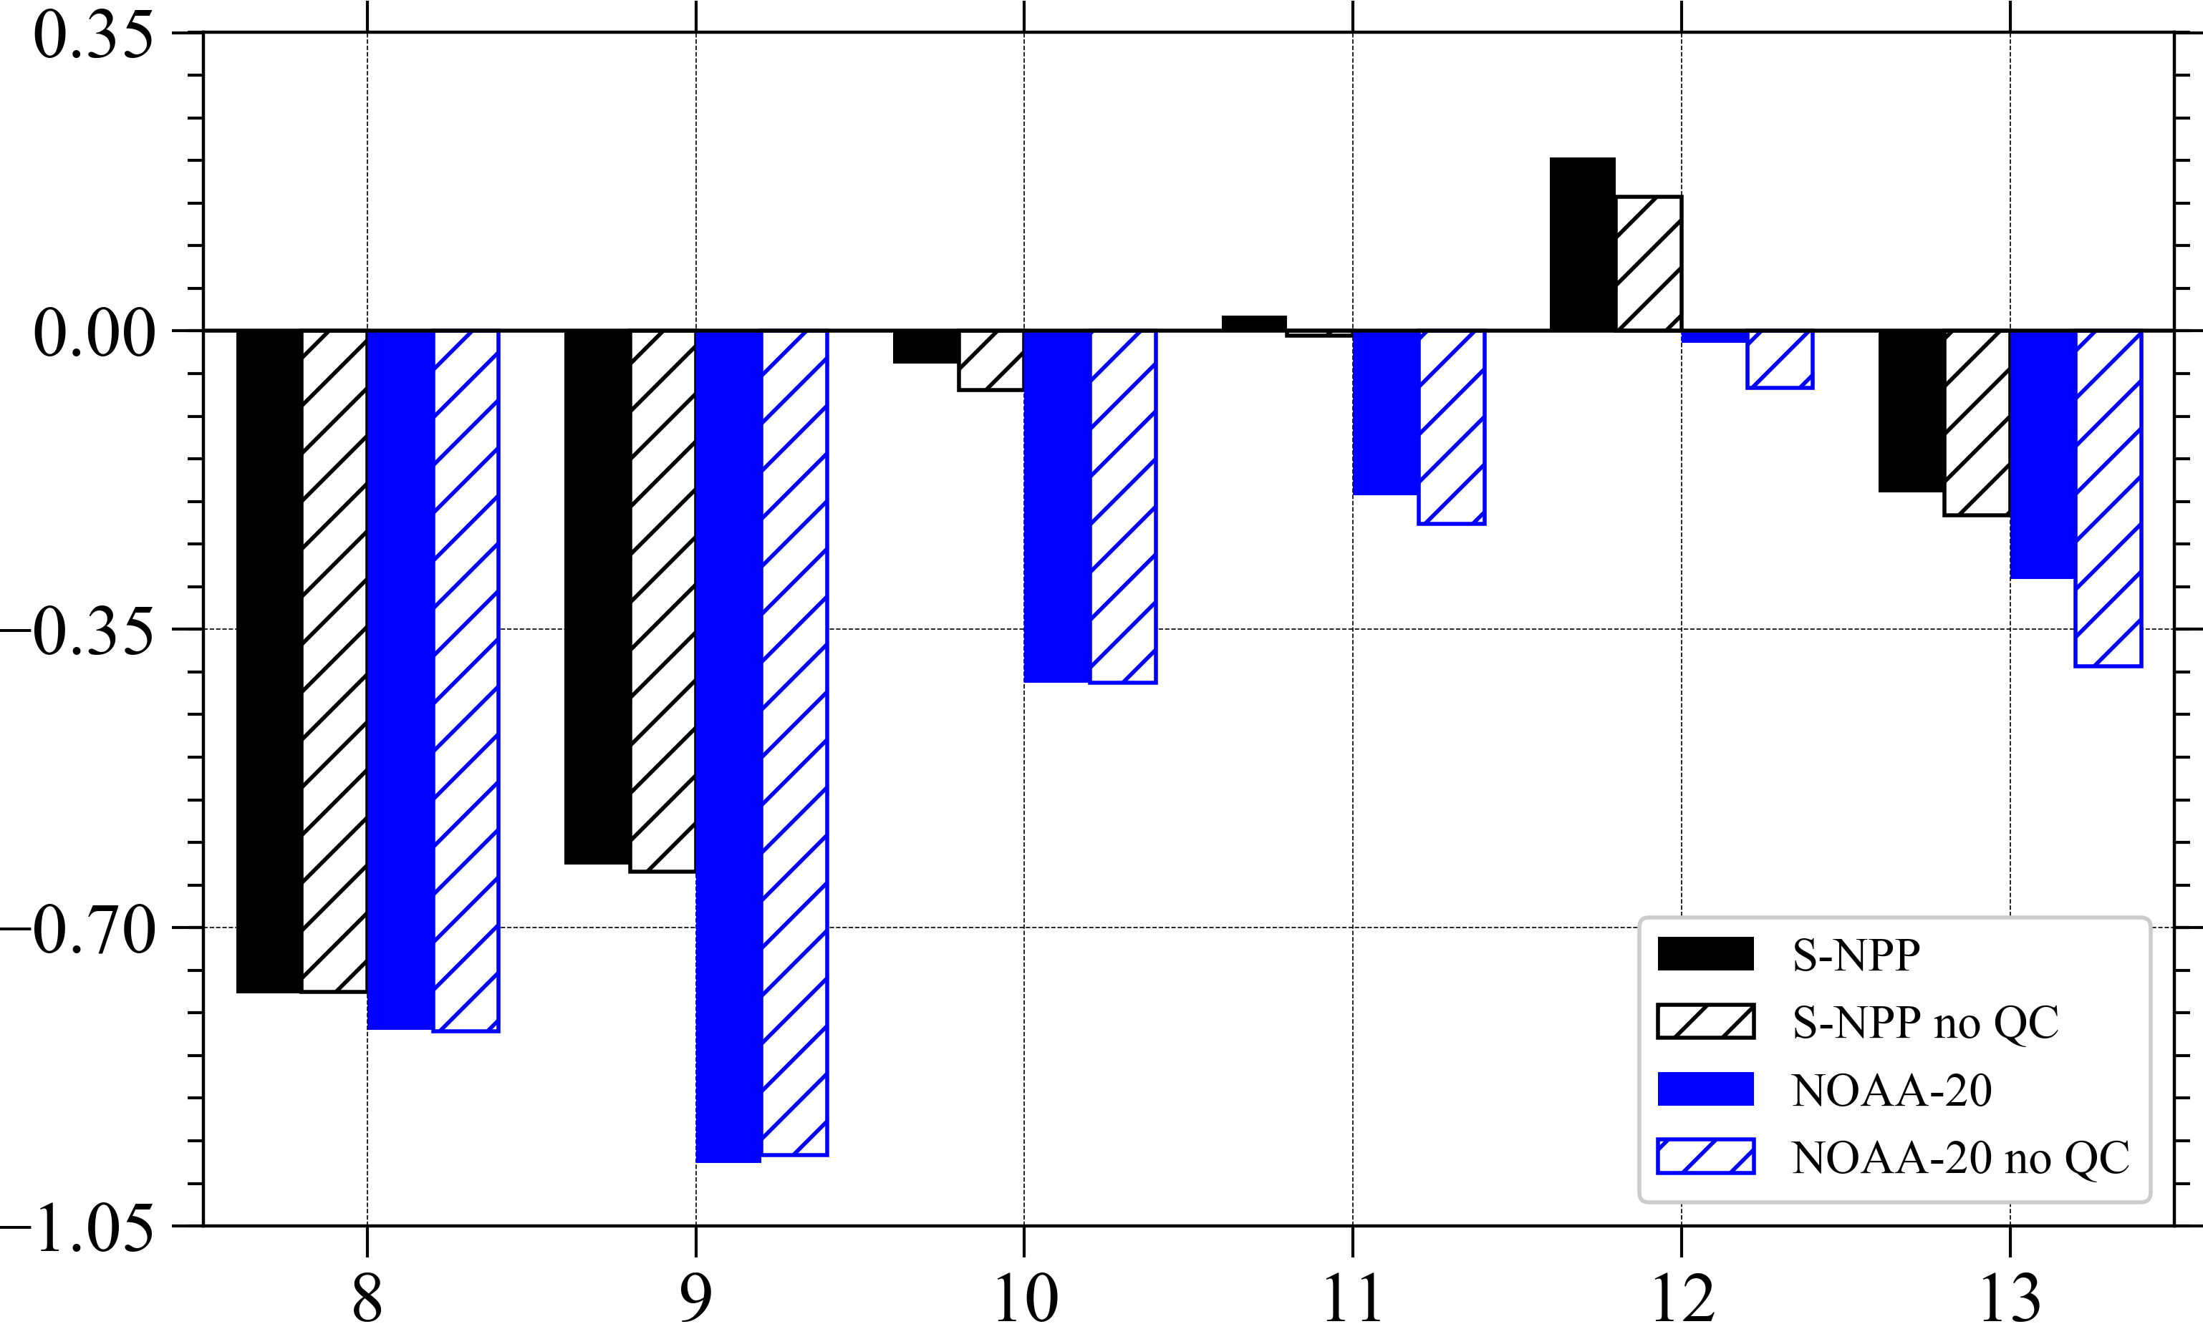
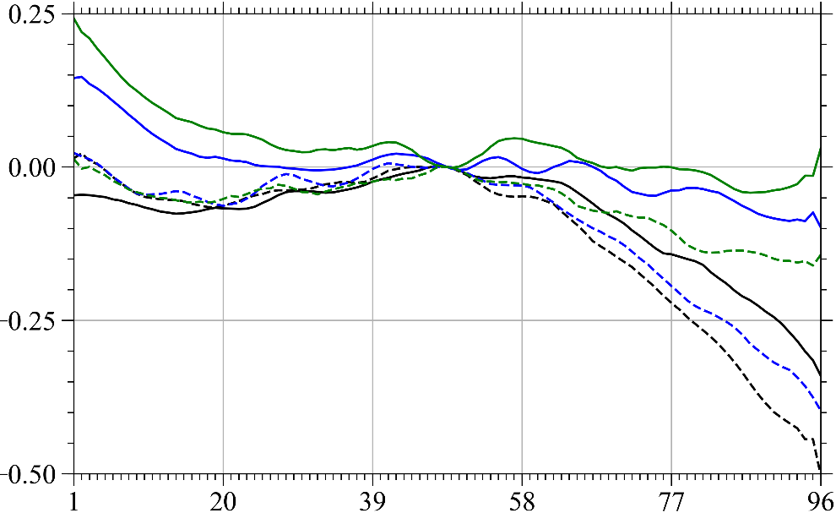
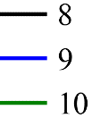
Comparisons of RO-Estimated ATMS Biases between NOAA-20 and S-NPP
Zou X. and X. Tian, Earth System Science Interdisciplinary Center, University of Maryland, USA
ATMS instrument biases from NOAA-20 are estimated and compared with those of S-NPP based on the differences between observed and simulated antenna temperatures in the six months period from 8 December 2017 to 8 June 2018
Vertical profiles of GPS RO temperature and water vapor retrieved from GRAS onboard MetOp-A/-B are used as input to the CRTM
ATMS channels 8–10, for which GPS RO data are most accurate, from NOAA-20 are more negatively biased than the corresponding channels from S-NPP
The scan patterns of the ATMS channel 8 from the two satellites agree quite well
Nadir Bias (K)
ATMS Channel Number
Scan Bias (K)
More results and discussions can be found in
Tian, X. and X. Zou, 2018: Comparison of RO estimated
ATMS biases between NOAA-20 and S- NPP. IEEE
J-STARS, (in revision)
NOAA-20 S-NPP
ATMS FOV Number

Slide 19
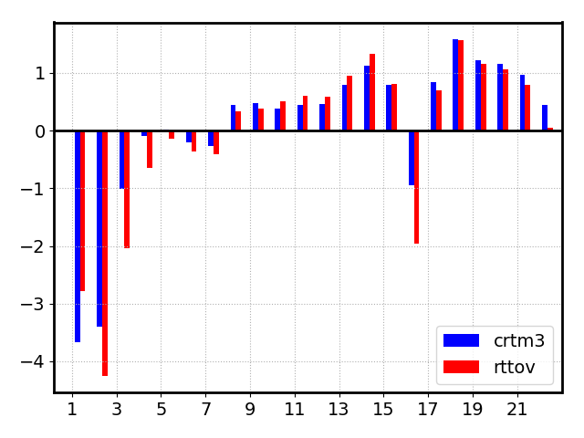
RT Studies in Support of JPSS Satellite Data Calibration
Objective was to evaluate fast and LBL radiative transfer models in the microwave region by inter-comparing several RTMs with satellite observations
Main findings:
RT models show a small bias for the temperature sounding channels but larger for water vapor and surface sensitive channels
The double differences ([RT-N20] – [RT-NPP]) show about 1K difference between N20 and NPP WV channels but just a small difference for temperature sounding channels
Difference between Tbs simulated using CRTM/RTTOV using Era5 profiles as input and ATMS N20 collocated measurements

