Slide 1
GDWG Report 2019
Masaya Takahashi (JMA),
Ashim Mitra (IMD) and Peter Miu (EUMETSAT)

Slide 2
Contents
Brief introduction to GDWG
Membership and recent GDWG activities
Notable GDWG actions
GSICS Collaboration Servers
Use of GitHub for collaborative work
Instrument Event Logging
Action Tracking
Agenda items at GDWG breakout session

Slide 3
GDWG?
Advisory body of GSICS-EP for data management and exchange issues
Composed of Data Management experts
To coordinate/support specification of:
data/metadata formats/procedures for data exchange among agencies
GSICS systems/tools administered by GSICS (e.g. Wiki, Product Catalogue)
To review/validate GSICS Deliverables from DM perspective
To provide guidance to contents/appearance of GSICS websites

Slide 4
Membership and recent GDWG activities
Affiliation | First Name | Last Name
CMA | Zhe | Xu
CMA | Yuan | Li
CMA | Min | Min
CMA | Di | Xian
EUMETSAT | Peter | Miu
EUMETSAT | Simon | Elliott
IMD | R.K. | Giri
ISRO | Nitant | Dube
JMA | Masaya | Takahashi
KMA | Jin | Woo
KMA | Hyunjong | Oh
NOAA | Manik | Bali
ROSHYDROMET | Sergey | Uspensky
WMO | Toshiyuki | Kurino
Recent GDWG activities
GSICS Collaboration Servers
Mirroring products
ISRO new server
Defining GSICS Conventions for new GSICS Deliverables
Updating GSICS Plotting Tool
Use of GitHub for collaborative work
Instrument Event Logging
Action Tracking Tool (GCC+GDWG)
GDWG Actions
20 actions at 2018 Annual Meeting
13 open actions at past meetings

Slide 5
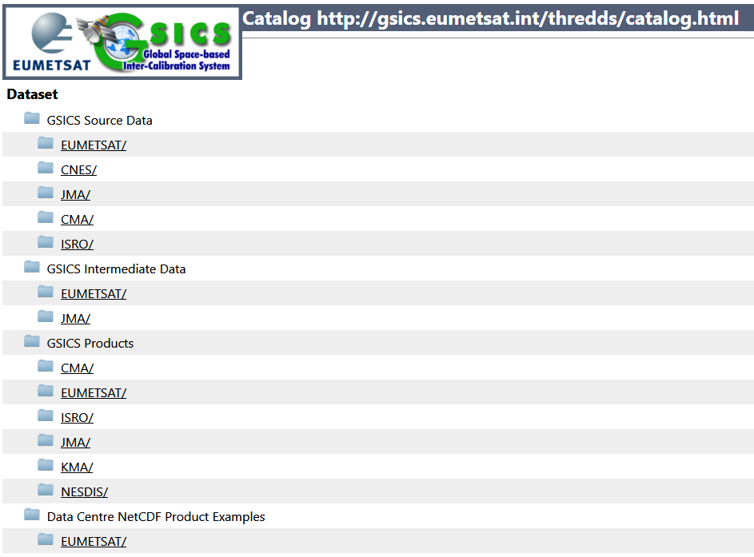
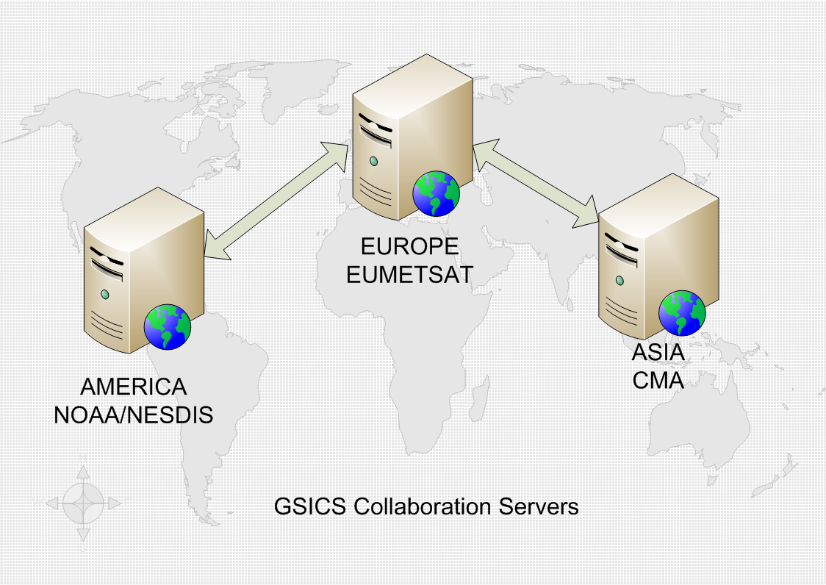
GDWG Notable Actions
GSICS Collaboration Servers (1/2)
Collaboration Server: individually known as Data and Products server
To provide a set of services for users to support data exchange/access to inter-calibration deliverables
GSICS Inter-calibration Products (GSICS Correction, netCDF)
Intermediate data to generate products (e.g. GEO-LEO-IR collocation netCDF)
Source dataset (inputs to inter-calibration ATBD like LEO L1 data)
3 servers at CMA/EUM/NOAA
KMA/JMA products: sent to EUM

Slide 6
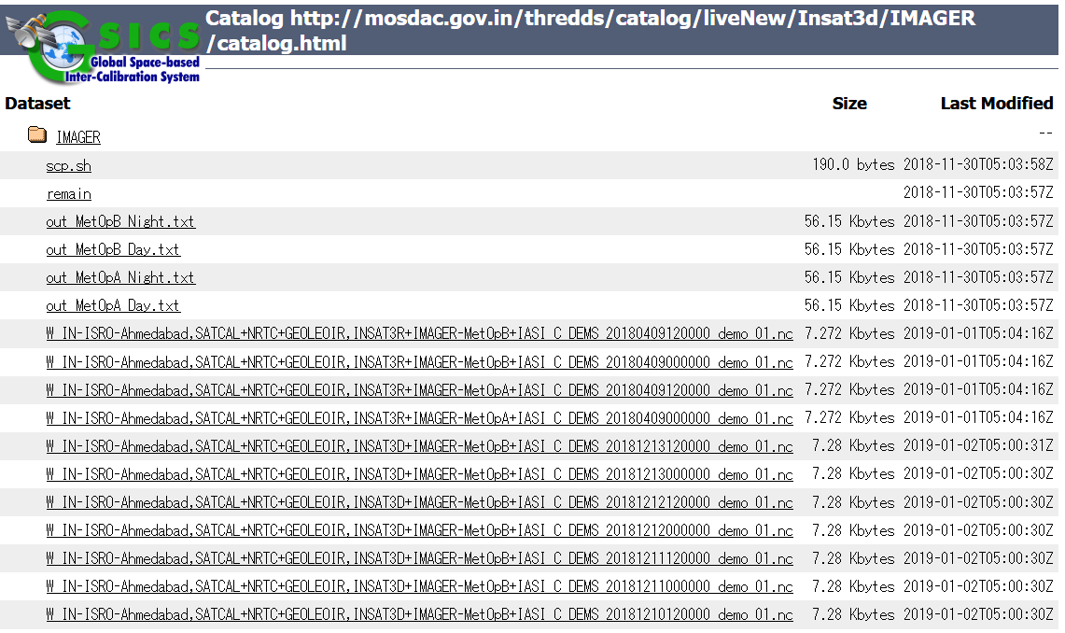
GDWG Notable Actions
GSICS Collaboration Servers (2/2)
Preservation of GSICS Products among Servers
Products in Operational Phase (currently SEVIRI-IASI IR only)
A way to get products has been discussed to overcome security constraints
CMA/NOAA created/tested scripts to download products from Collaboration Servers
New GSICS Sever at ISRO
2017: ISRO launched the server storing their GSICS Products
EUMETSAT/ISRO collaboration for 4th Collaboration Server: underway

Slide 7
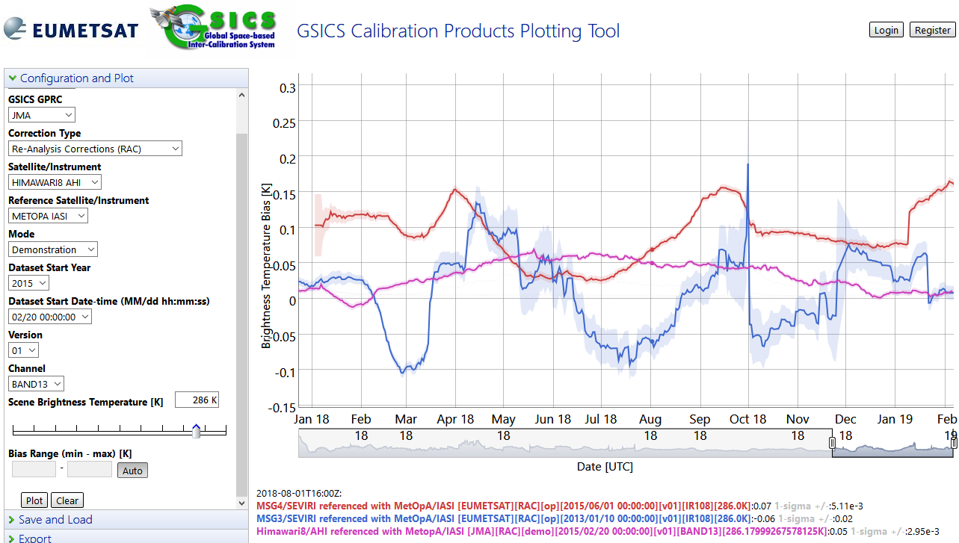
GDWG Notable Actions
Use of GitHub for collaborative work
GDWG GitHub repository: created by KMA in 2017
To collaboratively maintain/develop GDWG relevant tools/software
GSICS Plotting Tool: developed at EUMETSAT
Visualizing GSICS products on GSICS Collaboration Server
Very useful to compare multiple products, but IR Re-Analysis Correction are only supported
ISRO updated Plotting Tool to support Near Real Time Correction as well
Sharing codes in GitHub: to be discussed
VNIR products: to be supported at EUMETSAT’s MICMICS and hopefully be shared with GSICS community in future (R.GDWG.2018.5g.1)
MSG-3/SEVIRI IR10.8
MSG-4/SEVIRI IR10.8
Himawari-8/AHI B13 (10.4 μm)

Slide 8
GDWG Notable Actions
Instrument Events Logging
CGMS Task Team on Calibration Events Logging
Lead by Rob Roebeling (EUM), mainly composed of GDWG members
Goal: to develop a uniform approach for presenting, logging, and monitoring calibration information across satellite operators
A white paper was submitted to CGMS-45 (June 2017)
1st step: to create stable Landing Pages linked from WMO OSCAR/Space
2018: ROSHYDROMET launched their Landing Page
Minor updates of OSCAR/Space to get more traffics to Landing Pages
2nd step: to adopt nomenclature and standards for instrument events
Establishing sub-working group with technical/database experts needed
Further tasks were back to CGMS-46 in 2018 due to difficulty of achieving the goal under the current GDWG

Slide 9
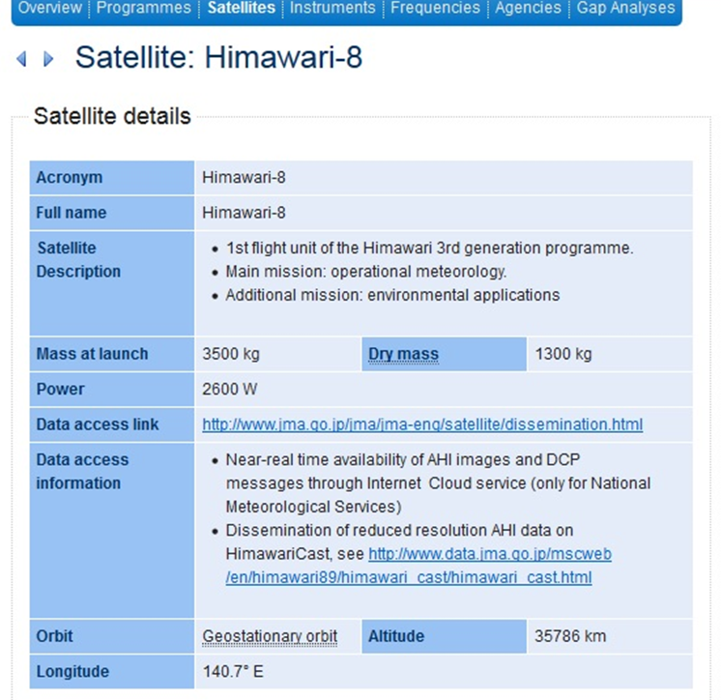
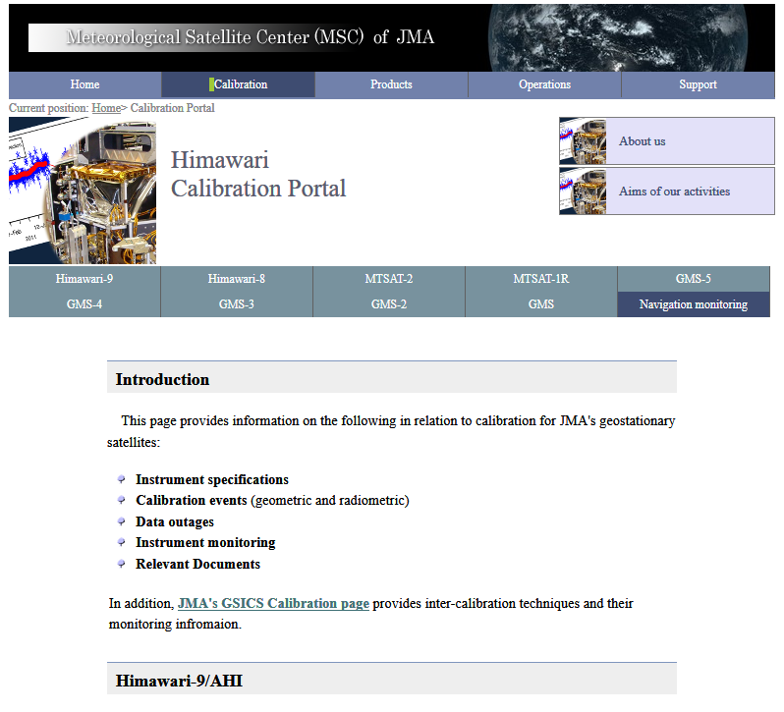
WMO OSCAR/Space
Landing Page at JMA
Hyperlink to Satellite Operator’s Landing Page

Slide 10
GDWG Notable Actions
Instrument Events Logging
CGMS Task Team on Calibration Events Logging
Lead by Rob Roebeling (EUM), mainly composed of GDWG members
Goal: to develop a uniform approach for presenting, logging, and monitoring calibration information across satellite operators
A white paper was submitted to CGMS-45 (June 2017)
1st step: to create stable Landing Pages linked from WMO OSCAR/Space
2018: ROSHYDROMET launched their Landing Page
Minor updates of OSCAR/Space to get more traffics to Landing Pages
2nd step: to adopt nomenclature and standards for instrument events
Establishing sub-working group with technical/database experts needed
Further tasks were back to CGMS-46 in 2018 due to difficulty of achieving the goal under the current GDWG

Slide 11
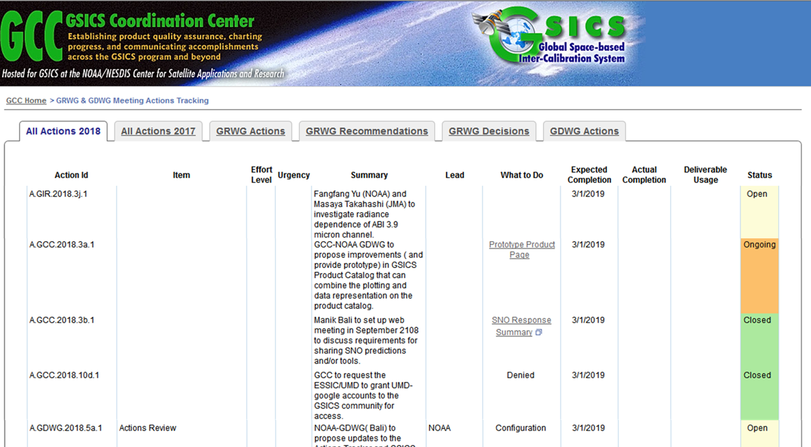
GSICS Action Tracking
Actions until 2016: tracked on the Wiki
Action Tracking Page on GCC Website
Periodical updates by Manik Bali (GCC + NOAA GDWG) to improve usability
Supporting GSICS-EP actions, reducing redundant columns, …

Slide 12
GDWG Session (Wed)
08:30 | Masaya Takahashi | JMA | Round Table Introduction + GDWG Actions Review | 6a | 0:30
9:00 | Alexander Uspensky | ROSHYDROMET | New Russian Cal/Val portal on meteorological satellite instruments and products | 6b | 0:20
9:20 | Jin Woo | KMA | GDWG Baseline Reviews - website, products metadata and structures | 6c | 0:30
9:50 | Toshiyuki Kurino | WMO | New WMO GSICS Portal | 6d | 0:40
10:30 |  |  | Coffee break |  | 0:30
11:00 | Masaya Takahashi | JMA | GSICS Convention for Spectral Response Function files | 6e | 0:20
11:00 | Peter Miu | EUMETSAT | How EUMETSAT’s pathfinder activities would benefit GSICS | 6f | 0:40
11:40 | All |  | Discussion | 6g | 0:20
12:00 | Lunch Break + Visit to the PHI-Experience |  |  |  | 2:00
14:00 | Mirko Albani | ESA | CEOS Working Group on Information Systems and Services (WGISS) | 6h | 0:30
14:30 | Andrea Della Vecchia / Damiano Guerrucci | ESA | ESA Collaborative Environment for Cal/Val | 6i | 0:30
15:00 | Rob Roebeling | EUMETSAT | Event Logging | 6j | 0:30
15:30 | Xiangqian (Fred) Wu | NOAA | GOES-16/-17 ABI Calibration Event Log | 6k | 0:20
15:50 |  |  | Coffee break |  | 0:30
16:20 | Zhe (Thomas) Xu / Di Xian | CMA | FY historical Big Data Reprocessing system establishment and sharing | 6l | 0:30
16:50 | Toshiyuki Kurino | WMO | Links from WMO OSCAR/Space to Calibration Landing Page | 6m | 0:30
17:20 | Jin Woo | KMA | Use of GitHub - updates | 6n | 0:30
17:50 | All |  | Discussion | 6o | 0:30

Slide 13
GDWG Session (Thu)
8:30 | Peter Miu | EUMETSAT | GSICS Collaboration Servers - History, Updates | 9a | 0:20
8:50 | Nitant Dube | ISRO | Status of THREDDS for GSICS Collaboration Servers | 9b | 0:40
9:30 | Zhe (Thomas) Xu | CMA | Updates on GSICS Collaboration Servers | 9c | 0:20
9:50 | Manik Bali | NOAA Affiliate | Updates on GSICS Collaboration Servers | 9d | 0:20
10:10 |  |  | Coffee break |  | 0:30
10:40 | Lin Chen | CMA | PICS/SNO data extraction function | 9e | 0:20
11:00 | Lin Chen | CMA | Data Dissemination | 9f | 0:20
11:20 | Masaya Takahashi | JMA | Visualization of GSICS Products on GSICS Plotting Tool - Current Status and User Requirements | 9g | 0:20
11:40 | Nitant Dube | ISRO | Implementation of GSICS Plotting Tool at ISRO | 9h | 0:20
11:40 | All |  | Discussion for future updates/collaboration on GSICS Collaboration Servers and Plotting Tool | 9p | 0:20
12:00 | Lunch Break |  |  |  | 1:00
13:00 | Manik Bali | NOAA Affiliate | Visualization of GSICS Products on GSICS Product Catalog | 9i | 0:30
13:30 | Manik Bali | NOAA Affiliate | Access for GSICS on Clouds | 9j | 0:30
14:00 | Manik Bali | NOAA Affiliate | Action tracking | 9k | 0:30
14:30 | Manik Bali | NOAA Affiliate | GSICS Wiki Migration | 9l | 0:30
15:00 | Coffee break |  |  |  | 0:30
15:30 | Peter Miu | EUMETAT | Automated validation tool for candidate GSICS products | 9m | 0:30
16:30 | Masaya Takahashi | JMA | Wrap-up: Plan activities for 2019/2020 | 9n | 0:30
17:00 | END

Slide 14
Thanks for your attention!
Notes:
Questions?

