Slide 1
Suomi-NPP VIIRS Sensor Data Record Reprocessing and Distribution Status
Sirish Uprety, Changyong Cao, Wenhui Wang, Xi Shao, Bin Zhang, Slawomir Blonski, Taeyoung Choi, Yalong Gu, Lin Lin
With contributions from
STAR OC Team: Junqiang Sun
GSICS Meeting
March 05, 2019
Frascati, Italy

Slide 2
Outline
S-NPP VIIRS Instrument
VIIRS Reprocessing Status
  Reprocessing ver. 1 (Completed, Will be phased out in near future: http://jlrdata.umd.edu/
  Reprocessing ver. 2 (Ongoing)
    On schedule, completed 1 year (2016) of data
Calibration Improvements
  RSB, TEB and DNB, geolocation
Reprocessing System and Data Distribution
Summary

Slide 3
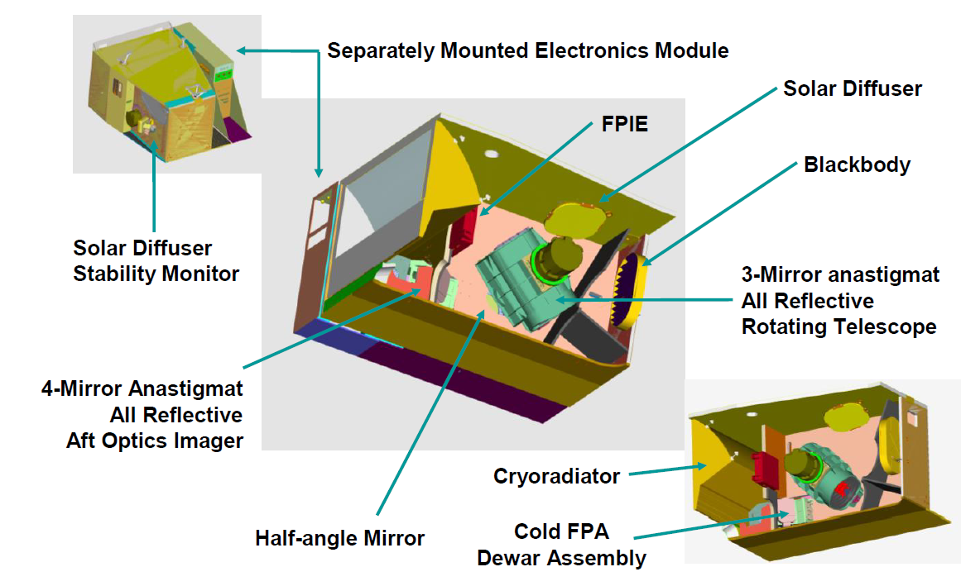
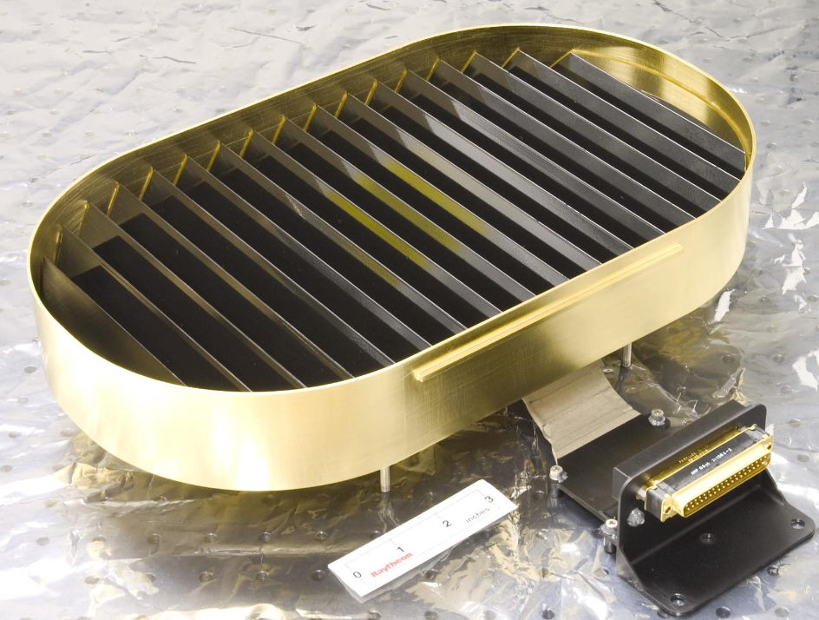
The VIIRS Instrument
Focal Plane Interface Electronics
Blackbody
Source: VIIRS Radiometric ATBD.

Slide 4
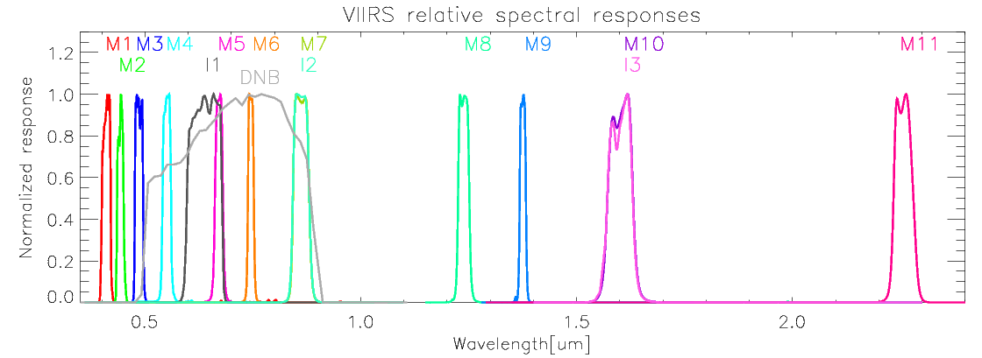
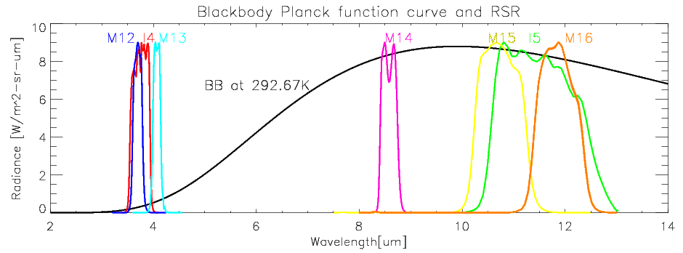
VIIRS Spectral Bands (RSB/DNB/TEB)
14 RSBs with 11 moderate bands (0.412-2.25 μm), 3 imagery and 1 Day-Night-Band (DNB).
  RSB calibrated using Solar Diffuser (SD) and Solar Diffuser Stability Monitor (SDSM).
  DNB calibrated using SD for LGS, using gain ratio approach for MGS and HGS.
7 TEBs with 5 moderate bands (3.7-12 μm) and 2 imagery (I4, I5) bands.
  Calibration sources are Onboard Blackbody (BB) and space view.

Slide 5
Background
S-NPP VIIRS was launched on November 28, 2011.
  More than 7 years of sensor data records (SDR) are available.
  Major LUT updates in early years
S-NPP VIIRS has been performing well since launch
  Degradation is slow, RTA mirror degradation has stabilized.
  Overall, user feedbacks are very positive.
Reprocessing aims to address remaining issues in the mission-long/life-cycle time series.
  Radiometric consistency in the long-term data records.
  Resolve major issues, such as
    Residual degradation in RSB SDRs after solar calibration.
    TEB calibration biases during warm-up/cool-down (WUCD)
    gain impacted by changing RSRs, Airglow impacted DNB calibration, straylight correction

Slide 6
S-NPP VIIRS V2 Reprocessing led Improvements
RSB Bands
  Using consistent RSBAutocal F-factors with MODTRAN/Kurucz solar spectrum (V1)
  OC F-factor based bias correction; Constant bias correction M5/M7 (V1/V2)
  RSBAUTOCAL F-factors based on re-analyzed SD/SDSM screen and BRDF LUTs annual oscillation removed + further smoothed (V2)
  Using Thuillier (2002) solar spectrum, consistent with NOAA-20 (V2); makes difference in radiance
  Updated OC F-factor based bias correction (V2)
  STAR Kalman Filter based bias correction factors based on LunarCal/DCC/SNO (V2) for VNIR bands
  STAR Surface Roughness-induced Rayleigh Scattering (SRRS) Model for SWIR bands (V2)
TEB Bands
  Preliminary WUCD bias correction applied to M15/M16 (V1)
  Improved EBBT LUT, radiance limit mismatch resolved + better BT limits (V1/V2)
  Improved WUCD bias correction (corrected DELTA-C-LUT error), applied to all TEBs (V2)
DNB
  Time dependent DNB RSRs (50+ RSR LUTs) (V1/V2) with improved RSBAUTOCAL LGS gains (V1/V2)
  Airglow free pitch maneuver based deep space data for dark offset, significant reduction in negative radiances (V1/V2)
  Reprocessed using on-orbit based offset and gain ratio (V1/V2)
  Reprocessing implements stray light correction for the entire record (V1/V2)
  Terrain corrected geolocation is generated for the entire data record(V1/V2)
  Improved calibration offsets with striping correction for Agg29-32 (V2)

Slide 7
Kalman Filter (V2) for VNIR Bands
Correcting long term degradation
Future plan
For F-Factor
RSBAutoCal F Factor
(Solar diffuser cal)
Kalman
AI based Forecasting
DCC Time Series
Estimated F-Factor Time Series
Lunar F Time Series
SNOx Time Series
Features:
Predict up to two weeks ahead of time for correction (used as a scaling factor);
Different time resolutions (some at irregular interval)
Combine input observations from different sources (subject to measurement uncertainty and noise)
After using Kalman Filter, excellent stability in VNIR bands, <0.3% change in 5 years.

Slide 8
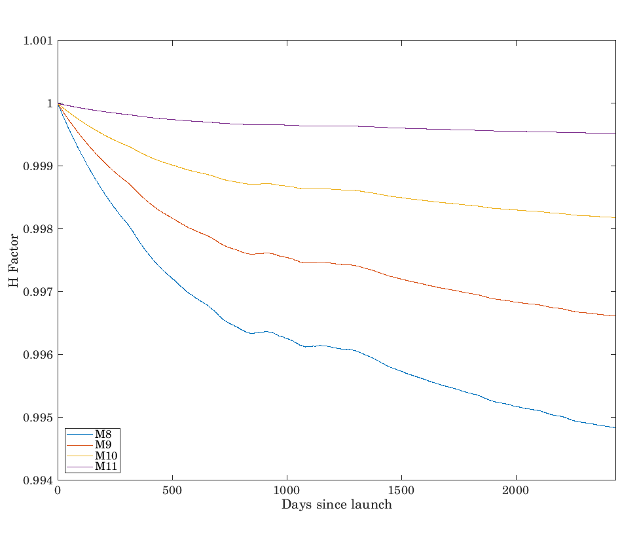
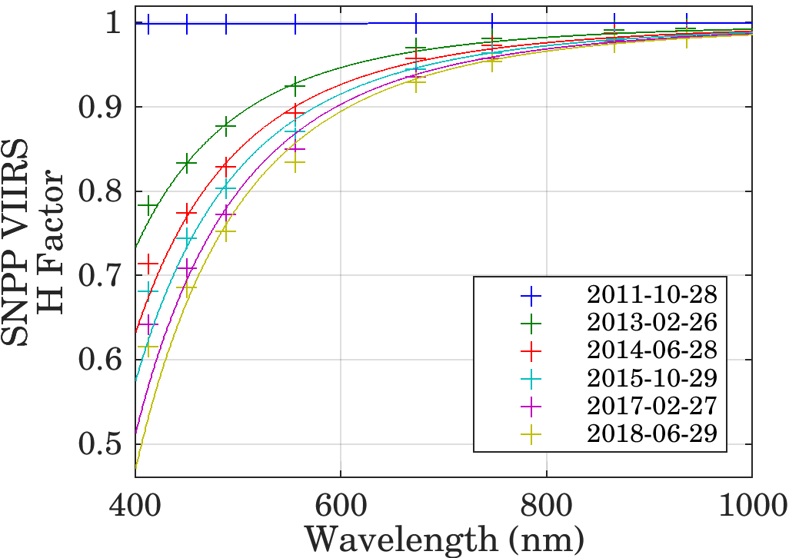
SRRS Model For VIIRS SWIR Band Correction
NOAA STAR Surface Roughness-induced Rayleigh Scattering (SRRS) Model
Ref: Shao, X.; Cao, Changyong; Liu, T.-C. Remote Sensing 2016, 8, 254
After using SRRS model, excellent stability in SWIR bands, <0.15% change in 5 years.

Slide 9
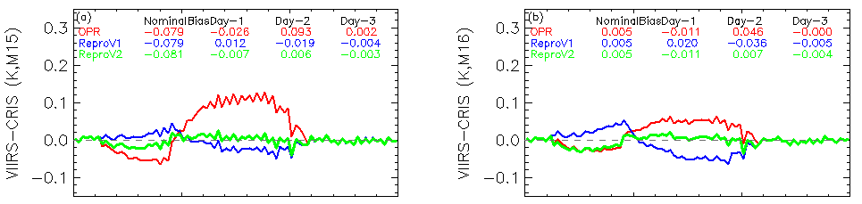
Version 2 Reprocessing Improvements -- TEB
Better TEB WUCD bias correction compared to Version 1:
  Version 1: Preliminary Ltrace WUCD bias correction for M15/M16 only.
    Over corrections, esp. in M16.
  Version 2: Improved WUCD bias correction (Ltrace + Ltrace 2, based on correct DELTA-C instrument temperature dimensions)
    Smaller residual WUCD biases, on the order of 0.01 K, for all TEBs.
    Positive feedback from STAR SST team (Dr. Ignatov)
(Cao et al. 2017 JGR; Cao et al. 2017 SPIE; Wang et al. 2017 SPIE; Wang et al. 2018 IEEE TGRS)

Slide 10
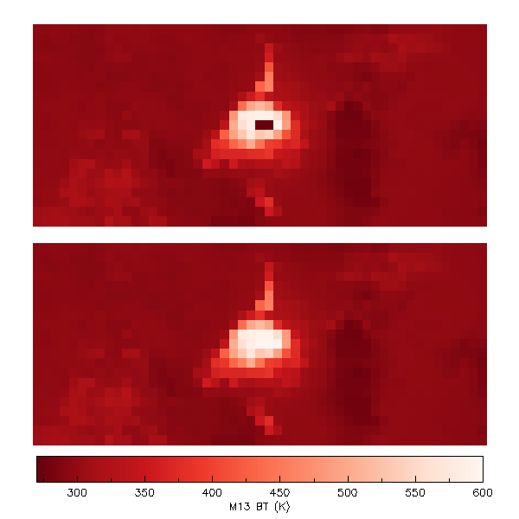
Reprocessing Improvements – TEB (V1/V2)
Improved EBBT LUT with better BT limits
  Radiance/BT limit mismatch in the early data records (before 6/22/2015) was resolved.
  Large radiance difference is expected for previously saturated pixels due to improved BT limits
  M13 BT limits
    IDPS (before update):
    199 – 634 K
    Reprocessed :
    180 –700 K
IDPS
saturated pixels
Reprocessed
650 K
d20140311_t1648343_e1649585

Slide 11
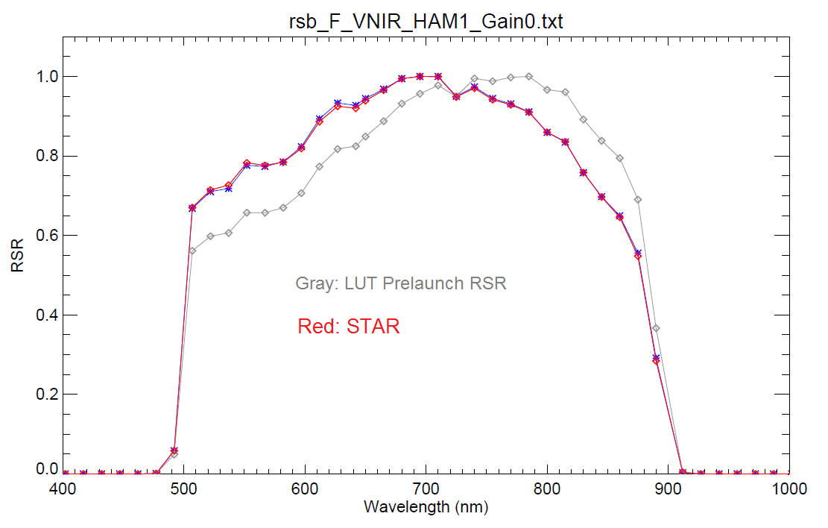
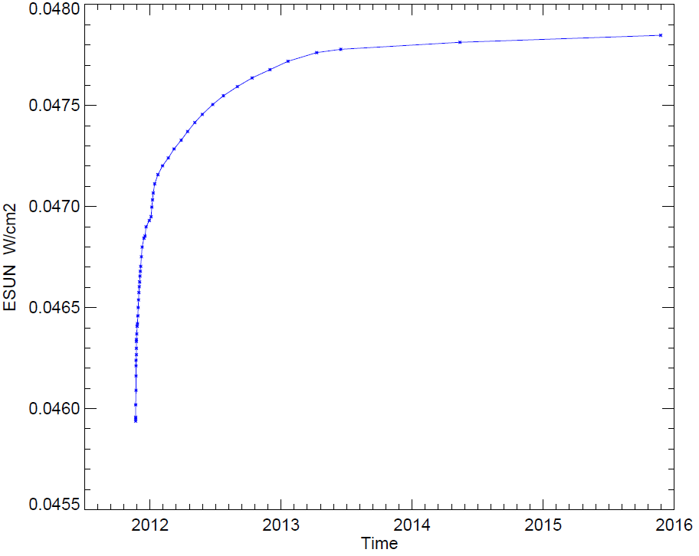
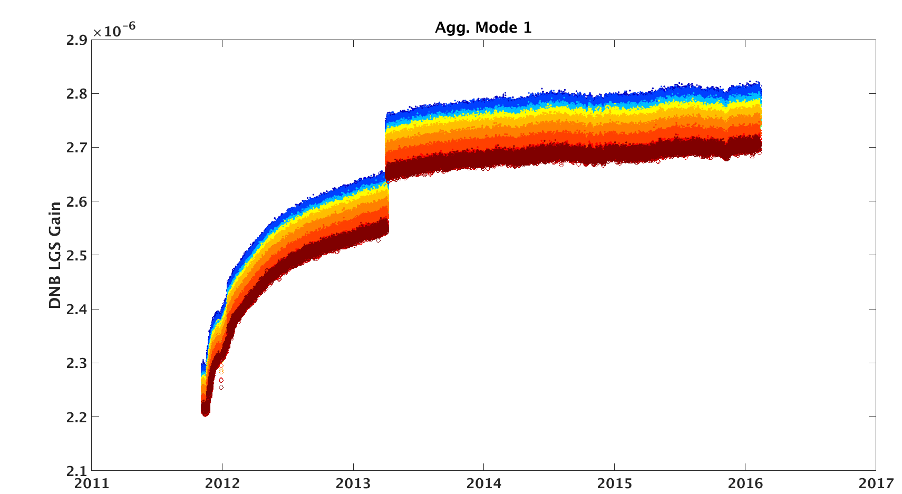
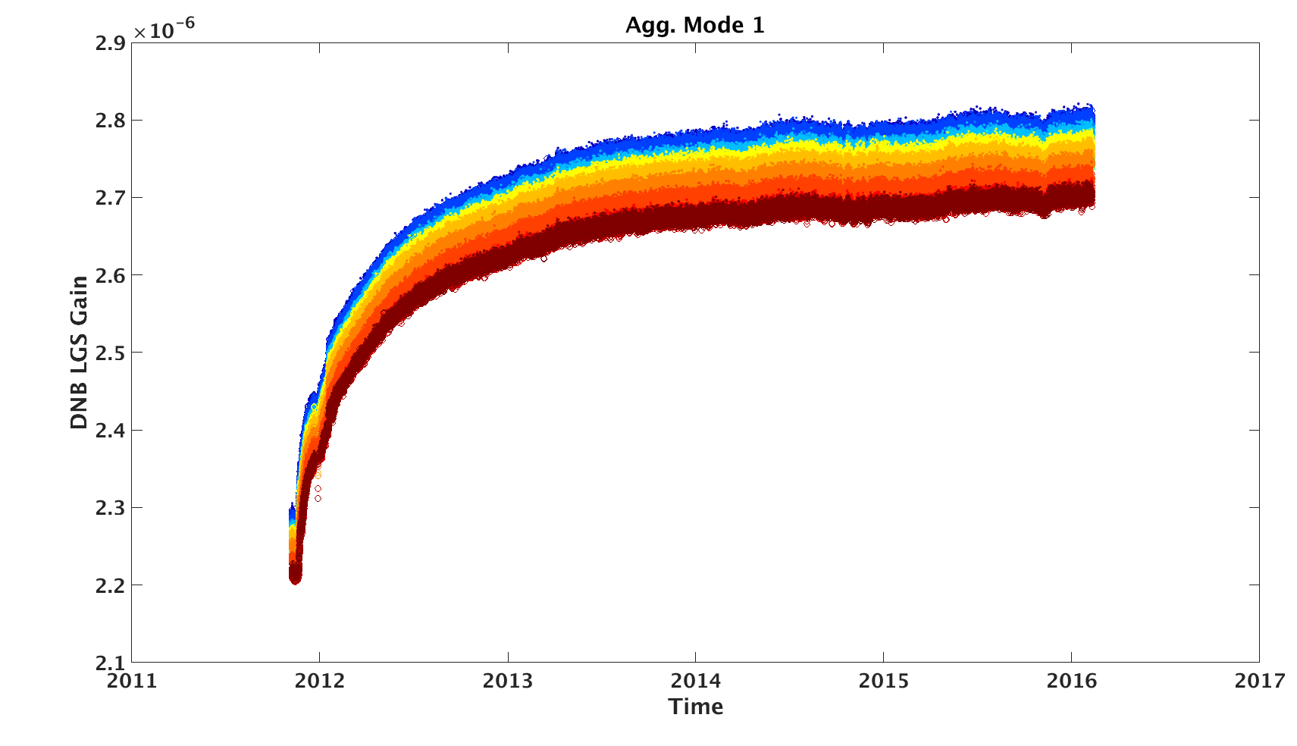
DNB Spectral Improvement
(Version 1 & Version 2)
Blue: IDPS LUT 4/5/2013
VIIRS DNB RSRs modulated by the telescope degradation
Approx. 50 time-dependent RSRs provide near-continues DNB E_{sun} changes with steps smaller than 0.1%
Discontinuity due to only 2 RSRs used in IDPS
Smooth trend due to time
dependant RSRs
LGS Gain in IDPS
LGS Gain in Reprocessed Data
Page | 11

Slide 12

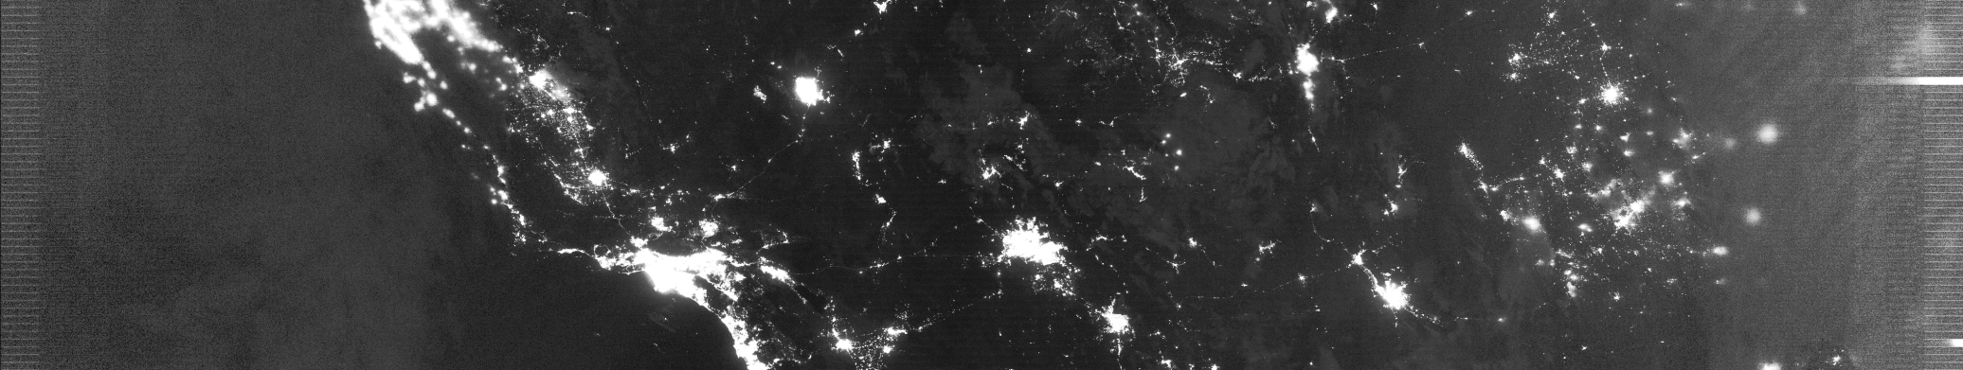
DNB Calibration Offset Improvement
(Version 1 & Version 2)
03/20/2012 (Improvement after Reprocessing)
IDPS SDR
(poor calibration)
Reprocessed SDR
(improved calibration)
IDPS uses on-orbit based offset and gain ratio starting from 03/21/2012.
Reprocessing uses on-orbit based offset and gain ratio to produce all DNB SDR
All data before 03/21/2012 are much improved after reprocessing!

Slide 13
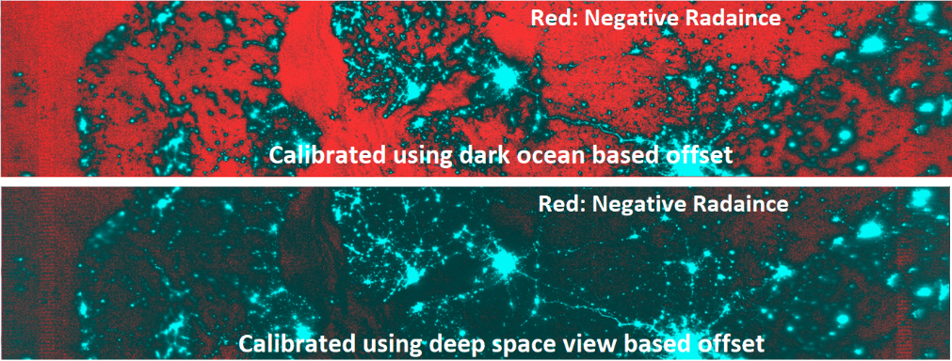
Improved DNB Radiance
  Reprocessing uses airglow free dark offset using deep space view data collected using pitch maneuver
  improved DNB absolute accuracy by >10% at 3nW/[cm²sr]
  Significantly reduced negative radiance pixels

Slide 14
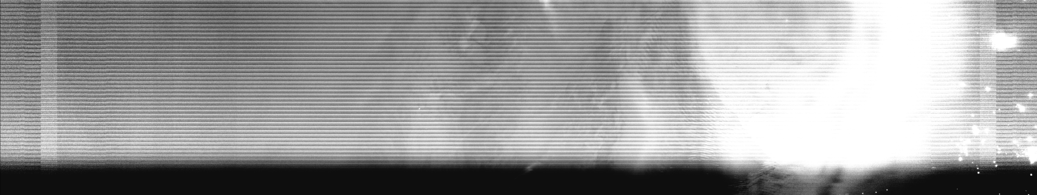
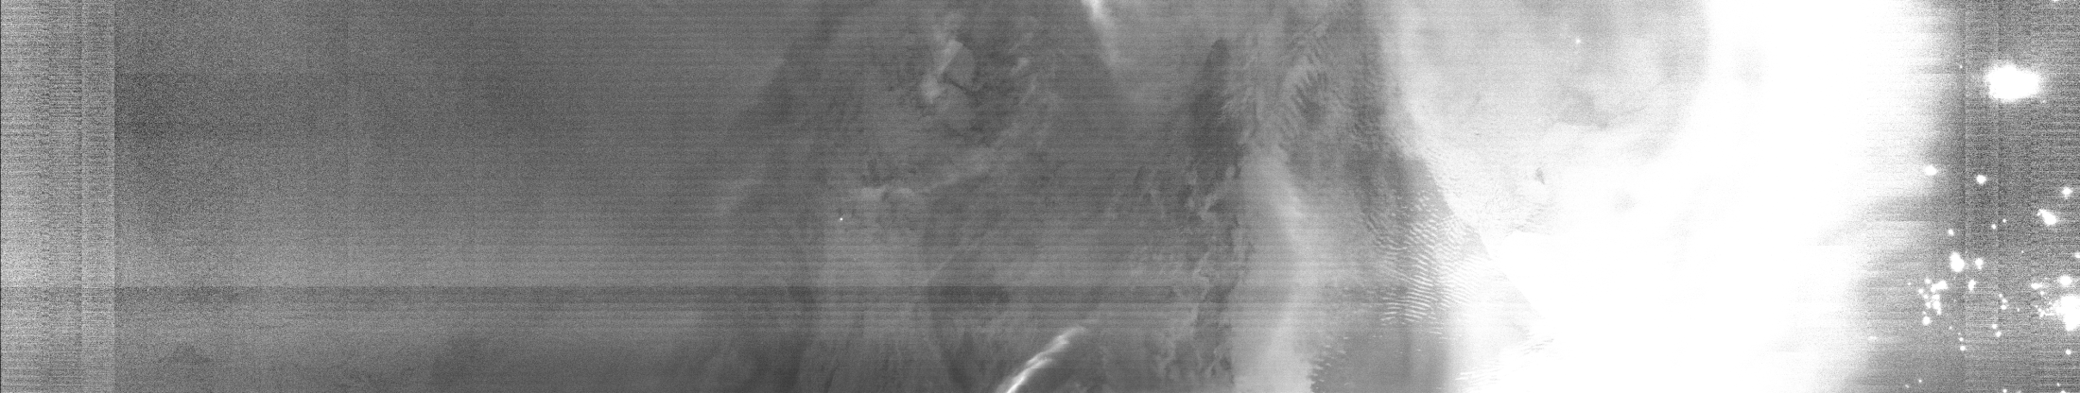
DNB Straylight Correction
(Version 1 & Version 2)
  Reprocessing implements straylight correction for all DNB SDR.
  Significant improvements in all DNB data before August 2014.
IDPS(12/16/2012)
(No Straylight correction)
Reprocessed Data
(Straylight Corrected)

Slide 15
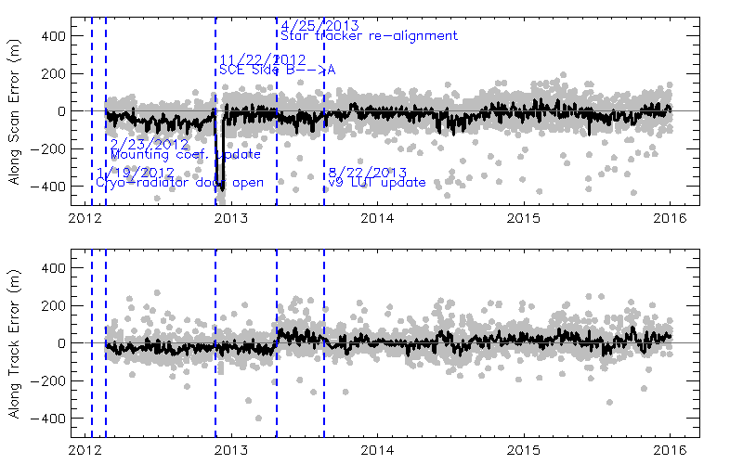
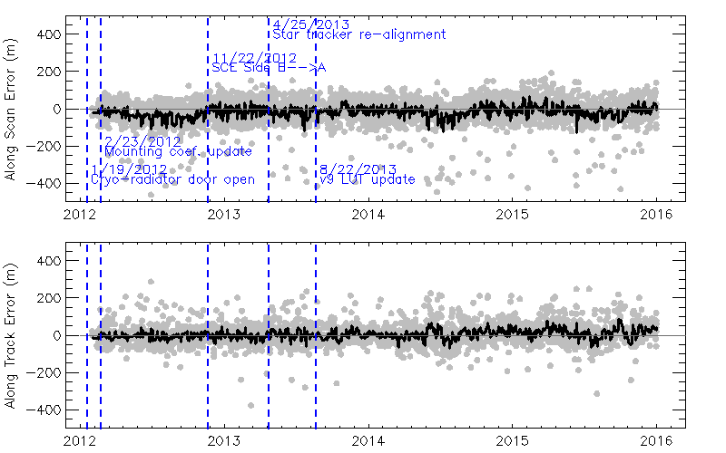
Reprocessing Improvements – Geolocation
(Version 1 & Version 2)
Before Reprocessing
Optimal versions of GEO PARAM LUTs used in reprocessing.
Short-term anomalies before August 2013 removed:
  Before the initial instrument to spacecraft mounting matrix update;
  The switch of scan control electronics (SCE) from Side-B to Side-A;
  Star tracker maintenance/re-alignment.
Along scan
Along track
After Reprocessing
Along scan
Along track

Slide 16
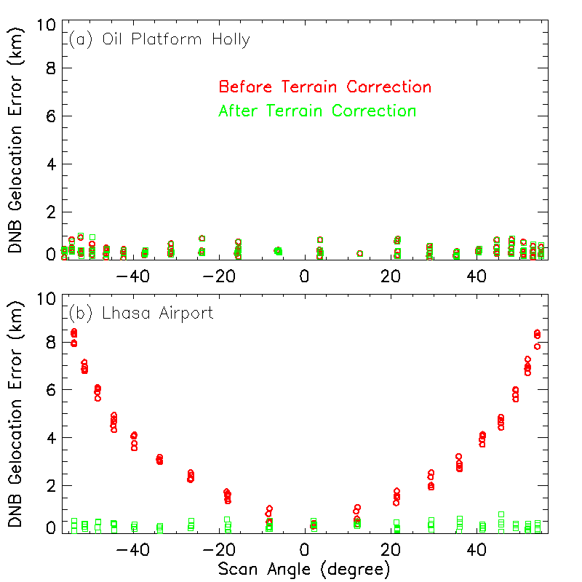
Reprocessing Improvements – Geolocation
(Version 1 & Version 2)
Operational processing: DNB terrain correction was implemented on May 22, 2014;
Reprocessing: DNB terrain corrected geolocation were produced for the entire data record;
  Removed DNB geolocation errors up to 10 km at high scan angles.

Slide 17
S-NPP VIIRS V2 Reprocessing Data Format
Reprocessing Script and ADL Version
  ADL Block 2, ADL_5_3_I2_1_01_00
  Parallelization fully using bamboo super computer at CICS/UMD
  Takes about 15 hours processing one month VIIRS SDR data (18 nodes; using 12 CPUs in each node)
Data files and Format
  Data files
    GITCO, GMTCO, GDNBO
    SVDNB, SVM01-SVM16 SVI01-SVI05, IVOBC
  Data Format
    GZIP Compressed HDF 5 (the same as current IDPS data format)
VIIRS SDR Data
Volume
File Type |  | Data Volume
GEO | File | Daily | Monthly | Yearly | Yearly Total
 | GITCO | 96 GB | 2.9 TB | 35 TB | 125 TB
 | GMTCO | 26 GB | 0.78 TB | 8.5 TB
 | GDNBO | 45 GB | 1.4 TB | 16.7 TB
RAD | IMG | 84 GB | 2.5 TB | 31 TB
 | MOD | 79 GB | 2.4 TB | 29 TB
 | DNB | 9 GB | 273 GB | 3.3 TB

Slide 18
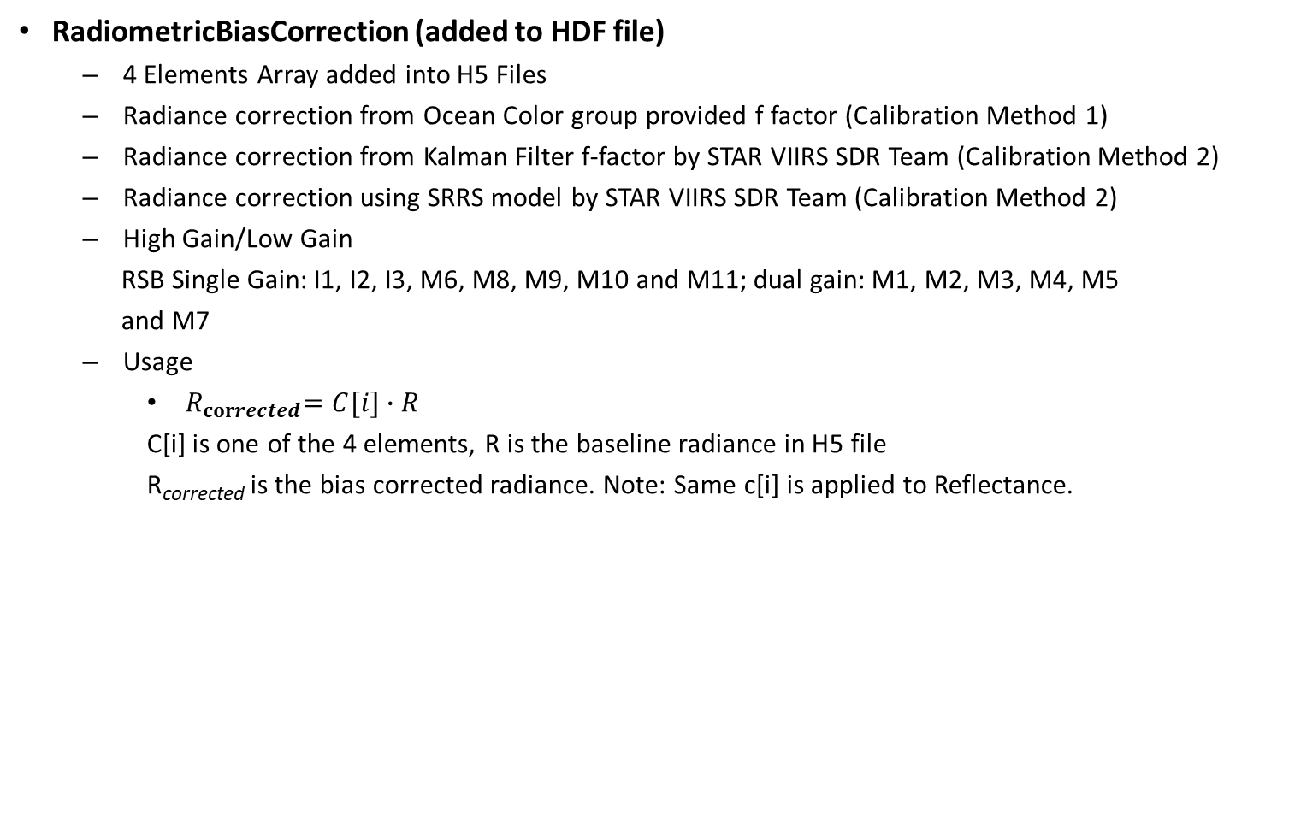
V2 Reprocessing “RadiometricBiasCorrection”
RadiometricBiasCorrection (added to HDF file)
  4 Elements Array added into H5 Files
  Radiance correction from Ocean Color group provided f factor (Calibration Method 1)
  Radiance correction from Kalman Filter f-factor by STAR VIIRS SDR Team (Calibration Method 2)
  Radiance correction using SRRS model by STAR VIIRS SDR Team (Calibration Method 2)
  High Gain/Low Gain
  RSB Single Gain: I1, I2, I3, M6, M8, M9, M10 and M11; dual gain: M1, M2, M3, M4, M5
  and M7
  Usage
    ${ R}_{corrected}=C[i]∙R$
    C[i] is one of the 4 elements, R is the baseline radiance in H5 file
    R_{corrected} is the bias corrected radiance. Note: Same c[i] is applied to Reflectance.
1st Element | Radiance Ratio between Calibration Method 1 and STAR reprocessed High Gain or Single gain values
2nd Element | Radiance Ratio between Calibration Method 1 and STAR reprocessed Low Gain values (for dual gain only; or set 1 for single gain)
3rd Element | Radiance Ratio between Calibration Method 2 and STAR reprocessed High Gain or Single gain values
4th Element | Radiance Ratio between Calibration Method 2 and STAR reprocessed Low Gain values (for dual gain only; or set to 1 for single gain)

Slide 19
S-NPP VIIRS V2 Reprocessing Data Distribution
Data server
  FTP or/and HTTP
  Both servers are located at Bamboo CICS/UMD due to large volume of dataset
  FTP push service highly recommanded for bulk transfer (part of Reprocessing onDemand using scp/sftp)
  Direct access to all available granules can be obtained through web browser but slow.
Investigating a SIPS -like web interface
  Driven by SQL DBMS server and geospatial search (leveraging NASA Atmosphere and Land SIPS technology)
  Web Interface design
  Subcategory for each sensor/data type (GMTCO GITCO GDNBO SVI SVM SVDNB)
    Provide bash scripts to users for easy downloading
Other options for very large volume datasets request (>1TB)
  provide large tar balls for easy downloading (e.g., ATMS tar ball files are available at ftp://jlrdata.umd.edu/pub/ATMS/)
  Automate control data flow for specific user (generate tar files, remove tar files after downloading, currently performing it for CrIS FSR data month by month ftp://jlrdata.umd.edu/pub/ATMS/CrIS/)
    Opportunity for GSICS partners to become host members for part of V2 reprocessed data distribution.

Slide 20
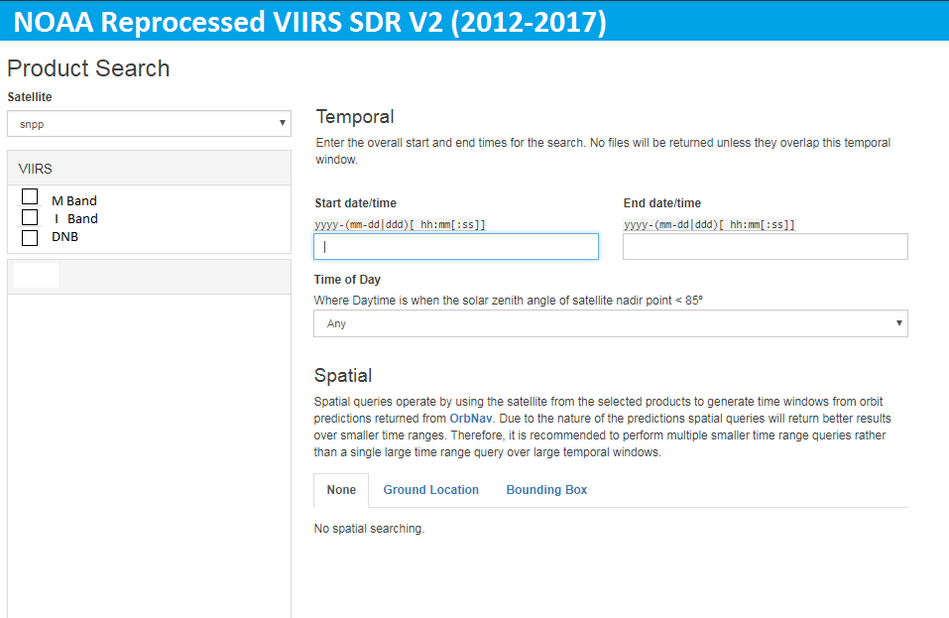
User Friendly Graphics User Interface for
Data Order
Ref: NASA Atmospheric SIPS webpage
Currently under design to input data order using temporal and/or spatial criteria

Slide 21
Summary
Accurate, consistent and temporally stable radiometric/geometric calibration, meeting all user needs
Completed reprocessing 2016 VIIRS data; scheduled to complete VIIRS archive from 2012/01-2017/03 by July, 2019
Data servers established for distribution using FTP or/and HTTP
Investigating on UW SIPS like web interface for more user friendly data distribution
  Version 2 provides the solid basis for further future reprocessing (except DNB straylight correction)
  In most cases, future reprocessing will be simply based on further improved bias correction without fundamentally reprocessing RDR to SDR.
    Opportunity for GSICS partners to become host members for part of the V2 reprocessed data distribution.

Slide 22
Backup

Slide 23
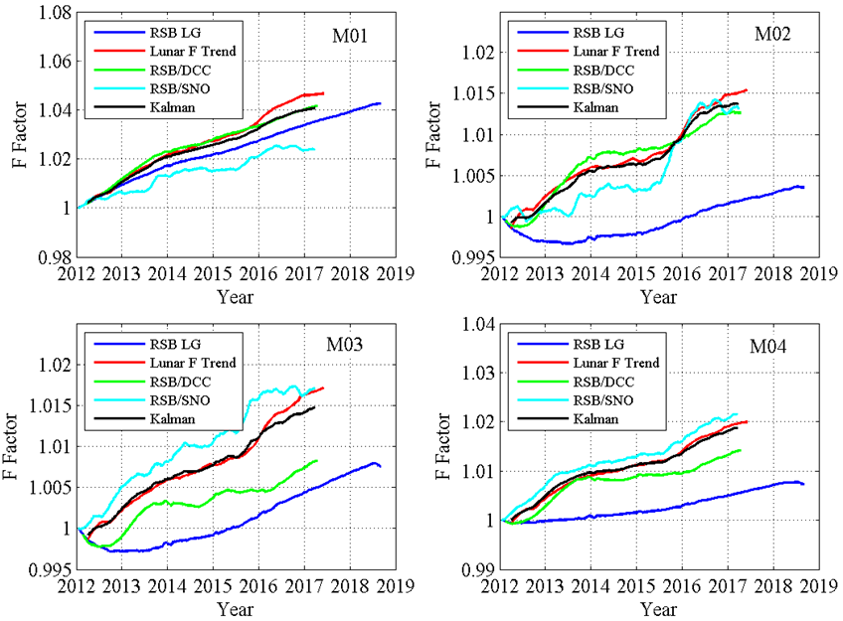
Kalman Filter Based Improved F-Factors
RSBAUTOCAL-F DCC-F SNOx-F Lunar-F Kalman-F

Slide 24
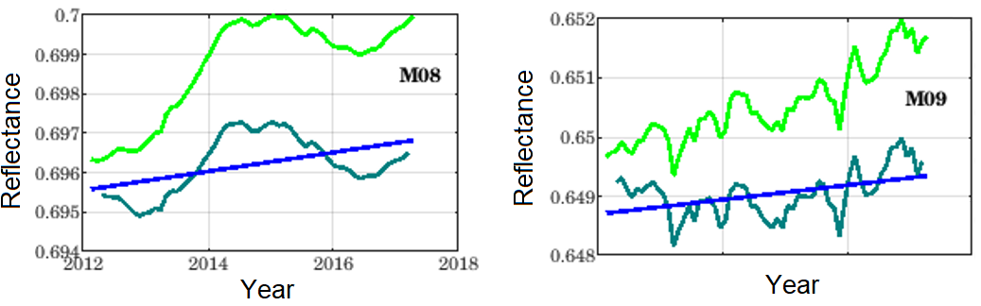
SRRS Model For VIIRS SWIR Band Correction
NOAA STAR Surface Roughness-induced Rayleigh Scattering (SRRS) Model
Ref: Shao, X.; Cao, Changyong; Liu, T.-C. Remote Sensing 2016, 8, 254
Before
DCC Trends
After
After using SRRS model, excellent stability in SWIR bands, <0.15% change in 5 years.

Slide 25
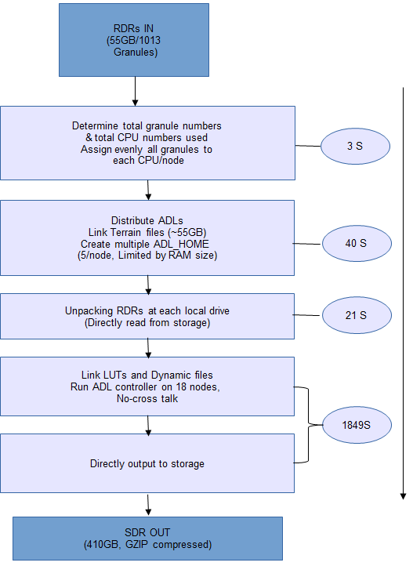
Reprocessing System
Flowchart of Version 1 S-NPP VIIRS SDR Reprocessing (B. Zhang)
33.4 Minutes

