Slide 1




Introduction of FY historical dataset reprocessing
Xiuqing(Scott) Hu, Peng Zhang, Ling Sun, Na Xu, Lin Chen, Shengli Wu, Di Xian….
FY data reprocessing team

Slide 2

Project information
Project: FY-1/2/3 historical data reprocessing and climate dataset generation （2018YFB0504905）
Source: National Key R&D Program of China
Period: 2018.7-2022.6

Slide 3
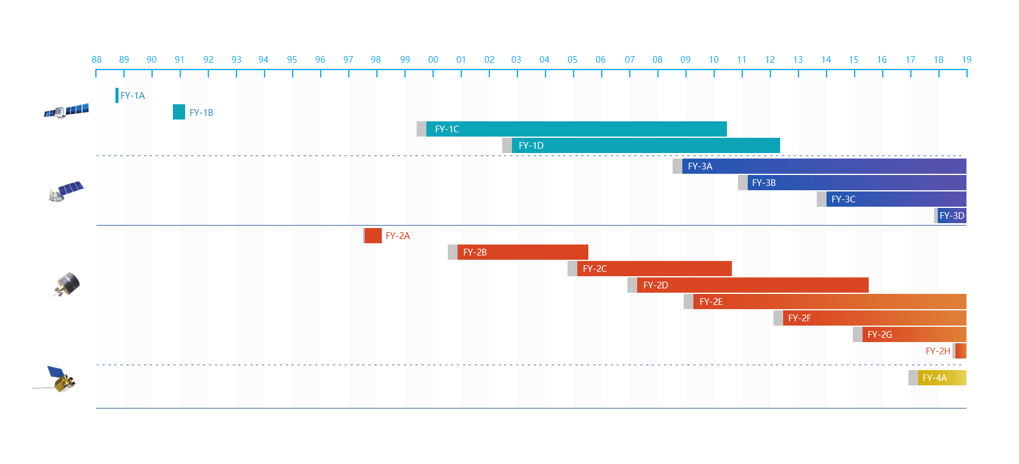
Sensor:
FY-1A/B/C/D FY-3A/B/C VIRR
FY-3A/B/C MERSI/IRAS/MWTS/MWHS/MWRI
FY-2A/B/C/D/E/G VISSR
Accuracy:
RSB: 8%(Exp.), 5%(Ope.)
TIR: 1K(Exp.), 0.5K(Ope.)
MW: 1K(Absorb),1.5K(Window)

Slide 4
Task Scope and Activities
Goals
Reprocessing/Recalibration and FCDR generation for VNIR, IR, MV observations of FENGYUN Meteorological satellite archive data for climate and environment change research
Activities
Data quality assessment and diagnose for Long-term Historical data
High accurate Re-navigation and Solution to missing of satellite attitude/orbit/GPS information at early phase
Reconstruction of defective/missing data in pixels or lines (AI)
Reference transfer for Inter-satellites consistent calibration
Long-term Recalibration and FCDR generation (consistent L1)
Typical Thematic CDR generation including SST, OLR, LST, NDVI
Rapid processing system establishment and distribution of satellite big data (Cloud/Big data tech)

Slide 5
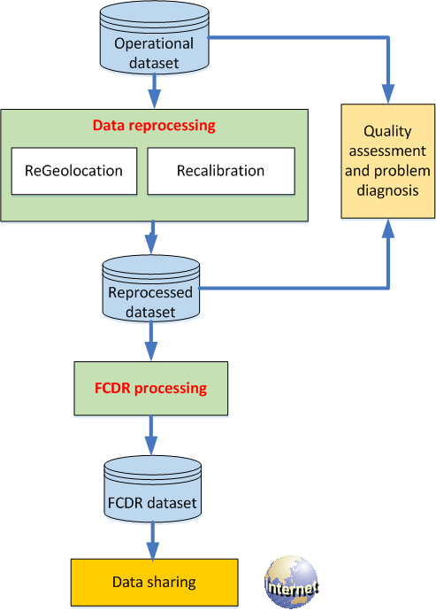
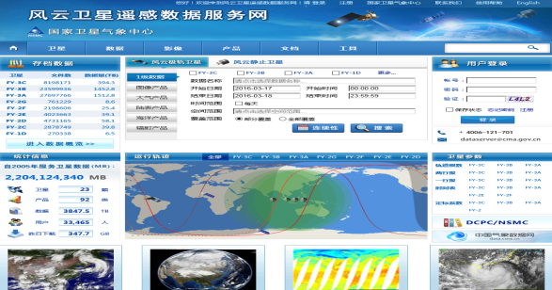
  Data Record Duration : 1999~ 2020

Slide 6
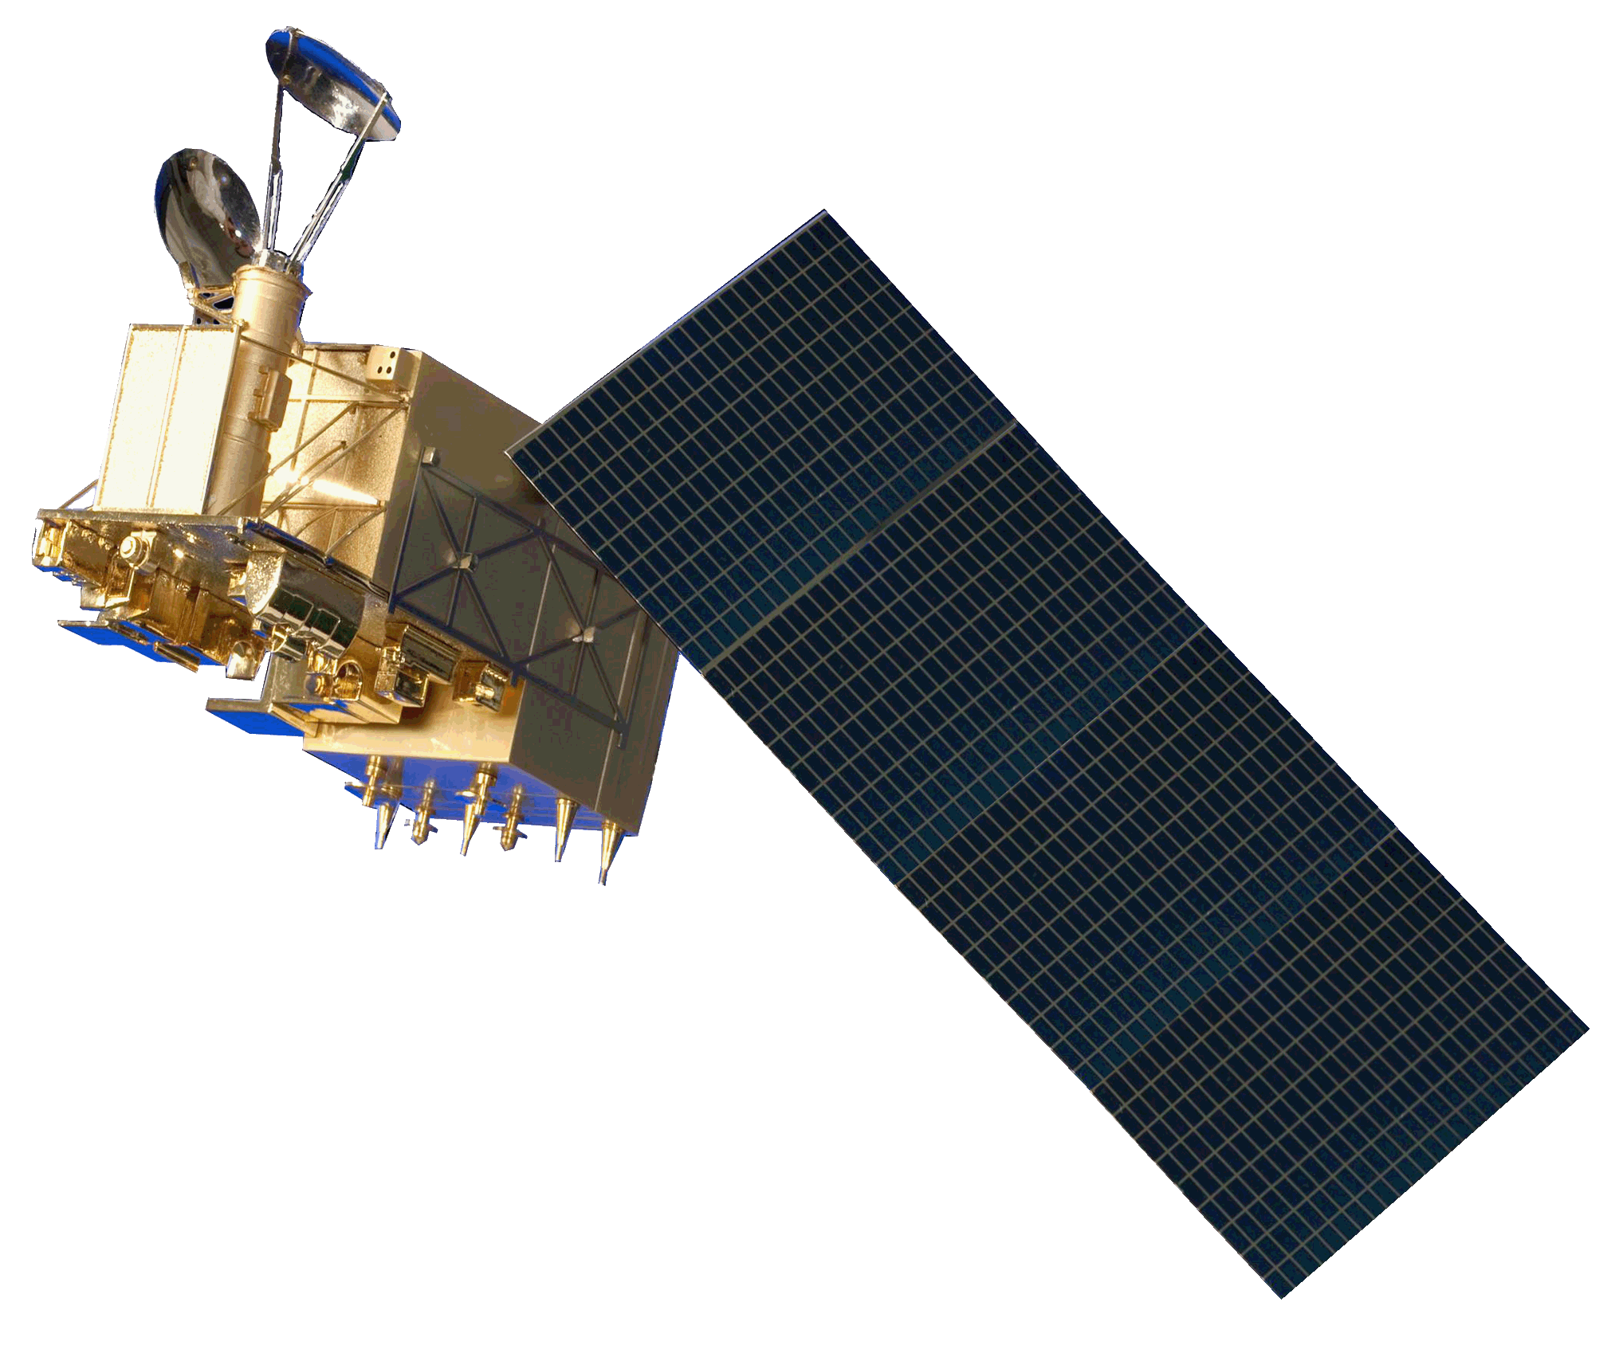
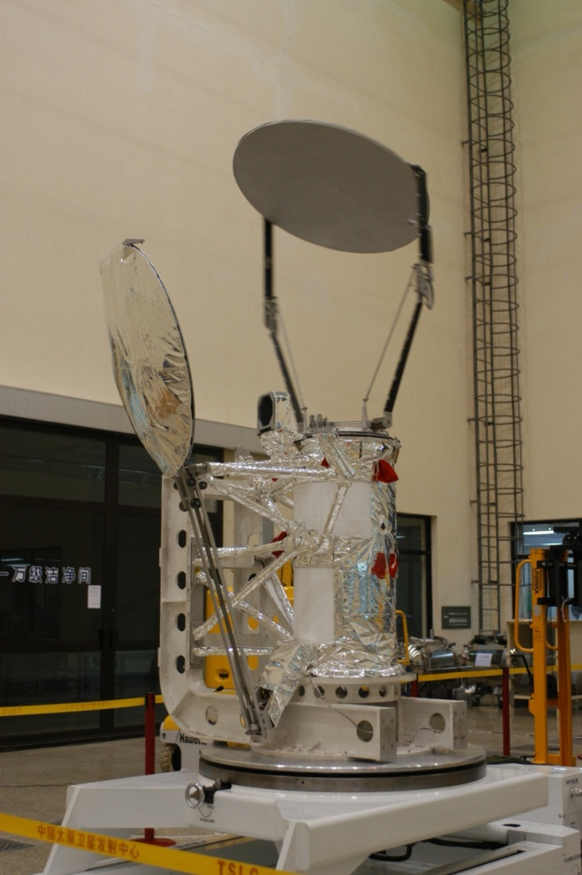
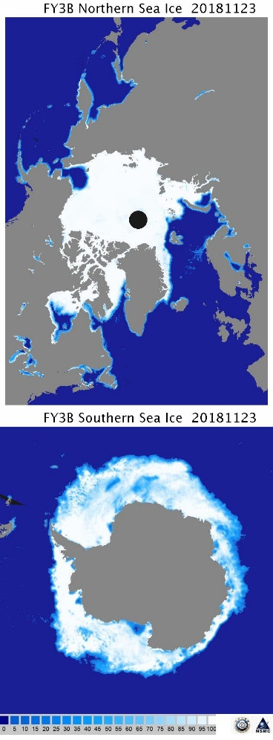
Reprocessing Scheme (MWRI)
Shut down:
  2008:FY-3A(10-89GHz, Dul-p);
On-orbit：
  2010:FY-3B(10-89GHz, Dul-p)
  2013:FY-3C(10-89GHz, Dul-p)
  2017:FY-3D(10-89GHz, Dul-p)
  Time series data record : 2010-2020

Slide 7
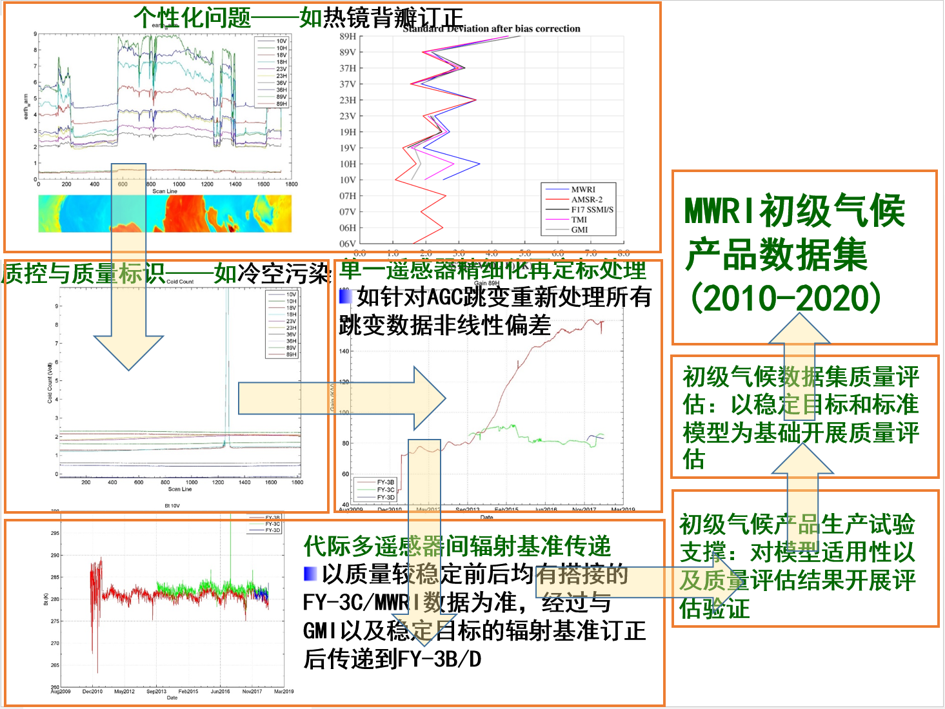
MWRI Recalibration Steps
Individual isues (Back lobe, A/D Bias etc)
MWRI FCDR
(2010-2020)
Quality contral (RFI, Solar, Luna)
Re-calibration of single sensor (AGC point change etc)
Assessment using GMI or other sensor
Experiment on sensor or land surface
Consistency calibration of different sensors (using FY-3D/MWRI as the reference sensor)

Slide 8
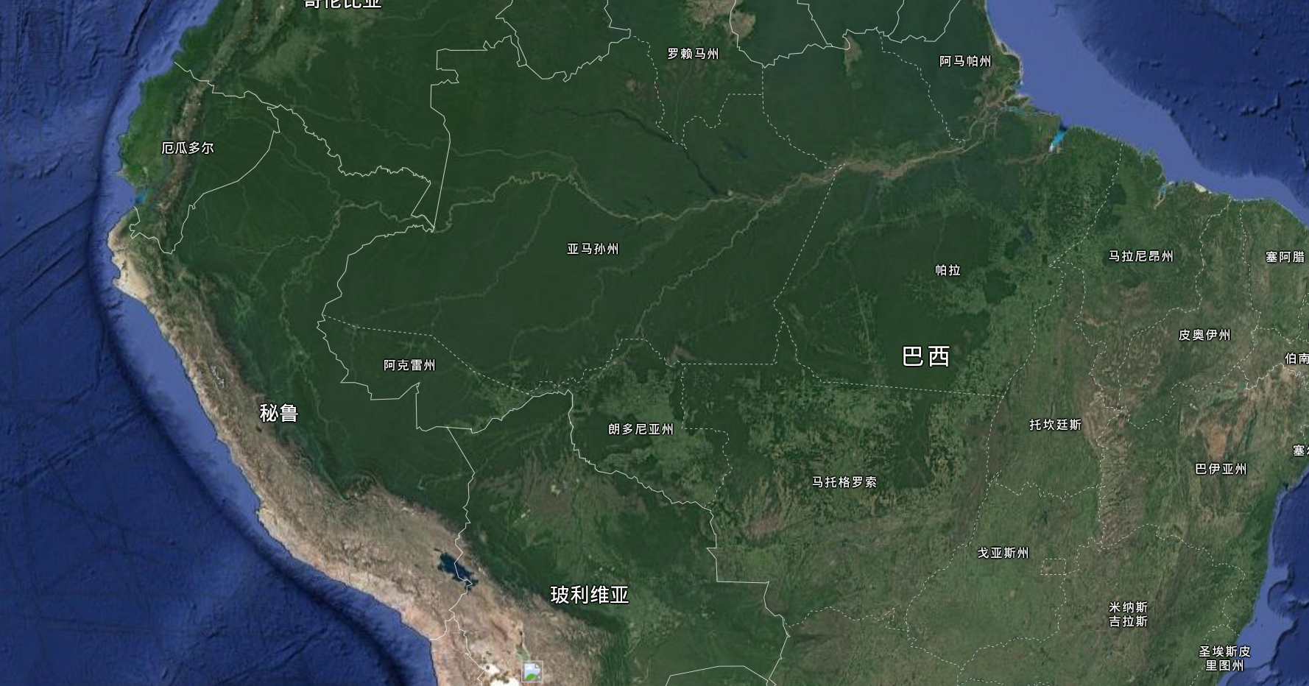
Identified MWRI Individual Issues
Periodic and non-periodic noise (RFI\Solar\Luna etc)
Antenna correction improvement
Hot load correction improvement
Cold target stability
Receiver performance with the change of environment temperature
Preliminary Quality Assessment
Amazon Tefe National forest
（64.82W-66.82W，4.55S-6.55S）

Slide 9
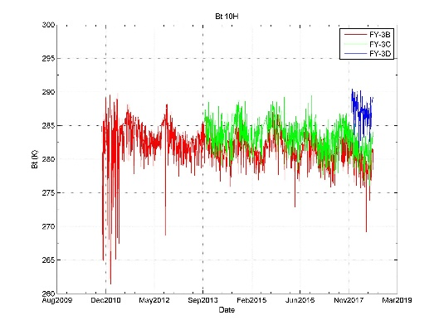
Time series of
FY-3B/3C/3D MWRI Brightness Temperature
10H
10V
18H
18V
23H
23V
36H
36V
89H
89V
10H

Slide 10
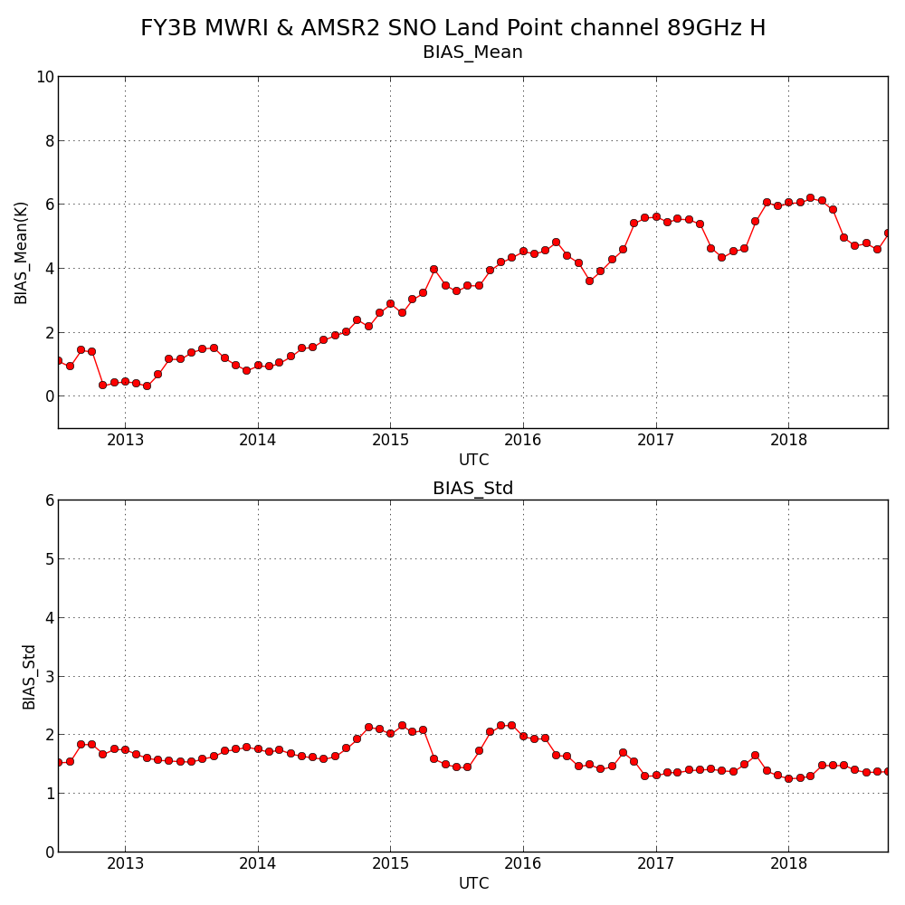
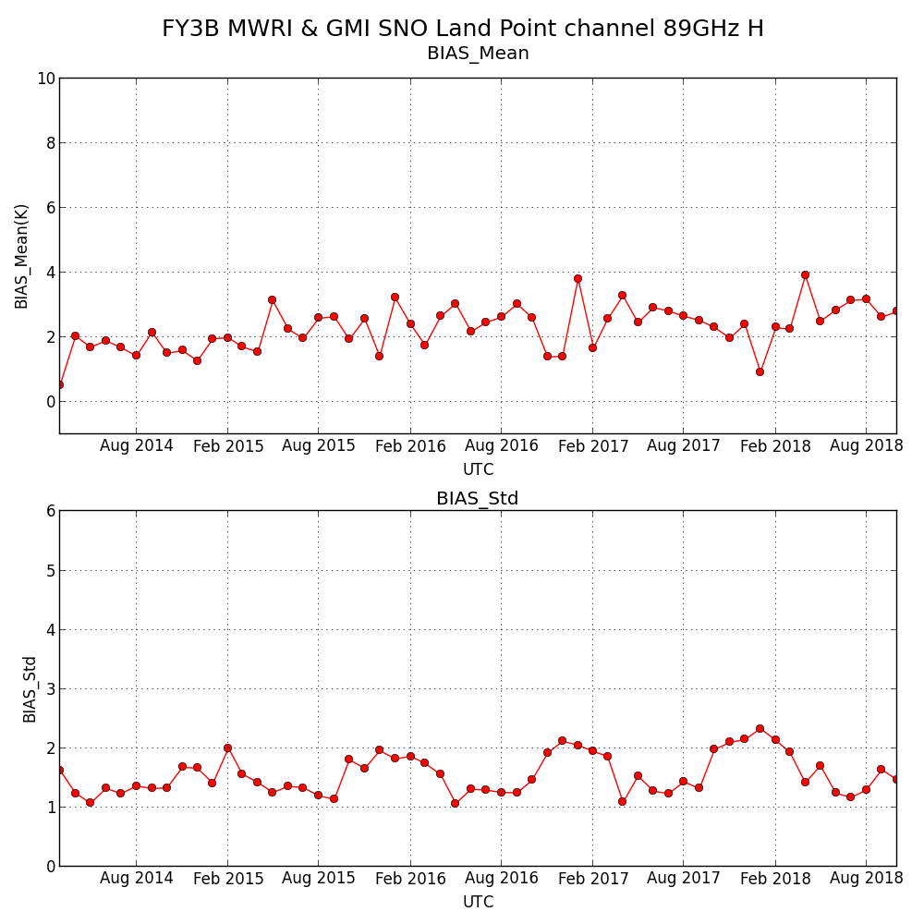
FY-3/MWRI VS AMSR2 and GMI
FY-3B VS AMSR2
89H Land
FY-3B VS GMI
89H Land

Slide 11
FY-3B/IRAS vs METOP-A/IASI

Slide 12
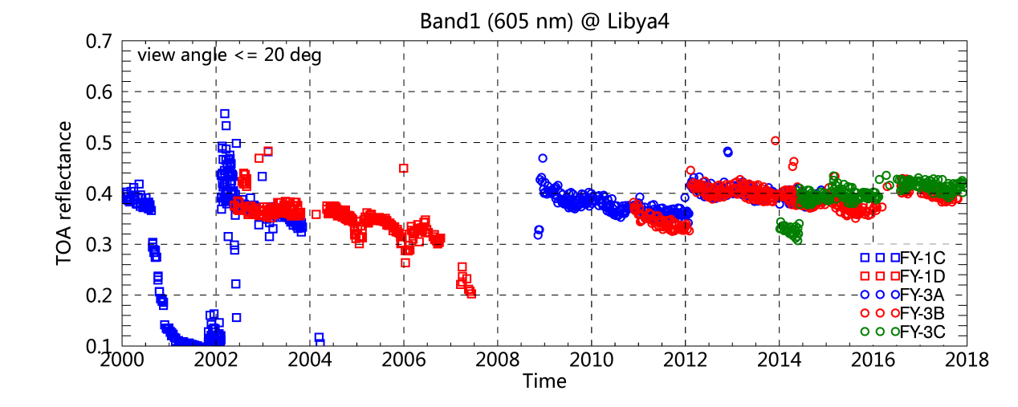

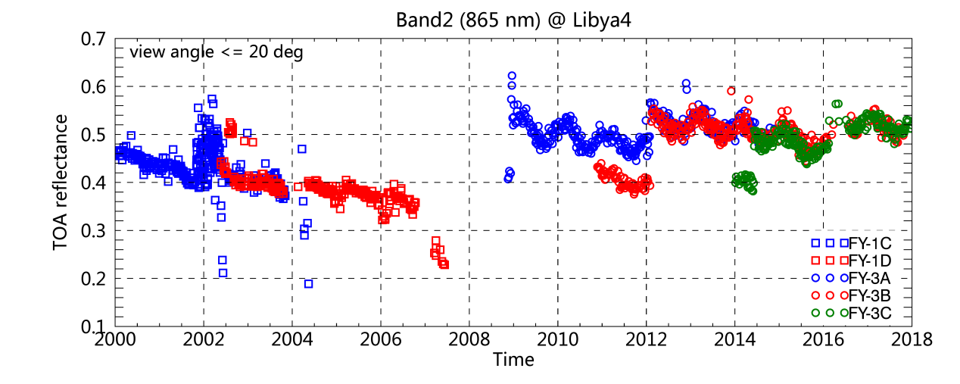
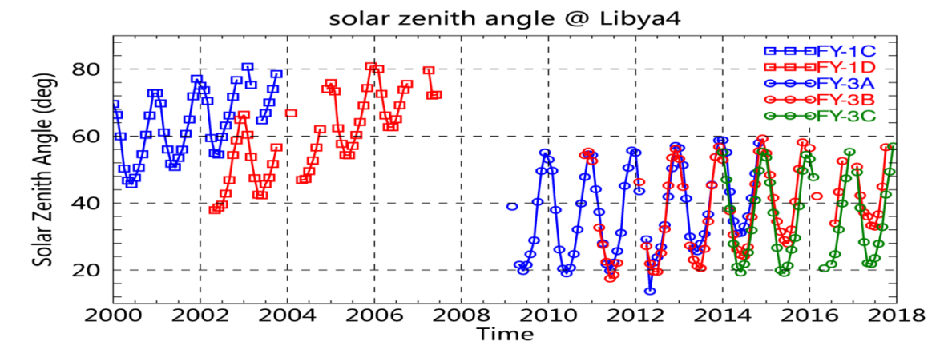
FY-1/3 VIRR consistent assessment using Libya 4
VIRR RGB image

Slide 13
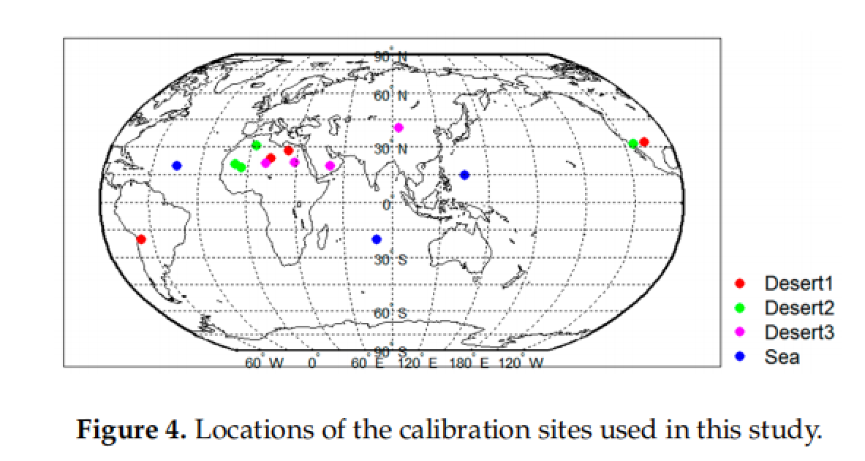
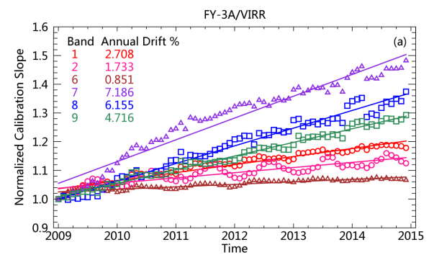
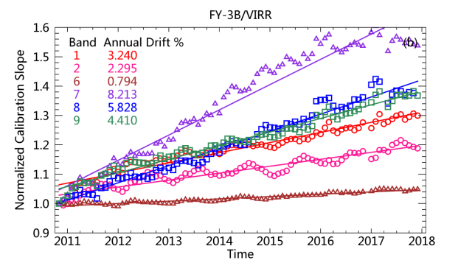
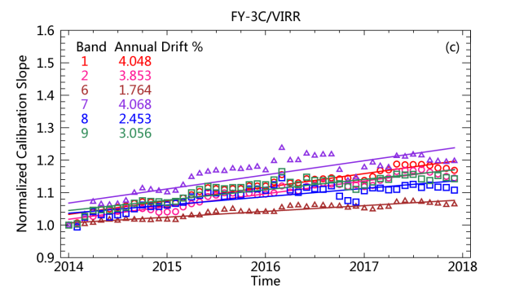
Consistent Calibration of VIRR Reflective Solar Channels Onboard FY-3A, FY-3B, and FY-3C Using a Multisite Calibration Method
Time series of the nadir (viewing angle within 10°) reflectance data in RSBs over Libya 4 from January 2009 to December 2017. (a,b) Operational calibration results; (c,d) recalibrated results using the MST calibration method
Trends in the VIRR normalized calibration slopes for (a) FY-3A, (b) FY-3B, and (c) FY-3C.
Ling Wang, Xiuqing Hu , Lin Chen, et al. . Remote Sensing, 2018, 10(9), 1336.

Slide 14
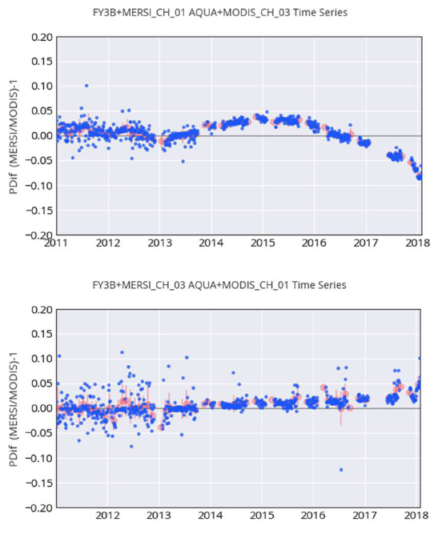
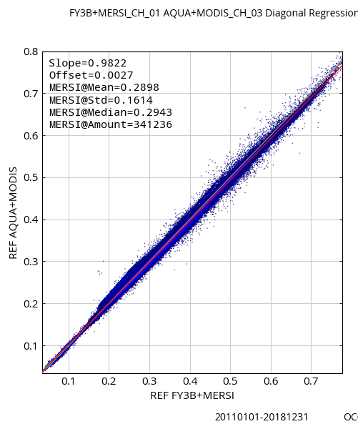

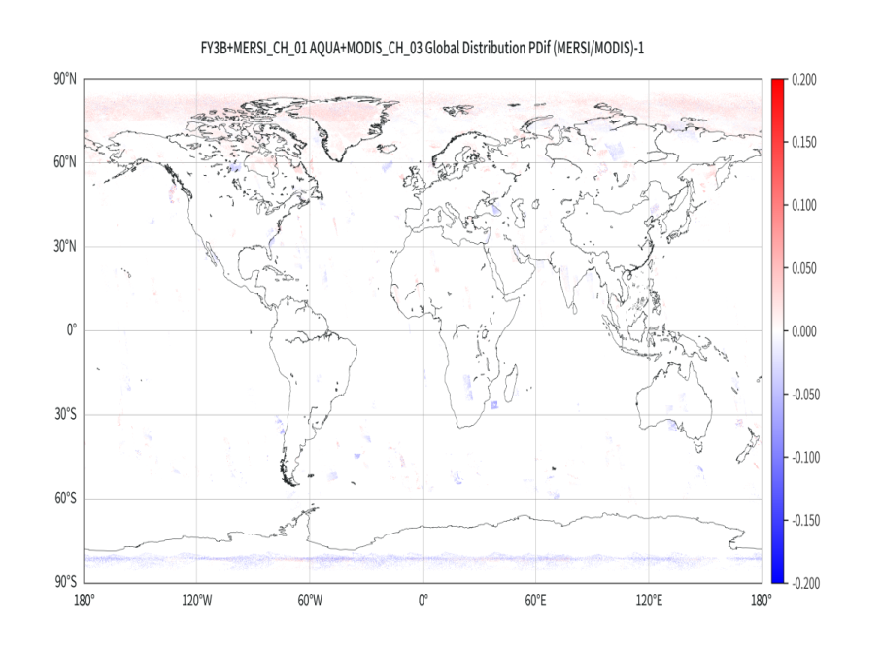
FY-3B/MERSI Test Data vs Aqua MODIS
470nm
650nm

Slide 15
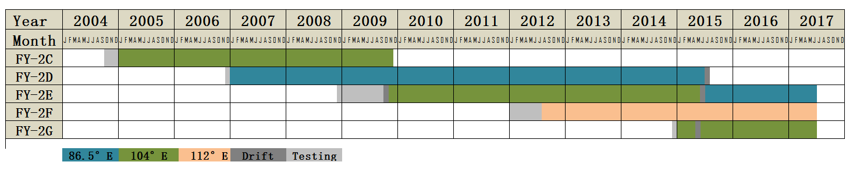
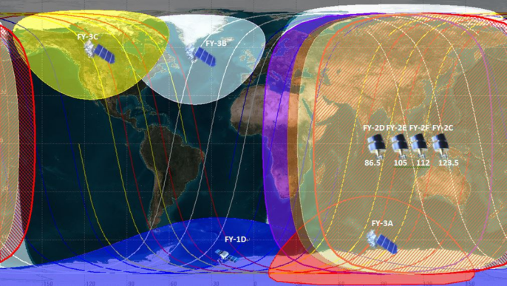
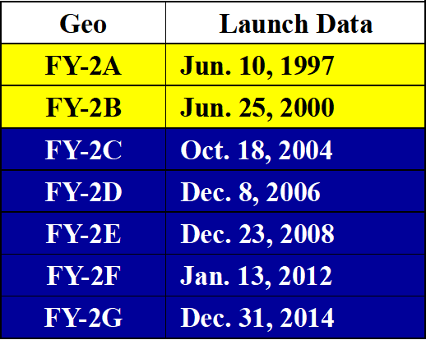
Status of historical FY-2 serials
FY2A&2B Test Sat
FY2C~2G Operational Sat
Notes:
多颗卫星，累积近30年的资料，任务重

Slide 16
FY-2 Operational Calibration
The design of the black body inserted after the optical path makes the infrared channel unable to be calibrated in real time；Multi-methods are used for operational calibration.
Before 2015, visible band of FY2 was never updated. After that, a method combined Dunhuang site and DCC was used for operational calibration.
Sat | IR | Period | VIS | Period
FY-2C | SNO：AVHRR+HIRS | Whole life-time | Pre-lauch | Whole life-time
FY-2D | SNO:AVHRR+HIRS | lauch - 2012/04/27 | Pre-lauch | Lauch-2015/02
 | SNO: IASI | 2012/04/27 – 2013/05/21 | Dunhuang Site+DCC | 2015/02 - 2015/04
 | CIBEL: Lunar | 2013/05/21- present
FY-2E | SNO:AVHRR+HIRS | lauch – 2012/01/12 | Pre-lauch | Lauch-2015/02
 | SNO: IASI | 2012/01/12-2013/03/27
 |  |  | Dunhuang Site+DCC | 2015/03-present
 | CIBEL: Lunar | 2013/03/27- present
FY-2F | CIBEL: Lunar | 2012/07 ~ present | Pre-lauch | Lauch-2015/02
FY-2G | CIBEL: Lunar | 2014/12-2018/09 | Pre-lauch | 2014/12-2016/02
 | SNO:IASI | 2018/10~present | Dunhuang Site+DCC | 2016/02-present

Slide 17
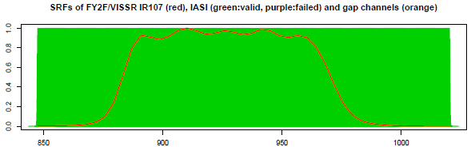
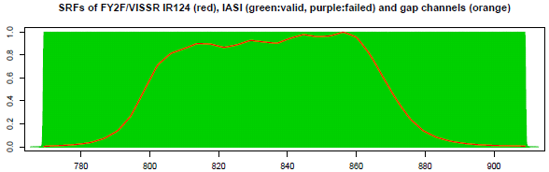
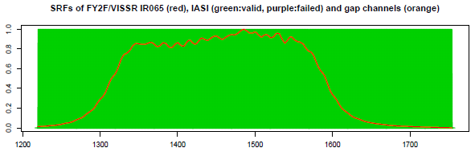
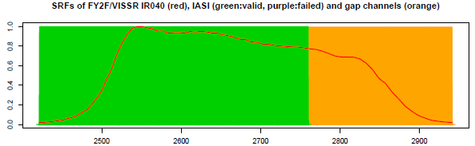
Spectral Response Functions
Bands | Wavelength /um
IR1 | 10.3~11.7
IR2 | 11.3~13.1
IR3 | 6.1~7.7
IR4 | 3.4~4.2
VIS | 0.4~0.9(FY2C FY2D FY 2E) 0.5~0.8(FY2F FY2G )
There is a big improvement for FY2F VIS band. The SRF is more narrow and move to shorter wavelength with less absorption.
FY-2 IR SRF (red line) Overlay on IASI

Slide 18
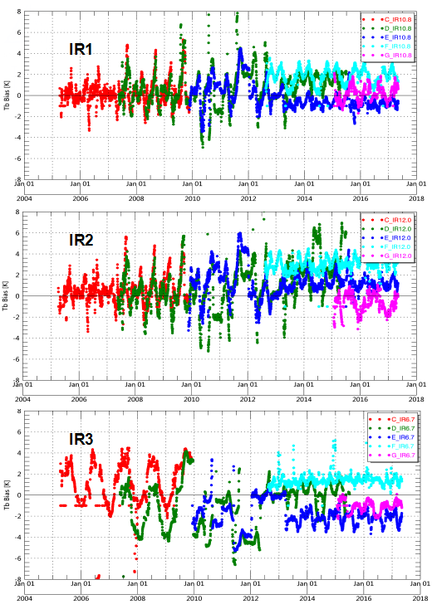
Evaluation of the FY-2 IR Operational Calibration
FY-2 serial satellites IR observation bias and consistency comparisons

Slide 19
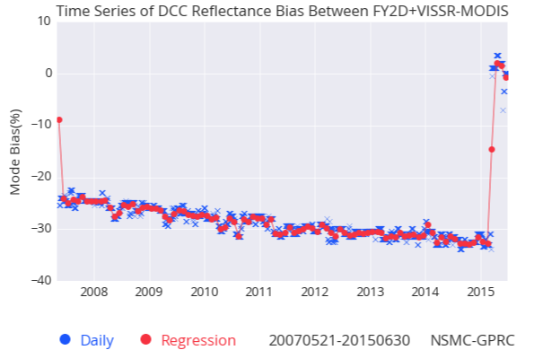
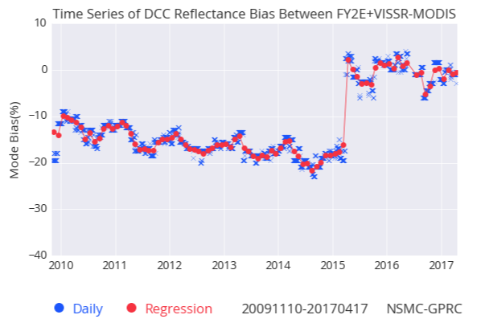
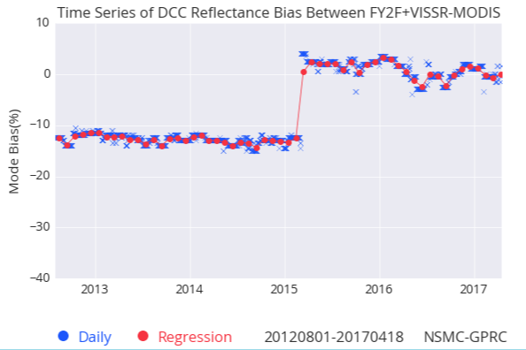
Evaluation of the FY2 Operational Calibration-VIS band
Before calibration updated, there is big bias in FY2 visible band. After that, the bias is greatly reduced.

Slide 20
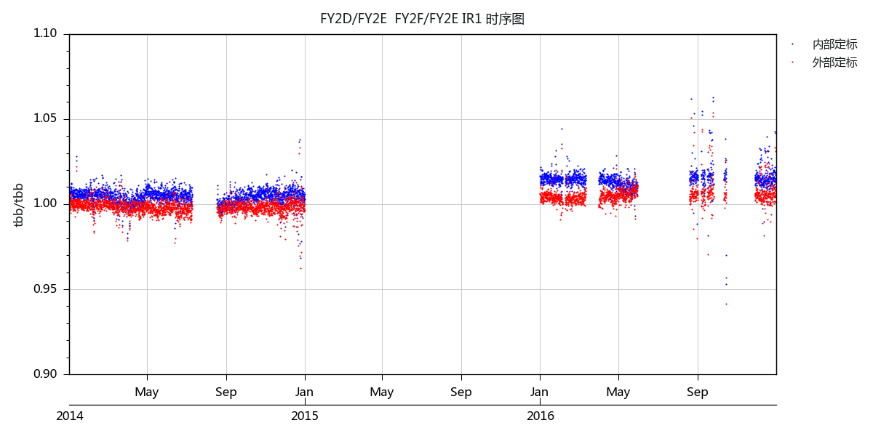
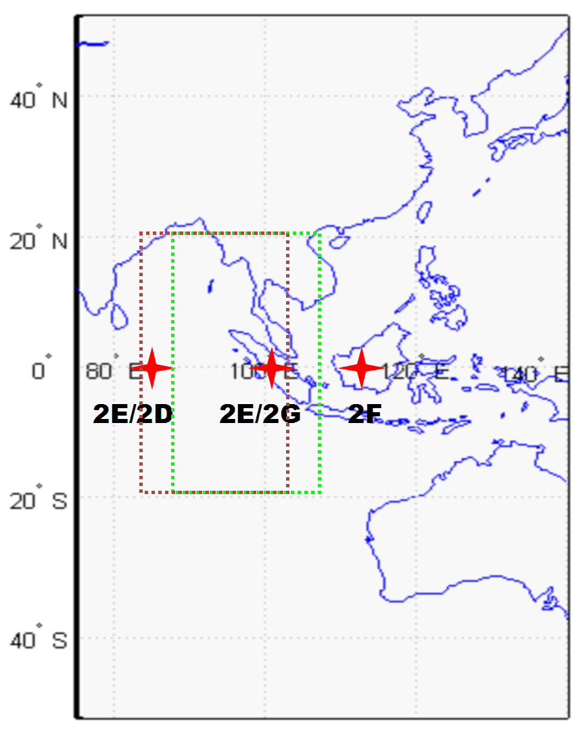
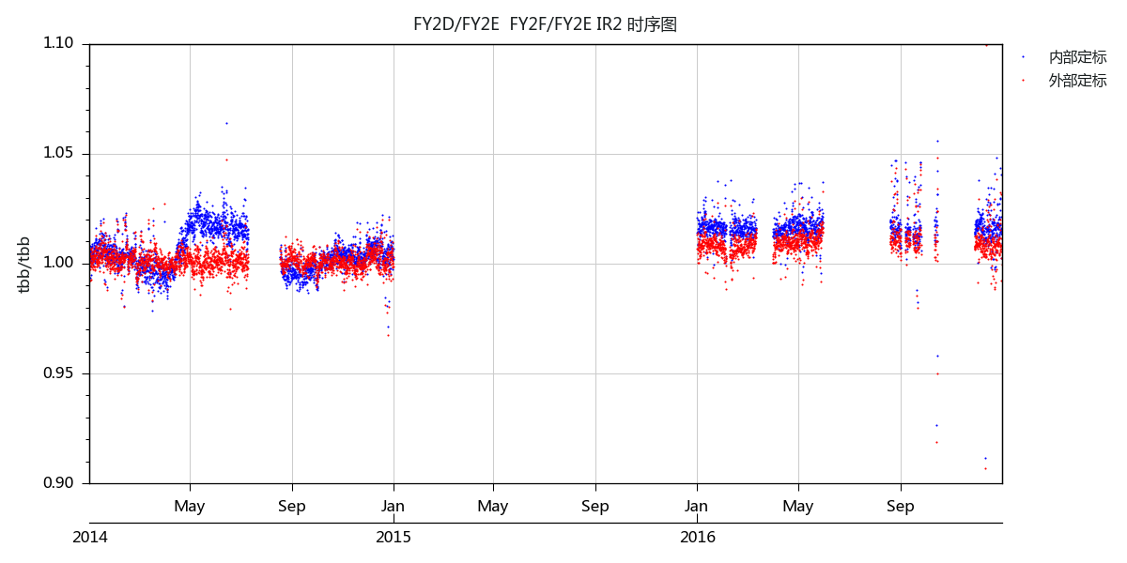
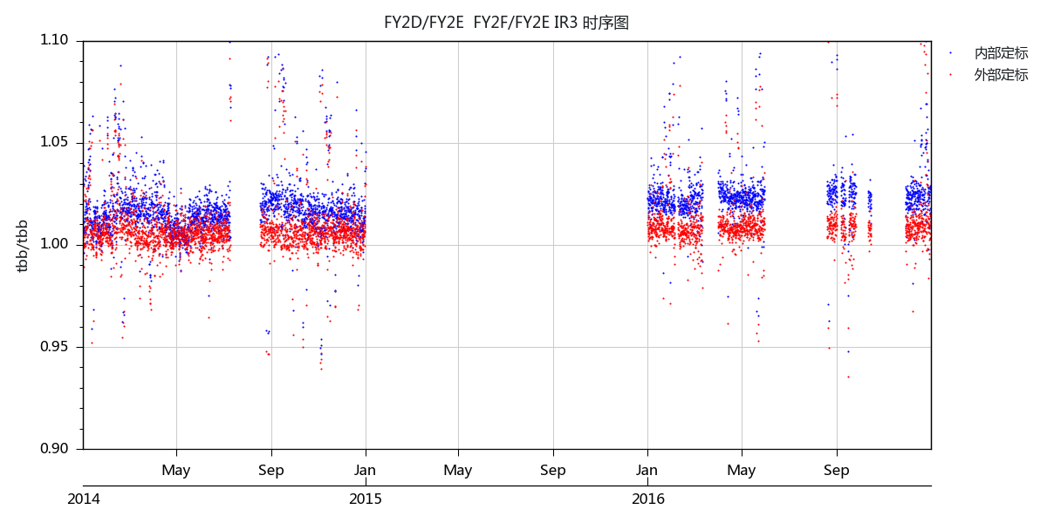
Preliminary evaluation results of the FY2 re-calibration-IR Bands
2D/2E
2F/2E
Evaluation the consistency of observations between two satellites using common observation areas
blue：operational；red：recalibration

Slide 21
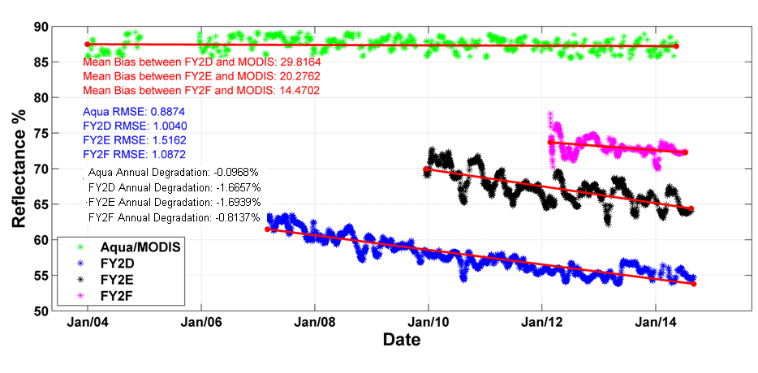

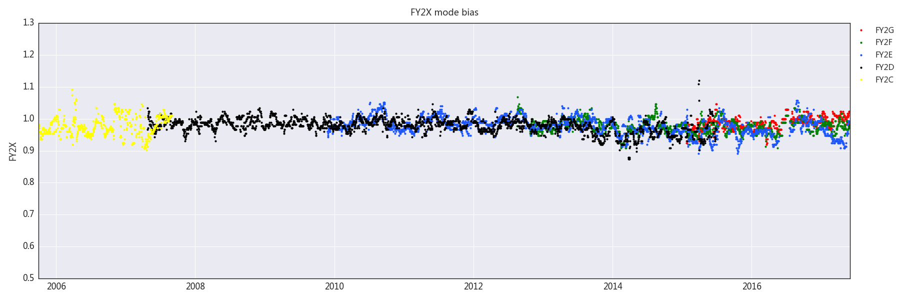
Preliminary evaluation results of the FY2 re-calibration-VIS Band
Operational calibration
After recalibration

Slide 22
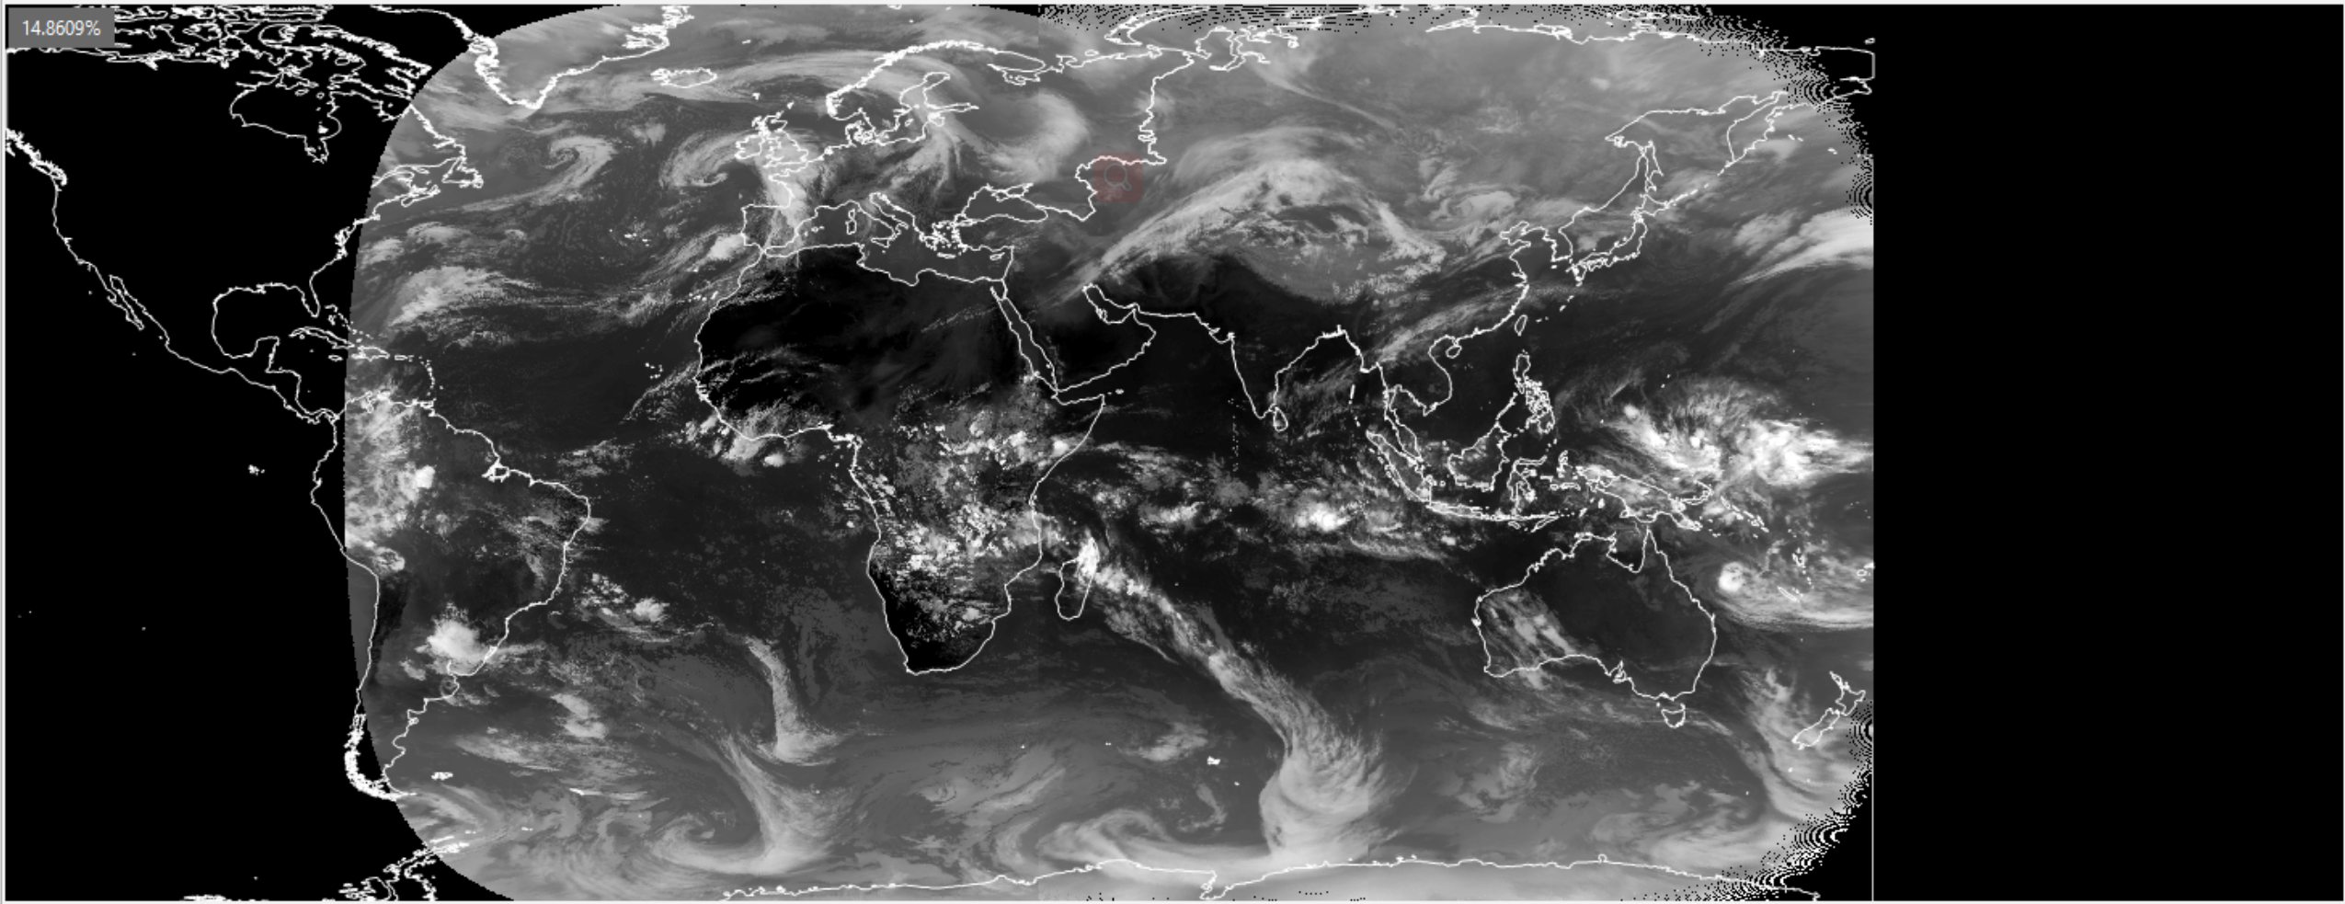
Example of GEO-Ring FY2E/FY2D/MSG IR1 band(11um)

Slide 23
Summary
The retrospective recalibration for FY FCDR was fully carried out, and Data quality assessment and behind mechanism diagnose for FY Long-term Historical data is being conducted and got some preliminary results (3n, 5j).
Current GSICS inter-calibration method (GEO-LEO, DCC, SNO et al) and bias monitoring/correction will be used to assess the archive data and consistent recalibration.
Rapid processing system is being established for these long-term satellite big data (Cloud/Big data tech).
TCDR generation will be also our next job after recalibration processing and FCDR/TCDR retrospective processing will be done again and again.

