Slide 1
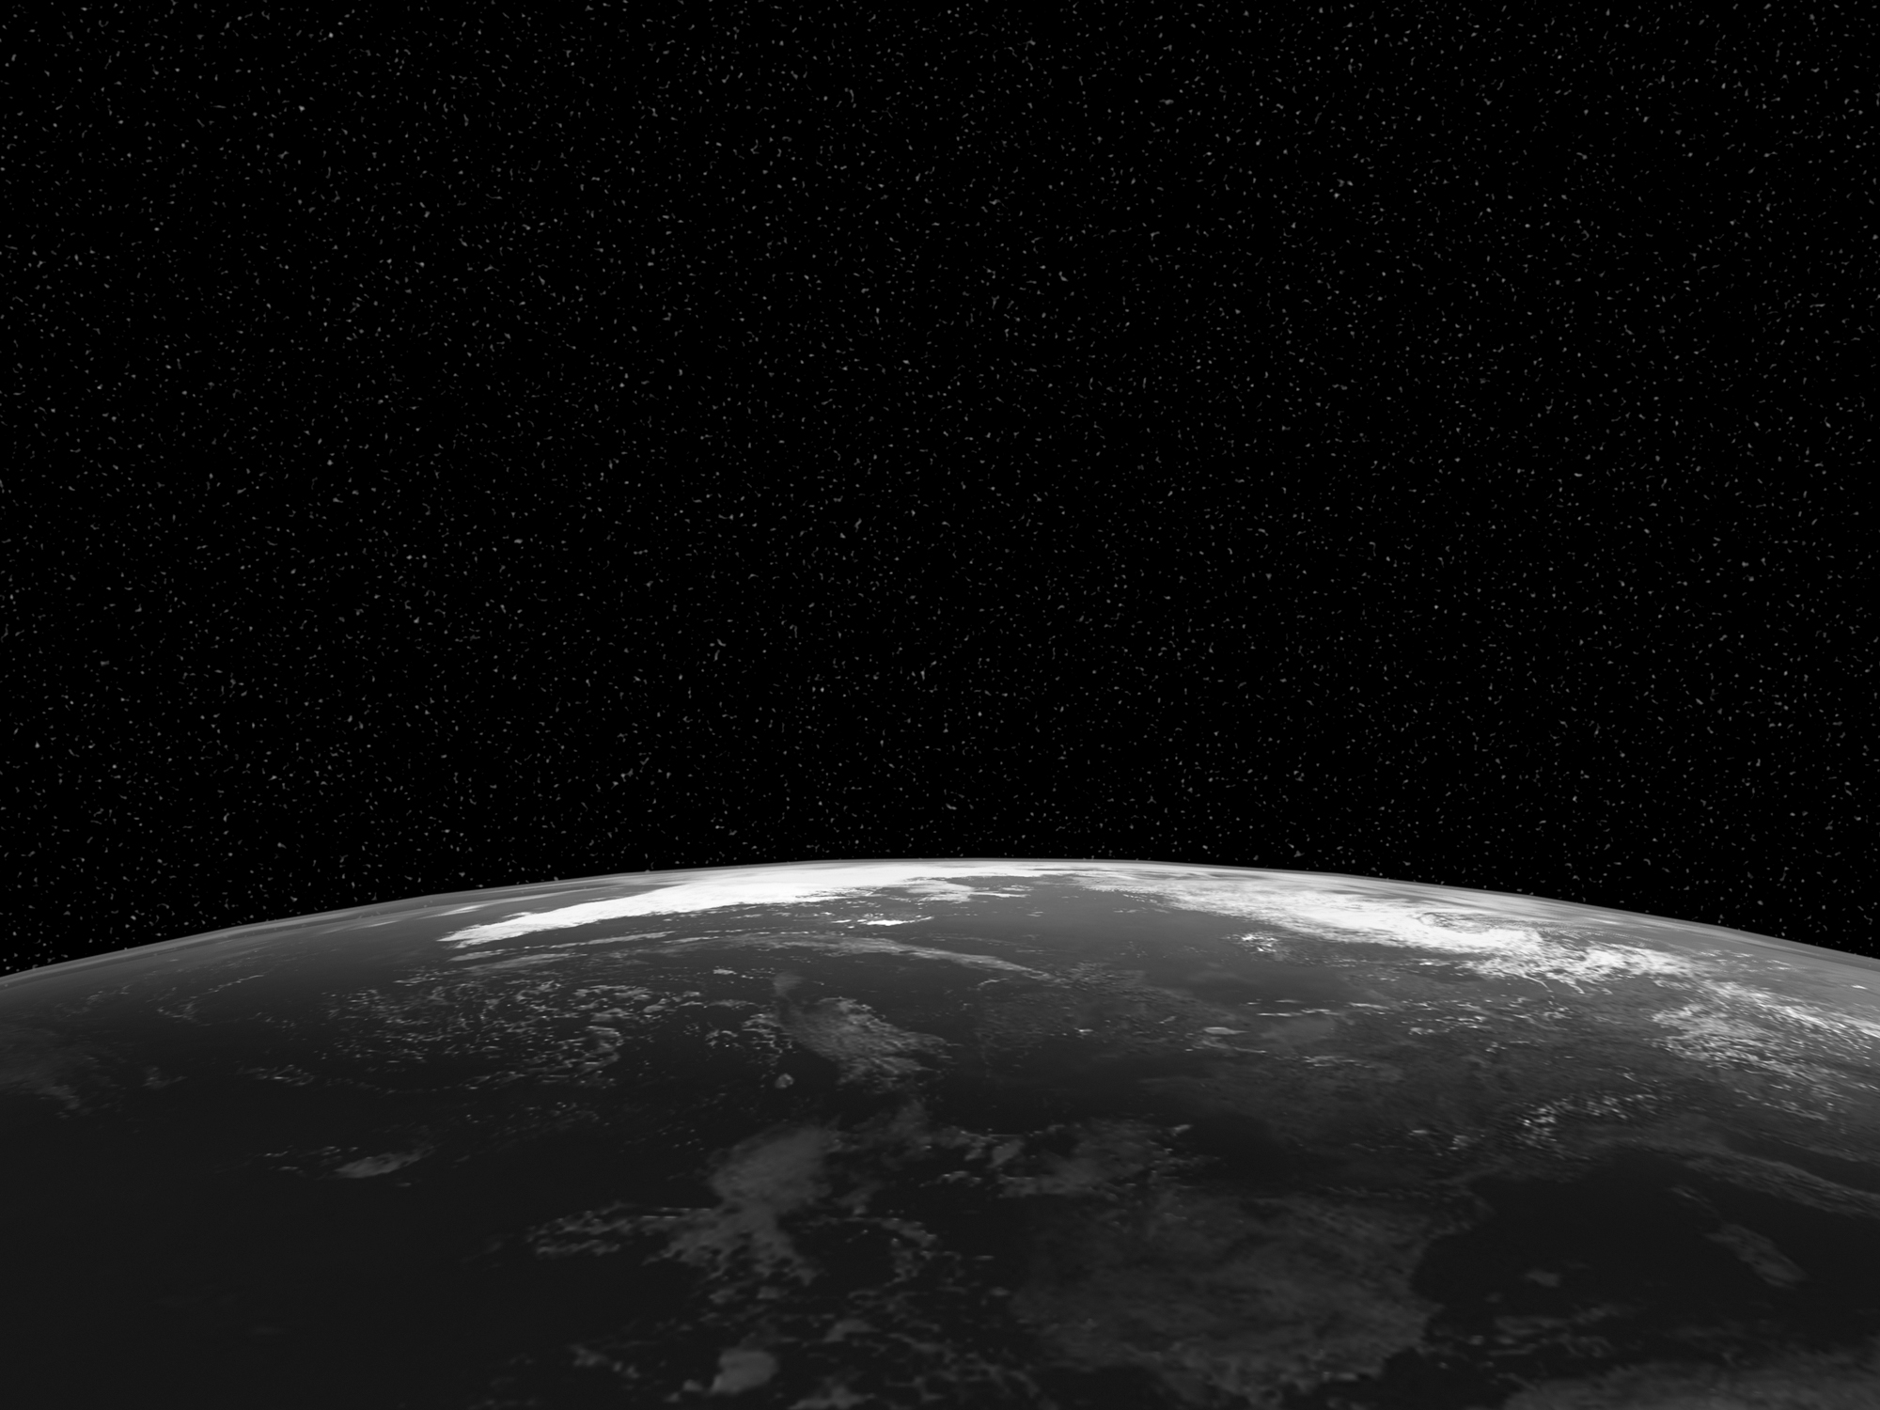
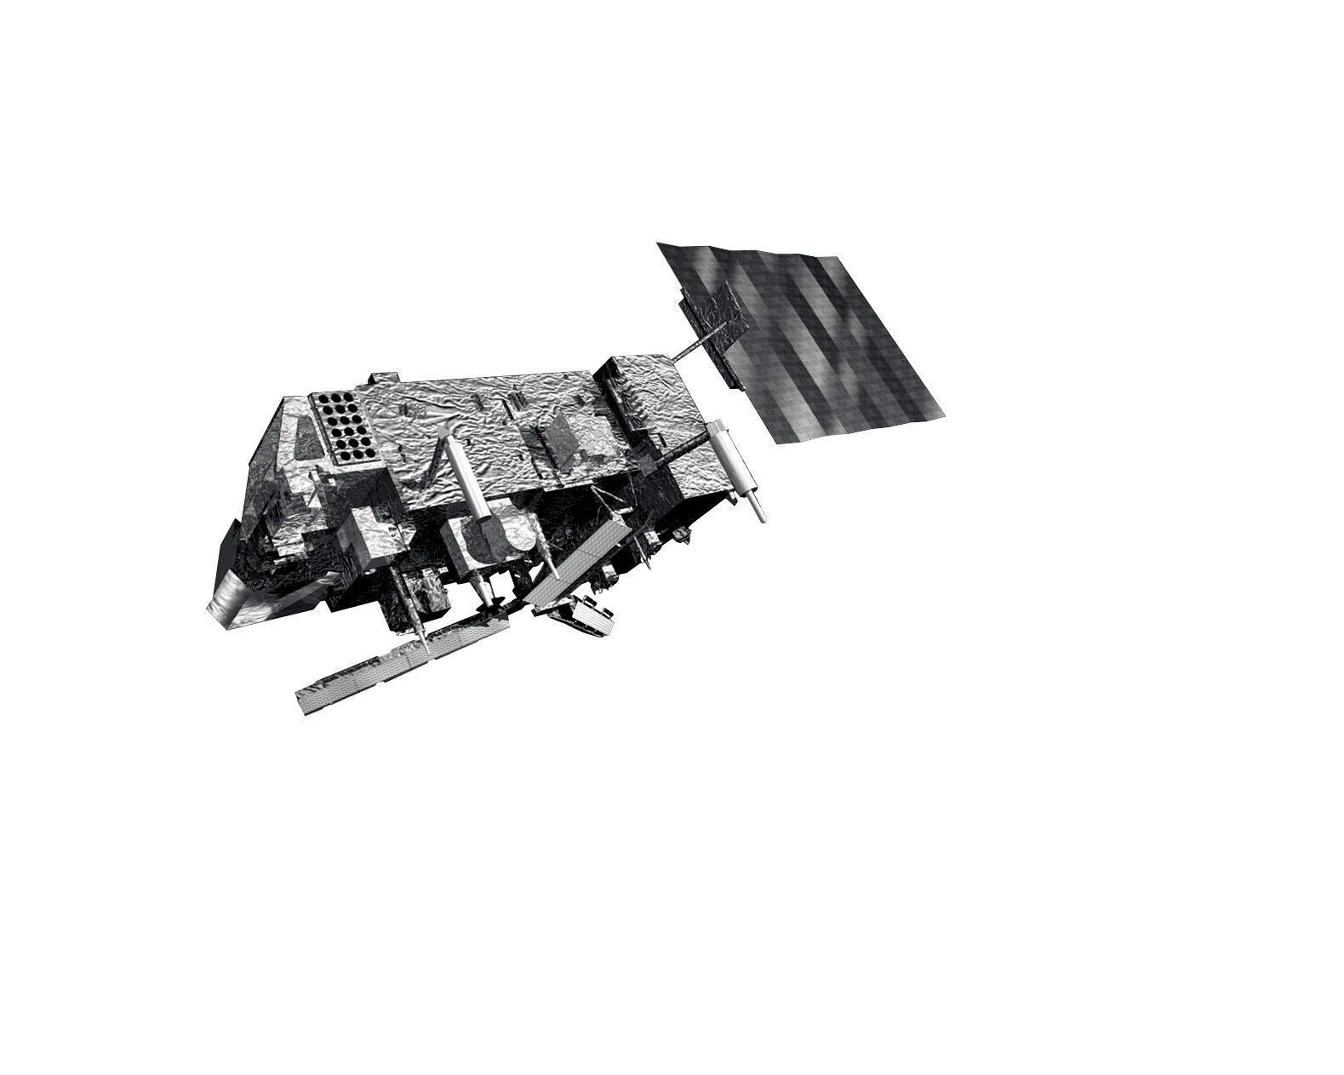
Long-term calibration monitoring using
Met Office NWP
Roger Saunders and Pete Francis
Acknowledgements to EUMETSAT for part funding

Slide 2
Rationale
It is crucial for climate and very desirable for NWP that we determine the characteristics of satellite radiance biases and try to understand their cause
Simultaneous Nadir Overpasses have a limited time and space sampling.
Comparing radiances against those simulated from a NWP model more can be learnt about the nature of the biases as the space and time matchup window can be relaxed using double differences with the NWP model as a transfer standard.
The Met Office model 6hr forecast background fields for the past 10 years are used for this study which assimilate many different satellite and in situ observations.

Slide 3
Why are there radiance biases?
Uncertainties in the calibration of the sensor (e.g. solar intrusion, sudden heating/cooling, poor BB, non-linearity in detector response, etc)
Lack of knowledge or changes in spectral response of channels (much less of an issue for IASI/AIRS,CRiS)
Biases can vary with time, scan position, orbital, diurnal and seasonal timescales.
Fast (and LbL) RT model errors (generally small but some effects can be important)

Slide 4
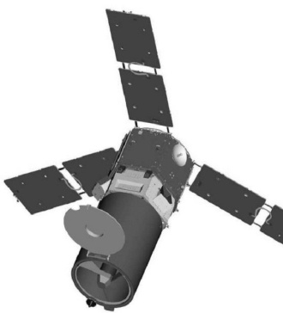
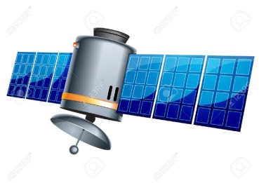
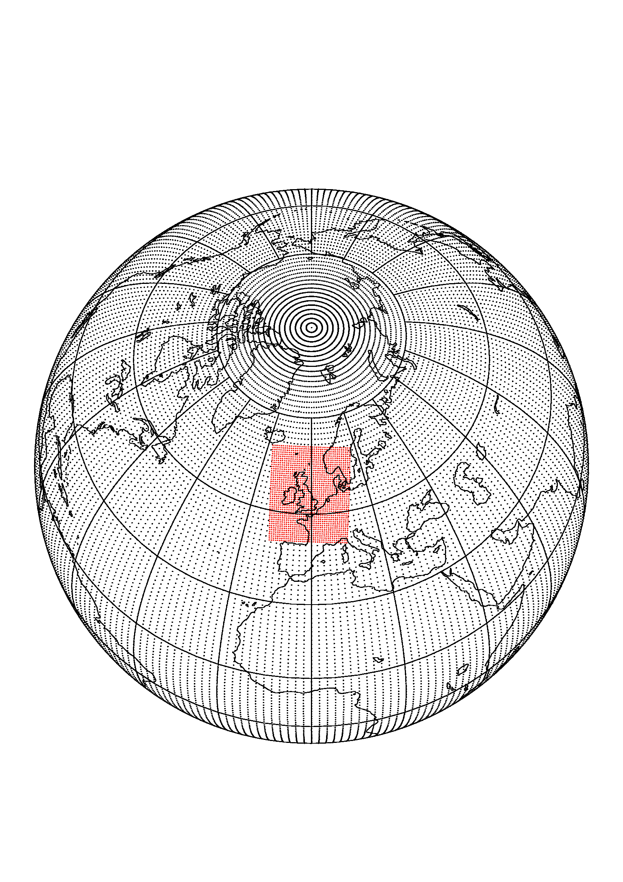
Calculation of radiance biases NWP as transfer standard
For channel n
Sensor 1: DBT(n) = mean{y_{n} - H_{n}(x_{i})}
i=1 to k obs
For channel m
Sensor 2: DBT(m) = mean{y_{m} - H_{m}(x_{i})}
i=1 to k obs
1
2
Assume same model bias?
x_{i} atmospheric state vector for observation i
Compare DBT(n) with DBT(m)
(double difference)

Slide 5
Calculation of radiance biases
H_{n}(x_{i})
RTTOV used for RT calculation with:
ISEM model assumed for surface emissivity over ocean for all IR sensors
Temperature and water vapour profiles from Met Office model background (6hr forecast)
Climatologically varying ozone profile used
All other gases assumed fixed, no cloud or aerosol

Slide 6
Processing
Suite running following operations (build, background files, coefficient files etc). Generates ASCII files with the raw observations
Not processing local (EARS/HRPT) data
Don’t use midnight data close to eclipse periods
Files created from these using data which has:
Passed QC
Converged in 1D-Var (Rejection ~10%)
‘Clear’ data is determined as follows:
Bayesian cloud test for polar data
Autosat cloud mask used for SEVIRI
AATSR cloud mask + additional O-B test
Cloudy radiances are kept but no simulated cloudy radiances

Slide 7
Infrared sensors included
Geostationary Satellite | Instrument | Channels | Source | Comments
Meteosat-8/9/10/11 | SEVIRI | 8 IR | EUMETCAST
Polar-orbit Satellite | Instrument | Channels | Source | Comments
Metop-A/B | IASI | See slide | EUMETCAST
 | HIRS | 19 IR | EUMETCAST | METOP-B outages/gaps in processing
Aqua | AIRS | See slide | NESDIS | Occasional outages
NOAA-17 | HIRS | 19 IR | NESDIS | Gap after mid Dec-09
NOAA-19 | HIRS | 19 IR | NESDIS
ENVISAT | AATSR | 3 IR Nadir 3 IR Fwd | FTP ESRIN | From 1 Sept 2010. There was a gap of about 1 week in late Oct 10. ENVISAT failed in April 2012

Slide 8
IASI | IASI | AIRS | AIRS | HIRS | SEVIRI | AATSR
Channel | Wavenumber | Channel | Wavenumber | Channel | Channel | Channel
92 | 667.75 | 75 | 667.78 | 1
141 | 680 | 123 | 680.14 | 2
179 | 689.5 | 138 | 689.49 | 3
212 | 697.75 | 168 | 697.71
242 | 705.25 | 193 | 704.72 | 4
246 | 706.25 | 198 | 706.14
280 | 714.75 | 227 | 714.48 | 5
345 | 731 | 295 | 734.15
381 | 740 | 318 | 741.29
434 | 753.25 | 355 | 753.06 | 7 | 11
457 | 759 | 375 | 759.57
546 | 781.25 | 475 | 801.1
756 | 833.75 | 528 | 820.83 |  | 10 | 1
1121 | 925 | 787 | 917.31 | 8 |  | 2
1133 | 928 | 791 | 918.75 |  | 9
1579 | 1039.5 | 1088 | 1039.23 | 9 | 8
1991 | 1142.5 | 1260 | 1135.57
2019 | 1149.5 |  |  |  | 7
2245 | 1206 | 1263 | 1216.97
2741 | 1330 | 1449 | 1330.98 | 11 | 6
3029 | 1402 | 1583 | 1402.15
3339 | 1479.5 | 1681 | 1476.25 |  | 5
3522 | 1525.25 | 1756 | 1524.35 | 12 | 5
3540 | 1529.75 |  |  | 12 | 5 | 0.00
3653 | 1558 | 1783 | 1556.1 |  | 5 | 0.00
3943 | 1630.5 |  |  |  | 5 | 0.00
5130 | 1927.25 |  |  |  |  | 0.00
 |  | 1873 | 2188.76 | 13 |  | 0.00
 |  | 1897 | 2210.85 | 14 |  | 0.00
6350 | 2232.25 | 1924 | 2236.23 | 15 |  | 0.00
 |  | 1937 | 2248.65 | 16 |  | 0.00
6463 | 2260.5 | 1948 | 2259.26 |  |  | 0.00
6601 | 2295 | 1988 | 2298.71 |  |  | 0.00
6962 | 2385.25 | 2106 | 2385.23 |  |  | 0.00
6980 | 2389.75 | 2111 | 2390.11 |  |  | 0.00
6997 | 2394 | 2115 | 2394.03 | 17 | 1 | 0.00
7424 | 2500.75 | 2189 | 2492.08 | 18 | 1 | 0.00
8007 | 2646.5 | 2363 | 2648.75 |  | 1 | 0.00
 |  | 2377 | 2664.14 | 19 | 1 | 0.00
Values in red may have high instrumental noise
IR Channel
list for sensors
in this study
Wavenumber
=
1/wavelength (cm)
1000cm⁻¹=0.001cm
=10µm

Slide 9
Analysis
10 years of data now collected to date from 20 Nov 08 to present (except AATSR and failed HIRS)
Generally only global mean plots shown which may “hide” things
Only clear radiances over ocean included in analysis
Comparisons with SEVIRI are only over a limited area
Radiances are not bias corrected of course

Slide 10
Model and observation changes
Date | Model/Observation change | Date | Model/Observation change
20 Aug 2009 | Start assimilation of NOAA-19 HIRS and AMSU radiances | 28 March 2012 | Hybrid DA updated to use MOGREPS-G
10 Nov 2009 | Change of model levels from 50 to 70 and model top raised from 0.1hPa to 0.01hPa | 17 Sept 2012 | Upgrade to RTTOV-9 in data assimilation
10 Nov 2009 | Change in bias correction of radiosonde relative humidity | 23 Jan 2013 | Moved to RTTOV-9 for bias stats presented here
17 Dec 2009 to 9 Feb 2010 | NOAA-17 HIRS not assimilated | 30 April 2013 | CrIS and ATMS assimilated
9 Mar 2010 | DMSP F-16 SSMIS window channels assimilated operationally – clear scenes only over ocean | 15 July 2014 | Increase in model resolution 25 km to 17 km. ENDGAME implemented.
2 Nov 2010 | Modify AIRS channel selection and assumed observation errors | 15 Mar 2016 | VarBC introduced for all radiances. Aircraft Rel Humidity assimilated.
2 Nov 2010 | SSMIS channels 21,22 introduced to improve mesospheric/upper stratospheric analysis | 8 Nov 2016 | More IR radiances assimilated over land. Added FY-3B MWHS radiances.
2 Nov 2010 | Introduce Meteosat-9 clear sky window and water vapour channel radiances | 11 July 2017 | Upgraded to RTTOV-11. Increased model horizontal resolution to 10km.
20 July 2011 | Introduce GOES-E+W clear sky window and water vapour channel radiances | 13 Feb 2018 | Assimilated GMI radiances. IASI and ATOVS thinning changed.
20 July 2011 | Use more IASI channels over land | 25 Sep 2018 | Upgraded to RTTOV-12. Cloud affected AMSU assimilated.
20 July 2011 | Change in humidity control variable from relative humidity to normalised pseudo relative humidity (Ingleby et. al . 2011)

Slide 11
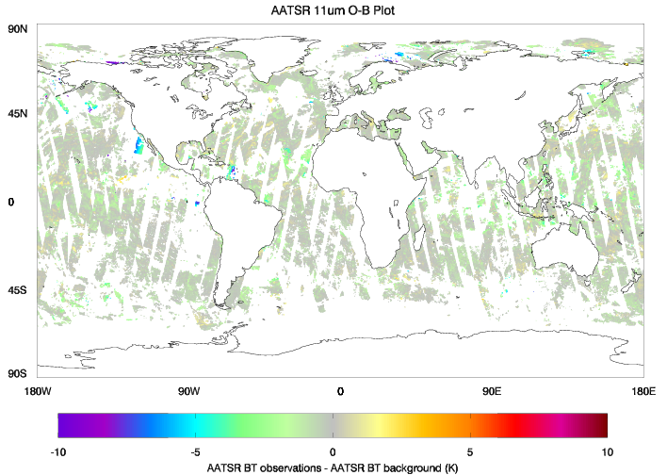
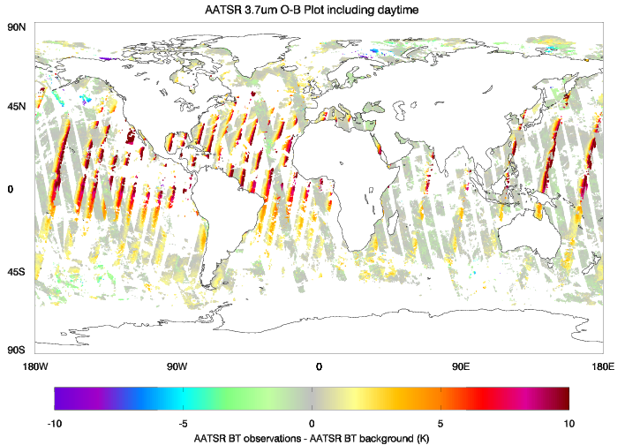
AATSR biases

Slide 12
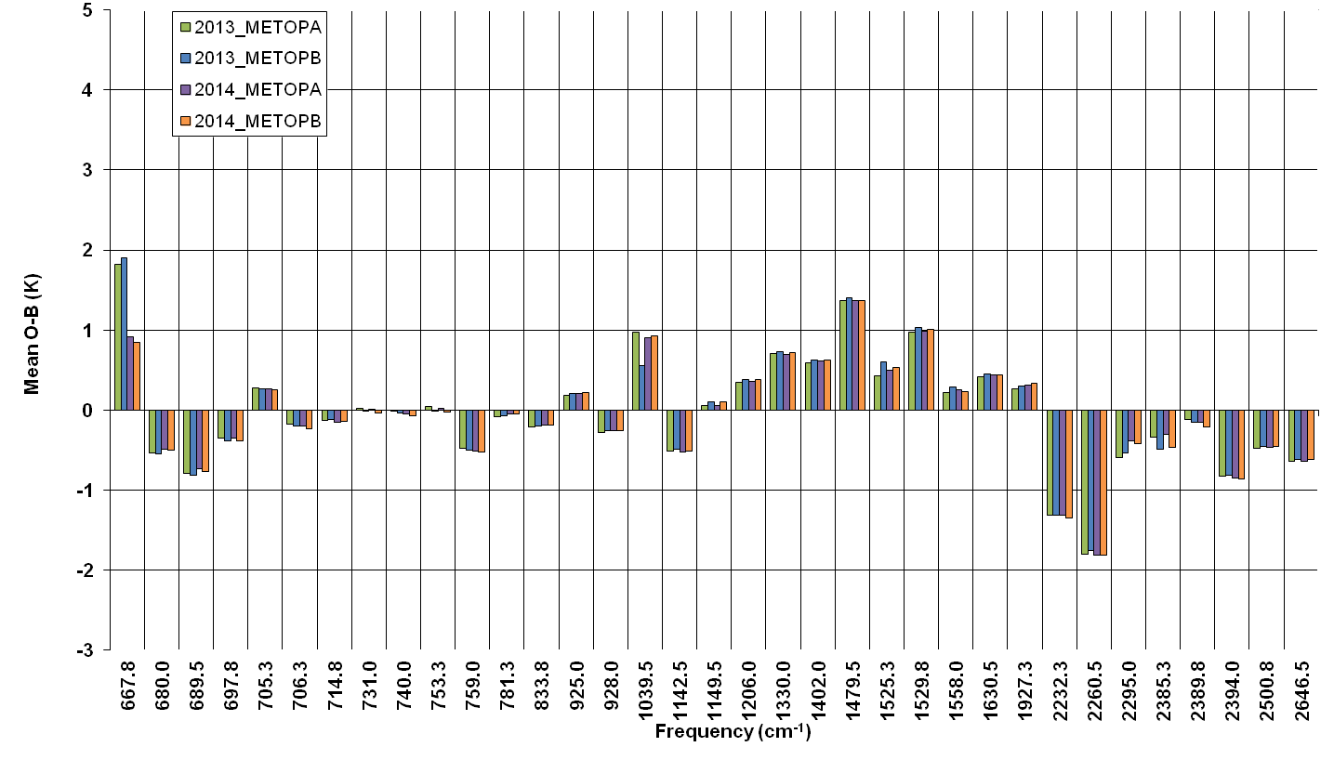
IASI-A vs IASI-B biases

Slide 13
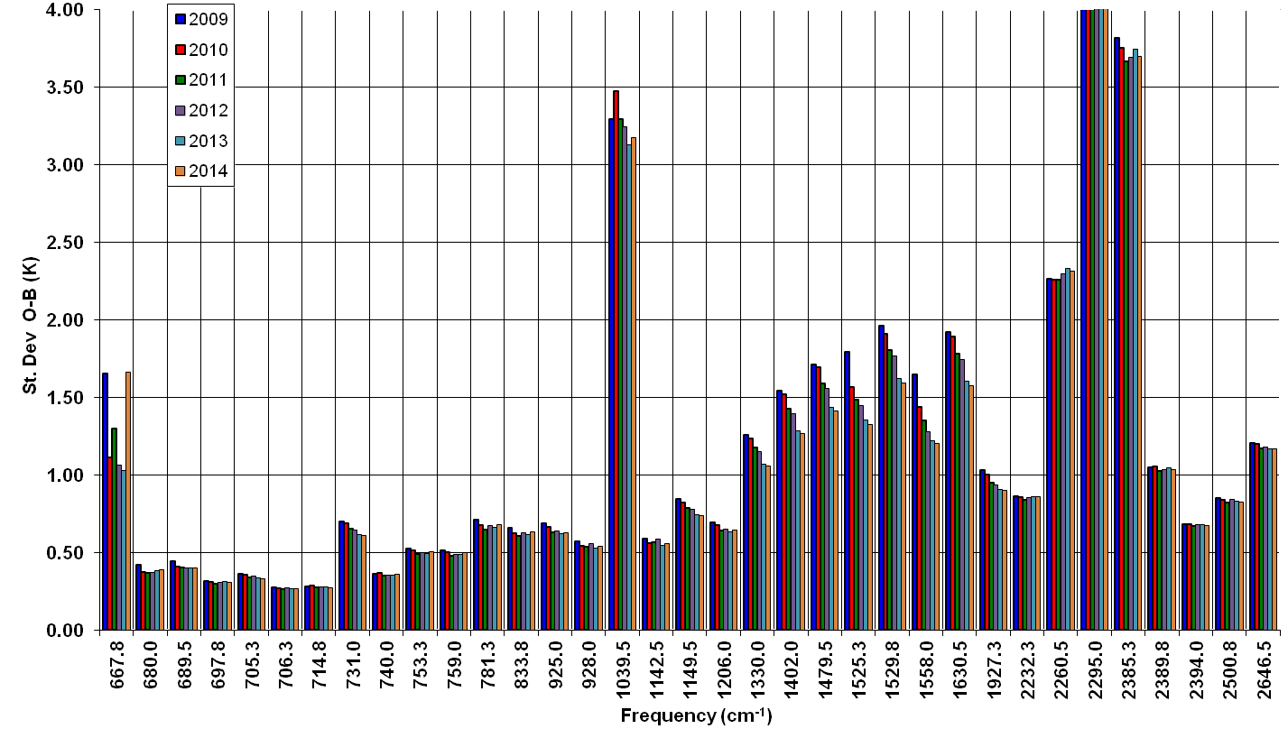
IASI-A St. deviation

Slide 14
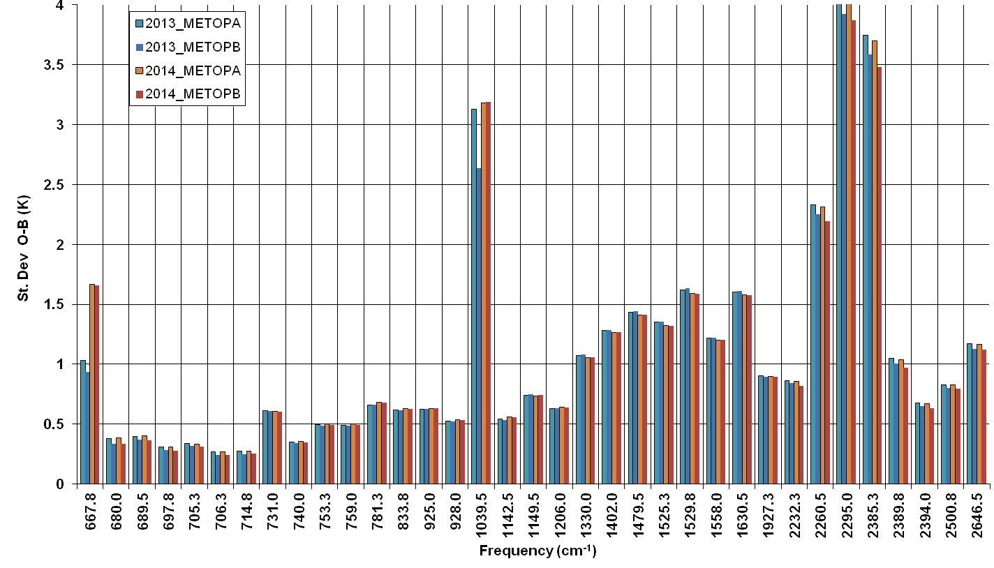
IASI-A vs IASI-B St Devs

Slide 15
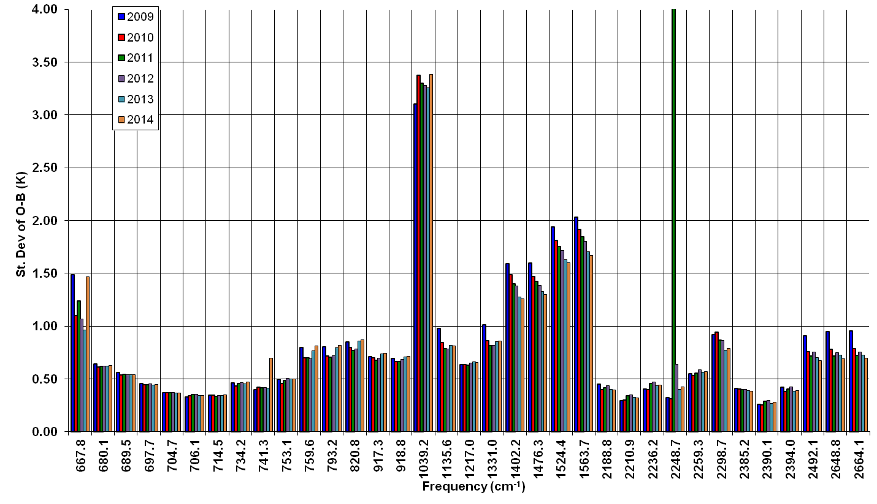
AIRS St. deviation

Slide 16
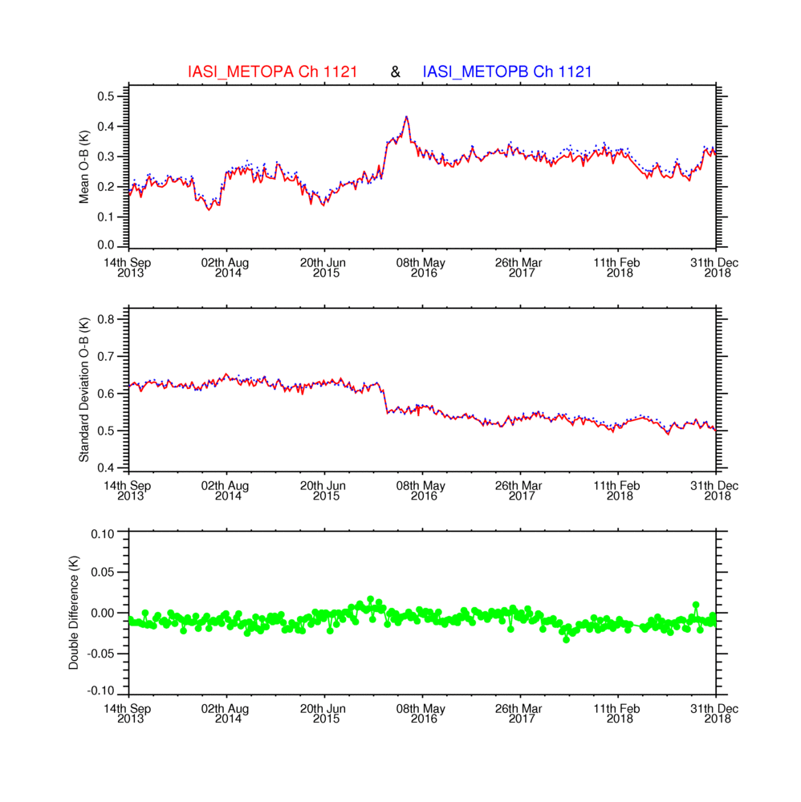
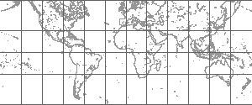
Good consistency between METOP-A and METOP-B for IASI 925 cm-1 channel
VARBC

Slide 17
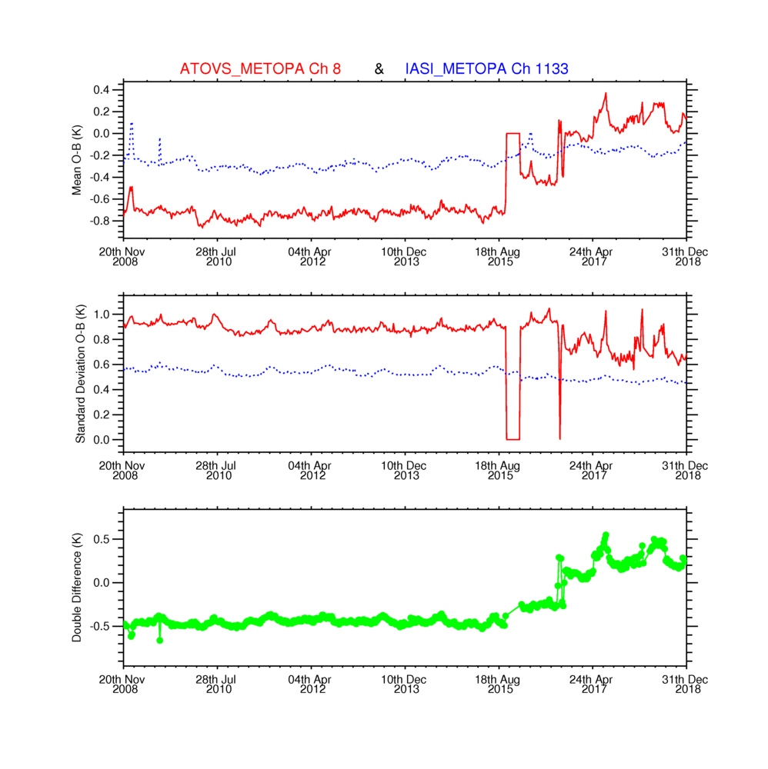
HIRS channel 8 and IASI 928 cm⁻¹ channel shows good consistency until METOP-A HIRS filter wheel jitters in 2015

Slide 18
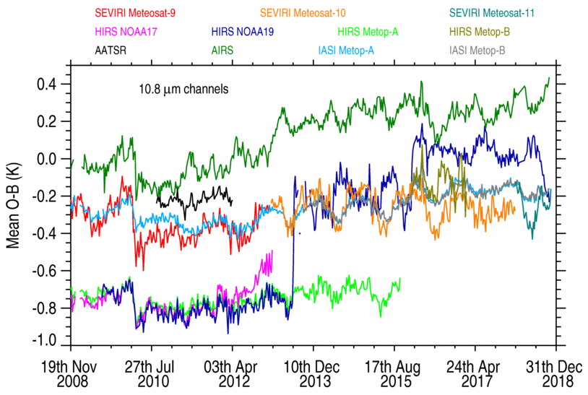
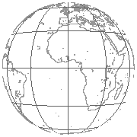
Meteosat disk
area
Ocean
Day + Night
HIRS filter wheel

Slide 19
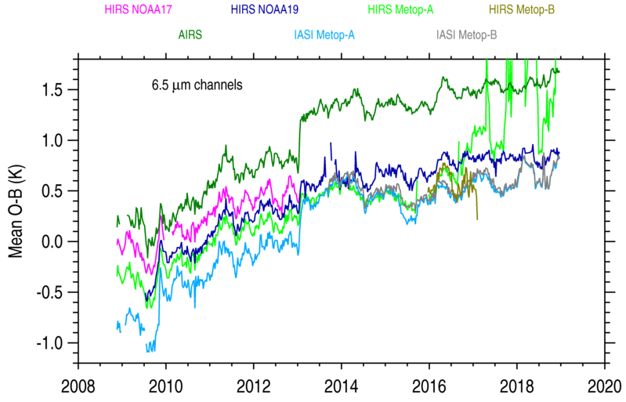
Gradual moistening of UTH in model
Global
Change RTTOV version
Change levels and R/S humidity corrn

Slide 20
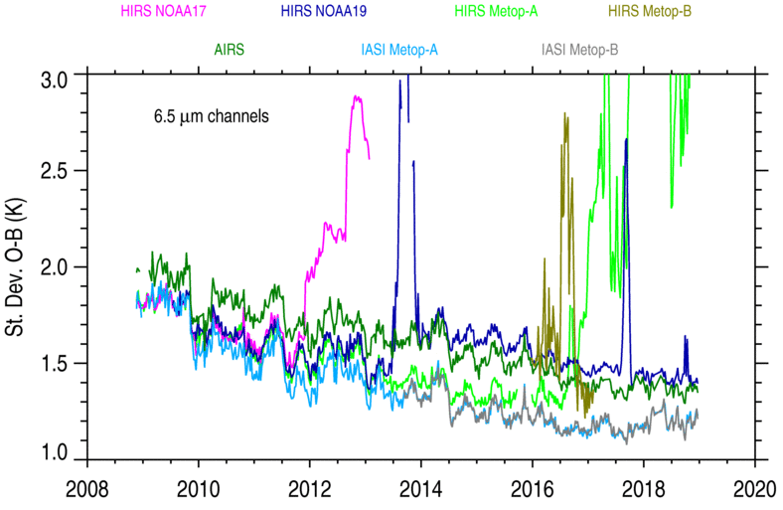
Gradual improving of UTH in model
Global
Change levels and R/S humidity corrn

Slide 21
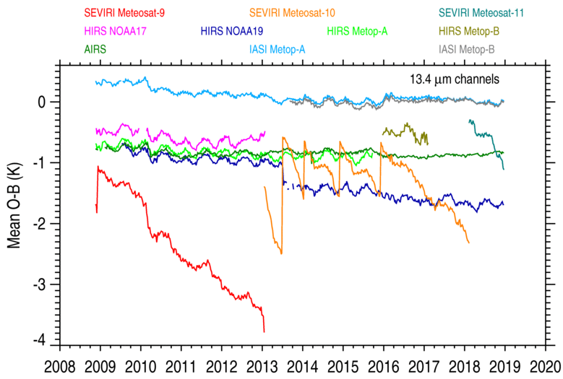
Meteosat
disk
SEVIRI Decontamination

Slide 22
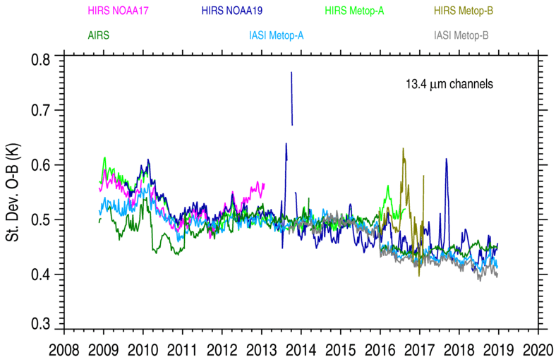
Global
SEVIRI Decontamination

Slide 23
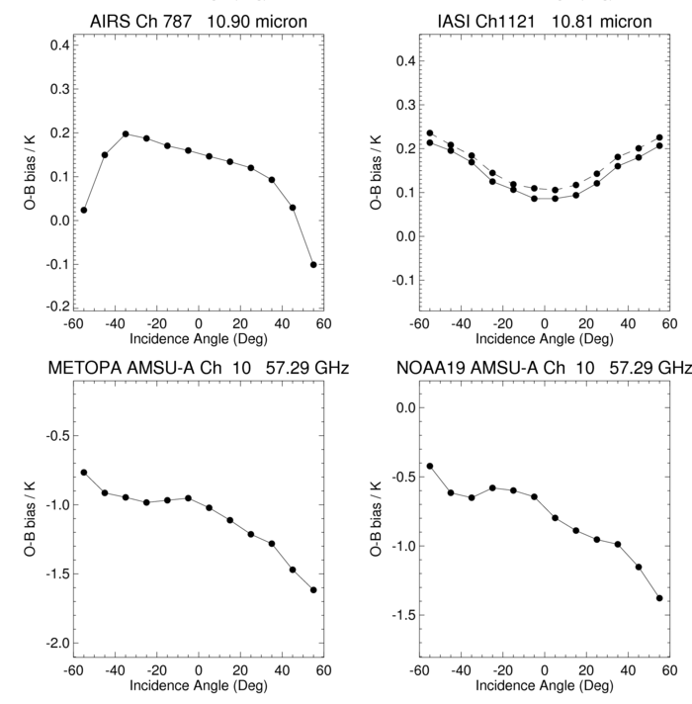
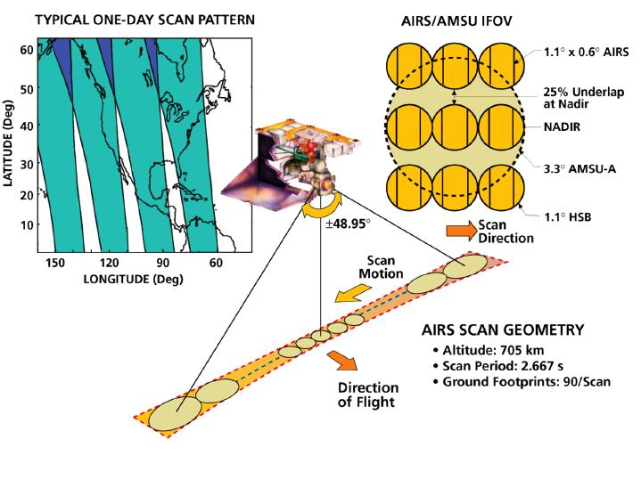
Scan biases for different sensors
Averages for 2013
B
IR sensors
A
AMSU-A

Slide 24
Scene Dependence
Averages for 2013
IASI-A
identical to
IASI-B
N.B. 2 black bodies

Slide 25
Summary 1
The biases for IASI-A and IASI-B are very similar and in general close to zero compared to NWP model. The scan dependence and scene dependence are identical. It is clear IASI radiances will make a very good Fundamental Climate Data Record.
The bias of the 13.4µm channels on SEVIRI, IASI and AIRS/HIRS (on METOP) are all significantly different from each other (instrument related). For the 6.2µm water vapour channel the biases are different due to different ISRFs but they all vary the same way (model related).
The changes in bias with scene temperature shows the limitation of the polar SNO method.

Slide 26
Summary 2
Changes in the NWP system can introduce changes in the bias (e.g. upper level moisture, upper stratosphere) but the double difference is insensitive to these.
The O-B bias becomes more positive with increasing scene temperature for all instruments except AATSR which uses 2 internal black bodies for its calibration. Message for instrument providers?
Various HIRS instruments have failed over the last 10 years as shown in the monitoring.

Slide 27
Questions and Discussion
03:21Z 1
3 Nov 14
S-NPP-VIIRS
Storms heading for UK in moonlight
Bardarbunga volcano is also visible

Slide 28
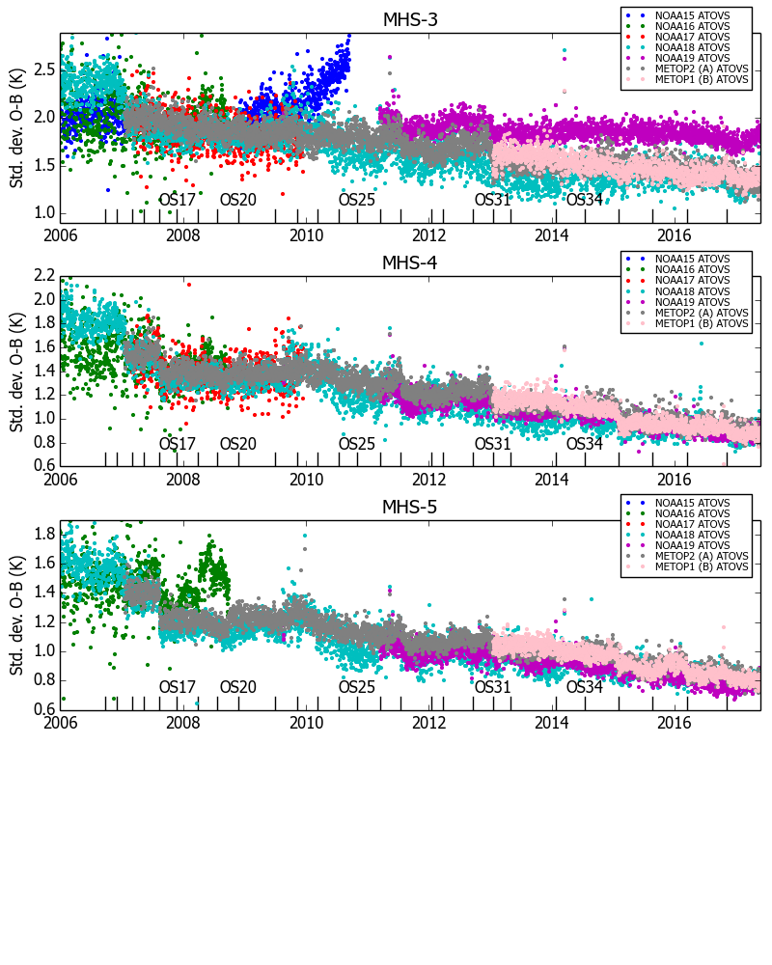
Improved model upper tropospheric humidity

