Slide 1
Updating WMO DOCUMENTS
RELATED TO GSICS
WORKS IN PROGRESS
THE CIMO GUIDE (WMO-No. 8)
THE GUIDE TO WIGOS (WMO-NO. 1156)
AND FUTURE prospects
WIGOS MANUAL (WMO-No. 1160)
Toshiyuki Kurino
(WMO Space Programme)

Slide 2
Contents:
WMO Documentation
CIMO Guide
WIGOS Guide
Future Roadmap for updating WMO Regulatory Documents to be reflected the GSICS activities on Space-based Inter-calibration: WIGOS Manual

Slide 3
WMO Documentation

Slide 4
WMO Documentation:
Basic Documents
Technical Regulations
Regulatory documents
Manuals
Non - Regulatory documents
Guides, guidelines, …

Slide 5
1. WMO Regulatory Documents
Basic Documents;
Technical Regulations;
Annexes to the Technical Regulations (Manuals);
Agreements and Working Arrangements with Other International Organizations.

Slide 6
Basic Documents
Convention
General Regulations
Staff Regulations
Financial Regulations
Agreements between the United Nations and the WMO
Convention of the Privileges and Immunities of the Special Agencies

Slide 7
Technical Regulations:
Volume I – General meteorological standards and recommended practices ;
Volume II – Meteorological service for international air navigation;
Volume III – Hydrology.

Slide 8
Purpose of the Technical Regulations
To facilitate cooperation in meteorology and hydrology among Members;
To meet, in the most effective manner, specific needs in the various fields of application of meteorology and operational hydrology in the international sphere;
To ensure adequate uniformity and standardization in the practices and procedures employed in achieving (a) and (b) above.

Slide 9
Annexes to the Technical Regulations
International Cloud Atlas (WMO-No. 407) – Manual on the Observation of Clouds and Other Meteors;
Manual on Codes (WMO-No. 306), Vol. I;
Manual on the Global Telecommunication System (WMO-No. 386);
Manual on the Global Data-Processing and Forecasting System (WMO-No. 485);
Manual on the Global Observing System (WMO-No. 544), Vol. I;
Manual on Marine Meteorological Services (WMO-No. 558), Vol. I;
Manual on the WMO Information System (WMO-No. 1060);
Manual on the WMO Integrated Global Observing System (WMO-No. 1160).

Slide 10
The Technical Regulations comprise
standard practices and procedures (shall)
Members are required to follow or implement and inform the Secretary-General, of any change in the degree of their implementation;
have the status of requirements in a technical resolution.
recommended practices and procedures (should)
Members are urged to comply;
have the status of recommendations.

Slide 11
2. WMO Guides
practices, procedures and specifications;
Members are invited to follow or implement;
help in establishing and conducting arrangements for compliance with the ToRs;
help in developing meteorological and hydrological services in Members’ respective countries.

Slide 12
CIMO Guide
The CIMO Guide:
1st edition in 1954 (12 chapters);
guidance on the most effective practices for measurements and observations to achieve a standard quality;
practical advice on techniques which are well established and in regular use, from the simplest to the most complex and sophisticated;
authoritative reference for all matters related to instrumentation and methods of observation in the context of WIGOS.

Slide 13
CIMO Guide

Slide 14
GUIDE TO INSTRUMENTS AND METHODS OF OBSERVATION (WMO-No. 8, CIMO Guide)
2018
2018
GUIDE TO METEOROLOGICAL INSTRUMENTS AND METHODS OF OBSERVATION
(WMO-No. 8, CIMO Guide)
Part | Title
I | MEASUREMENT OF METEOROLOGICAL VARIABLES
II | OBSERVING SYSTEMS
III | SPACE-BASED OBSERVING SYSTEMS
IV | QUALITY ASSURANCE AND MANAGEMENT OF OBSERVING SYSTEM
Vol. | Title
I | MEASUREMENT OF METEOROLOGICAL VARIABLES
II | MEASUREMENT OF CRYOSPHERIC VARIABLES
III | OBSERVING SYSTEMS
IV | SPACE-BASED OBSERVING SYSTEMS
V | QUALITY ASSURANCE AND MANAGEMENT OF OBSERVING SYSTEM

Slide 15
CIMO Guide
Vol I | MEASUREMENT OF METEOROLOGICAL VARIABLES
1 | General
2 | Measurement of temperature
3 | Measurement of atmospheric pressure
4 | Measurement of humidity
5 | Measurement of surface wind
6 | Measurement of precipitation
7 | Measurement of radiation
8 | Measurement of sunshine duration
9 | Measurement of visibility
10 | Measurement of evaporation
11 | Measurement of soil moisture
12 | Measurement of upper-air pressure, temperature, humidity
13 | Measurement of upper wind
14 | Observation of present and past weather; state of the ground
15 | Observation of clouds
16 | Measurement of atmospheric composition

Slide 16
CIMO Guide
Vol II | MEASUREMENT OF CRYOSPHERIC VARIABLES
1 | General
2 | Measurement of snow
3 | Measurement of glacier and ice caps
4 | Measurement of ice sheets
5 | Measurement of ice shelves
6 | Measurement of sea-ice
7 | Measurement of lake and river ice
8 | Measurement of permafrost and seasonally frozen ground
________________

Slide 17
CIMO Guide
Vol. III | OBSERVING SYSTEMS
1 | Measurements at automatic weather stations
2 | Measurements and observations at aeronautical meteorological stations
3 | Aircraft-based observations
4 | Marine observations
5 | Special profiling techniques for the boundary layer and the troposphere
6 | Electromagnetic methods of lightning detection
7 | Radar measurements
8 | Balloon techniques
9 | Urban observations
10 | Road meteorological measurements
________________

Slide 18
CIMO Guide
Vol. IV | SPACE-BASED OBSERVING SYSTEMS
Chapter | Title | P. No.
1 | Introduction | 3
2 | Principles of Earth observation from space | 46
3 | Remote-sensing instruments | 48
4 | Satellite programmes | 26
5 | Space-based observation of geophysical variables | 77
6 | Calibration and validation | 7
7 | Cross-cutting issues | 7
Introduced in 2014 edition;
Before 2014: Part II/Chapter 8 – Satellite observations (36 pages).

Slide 19
CIMO Guide
Vol V | QUALITY ASSURANCE AND MANAGEMENT OF OBSERVING SYSTEM
1 | Quality management
2 | Sampling meteorological variables
3 | Data reduction
4 | Testing, calibration and intercomparison
5 | Training of instrument specialists
________________

Slide 20
CIMO Guide Part IV: SPACE-BASED OBSERVING SYSTEMS Chapter 6. Calibration and Validation
CIMO Guide
6.1. INSTRUMENT CALIBRATION
6.1.1. Introduction
6.1.2. Factors affecting calibration
6.1.3. Pre-launch calibration
6.1.4. On-board calibration
6.1.5. Vicarious calibration
6.1.6. Intercalibration by simultaneous observations
6.1.7. Bias adjustment of long-term data records
6.1.8. Using calibration information
6.1.9. Traceability of space-based measurements
6.2. VALIDATION
6.2.1. Validation strategies
6.2.2. Validation of Level-1 Data
6.2.3. Validation of Geophysical Products (Level-2)
6.2.4. Validation by Way of NWP
References and further reading

Slide 21
WIGOS Guide

Slide 22
WIGOS Guide
Guide to WIGOS (WMO-No. 1156)
(2017 edition; draft update 2018; for approval by EC-70)
3.3.7 Satellites
For ensuring consistent accuracy among space-based observations from operational weather and environmental satellites of the Global Observing System (GOS) for climate monitoring, weather forecasting, and environmental applications, the Global Space-based Inter-Calibration System (GSICS), an international collaborative effort initiated in 2005 by WMO and the Coordination Group for Meteorological Satellites (CGMS), develops common methodologies and implements operational procedures to ensure quality and comparability of satellite measurements taken at different times and locations, by different instruments, operated by various satellite agencies.

Slide 23
WIGOS Guide
Draft Guide to WIGOS (WMO-No. 1156)
(2017 edition; draft update 2018; for approval by EC-70)
3.3.7 Satellites (cont.)
This is achieved through a comprehensive calibration strategy which involves:
monitoring instrument performances,
operational inter-calibration of satellite instruments,
tying the measurements to absolute references and standards, and
recalibration of archived data.
The resulting inter-comparisons achieve inter-calibration when the measurements are traceable to absolute references and standards. GSICS contributes to the integration of satellite data within the WMO Integrated Global Observing Systems (WIGOS).

Slide 24
WIGOS Guide
Draft Guide to WIGOS (WMO-No. 1156)
(2017 edition; draft update 2018; for approval by EC-70)
3.3.7 Satellites (cont.)
Meteorological satellites usually transport a variety of instruments, each mounted for specific applications required by a diverse user community. In fact, due to this variety of instruments and the specific observation programme chosen, the related metadata have a different nature than with the classic surface-based observations (see the Guide to Instruments and Methods of Observation (WMO-No. 8)). As a consequence, metadata for satellite observations with calibration information are collected as a separate database, OSCAR/Space.
Reference
Guide to GSICS Products and Services

Slide 25
Future Roadmap (WIGOS Manual)

Slide 26
WIGOS Manual
WIGOS Manual (WMO-No. 1160)
(2015 edition; updated in 2017)
4. ATTRIBUTES SPECIFIC TO THE SPACE-BASED SUB-SYSTEM OF WIGOS
4.1. Requirements
4.2. Design, planning and evolution
4.3. Instruments and Methods of Observation
4.3.1. Calibration and Traceability
4.4. Space Segment Implementation
4.5. Ground Segment Implementation
4.6. Observational Metadata
4.7. Quality Management
4.8. Capacity Development

Slide 27
4.3.1 Calibration and Traceability 4.3.1.1 Satellite operators shall perform a detailed instrument characterization before launch. Note: Members must strive to follow the pre-launch instrument characterization guidelines recommended by the Global Space-based Inter-calibration System. 4.3.1.2 After launch, satellite operators shall calibrate all instruments on a routine basis against reference instruments or calibration targets. Note 1: Advantage should be taken of satellite collocation to perform on-orbit instrument inter-comparison and calibration. Note 2: Calibration must be done in accordance with established and documented methodologies by the Global Space-based Inter-Calibration System (GSICS) and the Committee on Earth Observation Satellites (CEOS) Working Group on Calibration and Validation.
WIGOS Manual

Slide 28
4.3.1.3 Satellite operators shall ensure traceability to International Standards (SI) according to international approved standards. Note: The Implementation Plan for the Global Climate Observing System (WMO/TD-No. 1253) calls for sustained measurement of key variables from space traceable to reference standards, and recommends implementing and evaluating a satellite climate calibration mission. 4.3.1.4 To ensure traceability to International Standards (SI), satellite operators shall define a range of ground-based reference targets for calibration purposes. 4.7. Quality Management Satellite operators shall include appropriate quality indicators in the metadata for each dataset, in accordance with the provisions of section 2.5.
WIGOS Manual

Slide 29
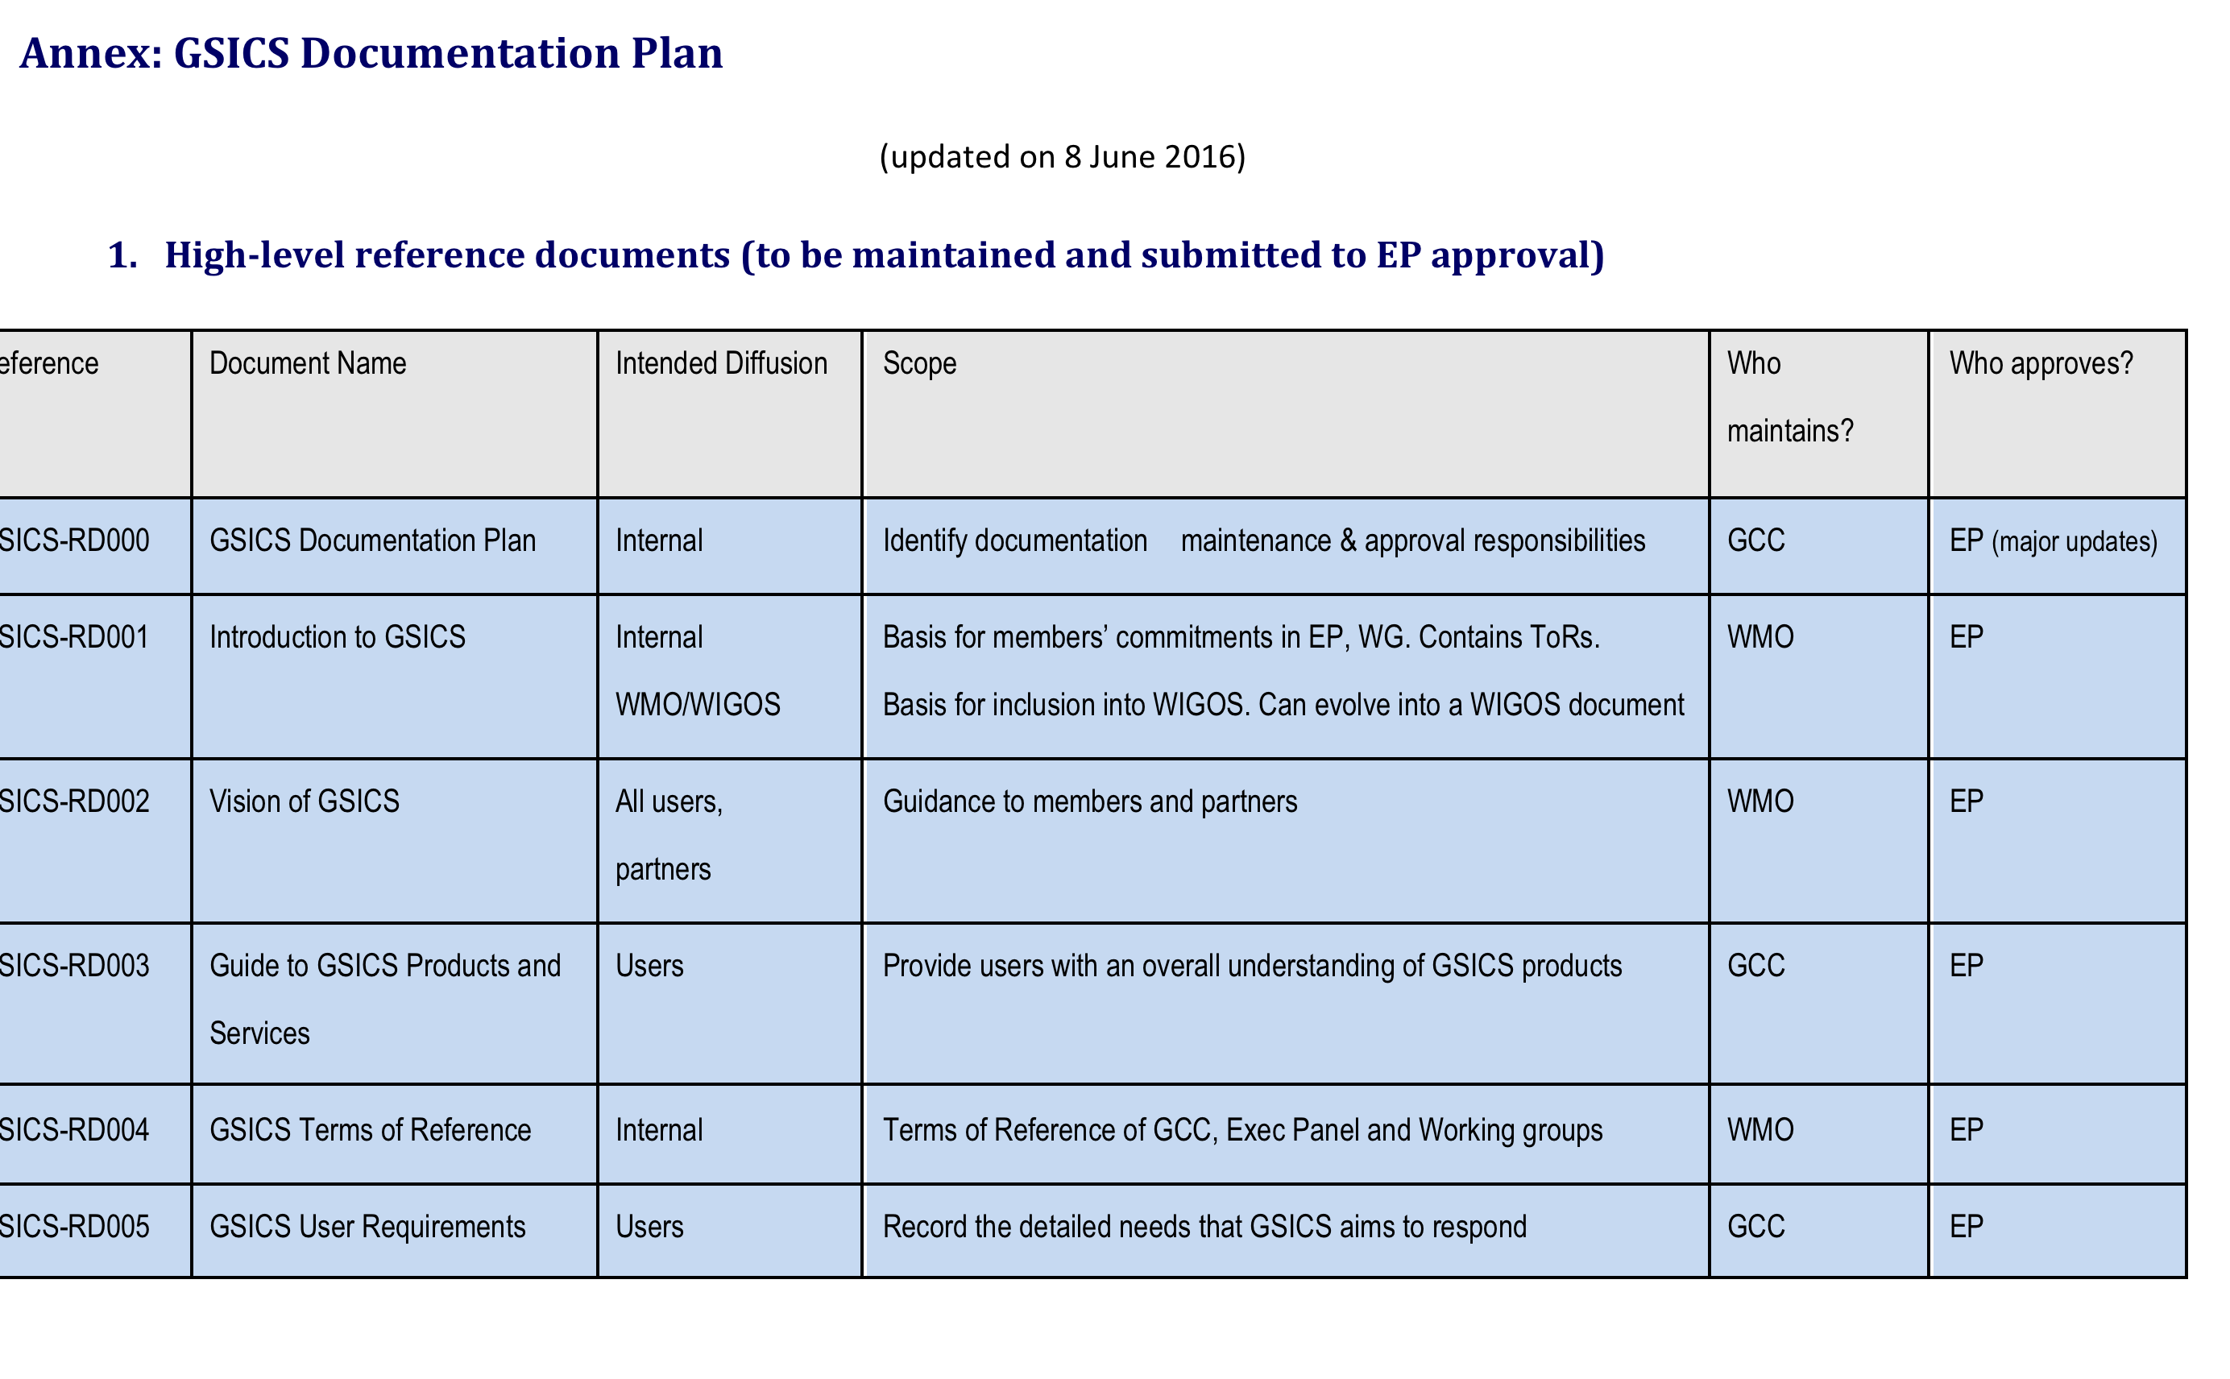
GSICS-RD000: GSICS Documentation Plan

Slide 30
Summary
GSICS to review the latest version of the WMO CIMO Guide Volume IV: SPACE-BASED OBSERVING SYSTEMS / “Chapter 6. Calibration and Validation” (deadline: 31 March 2019).
GSICS to accept the “Chapter 6” as a GSICS documentation for the “rolling review” for updating.
GSICS to review and update the GSICS high-level reference document “RD003: Guide to GSICS Products and Services” which was referred in the Guide to WIGOS (deadline: August 2019).
GSICS to support reviewing of the WMO “Manual on WIGOS” for reflecting GSICS contribution to Calibration and Traceability Data Quality Monitoring of space-based observations.

Slide 31
Thank you
Merci

Slide 32
GSICS Documentation
The following kinds of GSICS documentation are maintained:
GSICS high-level reference documents submitted to Executive Panel approval, including.
RD001: Introduction to GSICS
RD002: Vision of GSICS
RD003: Guide to GSICS Products and Services
RD004: Terns of Reference of GCC, EP, GDWG and GRWG
RD005: GSICS Service Specification
RD006: GIRO and GLOD Dataset Usage Policy
GSICS organization documents and procedures
GSICS technical standards and best practices
Technical guides for GSICS services and tools
Technical guides for GSICS products
GSICS outreach and communication material
In addition, the GCC keeps a record of:
Periodic GSICS publications (e.g. GSICS Quarterly)
Publications based on GSICS activities.

Slide 33
CIMO Guide
GUIDELINES FOR DRAFTING UPDATES / NEW EDITIONS (1)
techniques that are well established and in regular use should be described;
methods that are recommended or in common use should appear first;
methods that are rare or whose use is discouraged should appear afterwards;
if a method is strongly preferred/obsolete, this should be stated clearly in the CIMO Guide;

Slide 34
CIMO Guide
GUIDELINES FOR DRAFTING UPDATES / NEW EDITIONS (2)
advice on uncertainty, reliability and other aspects of performance, with comprehensive discussion of sources of error;
practical advice on aspects of observations and measurements;
an outline, and an introduction to the literature, for the well-informed non-specialist;

Slide 35
CIMO Guide
GUIDELINES FOR DRAFTING UPDATES / NEW EDITIONS (3)
the level of technical detail and the content should be appropriate;
well-documented comparisons or evaluations of instruments;
national practices and observing networks, particular manufacturers or suppliers and/or their observing networks should be avoided;

Slide 36
CIMO Guide
GUIDELINES FOR DRAFTING UPDATES / NEW EDITIONS (4)
headings in Vol II to V are much more flexible than in Vol I;
a structure of a new chapter drafted for Vol II to V, should be, as far as possible, consistent with the other chapters of a relevant Vol;
annexes can include almost anything that is inconvenient elsewhere in the text, e.g. formal statements; formulae, constants;

Slide 37
CIMO Guide
GUIDELINES FOR DRAFTING UPDATES / NEW EDITIONS (5)
reporting practices should not be included in the CIMO Guide, but in the Manual on Codes (WMO-No. 306);
the presentation of the material should follow the WMO Style Guide and the WMO Editorial checklist;
pictures may be included, but require obtaining written agreement of the copyright holders.

Slide 38
CIMO Guide
GUIDELINES FOR DRAFTING UPDATES / NEW EDITIONS (6)
Referencing:
WMO Manuals and other Guides and guidelines;
reviewed and readily available papers;
reports of conferences and in-house papers are often too transient or inaccessible to be very useful and should be used only if necessary and if no other material is available;
glossaries are not used.

Slide 39
CIMO Guide
GUIDELINES FOR DRAFTING UPDATES / NEW EDITIONS (7)
Terminology:
the International Meteorological Vocabulary (WMO-No. 182) http://library.wmo.int/pmb_ged/wmo_182-1992_en.pdf;
the International Vocabulary of Metrology – Basic and General Concepts and Associated Terms (VIM) http://www.bipm.org/en/publications/guides/vim.html;
the Evaluation of measurement data – Guide to the expression of uncertainty in measurement (GUM), http://www.bipm.org/en/publications/guides/gum.html.

Slide 40
CIMO Guide
GUIDELINES FOR DRAFTING UPDATES / NEW EDITIONS (8)
Vol IV is primarily intended to tell those responsible for surface-based measurements what they can expect from space-based systems;
References and Further Reading appear at the end of the Vol rather than at the end of each Chapter;
To use "free troposphere" and "planetary boundary layer", instead of "upper" and "lower troposphere", respectively (as agreed within WMO RRR activities).

Slide 41
CIMO Guide
Procedures for updating the CIMO Guide
Updates/revisions of the Guide are initiated as soon as a sound proposal is submitted;
Proposals (apart from minor changes and typos) have to be included in track-change mode in the MS-Word file of the most recent version of the CIMO Guide.

Slide 42
CIMO Guide
CIMO contributions
Contributions by other TC / groups
Revised chapter developed by expert
Revised chapter developed by expert
Review and approval by relevant ET
Review and approval by relevant ET
Review by CIMO authority
CIMO Ed. Board
Other TC President
CIMO President
CIMO Ed. Board
Consultation of WMO Members – Nomination of FP in case of comments
Posted on web repository
Final Approval by CIMO or CIMO President
________________

Slide 43
CIMO Guide
For more details, please visit:
https://www.wmo.int/pages/prog/www/IMOP/CIMO-Guide.html
https://www.wmo.int/pages/prog/www/IMOP/publications/CIMO-Guide/Prelim_2018_ed/Preliminary-2018-edition.html
________________

