Slide 1
Deliverables and their acceptance criterion
Document
Manik Bali and Larry Flynn
March 5th 2019
GSICS Annual Meeting
Frascati, Italy

Slide 2
Disclaimer
“The scientific results and conclusions, as well as any views or opinions expressed herein, are those of the author(s) and do not necessarily reflect the views of NOAA or the Department of Commerce."

Slide 3
Contents
Introduction
  What can be a GSICS deliverable
Proposed Deliverable Acceptance Matrix
  Deliverables submitted for acceptance
Existing entities on Collaboration server
  Several GSICS deliverables are available on GSICS Collaboration Server
      Source dataset, intermediate data, GSICS products
    SRF (Spectral Response Function) netCDF
    GSICS Convention was agreed in 2018
    Recent requirements for new deliverables
      Subset of PICS (Pseudo Invariant Calibration Sites), SNO (Simultaneous Nadir Overpass) prediction
Summary and discussion
Purpose of this talk
  To introduce existing deliverables and recent GRWG requirements
  To get GRWG feedbacks for inputs of practical discussions at GDWG session
  What we can collaborate to upgrade Collaboration Servers

Slide 4
Introduction
With the calibration community developing innovating algorithms and using newer data sets in GSICS it was important to give a GSICS stamp of acceptance to these entities. GSICS EP placed actions on GCC to identify entities as GSICS deliverables and propose an acceptance matrix
Actions from EP-16
Action: a) GCC to finalize the high-level categorization of GSICS holdings and deliverables, ensuring that actual or planned products can be mapped to these categories, indicating a target audience, delivery or access mode;
Action: b) GCC to propose appropriate review/acceptance mechanisms for each category of GSICS products (with a distinction between acceptance of the algorithms, and acceptance of the production of calibration coefficients or calibrated radiances).

Slide 5
What can be a GSICS Deliverable
Classical GSICS Products are Correction products made by inter-comparing two instruments using SNO.
Undergo GPPA ( inherited from QA4EO) and follow GSICS meta data format
GSICS Deliverables are entities that GSICS members find useful in achieving their instrument monitoring goals. Some of the examples are stated below.
Core products
  Subject to GPPA (Stamp of Approval)
Models and data sets
  These should be reviewed by GSICS prior to recommendation for use.
Tools
  These are made available because GSICS members find them useful.
GSICS Documents
  These are related to products, protocol and procedures.
GPRC and OSCAR Documents and Resources
  GSICS Disclaimer for external website content.
Reference: Larry Talk
http://www.wmo.int/pages/prog/sat/meetings/linkedfiles/GSICS-EP-17_Doc_10_Categorization-acceptance-V10.pptx

Slide 6

Proposed Acceptance Matrix and Decision Process
Objective of the Deliverable ( e.g why the Group/Subgroup/Community needs it etc)
How it was created
How to use it
Method of access (http download link and contacts)
References: Publications, websites etc.
If applicable Quality , Uncertainty Traceability to Standards
Apply
Hyperspectral Reference Radiance in NetCDF format
By Masaya Takahashi (JMA)
http://gsics.atmos.umd.edu/bin/view/Home/LEOnetCDFSourcedataset
GEO-LEO Intermediate Collocation (Himawari/MTSAT V Hyperspectral)
By Masaya Takahashi (JMA)
http://gsics.atmos.umd.edu/bin/view/Home/GEOLEOIRCollocationIntermediatedata
SRF for GIRO
By Masaya Takahashi (JMA)
http://gsics.atmos.umd.edu/bin/view/Home/SRFnetCDF
Level 1C Inter-Calibration Tables
By Wes Berg ( CSU) and Racheal Kroodsma (NASA)
http://gsics.atmos.umd.edu/bin/view/Development/Microwave-Deliverable
Discussion in the Subgroup and recommendations generated
Decision by GCC Director with GSICS EP

Slide 7
GSICS Server Upgrade - Requirements for New Deliverables
Masaya Takahashi
Japan Meteorological Agency

Slide 8
Overview and Purpose
Overview
  Several GSICS deliverables are available on GSICS Collaboration Server
    Source dataset, intermediate data, GSICS products
  SRF (Spectral Response Function) netCDF
  GSICS Convention was agreed in 2018
  Recent requirements for new deliverables
    Subset of PICS (Pseudo Invariant Calibration Sites), SNO (Simultaneous Nadir Overpass) prediction
Purpose of this talk
  To introduce existing deliverables and recent GRWG requirements
  To get GRWG feedbacks for inputs of practical discussions at GDWG session
  What we can collaborate to upgrade Collaboration Servers

Slide 9
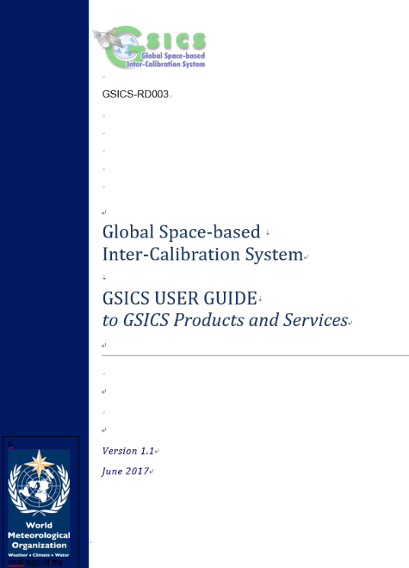
4 broad type of GSICS deliverables
(Section#5 of GSICS-RD003)
GSICS Products
  Inter-calibration of space-based instruments with GSICS references, and resulting calibration adjustments (GSICS Correction)
Documentation
  GSICS High-level documents, Inter-calibration ATBDs
Best practices/standard procedures
  Inter-calibration algorithms, data and metadata convention
Measurement references and tools
  Calibration references
  Software modules, datasets, infrastructure elements to support GSICS activities

Slide 10
GSICS deliverables on GSICS Collaboration Servers
LEO L1 netCDF (source dataset)
GEO-LEO-IR Collocation netCDF (intermediate data)
GSICS Products
SRF netCDF
  Currently several data available on the Wiki

Slide 11
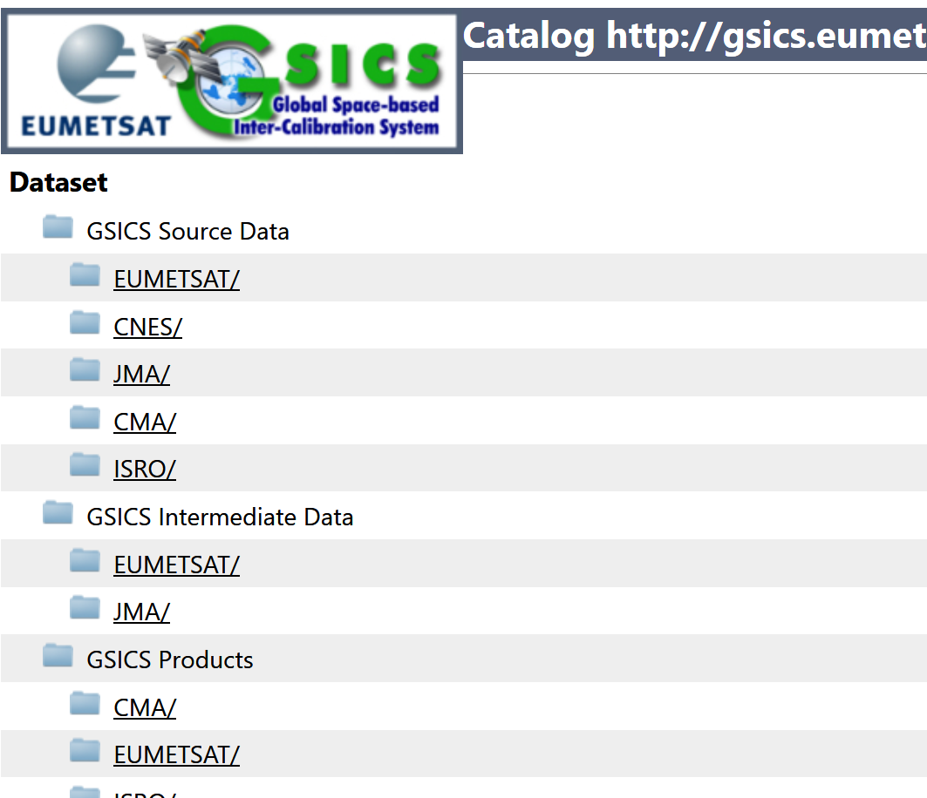
GSICS deliverables on
GSICS Collaboration Servers

Slide 12
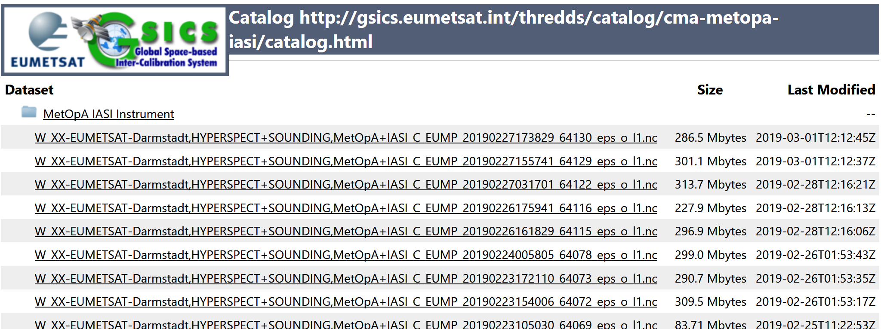
GSICS deliverables:
A) LEO L1 netCDF
Objective
  Several GSICS agencies need reference LEO L1 subset for their GEO-LEO collocation to generate GSICS products
How it was created
  Instruments operator (e.g. IASI L1C by EUMETSAT) creates netCDFs and makes it available on GSICS Collaboration Server based on user requests
How to use it
  Input (source) of ATBD
References
  EUMETSAT GSICS Collaboration Server

Slide 13
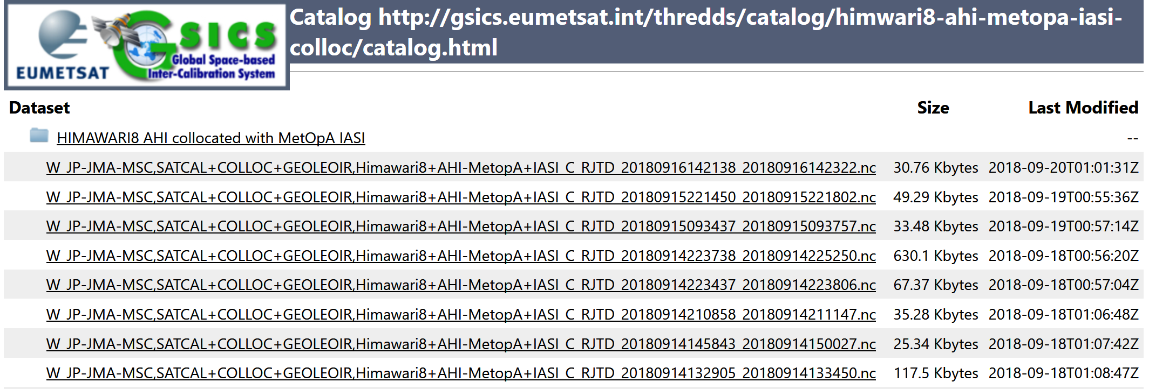
GSICS deliverables:
B) GEO-LEO Collocation netCDF
Objective
  GSICS agencies use the files to generate GSICS Corrections
How it was created
  Producers of GSICS Products (e.g. JMA)
How to use it
  Intermediate data for ATBD
  Maybe useful for users to replicate the products or use it for their own research
References
  GSICS Convention (template) on the Wiki
  Data: example of JMA's data¹
  ¹ Data transfer was tentatively stopped in 2018 due to FTP connection: root causes are under investigation

Slide 14
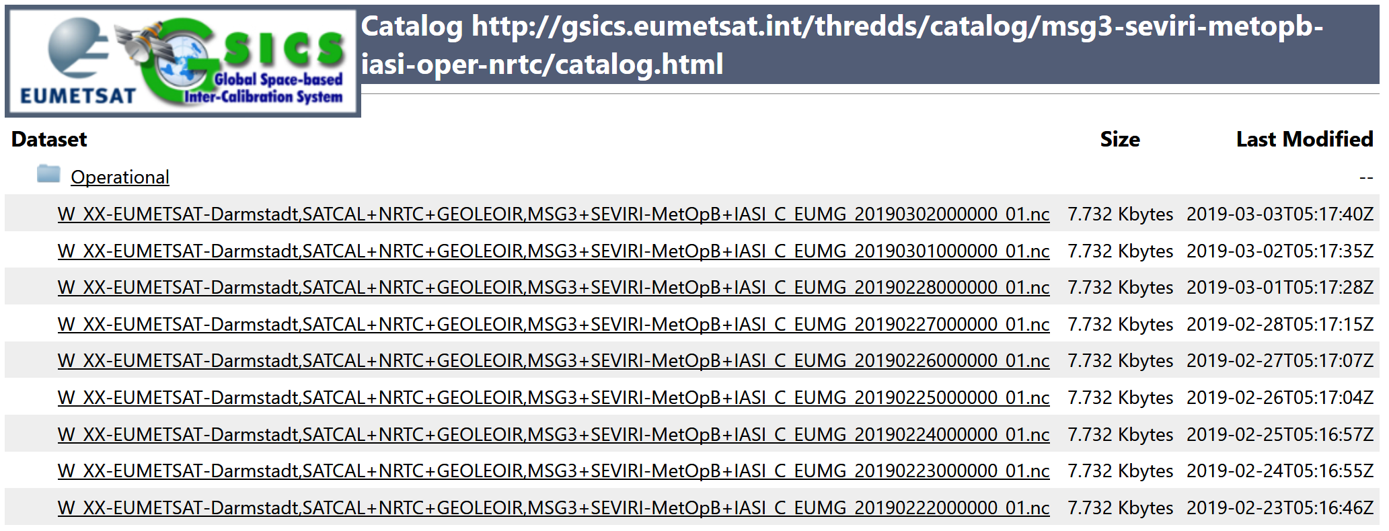
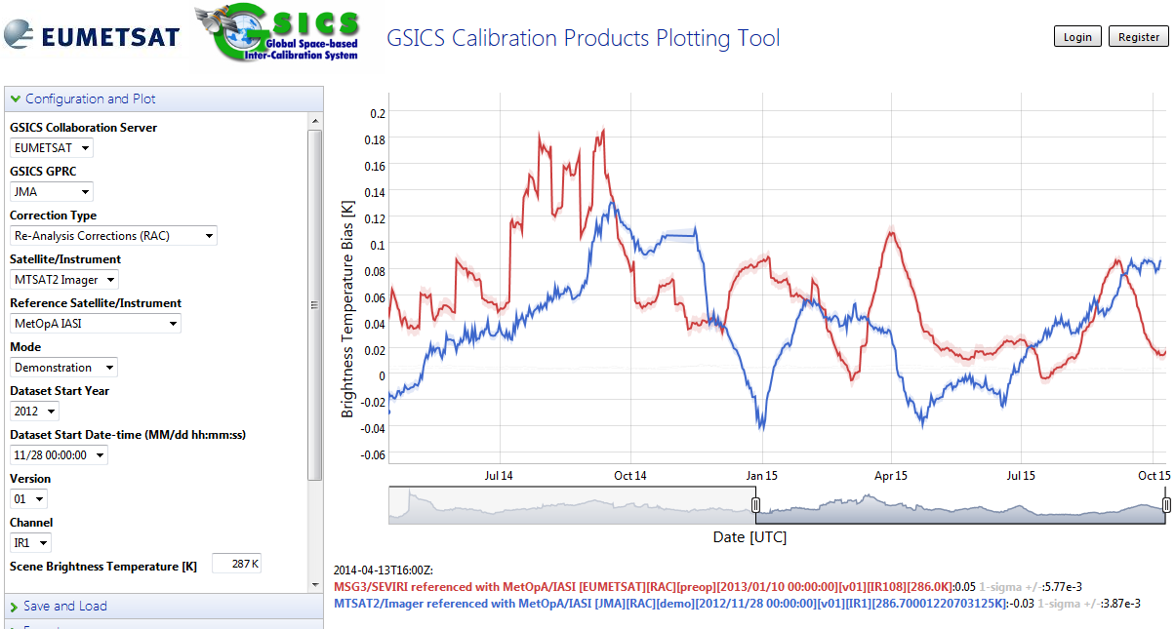
GSICS deliverables:
C) GSICS Correction
Objective
  GSICS agencies inter-calibrate in-orbit instruments to monitor the performance and to provide correction coefficients for satellite data users
How it was created
  Producers of GSICS Products (routinely) create/upload to Collaboration Server
How to use it
  Monitoring biases on Plotting Tool
  Applying the correction to operational L1
References
  Convention, ATBDs, User Guides on the Wiki and each producer’s website

Slide 15
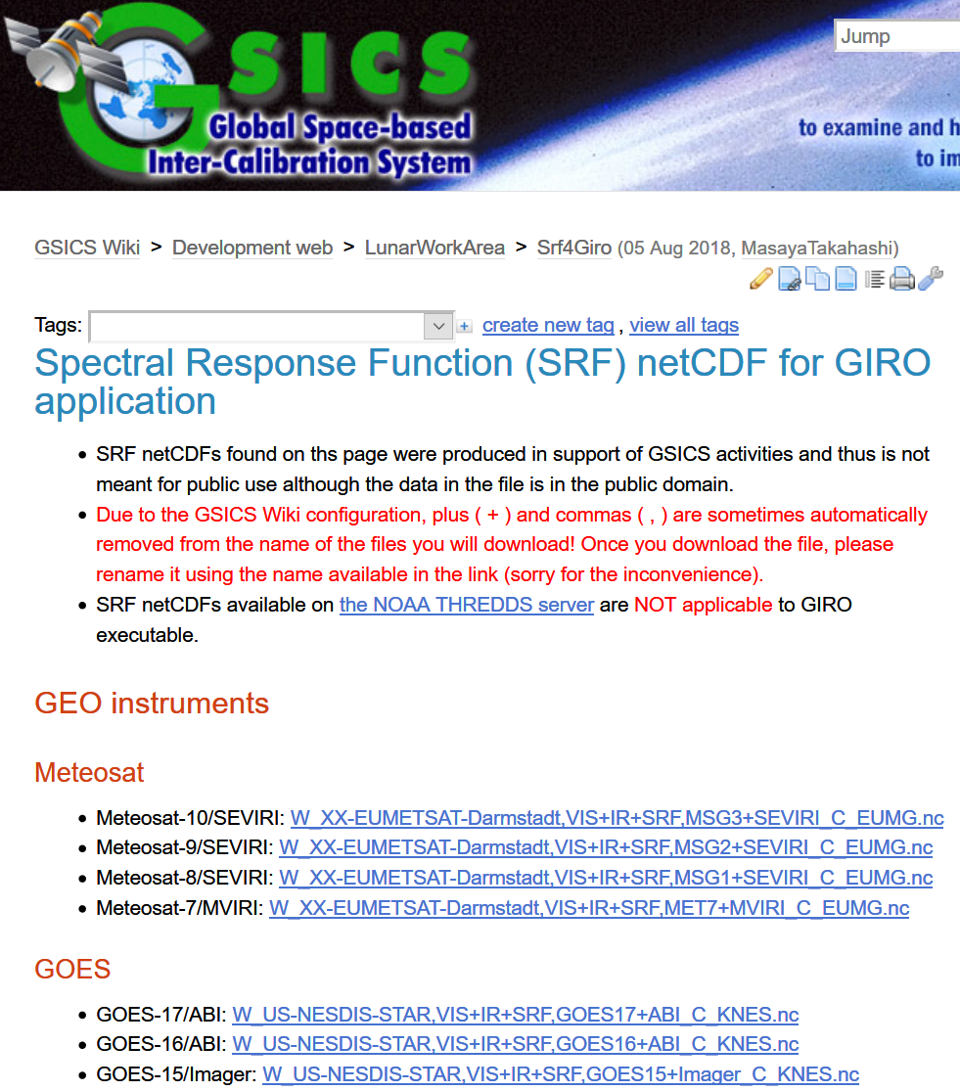
GSICS deliverables:
D) SRF netCDF
Objective
  To support GSICS activities such as Lunar Calibration using GIRO
How it was created
  GDWG Chair has created based on users‘ requests so far
  Users can also generate it by referring Convention or relevant document
How to use it
  Up to users (one application is GIRO)
References
  Data available on the Wiki
  Convention on the Wiki
  GIRO inputs/outputs documentation

Slide 16
Recent requirements for new GSICS deliverables
Proposed deliverables by CMA at 2018 GSICS Annual Meeting
  L1 subsets over PICS
  SNO Prediction Table
  Increase of reference instruments L1 data to be shared within GSICS community
Requirements for data generation/provision
  Near real-time generation by instrument operators
  New GSICS Conventions for the deliverables
  Notification of data readiness

Slide 17
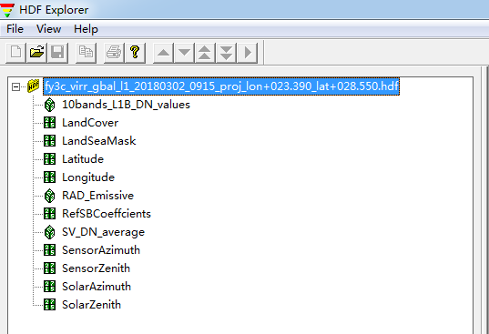
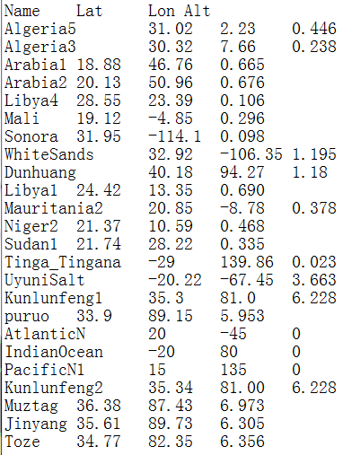
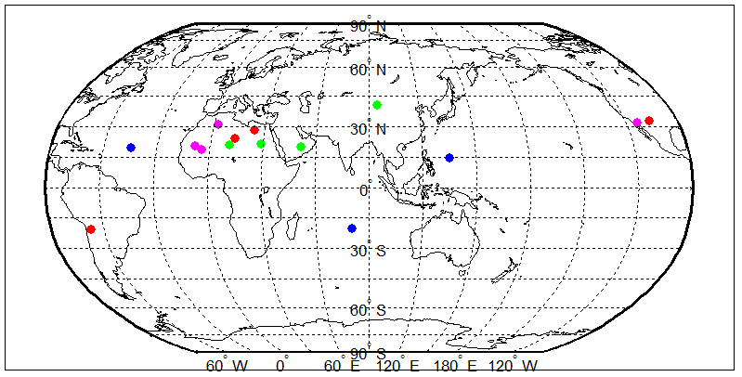
What kinds of L1 Data sharing
Chen (2018)
PICS(Pseudo Invariant Calibration Site) granule L1
  Reference-MODIS, VIIRS, GOME-2, SCIAMACHY, Hyperion
  Each agency payloads, such as FY3/MERSI, MERIS
File size: 1.5M

Slide 18
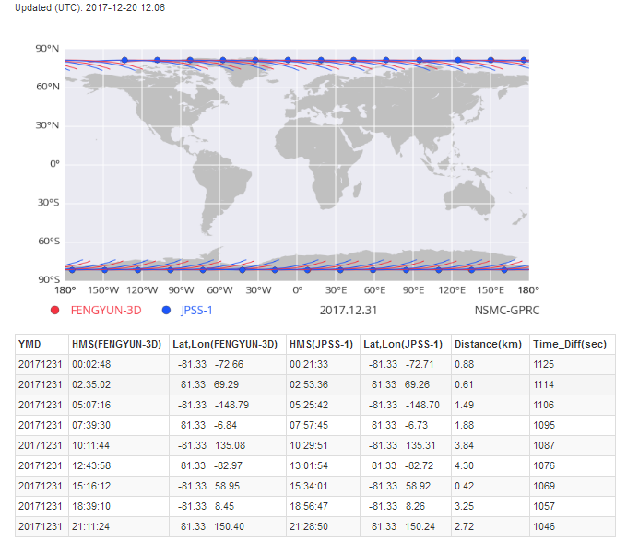
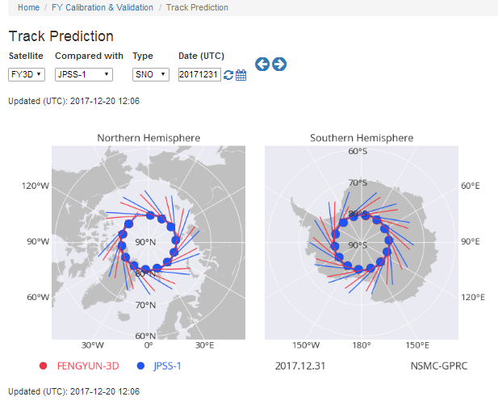
Chen (2018)
SNO Prediction Timetable

Slide 19
Chen (2018)
SNO Reference instruments L1B data
  Hyper-spectral : IASI, CrIS, GOME-2, HIRAS(FY-3D)
  Imager: MODIS, VIIRS
  Sounder : ATMS, AMSR-E, GMI, HIRS

Slide 20
Discussion
GDWG needs GRWG thoughts on new deliverables to be available on GSICS Collaboration Servers
  Other agencies / GRWG also have similar/other requirements?
  Practical collaboration (feasibility study): to be discussed at GDWG session
Issues at GDWG
GDWG roles
  To specify and agree to the configuration and guidelines
Limited resources
  Supports by GSICS agency are needed for realize the proposal

Slide 21
Discussion
A GSICS Deliverable acceptance matrix has been proposed
Four entities have been submitted to GCC to be designated as GSICS Deliverables
GDWG needs GRWG thoughts on new deliverables to be available on GSICS Collaboration Servers
  Other agencies / GRWG also have similar/other requirements?
  Practical collaboration: to be discussed at GDWG session
GDWG issues for upgrading GSICS Collaboration Server
GDWG roles: to specify and agree to the configuration and guidelines
Limited resources: actual supports by GSICS agency are needed for realize the proposals

Slide 22
Backup Slides

Slide 23
Background
Chen (2018)
Traditional way of GSICS L1 data acquirement for reference instrument is public website order and downloading in general when these reference data is not provided by theirselves. This leads to heavy time delay and operational instability and even frequently restricted because of security consideration and internet bandwidth occupation.
Three THREDDS severs in CMA, EUMETSAT and NOAA were setting down and provide the opportunity to share more data for GSICS operation, especially these data of their own reference instruments and target sensors for other GPRCs.
Current status of isolated data acquirement way in all GPRCs under GSICS community reveals weak organization, little collaboration, large unbalance between all GPRCs. This is disadvantageous to strengthen our voice and authority in EOS.
EUMETSAT GDWG have done a good demonstration in L1 sharing for CMA GSICS operation in L1 IASI.nc (for FY-2-IASI) requirement and is testing the provision of GOME-2 for FY-2 VIS inter-calibration.

Slide 24
Scope of GSICS L1 sharing
Chen (2018)
Reduce the time delay of GSICS operational processing based on L1 public website order procedure (2~3 days→1day) between different agencies and also reduce data volume transfer(by crop)
Keep operation stability of GEO-LEO and LEO-LEO GSICS processing in all GPRCs, especially NRTC products
Push GEO-GEO comparison such as FY-2-MTSAT/Himawari, FY-2-MSG , MSG-GOES for long term
VIS/NIR Inter-calibration and reference transfer based on global PICS sites (desert, snow and barren ocean)
Support other GSICS researches such as SBAF, BRDF

Slide 25
Provision and setting
Chen (2018)
L1 Data generation automatically by instrument operator
ROI Regional or Granule for spatial coverage for cutting data volume
Format and name following GSICS convention : HDF, NetCDF
Time delay: Near real time
Ready Notification
User feedback to the instrument operator or GCC

Slide 26
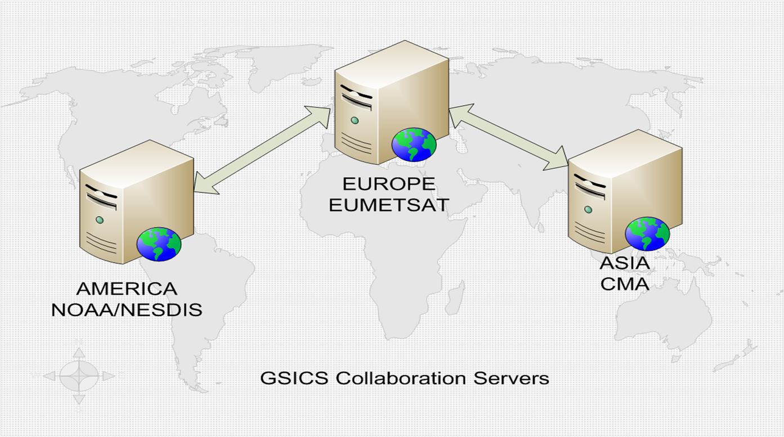
Current Status of GSICS THREDDS severs
Chen (2018)
3 Collaboration Servers available
GSICS Collaboration Server | Server URL
EUMETSAT GSICS Server (Europe) | http://gsics.eumetsat.int/thredds/catalog.html
NOAA GSICS Server (Americas) | http://gsics.nesdis.noaa.gov/thredds/catalog.html
CMA GSICS Server (Asia) | http://gsics.nsmc.cma.gov.cn/thredds/catalog.html

Slide 27
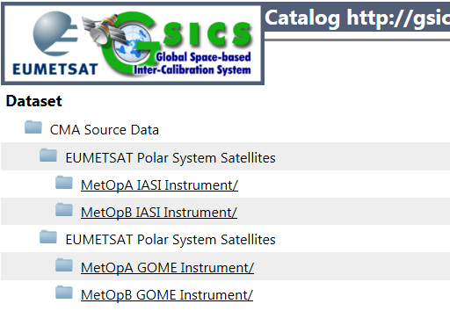
EUMETSAT L1 Source Data For CMA
Chen (2018)
Satellite: MetopA MetopB
Instrument: IASA GOME
Server: EUMETSAT GSICS Thredds
Timeline: Near real time
Spatial: Cropped for FY-2
Format:
  IASA: NetCDF
  GOME: HDF 5.0
    GOME NC demo data is being investigated by CMA now
We hope IASI and GOME-2 is also provided for FY-3 SNO collocation in the next step instead of our order from CLASS.

Slide 28
Background slides
THANK YOU

Slide 29
Content for Instrument Landing Pages
Instrument Specification (documents on instruments baseline physical basis of measurements and calibration)
Instrument Events (databases or documents with calibration related events)
Instrument Monitoring (databases or documents following the state of the instrument and any degradation of changes)
Data Outages (databases or documents with instrument outage periods)

Slide 30
Jerome’s Matrix to map GCC presentation to FOR document
GCC presentation | GSICS-FOR | Possible revision
Various GSICS Products But only some of them are subject to a product acceptance procedure | Various GSICS Deliverables But only some of them are called “Products”. All Products are subject to Product acceptance procedure | Various GSICS Deliverables. Including “GSICS Products” which are routine corrections generated in accordance with GSICS-certified methods.
Corrections and well determined methods | - The corrections (e.g. regression coefficients) delivered to satellite data users are “Products”. either NRT or wrongly named “reanalysis” | Products are routine corrections applicable to calibration coefficients (regression coefficients and ancillary information TBD) either in NRT, or delayed (centered time-averaging window) using certified algorithms. Products could also include corrected calibration coefficients (correction already applied)
 | - The methods to generate these NRT corrections (ATBDs) are mainly internal deliverable. | Certified algorithms applicable:
FCDRs, ECV | Algorithms to generate FCDRs (EP-15 clarified that FCDR are not GSICS products. Generating a FCDR from historical data requires another level of effort – close to archeology !) | - by climate users for archive reprocessing to generate FCDRs - by sat operators to generate the GSICS NRT or delayed products
Databases | For the purpose of high-level communication I suggest we merge these 3 deliverables in a broad category | Databases,
References |  | References,
Tools |  | and tools
Documentation | Documentation | Documentation
RTM | RTMs are beyond the role of GSICS. The agreed Vision recommended partnership with the RTM community.
Notes:
Does GPSRO provide traceable calibration of IR sensors? Does it need an RTM?
Does the MW community use spectral characterization in the CRTM?

