Slide 1
GSICS Server Upgrade - Requirements for New Deliverables
Masaya Takahashi
Japan Meteorological Agency

Slide 2
Overview and Purpose
Overview
Several GSICS deliverables are available on GSICS Collaboration Server
Source dataset, intermediate data, GSICS products
SRF (Spectral Response Function) netCDF
GSICS Convention was agreed in 2018
Recent requirements for new deliverables
Subset of PICS (Pseudo Invariant Calibration Sites), SNO (Simultaneous Nadir Overpass) prediction
Purpose of this talk
To introduce existing deliverables and recent GRWG requirements
To get GRWG feedbacks for inputs of practical discussions at GDWG session
What we can collaborate to upgrade Collaboration Servers

Slide 3
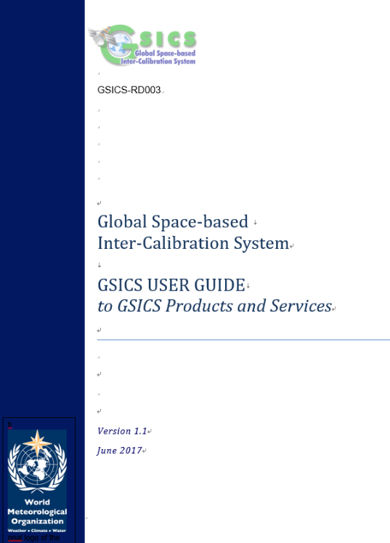
4 broad type of GSICS deliverables
(Section#5 of GSICS-RD003)
GSICS Products
Inter-calibration of space-based instruments with GSICS references, and resulting calibration adjustments (GSICS Correction)
Documentation
GSICS High-level documents, Inter-calibration ATBDs
Best practices/standard procedures
Inter-calibration algorithms, data and metadata convention
Measurement references and tools
Calibration references
Software modules, datasets, infrastructure elements to support GSICS activities

Slide 4
GSICS deliverables on GSICS Collaboration Servers
LEO L1 netCDF (source dataset)
GEO-LEO-IR Collocation netCDF (intermediate data)
GSICS Products
SRF netCDF
Currently several data available on the Wiki

Slide 5
GSICS deliverables on GSICS Collaboration Servers

Slide 6
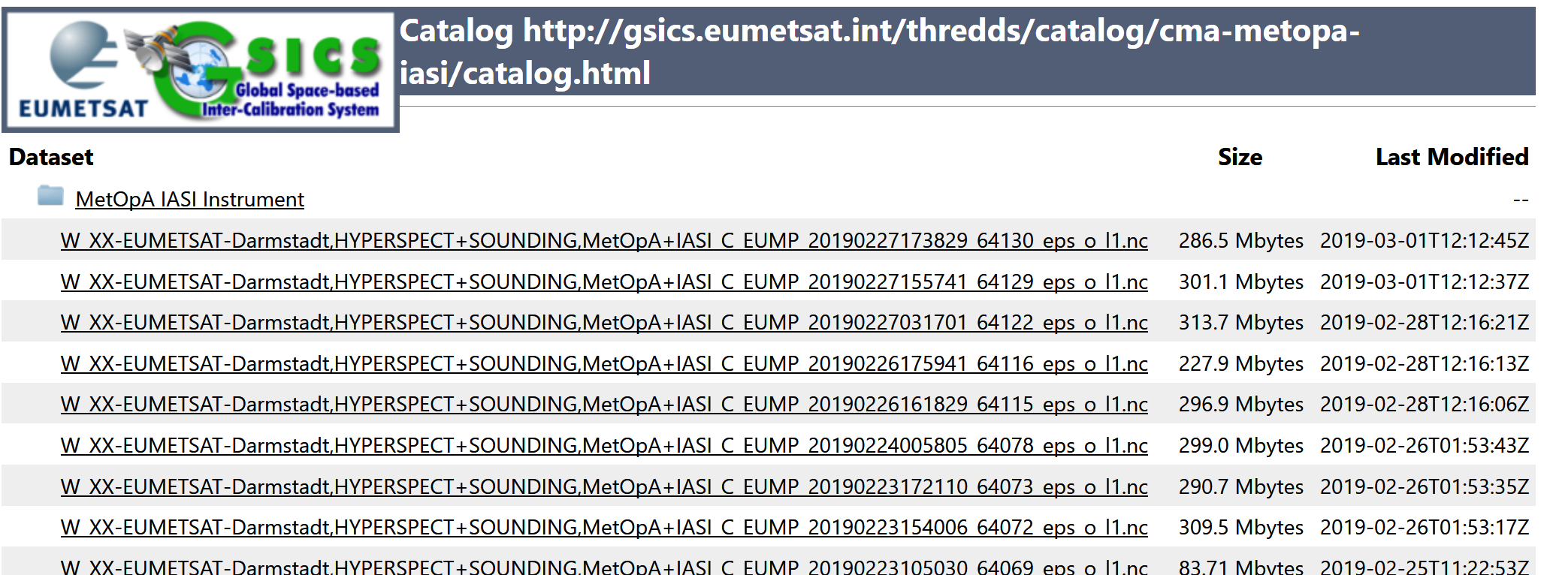
GSICS deliverables:
A) LEO L1 netCDF
Objective
Several GSICS agencies need reference LEO L1 subset for their GEO-LEO collocation to generate GSICS products
How it was created
Instruments operator (e.g. IASI L1C by EUMETSAT) creates netCDFs and makes it available on GSICS Collaboration Server based on user requests
How to use it
Input (source) of ATBD
References
EUMETSAT GSICS Collaboration Server

Slide 7
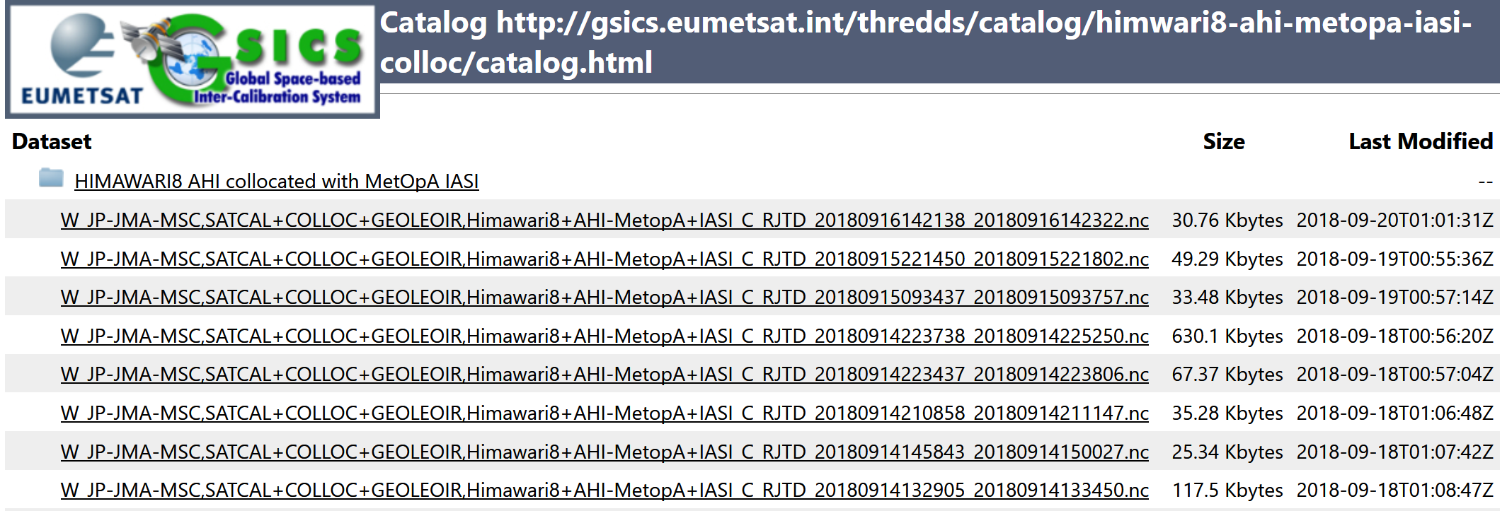
GSICS deliverables:
B) GEO-LEO Collocation netCDF
Objective
GSICS agencies use the files to generate GSICS Corrections
How it was created
Producers of GSICS Products (e.g. JMA)
How to use it
Intermediate data for ATBD
Maybe useful for users to replicate the products or use it for their own research
References
GSICS Convention (template) on the Wiki
Data: example of JMA's data¹
¹ Data transfer was tentatively stopped in 2018 due to FTP connection: root causes are under investigation

Slide 8
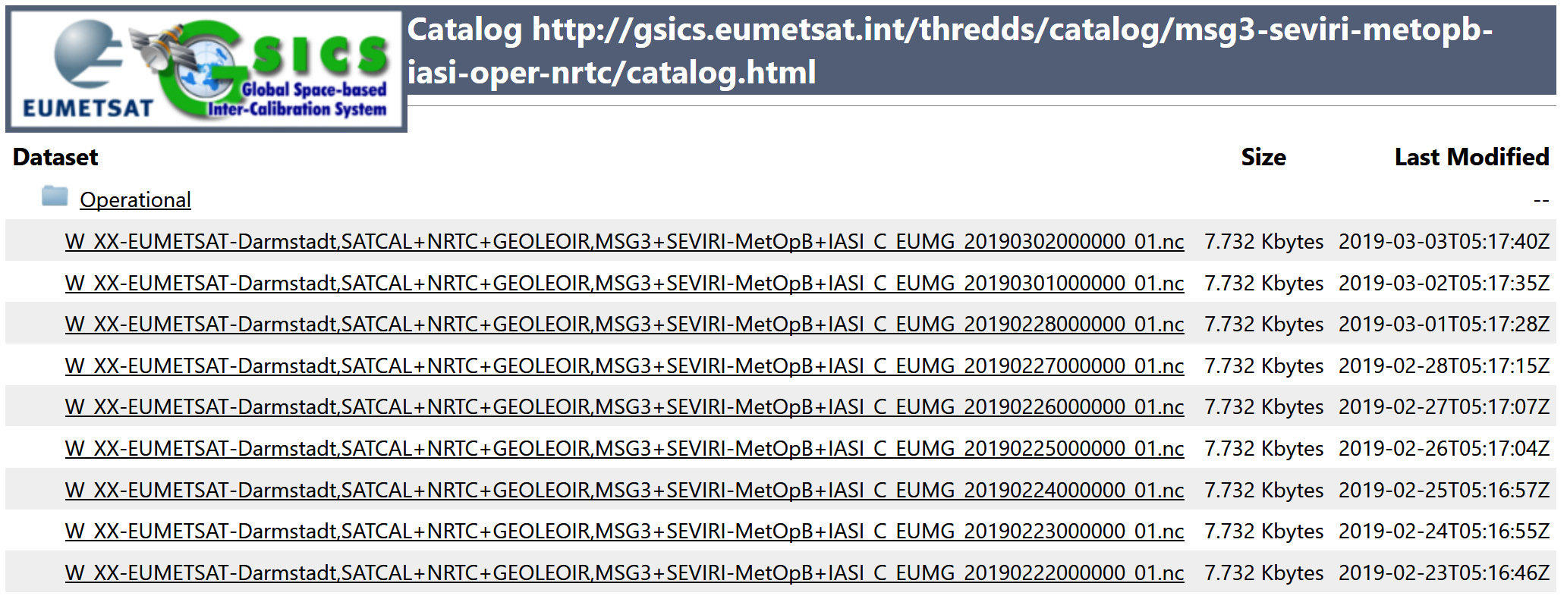
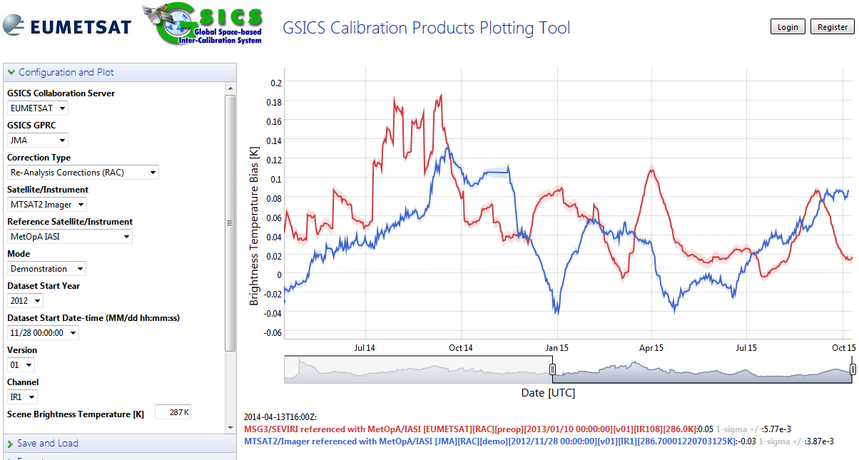
GSICS deliverables:
C) GSICS Correction
Objective
GSICS agencies inter-calibrate in-orbit instruments to monitor the performance and to provide correction coefficients for satellite data users
How it was created
Producers of GSICS Products (routinely) create/upload to Collaboration Server
How to use it
Monitoring biases on Plotting Tool
Applying the correction to operational L1
References
Convention, ATBDs, User Guides on the Wiki and each producer’s website

Slide 9
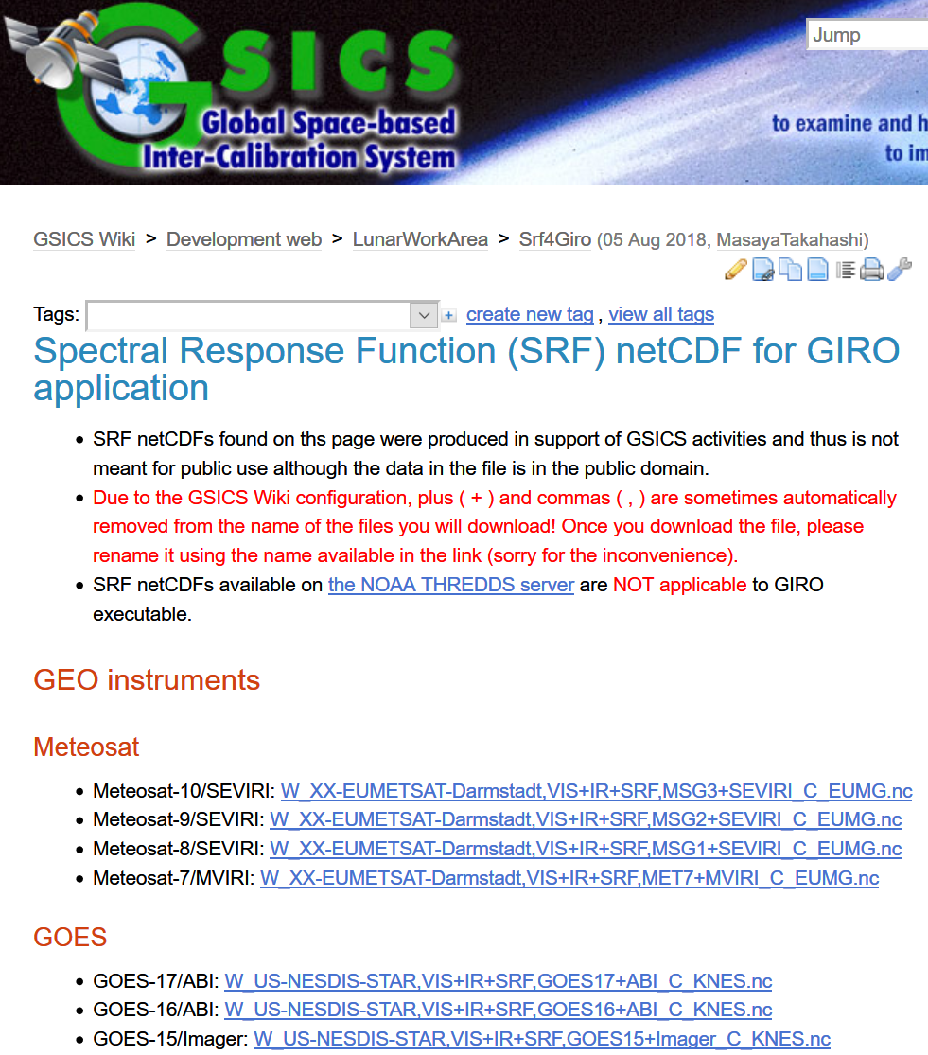
GSICS deliverables:
D) SRF netCDF
Objective
To support GSICS activities such as Lunar Calibration using GIRO
How it was created
GDWG Chair has created based on users‘ requests so far
Users can also generate it by referring Convention or relevant document
How to use it
Up to users (one application is GIRO)
References
Data available on the Wiki
Convention on the Wiki
GIRO inputs/outputs documentation

Slide 10
Recent requirements for new GSICS deliverables
Proposed deliverables by CMA at 2018 GSICS Annual Meeting
L1 subsets over PICS
SNO Prediction Table
Increase of reference instruments L1 data to be shared within GSICS community
Requirements for data generation/provision
Near real-time generation by instrument operators
New GSICS Conventions for the deliverables
Notification of data readiness

Slide 11
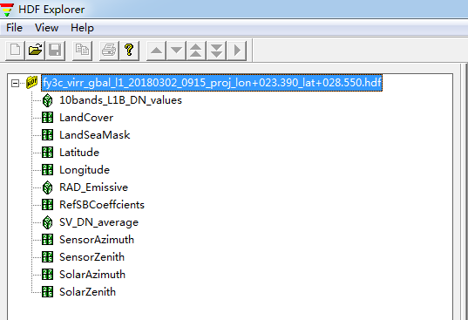
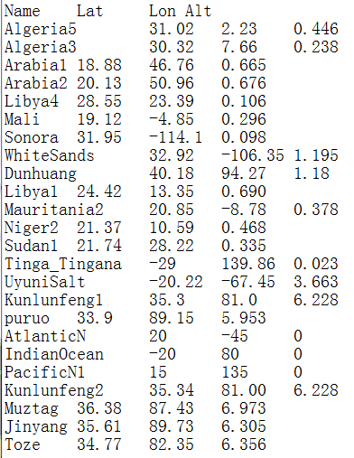
What kinds of L1 Data sharing
Chen (2018)
PICS(Pseudo Invariant Calibration Site) granule L1
Reference-MODIS, VIIRS, GOME-2, SCIAMACHY, Hyperion
Each agency payloads, such as FY3/MERSI, MERIS
File size: 1.5M

Slide 12
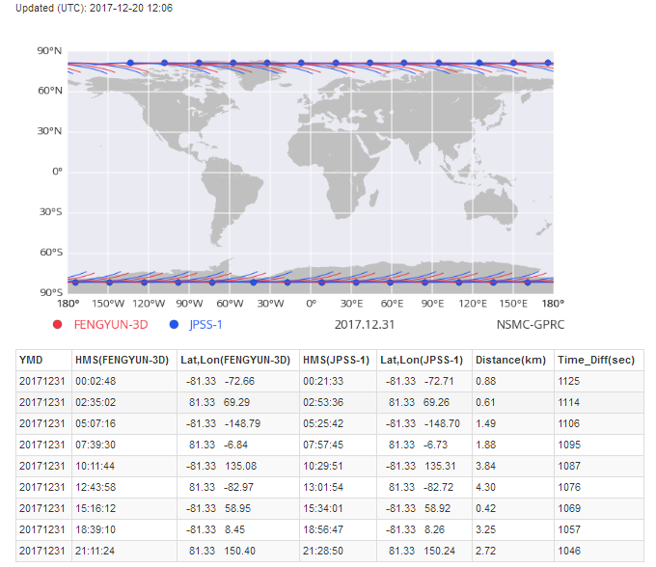
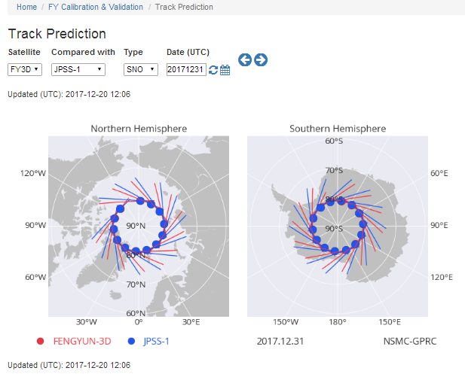
Chen (2018)
SNO Prediction Timetable

Slide 13
Chen (2018)
SNO Reference instruments L1B data
Hyper-spectral : IASI, CrIS, GOME-2, HIRAS(FY-3D)
Imager: MODIS, VIIRS
Sounder : ATMS, AMSR-E, GMI, HIRS

Slide 14
Discussion
GDWG needs GRWG thoughts on new deliverables to be available on GSICS Collaboration Servers
Other agencies / GRWG also have similar/other requirements?
Practical collaboration (feasibility study): to be discussed at GDWG session
Issues at GDWG
GDWG roles
To specify and agree to the configuration and guidelines
Limited resources
Supports by GSICS agency are needed for realize the proposal

Slide 15
Backup Slides

Slide 16
Background
Chen (2018)
Traditional way of GSICS L1 data acquirement for reference instrument is public website order and downloading in general when these reference data is not provided by theirselves. This leads to heavy time delay and operational instability and even frequently restricted because of security consideration and internet bandwidth occupation.
Three THREDDS severs in CMA, EUMETSAT and NOAA were setting down and provide the opportunity to share more data for GSICS operation, especially these data of their own reference instruments and target sensors for other GPRCs.
Current status of isolated data acquirement way in all GPRCs under GSICS community reveals weak organization, little collaboration, large unbalance between all GPRCs. This is disadvantageous to strengthen our voice and authority in EOS.
EUMETSAT GDWG have done a good demonstration in L1 sharing for CMA GSICS operation in L1 IASI.nc (for FY-2-IASI) requirement and is testing the provision of GOME-2 for FY-2 VIS inter-calibration.

Slide 17
Scope of GSICS L1 sharing
Chen (2018)
Reduce the time delay of GSICS operational processing based on L1 public website order procedure (2~3 days→1day) between different agencies and also reduce data volume transfer(by crop)
Keep operation stability of GEO-LEO and LEO-LEO GSICS processing in all GPRCs, especially NRTC products
Push GEO-GEO comparison such as FY-2-MTSAT/Himawari, FY-2-MSG , MSG-GOES for long term
VIS/NIR Inter-calibration and reference transfer based on global PICS sites (desert, snow and barren ocean)
Support other GSICS researches such as SBAF, BRDF

Slide 18
Provision and setting
Chen (2018)
L1 Data generation automatically by instrument operator
ROI Regional or Granule for spatial coverage for cutting data volume
Format and name following GSICS convention : HDF, NetCDF
Time delay: Near real time
Ready Notification
User feedback to the instrument operator or GCC

Slide 19
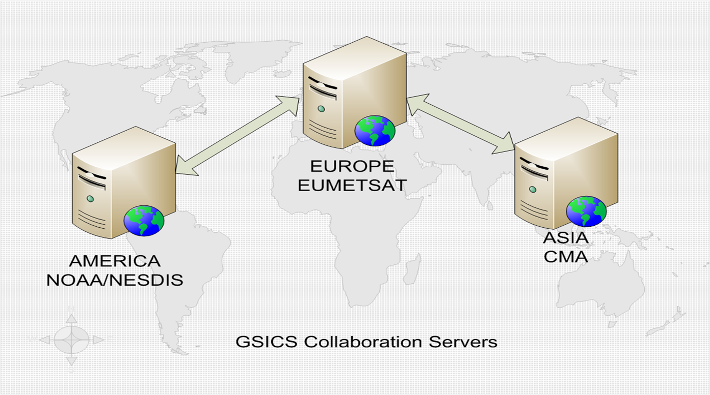
Current Status of GSICS THREDDS severs
Chen (2018)
3 Collaboration Servers available
GSICS Collaboration Server | Server URL
EUMETSAT GSICS Server (Europe) | http://gsics.eumetsat.int/thredds/catalog.html
NOAA GSICS Server (Americas) | http://gsics.nesdis.noaa.gov/thredds/catalog.html
CMA GSICS Server (Asia) | http://gsics.nsmc.cma.gov.cn/thredds/catalog.html

Slide 20
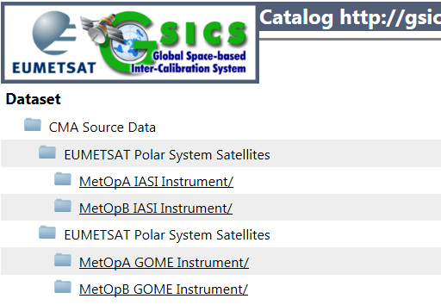
EUMETSAT L1 Source Data For CMA
Chen (2018)
Satellite: MetopA MetopB
Instrument: IASA GOME
Server: EUMETSAT GSICS Thredds
Timeline: Near real time
Spatial: Cropped for FY-2
Format:
IASA: NetCDF
GOME: HDF 5.0
GOME NC demo data is being investigated by CMA now
We hope IASI and GOME-2 is also provided for FY-3 SNO collocation in the next step instead of our order from CLASS.

