Slide 1
GSICS New Mini Site
and
Link from OSCAR/Space to GSICS Inter-calibration Page
Toshiyuki Kurino
WMO Space Programme

Slide 2
GSICS New Mini Site

Slide 3
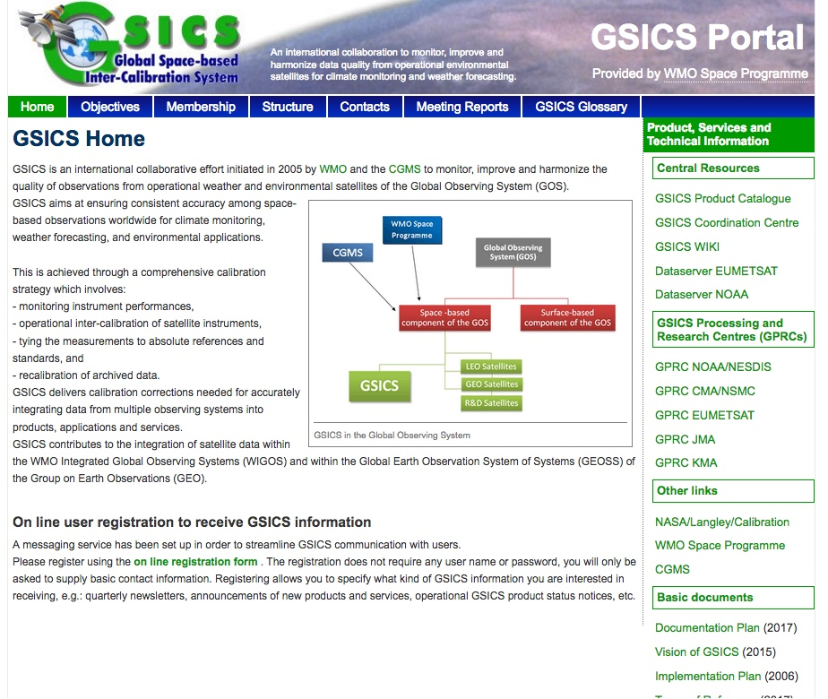
Changed from the “previous” GSICS Portal
new tab “Links”

Slide 4
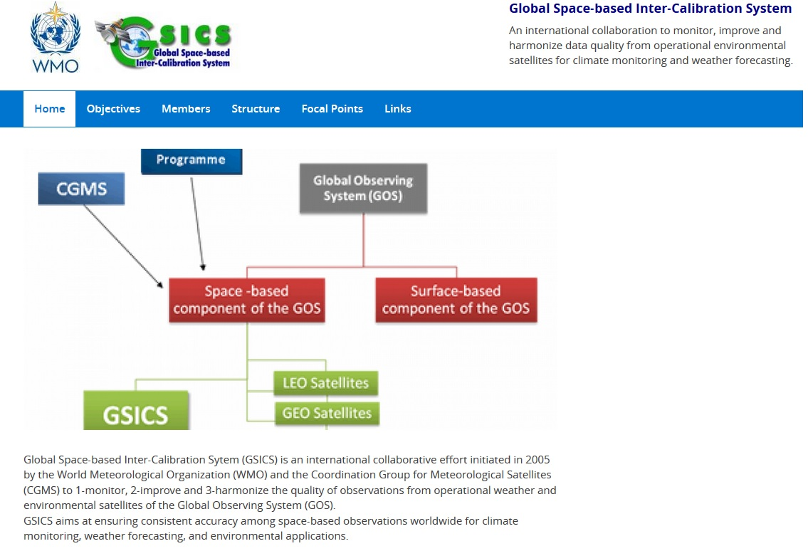
Click
https://gsics.wmo.int/en

Slide 5
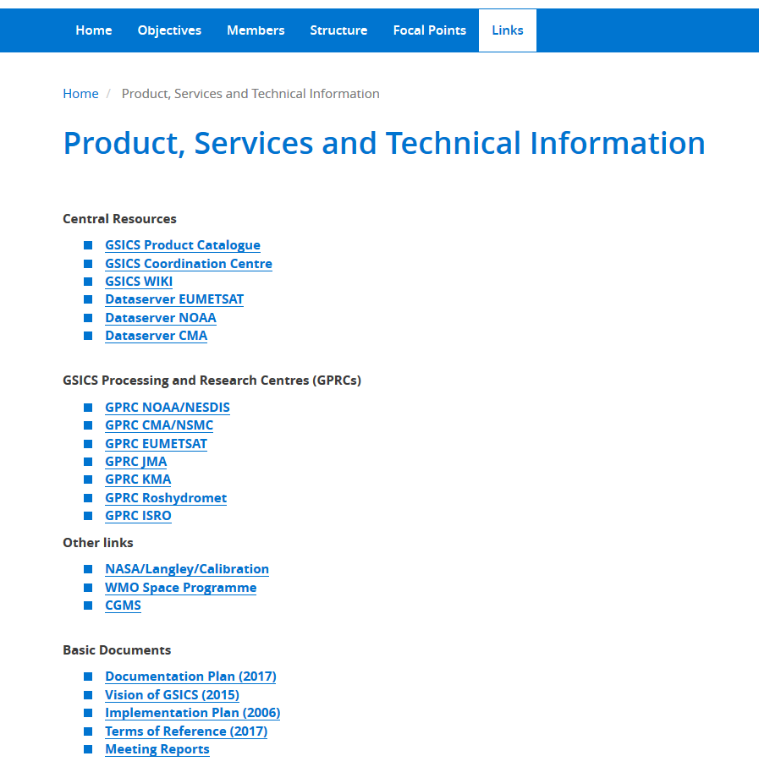

Slide 6
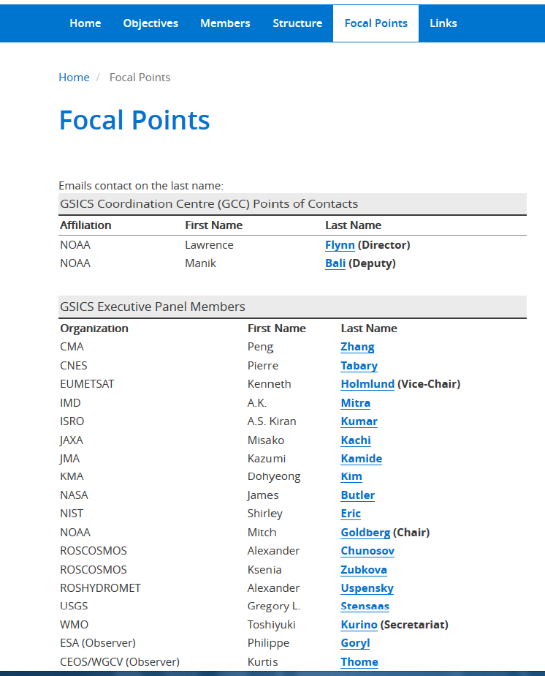
Click: “mail to:”
e-mail address is embedded

Slide 7
Guideline for the WMO New Website will be in public
https://public.wmo.int/en/resources/library/wmo-corporate-visual-identity-guidelines

Slide 8
An Example of WMO New Mini Site as a Reference
https://hydrohub.wmo.int/en/whos

Slide 9
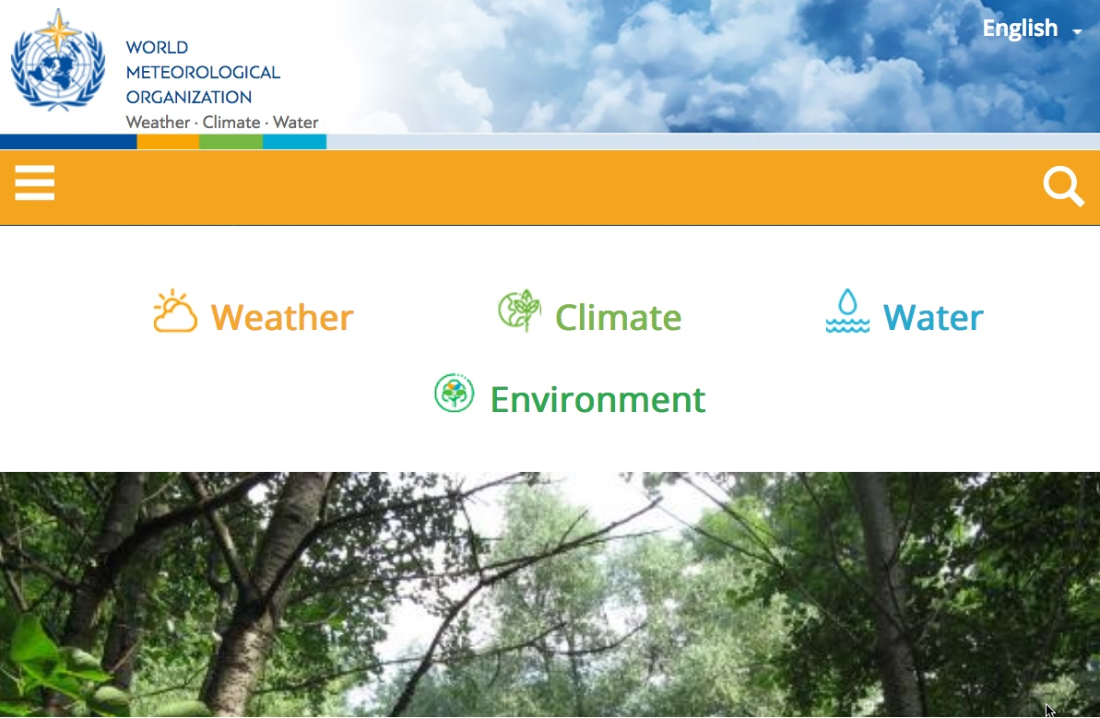
WMO New Website
https://www.wmo.int/

Slide 10
An Expected Improvement
GSICS website resource is outside of WMO
web-based editorial capability for updating the contents
GSICS members will edit contents with provided user account

Slide 11
Link from OSCAR/Space to
GSICS Inter-calibration Page

Slide 12
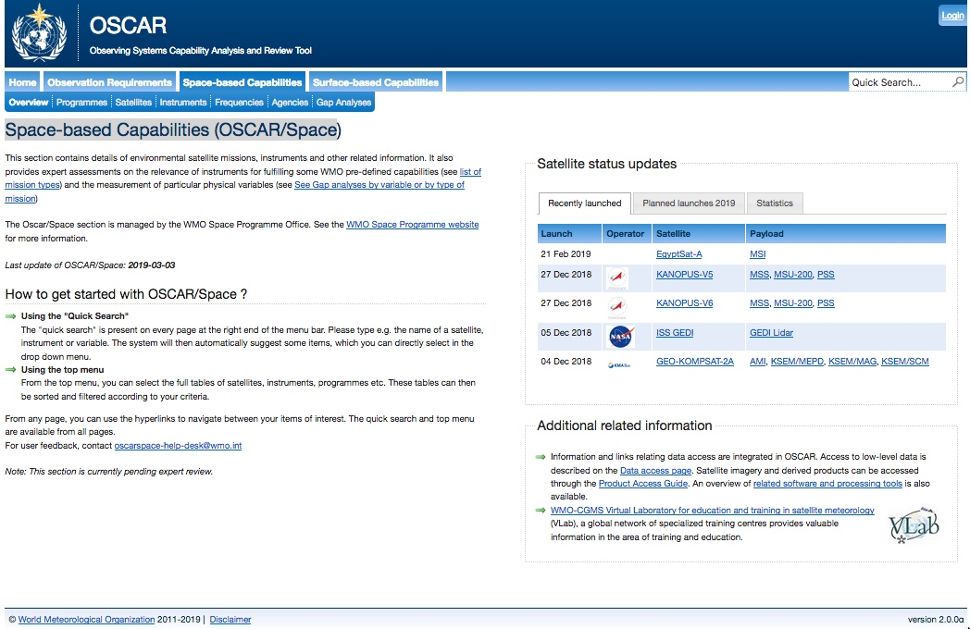
Space-based Capabilities (OSCAR/Space) Top Page
Click: “Instruments”
https://www.wmo-sat.info/oscar/spacecapabilities

Slide 13
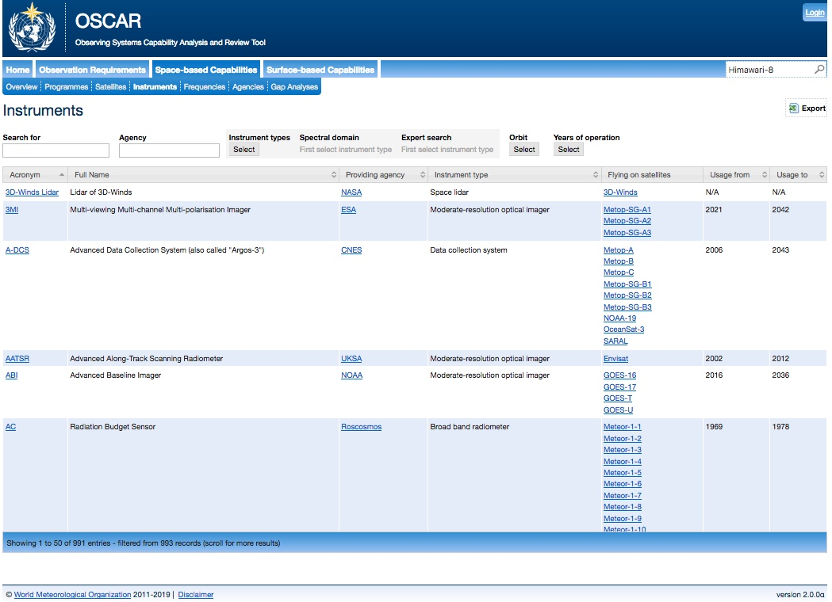
Space-based Capabilities (OSCAR/Space) “Instruments” Page
“Himawari-8”

Slide 14
Click

Slide 15
Link to Landing Page (Event Logging)
Link to Real-time Monitoring Page
on Calibration Status

Slide 16
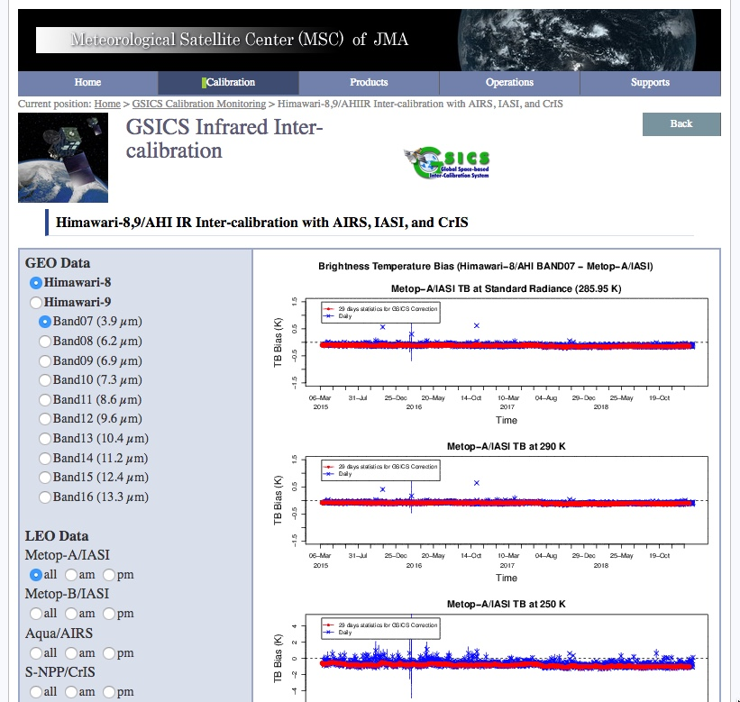
JMA GSICS Page: Himawari-8,9/AHI IR Inter-calibration with AIRS, IASI, and CrIS

Slide 17
GSICS members to provide “one-stop” linkage to provide a calibration status for each Instruments in “operation”

