Slide 1
Update of Modulation Transfer Function (MTF) Evaluation Using Lunar Measurements
X. Wu
2019-03-06

Slide 2
Needs, Opportunity, Issues, and GSICS
Evaluate the imaging quality of satellite instrument.
In addition to radiometric, geometric, and spectral calibration.
For users, instrument vendors, calibration specialists, satellite operators, program managers, among others.
Modulation Transfer Function (MTF) of the sharp lunar edge is a nearly ideal and widely available target for such evaluation.
Results have not been comparable
Different methods for common process, e.g., LSF => ESF.
Instrument-specific idiosyncrasy, e.g., overlapping.
GSICS is the right place for such coordinated effort.

Slide 3
Overall Conclusions
Participants recognized the importance of and expressed interest in evaluating the imaging quality of satellite instruments.
GSICS to recommend method(s) to compute the MTF based on lunar measurements that are applicable for all sensors and channels.
GSICS to reach out to the relevant expertise in other community such as WGCV of CEOS.

Slide 4
Plan and Progress
Collected lunar images by each instruments:
Currently 6: ABI on GOES-16, AHI on Himawari-8, Imager on GOES-15, MI on COMS, Imager on FY-2, and SEVIRI on METEOSAT-9.
Derive MTF with one method (NOAA) for all instruments. Results are somehow but not always satisfactory:
ABI is too different from AHI, and both are worse than MI & Imager;
New MI is worse than old Imager; and
0.5km channel is worse than 1km channel.
Derive MTF with as many different methods (agency) as possible for the same instrument
Compare the differences in methods, tradeoffs, and results.

Slide 5
Problems and Proposal
Key personnel (X. Shao) was busy and later left ABI team.
Not high priority for NOAA at present.
may not be able to move forward alone.
Seek members (at least one more) to the team.
Member is expected to be active and become a co-author.
Observers will be kept informed.

Slide 6
Action Items
NOAA to distribute the lunar data collected from various agencies. (Done)
Agency to re-affirm Member or Observer of the GSICS Lunar MTF Task Team (next page).
NOAA to seek inputs from the Task Team via a questionnaires. (next page).
NOAA to reach out to CEOS/IVOS for knowledge and consultation of MTF experience and analysis. (Seeking suggestion in questionnaire).
Members to identify technical path forward.

Slide 7
Lunar MTF Task Team Members are co-authors. Observers are informed
Agency | Member | Observer
CMA |  | Lin Chen
ESA |  | Ignacio Torralba Elipe
EUMETSAT |  | Claude Ledez
JMA |  | Masaya Takahashi
KMA |  | Dohyeong Kim
NASA |  | Lawrence Ong
NOAA | Xi Shao Fred Wu (interim)
…

Slide 8
Lunar MTF Questionnaire
Draft questionnaire.
Is a standardized Lunar MTF evaluation beneficial to your instrument? Please identify the instrument and illustrate the impacts.
What is the expected GSICS Role in Lunar MTF development?
Please describe the lunar MTF algorithm(s) used or planned at your agency.
Please suggest ways to reach out for lunar MTF expertise – publications, persons, organizations (CEOS), meetings.
Please suggest steps to develop GSICS lunar MTF.
Plan for quick response (say end of March).
Don’t have to answer all questions.
Don’t have to answer if not interested or can’t participate.

Slide 9
BACKUP SLIDES

Slide 10
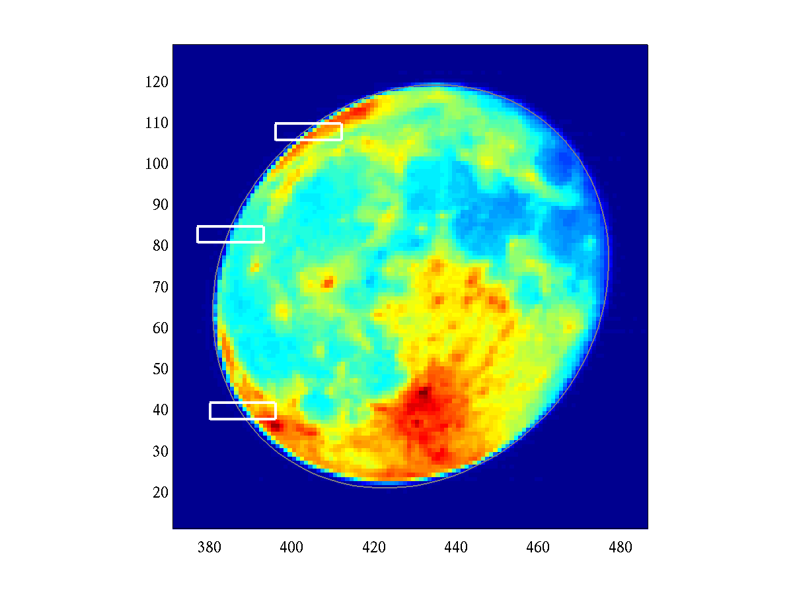
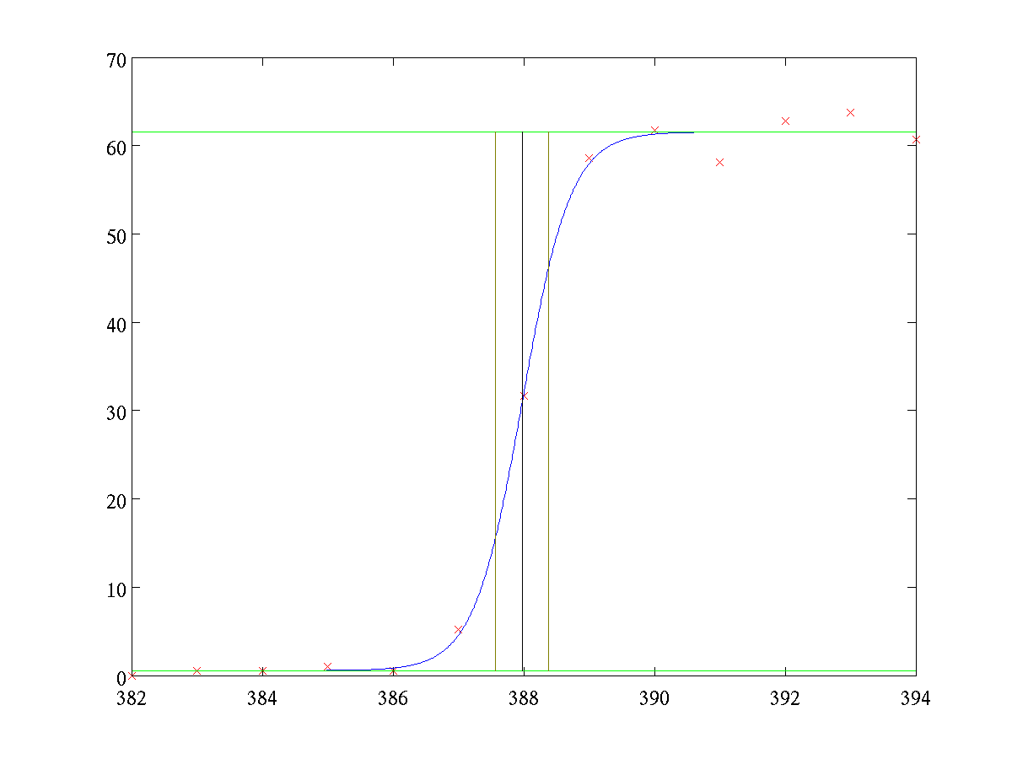
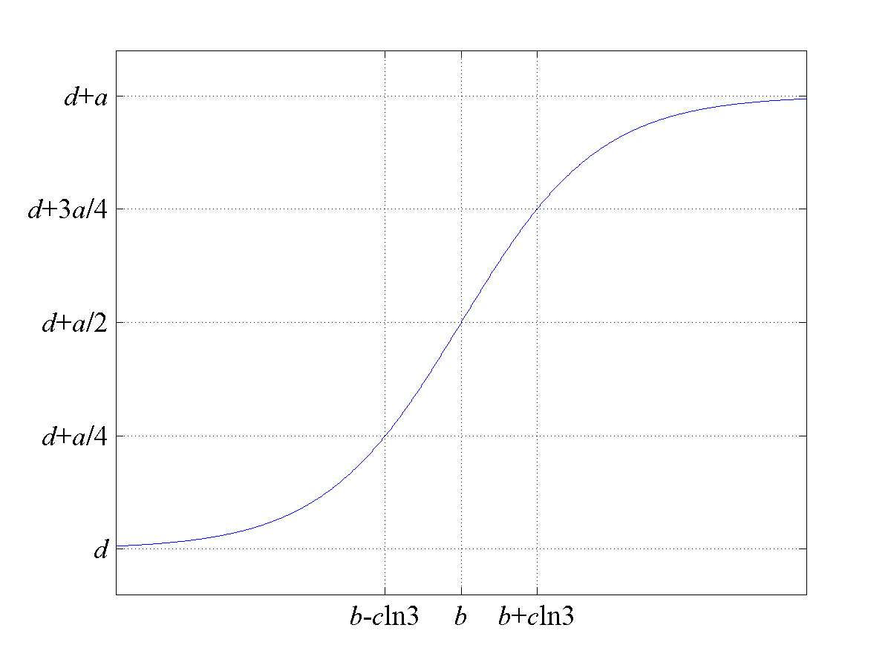
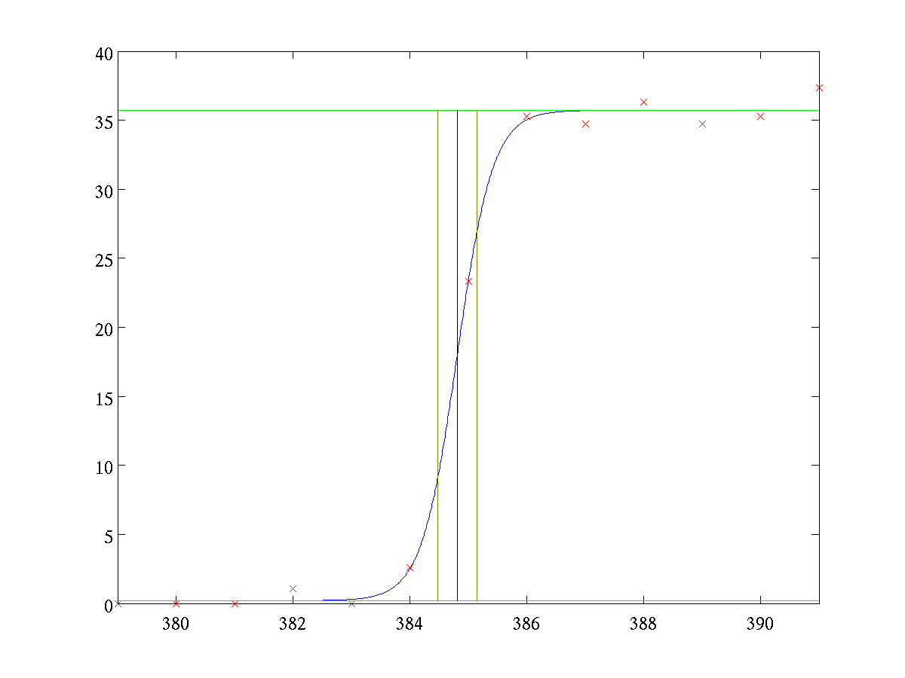
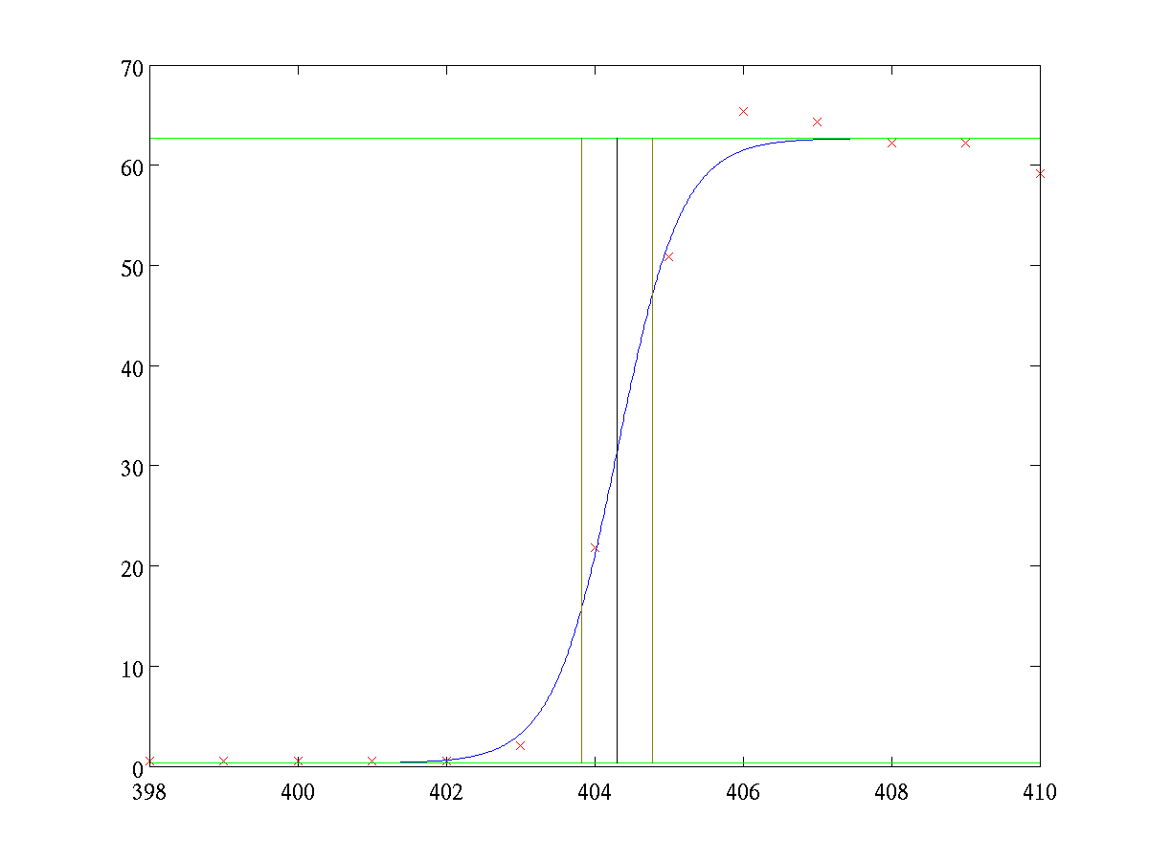
NOAA’s Method
Fit to a Fermi function (b is the edge location):
A. P. Tzannes and J. M. Mooney, 1995; Choi et al., 2014

Slide 11
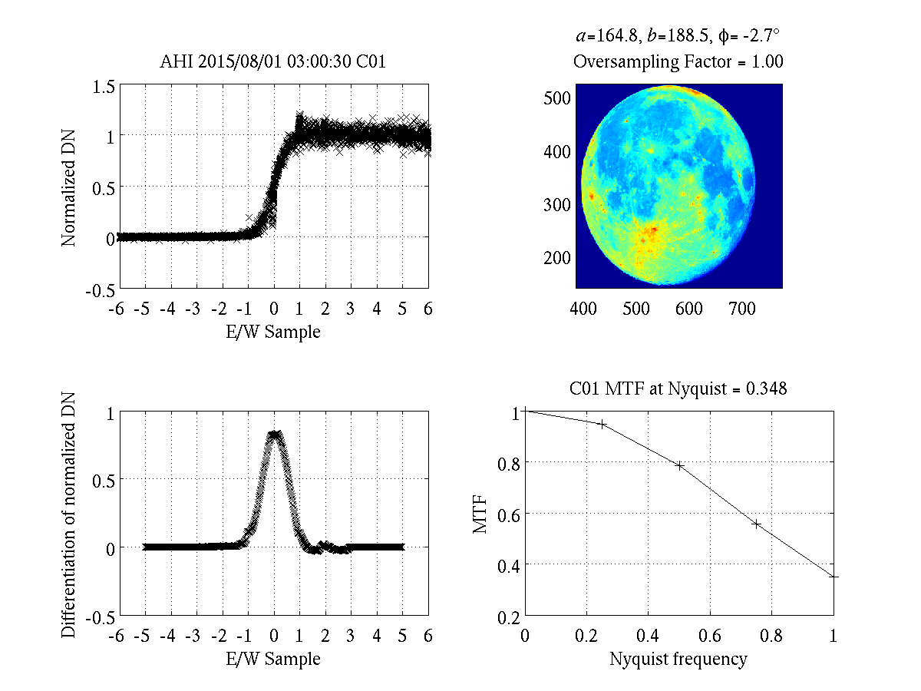
Lunar MTF Method
Normalization
Align the multiple background-to-Moon transition proﬁles at sub-pixel level along the scan-direction.
Sliding piecewise 2nd order polynomial filtering applied to ensemble of edge data
Differentiated to form the line spread function.
Apply Fourier transformation to the line spread function to derive MTF.
MTF at sub-Nyquist frequencies for imaging sensors (taking into account of Sensor specific oversampling factor)

Slide 12
Results and Discussions
Instrument | Date | Center λ(um) | Phase (deg.) | P1 | P2 | P3 | P4
AHI | 2015-08-01 03:00:30 | 0.64 | 9.85 | 0.845 | 0.600 | 0.393 | 0.198
ABI | 2017-02-11 19:12:28 | 0.64 | 9.75 | 0.939 | 0.788 | 0.590 | 0.396
KMA MI | 2016-11-13 01:13:33 | 0.675 | -22.09 | 0.926 | 0.791 | 0.607 | 0.399
GOES-15 | 2010-09-24 19:11:00 | 0.63 | 16.49 | 0.945 | 0.835 | 0.675 | 0.461
SEVIRI-9 | 2017-02-12 12:11:49 | 0.6 | 18.45 | 0.919 | 0.664 | 0.297 | 0.027
CMA FY-2G | 2015-04-03 03:01:06 | 0.5-0.75 | -15.10 | 0.734 | 0.348 | 0.148 | 0.140

Slide 13
Results and Discussions
Instrument | Date | Center λ(um) | Phase (deg.) | P1 | P2 | P3 | P4
AHI | 2015-08-01 03:00:30 | 0.64 | 9.85 | 0.845 | 0.600 | 0.393 | 0.198
ABI | 2017-02-11 19:12:28 | 0.64 | 9.75 | 0.939 | 0.788 | 0.590 | 0.396
KMA MI | 2016-11-13 01:13:33 | 0.675 | -22.09 | 0.926 | 0.791 | 0.607 | 0.399
GOES-15 | 2010-09-24 19:11:00 | 0.63 | 16.49 | 0.945 | 0.835 | 0.675 | 0.461
SEVIRI-9 | 2017-02-12 12:11:49 | 0.6 | 18.45 | 0.919 | 0.664 | 0.297 | 0.027
CMA FY-2G | 2015-04-03 03:01:06 | 0.5-0.75 | -15.10 | 0.734 | 0.348 | 0.148 | 0.140
ABI & AHI should be more similar

Slide 14
Results and Discussions
Instrument | Date | Center λ(um) | Phase (deg.) | P1 | P2 | P3 | P4
AHI | 2015-08-01 03:00:30 | 0.64 | 9.85 | 0.845 | 0.600 | 0.393 | 0.198
ABI | 2017-02-11 19:12:28 | 0.64 | 9.75 | 0.939 | 0.788 | 0.590 | 0.396
KMA MI | 2016-11-13 01:13:33 | 0.675 | -22.09 | 0.926 | 0.791 | 0.607 | 0.399
GOES-15 | 2010-09-24 19:11:00 | 0.63 | 16.49 | 0.945 | 0.835 | 0.675 | 0.461
SEVIRI-9 | 2017-02-12 12:11:49 | 0.6 | 18.45 | 0.919 | 0.664 | 0.297 | 0.027
CMA FY-2G | 2015-04-03 03:01:06 | 0.5-0.75 | -15.10 | 0.734 | 0.348 | 0.148 | 0.140
A brand new Imager vs. an aged MI

Slide 15
Results and Discussions
Instrument | Date | Center λ(um) | Phase (deg.) | P1 | P2 | P3 | P4
AHI | 2015-08-01 03:00:30 | 0.64 | 9.85 | 0.845 | 0.600 | 0.393 | 0.198
ABI | 2017-02-11 19:12:28 | 0.64 | 9.75 | 0.939 | 0.788 | 0.590 | 0.396
KMA MI | 2016-11-13 01:13:33 | 0.675 | -22.09 | 0.926 | 0.791 | 0.607 | 0.399
GOES-15 | 2010-09-24 19:11:00 | 0.63 | 16.49 | 0.945 | 0.835 | 0.675 | 0.461
SEVIRI-9 | 2017-02-12 12:11:49 | 0.6 | 18.45 | 0.919 | 0.664 | 0.297 | 0.027
CMA FY-2G | 2015-04-03 03:01:06 | 0.5-0.75 | -15.10 | 0.734 | 0.348 | 0.148 | 0.140
Difficult to compare visually.

Slide 16
Metric to Quantify Imaging Quality
SEVIRI-9
HIMAWARI-8 AHI
KMA COMS MI
FY-2G
GOES-16 ABI
GOES-15

Slide 17
Results and Discussions
Instrument | Date | Center λ(um) | Phase (deg.) | P1 | P2 | P3 | P4
AHI | 2015-08-01 03:00:30 | 0.64 | 9.85 | 0.845 | 0.600 | 0.393 | 0.198
ABI | 2017-02-11 19:12:28 | 0.64 | 9.75 | 0.939 | 0.788 | 0.590 | 0.396
KMA MI | 2016-11-13 01:13:33 | 0.675 | -22.09 | 0.926 | 0.791 | 0.607 | 0.399
GOES-15 | 2010-09-24 19:11:00 | 0.63 | 16.49 | 0.945 | 0.835 | 0.675 | 0.461
SEVIRI-9 | 2017-02-12 12:11:49 | 0.6 | 18.45 | 0.919 | 0.664 | 0.297 | 0.027
CMA FY-2G | 2015-04-03 03:01:06 | 0.5-0.75 | -15.10 | 0.734 | 0.348 | 0.148 | 0.140
Single parameter? Which one?

Slide 18
Results and Discussions
Instrument | Date | Center λ(um) | Phase (deg.) | P1 | P2 | P3 | P4
AHI | 2015-08-01 03:00:30 | 0.64 | 9.85 | 0.845 | 0.600 | 0.393 | 0.198
ABI | 2017-02-11 19:12:28 | 0.64 | 9.75 | 0.939 | 0.788 | 0.590 | 0.396
KMA MI | 2016-11-13 01:13:33 | 0.675 | -22.09 | 0.926 | 0.791 | 0.607 | 0.399
GOES-15 | 2010-09-24 19:11:00 | 0.63 | 16.49 | 0.945 | 0.835 | 0.675 | 0.461
SEVIRI-9 | 2017-02-12 12:11:49 | 0.6 | 18.45 | 0.919 | 0.664 | 0.297 | 0.027
CMA FY-2G | 2015-04-03 03:01:06 | 0.5-0.75 | -15.10 | 0.734 | 0.348 | 0.148 | 0.140
ABI & AHI should be more similar
Difficult to compare visually.
A brand new Imager vs. an aged MI
Single parameter? Which one?

Slide 19
AHI B01 (Oversampling Factor = 1)
Unintuitively, MTF for the 0.5km channel (AHI B03 & ABI B02) is worse than the 1km channel.

Slide 20
AHI B02 (Oversampling Factor = 1)
Unintuitively, MTF for the 0.5km channel (AHI B03 & ABI B02) is worse than the 1km channel.

Slide 21
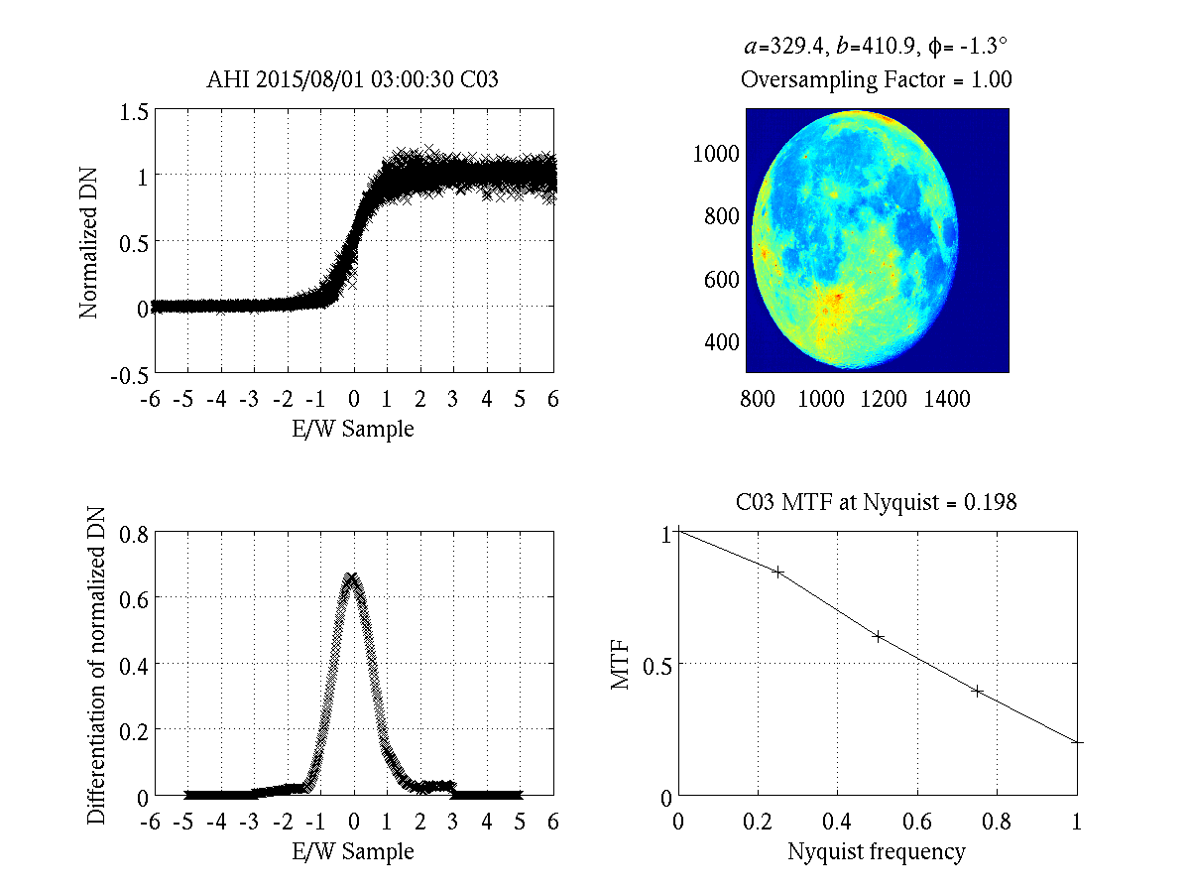
AHI B03 (Oversampling Factor = 1)
Unintuitively, MTF for the 0.5km channel (AHI B03 & ABI B02) is worse than the 1km channel.

Slide 22
ABI CH01 (2017-07-12)
Unintuitively, MTF for the 0.5km channel (AHI B03 & ABI B02) is worse than the 1km channel.

Slide 23
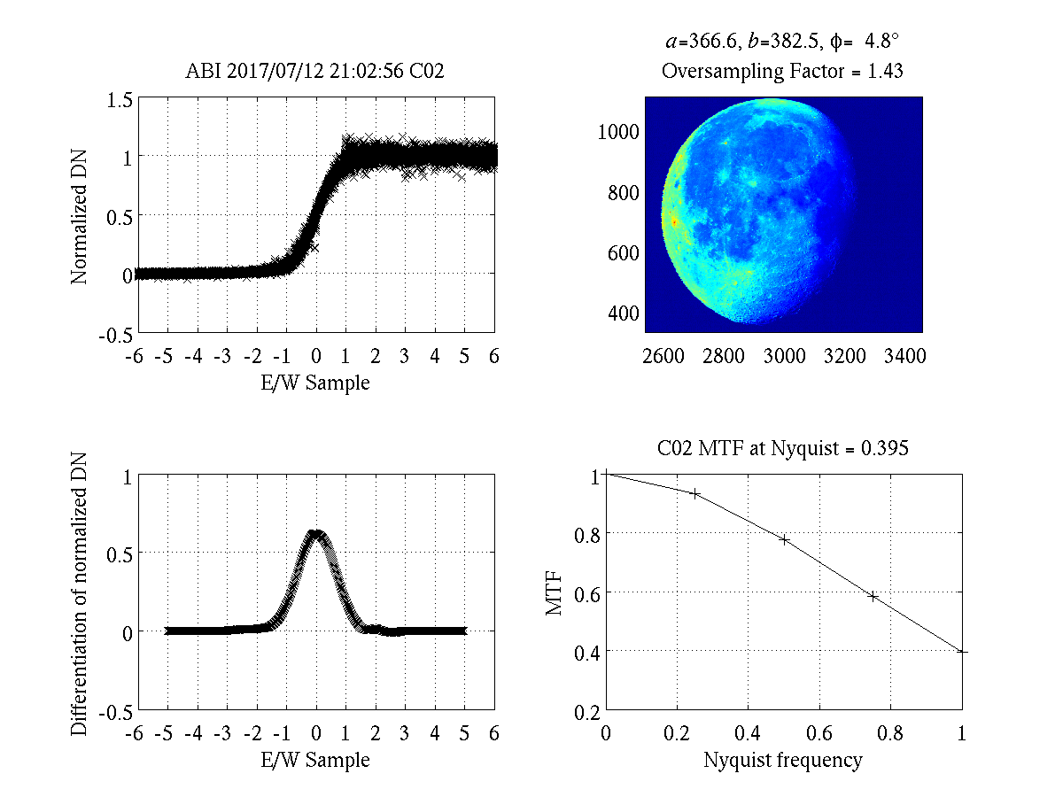
ABI CH02 (2017-07-12)
Unintuitively, MTF for the 0.5km channel (AHI B03 & ABI B02) is worse than the 1km channel.

Slide 24
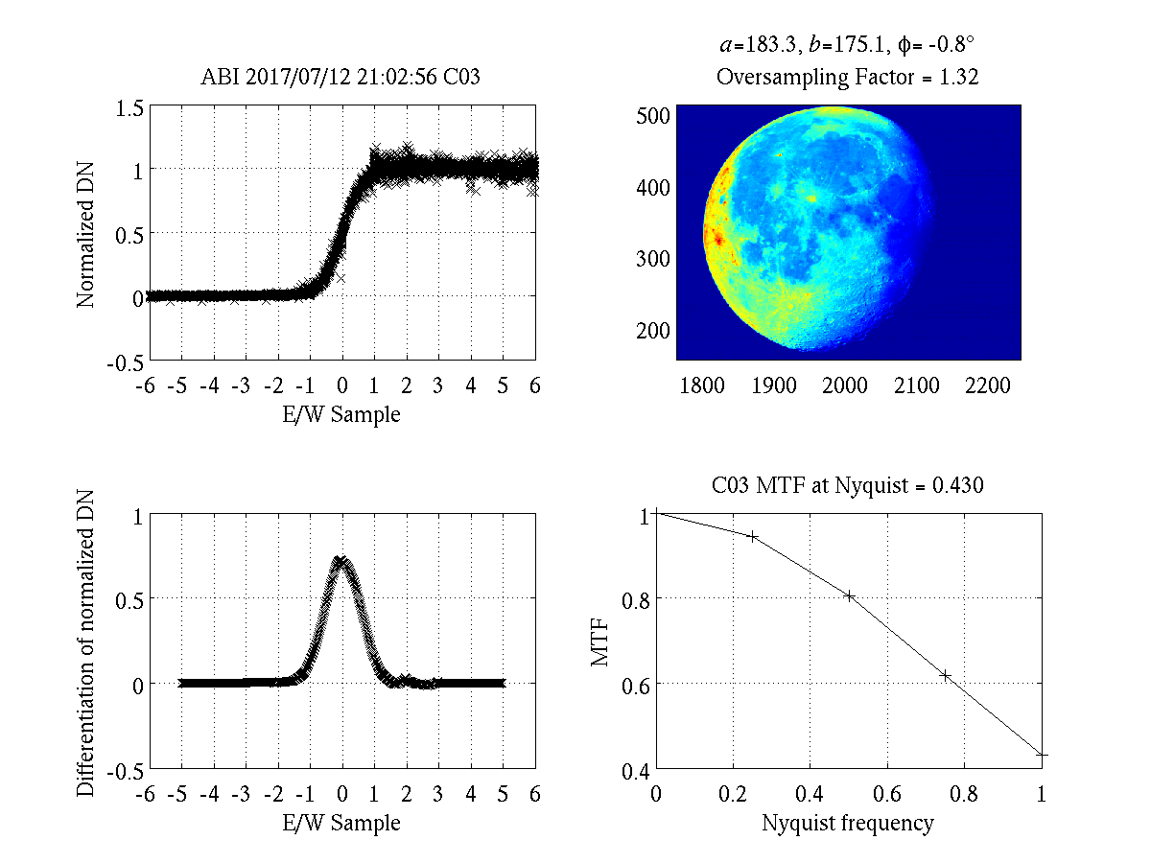
ABI CH03 (2017-07-12)
Unintuitively, MTF for the 0.5km channel (AHI B03 & ABI B02) is worse than the 1km channel.

Slide 25
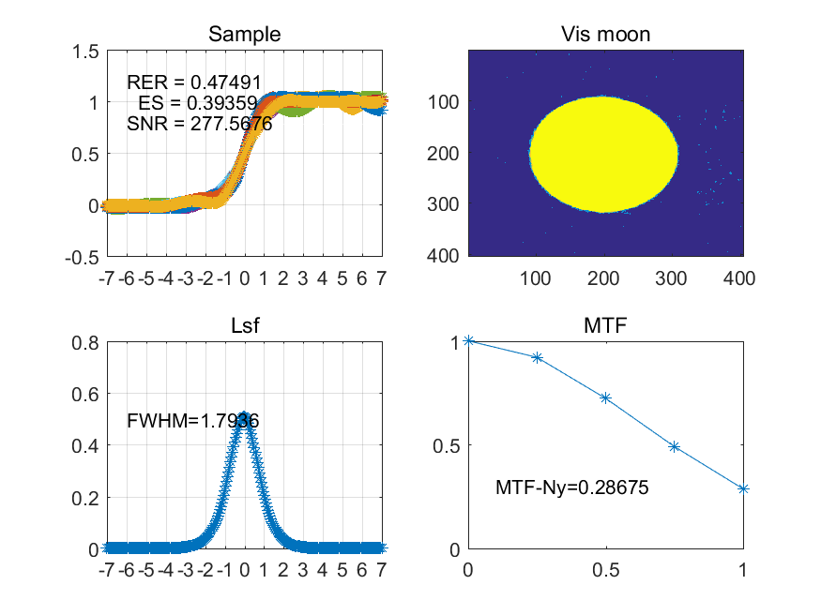
CMA Calculation on FY-2G
Have received some results.
Have not received algorithm.
Suggest other agencies to critique NOAA’s method based on their experience.

Slide 26
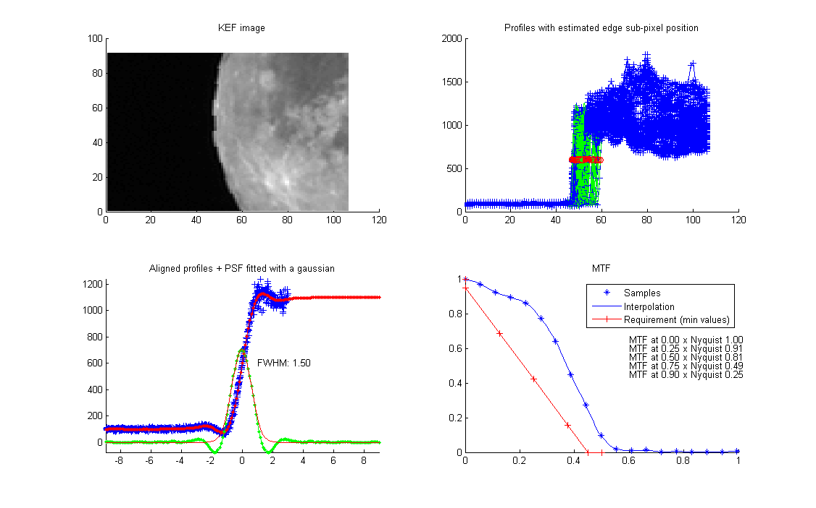
MSG-1 SEVIRI HRV in EW (by EUMETSAT)
Have received some results.
Have not received algorithm.
Suggest other agencies to critique NOAA’s method based on their experience.

Slide 27
Path Forward (1/3)
Fundamentals: Sampling, Oversampling, and Resampling.
The algorithm should account for spatial resolution.
In addition to (or instead of) frequency relative to “sampling grids”.
Would be a more useful tool, even if no longer MTF.
Oversampling: Scaling the grid before deriving ESF.
Oversampling may have uncertainty, however it’s determined.
Its propagation to MTF should be estimated, but perhaps nearly negligible.
Resampling: Fully resample the lunar measurements before deriving ESF.

Slide 28
Path Forward (2/3)
Other Details of the Algorithm Under Development:
Coordinate acquisition on the same day?
Restrictions on lunar phase (waning/waxing) and latitude?
Fermi function?
ESF: Piecewise 2nd order polynomial etc.
LSF: Padded 0 for those 3 pixels away from edge etc.
MTF: Consideration for FFT?

Slide 29
Path Forward (3/3)
Metric to Evaluate MTF:
Single parameter is preferred.
It is desirable to cut off frequencies above the Nyquist to minimize aliasing while maintaining a reasonably flat MTF up to the Nyquist.
Some (such as AHI/ABI) does that explicitly via resampling with sinc function.
Ideally MTF near Nyquist should approach 0.
Because of other constraints and data noise etc., any algorithm is rarely optimal for every cases.
Perhaps MTF at Nyquist = 1 is neither desirable nor reliable.
Recommend MTF at Nyquist = 0.5.

