Slide 1
goes-16/17 abi lunar calibration
Fangfang Yu, Xiangqian Wu, Xi Shao, Haifeng Qian, Hyelim Yoo and Zhipeng Wang
NOAA/NESDIS/STAR

Slide 2
G16/17 ABI Lunar Calibration Activities
Lunar North-South Scans (NSS), only collected in PLT/PLPT period
crosstalk, blooming, out-of-band response, detector response uniformity, etc. (2017 lunar calibration workshop)
MTF
Nominal scan lunar images
Crosstalk, ghosting, blooming etc. (2017 lunar calibration workshop)
MTF (Fred, 4f)
IR: band-to-band non-linearity response comparison (an application example: B07 Bias at cold scenes, 7u)
Validation of the BDS index implementation
Lunar band-to-band inter-calibration
Validation of response versus scan-angle (RVS) for the VNIR bands
Lunar calibration to validate the solar calibration results
Anomaly investigation

Slide 3
G16/17 ABI Lunar Calibration Activities
Lunar North-South Scans (NSS), only collected in PLT/PLPT period
crosstalk, blooming, out-of-band response, detector response uniformity, etc. (2017 lunar calibration workshop)
MTF
Nominal scan lunar images
Crosstalk, ghosting, blooming (2017 lunar calibration workshop)
MTF (Fred, 4f)
IR: band-to-band non-linearity response comparison (an application example: B07 Bias at cold scenes, 7u)
Validation of the BDS index implementation
Lunar band-to-band inter-calibration
Validation of response versus scan-angle (RVS) for the VNIR bands
Lunar calibration to validate the solar calibration results
Anomaly investigation

Slide 4
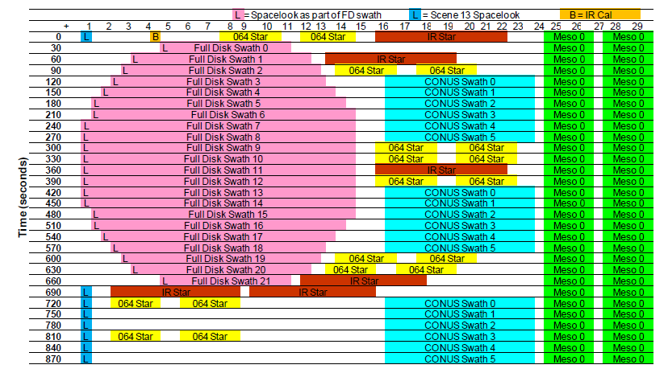
ABI Nominal Scan Lunar Image Collections
ABI lunar images are collected with the MESO scans
Each MESO scan consists of two swaths
The Moon is scanned with one of the two swaths
ABI Moon data is in Level1Alpha format – calibrated but not navigated datas
ABI Mode 3 timeline
Band name | Central Wavelength (µm) | EW ASD (µrad) | NS ASD (µrad) | Columns | Row
B01 | 0.47 | 22 | 22.7 | 3 | 676
B02 | 0.64 | 11 | 10.4 | 3 | 1460
B03 | 0.87 | 22 | 22.7 | 3 | 676
B04 | 1.38 | 44 | 41.6 | 6 | 372
B05 | 1.61 | 22 | 22.7 | 6 | 676
B06 | 2.25 | 44 | 41.6 | 6 | 372

Slide 5
Normal Lunar Image Collections: Chasing and Trending
Chasing:
ABI consecutively scans the Moon as it transits across the space within the Field of Regard (FOR).
The data is mainly used for the Response vs. Scan-angle (RVS) study, as well as trending analysis.
Only conducted during the PLT/PLPT periods.
Trending:
Conducted 2-4 times per month through the operational mission life.
Absolute phase angles in general within 5 and 60 degrees

Slide 6
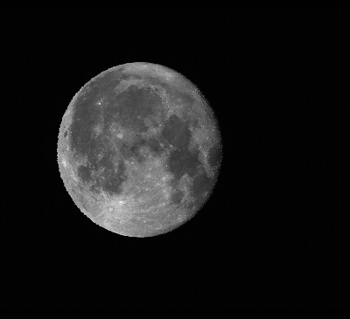
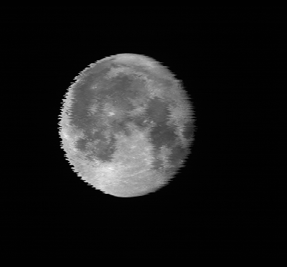
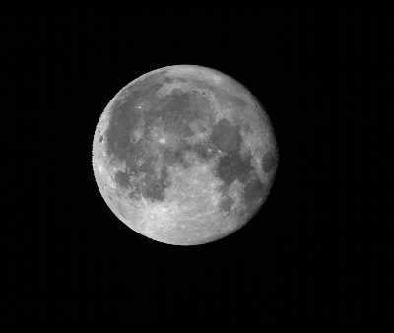
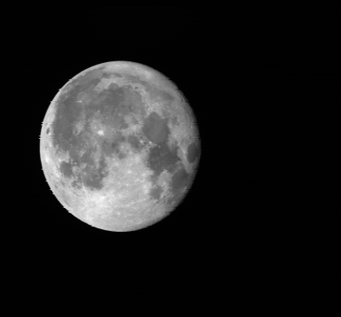
GOES-16 ABI Lunar Images
B01
B02
B03
B04
B05
B06
Phase angle ≈ 15 degree

Slide 7
G16/17 ABI Lunar Calibration Activities
Lunar North-South Scans (NSS), only collected in PLT/PLPT period
crosstalk, blooming, out-of-band response, detector response uniformity, etc. (2017 lunar calibration workshop)
MTF
Nominal scan lunar images
Crosstalk, ghosting, blooming (2017 lunar calibration workshop)
MTF (Fred, 4f)
IR: band-to-band non-linearity response comparison (an application example: B07 Bias at cold scenes, 7u)
Validation of the BDS index implementation
Lunar band-to-band inter-calibration
Validation of response versus scan-angle (RVS) for the VNIR bands
Lunar calibration to validate the solar calibration results
Anomaly investigation

Slide 8
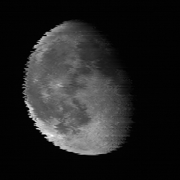
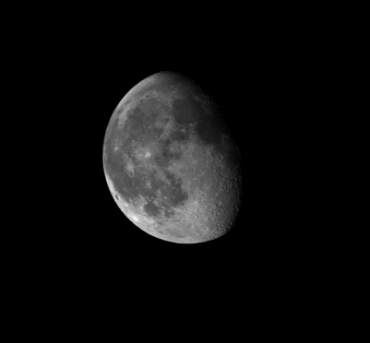
Band 4
Before Shifting
After BDS relative detector position (RDP) shifting

Slide 9
G16/17 ABI Lunar Calibration Activities
Lunar North-South Scans (NSS), only collected in PLT/PLPT period
crosstalk, blooming, out-of-band response, detector response uniformity, etc. (2017 lunar calibration workshop)
MTF
Nominal scan lunar images
Crosstalk, ghosting, blooming (2017 lunar calibration workshop)
MTF (Fred, 4f)
IR: band-to-band non-linearity response comparison (an application example: B07 Bias at cold scenes, 7u)
Validation of the BDS index implementation
Lunar band-to-band inter-calibration
Validation of response versus scan-angle (RVS) for the VNIR bands
Validation of the solar calibration results
Anomaly investigation

Slide 10
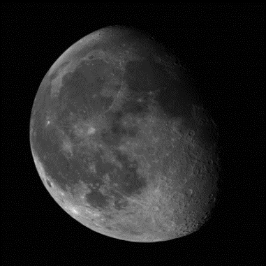
Band-to-Band Inter-Calibration
Band-to-band inter-calibration to confirm the GEO-LEO inter-calibration results
Confirmed that ABI B02 is over calibrated as shown with the GEO-LEO Ray-matching result
B03 as the reference

Slide 11
G16/17 ABI Lunar Calibration Activities
Lunar North-South Scans (NSS), only collected in PLT/PLPT period
crosstalk, blooming, out-of-band response, detector response uniformity, etc. (2017 lunar calibration workshop)
MTF
Nominal scan lunar images
Crosstalk, ghosting, blooming (2017 lunar calibration workshop)
MTF (Fred, 4f)
IR: band-to-band non-linearity response comparison (an application example: B07 Bias at cold scenes, 7u)
Validation of the BDS index implementation
Lunar band-to-band inter-calibration
Validation of response versus scan-angle (RVS) for the VNIR bands
G16 and G17 have the similar results/patterns. Use G16 ABI as an example.
Validation of the solar calibration results
Anomaly investigation

Slide 12
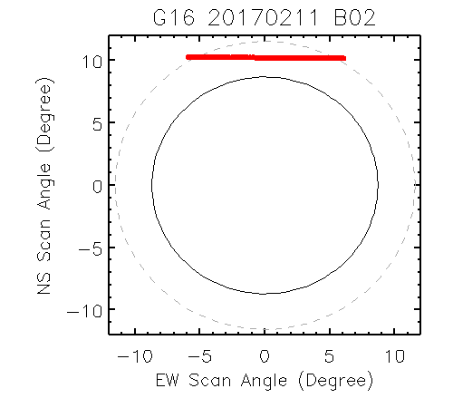
Normalized Irradiance Ratio – G16 RVS Validation
G16 spatial response uniformity at the EW direction meets the requirement for all the 6 VNIR bands
Very small variation (~1-2 count) in the space-look.
GS was not stable for the solar calibration during the G16 early PLT/PLPT period. These lunar images were re-processed with the GOES-R CWG in-house radiometric calibration package.
Yu et al. SPIE 2018

Slide 13
G16/17 ABI Lunar Data Analyses Activities
Lunar North-South Scans (NSS), only collected in PLT/PLPT period
crosstalk, blooming, out-of-band response, detector response uniformity, etc. (2017 lunar calibration workshop)
MTF
Nominal scan lunar images
Crosstalk, ghosting, blooming (2017 lunar calibration workshop)
MTF (Fred, 4f)
IR: band-to-band non-linearity response comparison (an application example: B07 Bias at cold scenes, 7u)
Validation of the BDS index implementation
Lunar band-to-band inter-calibration
Validation of response versus scan-angle (RVS) for the VNIR bands
Validation of the solar calibration results
Anomaly investigation

Slide 14
Lunar Trending for G16 ABI VNIR Bands
Scattering: under investigation, most likely due to the measured irradiance
Unstable VNIR ground system
Lunar irradiance ratio is normalized to the Day1 value

Slide 15
Lunar Trending for G16 ABI VNIR Bands
Phase angle dependent GIRO results?
Seasonal variation?
B04/B05/B06 show the impact of phase angle dependent GIRO irradiance
B05 and B06 seem to have seasonal variation of the ratio.

Slide 16
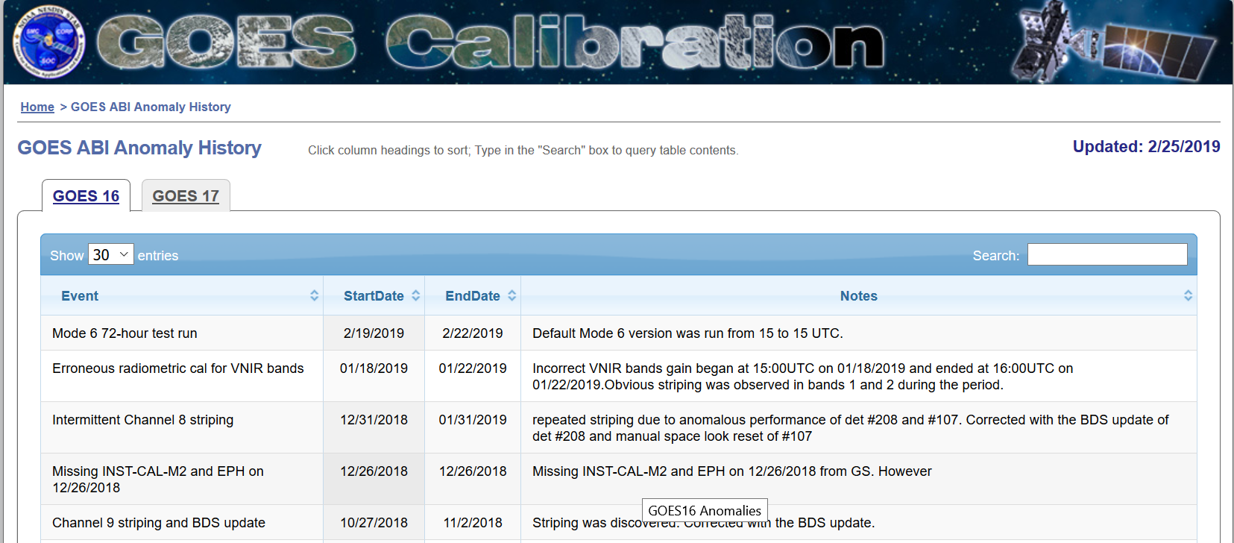
G16 ABI VNIR L1B Data after Dec. 2018
GOES-16 ABI VNIR ground system is in general stable since the L1B data became operational in Dec. 2018.
There was only GS anomaly in late Jan. 2019
This anomaly didn’t affect the lunar calibration – no lunar image collected during this period
ABI Calibration Event Log:
https://www.star.nesdis.noaa.gov/GOESCal/goes_SatelliteAnomalies.php
No lunar images collected during this GS anomaly period

Slide 17
G16/17 ABI Lunar Calibration Activities
Lunar North-South Scans (NSS), only collected in PLT/PLPT period
crosstalk, blooming, out-of-band response, detector response uniformity, etc. (2017 lunar calibration workshop)
MTF
Nominal scan lunar images
Crosstalk, ghosting, blooming (2017 lunar calibration workshop)
MTF (Fred, 4f)
IR: band-to-band non-linearity response comparison (an application example: B07 Bias at cold scenes, 7u)
Validation of the BDS index implementation
Lunar band-to-band inter-calibration
Validation of response versus scan-angle (RVS) for the VNIR bands
Validation of the solar calibration results
Anomaly investigation

Slide 18
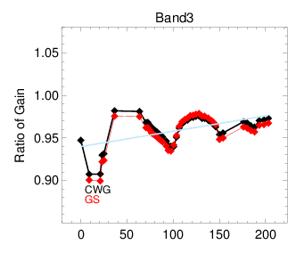
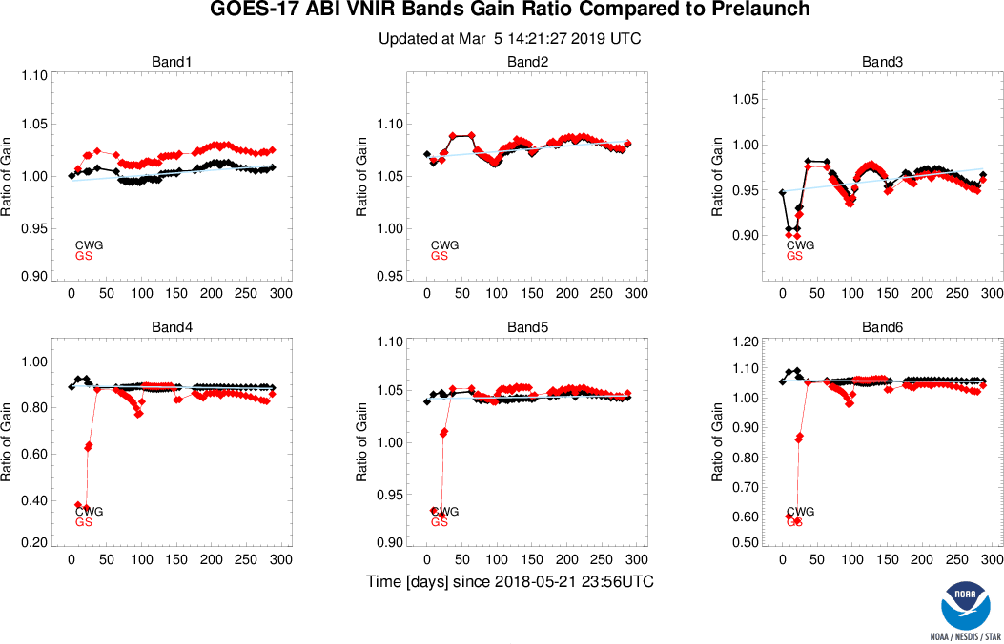
G17 B03 Gain Variation
G17 ABI B03 displays strong seasonal variation of solar calibration gain values
Observed with both CWG and GS results
Also shown in the other bands, to less degree with different patterns
08/31/2018
10/17/2018
Time series of solar calibration gain ratio to pre-launch values.
GS at G17 VNIR B1/B4/B6 bands seems not stable yet
https://www.star.nesdis.noaa.gov/GOESCal/G17_ABI_Solar_Cal_static.php

Slide 19
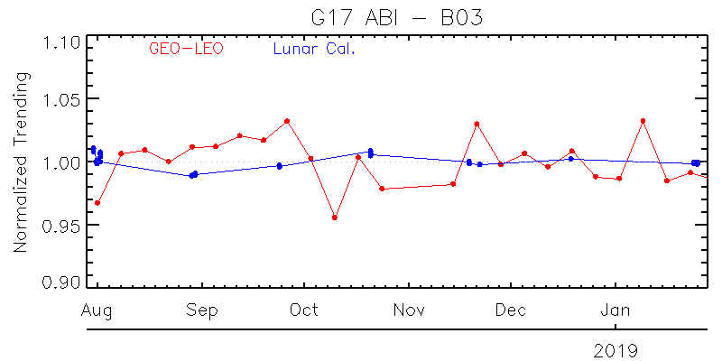
Relative Stable L1B Radiance
Post-launch calibration results indicated that the radiometric calibration accuracy of this channel is stable.
Time-series of combined GEO-LEO (ABI vs. VIIRS, ray-matching) and lunar trending results
Time-series of Uyuni desert reflectance
*to be combined with GEO-LEO and lunar trending results
GEO-LEO (ABI vs. VIIRS), lunar trending and the time-series of desert reflectance show that the G17 B03 L1B data is stable

Slide 20
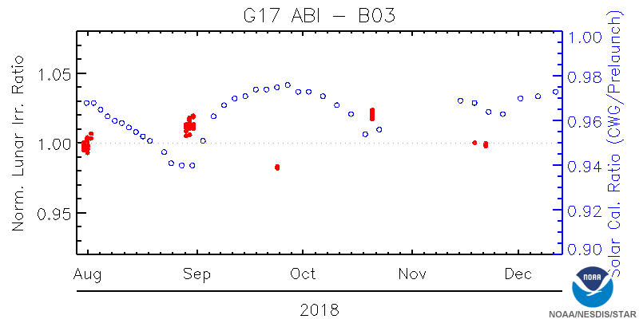
Anomaly Investigation
GIRO (ROLO) model has good relative calibration accuracy at 0.86um (ABI B03) when the absolute phase angles are within 5 and 60 degrees.
Re-process the lunar data by applying the Day1 solar calibration coefficients
To separate the instrument performance from the solar diffuser calibration
G17 ABI B03 experience apparent instrument performance variation
Is it VNIR FPM temperature dependent?
Time-series of normalized lunar sim/ reprocessed obs irradiance ratio and solar cal. gain ratio between in-orbit and pre-launch values

Slide 21
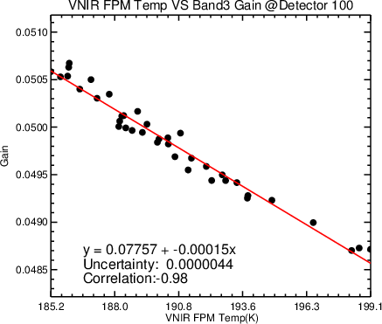
Relationship between VNIR FPM Temp and B03 Solar Cal. Coefficients
Strong negative correlation between VNIR FPM Temp and Gain.

Slide 22
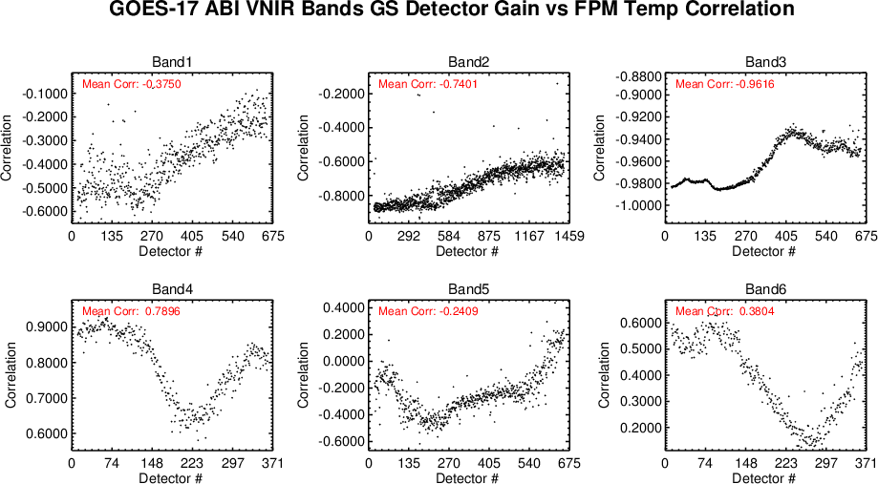
Relationship between VNIR FPM Temp and Gains for all the Detectors

Slide 23
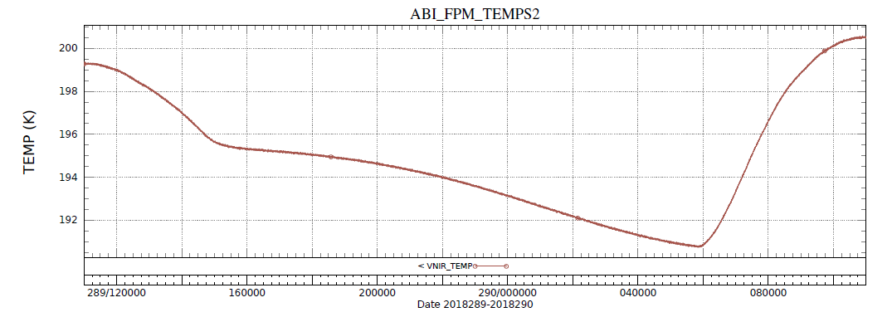
Impacts of the Anomaly
Possible diurnal and day-to-day radiometric calibration accuracy variations
Up to 2-3K VNIR FPM temperature variation in the day-time in the eclipse season, which may result in ~0.7-1.0% change in radiance at G17 B03
One option to mitigate the impact is to schedule more solar calibration events, especially within the eclipse seasons
8amSLT
5pmSLT
SSP daytime
~2-3K difference
10/17/2018

Slide 24
Summary
Lunar images are very valuable to validate the solar cal. results, better understand instrument performance, and improve the calibration accuracy
B04/B05/B06 show the impact of phase angle dependent GIRO irradiance
New version of GIRO/ROLO to reduce the impact?
G16 ABI B05 and B06 lunar calibration results seem to have seasonal variation
Will work with JMA with the AHI-8 lunar data

