Slide 1




Lunar irradiance measurement and modelling
Using a modified aerosol meter
Stefan Adriaensen (VITO), M. Bouvet (ESA), Emma Woolliams (NPL), Sarah Taylor(NPL), Maria Garcia Miranda(NPL), Carlos Toledano (Univ. Valladolid), Alberto Berjón (Univ. Valladolid), África Baretto (Univ. Valladolid)
GSICS Annual meeting – ESA/ESRIN, Frascati, 06/03/2019

Slide 2
Presentation outline
Project Overview
Location
Instruments
Instrument Calibration
Operations
Uncertainties
Measurements
Modelling
Model vs measurements
Comparison with EO sensors

Slide 3
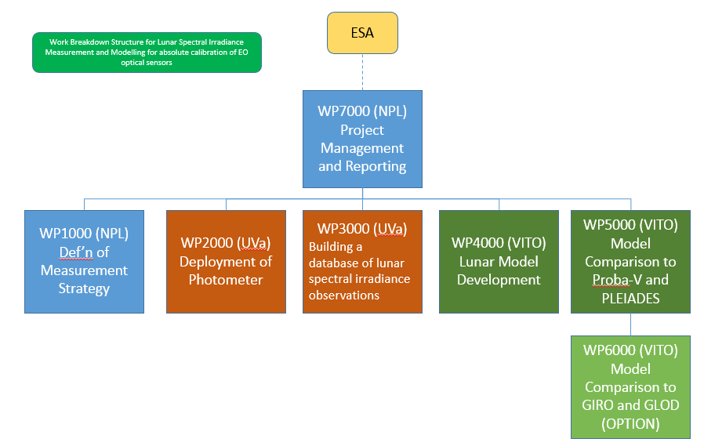
Project Overview : goal
Define a strategy for lunar irradiance measurements
Acquire and calibrate a capable instrument
Install at a location with optimal atmospheric conditions and make operational
Store the irradiance measurements in a database system
Model the irradiance based upon knowledge, target sub 2% absolute radiometric accuracy
Compare the model irradiance with space based lunar irradiance measurements

Slide 4
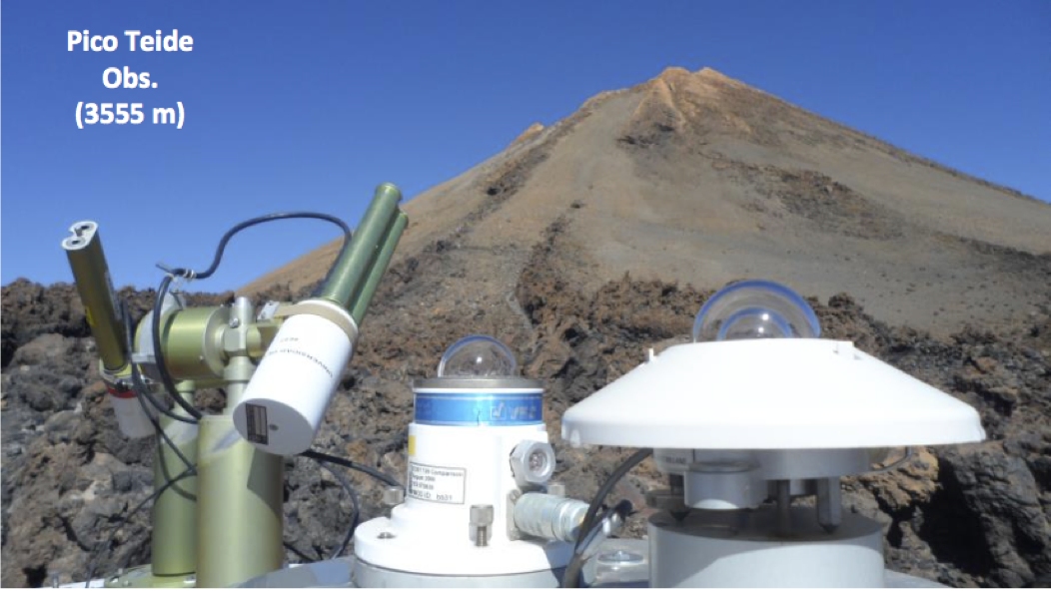
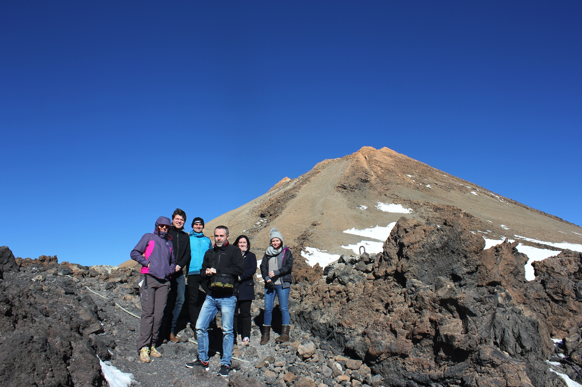
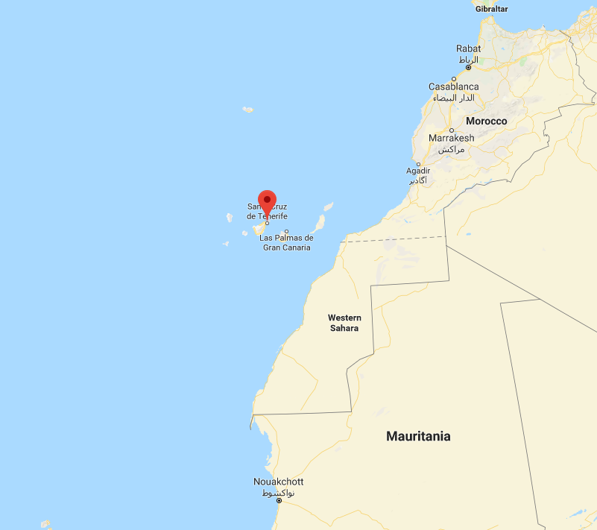
Location
On Island Tenerife (Spain) in the North Atlantic Ocean
Pico Teide (3555 m)
Izaña : Atmospheric Research Center (2391 m)
Very stable and ‘clean’ atmosphere
+100 measurements per year
  Sahara dust events
  Weather conditions on the Peak Teide
Aerosol Optical Loading (500nm) between 0.007 and 0.1

Slide 5
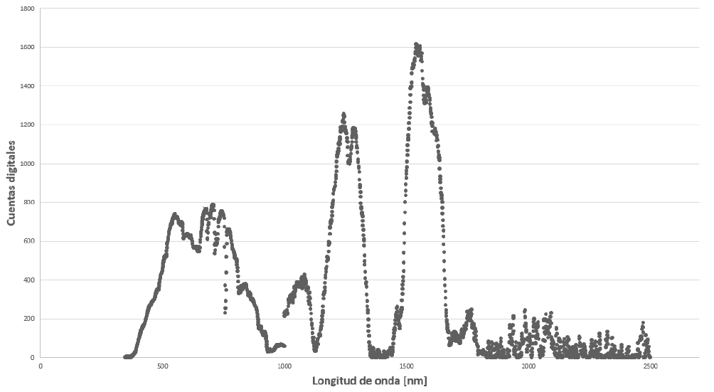
Instruments
Irradiance measurements
  the Sun-Sky-Lunar photometer CE318 from CIMEL designed for night aerosol retrieval and adapted specifically for this project:
  Spectral channels: 340, 380, 440, 500, 670 870, 936, 1020, 1640 nm
  Double filter wheel for polarimetric measurements
  Modification of firmware for polarimetric capabilities in direct lunar observation configuration
  Installed and operational since April 2018
Spectral Measurements (for spectal smoothing the model output)
  ASD field spectrometer ( >1800nm)
Example lunar spectrum

Slide 6
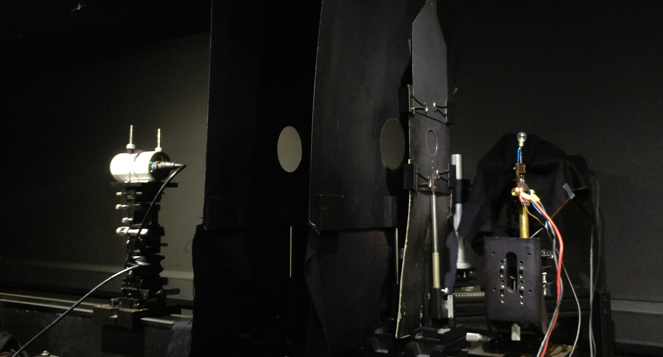
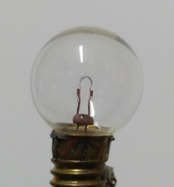
Instrument Calibration
Full instrument calibration conducted at NPL, in cooperation with Uva
  Linearity
  Irradiance & Radiance Responsivity
  Temperature characterization
  Reference plane
NPL SI traceability
Miners lamp
Calibration Setup : irradiance responsivity measurement

Slide 7
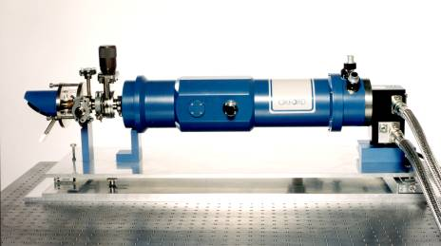

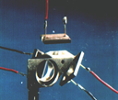
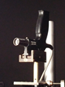
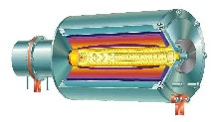
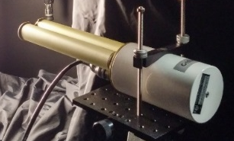

Instrument Calibration ( traceability )
Cryogenic Radiometer
FEL Lamp
Trap Detector
Transfer Spectrometer
Standard to FEL calibration
Filter Radiometer
Miner’s lamp
Blackbody
Lunar Photometer
FEL Lamp
Transfer FEL to Miners lamp

Slide 8
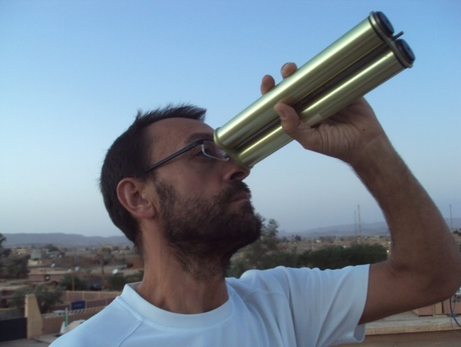
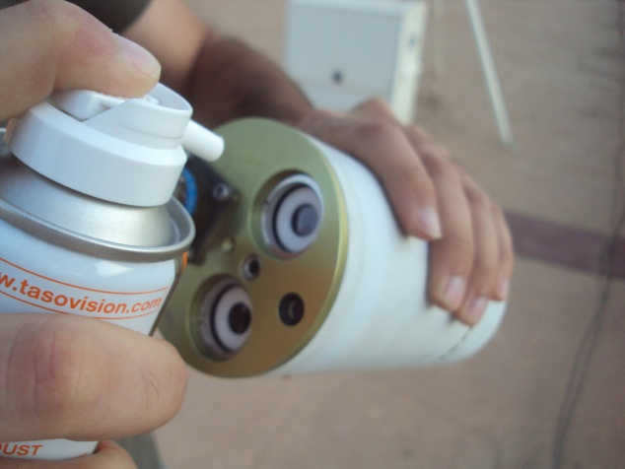
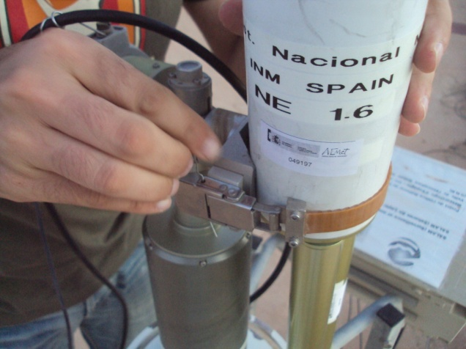
Operations
Develop an automated processing scheme for deriving lunar spectral irradiance measurements
Archive the raw data
Process the raw data into lunar spectral irradiance measurements
Build a database of lunar spectral irradiance measurements

Slide 9
Uncertainties
calibration
Langley TOA signal
model

Slide 10
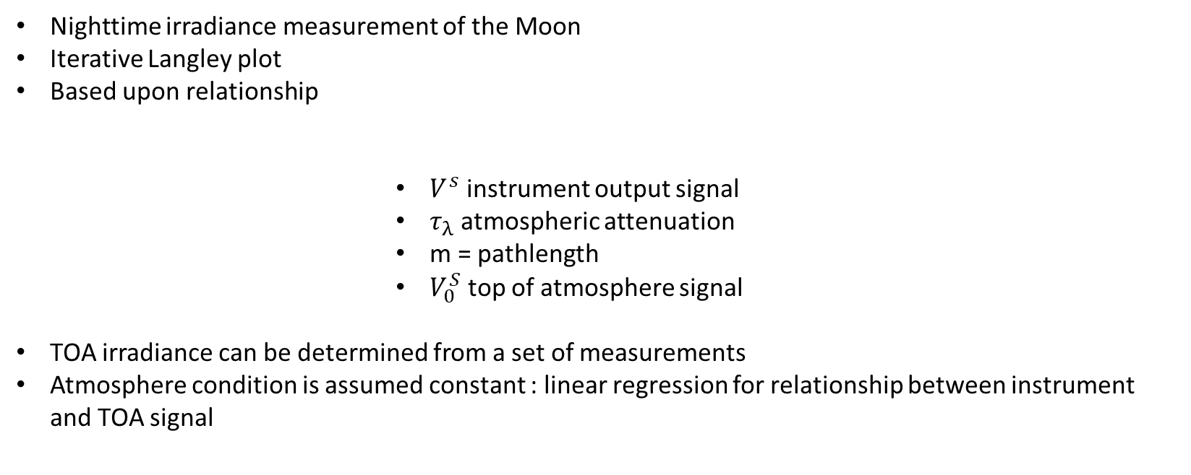
Measurements
Nighttime irradiance measurement of the Moon
Iterative Langley plot
Based upon relationship
              $V^{s}$ instrument output signal
              $τ_{λ}$ atmospheric attenuation
              m = pathlength
              $V_{0}^{S}$ top of atmosphere signal
TOA irradiance can be determined from a set of measurements
Atmosphere condition is assumed constant : linear regression for relationship between instrument and TOA signal

Slide 11
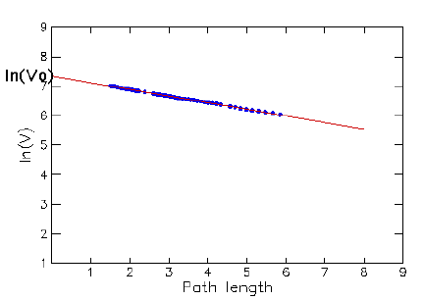
Measurements
Example Langley plot
Nighttime lunar observations
Instrument counts
Airmass between 2 and 5
D’ = corrected count (equals V in counts)
D = instrument count
F = temperature corr (coeffs and measurement of T)
Kdist = distance earth sun moon correction
A(tref)/A(t) = phase angle, sol/obs selen longitude latitude correction
Example Langley plot

Slide 12
Measurements
D’ = corrected count
D = instrument count
F = temperature corr (coeffs and measurement of T)
Kdist = distance correction
A(tref)/A(t) = phase angle, son/obs selen lon/lat correction
+0 : unknown uncertainty aerosol cycle

Slide 13
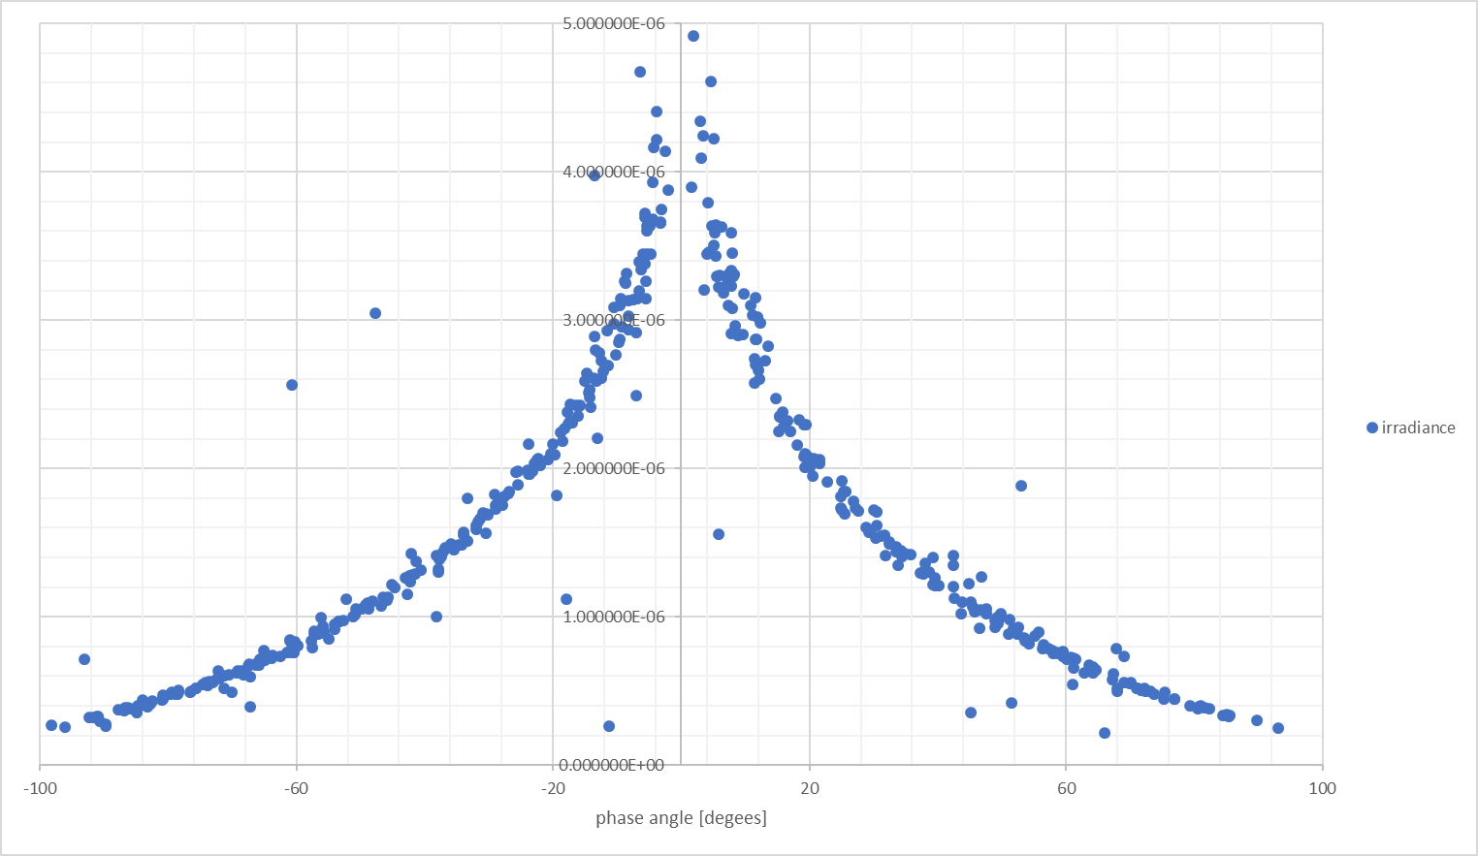
Measurements
440nm
About 400 irradiance measurements
Combination
  2 datasets of 2 instruments
Clean but outliers
Plot : irradiance against phase angle
Increased uncertainty in low phase angles

Slide 14
Modelling
Based upon the work done by USGS : Kiefer and Stone 2005
  Phase angle
  Solar selenographic lon, observer selenographic lat and lon
Linear and non-linear part in the equation
  Specific regression methods for both parts
  First linear part, non-linear part based upon residuals
Outliers need filtering, big influence on regression result
Iterative procedure : removal of the outliers, then refit
Conversion of reflectance to irradiance using solar irradiance

Slide 15

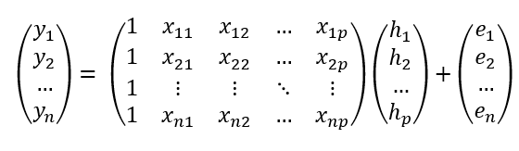

Modelling
Linear part :
least squares regression
Matrix formulation
h matrix is the solution

Slide 16
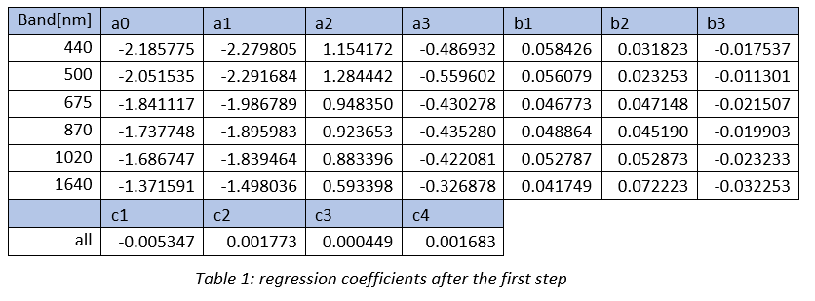
Modelling

Slide 17
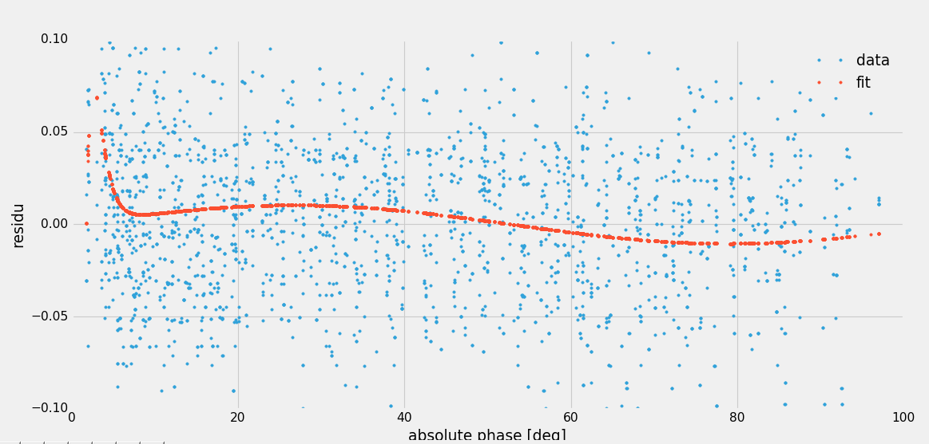
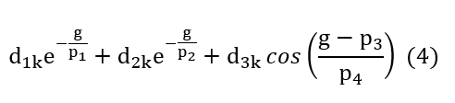
Modelling
Non linear for absolute phase angle
  Levenberg-Marquardt
  Fit over all residuals from previous step, after removing 3sigma outliers
  Band independent parameters p1-p4
Work in progress !

Slide 18
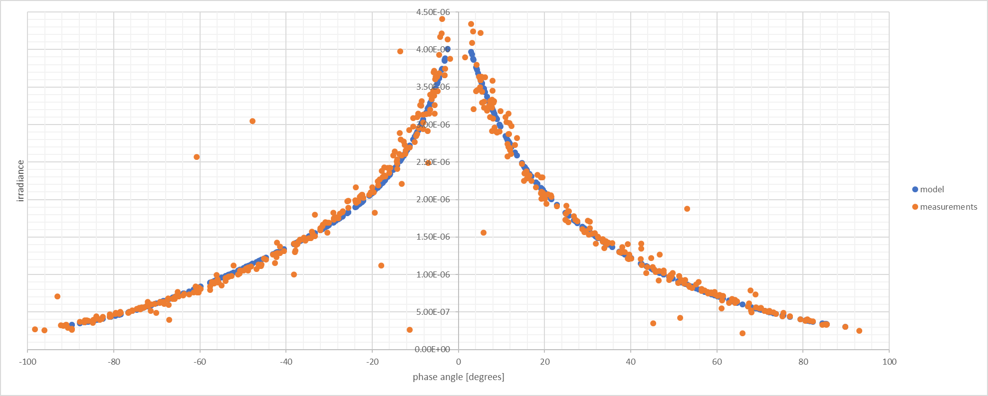
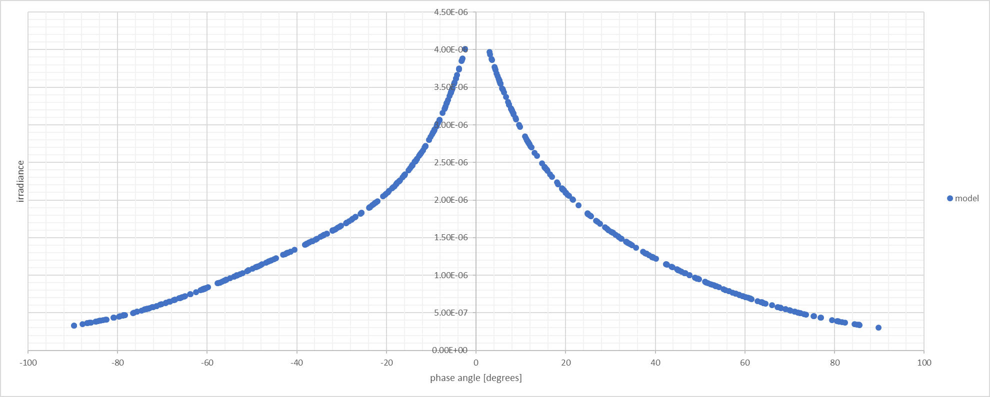
Model vs measurements

Slide 19
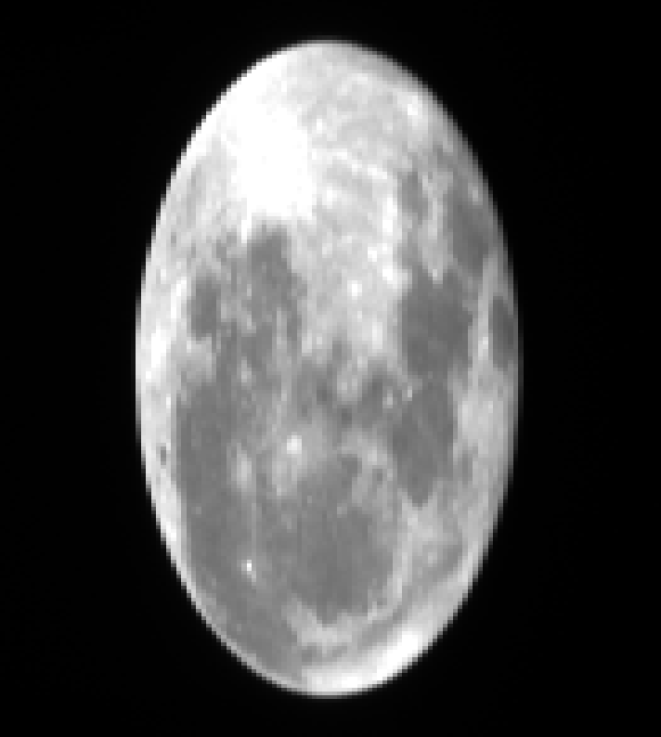
Comparison with EO sensors and models
Currently under development
Similar approach as Kieffer and Stone but less spectral bands in the model
Spectral smoothing based upon EO instrument spectral response
ASD measurements to asses Apollo sand spectra and possibly replace
PROBA-V and PLEIADES lunar acquisitions are currently baseline
Extra :
  Candidates from GLOD
  GIRO
Lunar irradiance image PROBA-V 06/09/2017
Comparison of VITO

Slide 20
Thank you !

