Slide 1
Discussion on Solar Spectra for Vis/NIR Calibrations
Tom Stone — USGS, Flagstaff AZ USA
GSICS 2019 Annual Meeting
06 March 2019

Slide 2
Example of Vis/NIR sensor reflectance calibration:
VIIRS calibration lookup tables (LUTs) contain factors E_{sun}/π for each band
for VIIRS LUTs, the solar irradiance spectrum E_{sun}(λ) used is Thuillier (2003)
ROLO/GIRO lunar model: conversion from disk reflectance to lunar irradiance:
[JPSS VIIRS Radiometric Calibration ATBD (rev C) Eq. 81]

Slide 3
Some commonly used solar irradiance models
Thuillier [Solar Physics 214, 1-22 (2003)]
measurements acquired by SOLar SPECtrum (SOLSPEC) instrument aboard the U.S. space shuttle 1992-1994
spectrometer lab calibration against high-temperature blackbody at Heidelberg Observatory
mean absolute uncertainty 2-3%
used for reflectance calibrations for VIIRS, Landsat OLI, others
Neckel and Labs [Solar Physics 90, 205-258 (1984)]
Kitt Peak FTS measurements, convolved to 1-2 nm resolution
calibrated against reference lamps, traceable to Heidelberg blackbody
used by MODIS, SeaWiFS, others

Slide 4
Some commonly used solar irradiance models
Wehrli (1985) PMOD publication 615
ftp://ftp.pmodwrc.ch/pub/publications/pmod615.asc
composite of earlier measurement data:
200-310 nm: Brasseur and Simon, JGR 86, 7343 (1981)
310-330 nm: Griffin and Pearson, Applied Optics 8, 2215 (1969)
330-869 nm: Neckel and Labs, Solar Physics 90, 205-258 (1984)
870 nm to IR: Smith and Gottlieb, Space Sci. Rev. 16,771 (1974)
used by ROLO (and GIRO) to convert lunar disk reflectance to irradiance
required for consistency with ROLO model construction

Slide 5
Some commonly used solar irradiance models
Kurucz irradiance (2005, revised 2010)
http://kurucz.harvard.edu/sun/irradiance2005/
high resolution (1 cm⁻¹) Kitt Peak FTS [Kurucz et al., Solar Flux Atlas from 296 to 1300 nm, National Solar Observatory, Sunspot New Mexico, 240 pp. (1984)]
resolution reduced and scaled to Thuillier (2003)
MODTRAN
several built-in spectra, plus user-defined option
Kurucz
Kurucz re-calibrated by K. Chance (ChKur)
ChKur supplemented by SSBUV measurements by Cebula (CebChKur)
Kurucz/Thuillier (ThKur)

Slide 6
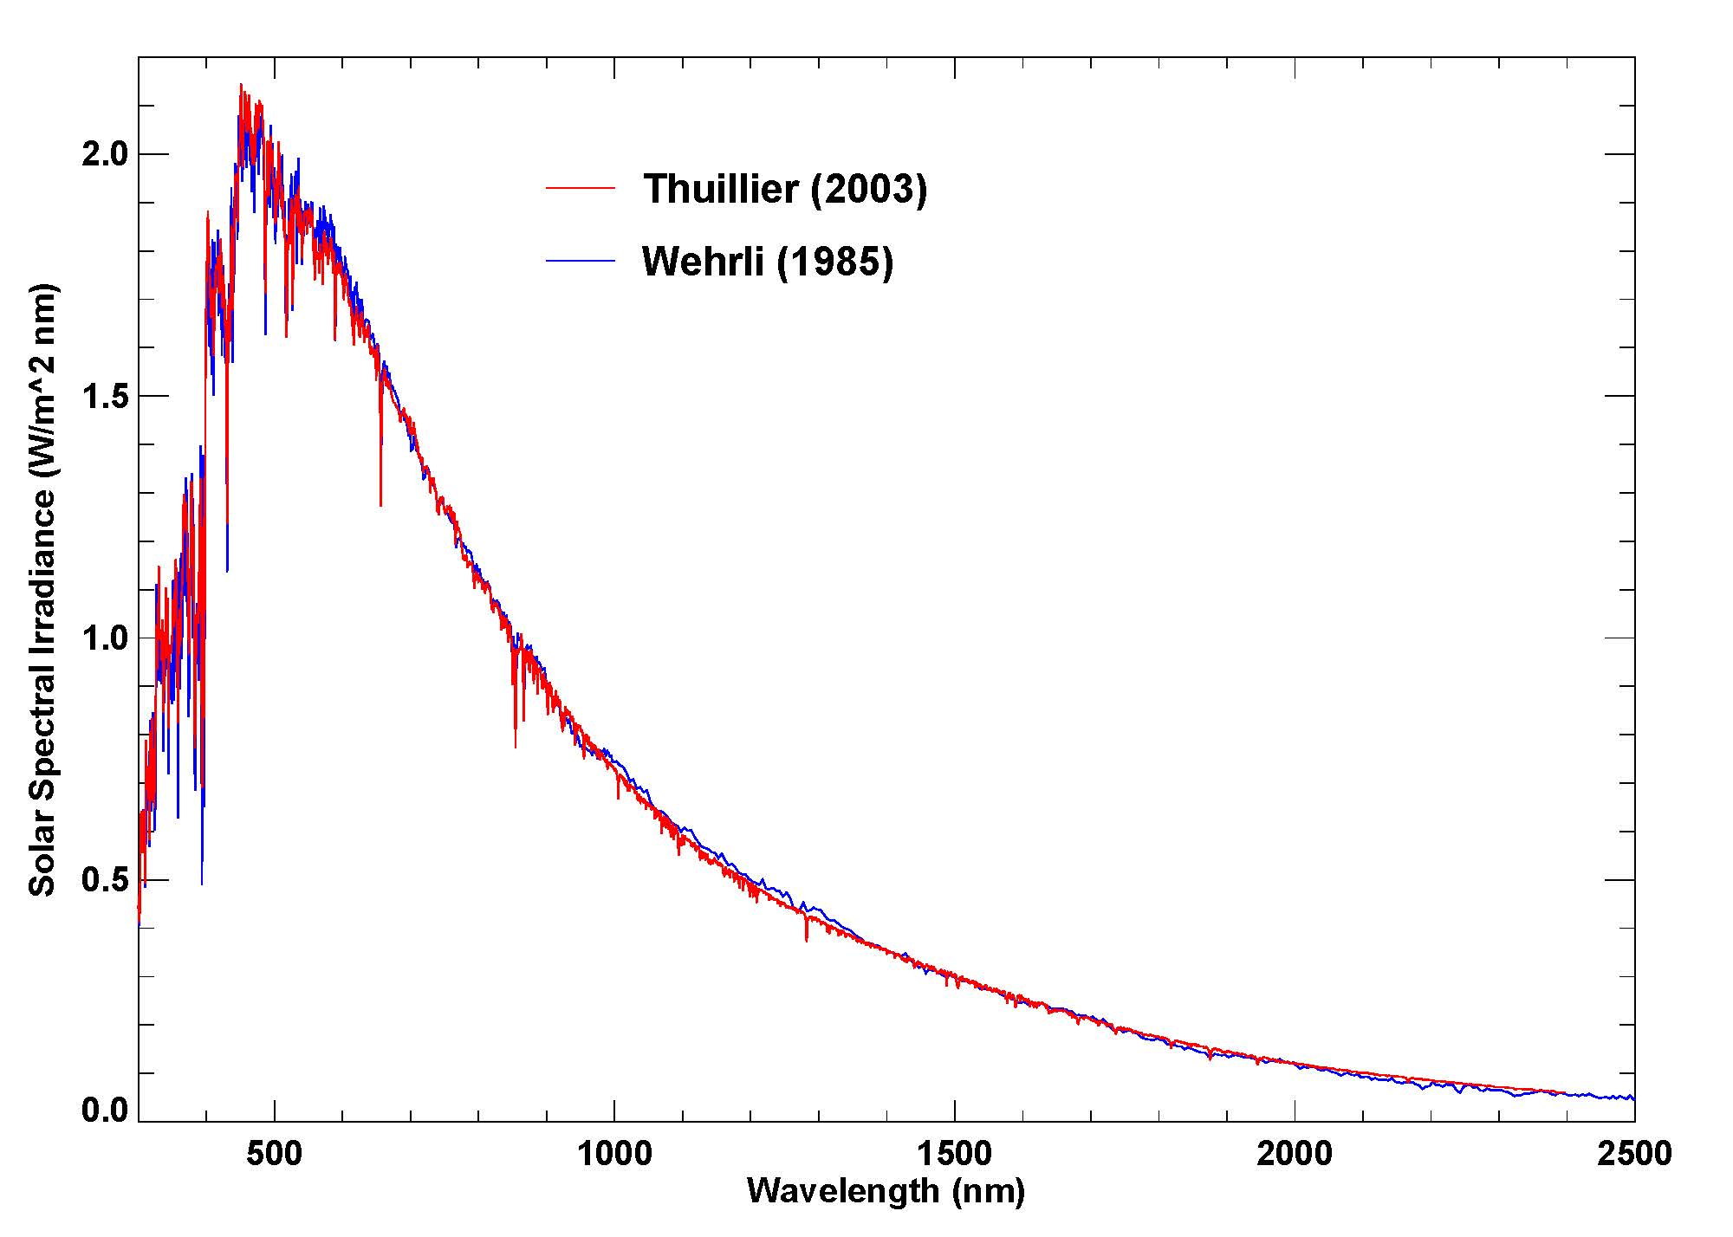
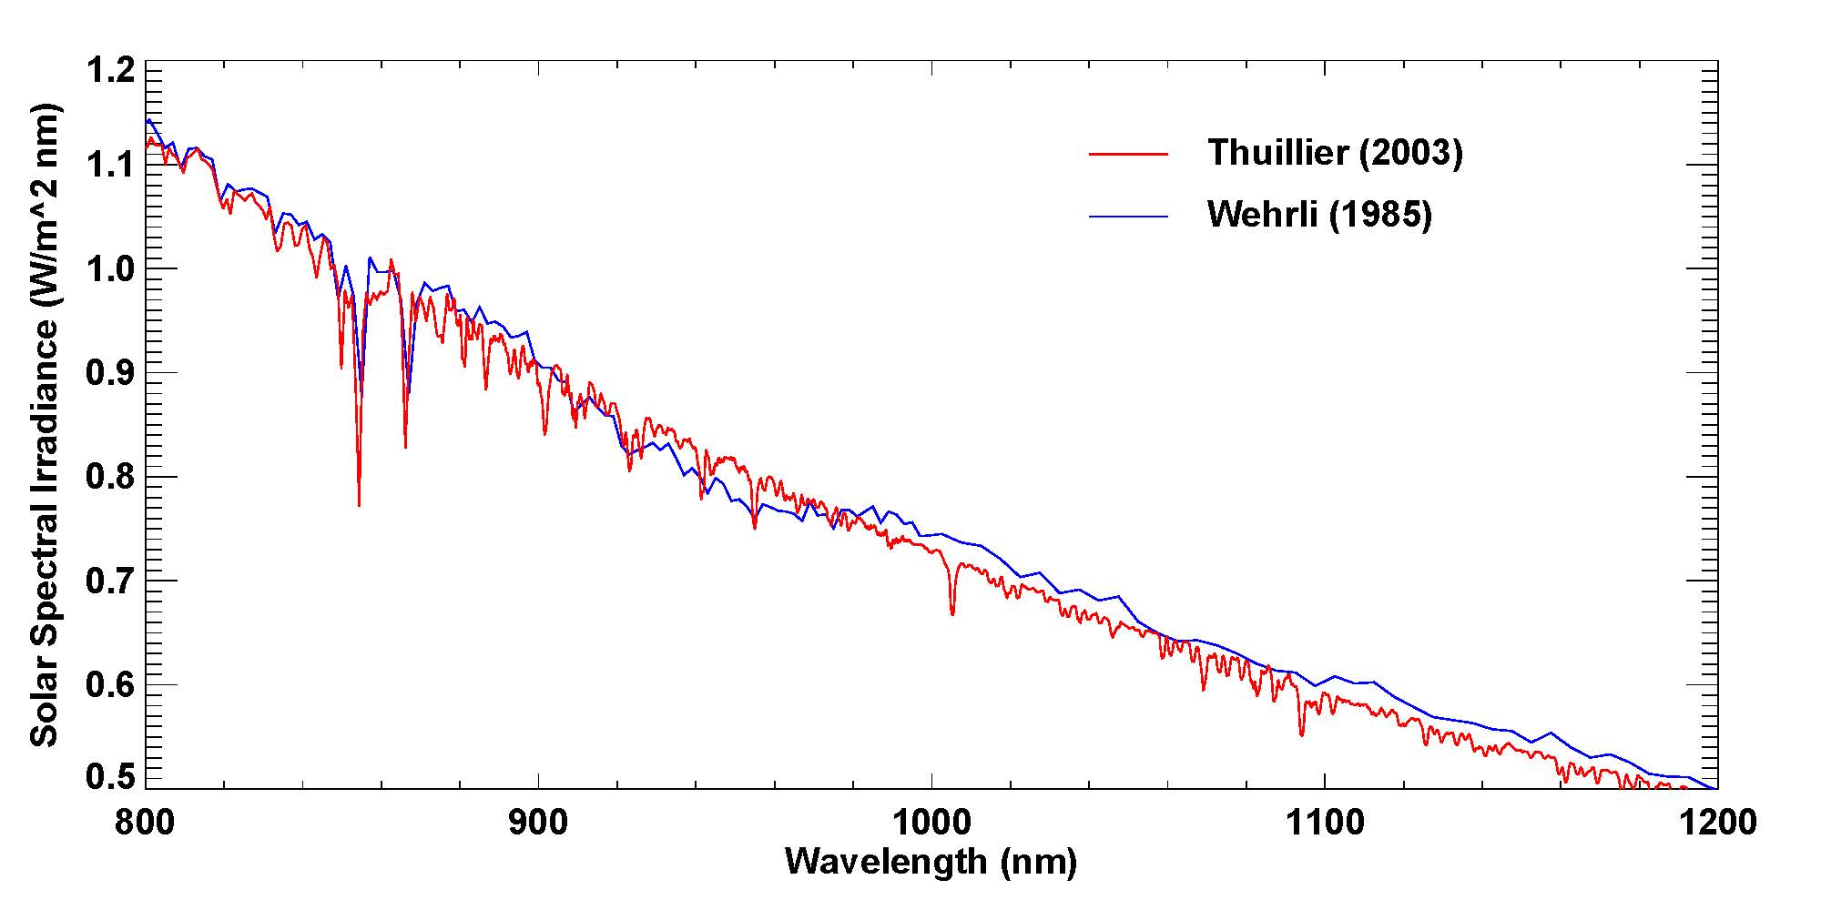
Differences between Thuillier and Wehrli
significant influence on ROLO/GIRO analysis for spectrometer instruments!

Slide 7
A new solar spectral irradiance composite
SOLID — First European Comprehensive Solar Irradiance Data Exploitation
http://projects.pmodwrc.ch/solid/
combination of datasets from >20 instruments/missions
wavelengths from EUV through shortwave IR
missions from 1970s (NIMBUS-7 SBUV) to 2015 (SORCE SIM)
Schöll et al., J. Space Weather Space Clim. 6, A14 (2016)
www.swsc-journal.org/articles/swsc/pdf/2016/01/swsc150020.pdf
time-dependent SSI model, data available from PMOD:
ftp://ftp.pmodwrc.ch/pub/projects/SOLID/database/composite_published
endorsed by CEOS-IVOS

Slide 8
Discussion: considerations for calibration inter-consistency
Calibration inter-consistency requires using a common solar spectrum
for LUT approach, tables must be built using a static solar model
TSIS can provide SI-traceable SSI as a near-realtime data stream
enables using the solar irradiance incident upon the calibrator (solar diffuser, vicarious ground site, DCC, Moon) at the time of calibration observations
a different paradigm than LUTs — will it be adopted?
TSIS can validate a static solar model — which solar activity to use?
for spectrometers or hyperspectral instruments, need higher spectral resolution than Thuillier
ROLO approach: reduced resolution Kurucz, scaled to Wehrli (similar method to Kurucz 2005 irradiance spectrum)
Should GSICS endorse a recommended solar spectrum for Vis/NIR cal?

