Slide 1
Suomi-NPP VIIRS Reprocessing and Calibration Improvements in VNIR Bands
Sirish Uprety, Changyong Cao, Wenhui Wang, Xi Shao, Bin Zhang, Slawomir Blonski, Taeyoung Choi
With contributions from
STAR OC Team: Junqiang Sun
GSICS Annual Meeting
March 06, 2019
Frascati, Italy

Slide 2
Outline
S-NPP VIIRS Instrument Performance
VIIRS V2 Reprocessing Status
Issues in operational RSB Calibration
Improvements In reprocessed RSB calibration
Improvements in RSBAutoCal F-factor
Kalman Filter for improved gain characterization
NOAA STAR Surface Roughness-induced Rayleigh Scattering (SRRS) Model
DCC and SNO-x Temporal trends
Summary

Slide 3
Background
S-NPP VIIRS was launched on November 28, 2011.
14 Reflective Solar Bands (RSB, I1-I3 and M1-M11) with spectral range from 0.412 μm to 2.25 μm.
More than 7 years of sensor data records (SDR) are available.
S-NPP VIIRS has been performing well since launch
Degradation is slow, RTA mirror degradation has stabilized.
Overall, user feedbacks are very positive.
Reprocessing aims to address remaining issues in the mission-long/life-cycle time series.
Radiometric consistency in the long-term data records.
Resolve major issues, such as
Residual degradation in RSB SDRs after solar calibration.
Bias correction

Slide 4
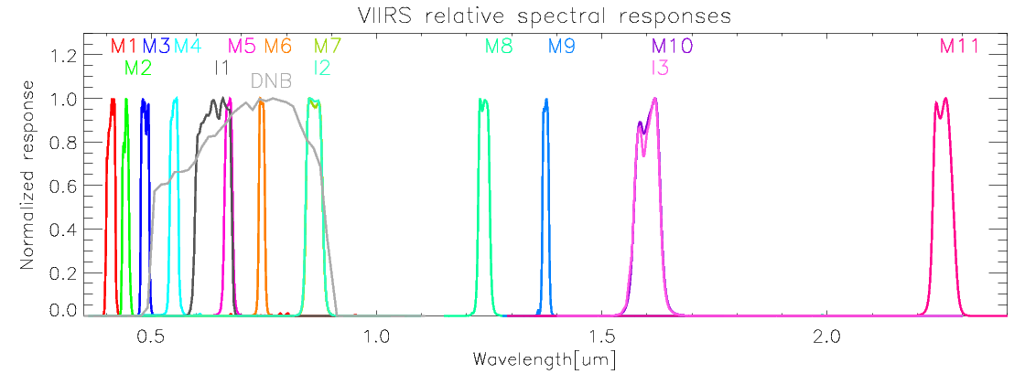
VIIRS Spectral Bands (RSB)
11 moderate bands (0.412-2.25 μm).
3 imagery bands
1 Day/Night band (DNB)
Calibrated using Solar Diffuser (SD) and Solar Diffuser Stability Monitor (SDSM).

Slide 5
Operational Calibration major Issues and Updates

Slide 6
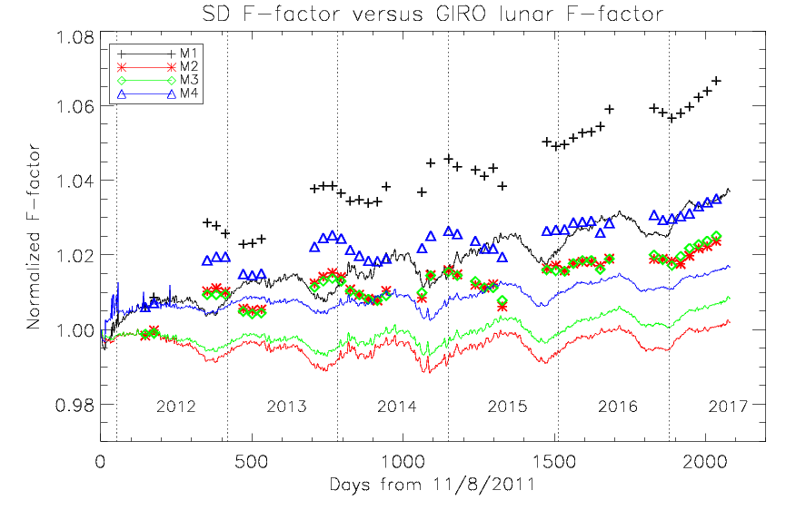
Lunar Calibration Suggests Residual Degradation in Operation Calibration
How to incorporate lunar calibration in VIIRS reprocessing?
Divergence between Lunar and Solar calibration indicates residual degradation;
Lunar calibration is likely more stable. However, lunar measurements are sparse, with 9 data points per year;
As a result, a combination of different validation sources including lunar is needed for near realtime correction of the residual degradation
Lunar
Solar
Use Kalman Filter to achieve improved calibration using SD, lunar, DCC and SNOx

Slide 7
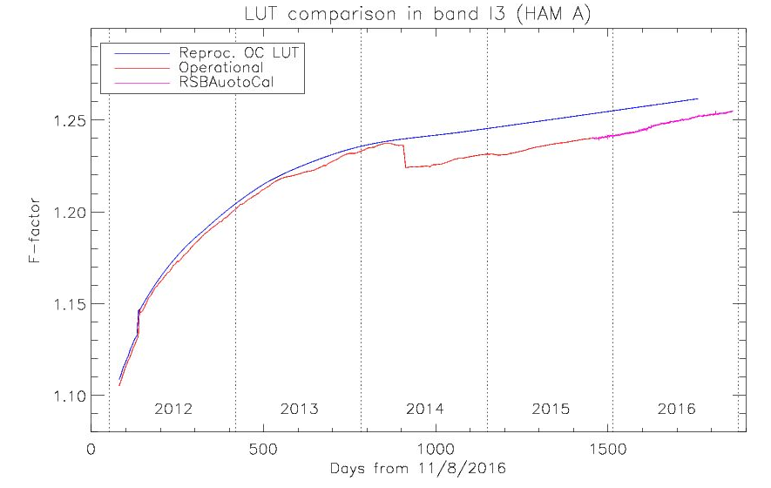
Reflective Solar Band (RSB) Consistency
Resolving inconsistencies due to incremental updates. For example:
In the calibration equation, C0=0 update applied on May 9, 2014.
I3 shows approximately 1% drop.
H-Factor filter update in May 2014
1-2% increase in blue bands
C0=0 update

Slide 8
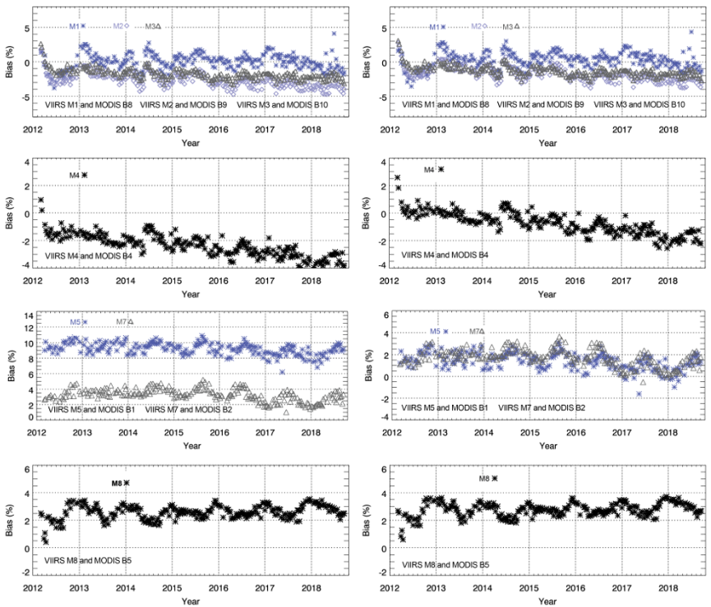
Operational SNPP VIIRS Comparison with AQUA MODIS
Before Applying SBAF
After Applying SBAF
Ref: https://ncc.nesdis.noaa.gov/VIIRS/VIIRS_MODIS_Intercomparison.php

Slide 9
S-NPP VIIRS V2 Reprocessing led calibration Improvements

Slide 10
S-NPP VIIRS V2 Reprocessing Improvements
STAR Kalman Filter
Uses Lunar/DCC/SNO; future AI capabilities
Provides longterm degradation correction for VNIR Bands
STAR Surface Roughness-induced Rayleigh Scattering (SRRS) Model
longterm degradation correction for SWIR bands
Other Improvements
Improved RSBAUTOCAL F-factors
re-analyzed SD/SDSM screen and BRDF LUTs (annual oscillation removed + further smoothing)
Used Thuillier (2002) solar spectrum, consistent with NOAA-20
Changes radiance
Updated OC F-factor based bias correction (V2)
Constant bias correction M5/M7 (V1/V2)

Slide 11
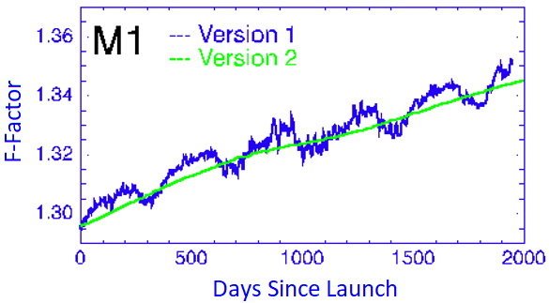
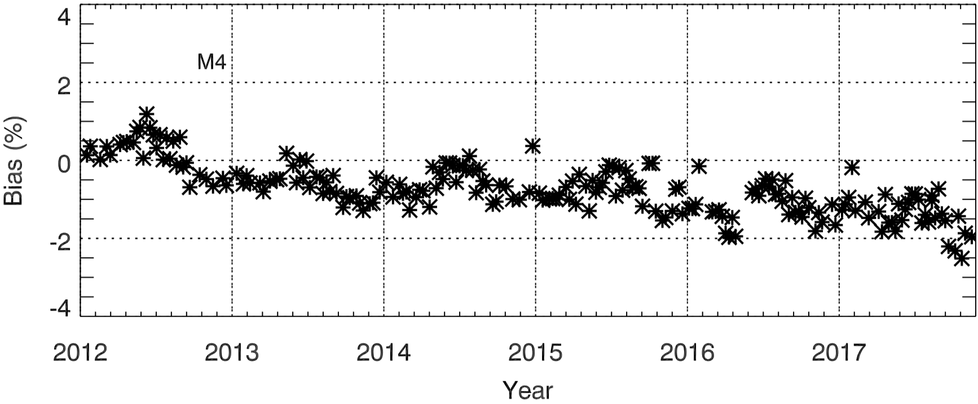
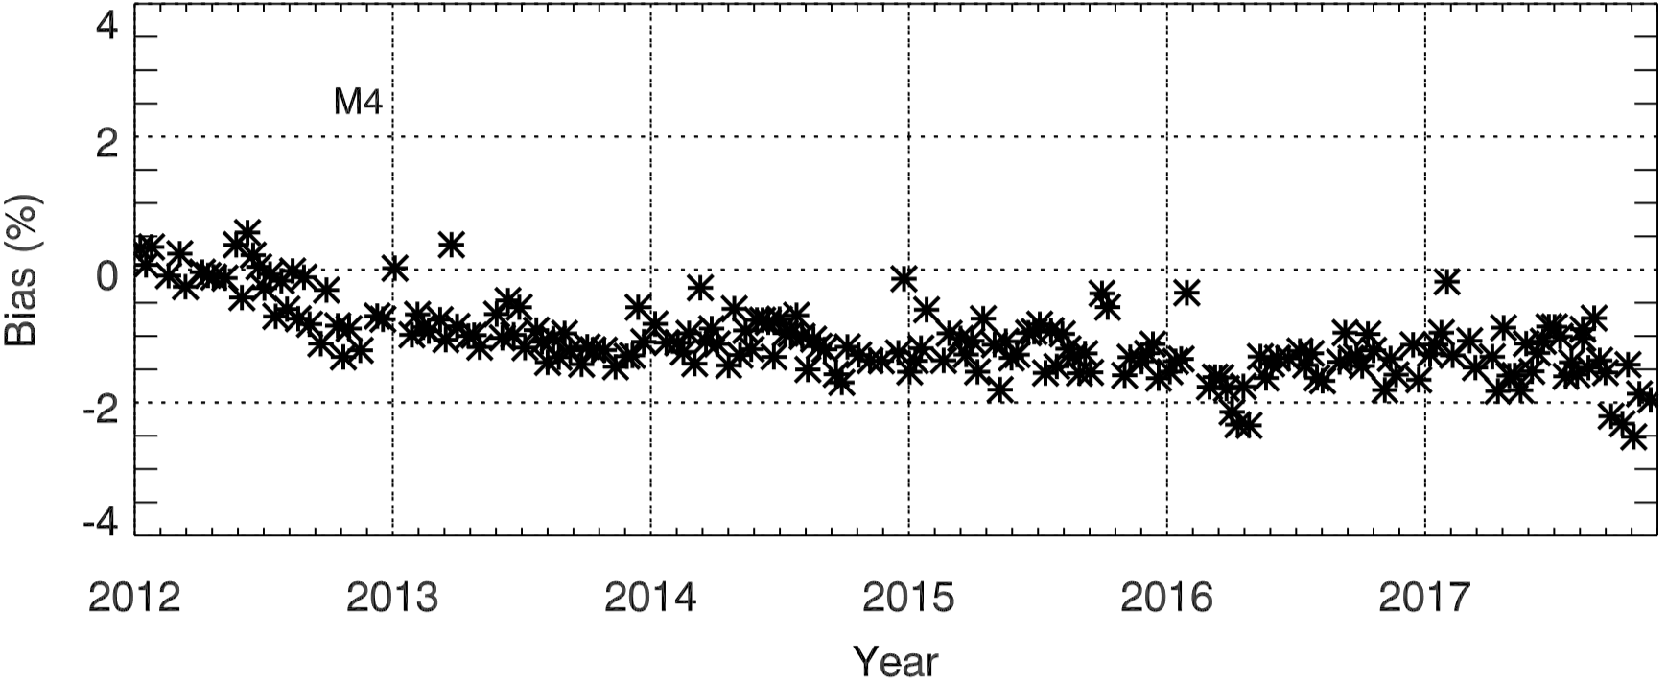
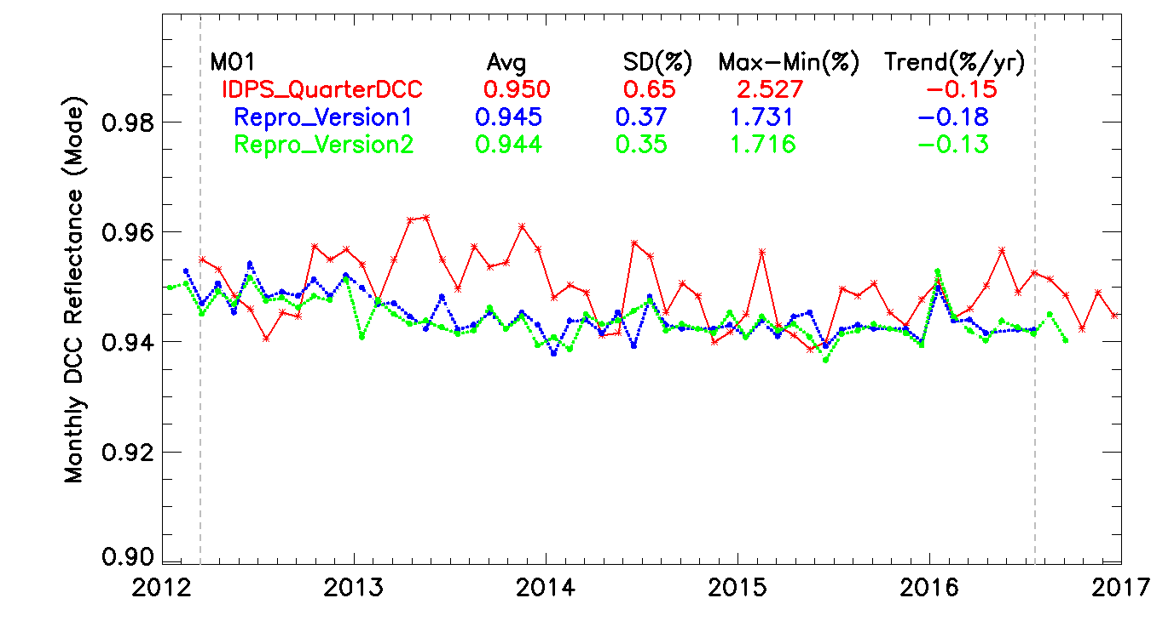
Baseline Calibration Improvements (SD F-Factors)
Baseline SDRs are generated using RSBAUTOCAL F-factors based on re-analyzed SD/SDSM screen and BRDF LUTs
Annual oscillation removed + further smoothed with moving window averaging filter.
Version 2 baseline SDRs show smaller annual cycles and less degradations.
Bias relative to AQUA MODIS, Bias= (V-M)*100%/M
Version 1
Version 2
M01 DCC Trend

Slide 12
Kalman Filter for Improved F-factor
(Reprocessing Version 2)
RSBAutoCal F Factor
(Solar diffuser cal)
Future plan
Kalman
AI based Forecasting
DCC Time Series
Estimated F-Factor Time Series
F-Factor
Lunar F Time Series
SNOx Time Series
Validation Prediction
Features:
Predict up to two weeks ahead of time for correction (used as a scaling factor);
Different time resolutions (some at irregular interval)
Combine input observations from different sources (subject to measurement uncertainty and noise)

Slide 13
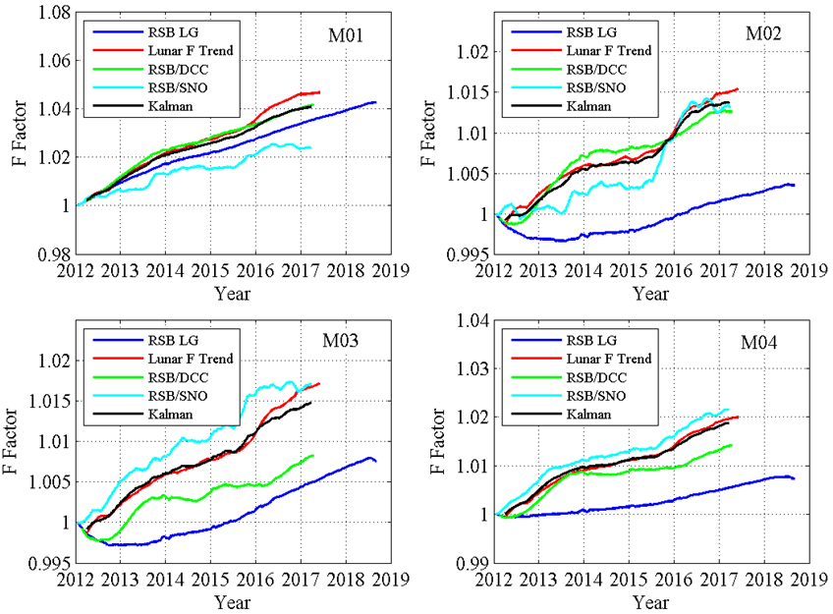
Kalman Filter Based Improved F-Factors
RSBAUTOCAL-F DCC-F SNOx-F Lunar-F Kalman-F

Slide 14
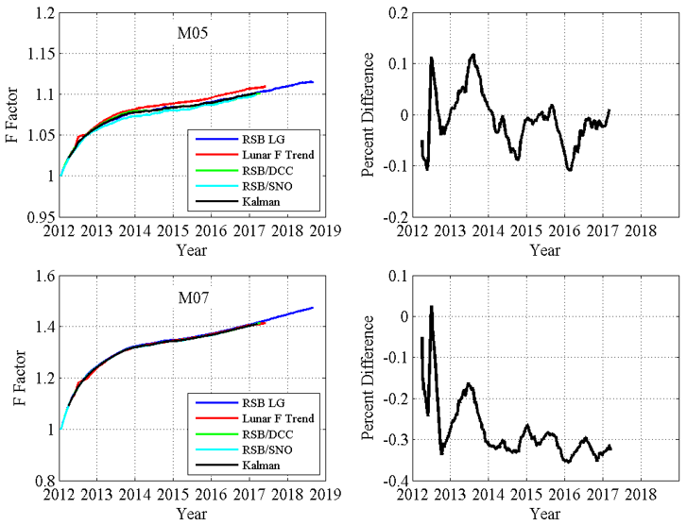
Kalman Filter Based Improved F-Factors

Slide 15
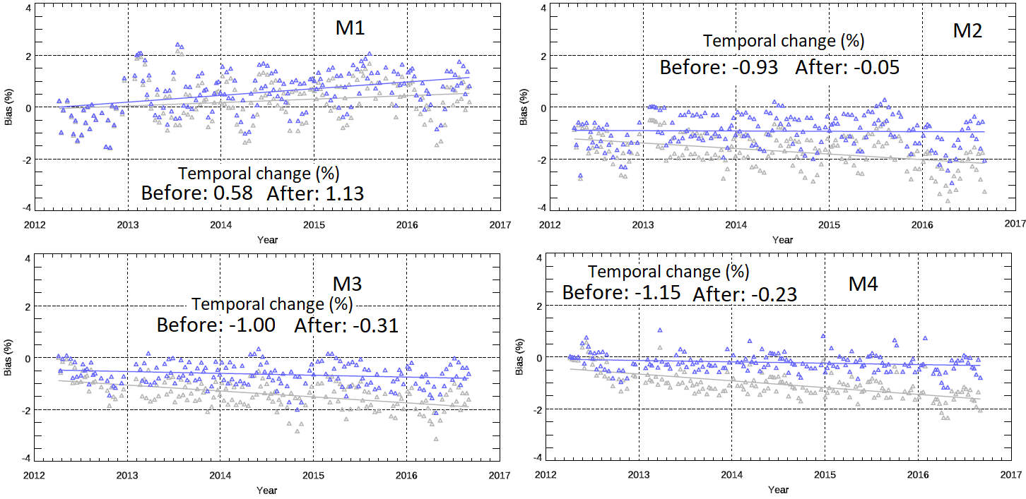
SNOx Trending (Before and After Kalman)
Gray: Before correction Blue: After correction
M1 shows dip in 2012, could be related to MODIS since this is not observed in DCC trend. Stable to 0.3% using data after 2013 only.
Rest of the bands shows change less than 0.3% with 1-sigma <0.5%.

Slide 16
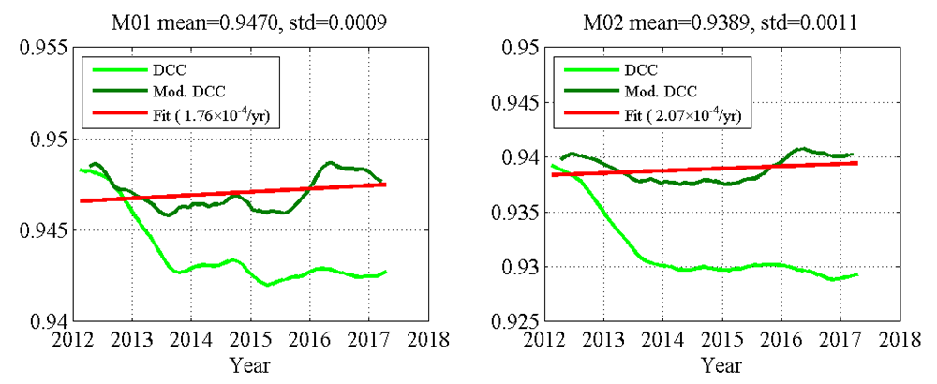
DCC (Before and After Kalman)
Stability < 0.1%
After
Stability < 0.1%
M01
Before
M02
Green: Before correction Black: After correction
Stability: better than 0.3% for most of the bands over 5 years

Slide 17
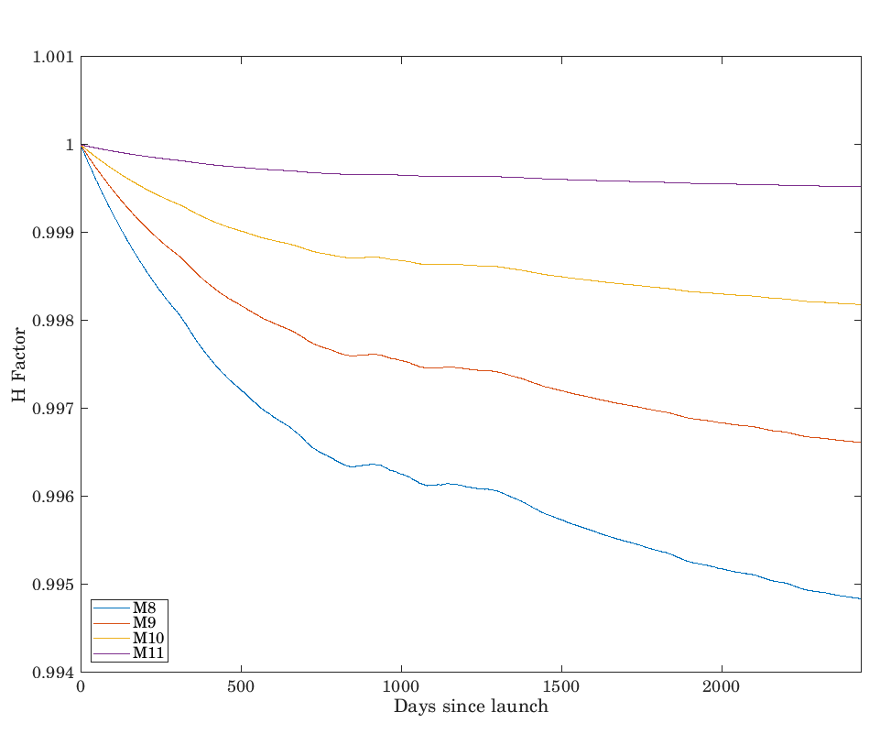
SRRS Model For VIIRS SWIR Band Correction
NOAA STAR Surface Roughness-induced Rayleigh Scattering (SRRS) Model
Ref: Shao, X.; Cao, Changyong; Liu, T.-C. Remote Sensing 2016, 8, 254
Before
DCC Trends
After
After using SRRS model, excellent stability in SWIR bands, <0.15% change in 5 years.

Slide 18
Bias Correction Factors for V2 Reprocessing
RadiometricBiasCorrection (added to HDF file)
4 Elements Array added into H5 Files
Radiance correction from Ocean Color group provided f factor (Calibration Method 1)
Radiance correction from Kalman Filter f-factor by STAR VIIRS SDR Team (Calibration Method 2)
High Gain/Low Gain
RSB Single Gain: I1, I2, I3, M6, M8, M9, M10 and M11; dual gain: M1, M2, M3, M4, M5
and M7
Usage
${ R}_{corrected}=C[i]∙R$
C[i] is one of the 4 elements, R is the baseline radiance in H5 file
R_{corrected} is the bias corrected radiance/reflectance
1st Element | Radiance Ratio between Calibration Method 1 and STAR reprocessed High Gain or Single gain values
2nd Element | Radiance Ratio between Calibration Method 1 and STAR reprocessed Low Gain values (for dual gain only; or set 1 for single gain)
3rd Element | Radiance Ratio between Calibration Method 2 and STAR reprocessed High Gain or Single gain values
4th Element | Radiance Ratio between Calibration Method 2 and STAR reprocessed Low Gain values (for dual gain only; or set to 1 for single gain)
0 | HG | F-factor ratio using OC and STAR
1 | LG
2 | HG | STAR VIIRS SDR Team Kalman Filter and Constant radiometric bias for M5 and M7
3 | LG

Slide 19
Summary
After V2 reprocessing, DCC and SNO-x trends for VNIR indicate excellent stability to within 0.3% for most of the bands
RSB baseline SDRs calibrated using improved (removed annual oscillation and smoothed) SD calibration.
Radiometric bias correction is provided to users for each granule
Kalman model derived coefficients (using lunar, DCC, SNO and SD) integrated with M5 and M7 absolute bias for VNIR bands.
Option to use OC derived gain trends
Surface Roughness-induced Rayleigh Scattering (SRRS) Model for SWIR bands
As of 2/28/2019, completed VIIRS SDR V2 reprocessing for 2016. Completion timeline for VIIRS SDR V2 reprocessing for 2012/01-2017/03 is by the end of July (on schedule)
Version 2 provides the solid basis for further future reprocessing. In most cases, future reprocessing will be simply based on further improved bias correction without fundamentally reprocessing RDR to SDR.
V2 reprocessing provides more accurate, stable, and consistent radiometric calibration, meeting all user needs

Slide 20
Backup

Slide 21
VIIRS RSB/TEB/DNB
Band | Center wavelength [um] | Spatial reso. at nadir [m] | Gain | Band | Center wavelength [um] | Spatial reso. at nadir [m] | Gain
M1 | 0.412 | 750 | High/Low | M12 | 3.70 | 750 | Single
M2 | 0.445 | 750 | High/Low | M13 | 4.05 | 750 | High/Low
M3 | 0.488 | 750 | High/Low | M14 | 8.55 | 750 | Single
M4 | 0.555 | 750 | High/Low | M15 | 10.76 | 750 | Single
M5 | 0.672 | 750 | High/Low | M16 | 12.01 | 750 | Single
M6 | 0.746 | 750 | Single | I1 | 0.640 | 375 | Single
M7 | 0.865 | 750 | High/Low | I2 | 0.865 | 375 | Single
M8 | 1.24 | 750 | Single | I3 | 1.61 | 375 | Single
M9 | 1.38 | 750 | Single | I4 | 3.74 | 375 | Single
M10 | 1.61 | 750 | Single | I5 | 11.45 | 375 | Single
M11 | 2.25 | 750 | Single | DNB | 0.7 | 750 | H/M/L†
*The shaded area indicates thermal emissive bands.
†High, mid, and low gain states

Slide 22
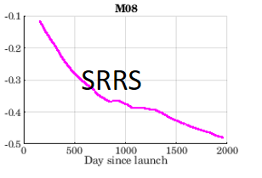
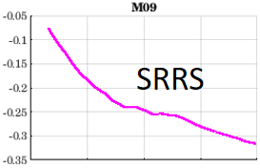
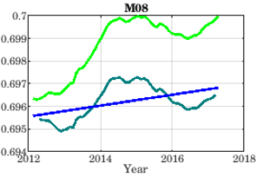
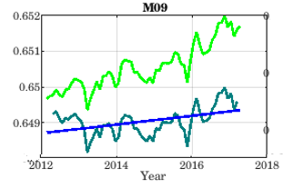
VIIRS SWIR Band Corrected with SRRS Model
Percent Correction Factor
Percent Correction Factor
DCC Mode
DCC Mode
After Correction
Slope < 0.15% over 5 years
Slope < 0.1% over 5 years
After Correction

