Slide 1
Ice Radiance Method for Sensor Monitoring and Intercomparison
Glen Jaross | NASA Goddard Space Flight Center
Jeremy Warner | Science Systems and Applications, Inc.
Outline
Justification for using ice surfaces
The monitoring technique
TOA reflectance model
Intercomparison results for OMI, TropOMI, MODIS, OMPS
GSICS Meeting – 6 Mar, 2019

Slide 2
What products benefit most from scene-based calibration ?
Cloud Fractions (λ-independent radiance errors)
Cloud studies
Energy balance and UV irradiance
Cloud height: errors are directly proportional to cloud fraction (low cloud amounts)
Gas vertical column amounts: Air Mass Factor errors directly related to cloud fraction. ( 3% - 5% column NO₂ error per 5% cloud error; low cloud amounts)
Aerosol Properties (λ-independent and λ-dependent radiance errors)
0.015 error in single-scatter albedo per 1% radiance error
Optical Depth error 0.06-0.12 per 1%/100 nm λ-dependent radiance errors
Other broad spectral dependences, e.g. NDVI

Slide 3
Where is scene-based calibration less effective ?
Spectral fitting algorithms (e.g. DOAS)
Insensitive to low-order-in-λ calibration errors
Conversion from slant to vertical column still sensitive
Gas abundances (slant column)
Need knowledge of abundance to calculate expected radiances, but gas abundance depends upon calibration
Limb scattering and Occultation
Normalizing radiances at a reference height nearly eliminates sensitivity to underlying scene reflectance
Most instruments do not have a nadir view

Slide 4
East Antarctica is a good radiance calibration target
Pros
High Reflectance
high direct / diffuse TOA radiance ratio reduces uncertainty due to atmospheric variations (e.g. aerosols)
reduced cloud influence
Stable Reflectance (polar vortex keeps ice clean)
Low Aerosol Loading
Small cloud fractions
Uniform reflectance over a large area
excellent statistics
applicable to heritage instruments
TOMS / Earth Probe (1996)
90 %
100 %
360 nm Lambertian Reflectivity
Cons
Not totally immune to aerosols
Useful range is 330 nm – 800 nm
limited by ozone absorption in atmosphere and water absorption in surface
Polar orbiters only
High solar zenith angles magnify small errors
Limited seasonal use

Slide 5
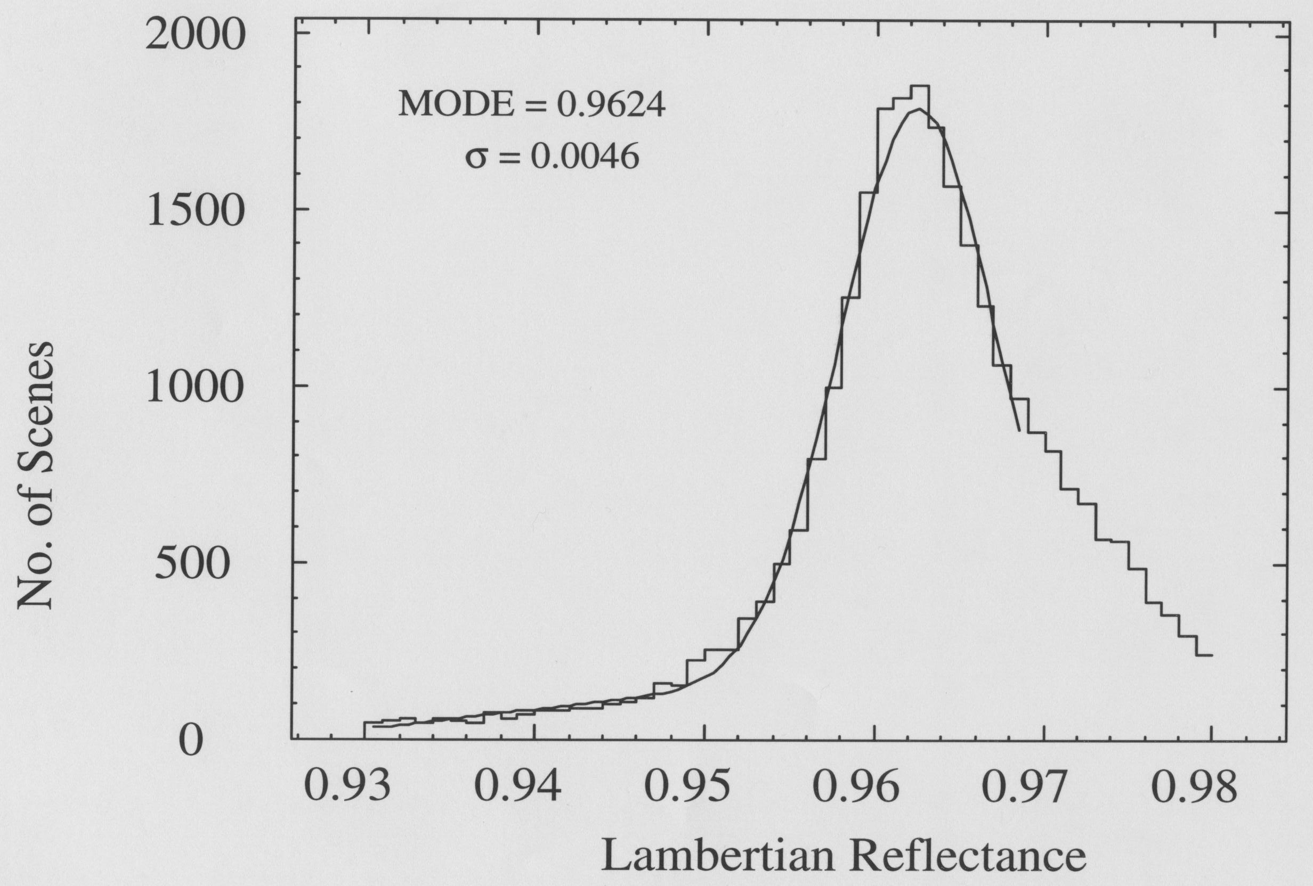
Data Selection Region
Areas with Slope<0.005 radians
Region selected for
low surface slope
high reflectivity
uniformity
little cloud cover
TOMS Earth Probe
360 nm Lambert-equiv. Reflectivity (1996)

Slide 6
Time Dependence of radiometric calibration
Assume reflected signal depends only on SolZA and SatZA
Select reference period near solstice and bin signal in SolZA (and in cross-track swath, if applicable)
Likewise bin other periods (daily or weekly) in the data record
Compute mean in each bin and compute ratio to reference bins
Repeat for Greenland (adjust by 1%)
TOMS / Nimbus 7 (nadir view, 380 nm)
Greenland
Antarctica
Normalized Radiance
×
Reference Period
Nimbus TOMS was calibrated via a Rayleigh scatter method
Pinatubo Effect
Seasonal Cycle:
Solstice data are from higher latitudes than at other times (clouds more prevalent ?)
Restrict results to near solstice

Slide 7
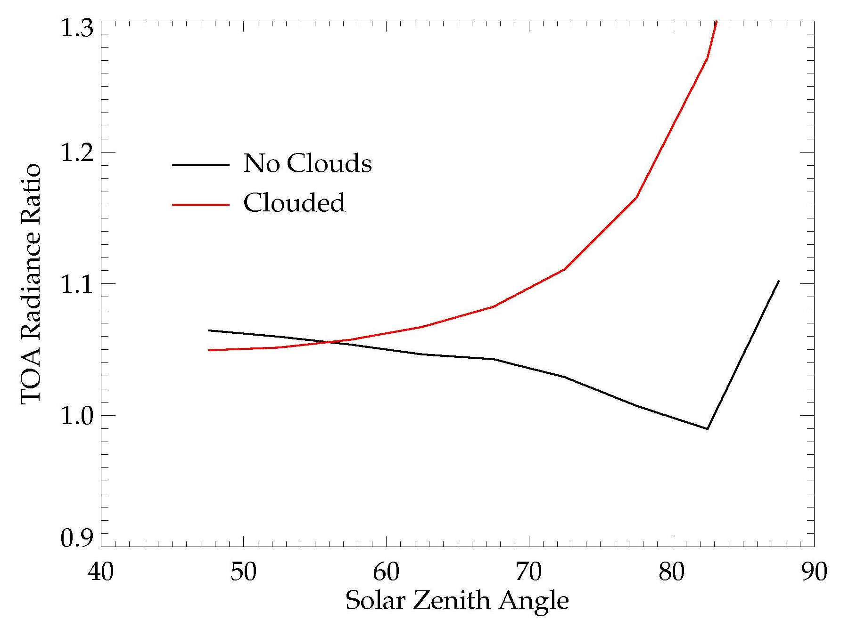
Are clouds an issue ?
Either the cloud model is wrong,
or …
τ_{cloud} = 5 at 440 mb
Modeled nadir-scene
357 mn
775 nm
albedo ratio
Clouds are statisticallyunimportant
GOME (Jan. 2000) nadir-scene
357 mn
775 nm
albedo ratio

Slide 8
TOMS / Earth Probe
TOMS / Earth Probe 360 nm
This TOMS calibrated using solar diffuser measurements
Normalized Radiance
Greenland
Antarctica
TOMS / EP experienced anomalous scan mirror degradation affecting solar calibrations

Slide 9
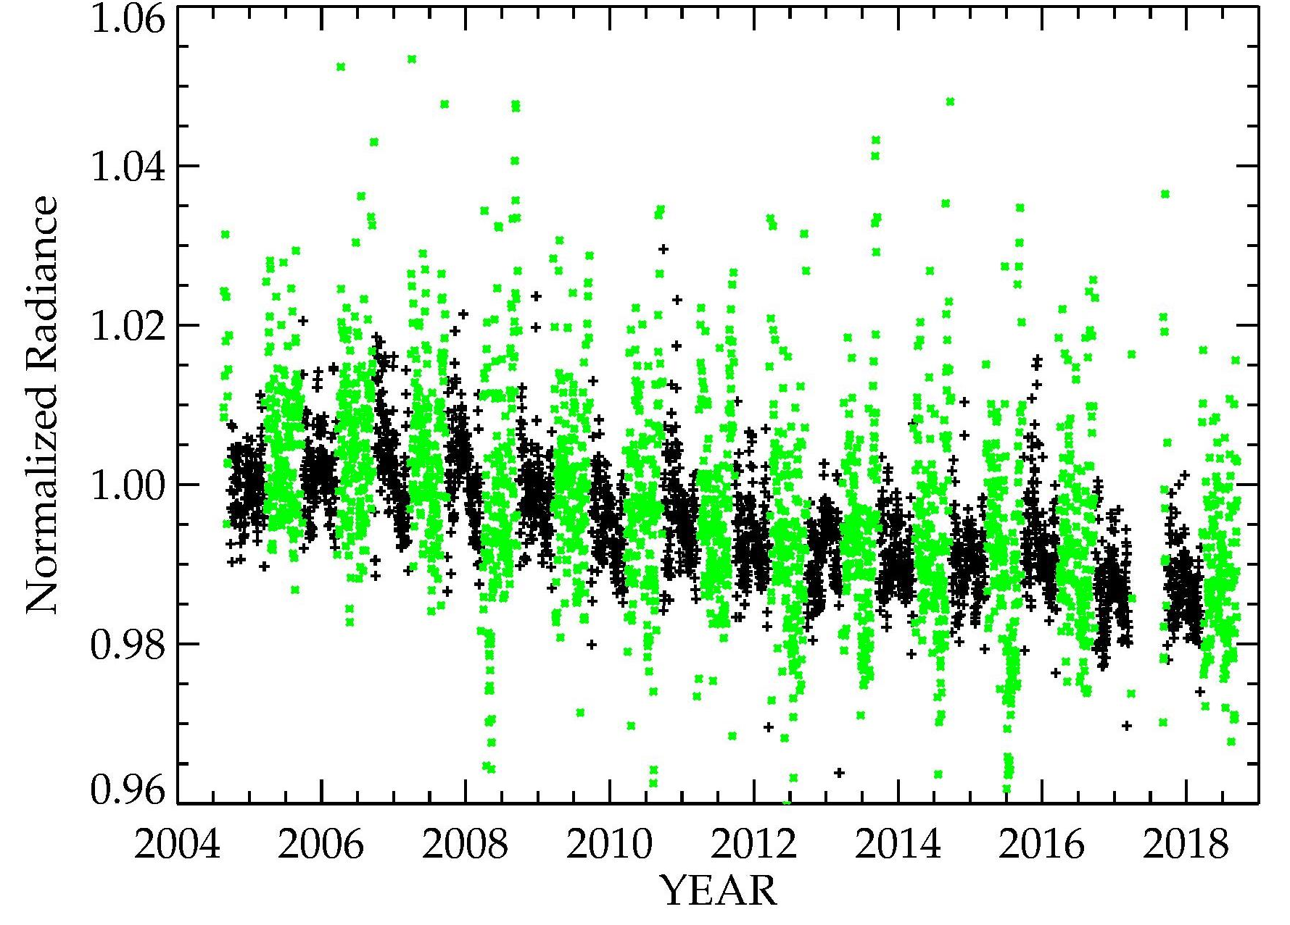
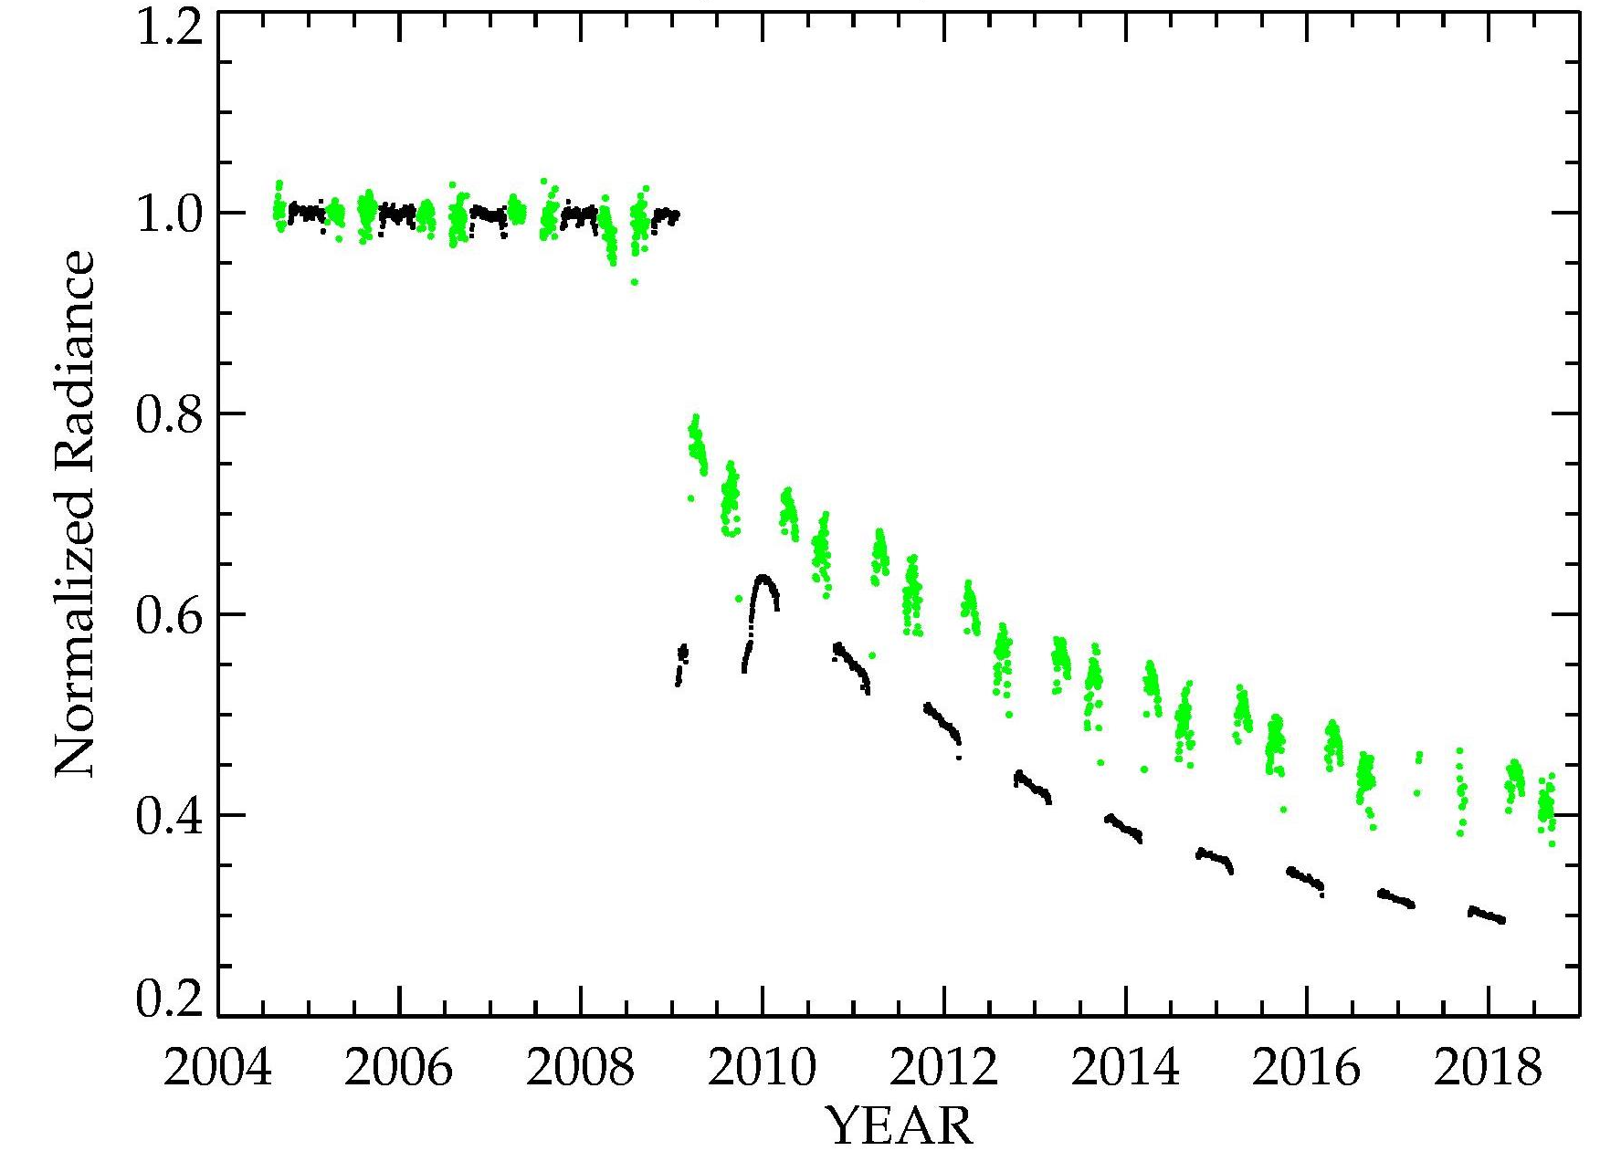
OMI / Aura
354 nm, West swath edge
360 nm, nadir
62º < SolZA < 67º
Greenland
OMI has had no post-launch calibration corrections
Antarctica
OMI experienced blockage in the nadir detector rows starting early 2009

Slide 10
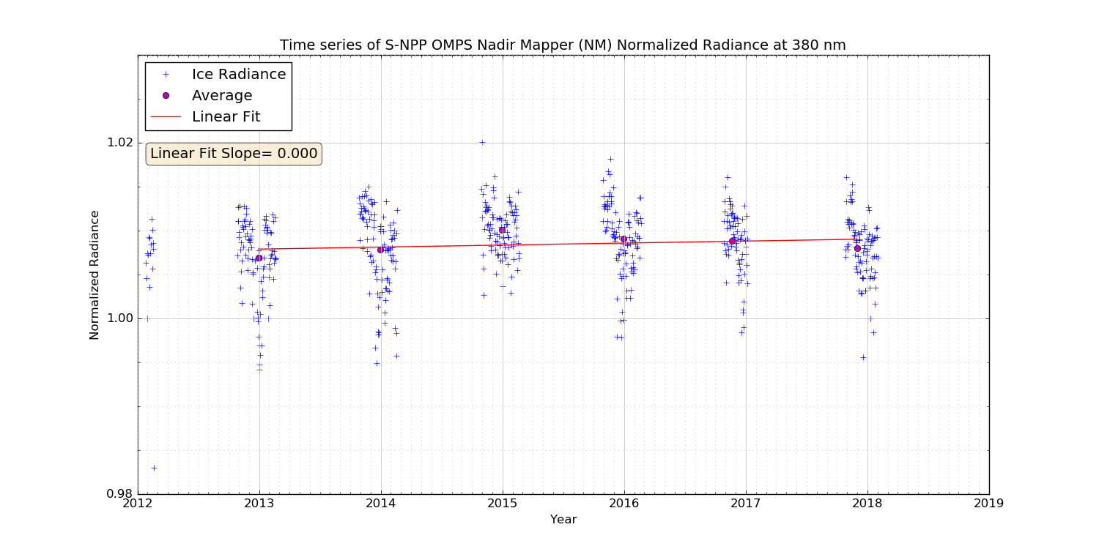
OMPS / Suomi NPP
380 nm, nadir
360 nm
1.02
No calibration corrections have been applied to OMPS
Normalized Radiance
1.00
62º < SolZA < 67º
0.98
2012
2013
2014
2015
2016
2017
2018
2019
YEAR
Antarctica
Antarctic radiances are entirely consistent with solar calibration results

Slide 11
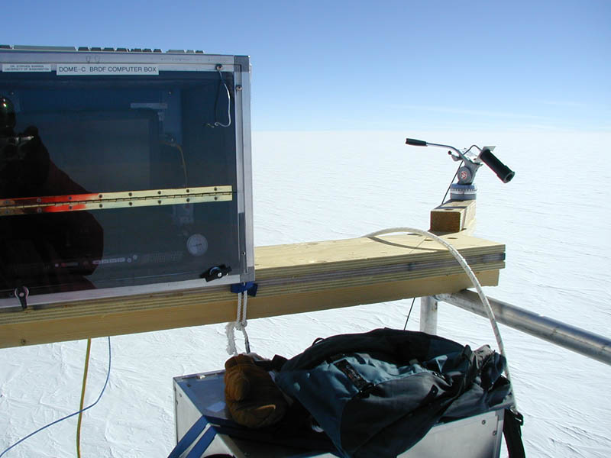
Validation of Absolute Satellite Radiometry
Measurements by Warren et al. at Dome C, 2003-2005
Spectral BRDF of surface 0.35 – 2.5 μm
Solar Zenith Angles 52° - 87°
Measure spectral transmission of sunlight into snow
in support of radiometric validation for SPOT4
Our Approach
Develop a 2π steradian directional reflectance (BRDF) model for the Antarctic surface (see JGR, 113, 2008)
surface measurements of total hemispheric reflectance measurements; wavelength-dependent
surface measurements of reflectance anisotropy; independent of wavelength
Create a look-up table of sun-normalized Top-of-the-Atmosphere (TOA) radiances for all satellite observing conditions using a radiative transfer model (RTM)
Compute ratio between each measurement and table entries; average results
Notes:
A common standard means it’s easy to intercompare sensors even if the standard itself is not accurate (it has relative accuracy)

Slide 12
Surface properties based upon reflectance measurements by Warren et al.
Spectral Albedo Measuremnts at South Pole, 1986
λ = 600 nm
Sol. ZA = 80°
Warren et al. Reflectance anisotropy derived from 1986-1992 data
BRDF is likely constant:
300-800 nm
BRDF derived from parameterization of measured reflectance anisotropy (Warren et al., JGR 103, E11, 1998)

Slide 13
Surface BRDF model vs. Solar Zenith Angle
SolZA=40°
SolZA=50°
SolZA=60°
SolZA=85°

Slide 14
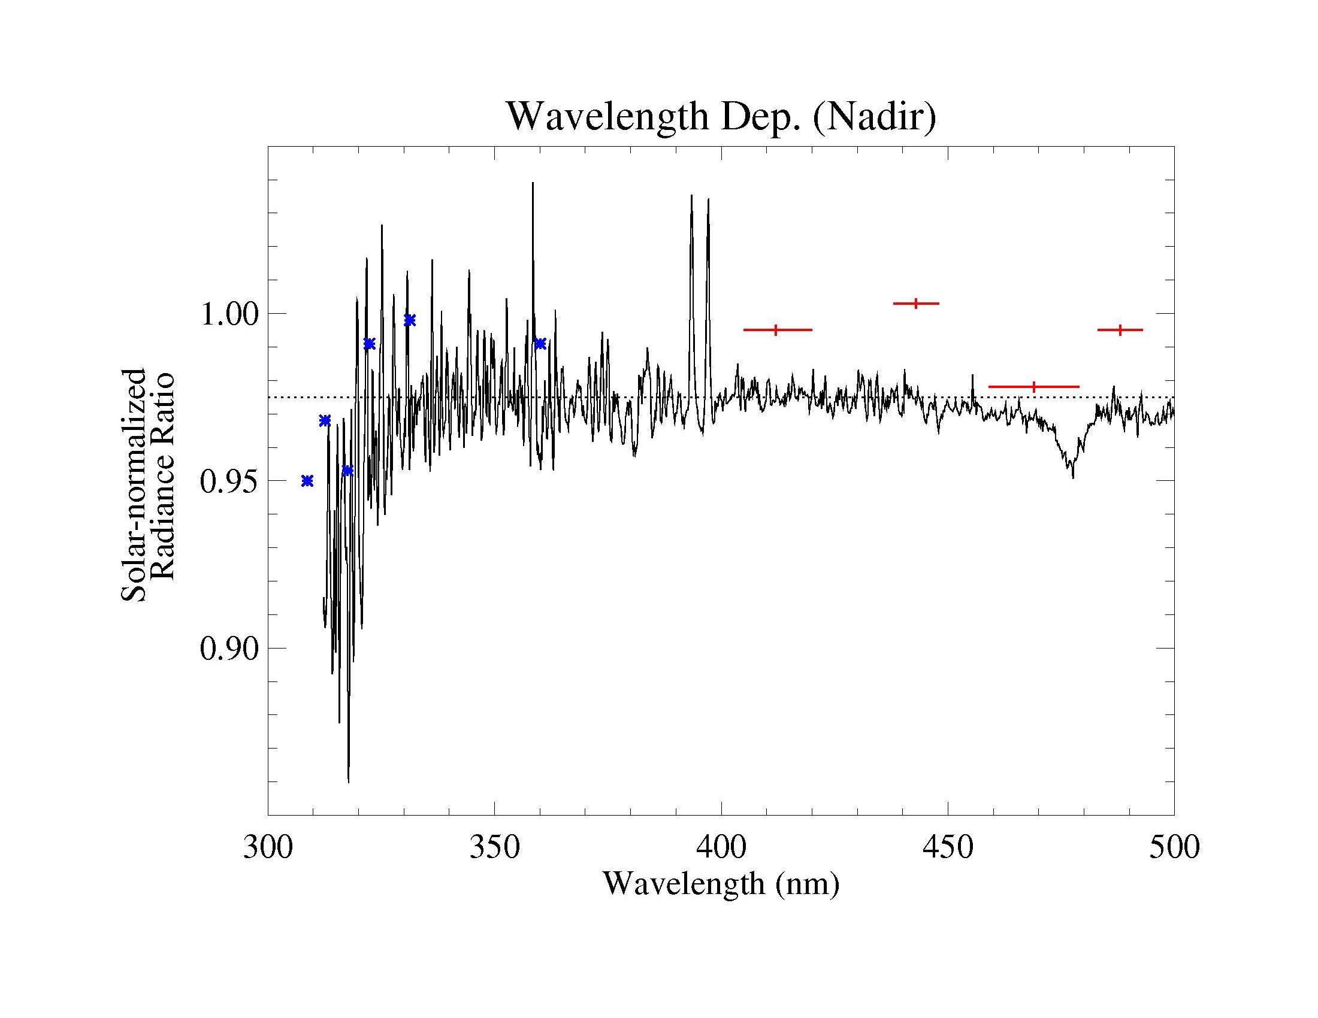
Comparison between MODIS, OMI, TOMS and model radiances
Nadir-view Results
RTM handles ozone poorly at λ < 330 nm
TOMS / EP
MODIS / Aqua
RTM does not include Ring Effect or O₂-O₂ abs.
OMI / Aura (Collection 2)
O₂O₂ Absorption
How do we know this result is correct ?

Slide 15
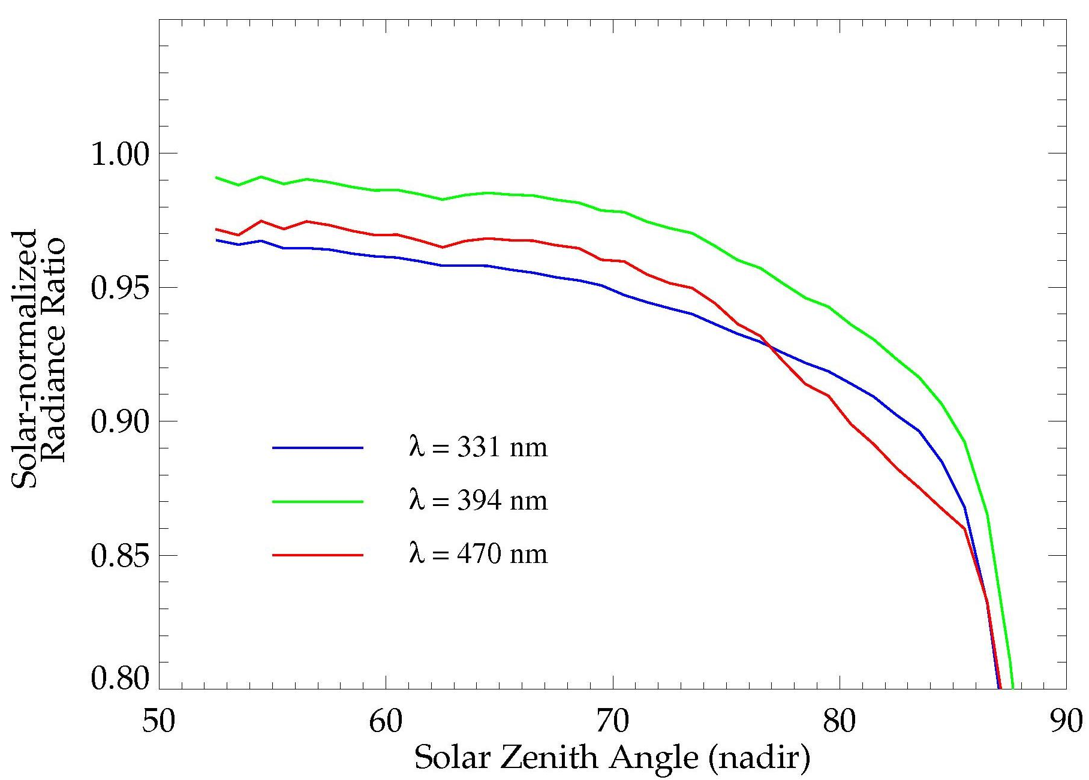
OMI Results vs. Solar Zenith Angle
Measured – Model difference should be independent of SolZA
OMI Level 1b (Coll. 2) 7 Dec – 4 Jan, 2004
Proposed use range (1330 orbit)
Plot suggests probable radiative transfer errors
surface BRDF model
treatment of atmosphere
Results obtained below SolZA = 70º fall within a 2.2% uncertainty estimate

Slide 16
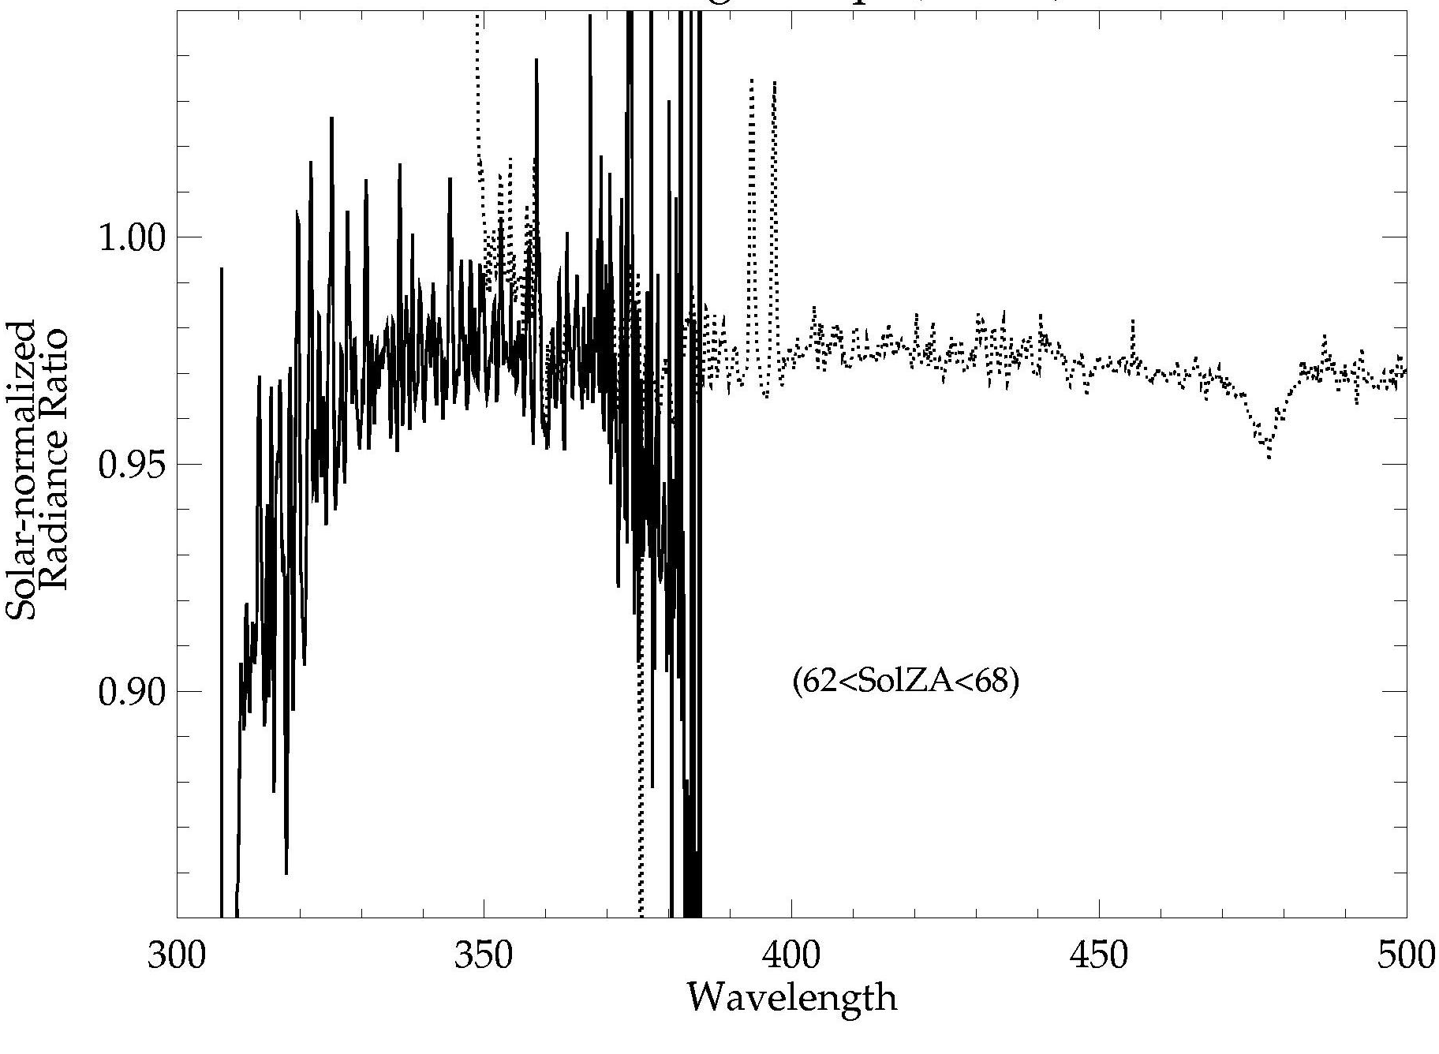
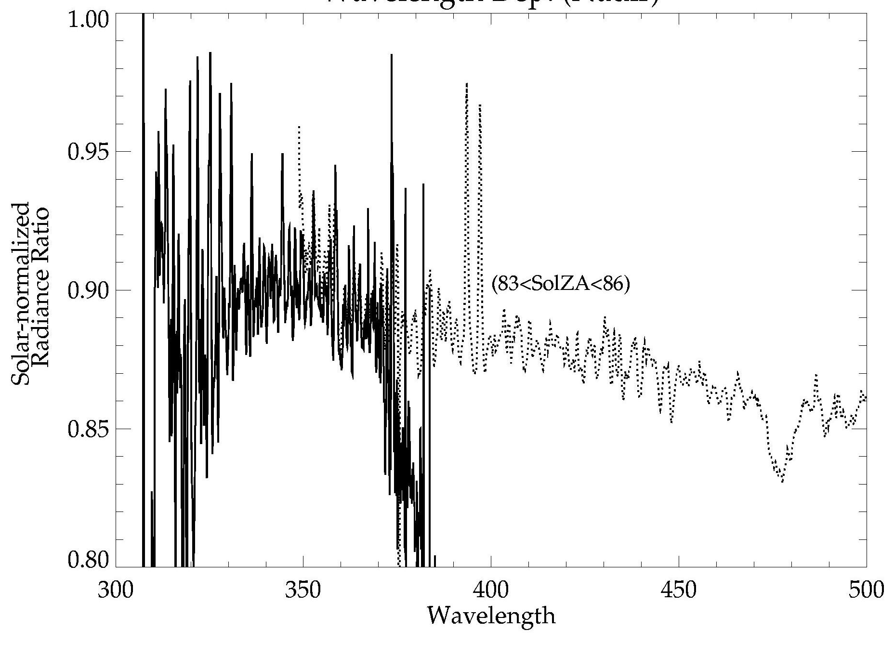
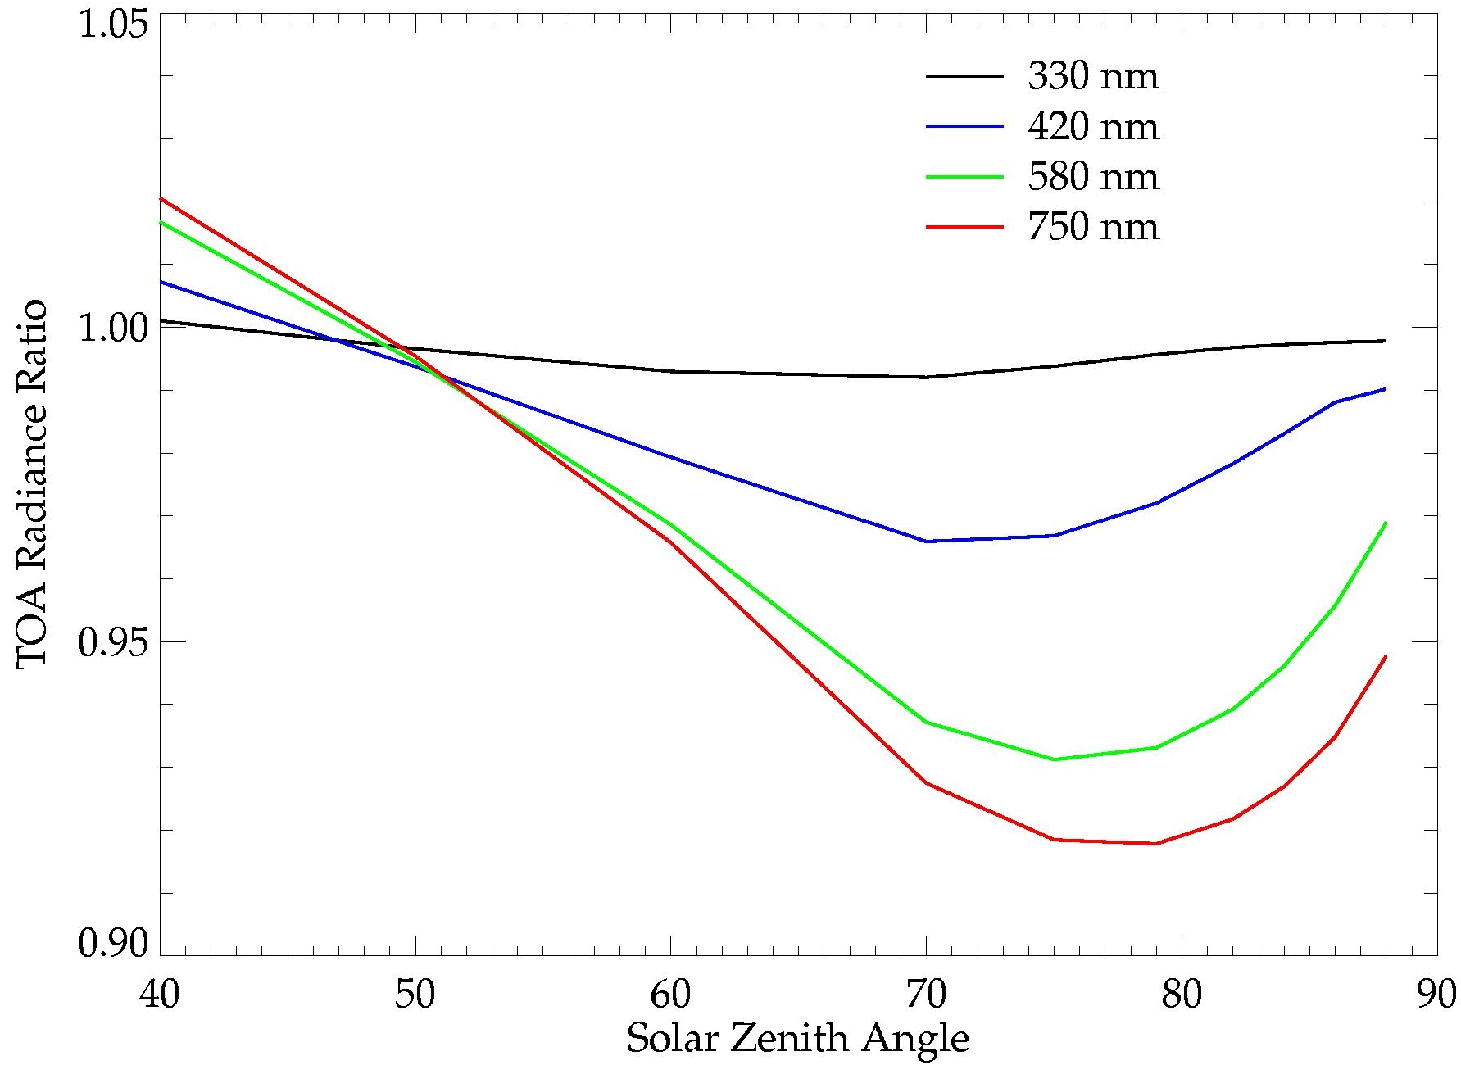
OMI Results vs. Solar Zenith Angle
62° < SolZA < 68°
83° < SolZA < 86°
Non-Lambertian / Lambertian Reflectance Ratio (model)
Apparent error increases at long λ as predicted
Spectral dependence is consistent with BRDF that is too Lambertian

Slide 17
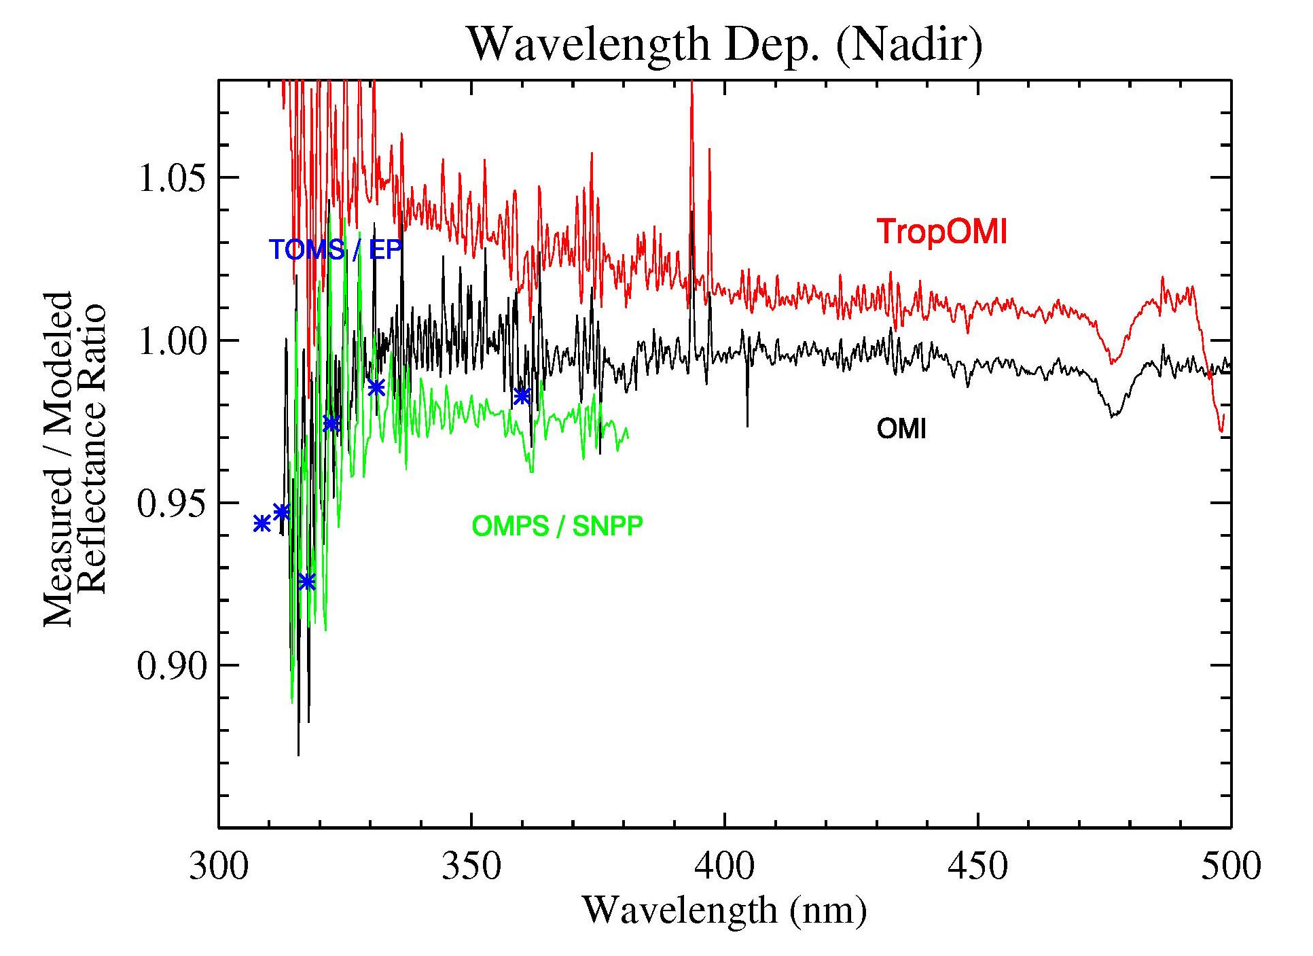
TropOMI wavelength-dependent error
Wavelength dependence caused by pre-launch calibration errors
( Coll. 3 )
Based on one day of TropOMI data

Slide 18
OMPS / SNPP cross-track dependence
Fine structure is likely from entrance slit roughness
Comparison with other data (Rayleigh scatter method) confirms dependence
Change in swath dependence consistent with known BRDF error
Binned Pixel Position

Slide 19
Summary
Permanent ice (Antarctica & Greenland) ideal for long-term monitoring (but not short-term)
Model calculations of TOA radiances over Antarctica are good to approximately 2% at solar zenith angles < 70º (best near Dec. 21)
Provides validation of radiometric characteristics of nadir-viewing sensors up to ~750 nm
Wavelength-to-wavelength radiometry is better than 2%, but not useful for absorption spectroscopy
Future Work :
Refine BRDF for improved performance at high SolZA and SatZA
extends useful period away from solstice
needed for sensor channels that saturate at low SolZA
needed for comparisons with east side of swath - afternoon orbits (west side for morning orbits)

Slide 20
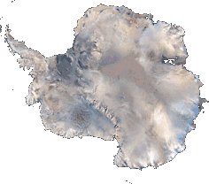
Spares

Slide 21
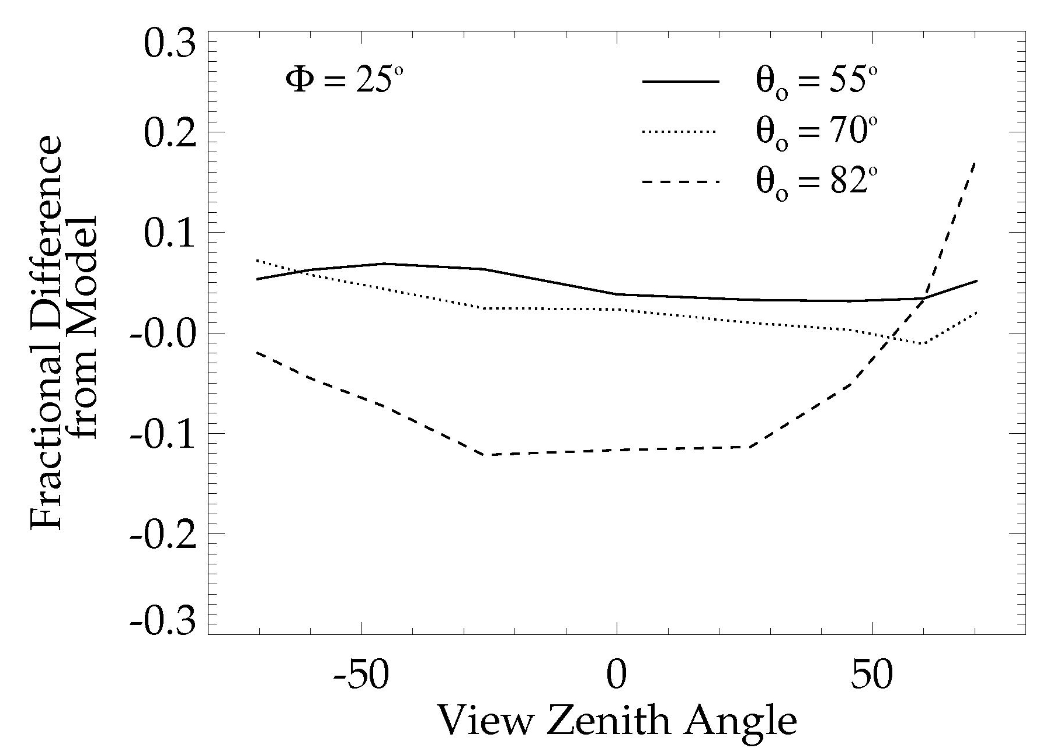
Modified BRDF model
Warren et al. parameterization
Modified “forward” parameterization
MISR / Terra comparison to Warren model
TOMS / Meteor3 comparison to three models (𝜙 = 0º)
Lambertian
Warren
Strong
Forward

Slide 22
Model TOA Reflectance Error Budget
Surface BRDF model represents single largest error source

Slide 23
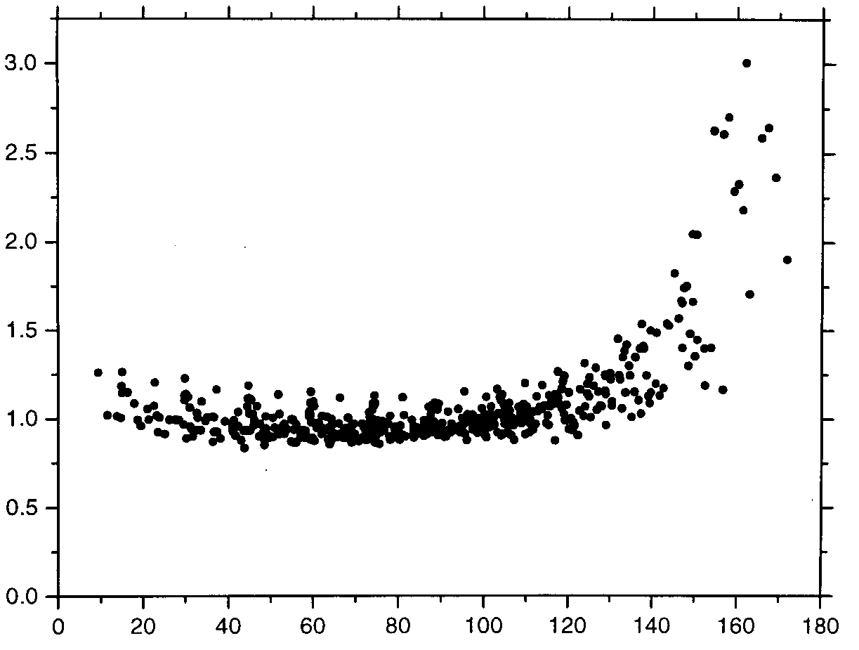
Developed a 2π steradian BRDF model
Existing parameterization from
Warren et al.
J. Geophys. Res., 103, 1998
θ_{s} ≤ 50° θ_{o} ≥ 67° all φ
Extrapolate function for use at θ_{s} > 50°
Invoke reciprocity ( θ_{s} > 67° θ_{o}< 67° )
Fill remaining “hole” ( θ_{s} < 67° θ_{o}< 67° )
assume ρ ∝θ_{s}² dependence for all θ_{o} < 67°
derive ρ (θ_{s}=0) at each θ_{o} < 67° from a quadratic parameterization of observed scattering phase fn. (Warren, et al., ibid)
ρ
- 67
θ_{s}
+ 67
ρ (θ_{s}= 0)
θ_{o}

Slide 24
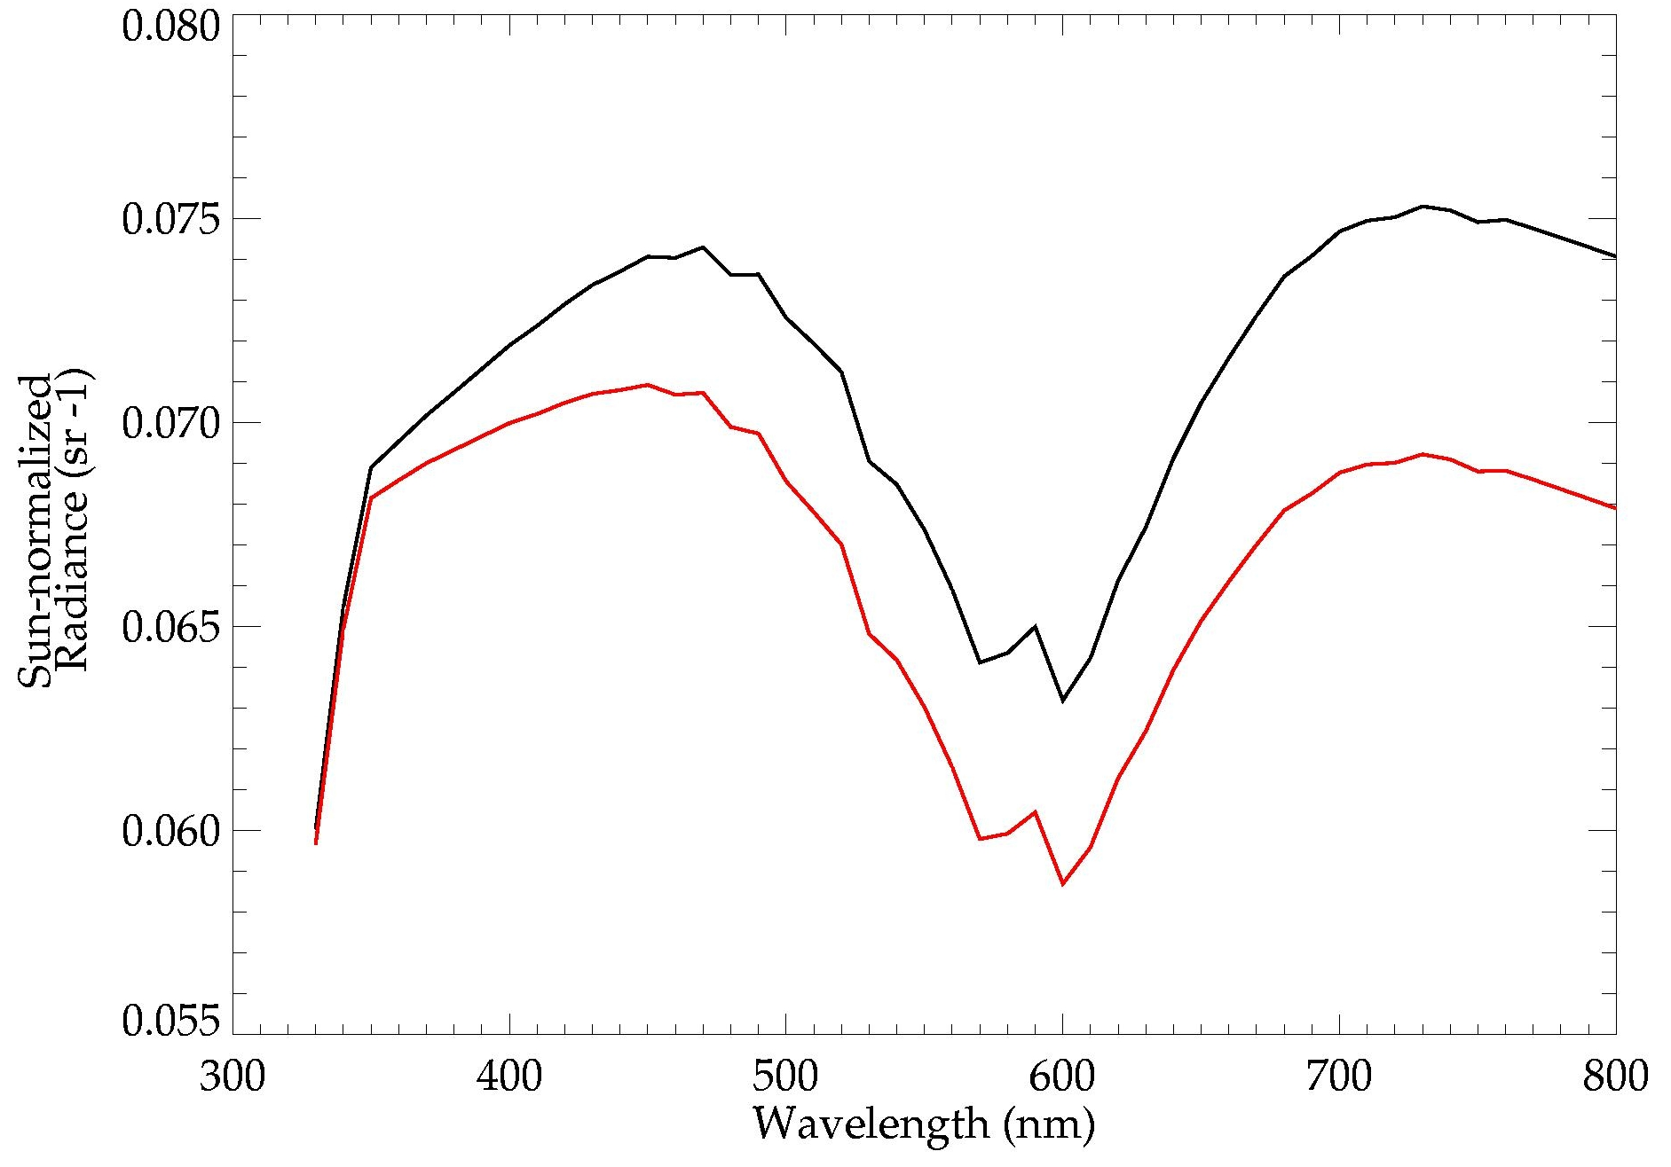
BRDF is most important at longer wavelengths
BRDF plays bigger role as
diffuse / direct ratio decreases
Simulated Nadir-scene albedos
Solar Zenith Angle = 75°
Column Ozone = 325 DU
Non-Lambertian / Lambertian Radiance Ratio
Lambertian
Non-Lambertian

Slide 25
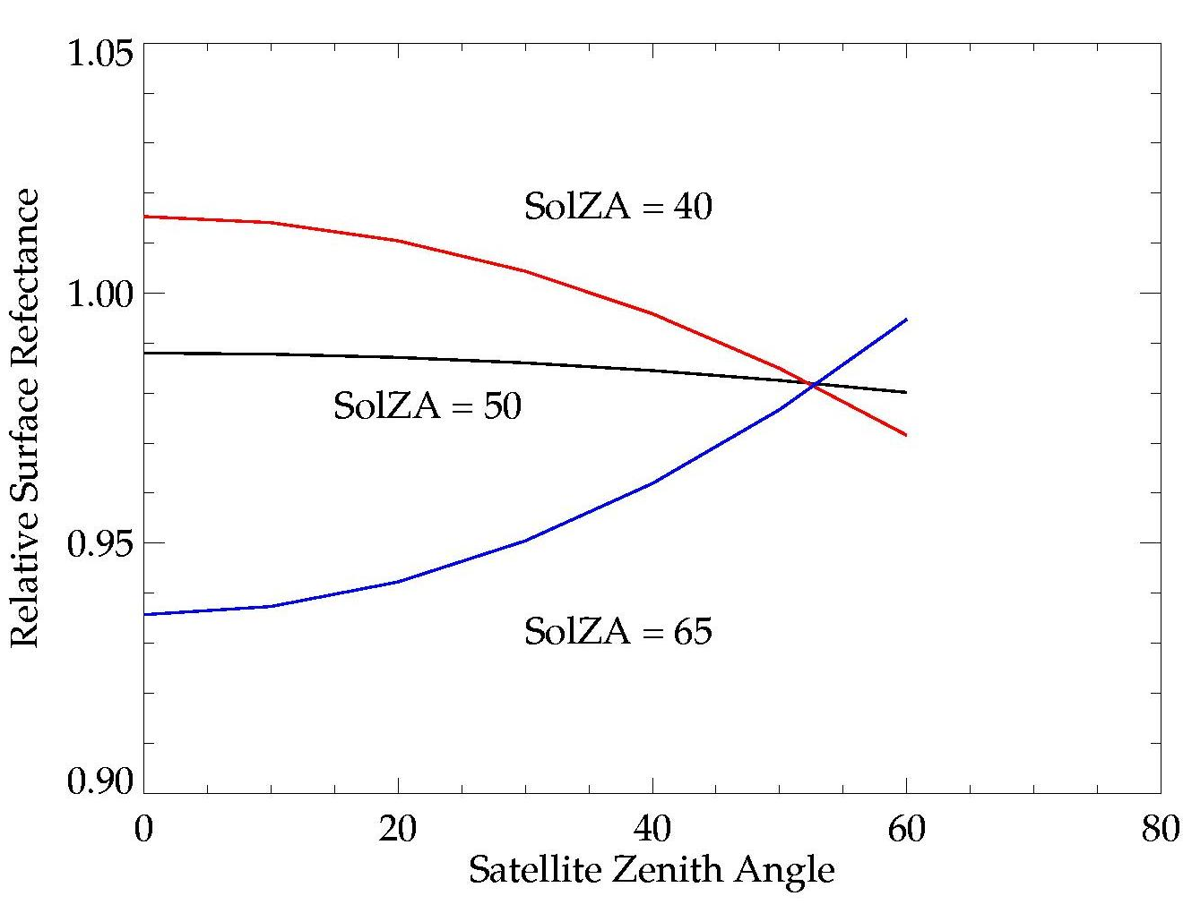
X-track dependence is mostly Lambertian near SolZA = 50°
BRDF surface slices at Φ ≈ 67°
Results near 50° are least affected by BRDF errors

Slide 26
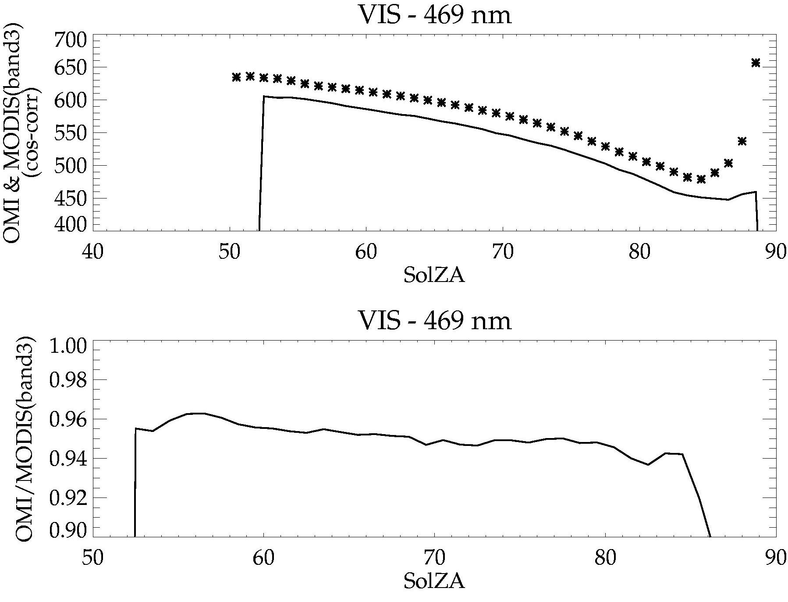
OMI radiances compared directly to MODIS / Aqua band 3
MODIS
OMI
Same time and geographic location
MODIS has broad bandwidth
(459 < λ < 479 nm) which includes O₂-O₂ absorption

Slide 27
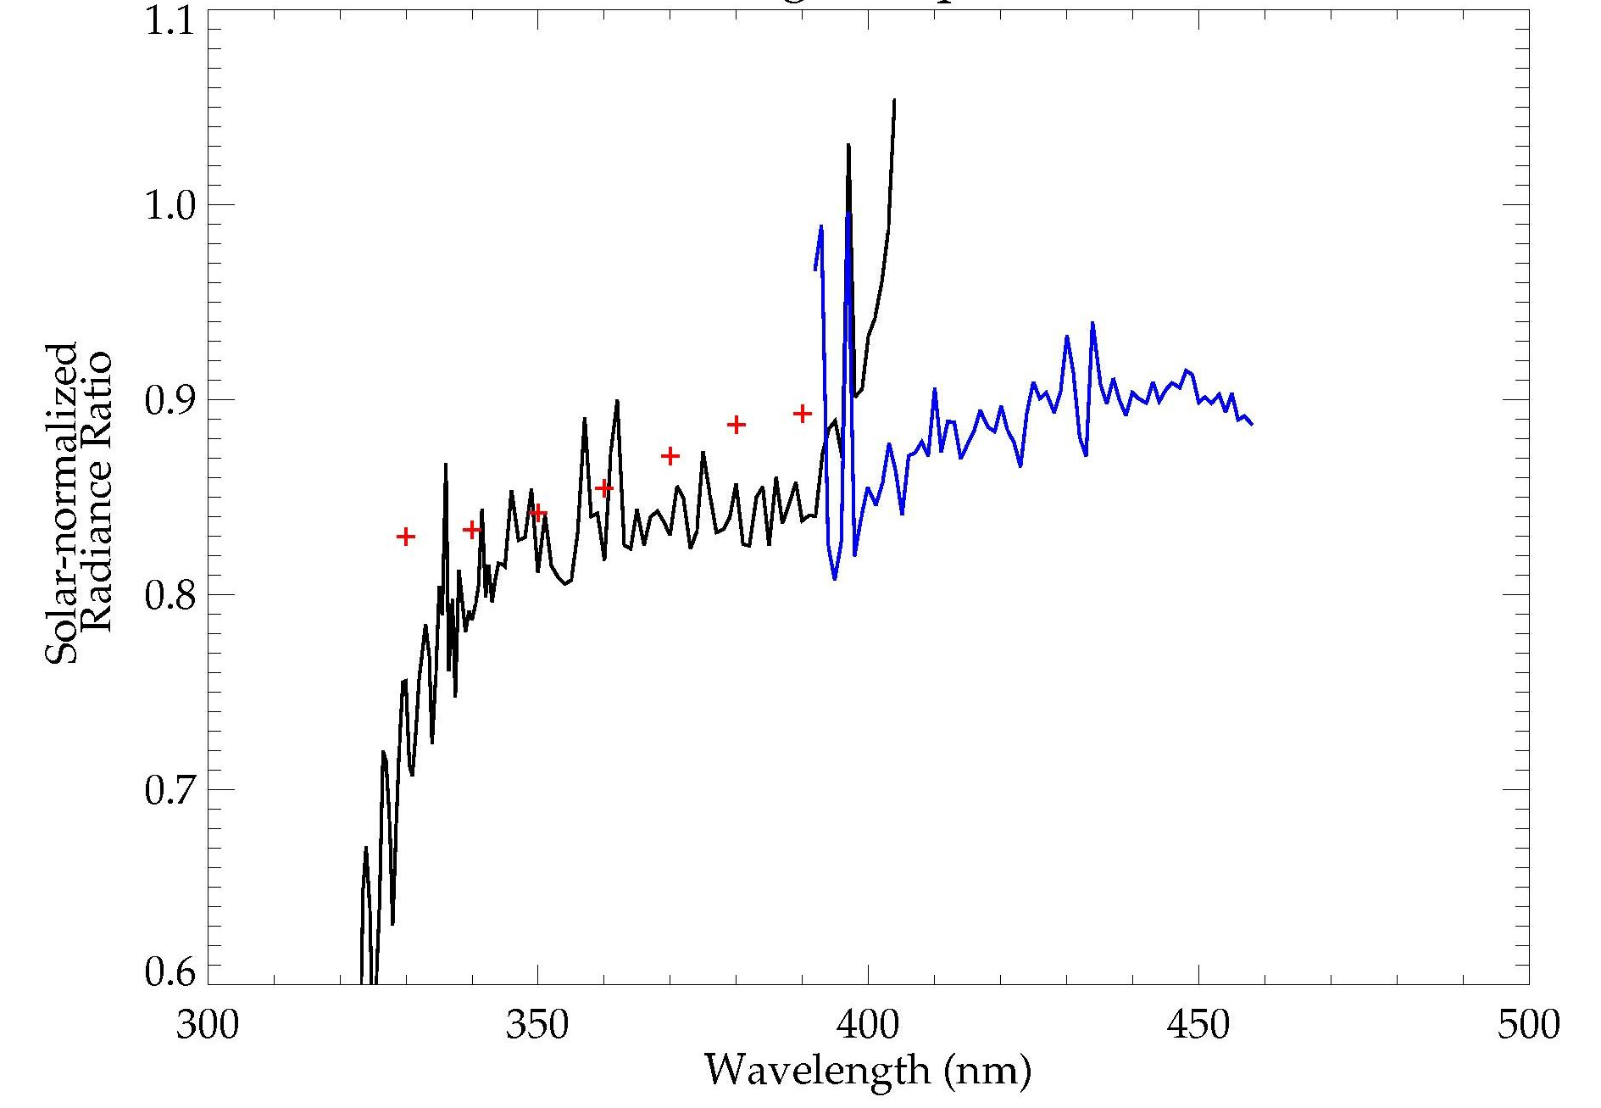
Preliminary SCIAMACHY Results
SCIAMACHY Level 1b ( v5.04 )
18 – 24 Dec., 2004
Provided by R. van Hees, SRON
}
Comparison with RTM over Sahara (from G. Tilstra, KNMI)
Ozone Absorption ignored

